Slide 1
Community Site
By: Darryl Karney, Adiba Mohammed

Slide 2
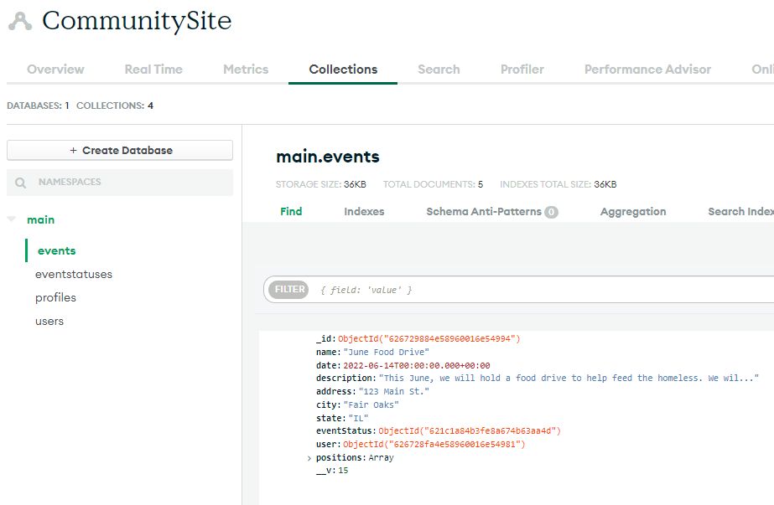
MongoDB Atlas
Online database

Slide 3
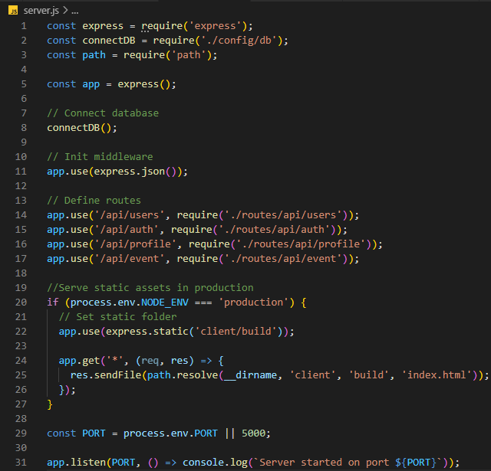
Server.js
Initial file ran when website is started
Defines API routes
Tells host how to start website

Slide 4
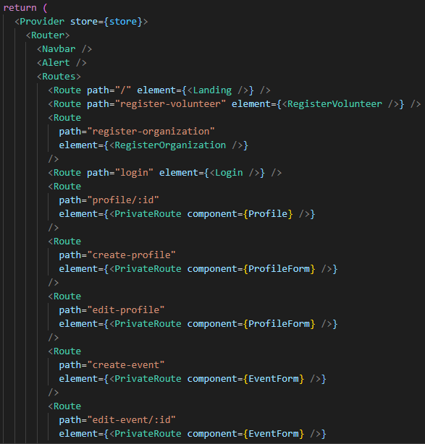
app.js
Tells React what components to render

Slide 5
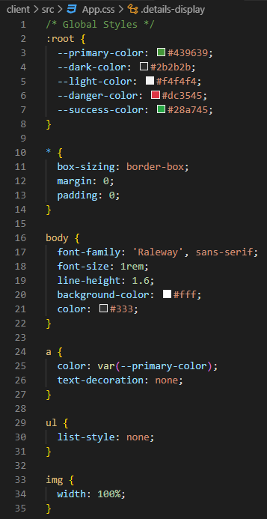
app.css
Defines styles for website

Slide 6
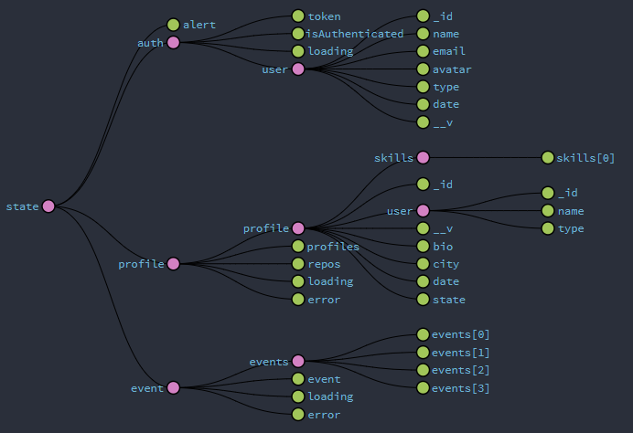
Redux
Website wide state management

Slide 7
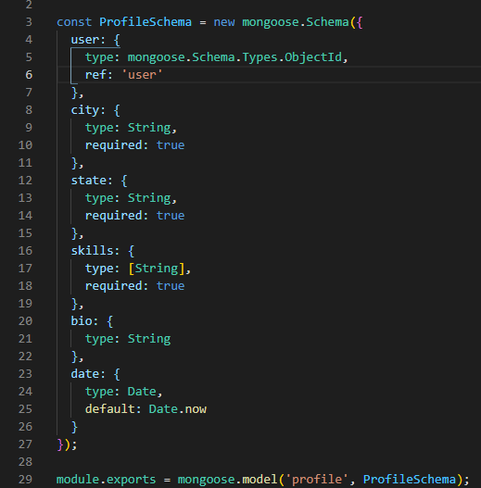
Models
Maps MongoDB collections to objects on website

Slide 8
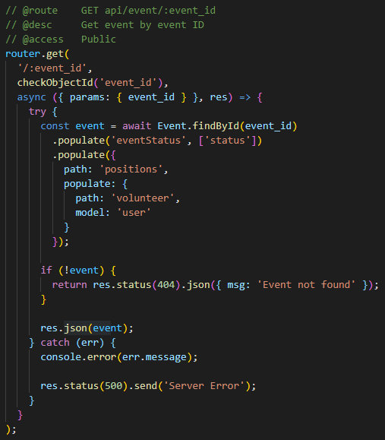
API Routes
Access MongoDB Atlas and return results

Slide 9
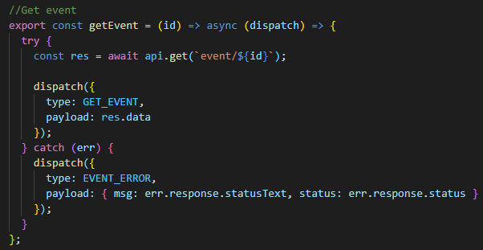
Actions
Layer between React components and API Routes
Interact with API Routes
Update Redux

Slide 10
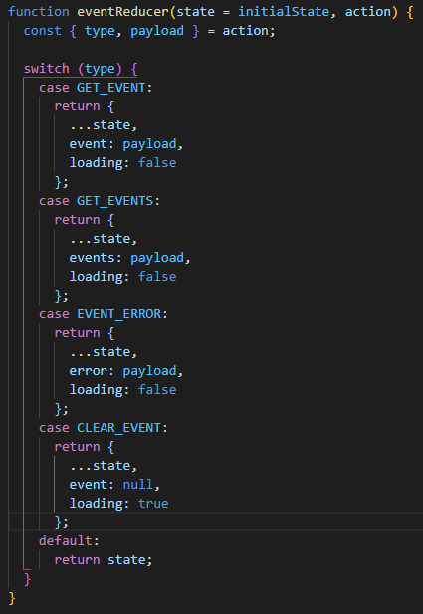
Reducers
Tells Redux how to update state

Slide 11
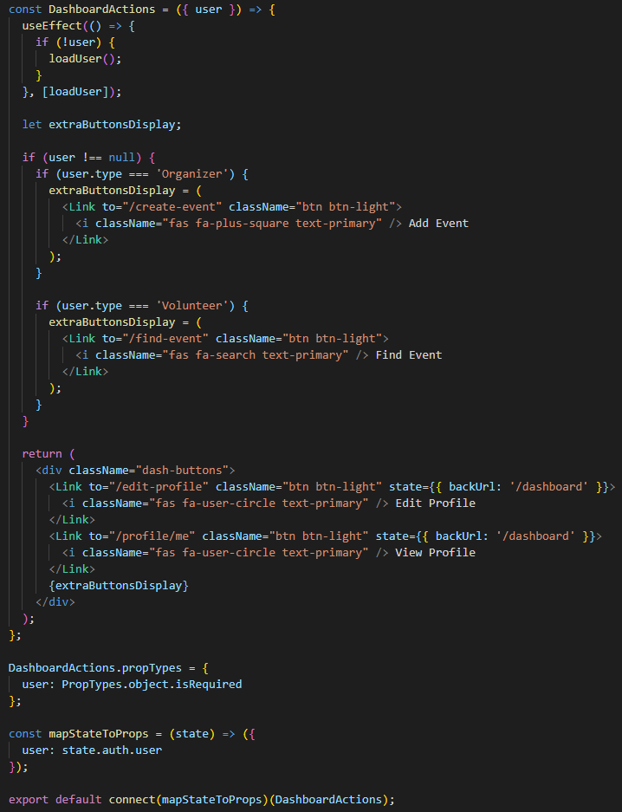
React components
Define how to render front end
Can run actions
Uses JSX to return dynamic HTML
Is mapped to Redux state

