Slide 1
DAIS Trading Deck
Auto-generated performance and strategy summary

Slide 2
JEPI — Performance Metrics
Total Return: 0.0061
Annualized Return: 0.0023
Annualized Volatility: 0.0038
Sharpe Ratio: 0.6072
Max Drawdown: -0.0038
Blended True Beta: 0.4973

Slide 3
JEPI — Sell Discipline
Total Sell Attempts: 0
Blocked by MA20: 0
Blocked by Avg Cost: 0

Slide 4
JEPI — Trade Activity
Total Buys (shares): 0
Total Sells (shares): 0
Largest Buy (shares): 0
Largest Sell (shares): 0

Slide 5
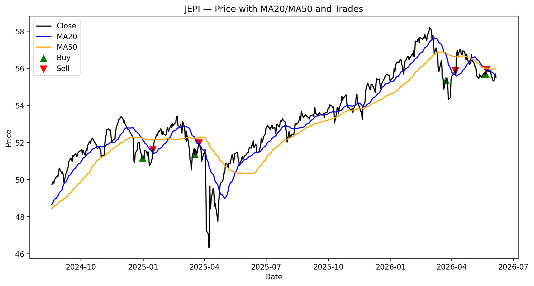
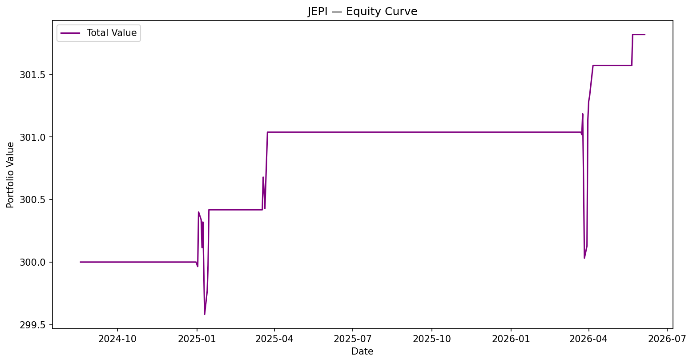
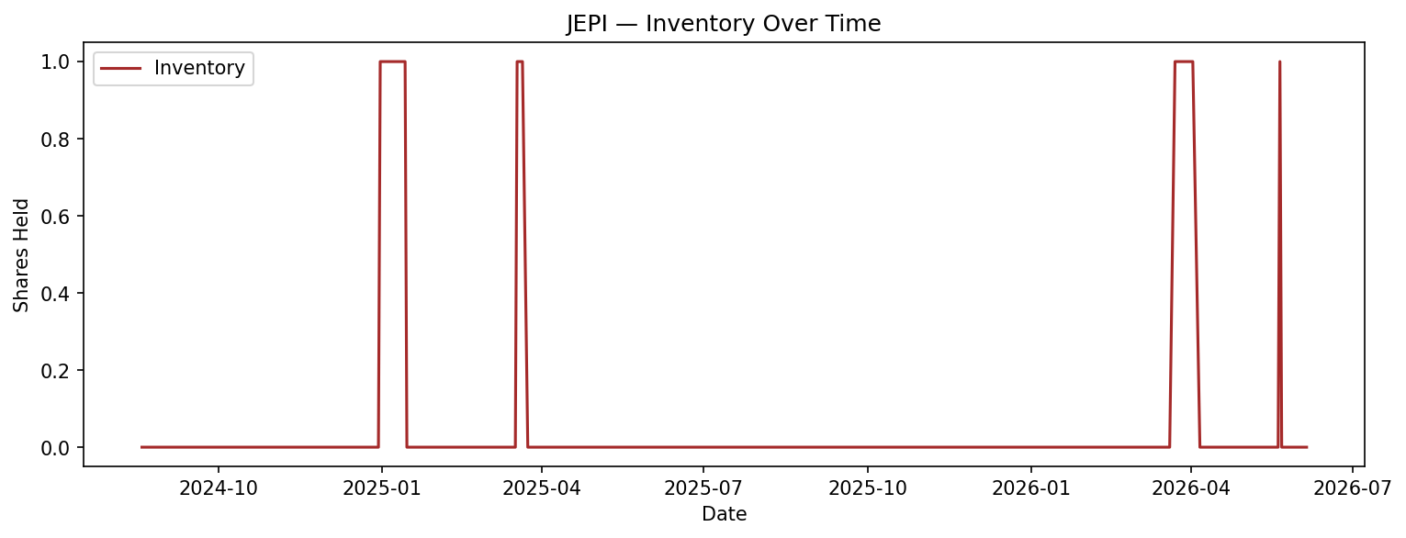
JEPI — Charts

Slide 6
VYM — Performance Metrics
Total Return: 0.0000
Annualized Return: 0.0000
Annualized Volatility: 0.0000
Sharpe Ratio: nan
Max Drawdown: 0.0000
Blended True Beta: 0.6826

Slide 7
VYM — Sell Discipline
Total Sell Attempts: 0
Blocked by MA20: 0
Blocked by Avg Cost: 0

Slide 8
VYM — Trade Activity
Total Buys (shares): 0
Total Sells (shares): 0
Largest Buy (shares): 0
Largest Sell (shares): 0

Slide 9
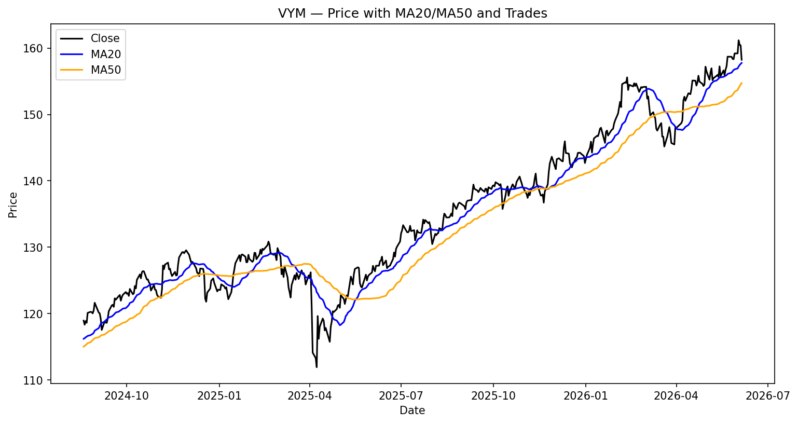
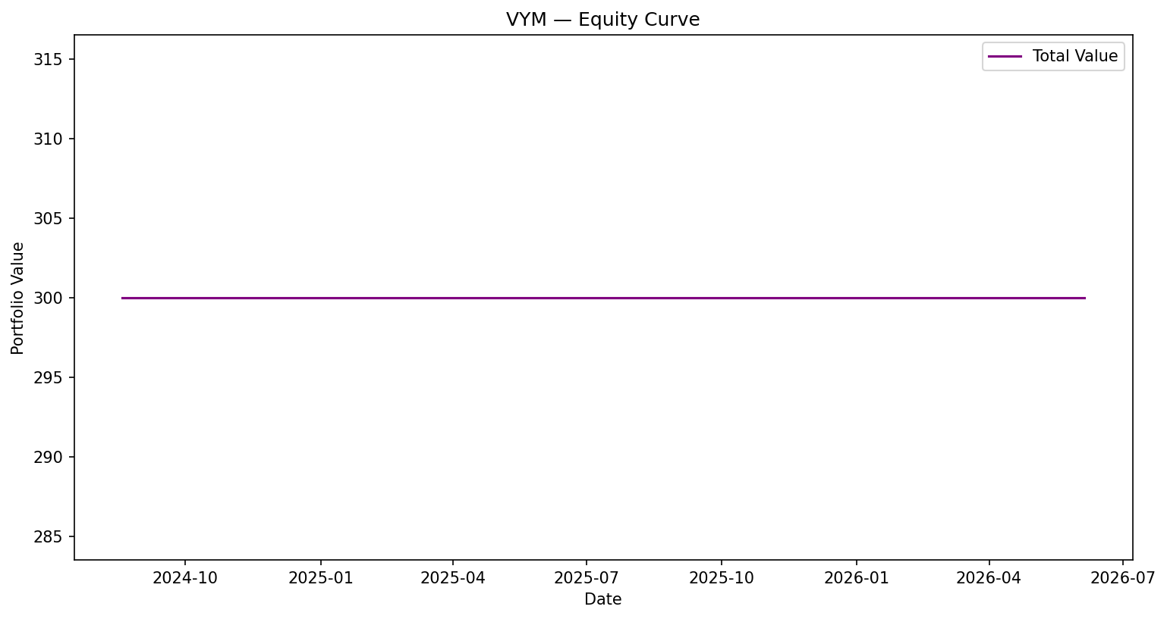
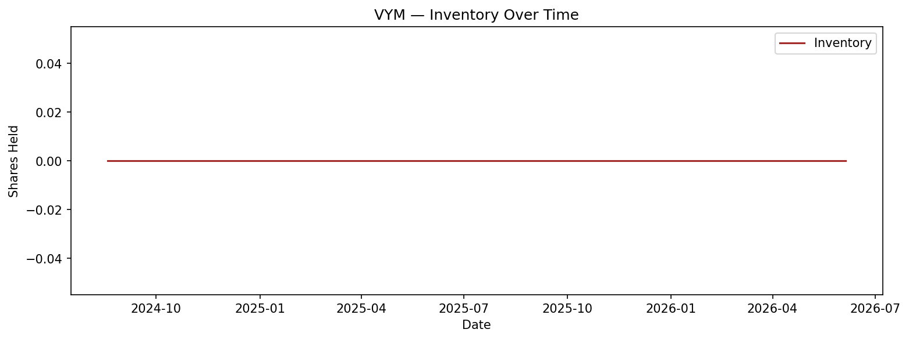
VYM — Charts

Slide 10
DGRO — Performance Metrics
Total Return: 0.1190
Annualized Return: 0.0442
Annualized Volatility: 0.0414
Sharpe Ratio: 1.0677
Max Drawdown: -0.0504
Blended True Beta: 0.6207

Slide 11
DGRO — Sell Discipline
Total Sell Attempts: 0
Blocked by MA20: 0
Blocked by Avg Cost: 0

Slide 12
DGRO — Trade Activity
Total Buys (shares): 0
Total Sells (shares): 0
Largest Buy (shares): 0
Largest Sell (shares): 0

Slide 13
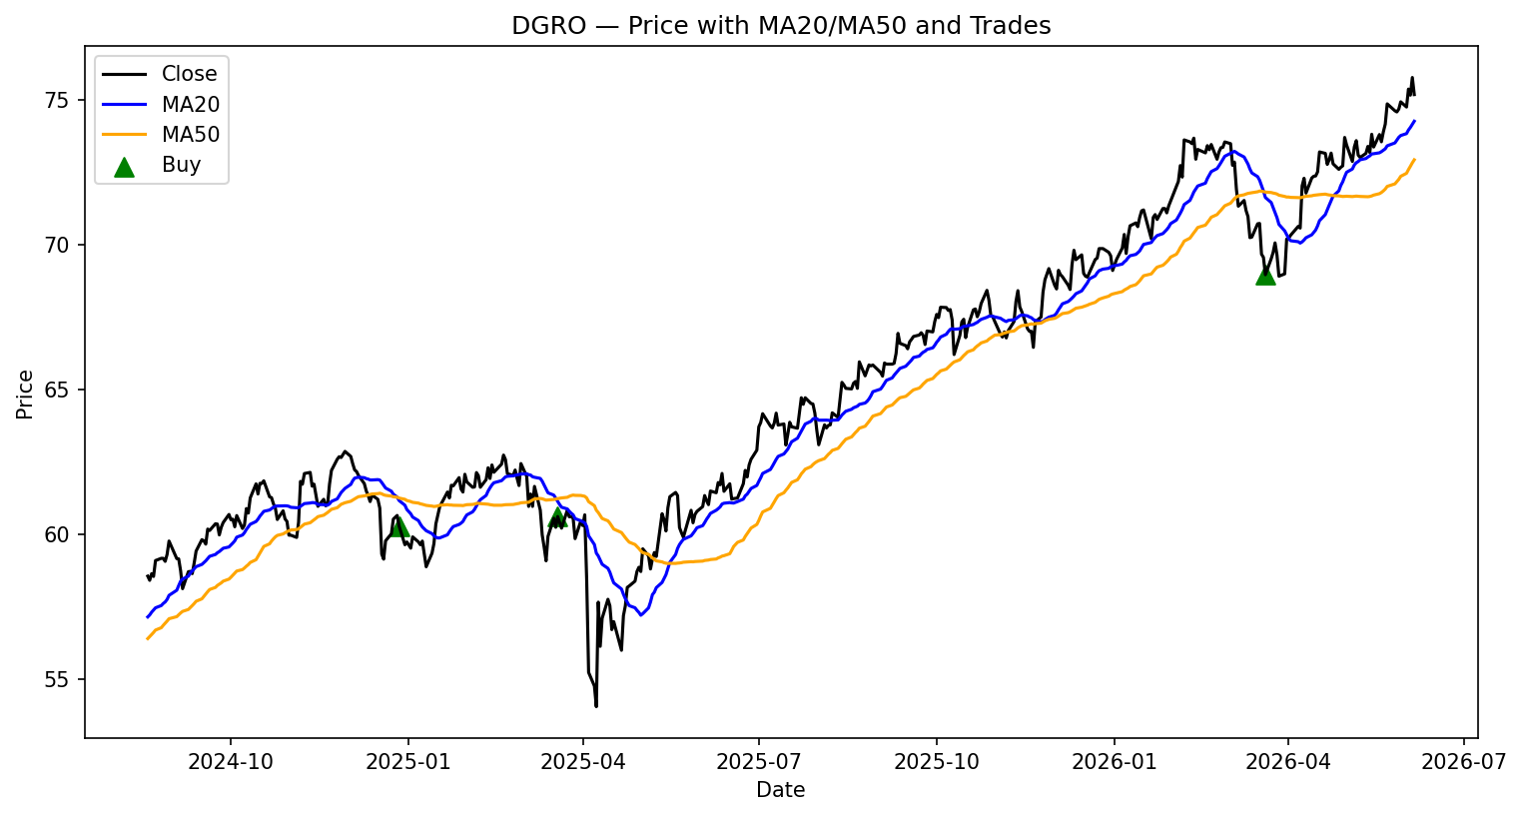
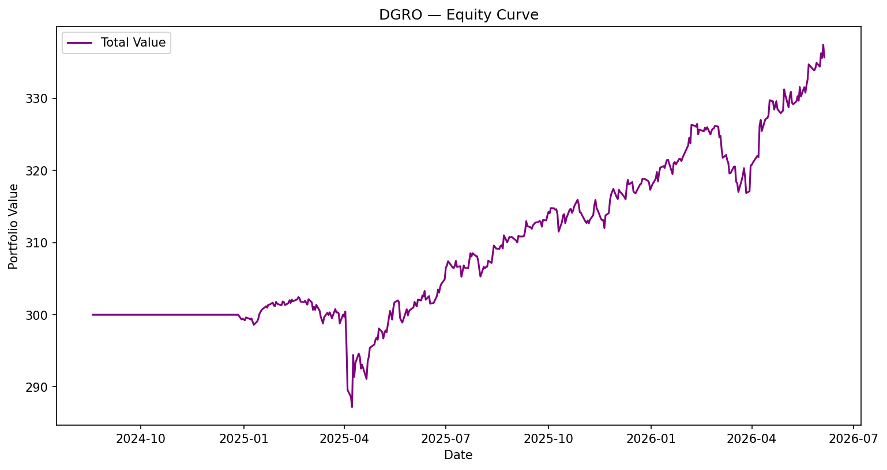
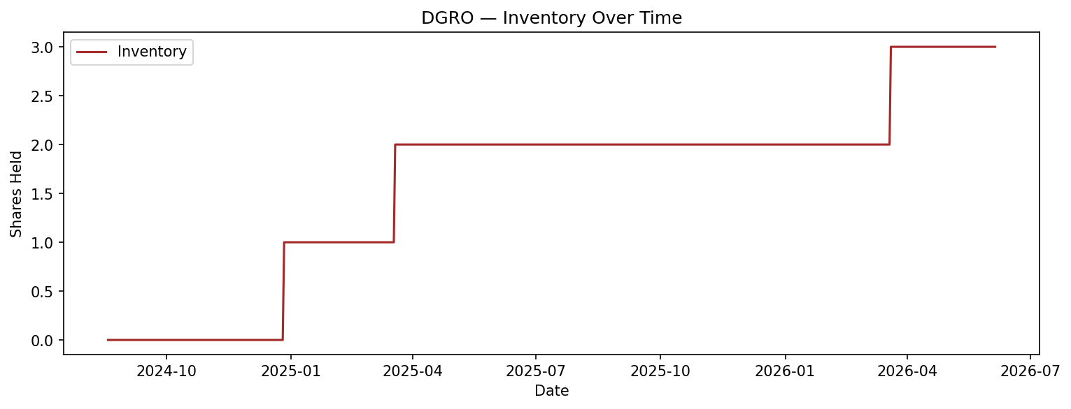
DGRO — Charts

Slide 14
SCHD — Performance Metrics
Total Return: 0.1793
Annualized Return: 0.0655
Annualized Volatility: 0.0635
Sharpe Ratio: 1.0311
Max Drawdown: -0.0704
Blended True Beta: 0.4122

Slide 15
SCHD — Sell Discipline
Total Sell Attempts: 0
Blocked by MA20: 0
Blocked by Avg Cost: 0

Slide 16
SCHD — Trade Activity
Total Buys (shares): 0
Total Sells (shares): 0
Largest Buy (shares): 0
Largest Sell (shares): 0

Slide 17
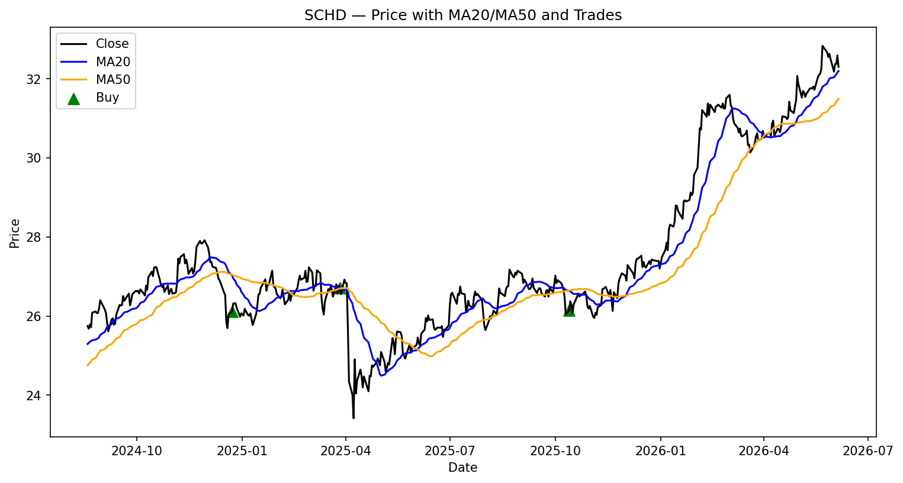
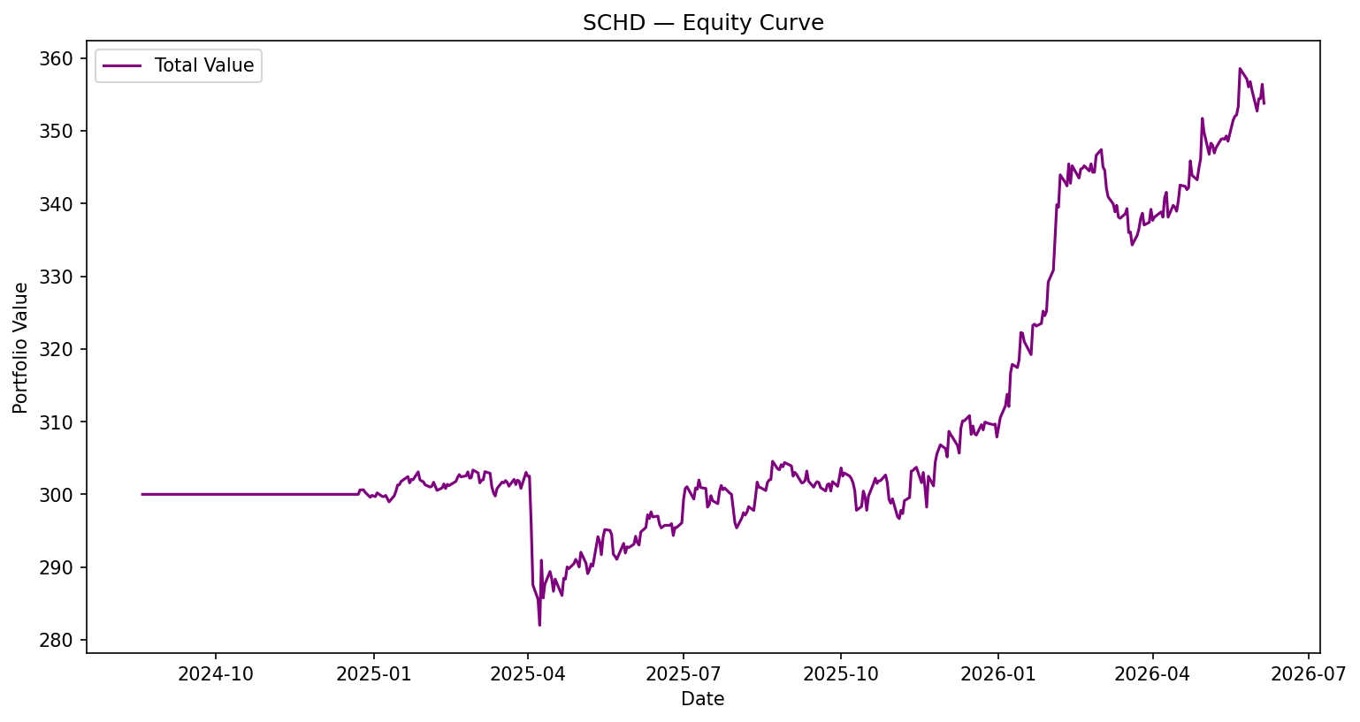
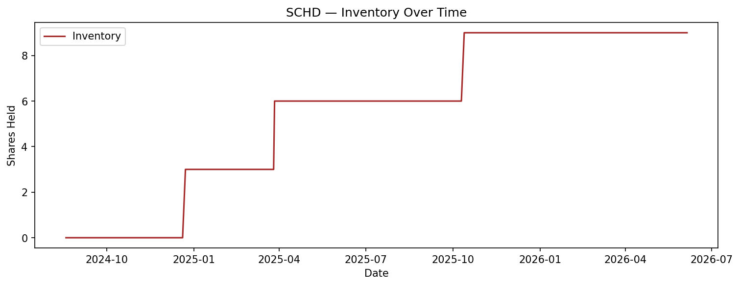
SCHD — Charts

Slide 18
KBWY — Performance Metrics
Total Return: 0.1694
Annualized Return: 0.0620
Annualized Volatility: 0.0842
Sharpe Ratio: 0.7369
Max Drawdown: -0.0840
Blended True Beta: 0.5537

Slide 19
KBWY — Sell Discipline
Total Sell Attempts: 0
Blocked by MA20: 0
Blocked by Avg Cost: 0

Slide 20
KBWY — Trade Activity
Total Buys (shares): 0
Total Sells (shares): 0
Largest Buy (shares): 0
Largest Sell (shares): 0

Slide 21
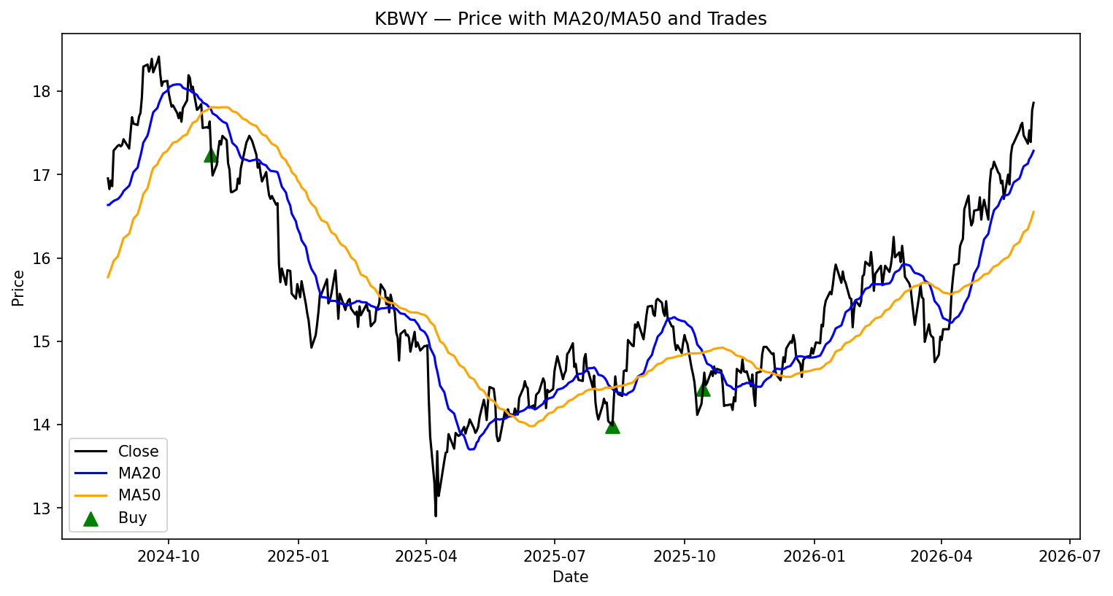
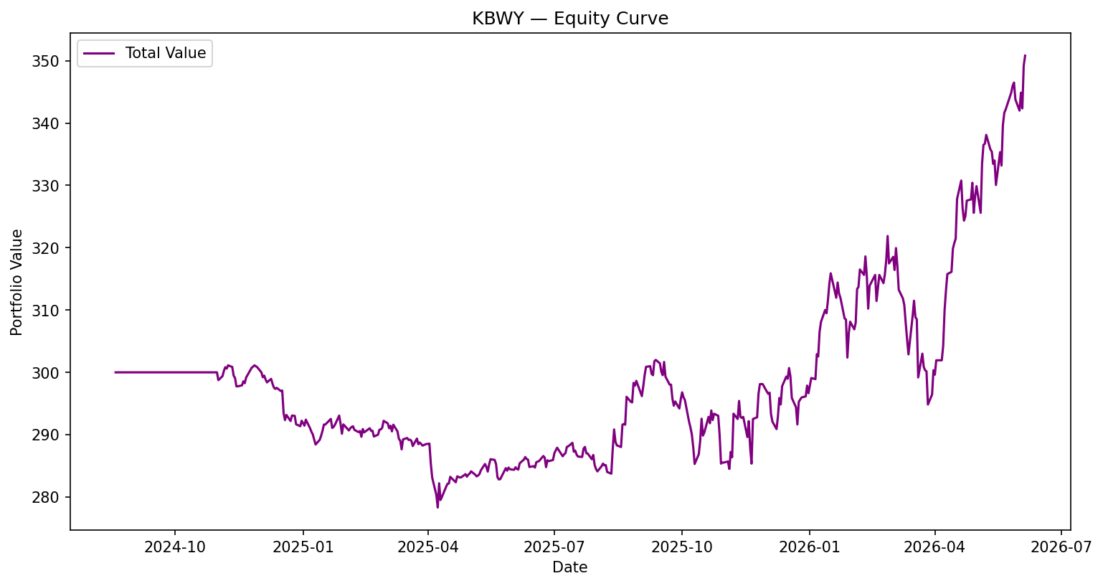
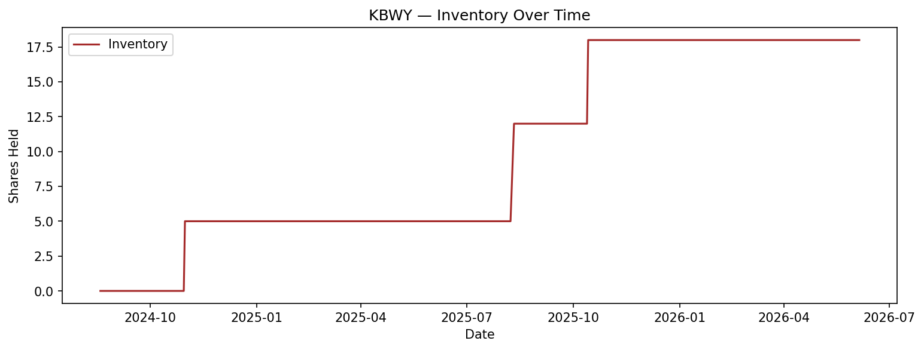
KBWY — Charts

