Slide 1
DAIS Strategy Overview
Dynamic Asymmetric Inventory-Aware Strategy

Slide 2
JEPI — Performance Summary
total_return: 0.11592221287019822
annualized_return: 0.058768795712487165
annualized_vol: 0.09561981463218865
sharpe: 0.6146089692659134
max_drawdown: -0.10197833958905456

Slide 3
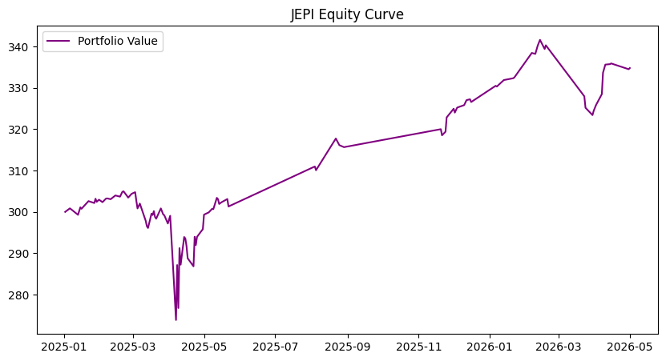
JEPI Chart

Slide 4
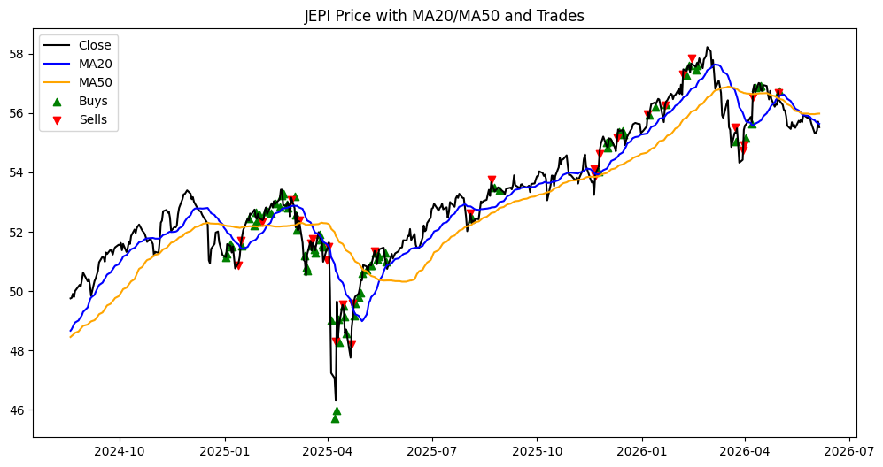
JEPI Chart

Slide 5
DGRO — Performance Summary
total_return: 0.25118601157138176
annualized_return: 0.11425085673629143
annualized_vol: 0.09118519871438767
sharpe: 1.2529539700204035
max_drawdown: -0.10186384671893234

Slide 6
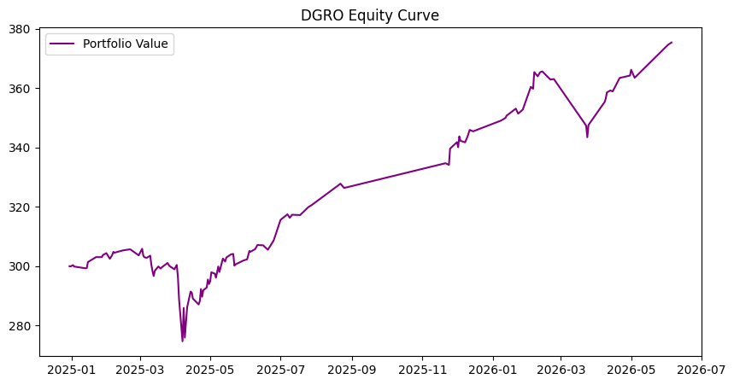
DGRO Chart

Slide 7
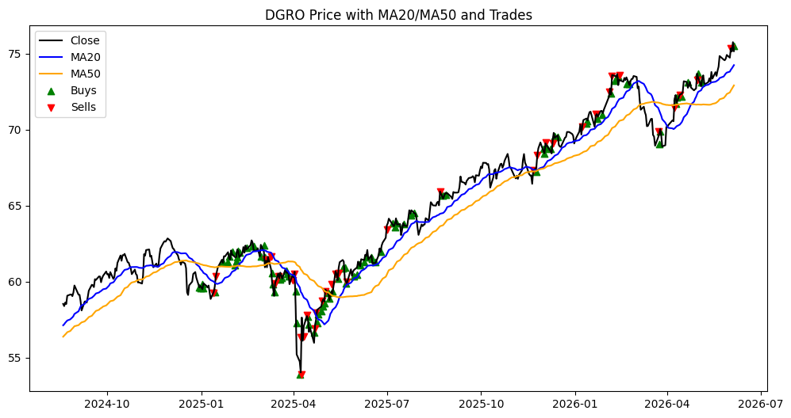
DGRO Chart

Slide 8
SCHD — Performance Summary
total_return: 0.23103868850110687
annualized_return: 0.10429275121176662
annualized_vol: 0.09695044742282038
sharpe: 1.0757325415624435
max_drawdown: -0.0977225344906888

Slide 9
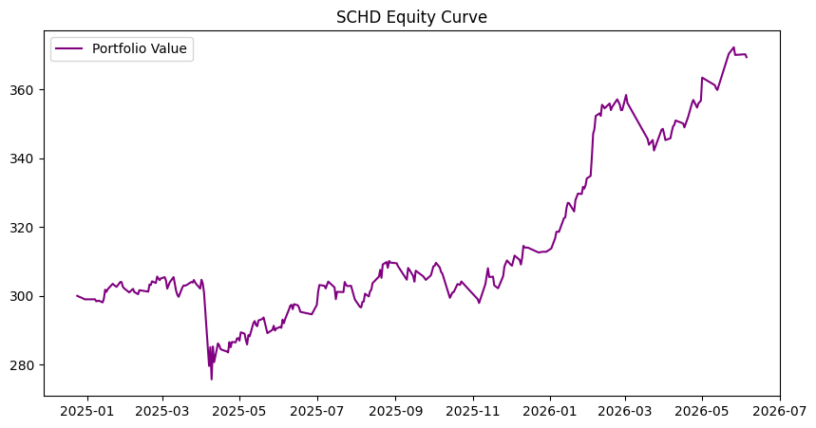
SCHD Chart

Slide 10
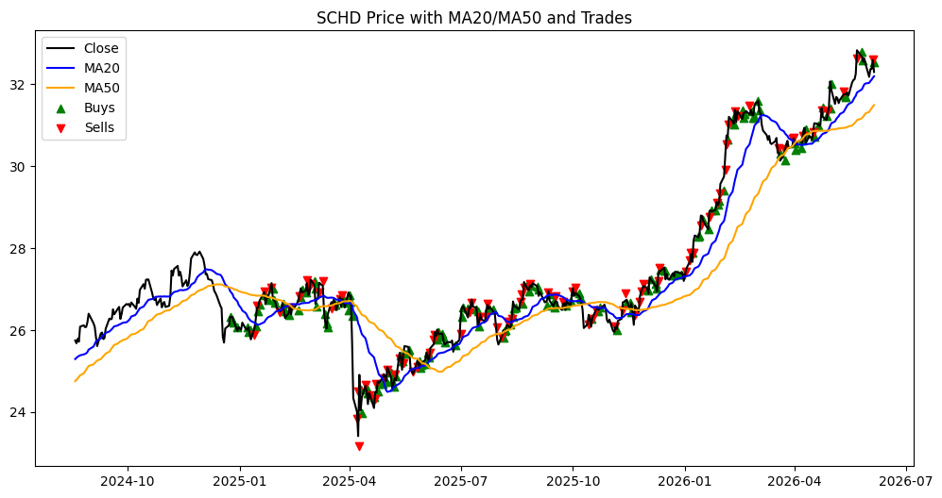
SCHD Chart

Slide 11
VYM — Performance Summary
total_return: 0.2414603817226677
annualized_return: 0.118422557093397
annualized_vol: 0.09906063907830125
sharpe: 1.195455210013246
max_drawdown: -0.08484761217583414

Slide 12
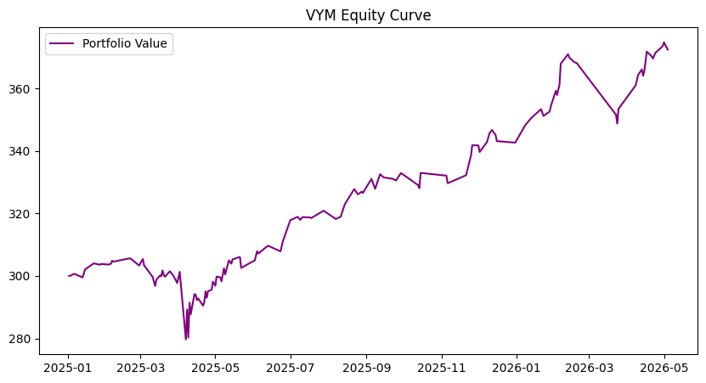
VYM Chart

Slide 13
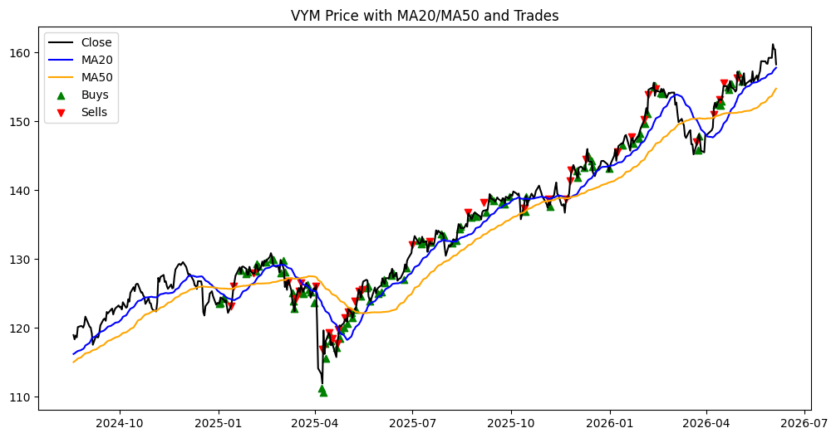
VYM Chart

Slide 14
KBWY — Performance Summary
total_return: 0.11291398609080461
annualized_return: 0.0474951465579021
annualized_vol: 0.10636351420498842
sharpe: 0.4465360787757292
max_drawdown: -0.14530199438886338

Slide 15
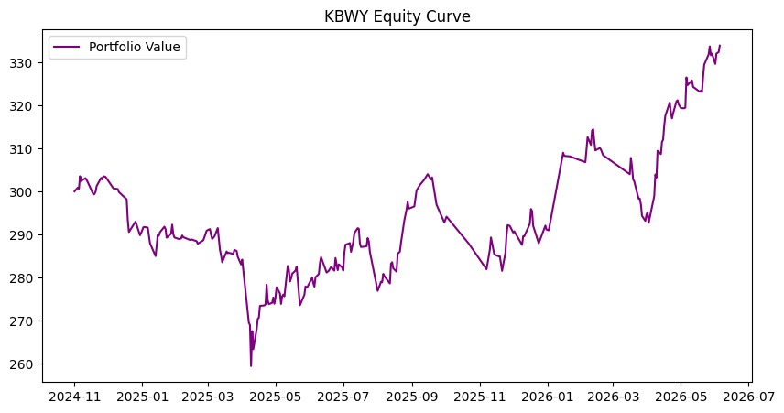
KBWY Chart

Slide 16
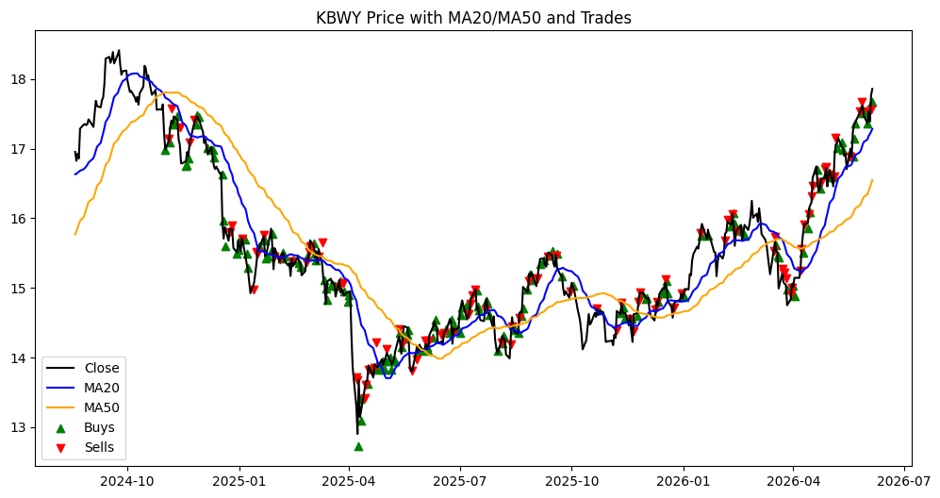
KBWY Chart

