Slide 1
DAIS Project: High-Frequency Strategy Results
Intraday Engine Telemetry Brief | Horizon: 30 Days | Interval: 5m

Slide 2
Global Portfolio Performance Matrix
Ticker | Total Return | Ann. Return | Sharpe Ratio | Max Drawdown | True Beta
CMCI | 0.00% | 0.00% | 0.00 | 0.00% | N/A
BGLD | 0.00% | 0.00% | 0.00 | 0.00% | 0.24
JEPQ | 0.00% | 0.00% | 0.00 | 0.00% | 0.61
QQQI | 0.00% | 0.00% | 0.00 | 0.00% | 0.84

Slide 3
Execution Performance Stream: CMCI
Executed Sells: 0 | Overnight Liquidations: 0 | Rejected via MA20: 0 | Rejected via Cost Basis: 0

Slide 4
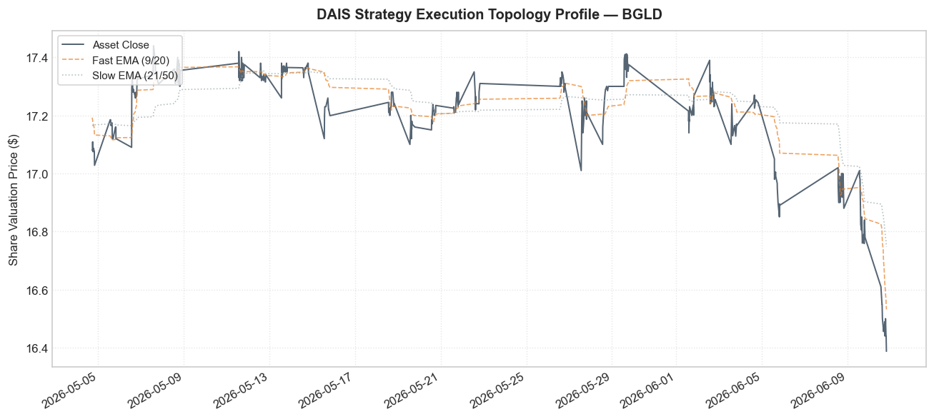
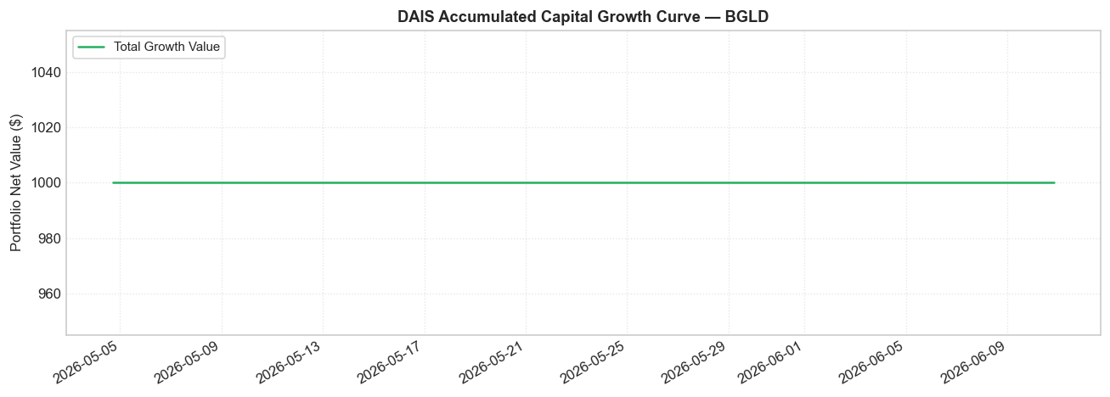
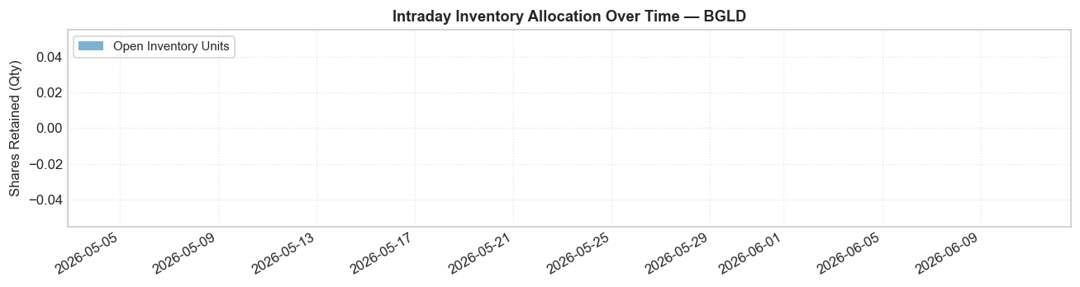
Execution Performance Stream: BGLD
Executed Sells: 0 | Overnight Liquidations: 0 | Rejected via MA20: 0 | Rejected via Cost Basis: 0
Execution Strategy Topology Profiles
Accumulated Growth Value Optimization
Intraday Base Share Inventory Density Allocations

Slide 5
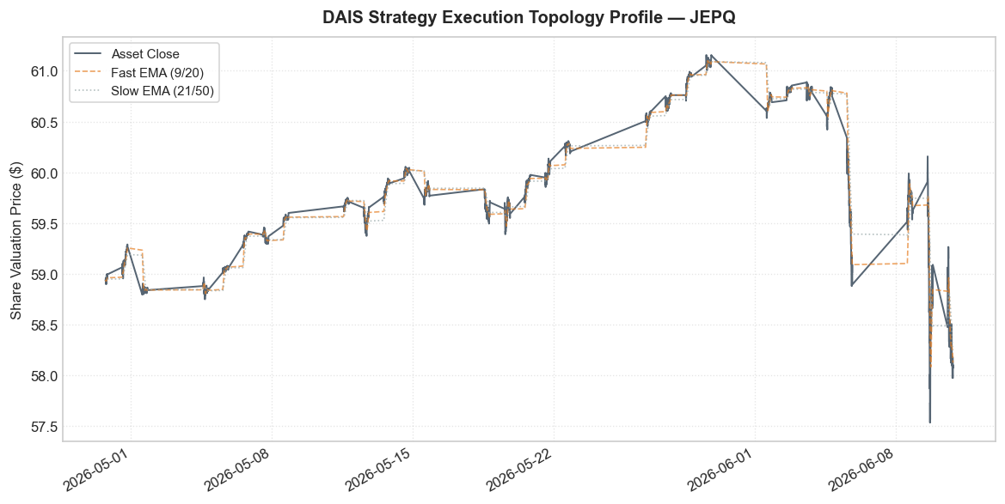
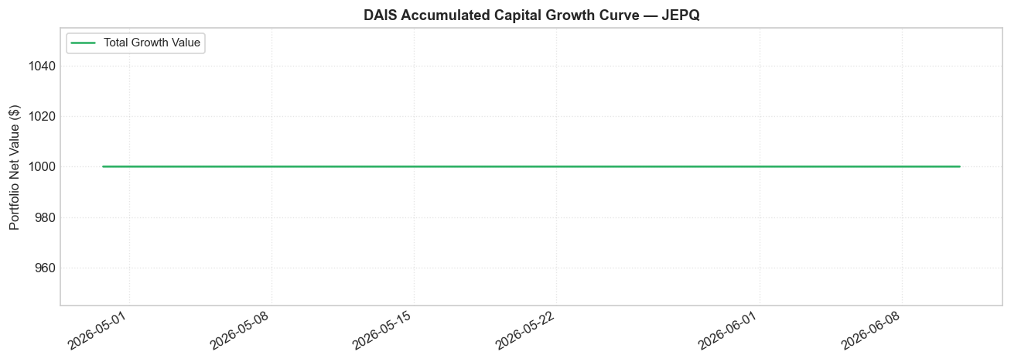
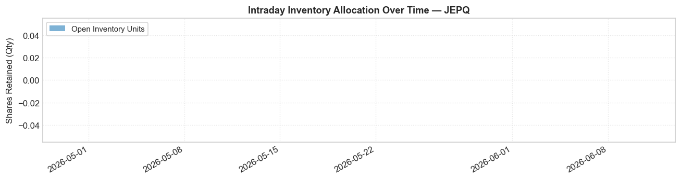
Execution Performance Stream: JEPQ
Executed Sells: 0 | Overnight Liquidations: 0 | Rejected via MA20: 0 | Rejected via Cost Basis: 0
Execution Strategy Topology Profiles
Accumulated Growth Value Optimization
Intraday Base Share Inventory Density Allocations

Slide 6
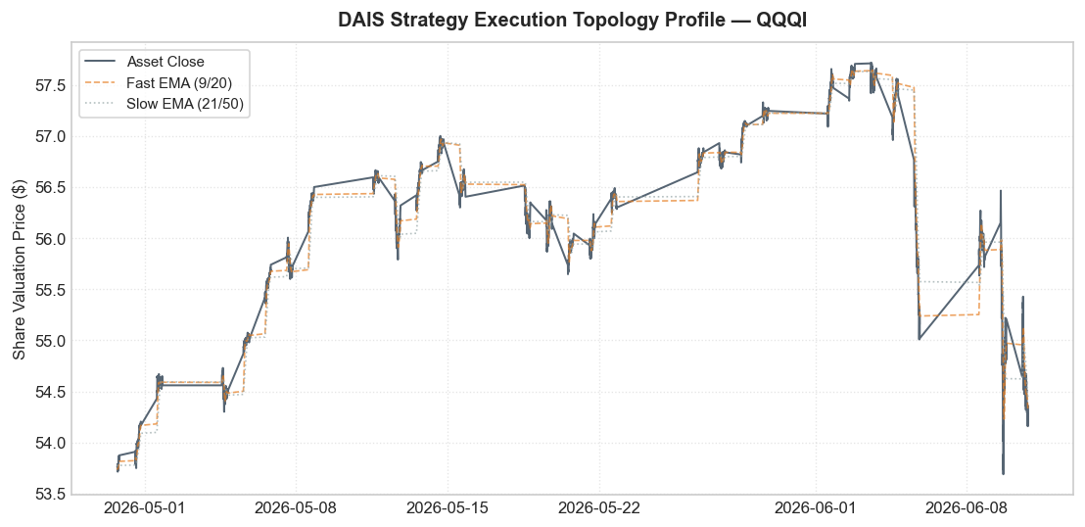


Execution Performance Stream: QQQI
Executed Sells: 0 | Overnight Liquidations: 0 | Rejected via MA20: 0 | Rejected via Cost Basis: 0
Execution Strategy Topology Profiles
Accumulated Growth Value Optimization
Intraday Base Share Inventory Density Allocations

