Slide 1

Algorithm
Definition
An algorithm is a finite set of instructions that, if followed, accomplishes a particular task. In addition, all algorithms must satisfy the following criteria:
(1)Input. There are zero or more quantities that are externally supplied.
(2)Output. At least one quantity is produced.
(3)Definiteness. Each instruction is clear and unambiguous.
(4)Finiteness. If we trace out the instructions of an algorithm, then for all cases, the algorithm terminates after a finite number of steps.
(5)Effectiveness. Every instruction must be basic enough to be carried out, in principle, by a person using only pencil and paper. It is not enough that each operation be definitei and also must be feasible.

Slide 2
Performance Analysis
Performance evaluation
Performance analysis
Performance measurement
Performance analysis - prior
an important branch of CS, complexity theory
estimate time and space
machine independent
Performance measurement -posterior
The actual time and space requirements
machine dependent

Slide 3
Space Complexity
Definition
The space complexity of a program is the amount of memory that it needs to run to completion
The space needed is the sum of
Fixed space and Variable space
Fixed space
Includes the instructions, variables, and constants
Independent of the number and size of I/O
Variable space
Includes dynamic allocation, functions' recursion
Total space of any program
S(P)= c+ S_{p}(Instance)

Slide 4
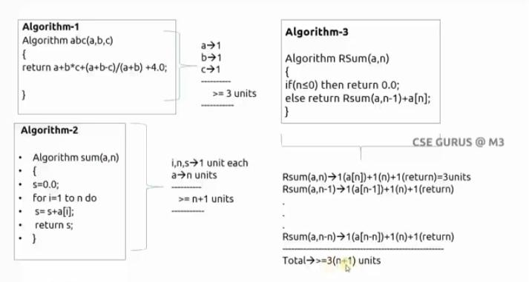

Slide 5
Time Complexity
Definition
The time complexity, T(p), taken by a program P is the sum of the compile time and the run time
Total time
T(P)= compile time + run (or execution) time
= c + tp(instance characteristics)
Compile time does not depend on the instance characteristics
Definition of a program step
A program step is a syntactically or semantically meaningful program segment whose execution time is independent of the instance characteristics.

Slide 6
Examples of Determining Steps
the first method: count by a program
float sum(float list[], int n)
{
float tempsum= 0; count++; /* for assignment */
for(int i=0; i< n; i++) {
count++; /* for the for loop */
tempsum+= list[i]; count++; /* for assignment */
}
count++; /* last execution of for */
count++; /* for return */
return tempsum;
}
2n+ 3

Slide 7
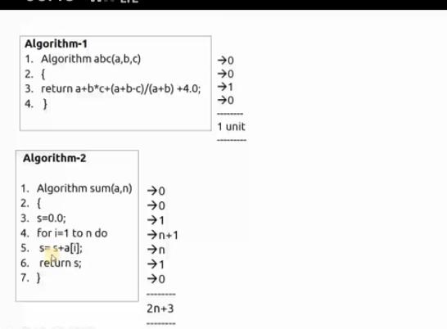

Slide 8
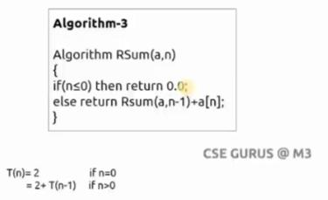

Slide 9
Examples of Determining Steps(Cont.)
The second method: build a table to count
s/e: steps per execution
frequency: total numbers of times each statements is executed

Slide 10
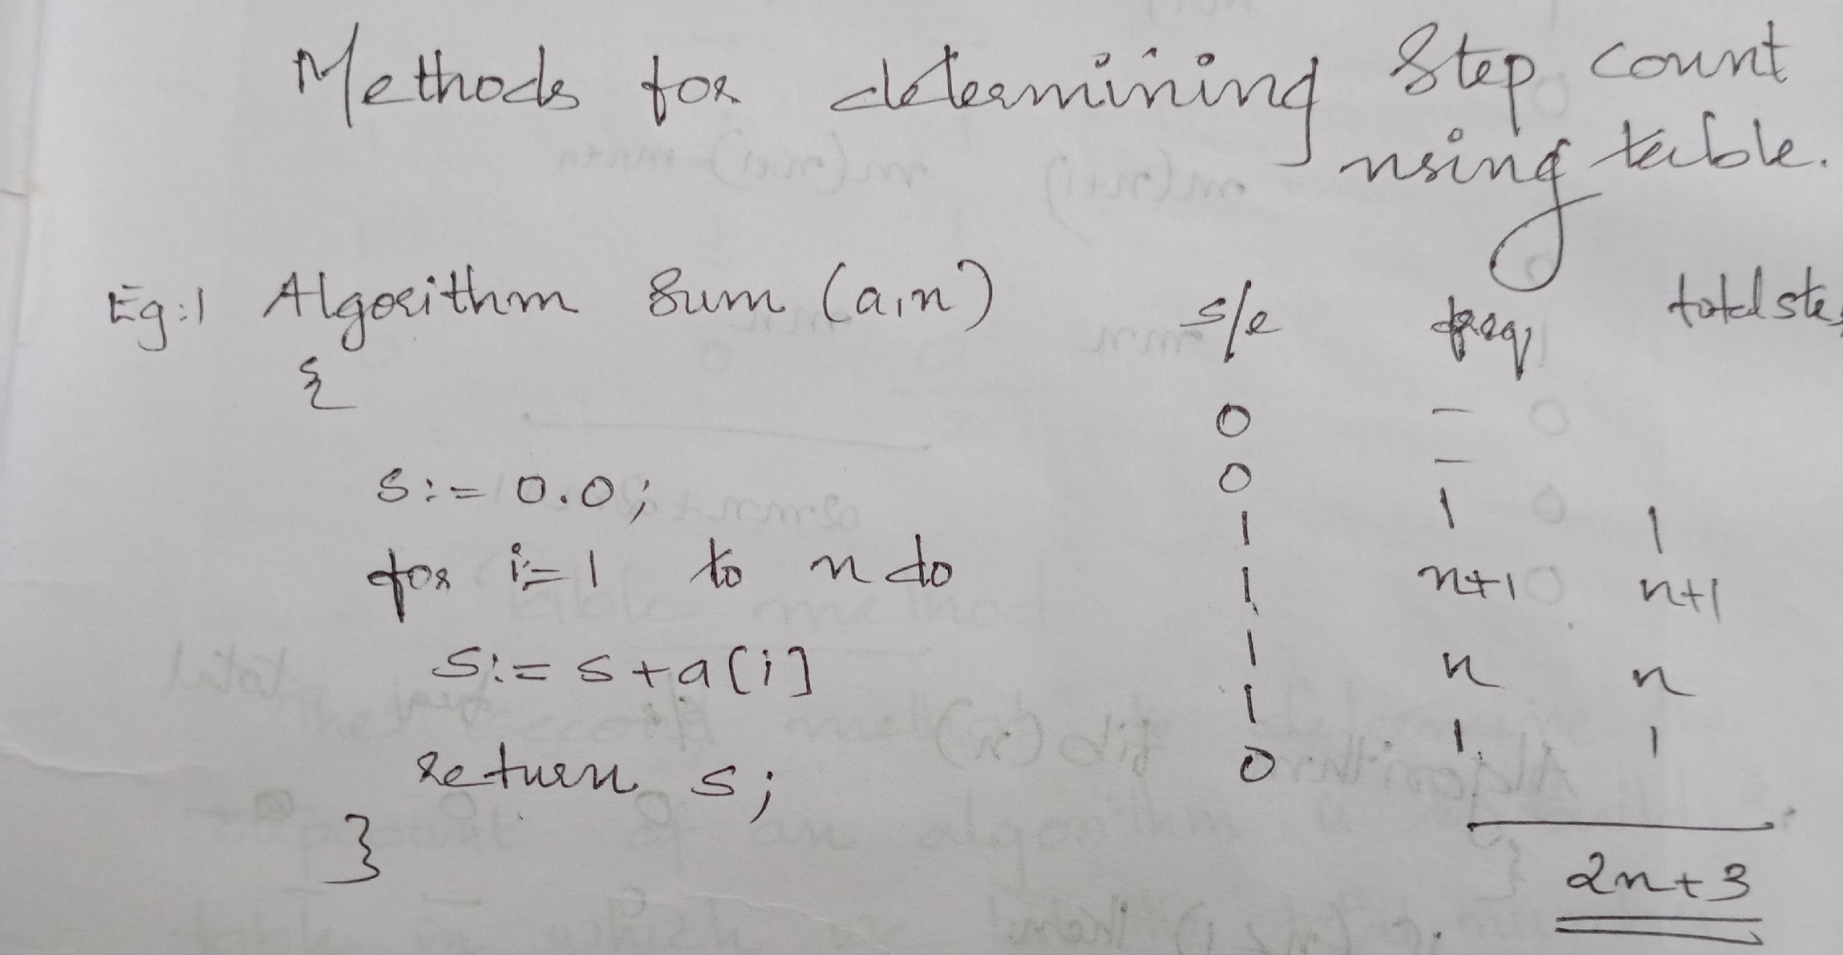

Slide 11
Remarks of Time Complexity
Difficulty: the time complexity is not dependent solely on the number of inputs or outputs
To determine the step count
Best case, Worst case, and Average.

Slide 12
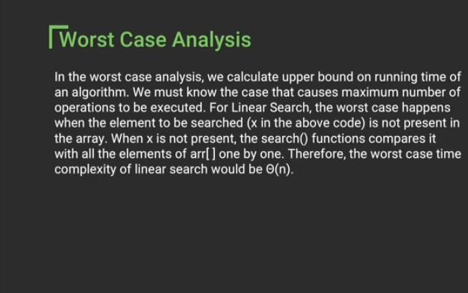

Slide 13
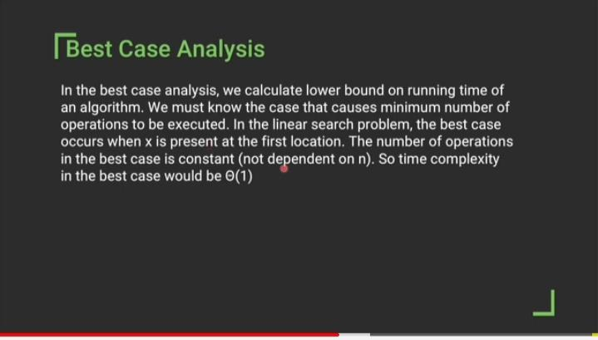

Slide 14
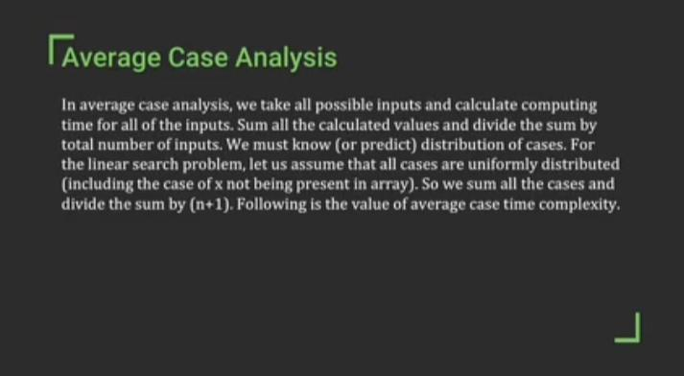

Slide 15
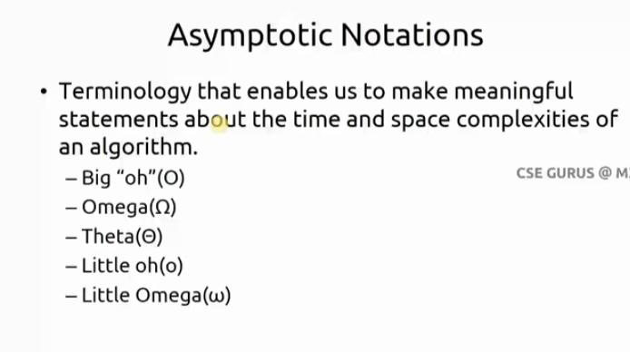

Slide 16
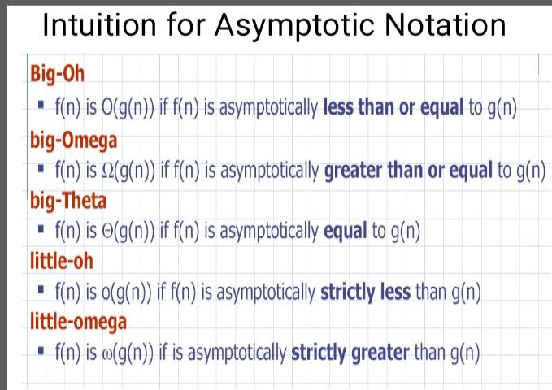

Slide 17
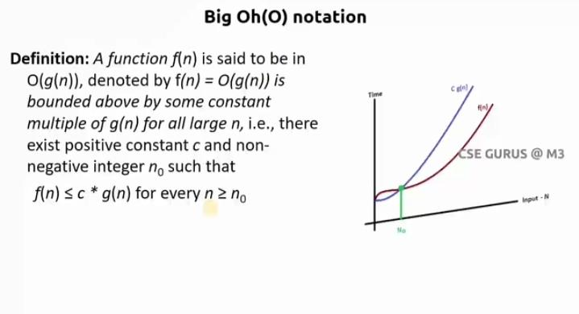

Slide 18
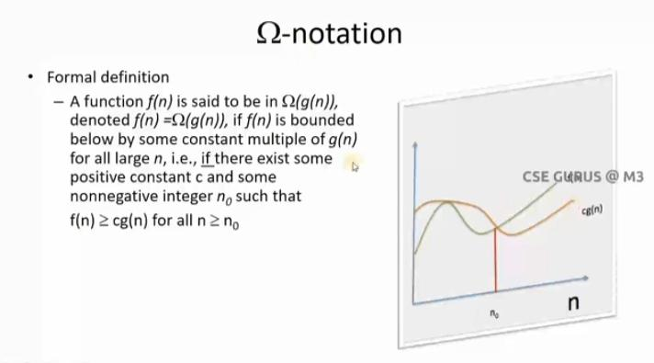

Slide 19
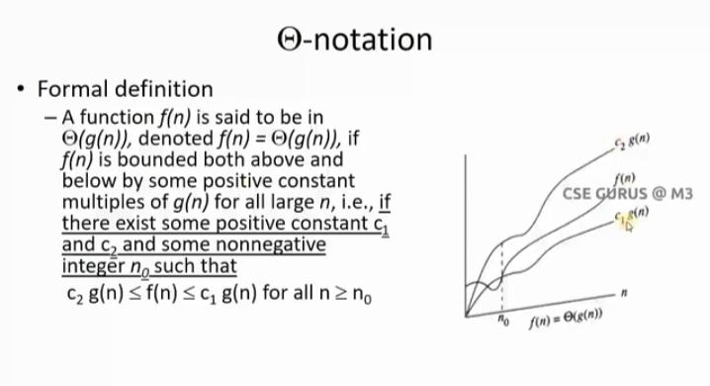

Slide 20
Properties
Reflexivity: If f(n) is given then f(n) = O(f(n))
Symmetry:
f(n) = Θ(g(n)) if and only if g(n) = Θ(f(n))

Slide 21
Transistivity: f(n) = O(g(n)) and g(n) = O(h(n))
⇒ f(n) = O(h(n))
Transpose Symmetry:
f(n) = O(g(n)) if and only if g(n) = Ω(f(n))

Slide 22
Recurrence Relation
Recurrence: an equation that describes a function in terms of its value on smaller functions.

Slide 23
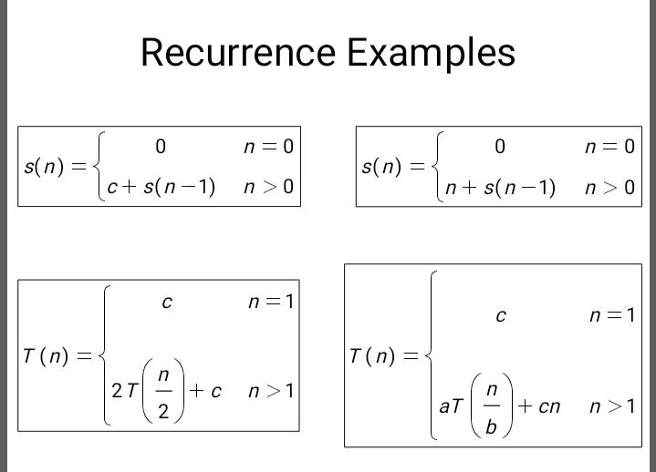

Slide 24
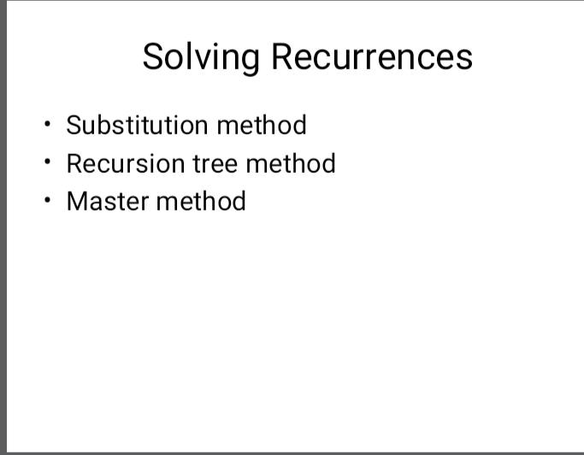

Slide 25
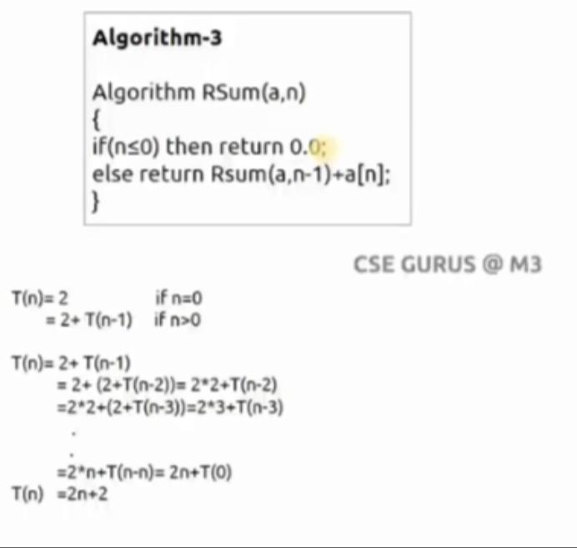
Substitution method

Slide 26
Master's thereom/ method
The master method applies to recurrences of the form T(n) = a T(n/b) + f (n)
Describe the running time of an algorithm that divides a problem of size n into a sub problems, each of size n/b.
There are three common cases

Slide 27
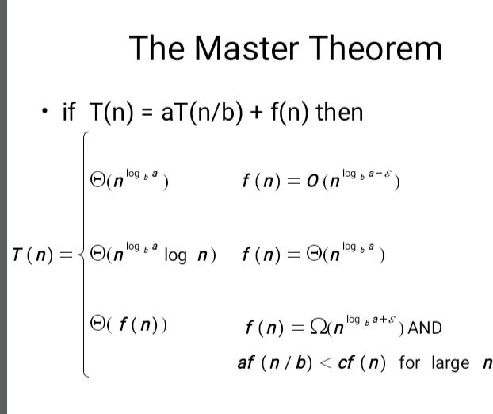

Slide 28
