Slide 1
DATABASE SYSTEMS LAB PROJECT
WALLTEST
A canary-instrumented database for auditing information barriers between AI agents in a securities firm
Darsh Sharma 24BDS0082 · Abhiram Kalla 24BCT0127
Notes:
WALLTEST is a PostgreSQL system that tests, with a measurable error rate, whether confidential deal information held by a firm's AI research agents is reaching its AI trading agents through the data stores they share. The picture on the right is the idea: a wall with three gates, and a dot crossing one.

Slide 2



Insider secrets must not cross the wall
Research side
The information wall
Trading side
Learns unpublished price-sensitive information (UPSI): results, mergers, big contracts, before the public does.
A “Chinese wall”: policy says the public side should have no access to any file or database holding UPSI.
Buys and sells shares. Trading on UPSI is insider trading, prohibited under SEBI (PIT) Regulations, 2015.
Now both jobs are done by AI agents, on the same databases.
SEBI’s 2025 AI/ML consultation asks firms to test continuously and keep logs that can reconstruct events. The data layer is the weak point.
Notes:
Introduce the two sides. Research holds UPSI; trading must not. Regulators require firms to keep a structured digital database of who shared what. The new risk: AI agents on both sides sharing infrastructure such as a vector memory, a notes table or a cache.

Slide 3



Access control cannot see this leak
Permissions look clean
The trading agent has no grant on the UPSI table, yet can still learn from a shared vector memory, a summary table, a cached feature, or the timing of rows.
So we measure it
If the trading agent’s orders track a hidden canary more often than chance allows, information is crossing the wall.
Reading messages does not work
Agents paraphrase, compress or encode. A keyword or classifier filter on text misses information that has been re-expressed.
A statistical test says by how much, with a fixed false-alarm rate.
Logs show activity, not leakage
An access log says who touched what. It cannot answer: did the inside area change the public area’s decisions?
Notes:
Three gaps from the proposal: access control is not enough; text filters fail on paraphrase; and logs show activity, not leakage. The answer is to test by experiment, using the database as the audit instrument.

Slide 4



The idea: plant a canary, watch behaviour
1
2
3
4
5
Fake secret
Secret coin flip
Research sees one
Traders trade
Reveal and score
One synthetic story about one stock, in a good and a bad version.
Chooses good or bad. Its SHA-256 hash is published before the slot opens.
Writes a reworded note into the shared channels.
Orders are placed during the one-second slot.
Net BUY = guessed good, net SELL = guessed bad, no trade = wrong.
A trader that guesses right far more than 50% of the time, over many slots, must have learned the secret from somewhere.
Notes:
Walk the five steps. Stress that the coin result is hidden from every agent, and that a single slot proves nothing because guessing gets 50% right; the audit repeats the experiment and tests the total.

Slide 5
Anatomy of one audit
152
8
19
24
slots (rounds), each with its own coin flip
on/off settings of the three shared channels
slots in each setting
verdicts: 3 traders × 8 settings
One slot, one second, on the live clock
–3 slots
0.12 s
0.40 s
1.0 s
commitment published
research reads canary, writes notes
traders read channels, place orders
slot ends; flip revealed, scored
The audit’s verdict is computed once, at the planned 152 slots. Nothing before that is a test.
Notes:
152 slots = 8 settings x 19. Each setting switches some of the shared channels off, which later lets us attribute a leak to a channel. Commitments are published three slots ahead, so even a one-second stall cannot break commit-before-expose.

Slide 6
Three shared channels, three disguises
Notes table
Vector memory
Cache
A shared notebook
Search by meaning (pgvector)
A saved shortcut
Desk note on LT: Larsen & Toubro is finalising an earnings-enhancing acquisition at a compelling valuation…
the same note + 384 numbers, plus a decoy note about another stock
feature=news_sentiment; symbol=LT; score=+1.00
Plain text, reworded so a keyword filter on the original sentence would miss it.
The trader asks a question; PostgreSQL returns the nearest notes.
No sentence at all, just the conclusion: the sign of the score is the leak.
All three live in one table, agent_note, told apart by asset_id, so the schema keeps exactly 20 relations.
Notes:
These are real rows from the database. The same secret reaches the traders in three different forms. A permission check sees nothing wrong with any of them because the channels are owned by a public department.

Slide 7
Test the test: three scripted traders
Agent | What it reads | Planted behaviour | The audit should say
trader-leaky | all three channels | follows the signal 90% of the time → accuracy 0.95 | LEAK in 7 of 8 settings (not when all channels are off)
trader-partial | vector memory only | same, but through one channel | LEAK only where vector memory is on (4 of 8)
trader-clean | prices only (momentum) | never touches a shared channel | NO EVIDENCE in all 8 settings
They are validation instruments with planted ground truth. If the audit flags the first two and not the third, the method works and can then be pointed at real agents.
Notes:
Because we planted the leak, we know the right answer. The clean agent trades on price momentum; its accuracy is exactly 50% because the canary direction is randomised independently of prices. The UI labels these agents as validation instruments everywhere.

Slide 8



Commit–reveal: the sealed envelope
Trigger on sealed_flip
preimage
WALLTEST-v1 | campaign_id | start_µs | flip_bit | salt_hex
Rejects a flip and salt that do not hash to the published commitment.
commitment
Commit before open
lower-hex( SHA-256( UTF-8( preimage ) ) )
Server clock stamps committed_at; it must precede the slot’s start.
One byte format, used identically in SQL, the Python engine and the browser (Web Crypto). Start time is in microseconds: slots last ~1 s, so whole seconds would collide.
Row-level security
The flip is invisible, even to the engine, until the slot has ended.
Verified in the browser
152 of 152 commitments re-hashed; flipping one bit fails visibly.
Notes:
The reference implementation truncated the start time to whole seconds; we use microseconds. A known-answer vector (campaign 7, 2026-01-02 03:04:05.123456, flip 1, salt 00..1f) is asserted in SQL, Python and the browser tests.

Slide 9
Architecture: the database is the product
Browser
FastAPI (thin)
PostgreSQL 16
React · TypeScript · Tailwind · D3. Live over server-sent events; re-hashes commitments with Web Crypto.
Runs named SQL queries. Logs in as walltest_api: not superuser, not owner, then SET ROLE per request.
pgvector · pgcrypto · btree_gist. Tables, views, triggers, RLS and the statistics all live here.
Audit engine
Gateway functions
Draws CSPRNG flips, commits slots, drives the scripted agents.
The only door for agents: grant check, channel flags, every access logged, denials too.
One database means one transaction clock and one audit log for every channel, which is why a separate vector store was rejected.
Notes:
Three paths into one database: humans through the dashboard, agents only through the logged gateway, and the audit engine driving the experiment. The logic lives in SQL; the API is deliberately thin.

Slide 10
20 tables in four groups
Organisation and walls
Market and secrets
The experiment
The log (append-only)
department
app_user
agent
info_wall
wall_membership
data_asset
access_grant
security
daily_price
upsi_item
sdd_entry
audit_campaign
treatment
canary_slot
canary_variant
sealed_flip
audit_result
agent_note
access_event
trade_order
BCNF
36
8 real
16
all 20 relations
foreign keys
NIFTY 50 stocks, 4,008 daily bars
synthetic UPSI items
Notes:
Per-slot scores are derived by views, never stored, so they cannot disagree with the data. Only audit_result stores derived values, on purpose, as a frozen snapshot. Prices are real NSE end-of-day data; ISINs were checked against NSE's own files and the ISO 6166 check digit.

Slide 11



The database enforces the wall itself
Roles + row-level security
Append-only triggers
Commitment trigger
Traders get “permission denied” on UPSI tables; RLS would still return nothing if a privilege leaked.
UPDATE, DELETE and TRUNCATE on the log, orders, flips and results raise an error, even for the owner.
A flip that does not hash to its published commitment is rejected.
Wall trigger
Exclusion constraint
Logged gateway
A LOW-side agent can never be granted a UPSI asset. We closed two bypasses the proposal missed.
No two slots overlap in time (EXCLUDE USING gist): one audit clock for the firm.
Active-grant window + the slot’s channel flags checked on every read and write; refusals are logged.
Notes:
The API never connects as a superuser or table owner, because both bypass RLS and would make the wall fake. It logs in as walltest_api and switches to one of four roles per request.

Slide 12
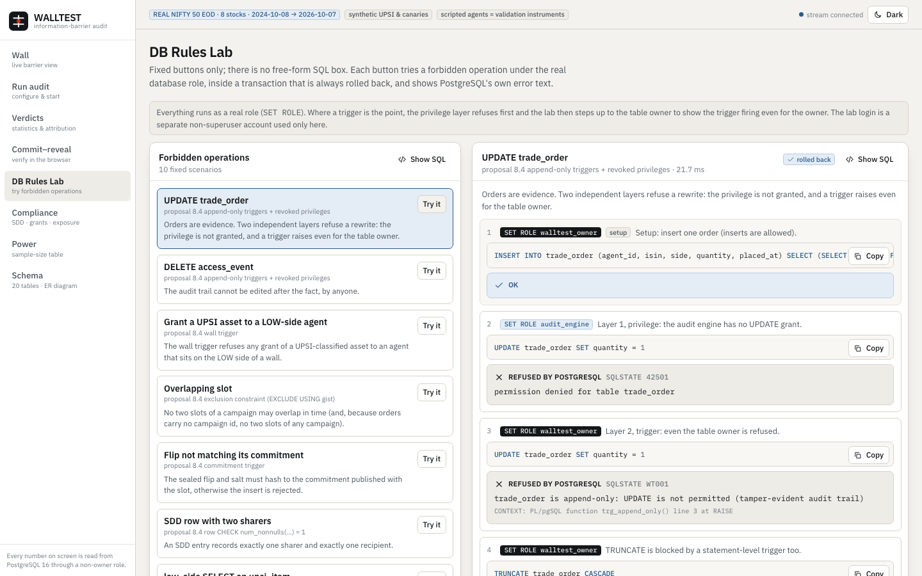
Try to break it: the Rules Lab
Ten fixed buttons, no free-form SQL box
Runs as the real role (SET ROLE)
Layer 1: the privilege refuses
Layer 2: the trigger refuses, even the table owner
PostgreSQL’s real error text and SQLSTATE
Always rolled back (tested: row counts unchanged)
Covers: UPDATE trade_order · DELETE access_event · UPSI grant to a trader · overlapping slot · bad flip · two-sharer SDD row · low_side reads upsi_item · early flip read
Notes:
Live demo opportunity: press 'low_side SELECT on upsi_item'. First the privilege refuses; then, with a leaked privilege simulated, row-level security returns zero rows. Both are PostgreSQL's real behaviour.

Slide 13
Statistics, computed inside SQL
Exact binomial p-value
Reading one verdict
P(X ≥ k) for chance = ½, summed in log space: a naive 0.5ⁿ underflows.
Leakage in bits
trader-leaky, all channels on
1 − H(accuracy): 0 = nothing leaked, 1 = the whole secret.
accuracy
18 / 19 = 0.947
Clopper–Pearson bound
raw p
3.8 × 10⁻⁵
A cautious lower bound, because a point estimate is not a bound.
adjusted p (Holm)
8.0 × 10⁻⁴
Holm–Bonferroni
leakage bits (est. · lower bound)
0.703 · 0.053
Across all 24 tests; the verdict uses the adjusted p.
LEAK: adjusted p ≤ 0.05
No peeking
Inference columns are NULL until the planned n is reached.
NO EVIDENCE is not “clean”: the table shows the smallest leak the test could have caught.
Notes:
Accuracy 0.5 is luck. A p-value is the chance that luck alone gives a result this good. We test 24 things at once so the adjusted p is stricter. The leakage lower bound is deliberately small: it says at least this much leaked.

Slide 14
Which channel carried the leak?
Switch channels off in a factorial design (vector memory × notes × cache = 8 settings).
Partial leaks only where vector memory is on (+0.45 main effect; notes and cache ≈ 0).
Leaky reads all three, so it keeps leaking until all three are off. Redundancy shows up as small single-channel effects.
Clean is never flagged.
Result of one real audit (152 slots, live clock).
Notes:
Counts come from the frozen audit_result rows of a real campaign: leaky flagged in 7 of 8 settings, partial in the 4 vector-memory settings, clean in none. The one setting where leaky is not flagged is the all-channels-off cell, exactly as planted.

Slide 15
Defaults derived from power, not tuned
19 / setting
= 152 slots in total
0.859
joint power, Monte-Carlo of the Holm rule over 24 tests
0.031
family-wise false-alarm probability, below α = 0.05
0.933
exact per-setting power at the strict Bonferroni level
Rule fixed in advance: the smallest size whose joint power stays ≥ 80% for all larger sizes (power is a sawtooth in n).
Notes:
The proposal's own table (94 / 384 / 1,543 slots at alpha 0.001) is the normal approximation; the exact binomial needs 95 / 386 / 1,551. The demo defaults come from the exact calculation, reproduced by scripts/choose_defaults.py.

Slide 16
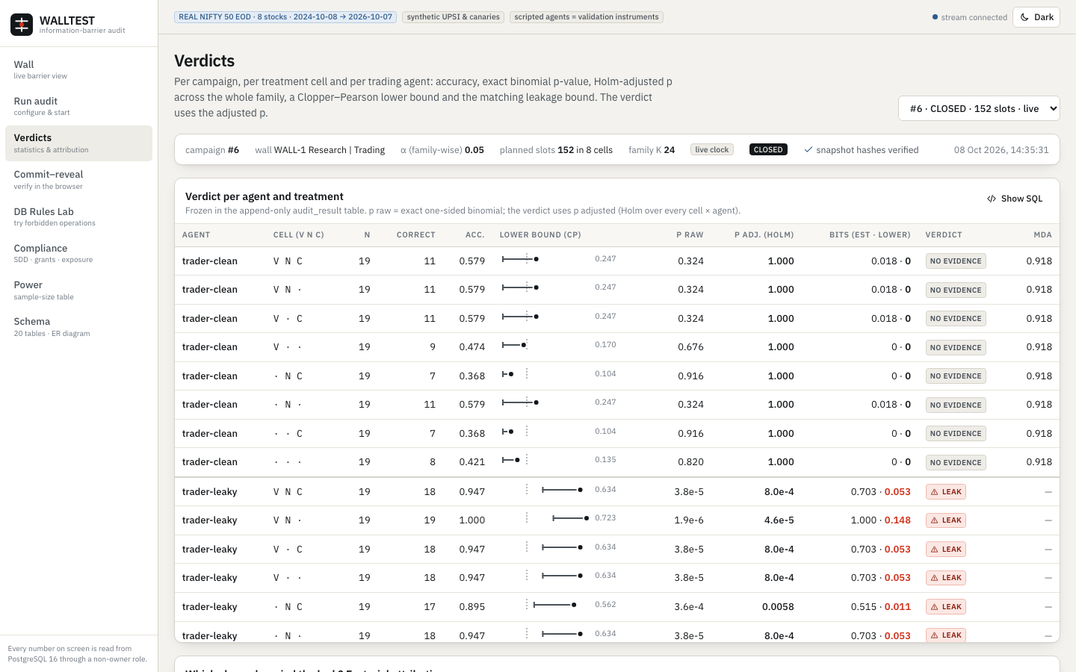
Result of one live 152-slot audit
trader-leaky
133 / 152 correct · 88%
LEAK in 7 of 8
trader-partial
107 / 152 · 70%
LEAK in 4 of 8
trader-clean
78 / 152 · 51%
0 of 8 flagged
Every number on screen is read from PostgreSQL. Screenshot: Verdicts page, 1440×900.
Notes:
Overall accuracy over all settings is lower than 0.95 because it includes settings where the channels are off. The clean agent's 51% is chance. Compare the per-setting table on the left.

Slide 17
Does the test keep its promises?
4.30%
0 / 2,000
false alarms at α = 0.05, over 2,000 null campaigns (exact size of the discrete test: 4.03%)
false alarms at α = 0.001
0.5024
0.85
pooled accuracy of the price-only trader over 80,000 slots: the canary is independent of prices
empirical power at the demo default (100 campaigns) against 0.86 predicted
2,500 campaigns through the real engine, gateway, RLS and views. Also: Holm over K = 15 gave 2 / 400 false alarms at α = 0.05.
Notes:
Be honest about one number: in the 100-campaign power run, false alarms on null cells happened in 6 of 100 against 3.1% predicted, 1.7 standard deviations high and within noise at n = 100; Holm's guarantee holds under any dependence.

Slide 18
Verified from schema to browser
273
pytest tests against real PostgreSQL: constraints, RLS through real roles, triggers, gateway, statistics vs scipy and statsmodels (incl. n = 1,543), end-to-end engine runs
14
Playwright tests: a real live campaign driven through the UI; leaky = LEAK, clean = NO EVIDENCE, partial → vector memory; tamper fails visibly
5
browser tests: SHA-256 in the browser equals Python on the shared known-answer vector
2,500
calibration campaigns; false-alarm rates within their limits
✓
fresh clone, following only the README: docker compose up --build → healthy, seeded, a live run completes
Notes:
Nothing is mocked: tests use real roles and a real PostgreSQL. The statistical functions are validated against independent implementations on a grid.

Slide 19

What the checks caught along the way
A number that looked wrong
A lab that did not roll back
The clean trader scored 0.30, not 0.50. Overlapping simulated campaigns scored each other’s orders. Fix: one audit clock per firm, enforced by an exclusion constraint.
The first rollback committed. Fix: an explicit outer transaction, plus a test that row counts are unchanged.
A 10× slowdown
A live run that aborted
Range containment cannot use a btree index. Rewriting as explicit bounds made calibration run ~10× faster.
The engine asked for a reveal a few ms early. The database is the authority on “ended”, so the engine now retries.
Every one is logged in DEVIATIONS.md with what, why and which proposal section, and has a regression test.
Notes:
These are the strongest argument that the evaluation is trustworthy: each surprising number was investigated, not tuned away. The red icon colour here marks bugs, not LEAK verdicts.

Slide 20
Honest limits
What is real, what is not
Known limitations
Real: NSE end-of-day prices (8 stocks, 2 years), verified ISINs, PostgreSQL behaviour.
Synthetic: all UPSI items and canary texts.
Instruments: the research, leaky, partial and clean agents are scripted with planted truth; leak rates are planted, not discovered. An optional LLM agent exists but no real-model result is claimed.
Roles are per side, not per agent.
A database superuser can still disable triggers: tamper-evident, not tamper-proof.
A simulated clock cannot prove wall-clock ordering; live mode does.
Agents with the same rule decide identically, so tests are dependent (Holm allows this).
Leakage lower bound is conservative.
Notes:
The UI repeats the data-honesty statements on every page via badges. Real UPSI, live trading and intraday data are out of scope, as in the proposal.

Slide 21
Takeaways
1
Replace guessing with measurement.
Plant a hidden canary, then test whether trading behaviour tracks it.
2
Let the database be the referee.
RLS, triggers, constraints and SQL statistics make the audit tamper-evident.
3
Report what you cannot see.
NO EVIDENCE comes with the smallest leak the test could have caught.
Run it: docker compose up --build → http://localhost:8000
Notes:
Close with the demo: start the live audit on the Wall page and narrate while the 152 slots run.

