Slide 1














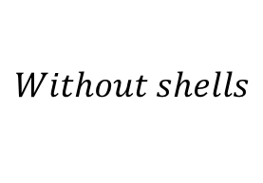









$$t$$
$$ΔM$$
$$−ΔM$$
$$δt_{0}$$
$$δτ_{0}$$
$$δτ_{2}$$
$$With double shell$$
$$δτ_{1}$$
$$I$$
$$II$$
$$I$$
$$δt_{e}$$
$$δτ_{e}$$
$$l$$
$$Δl$$
$$r_{1}$$
$$r_{2}$$
$${δ\overline{t}}_{0}$$
$${δ\overline{τ}}_{0}$$
$$Without shells$$
$$δ\overline{t_{e}}$$
$${δ\overline{τ}}_{e}$$
$$r_{e}$$
$$r_{0}$$
$$r$$

