Slide 1
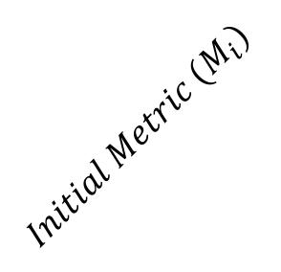
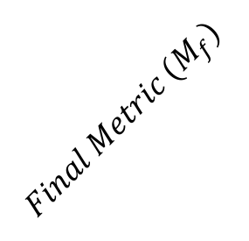







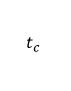




$$t$$
$$r_{A}(t)$$
$$r_{B}(t)$$
$$t+t_{1}+t_{2}$$
$$Final Metric (M_{f})$$
$$Initial Metric (M_{i})$$
$$τ$$
$$t+t_{1}$$
$$t_{c}$$
$$t$$
$$d$$
$$t=0$$
$$r_{0}$$
$$\overline{τ}$$

