Slide 1
Senti-Me
Understanding the change in behavior of people and small businesses due to covid19
Team : Darsh Kodwani, Tharshi Sri, Samuel Greenbank, Zaria Levi, ChristyAna Taveras

Slide 2
Goal
Design a complete data driven pipeline that uses textual data from publicly available sources to gauge the public sentiment and its impact on business

Slide 3
Structure of SENTIMENT ANALYSIS
Sentiment analysis
Twitter data
Google trends
Energy consumption

Slide 4
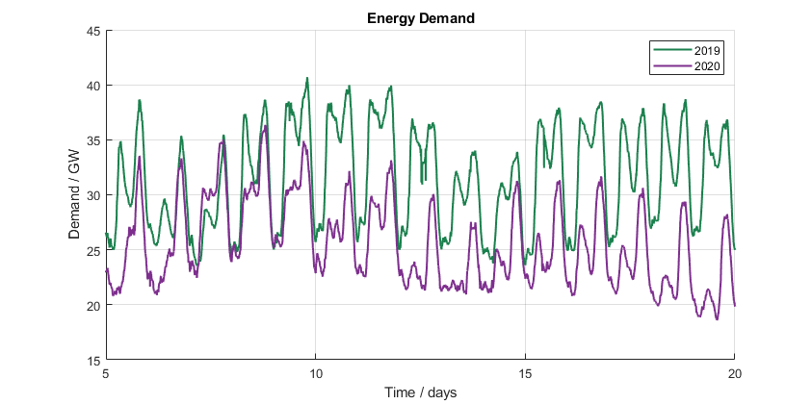
Sentiment analysis - Energy Consumption
Energy consumption during lockdown in 2020 compared to same dates in 2019 in UK.
2020 has been much warmer which is why the energy demand is lower.
Suggests dominant factor for energy consumption is heating as opposed to other activities.
In addition, closure of local businesses contributes to drop in demand

Slide 5
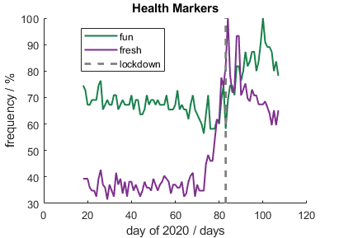
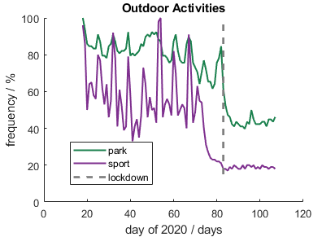
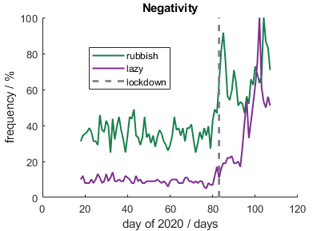
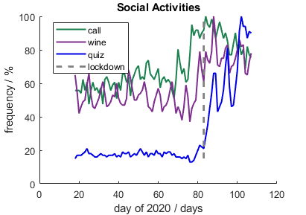
Sentiment analysis – Google trends
Words trending in google over the lockdown period
Classified according to 4 sentiments
Shows clear, interpretable results
These can be used to inform what local businesses should focus on and address

Slide 6
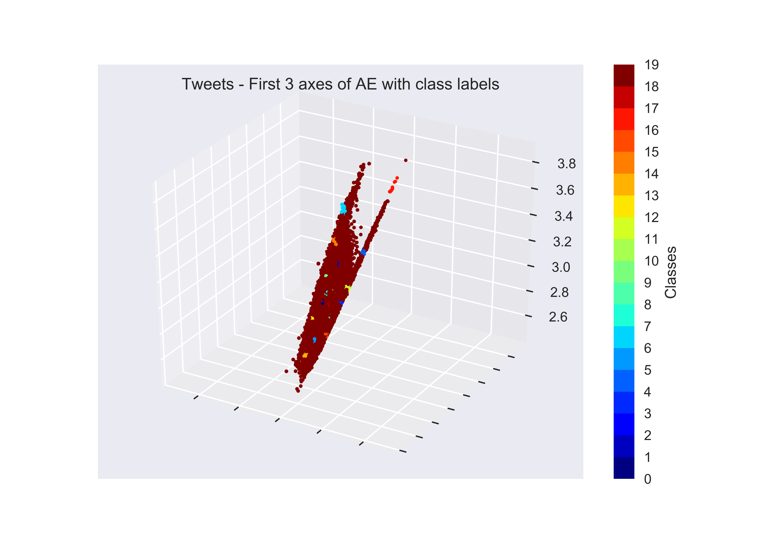
Sentiment analysis – Twitter data
Doing sentiment analysis using NLP in python
Looking at clustering of twitter data using wordtovec model
Auto-encoders are used as dimensionality reduction technique to find non-linear combinations of clusters
The clusters contain sentences that one can use supervised NLP to make sense of

Slide 7
Roadmap of Senti-Me
Sentiment analysis
Twitter data
Google trends
Energy consumption
Impact on local business and public
Recommender system/chatbox
Step 1
Step 2
Step 3

