Slide 1

Data Analysis POKEMON dataset
Darsh Patel
Introduction to Analytics (ALY 6000)
Prof. Steven Habbous

Slide 2
Introduction
I have chosen the database of famous cartoon among the kids which is Pokemon. The dataset consists of different types of pokemons, their physical statistics, attack power, etc.
A few questions to be answered:
How many pokemons types are there and what are the frequency for each type?
Whether the legendary pokemons have high attack damage than non-legendary pokemon or not?
What are the generation levels of the pokemons (which has highest frequency)?
Which pokemon types are the fastest in terms of speed?

Slide 3
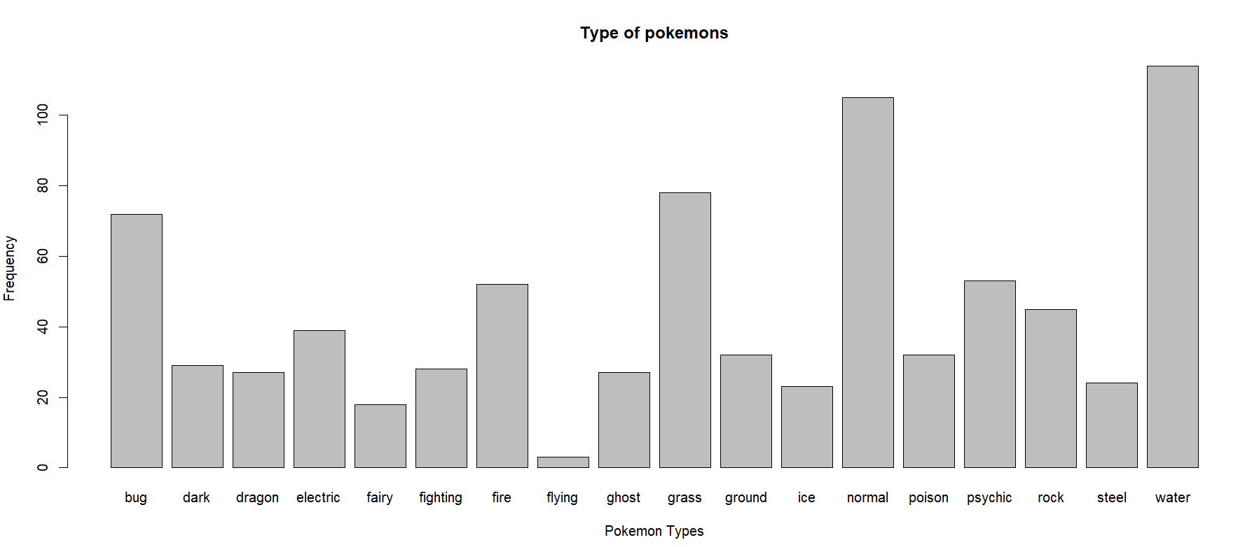
Types of Pokemon and their frequency
Looking at the dataset, it was difficult to determine which type of pokemon have maximum frequency, so using barplot we can determine that Water type has the maximum frequency and Flying type has the lowest.

Slide 4
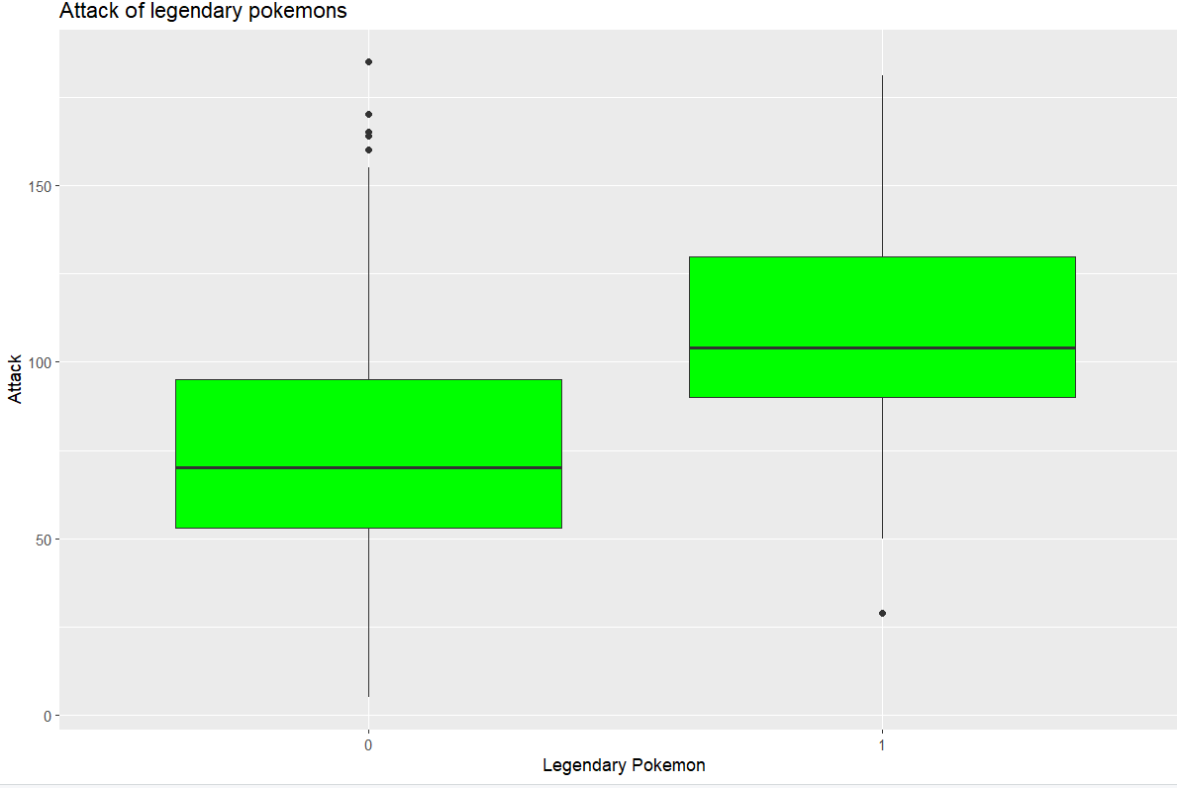
Attack damage of Legendary vs Non-Legendary Pokemons
As the name ‘Legendary’ indicates that those pokemons are meant to be powerful than the non-legendary, so I had interpreted that Attack damage of Legendary pokemons will be greater.
To determine, I used ggplot to plot the attack damage of Non-Legendary Pokemoms (left hand side) with Legendary Pokemons (right hand side) and the graph clearly indicates that Legendary pokemons have higher attack damage than non-legendary.

Slide 5
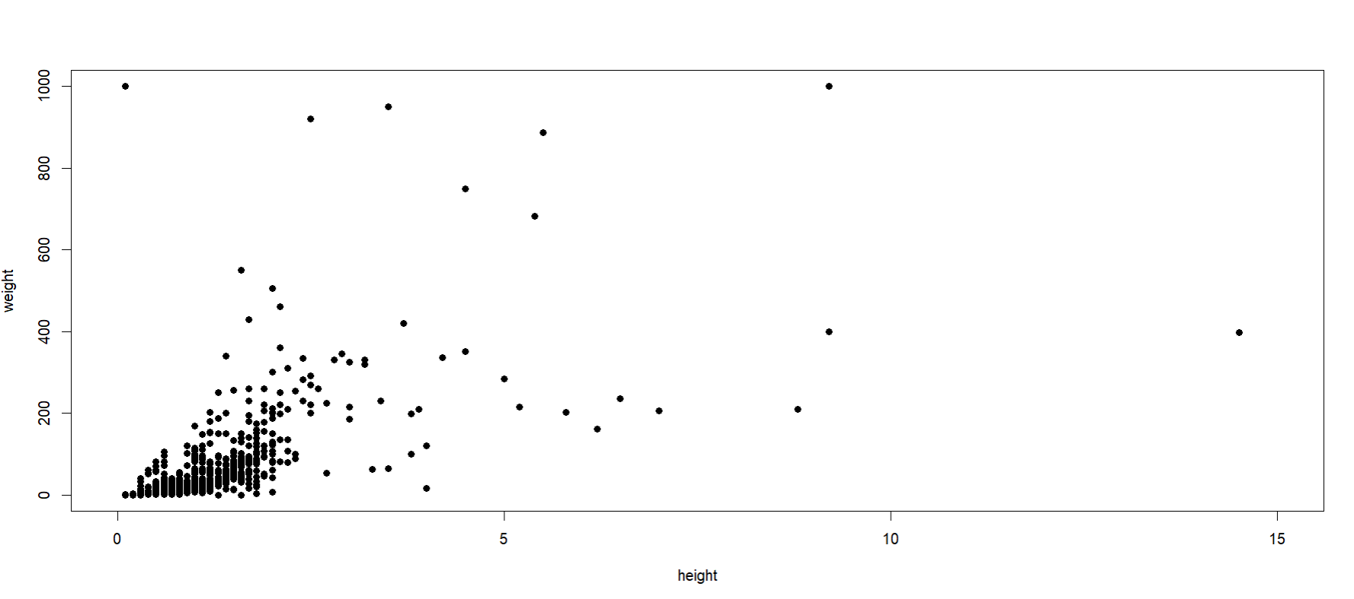
What are the height and weight of different pokemons
To determine, the height and weight distribution of the pokemons, I used scatter plot.
X-axis = Height (in kg)
Y-axis = Weight (in meter)
The graph indicates that height of most of the pokemon is under 3 meter and weight of most pokemon is under 300 kg.

Slide 6
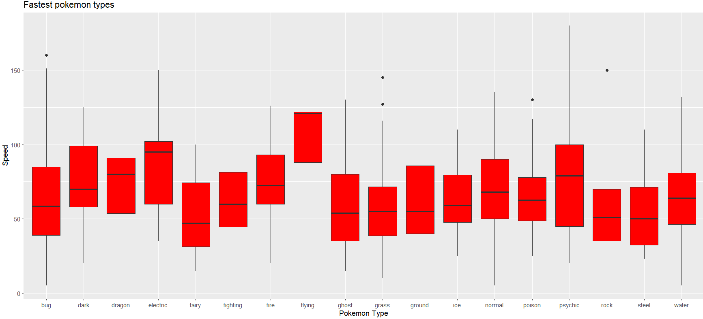
Fastest Pokemon types
In order to analyse which pokemon are the fastest in terms of speed, I used ggplot.
The below graph indicates that flying type pokemons are the fastest among any other type and rock, steel, and fairy type pokemons are slowest among other types.

Slide 7
Analysis of the dataset after performing different operations
After performing the thorough analysis of this dataset, I can conclude that legendary pokemons are fewer in number, but they are more powerful than the non-legendary pokemons and hence legendary pokemons have better statistics over non-legendary pokemons.
Moreover, if the pokemon type are flying then such pokemons are supposed to be the fastest among others.
If any pokemon gets into one-on-one battle with the legendary pokemon, then the legendary pokemon has higher possibility of winning the battle.

Slide 8
Thank you
References:
Banik, R.(2017) The Complete Pokemon Dataset | Kaggle. https://www.kaggle.com/datasets/rounakbanik/pokemon?resource=download
https://r-charts.com/

