Slide 1

“SIGN LANGUAGE TO SPEECH”
Project Presentation
MITU21BTCS0743:-Yuvraj Singh
MITU20BTCS0388:- Omkar Pawar
MITU20BTCS0177:- Darsh Thakur
MITU21BTCS0652:- Syed Shariq
Guided by
Prof. Prashant Yelmar (Computer Science & Engineering)
Prof. Dr. Ganesh Pathak (HOD, Computer Science & Engineering)
Department of Computer Science & Engineering, MITSoC, Loni Kalbhor

Slide 2
Outline
Introduction
Problem Statement
Objectives
Concepts & Methods
Literature Review
Identification of gaps & scope of work
Implementation
Reference
Q&A
Department of Computer Science & Engineering, MITSoE, Loni Kalbhor

Slide 3
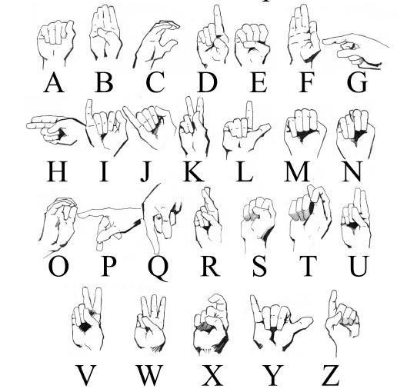
Introduction
TO CREATE A COMPUTER SOFTWARE AND TRAIN A MODEL USING CNN WHICH TAKES AN IMAGE OF HAND GESTURE OF AMERICAN SIGN LANGUAGE AND SHOWS THE OUTPUT OF THE PARTICULAR SIGN LANGUAGE IN TEXT FORMAT AND CONVERTS IT INTO AUDIO FORMAT AS WELL.
Department of Computer Science & Engineering, MITSoE, Loni Kalbhor

Slide 4
Problem Statement
Sign-to-speech systems aim to bridge the communication gap for sign language users, but challenges like limited accuracy, difficulty with fast gestures, and reliance on specific hardware hinder their effectiveness. There is a need for more reliable, user-friendly, and accessible solutions to promote seamless communication and inclusion.
Objectives
It is hard to make everybody learn the use of sign language with the goal of ensuring that people with disabilities can enjoy their rights on an equal basis with others.
So, the aim is to develop a user-friendly human computer interface (HCI) where the computer understands the American sign language This Project will help the dumb and deaf people by making their life easy.
Department of Computer Science & Engineering, MITSoE, Loni Kalbhor

Slide 5
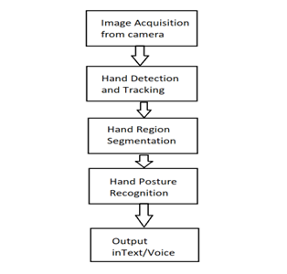
4. Flowchart:-
Department of Computer Science & Engineering, MITSoE, Loni Kalbhor

Slide 6
5. Literature Survey
Sr. no | Literature Title |  |  | Author | Findings
1. | Sr No | Title | Author | Year | Summary
 | 1 | A Survey on Sign Language Recognition and Translation | P. K. P. Chowdhury, M. S. Islam | 2020 | Reviews techniques like machine learning for translating sign language to speech.
 | 2 | Deep Learning for Gesture and Sign Language Recognition | R. L. Shah, H. B. Bhalerao | 2021 | Focuses on CNNs and RNNs for sign language recognition and speech conversion.
 | 3 | Sign Language to Speech: Techniques and Challenges | M. S. Imran, A. K. D. Mollah | 2019 | Discusses visual and sensor-based methods for converting sign language to speech.
 | 4 | Sign Language Recognition with Deep Learning | P. S. Ghosal, S. Mondal | 2022 | Explores deep learning methods for real-time sign language recognition and speech translation.
2. | 5 | A Survey on Sign Language Recognition using Machine Learning | H. S. Raut, S. S. Shinde | 2021 | Reviews machine learning techniques for sign language recognition and speech generation.
Department of Computer Science & Engineering, MITSoE, Loni Kalbhor

Slide 7
6. Tools and Languages
1. Computer Vision.
2. Deep learning.
3.Gesture Classification.
4. Gtts – google text to speech convert.
5.Dataset-Kaggle Asl dataset
Department of Computer Science & Engineering, MITSoE, Loni Kalbhor

Slide 8
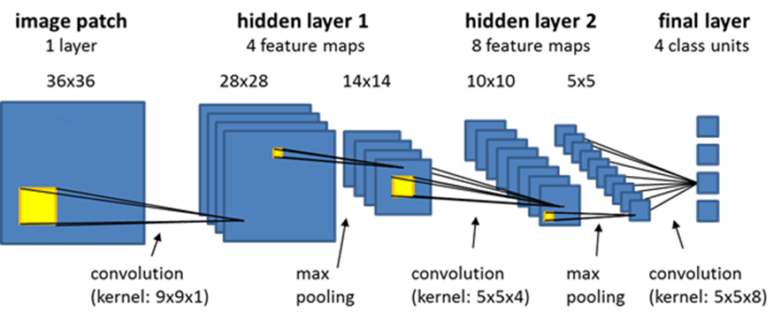
MODEL ARCHITECTURE:-
Department of Computer Science & Engineering, MITSoE, Loni Kalbhor

Slide 9
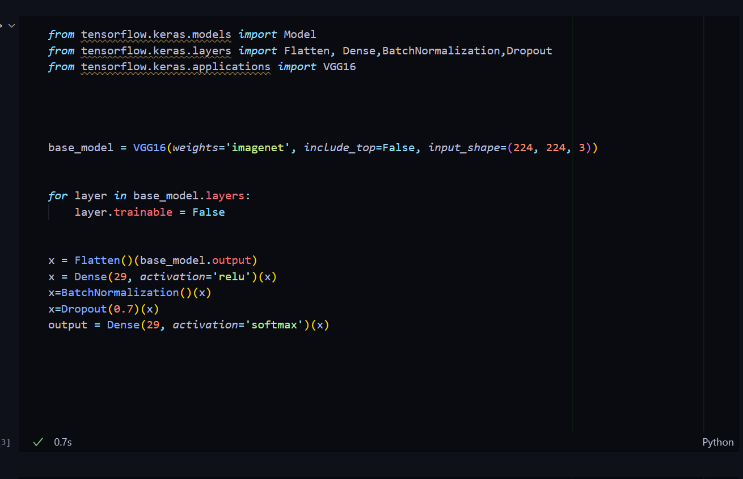
MODEL :-
Department of Computer Science & Engineering, MITSoE, Loni Kalbhor

Slide 10
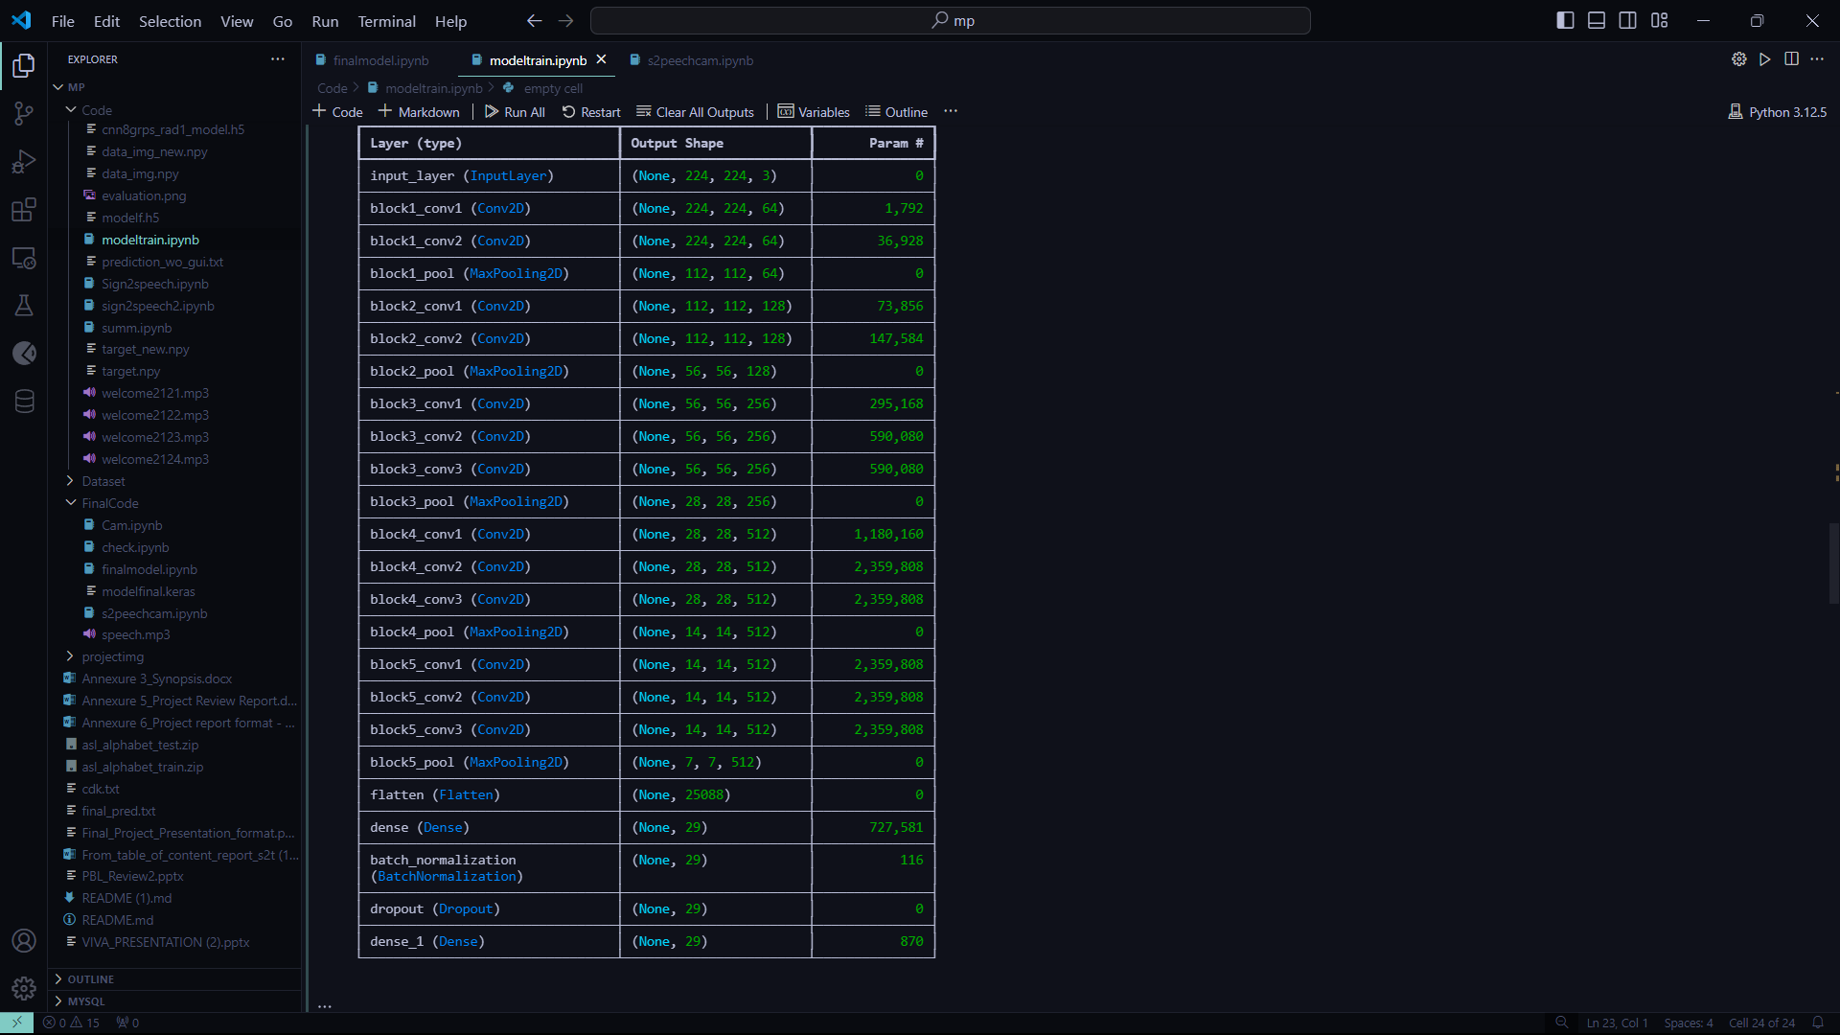
MODEL :-
Department of Computer Science & Engineering, MITSoE, Loni Kalbhor

Slide 11
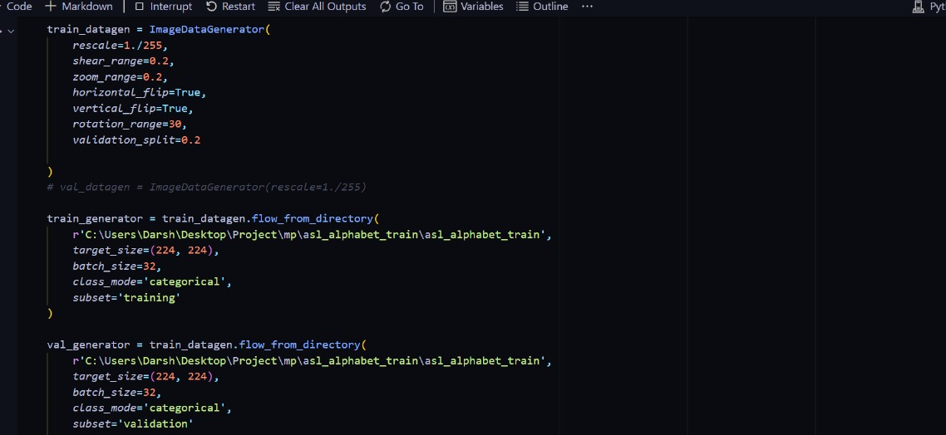
MODEL :-
Department of Computer Science & Engineering, MITSoE, Loni Kalbhor

Slide 12
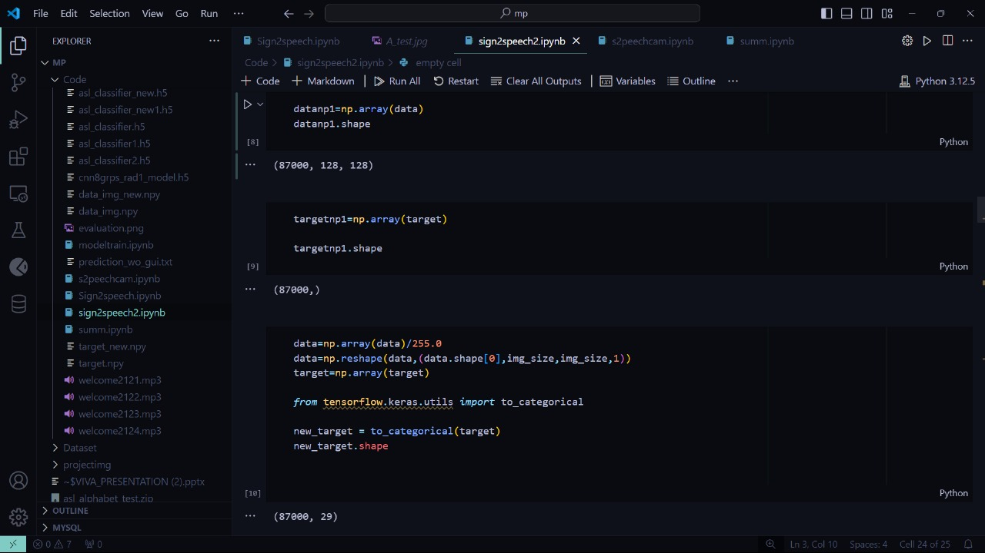
DATA CONVERSION :-

Slide 13
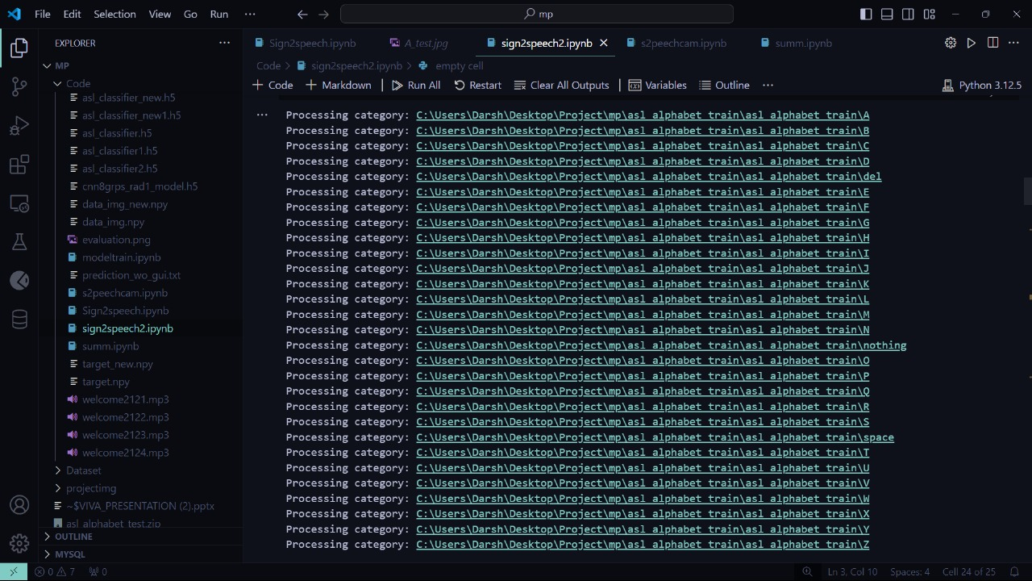
CATEGORISATION:-

Slide 14
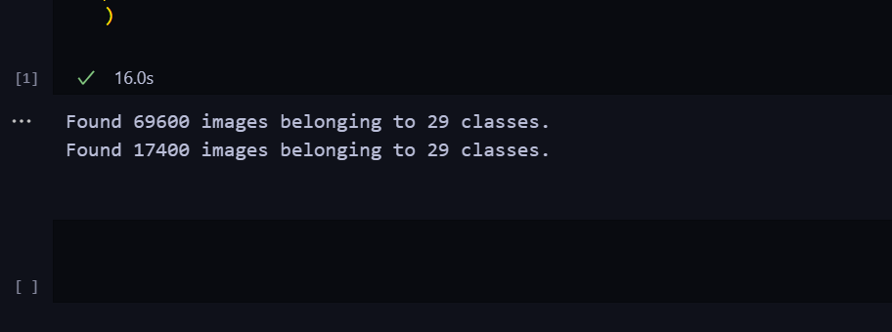
CATEGORISATION:-
Asl – Dataset categorisation

Slide 15
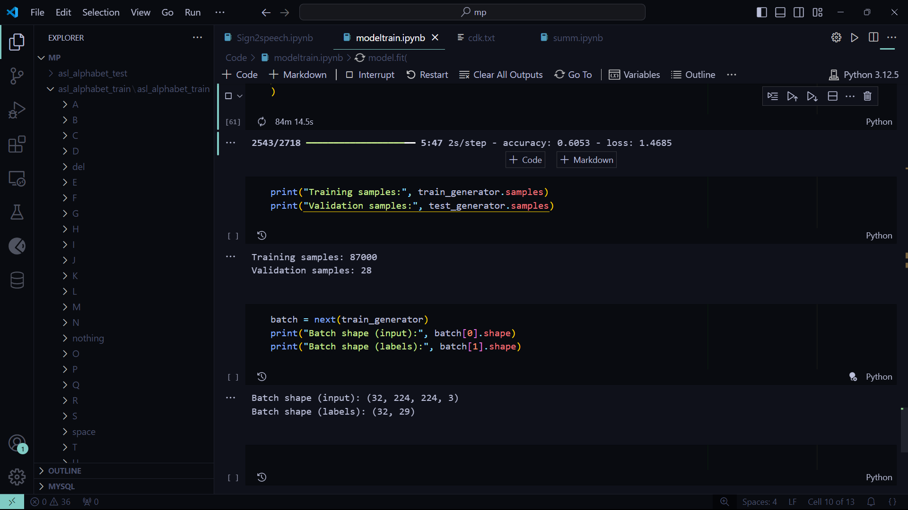
8. Implementation
Department of Computer Science & Engineering, MITSoE, Loni Kalbhor

Slide 16
8. Implementation
Department of Computer Science & Engineering, MITSoE, Loni Kalbhor

Slide 17
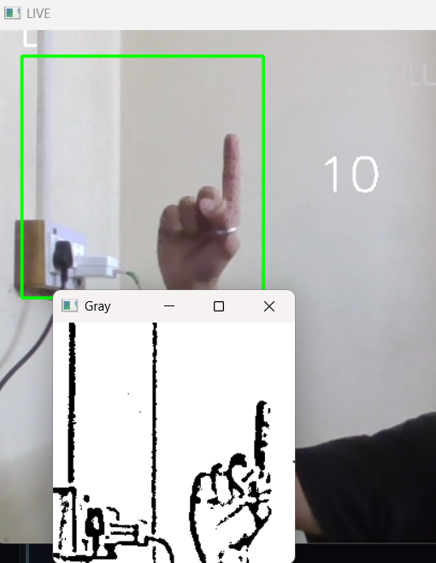
9. Results
Department of Computer Science & Engineering, MITSoE, Loni Kalbhor

Slide 18
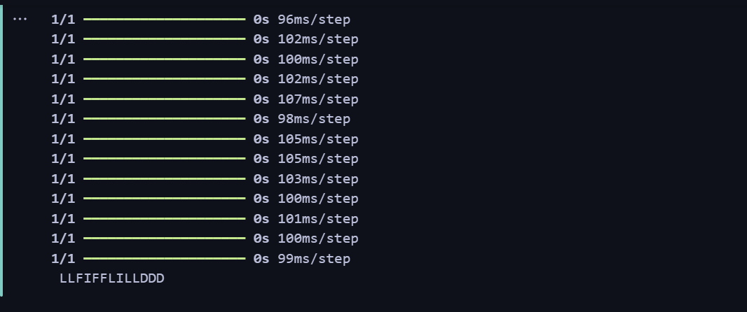
9. Results
Department of Computer Science & Engineering, MITSoE, Loni Kalbhor

Slide 19
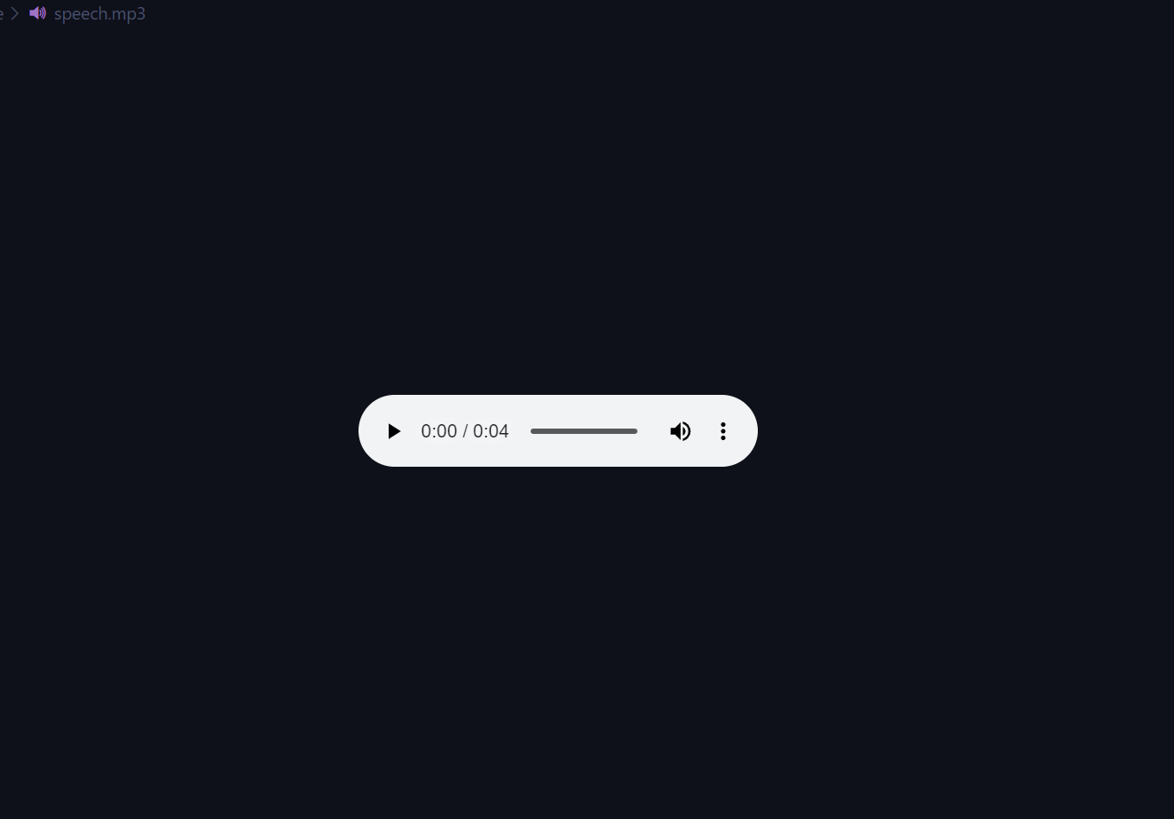
9. Results
Department of Computer Science & Engineering, MITSoE, Loni Kalbhor

Slide 20
10. Conclusion and Future Work
Computer vision, machine learning, and natural language processing, such systems enable seamless interpretation of hand gestures into spoken language.
This technology evolves, it holds the potential to break down language barriers further and empower the deaf and hard-of-hearing community to communicate effortlessly with the broader world.
Department of Computer Science & Engineering, MITSoE, Loni Kalbhor

Slide 21
References
[1] F. Jia and L. Z. Kong, “Intrusion Detection Algorithm Based on Convolutional Neural Network,” "Beijing Ligong Daxue Xuebao/Transaction Beijing Inst. Technol., vol. 37, no. 12, pp. 1271–1275, 2017, doi: 10.15918/j.tbit1001-0645.2017".12.011.
[2] L. Mohammadpour, T. C. Ling, C. S. Liew, and C. Y. Chong, “A Convolutional Neural Network for Network Intrusion Detection System,” "Proc. Asia-Pacific Adv. Netw., vol. 46, no. 0, pp. 50–55", 2018.
[3] U. Gur Çekmez et al., “Derin Ö˘ grenme ile A˘ g Anomali Tespiti Network Anomaly Detection with Deep Learning Ozgur Koray Sahingoz,” 2018, pp. 1–4.
[4] A. Chawla, B. Lee, S. Fallon, and P. Jacob, “Host Based Intrusion Detection System with Combined CNN/RNN Model,” "Lect. Notes Comput. Sci. (including Subser. Lect. Notes Artif. Intell. Lect. Notes Bioinformatics), vol. 11329 LNAI", pp. 149–158, 2019.
[5] S. Naseer and Y. Saleem, “Enhanced network intrusion detection using deep convolutional neural networks,” "KSII Trans. Internet Inf. Syst., vol. 12, no. 10, pp. 5159–5178, 2018, doi: 10.3837/tiis.2018".10.028.
Department of Computer Science & Engineering, MITSoE, Loni Kalbhor

Slide 22
Thank You ☺
Department of Computer Science & Engineering, MITSoE, Loni Kalbhor

