Slide 1
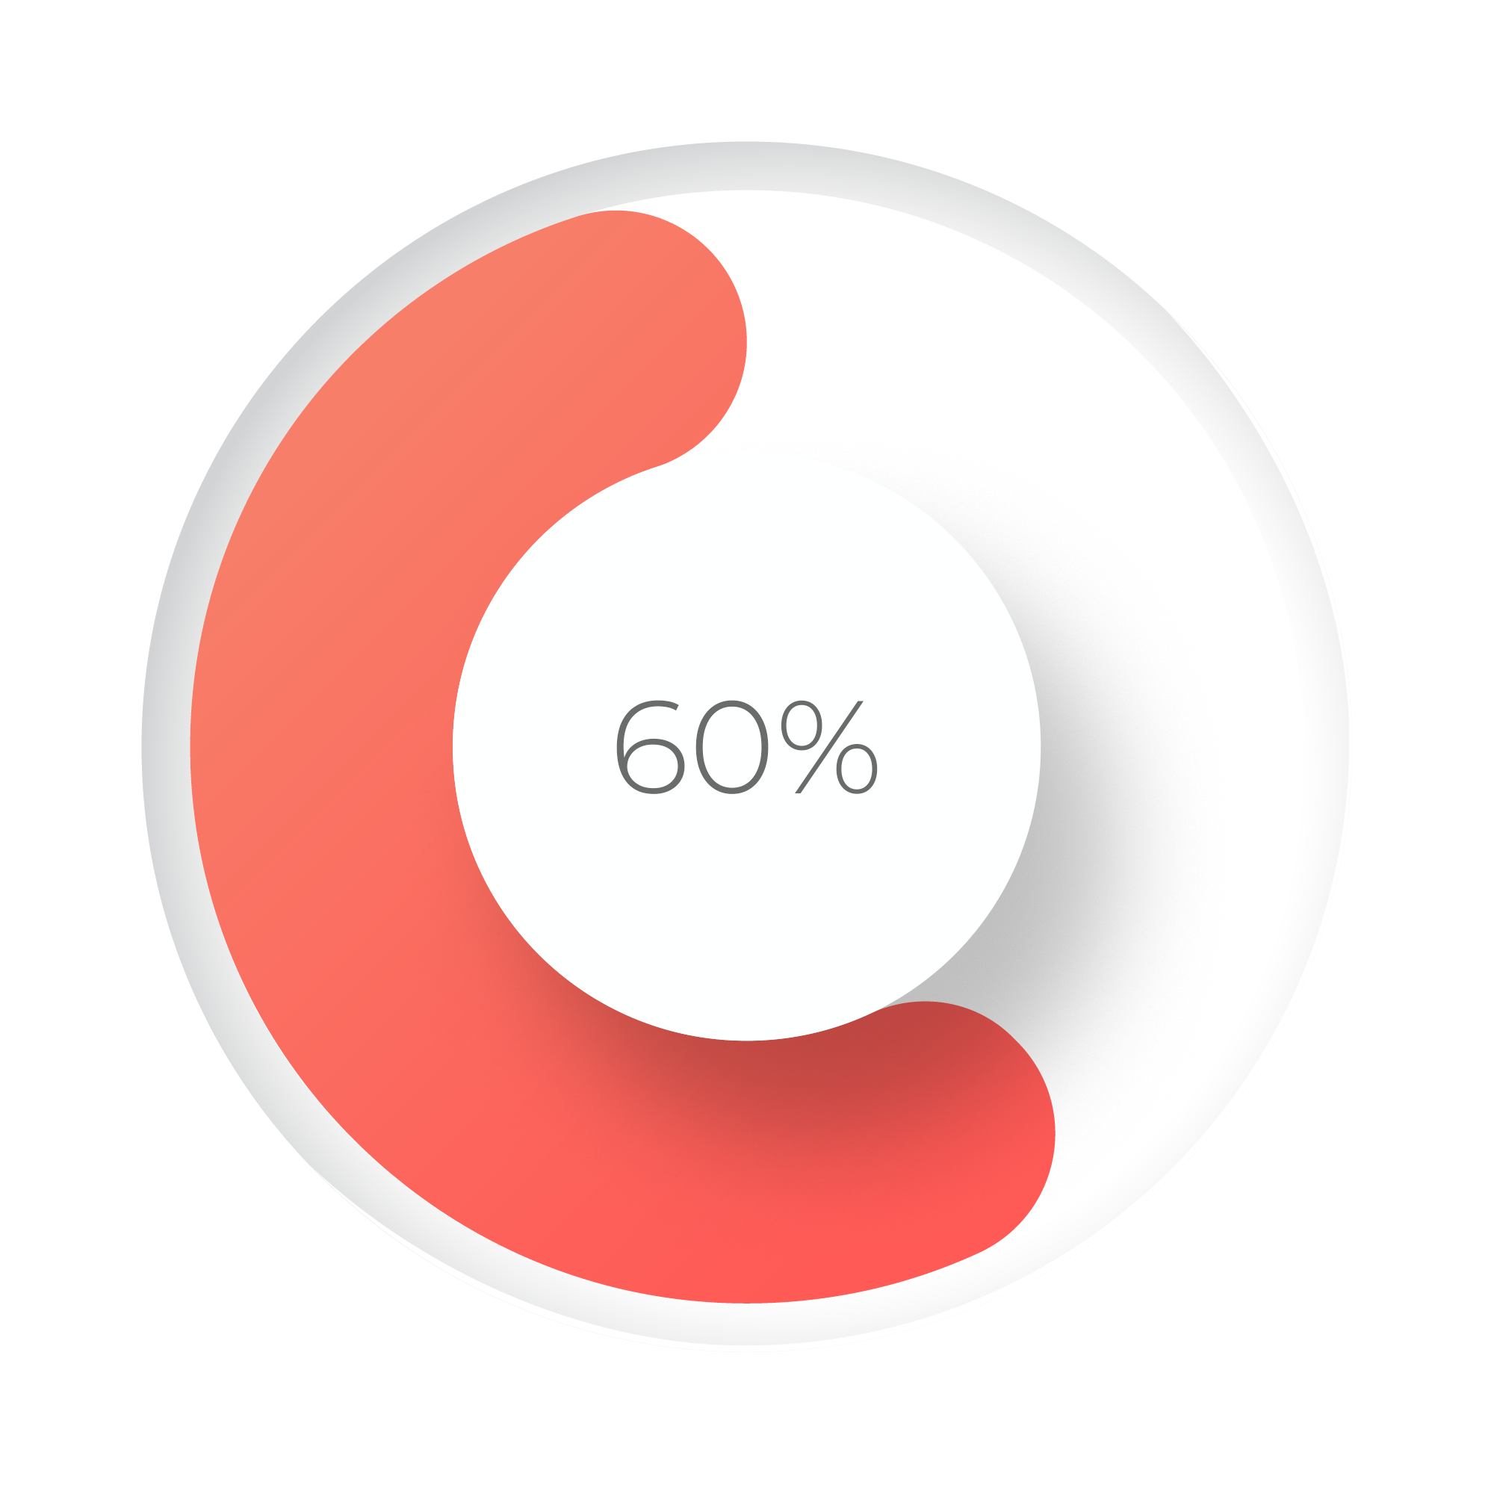







Wellness report
Patient name
age
73.1 kg
Weight
InBody
24.2 %
Body Fat
InBody
25.8 BMI
BMI
InBody
65 bpm
Heart Rate
ECG
57 J
Bio-Energy
BioWell
87 %
Energy Reserve
BioWell
2.97
LF/HF Ratio
HRV
64 bpm
Nadi Pulse
Nadi
Physical
emotional
Small description
Small description
Psychological
spiritual
Small description
Small description
45%
45%
45%
45%
Normal/
need attention
Normal/
need attention
Normal/
need attention
Normal/
need attention
Nervous system
Cardiovascular system
Respiratory system
Muscle and bone
45%
45%
45%
45%
Normal/
need attention
Normal/
need attention
Normal/
need attention
Normal/
need attention
Digestive system
Integumentary system
Endocrine system
Urogenital system
45%
45%
Normal/
need attention
Normal/
need attention
Reproductive system
Immune system

Slide 2
Wellness report
Patient name
age
Wellness Offerings
Diet
Yoga therapy
Physical activity
Sleep
Stress
Supplements
Medicine

