Slide 1
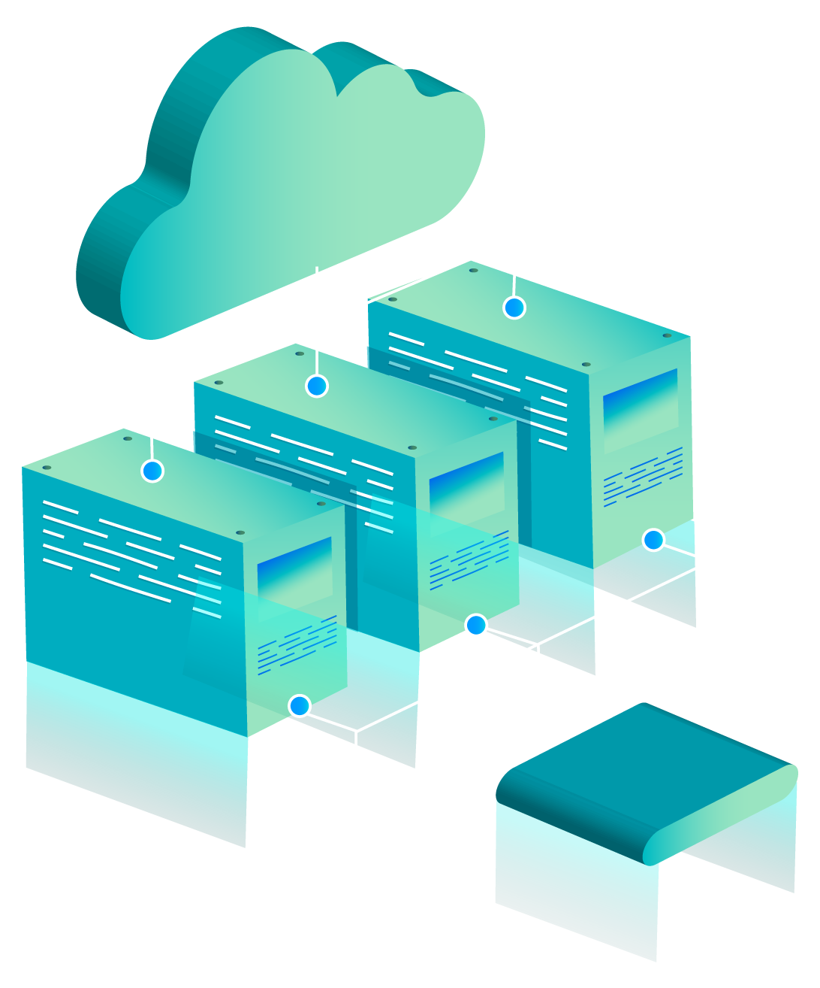
CLOUD FRONT Content Delivery Network

Slide 2
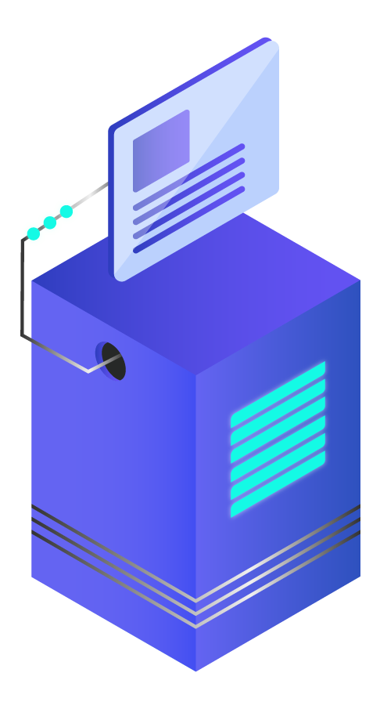
QUICK UNDERSTANDING
Used for effective distribution of content to users across the world.
Distributes content with the help of edge location.
Users receive the content from the closest edge location.

Slide 3

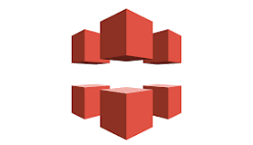
EXAMPLE:
:
Edge Location
Edge Location
EC2 Instance
Web Application Deployed
CloudFront
Mumbai
Edge Location
Edge Location

Slide 4
How it works…?
03
02
04
There are multiple Data Centers(Edge Location) where data get saved automatically on all regions. So the delay will be reduced to access the data from original location(Mumbai) to destination location(US).
Multiple copies of data ( web contents & pages) get cached across all the edge location to deliver the content at the faster rate from the source location

Slide 5
Benefits of CloudFront
Mainly cloudFront is used to maintain the delay period while using services.
ex: audio/video, streaming, live television etc.
Without delay the customer should access the service.
Improved Security: For application protection, you can integrate AWS WAF, managed third party firewall options into cloudFront workloads.
High Availability to end users.

Slide 6
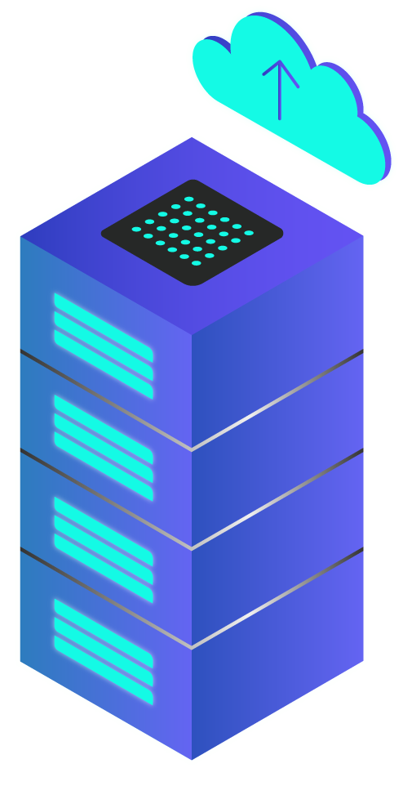
NOTE:
CDN is distributed system of distributed network which delivers the web content on different geographical location for the end users.
This improves the speed and performance of the website by reducing the distance b/w the server and the user

Slide 7
THANK YOU!

