Slide 1
VOICE/TEXTUAL CHAT BOT MOBILE APP
PIP2001 Capstone Project
Review-1
Batch Number: 02
Roll Number | Student Name
20211CSD0087 | Pawan Kumar D
20211CSD0075 | Sai Abhishek
20211CSD0079 | Nihal Gagan Kunte
20211CSD0061 | Darshan Naik N
20211CSD0159 | S Punith Kumar
Under the Supervision of,
Dr./Mr./Ms./Prof. DR.SARAVANA
Professor / Associate Professor / Assistant Professor
School of Computer Science and Engineering
Presidency University
Name of the Program: B-Tech
Name of the HoD: : Dr. Saira Banu
Name of the Program Project Coordinator: DR.SARAVANA
Name of the School Project Coordinators: Dr. Sampath A K / Dr. Abdul Khadar A / Mr. Md Ziaur Rahman

Slide 2
Introduction
This project aims to develop a versatile chatbot that supports both text and voice interactions. The bot leverages Natural Language Processing (NLP) and Machine Learning to understand user inputs and respond intelligently. By integrating speech recognition and text-to-speech features, users can communicate naturally through either typing or speaking, offering an engaging and flexible conversational experience. Key applications include virtual assistants, customer service automation, and real-time chat interfaces.

Slide 3
Literature Review
Introduction
Textual Chatbots AI systems designed to interact using text-based interfaces.
Voice Chatbots Use Automatic Speech Recognition (ASR) and Text-to-Speech (TTS) for speech interactions.
Python's Role Python is widely used due to its libraries and simplicity for chatbot development.
Key Components in Research
Natural Language Processing (NLP)
Libraries like NLTK, spaCy, and Rasa are crucial for handling text input, intent recognition, and dialogue management.
Research shows that Rasa provides strong support for machine learning-based conversational AI.
Speech Processing
SpeechRecognition and pyttsx3 have been studied for real-time speech-to-text and text-to-speech conversion.
Cloud services like Google Cloud Speech-to-Text API are often used for high-accuracy ASR.
Applications
Text chatbots are used in customer service, ecommerce, and healthcare.
Voice chatbots have been applied in virtual assistants (e.g., healthcare bots like Woebot) and smart devices.

Slide 4
Literature Review
Challenges in Development
NLP Challenges
Difficulty in understanding user context and intent shifts.
Studies point to challenges with ambiguous queries and handling diverse languages.
Voice Chatbot Limitations
Research highlights issues with latency in ASR and TTS.
Noise interference and accents can reduce the accuracy of voice recognition.
Recent Advances
Deep Learning in Chatbots
Transformer models (e.g., BERT, GPT) are improving the ability of chatbots to understand context and provide more natural interactions.
These models are being integrated with Python-based frameworks for enhanced chatbot experiences.
Future Directions
Multimodal Systems Combining text, voice, and even image input for more robust conversational agents.
Ethical Considerations More research is focusing on chatbot privacy, data handling, and addressing biases, particularly in voice data.

Slide 5
Existing method Drawback
Limited contextual understanding
Lack of natural language generation
Difficulty understanding emotions
Domain specificity
Ethical considerations
Technical limitations

Slide 6
Proposed Method
1 Enhanced Contextual Understanding and Natural Language Generation
Leverage advanced NLP techniques (transformers, RNNs, GNNs)
Utilize world knowledge (external knowledge bases)
Employ generative models (GANs, VAEs)
Implement reinforcement learning.
2 Enhanced Emotional Intelligence, Domain Adaptability, and Ethical Considerations
Develop emotion detection models
Implement empathetic response generation
Utilize transfer learning
Implement few-shot learning
Ensure bias mitigation
Implement transparency and accountability.

Slide 7
Objectives
Enhance contextual understanding: Improve chatbots' ability to comprehend the broader context of a conversation.
Improve natural language generation: Generate more creative, informative, and engaging responses.
Enhance emotional intelligence: Enable chatbots to recognize and respond appropriately to emotions.
Increase domain adaptability: Make chatbots more versatile and adaptable to new domains and tasks.
Address ethical concerns: Ensure chatbots are unbiased, transparent, and accountable.
Optimize technical performance: Improve computational efficiency and real-time processing capabilities.

Slide 8
Methodology
Data Collection and Preprocessing
Feature Engineering
Model Selection and Training
Model Evaluation
Deployment and Monitoring
Ethical Considerations

Slide 9
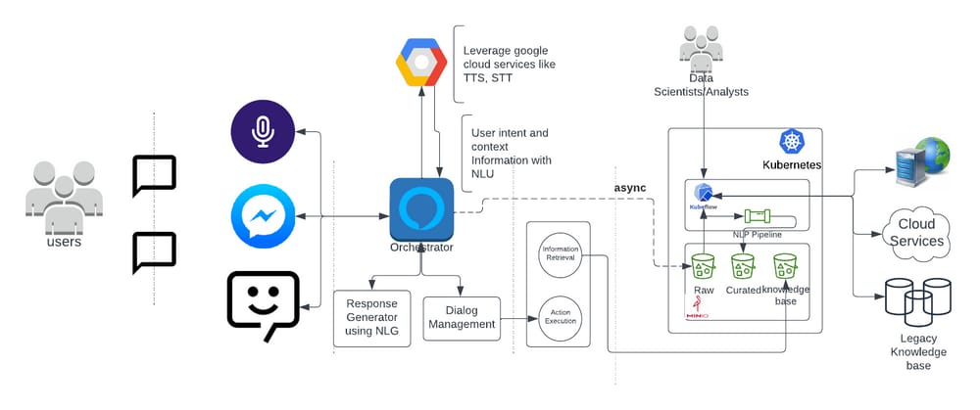
Architecture

Slide 10
Hardware/software components
Organization: Dalmia Cement
Category (Hardware / Software / Both) :SOFTWARE
Problem Description: For our project, which involves building a generic BOT mobile app for voice/textual chat interactions (via Flutter) and integrates with a Node.js backend for handling structured and unstructured queries (e.g., order status, payment status, etc.), you'll need a technology stack that includes both frontend and backend components.
Difficulty Level: COMPLICATED

Slide 11
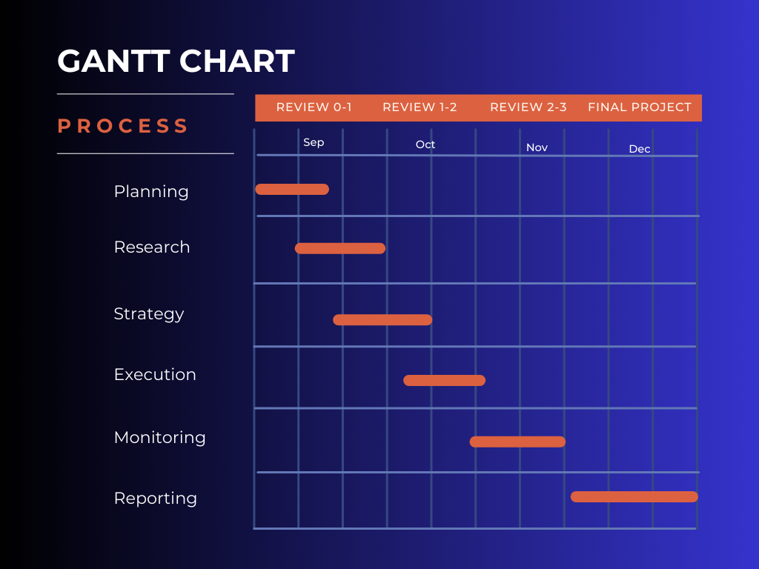
Timeline of Project
Review 0 : 18/09/2024
Review 1 :18/10/2025

Slide 12
Expected Outcomes
User: What’s the weather today?
Bot: I don't have live data, but you can check a weather website for the latest update in your area.
User: What types of cement does Dalmia Cement offer?
Bot: We offer a wide range of cement products such as Portland Pozzolana Cement, Ordinary Portland Cement, and Sulphate Resisting Portland Cement. Which one would you like more details on?
User: I’d like to order 10,000 bags of cement.
Bot: Your order for 10,000 bags of Ordinary Portland Cement has been placed. It will be delivered within 5 business days.

Slide 13
Conclusion
Implementing a chatbot solution—whether text-based, voice-based, or both—for Dalmia Cement offers significant advantages across various facets of the organization. From enhancing customer service with quick responses about product information and order tracking, to supporting internal operations like employee assistance, maintenance scheduling, and sustainability reporting, a chatbot can drive efficiency, save time, and improve overall user experience.
By leveraging AI-driven chatbots, Dalmia Cement can significantly improve its operational efficiency, enhance customer engagement, and support strategic growth initiatives, all while reducing manual efforts. This positions the company as a forward-thinking organization, embracing digital transformation in the cement industry.

Slide 14
Github Link
The Github link provided should have public access permission.
https://github.com/Darshan-61/capstone_project

Slide 15
References
1.A Neural Conversational Model (Vinyals & Le, 2015) - Introduced sequence-to-sequence models for human-like conversation generation, foundational for chatbot architectures.
https://arxiv.org/abs/1506.05869
2.Building End-to-End Dialogue Systems Using Generative Hierarchical Neural Networks (Serban et al., 2016) - Proposed a hierarchical neural model to better handle conversation context in dialogue systems.
https://arxiv.org/abs/2006.12442
3.Improving Language Understanding by Generative Pre-Training (Radford et al., 2018) - Developed GPT, a generative model trained on large datasets, which became crucial for conversational AI.
4.Speech and Language Processing (Jurafsky & Martin, 2020) - Comprehensive book on NLP and speech processing techniques, relevant for building text and voice chatbots.
https://arxiv.org/abs/2103.09916

Slide 16
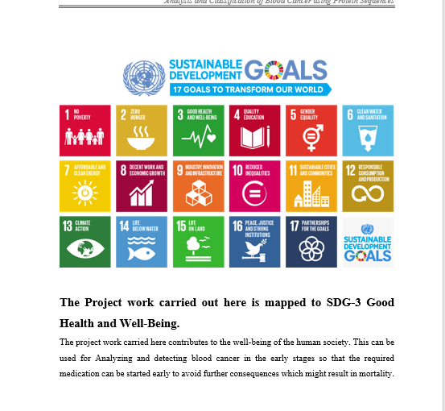
Project work mapping with SDG

Slide 17
Thank You

