Slide 1
TAX PLANNING
Name: Darshan Viramgama
PRN No.: 2020033800071542

Slide 2
Introduction
A tax planning project report is an important document that provides a comprehensive overview of the various tax planning strategies used by individuals and businesses to minimize their tax liabilities while remaining compliant with applicable tax laws and regulations.
This report is aimed at analyzing different tax planning techniques and their effectiveness
in reducing tax liabilities. It will also provide recommendations for individuals and businesses to optimize their tax planning strategies, including investment planning, retirement planning, and estate planning. The report will draw on research from various sources, including tax laws and regulations, industry publications, and expert opinions, to provide a thorough understanding of the complex field of tax planning. The purpose of this report is to help
individuals and businesses better understand the tax planning process and provide practical recommendations to optimize their tax planning strategies.

Slide 3
OBJECTIVE OF STUDY
• To know how much people are aware about tax planning
• To Know how people allocate their income
• To give a general awareness to the public by the report
• To provide an overview of the tax laws and regulations
To provide guidance for doing tax planning
To help people to save money from tax

Slide 4
Short Range Tax Planning
Plan for current year to reduce tax.
Types of Tax Planning
Long Range Tax Planning
Plan for more than a year to reduce tax
Permissive Tax Planning
Planning by taking advantage of
loopholes in the tax laws.
Purposive Tax Planning
Planning for achieving specific tax
objectives or purposes

Slide 5
SCOPE AND COVERAGE OF STUDY
Individual
HUF
Hindu Undivided Family
Proprietorship
Firm
OPC
One Person Company
Company

Slide 6
RESEARCH DESIGN AND METHODOLOGY
In research we will go in detail about the people’s perception about tax planning and their mentally through a survey report and different available tax deduction sources and investment by which we can reduce tax liability and know about government schemes and also have a case study with a normal way of tax payment and on other side by a planned way tax filing.
The research will be a mixed-methods study, combining survey data collected through Google Form and secondary data analysis.
Primary Data
Data collection
Google form
Respondents
From Gujarat
Data Analysis
Graphs, Charts and table
Sampling Technique
Simple Random
Secondary Data
To know what people done to save money from tax and how do they allocate their funds and mentality about tax planning
Income Tax Act, 1969
ICAI Module
Government Institute
ICICI Bank
Tax planning research study also provide insights into how individuals can effectively manage their tax obligations and enhance their financial well-being is what makes it significant.

Slide 7
SIGNIFICANCE OF STUDY
Increasing Tax Knowledge
Help to Change People’s Mentality
Tax Savings to the Fullest
Reduced Tax Obligation
Illuminating Strategy Choices
Planning for the Future

Slide 8
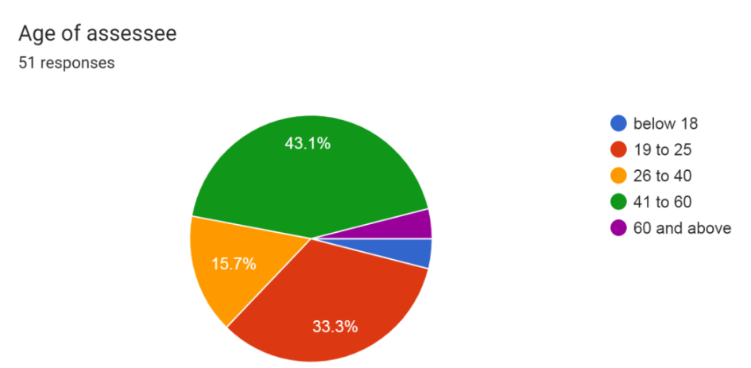
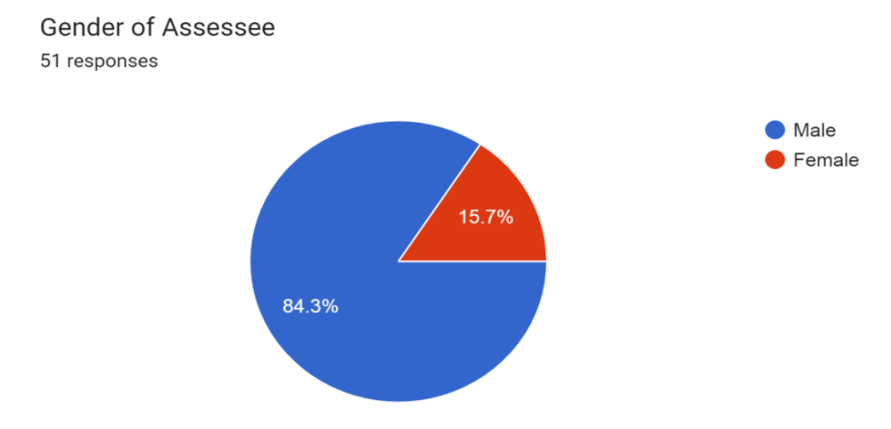
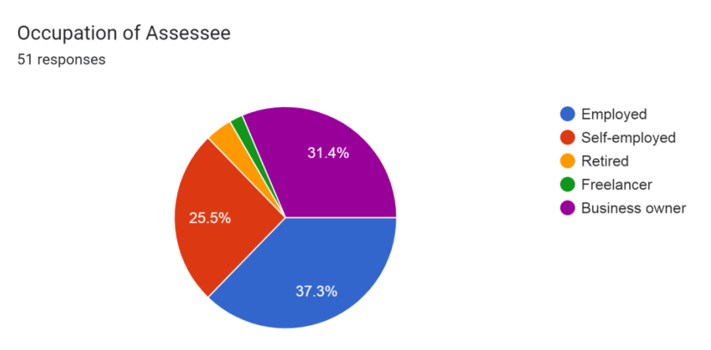
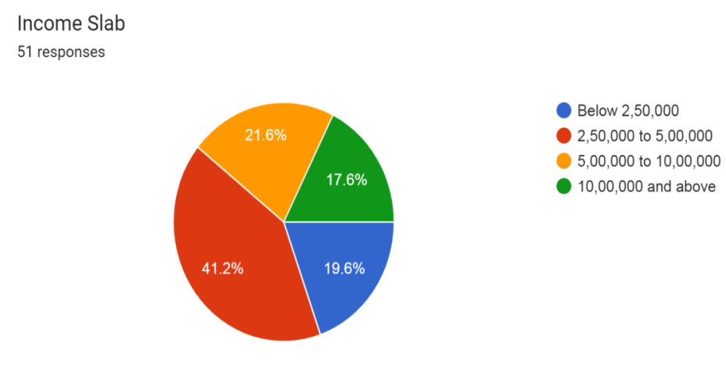
DATA ANALYSIS AND INTERPRETATION
3.9%
3.9%
3.9% 2%

Slide 9
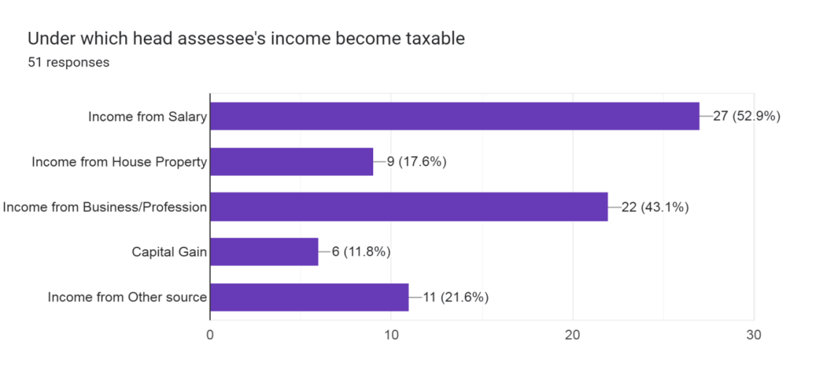
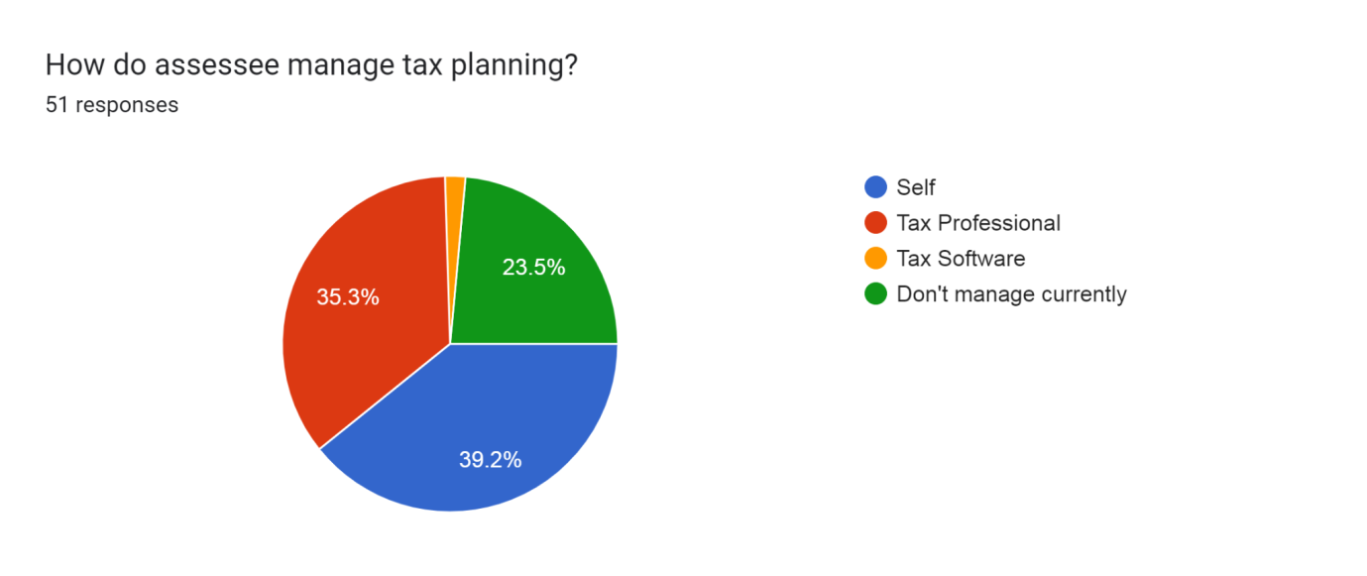
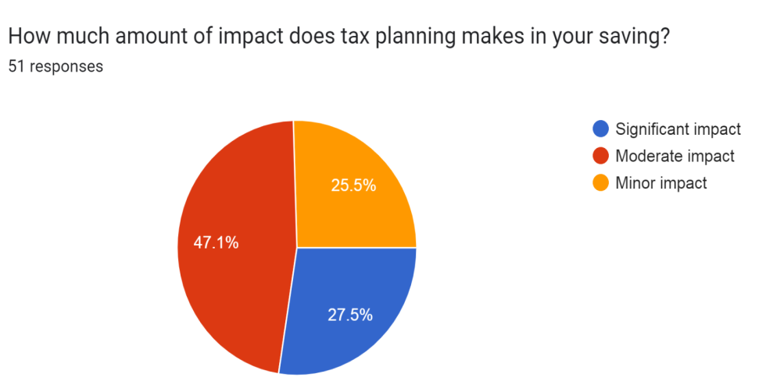
Continue:
2%

Slide 10
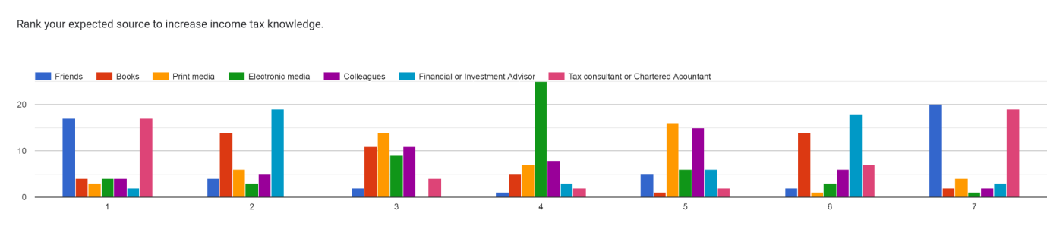
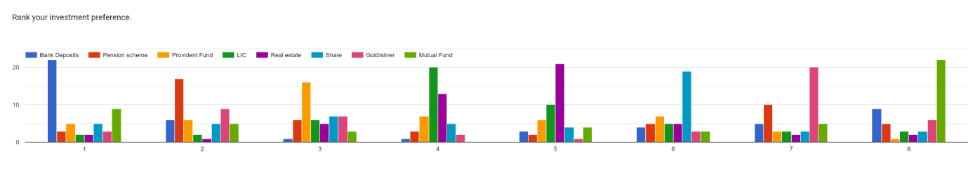
Continue
Ranking Source of Knowledge Regarding Tax
Ranking Investment as per Preference
Source \ Rank | 1 | 2 | 3 | 4 | 5 | 6 | 7
Friends | 17 | 4 | 2 | 1 | 5 | 2 | 20
Books | 4 | 14 | 11 | 5 | 1 | 14 | 2
Print media | 3 | 6 | 14 | 7 | 16 | 1 | 4
Electronic Media | 4 | 3 | 9 | 25 | 6 | 3 | 1
Colleagues | 4 | 5 | 11 | 8 | 15 | 6 | 2
Financial or Investment Advisor | 2 | 19 | 0 | 3 | 6 | 18 | 3
Tax consultant or Chartered Acountant | 17 | 0 | 4 | 2 | 2 | 7 | 19
Investment \ Rank | 1 | 2 | 3 | 4 | 5 | 6 | 7 | 8
Bank Deposits | 22 | 6 | 1 | 1 | 3 | 4 | 5 | 9
Pension scheme | 3 | 17 | 6 | 3 | 2 | 5 | 10 | 5
Provident Fund | 5 | 6 | 16 | 7 | 6 | 7 | 3 | 1
LIC | 2 | 2 | 6 | 20 | 10 | 5 | 3 | 3
Real estate | 2 | 1 | 5 | 13 | 21 | 5 | 2 | 2
Share | 5 | 5 | 7 | 5 | 4 | 19 | 3 | 3
Gold/silver | 3 | 9 | 7 | 2 | 1 | 3 | 20 | 6
Mutual Fund | 9 | 5 | 3 | 0 | 4 | 3 | 5 | 22

Slide 11
Tax Planning for Salaried Individual
Ranking Investment as per Preference
Making use of Section 80C
Restructuring of Salary
Request a Housing Allowance
Donations to charities
Tax Harvesting
Investment in NPS
Renting to parents
Invest in wife’s name
Use exception for senior residents
Invest in the adult child's name
Take Benefits of Home Loan

Slide 12
Tax planning for the Business/Profession
Preliminary expenses
Regular Expenses
Accurately Deduct Assessment at Source
Donation
Housing Loan
Depreciation
Avoid Cash Transaction
Inventory Valuation
Keeping accurate records of cash expenses
Stock Valuation
File your Tax Return Assessment form on Time

Slide 13
LIMITATION OF STUDY
Limited to specific region
Sample size
Self-reported data
Limited reach of the survey
Incomplete coverage of the population
Time and resource constraints
Response bias

Slide 14
Thank you
-Darshan Viramgama

