Slide 1


Smart Agriculture system using IoT
Tech Pirates
Product Pitch making and analyzing for launch

Slide 2
Creative
01
Modern Problems require modern solutions with more impactful amount of technology adding into the daily life.
content
vision
02
Our vision is to offer our assistance of technology with use of business to inspire and implement solutions to the environment and agriculture related activities with more easeful results.
Design and Solution
03
Our product design and solution to the required problem with more efficient visualization and analyzing the problem.
Sales
04
Business Strategy, Product Benchmarking and Marketing

Slide 3


Why Choose us:
Passion: Done with Love
24/7 service
Make success in sustainable way
Commitment towards work
Creativity
Attention to Details
Dedicated Team
Focus on new innovations
Respect of client needs and objectives

Slide 4
Creative:
Agriculture is a field, where modern technologies can be applied efficiently. Although, the farming sector may seem something archaic for many people.
smart farming conception is not a sci-fi one, it is a real working approach that simplifies agricultural processes and makes them automated.
IoT helps biologists study the effects of genomes and micro-climates on crop production to optimize quality and yield.
IoT in agriculture is designed to help farmers monitor vital information like humidity, air temperature and soil quality using remote sensors, and to improve yields, plan more efficient irrigation, and make harvest forecasts.

Slide 5
Vision:
India is an agricultural country. Around 80% of India’s population is dependent
upon farming for their livelihood. It employs around 52% of labors. It contributes
between 14 to 15% of the Gross Domestic Product(GDP). Still in India, a large
number of farmers are dependent on the traditional methods of farming. In order
to increase the production of crops in our country, there is a need to adapt to smart farming practices.
Our Vision is to Change the fusion of traditional farm management and practices with emerging technologies like embedded systems, Internet of Things (IoT) and communication systems etc. Smart farming benefits farmers in various ways. It reduces waste develops productivity and management of the greater volume of resources through remote sensing.
It can reduce waste and keep the environment quality.
It reduces time and increasing labor reduces.
To make useful of technology to the poor and economically weak farmers for better yielding of crop
.

Slide 6
Design of our innovation:
Components we used to make smart agriculture system using IoT:
S.NO | Components | Quantity
1) | Node MCU(Esp8266) | 2
2) | Capacitive Soil Moisture Sensor | 1
3) | DHT-11 | 1
4) | DC Pump | 1
5) | Relay Module | 1
6) | Jumping wires | 12
7) | Battery | 1

Slide 7
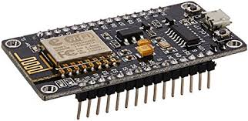
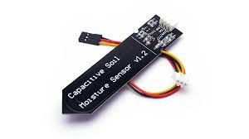
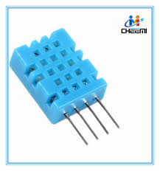
Node MCU(Esp8266)
Controller to communicate between senors and actuators
Capacitive soil moisture sensor
Sensor to sense the moisture content.
DTH-11
Temperature and Humidity Sensor for environment (not for soil)

Slide 8
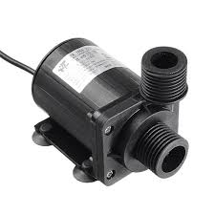
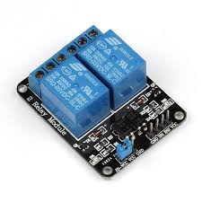
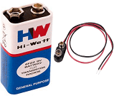
DC Pump
Actuator to pump the water in soil to increase moisture content
Relay Module
To control high voltage motor by controller
Battery
To give power to the system

Slide 9
Software used for security and process of system
MQTT :
Message Queuing Telemetry Transport introduction which is one of the most important of the 7 protocols. Consequently known as the messaging protocol of the IoT. Which can transfer the data with minimal network bandwidth.
Example:
Topic: Experts Hub
Message: meeting Details
(Subscribed)
Experts Hub MQTT Broker Laptop
(Publishing) (meeting details)
Mobile
(not subscribed)

Slide 10
In MQTT there are two types of communication takes place which are interconnected to one another for process of system
Publishing: Sending data to the server.
Subscribing: Receiving data from the server.
The OASIS MQTT TC is producing a standard for the Message Queuing Telemetry Transport Protocol compatible with MQTT V3.1, together with requirements for enhancements, documented usage examples, best practices, and guidance for use of MQTT topics with commonly available registry and discovery mechanisms.
It is the parent organization which controls the MQTT.

Slide 11
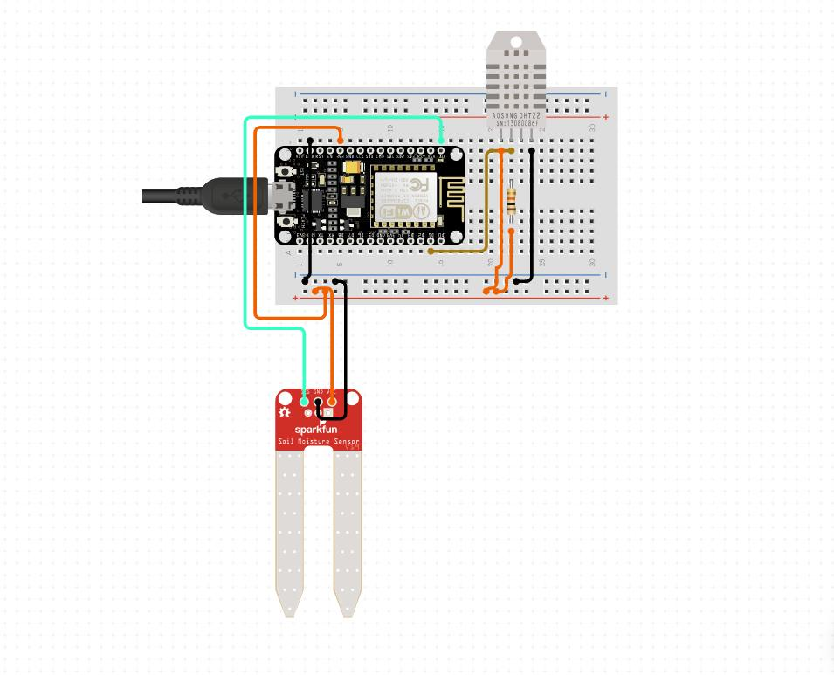
Schematic diagram of product
As we are using MQTT Protocol for our smart agriculture system using IoT, we have both publishing and subscribing circuits.
Publishing side:
Used: Node MCU, DHT-11, Capacitive soil moisture sensor

Slide 12
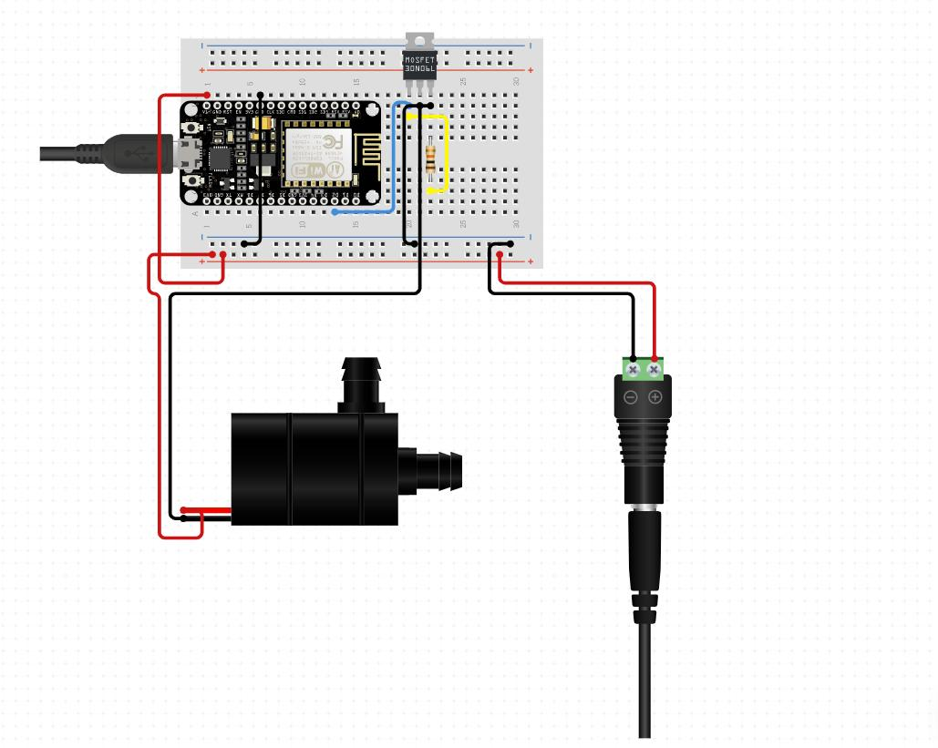
Subscribing side:
Used : Node MCU, DC water pump, Relay module

Slide 13
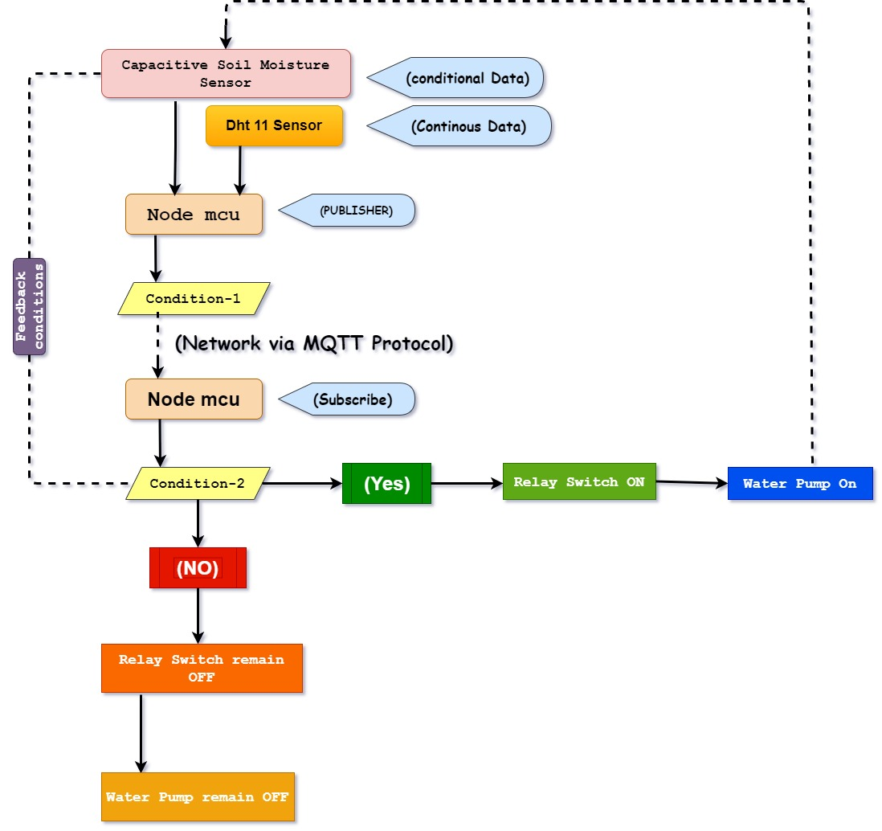
Algorithm used for system process using IoT:
Algorithm used for system process using IoT:
Condition-1 : All data will be published to Node MCU subscribe.
Condition-2 : For capacitive soil moisture sensor if humidity is less than 20 % relay ON else relay OFF for DHT -11 all data publish.
Feedback Condition: If humidity is 100% relay OFF else relay ON

Slide 14
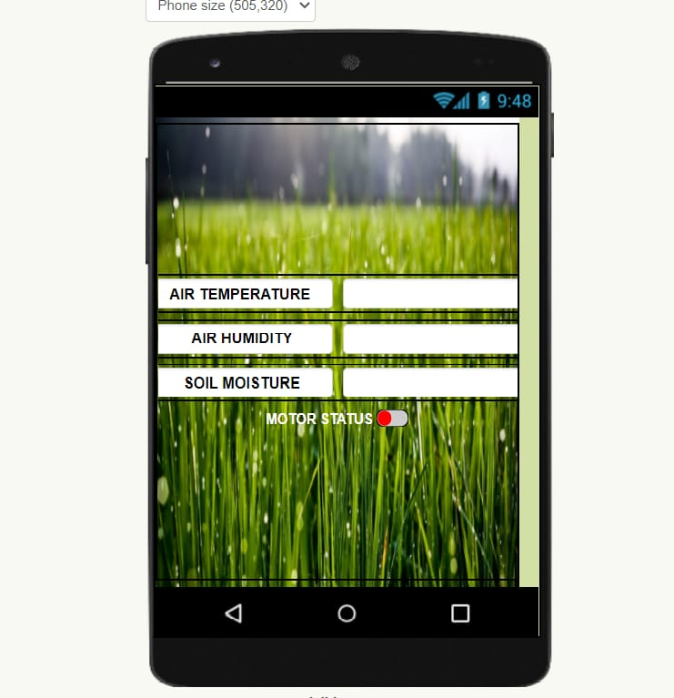
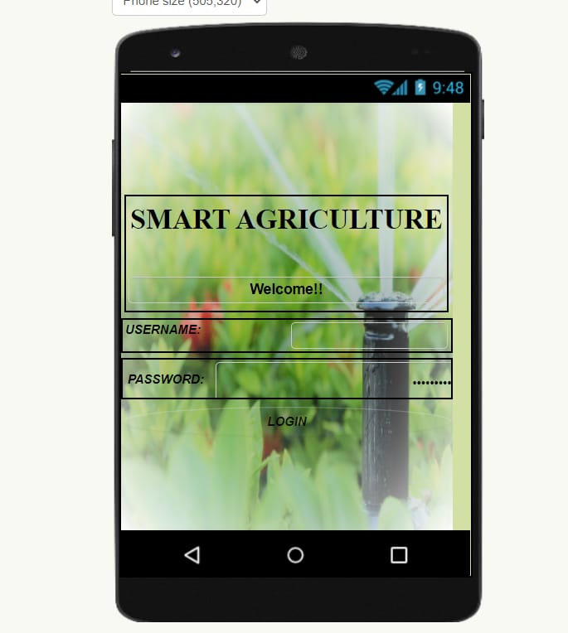
We have used publishing and subscribing codes for better communication from the Server to the client using MQTT broker.
As our system is dependent on Internet , so we have created a android application for easy approach and control of the system using MIT app inventor.
The interface of android application is as follows:

Slide 15
Sales:
Business Strategy
Product Benchmarking
Market Analysis And Marketing

Slide 16
Cost of the product:
This is the most advantage part of our product for both investors and clients.
It is the most cost-effective product in the market for smart agriculture system using IoT.
S.NO | Components | Rate | Quantity | Final rate
1) | Node MCU(Esp8266)(CH-340) | 249 | 2 | 498
2) | Capacitive Soil Moisture Sensor(v2.0) | 190 | 1 | 190
3) | DHT-11 | 99 | 1 | 99
4) | DC Pump(6-12V) | 158 | 1 | 158
5) | Relay Module(1-channel with 5V) | 59 | 1 | 59
6) | Battery | 199 | 1 | 199
7) | Jumping wires | 65(12) | 12 | 65
 | TOTAL PRICE OF THE PRODUCT |  | = | 1268/-

Slide 17
Product Benchmarking:
Cost - Effective
Cost - Effective
Cost - Effective
Cost - Effective
Cost - Effective
Reduction of Risks
Visualization of Fetched Data
Product
Product
Product
Can Access Easily

Slide 18
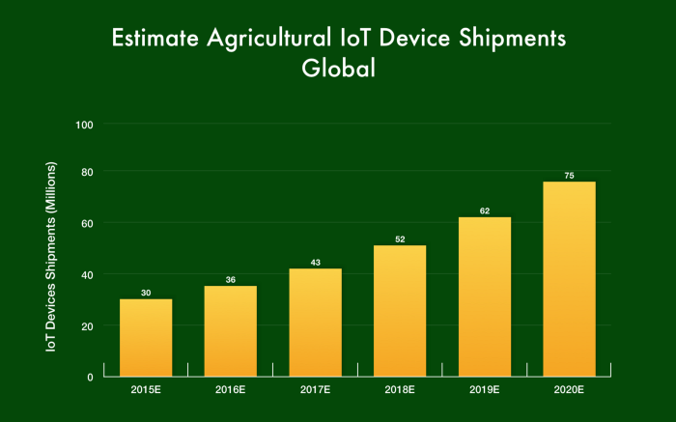
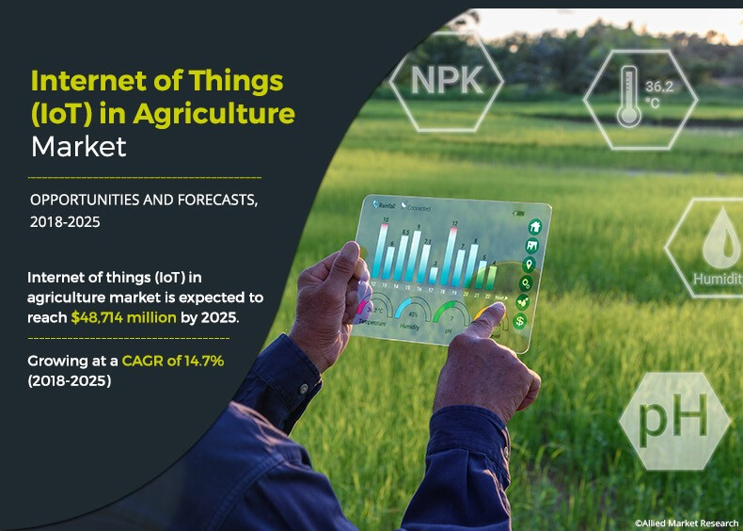
Market Analysis:
The IoT in agriculture market size was valued at $ 16,330 million in 2017, and is projected to reach $48,714 million by 2025, growing at a CAGR of 14.7% from 2018 to 2025.
It is said that by the end of 2025 more than 75 billion of things will be connected to the internet and provide services.
real-time monitoring and prediction systems, farmers can quickly respond to any significant change in weather, humidity, air quality as well as the health of each crop or soil in the field.

Slide 19
Marketing Strategy:
Marketing Strategy:
PRICING
PROMOTION
Discount
Offer price
Credit policy
Advertising
Publicity
Sales promotion
PRICING
PROMOTION
P
P
PPPP
P
P
PLACE
PRODUCT
Market
Channel
Distribution
PLACE
PRODUCT
Brand
Services
Packaging
PLACE

Slide 20
Architecture of Sales strategy :
Initiating
Instigating
Corporate Social responsibility
Awareness
CSR
Bringing Awareness in the farmers.
Digital marketing
Social media and other areas

Slide 21
Future of IoT:
21 billion
24.1 billion
By 2025, it is estimated that there will be more than to 21 billion IoT devices.
24.1 billion in 2030, a compound annual growth rate (CAGR) of 11%, according to new research published today by Transforma Insights.

Slide 22
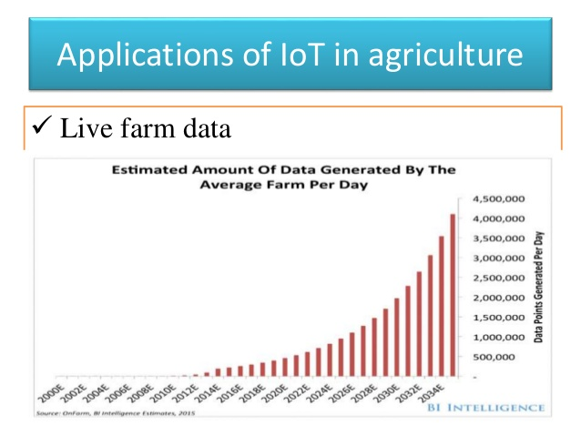
Applications of IoT shall have a booming Business in the future by combining with the emerging technologies like Artificial Intelligence and Machine Learning.

Slide 23
IoT Apllications Booming Business areas :

Slide 24
Conclusion:
The IoT agricultural applications are making it possible for ranchers and farmers to collect meaningful data. ... With the population growing rapidly, the demand can be successfully met if the ranchers, as well as small farmers, implement agricultural IoT solutions in a prosperous manner

Slide 25
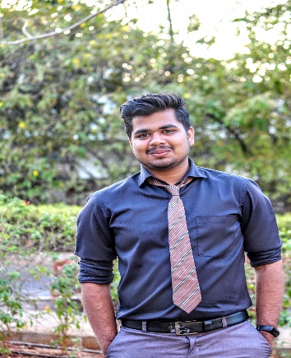
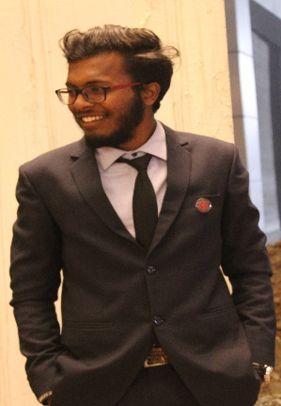


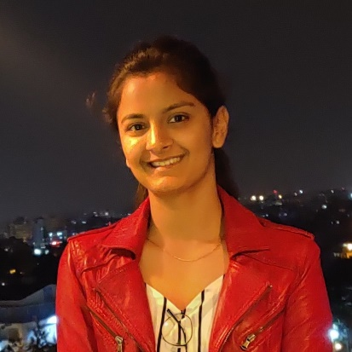

Our team
Darshan Sarode
Embedded system engineer
S. Sai Charan
Business operations
Tech Pirates
Subham subhashis
Researcher and solutions architect
Nitin Thakkar
Embedded system engineer
Shwetha shardul
Software Engineer
Jeshwanth
Software Engineer
We Create Future

Slide 26
Thank You

