Slide 1
About Me?
Darshan Radadiya

Slide 2
Introduction
Built a webpage that gives a information about myself by using HTML language.
In my code I have Use different buttons that directly take users to my different social media profile.
I also made a Contact me page that allow user to write a direct message to me.

Slide 3
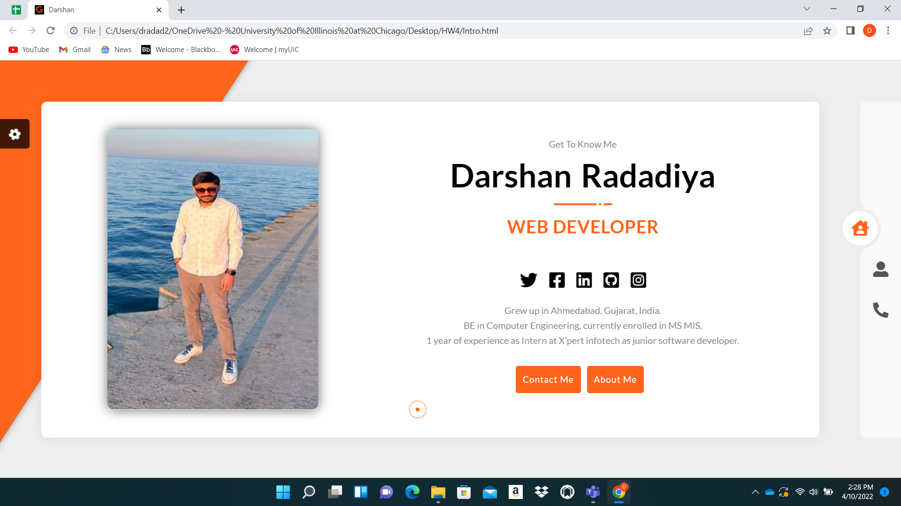
1. Home Page

Slide 4
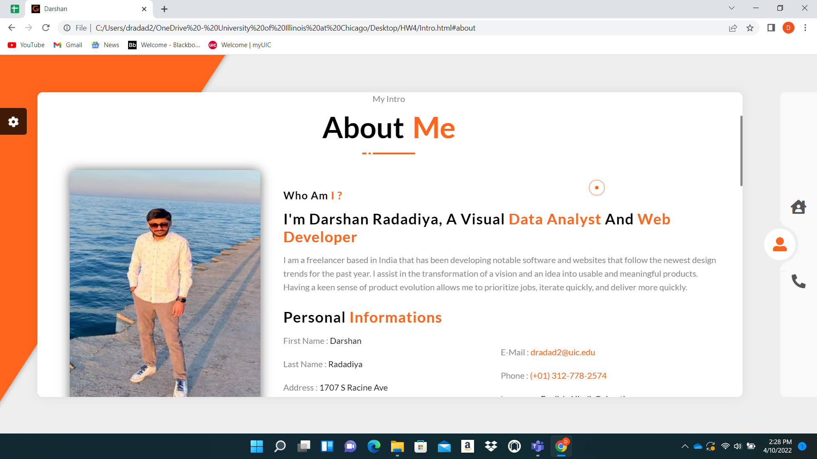
2. About Me Page

Slide 5
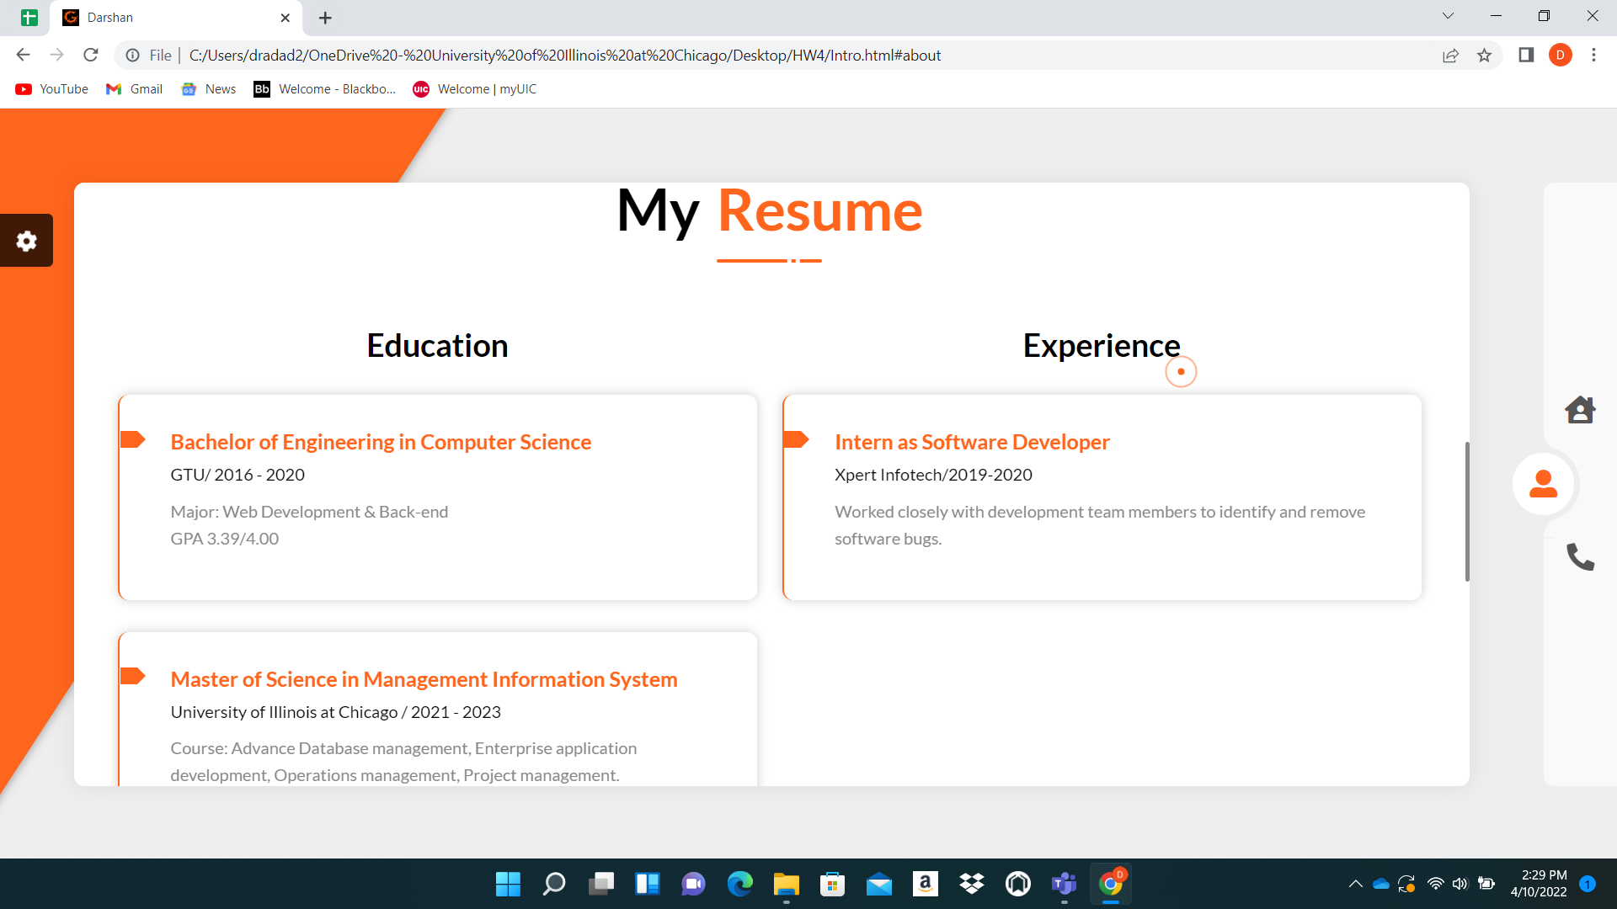

Slide 6
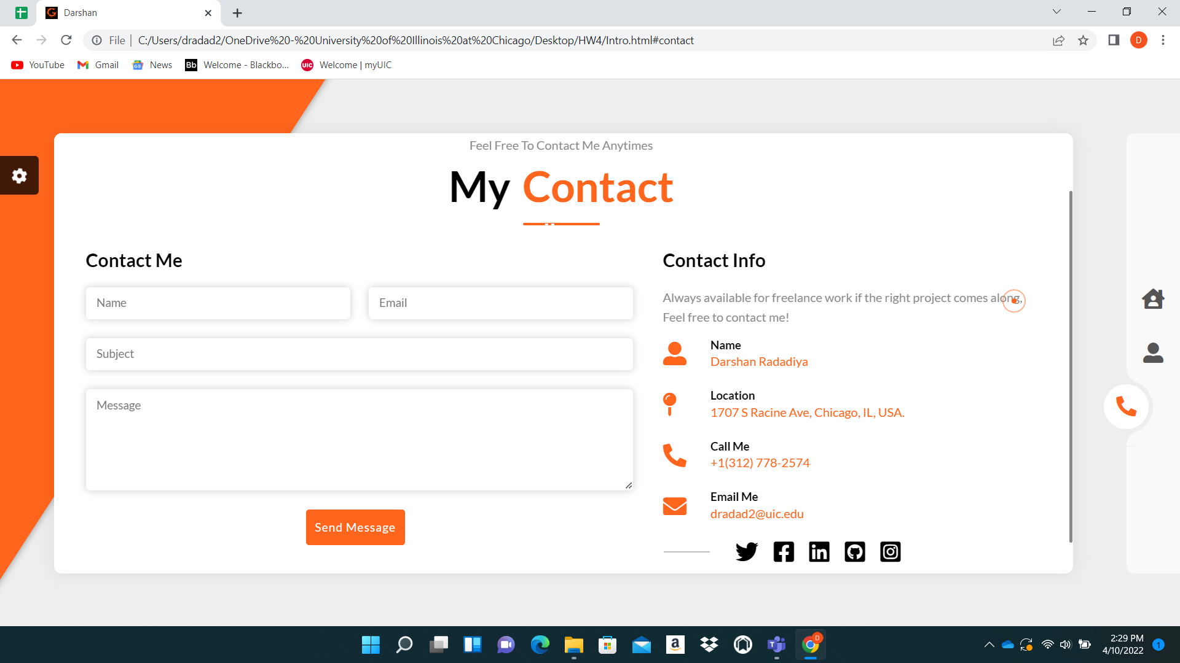
3. Contact Me Page

Slide 7
Thank you
Darshan Radadiya
dradad2@uic.edu
UIN: 656230601

