Slide 1

Customer Engagement and Sales Strategy for Dunnhumby Client
MGMT 687 – AI For Business Decisions
Group 30
Darshan Upadhyay
Jayesh Chaudhari
Soutik Banerjee

Slide 2
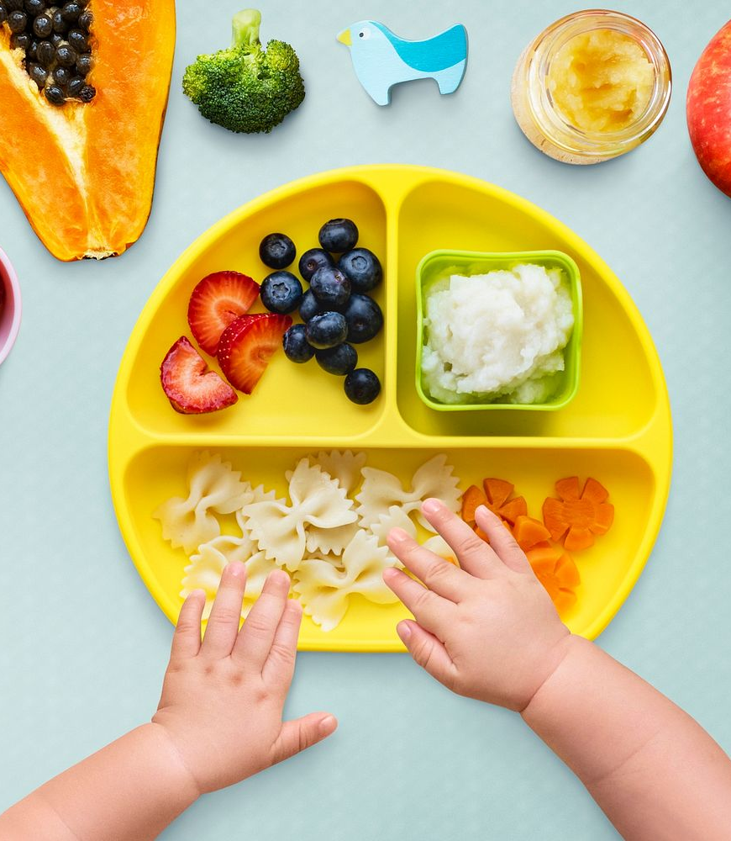
Executive Summary
Aim:
To identify opportunities for growth and targeted customer engagement for Manufacturer 177 in the Baby Foods space.
Focal Brand: Manufacturer 177
Product Category: Baby Foods

Slide 3
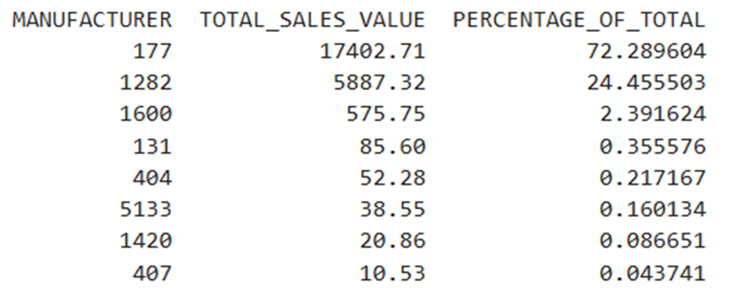
Why Baby Foods and why Manufacturer 177?
Baby Foods is non-seasonal (has year-long demand) and will never become obsolete
Has a good number of players in the market
Below code output shows that 177 is the dominant player, with 72.3% market share
Brand 1282 is the closest competitor with 24.4% market share

Slide 4
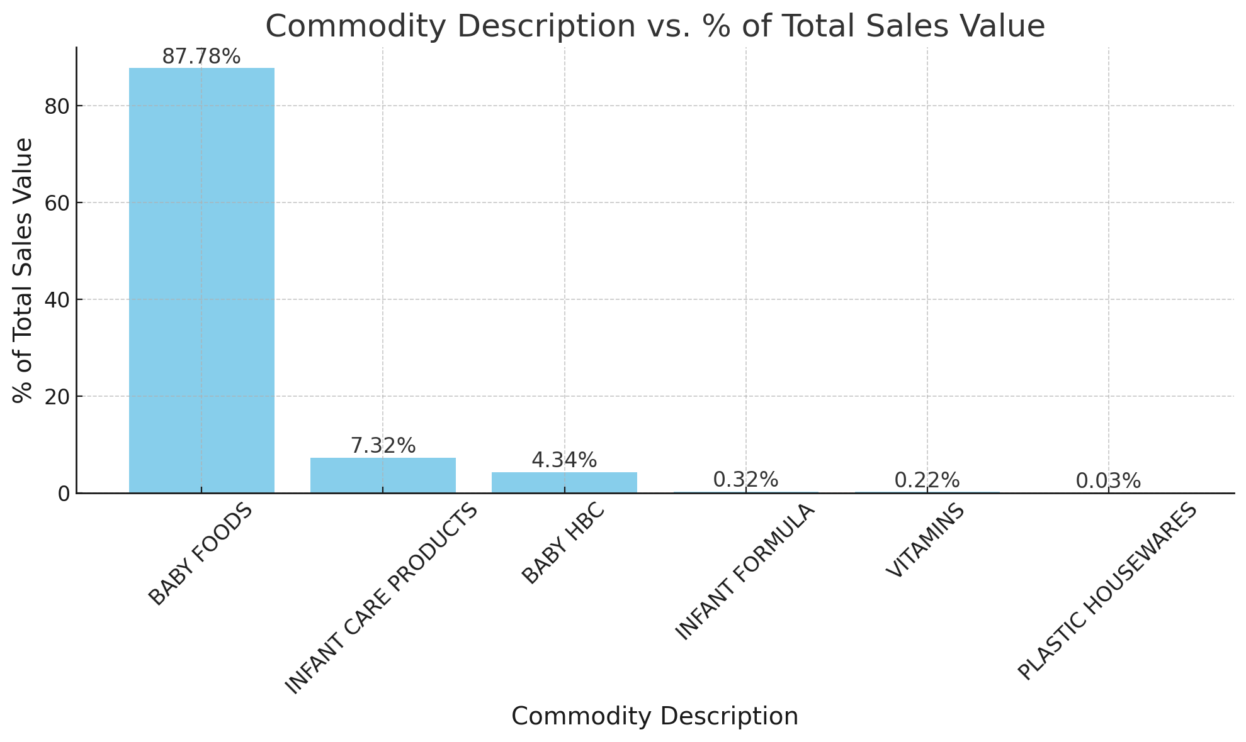
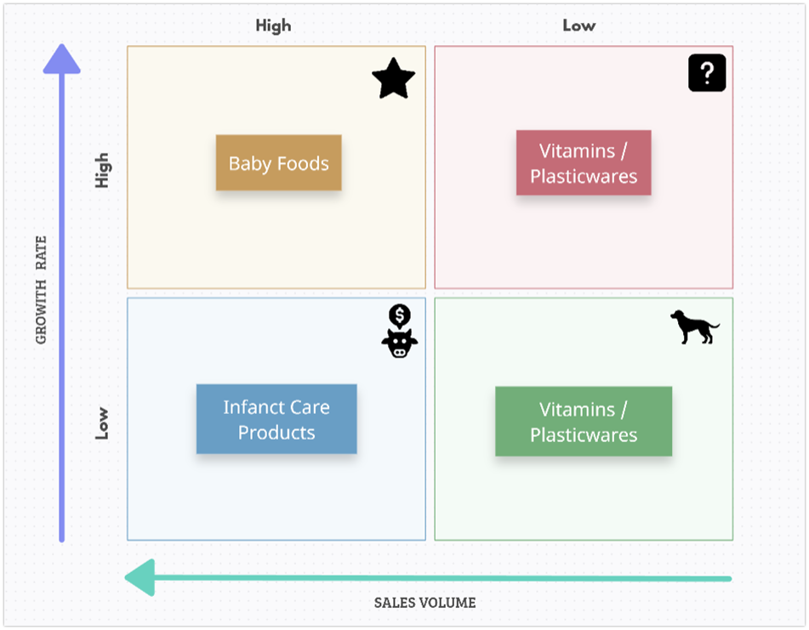
Product Portfolio of 177
Baby Foods is the ‘Star’ product, having the largest sales share category, and growing fast.
So, it makes sense for Manufacturer 177 to focus on the sales of Baby Foods

Slide 5

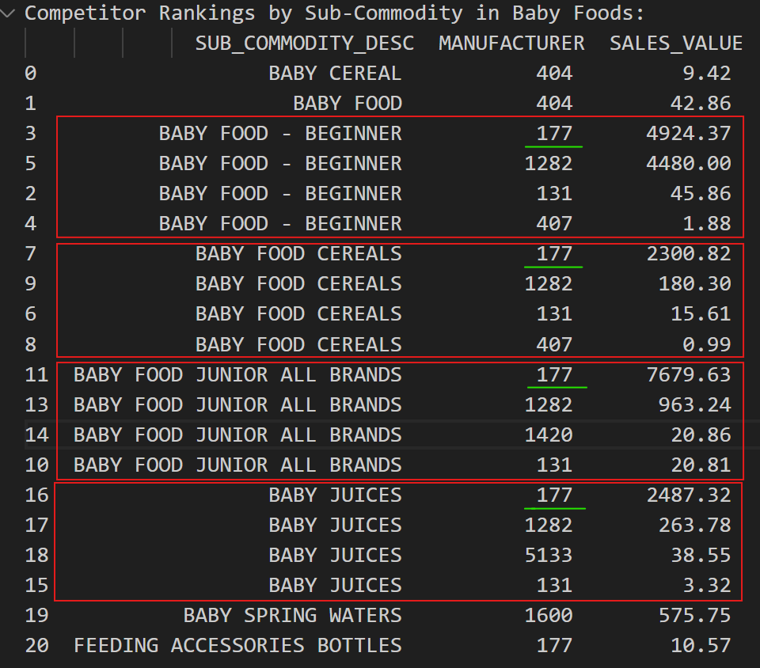
Competition in the market
Out of 5 sub-commodities that 177 sells, it is the biggest manufacturer by sales in 4, maintaining huge margins over the next manufacturers.
Main competitors : 1282 and 131

Slide 6
Business problem
Key business insights for Manufacturer 177 :
Predicting customer behavior (e.g., loyalty and churn)
Identifying the most responsive customer groups to coupons/ campaigns/ discounts
Forecasting sales for the next year under current conditions to help in planning

Slide 7
Solution overview
Customer Segmentation: K-Means to classify customers into actionable groups.
Churn Prediction: Random Forest Classifier for churn analysis.

Slide 8
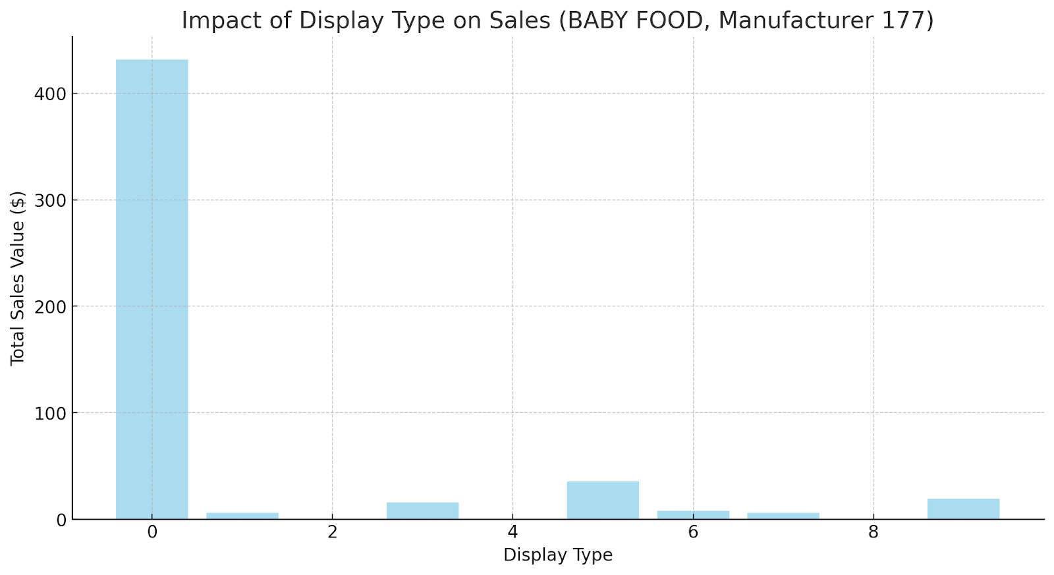
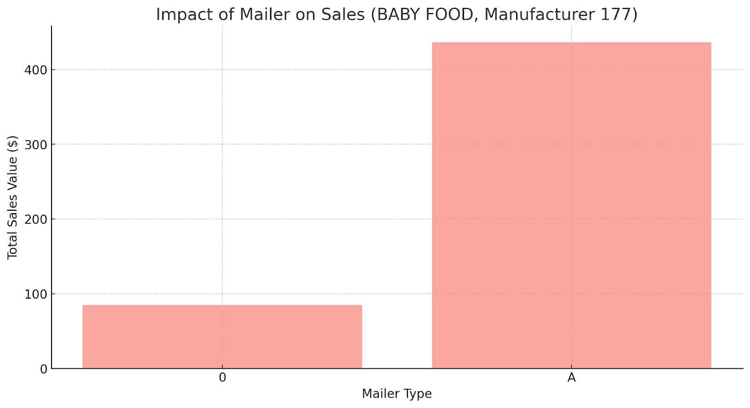
Effect of promotion and placement on sales
Display Impact:
Display Type 0 (Not on Display) dominates sales with $431.71.
Rear End Cap (Type 5) shows the second-highest sales, contributing $35.16.
Secondary Location Display (Type 9) has a moderate impact with $19.17.
Mailer Impact:
Presence of Mailer Type "A" drives most sales, accounting for $436.51.
Absence of mailer (Type 0) results in significantly lower sales, totaling $84.92.

Slide 9
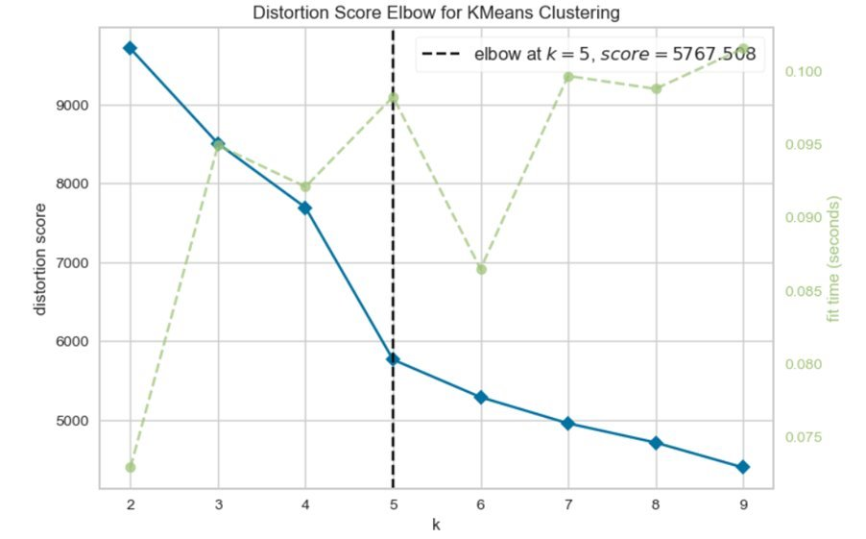
Customer Segmentation
Clustering the households using K-Means:
Cluster number | Number of households
1 | 142
2 | 77
3 | 172
4 | 232
5 | 178
KElbowVisualizer under the Yellowbrick package gives us the optimum number of clusters
K-Means clustering yields the below clusters

Slide 10
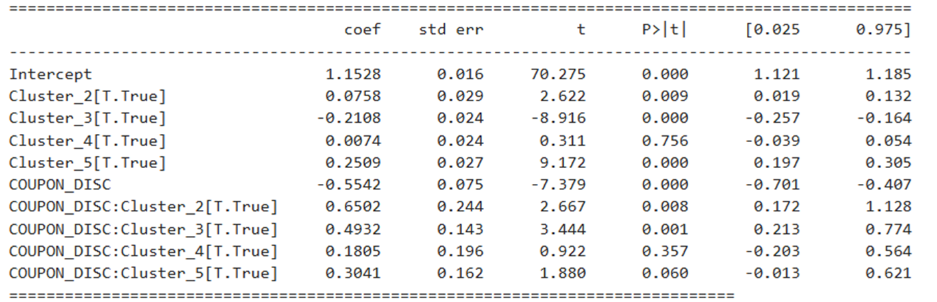
Which clusters are most responsive to coupons?
Model 2: Linear Regression model for sales
We fitted a linear regression model with sales value as the target, having interaction terms between the clusters and the coupon discount field, using the ‘transaction_data’ table
This model tells us that Clusters 2 and 3 are the most responsive to coupon discounts

Slide 11
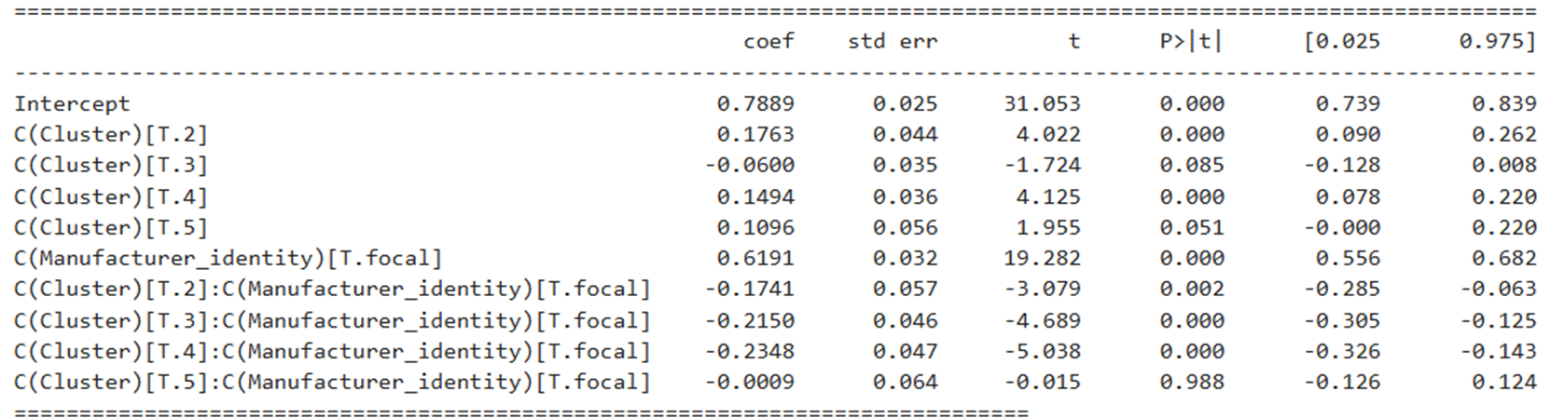
Which clusters are loyal to brand 177?
Model 3: Linear Regression model for sales
We fitted another linear regression model, with sales value as the target, having interaction terms between the clusters and manufacturer identity (focal / competitor)
This model tells us that Clusters 1 contains the households which are most loyal to brand 177

Slide 12
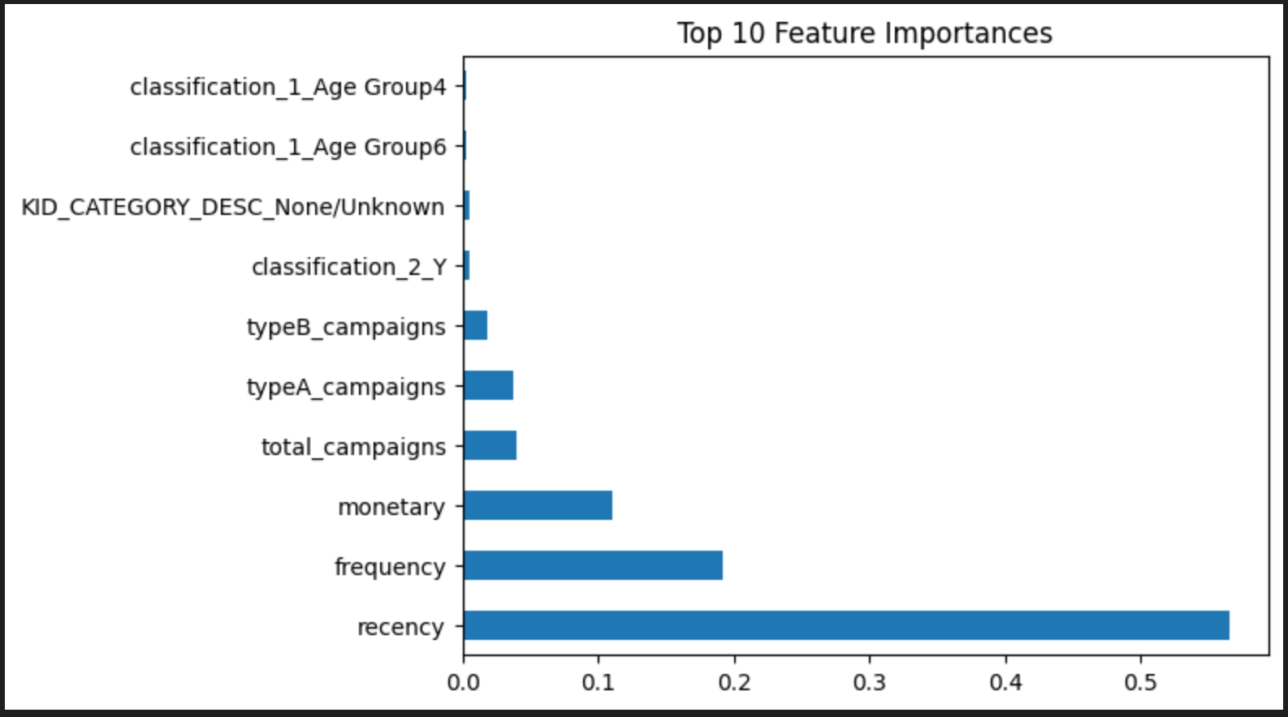
Churn Prediction
Defined churn as customers with no transactions in the last 12 weeks.
Features: Recency, Frequency, and campaign engagement.
Performance: High ROC-AUC.
Insights: TYPEB_CAMPAIGNS and lack of recent transactions are top churn drivers.

Slide 13
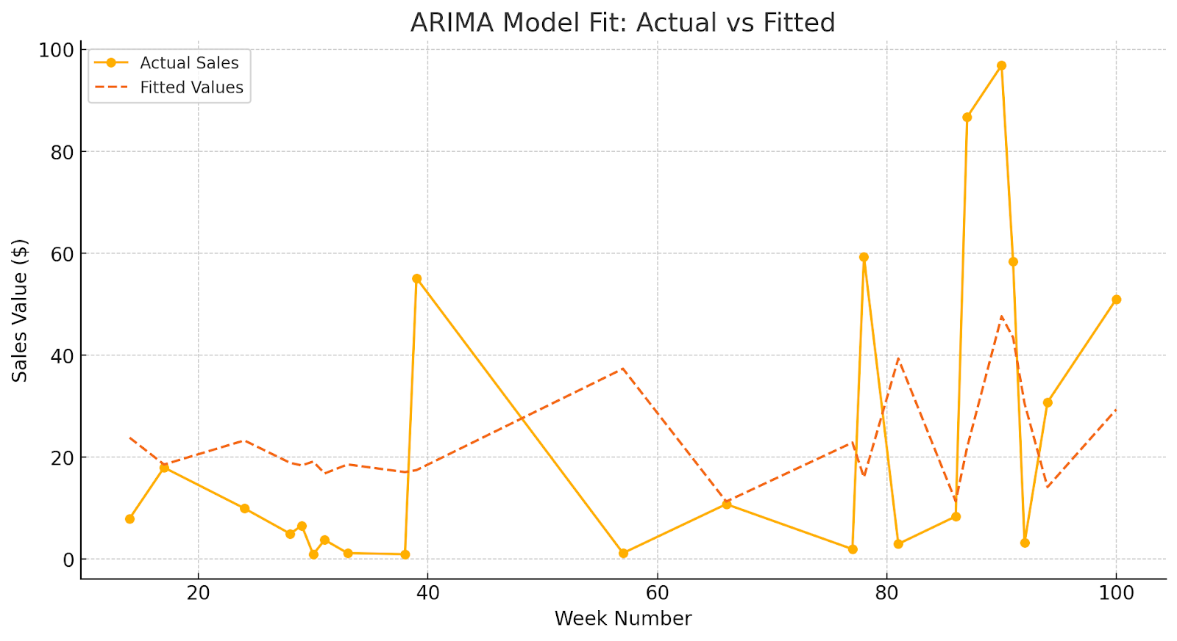
Time Series Forecasting with Causal Factors
ARIMA - Autoregressive Integrated Moving Average

Slide 14
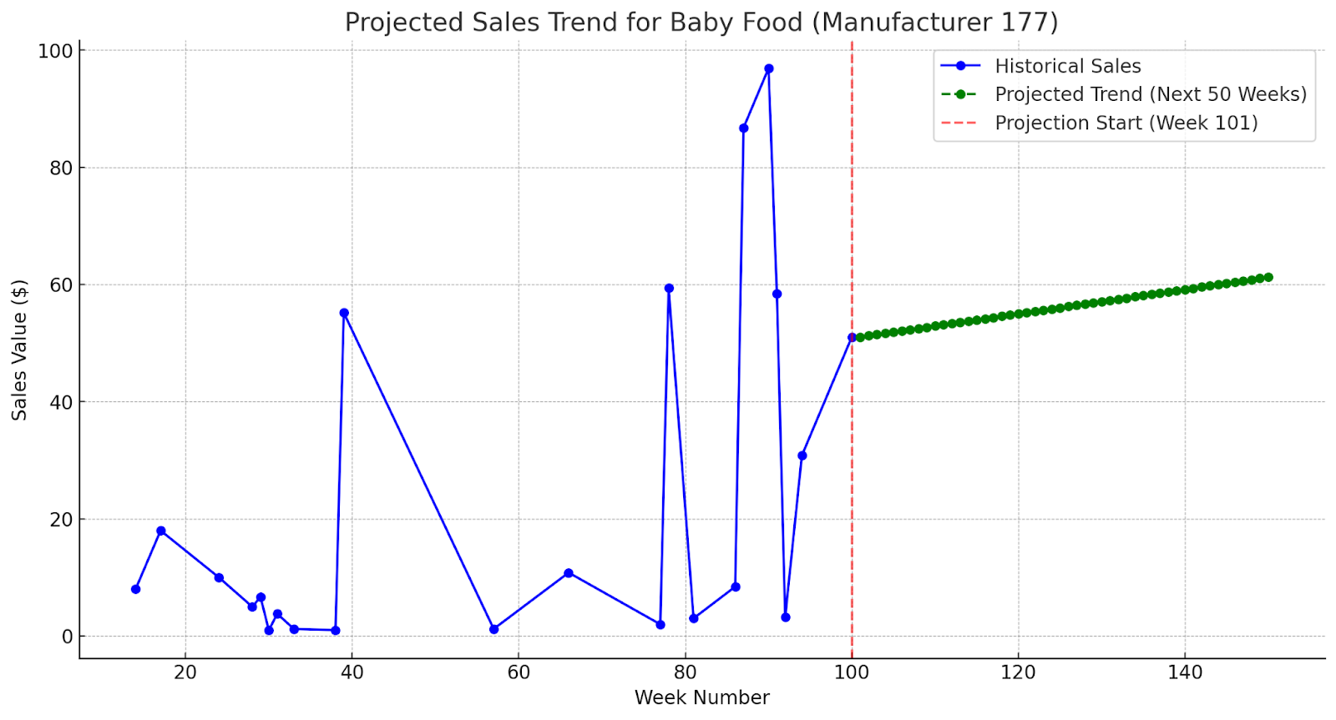
Time Series Forecasting with Causal Factors
ARIMA - Autoregressive Integrated Moving Average

Slide 15
Recommendations
From clustering and regression:
Target Clusters 2 and 3 with discount coupons, they are buying competitor’s products but are known to be responsive to coupons
Focus retention efforts on Cluster 1, who are loyal customers of Brand 177
Retention effort could be sending a product catalog pamphlet, or tickets to an amusement park on scanning a certain number of QR codes inside packaging

