Slide 1




March 11, 2025
Darshan Naik
naikdarshan221@gmail.com
BUMBLE UX DATA ANALYSIS
https://github.com/Darshan2908221/Bumble_UX_Data_Analysis/blob/main/Bumble_Dating_App.pbix

Slide 2
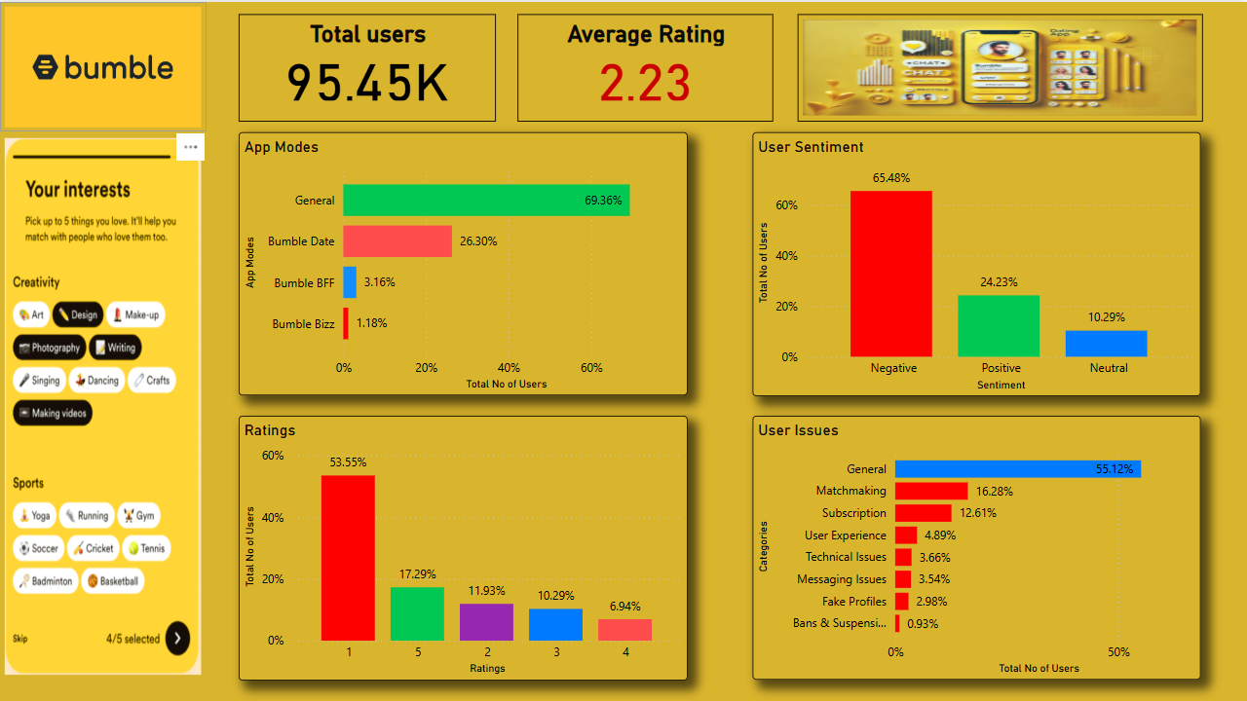

Slide 3
March 11, 2025
Darshan Naik
naikdarshan221@gmail.com
Findings from the Bumble Dating App Data Analysis:
1 ] User Engagement & App Modes
The majority (69.36%) of users operate in General mode, followed by Bumble Date (26.30%).
Bumble BFF (3.16%) and Bumble Bizz (1.18%) have significantly lower engagement, indicating limited interest in non-dating functionalities.

Slide 4
March 11, 2025
Darshan Naik
naikdarshan221@gmail.com
Findings from the Bumble Dating App Data Analysis:
2] User Ratings & Sentiment
The average rating is (2.23), suggesting primarily negative feedback.
A majority of users (53.55%) have rated the app 1 star, while only 17.29% gave it 5 stars.
Negative sentiment (65.48%) dominates user reviews, with only 24.23% positive feedback.

Slide 5
March 11, 2025
Darshan Naik
naikdarshan221@gmail.com
Findings from the Bumble Dating App Data Analysis:
3] Common User Issues
General issues (55.12%) are the biggest concern, Indicating overall dissatisfaction.
Matchmaking (16.28%) and subscription problems (12.61%) are key pain points.
User experience (4.89%), technical issues (3.66%), and messaging issues (3.54%) suggest platform usability concerns.
Fake profiles (2.98%) and bans/suspensions (0.93%) indicate some trust and security issues.

Slide 6
March 11, 2025
Darshan Naik
naikdarshan221@gmail.com
Findings from the Bumble Dating App Data Analysis:
Recommendations:
Improve matchmaking algorithms to enhance user experience(16.28%).
Address subscription-related concerns to reduce dissatisfaction(12.61%).
Enhance user experience & technical stability to lower complaints i.e resolving 8% of user complaints.
Strengthen fraud detection & moderation to tackle fake profiles.
Increase engagement in Bumble BFF & Bizz through better marketing or feature improvements.
Thank You!

