Slide 1

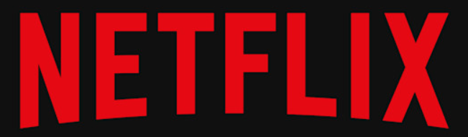
March 11 2025
Darshan Naik
naikdarshan221@gmail.com
Netflix UX Data Analysis
Your paragraph texthttps://github.com/Darshan2908221/Netflix_UX_Data_Analysis

Slide 2
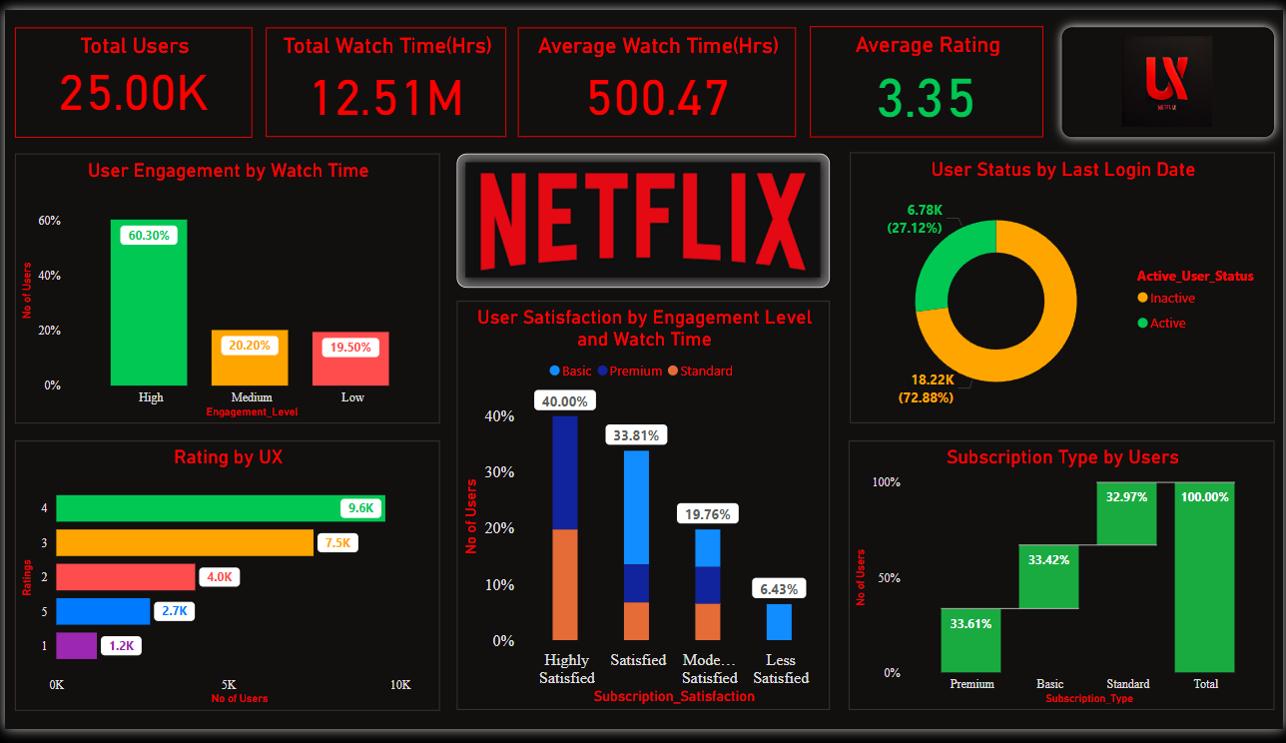

Slide 3

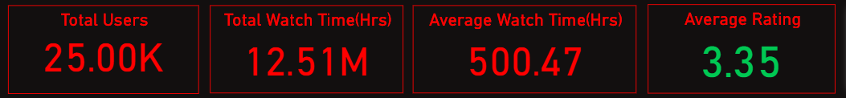
March 11 2025
Darshan Naik
naikdarshan221@gmail.com
1] Key Metrics
Total Users: 25K
Total Watch Time: 12.51M hours
Avg Watch Time per User: 500.47 hours
Avg Rating: 3.35

Slide 4
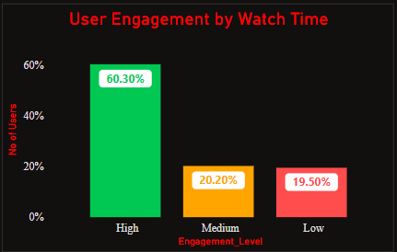
March 11 2025
Darshan Naik
naikdarshan221@gmail.com
2] User Engagement Based on Watch Time
High Engagement – Watch time ≥ 80% of the average watch time (60.30% of users).
Medium Engagement – Watch time between 40% and 80% of the average watch time (20.20% of users).
Low Engagement – Watch time ≤ 40% of the average watch time (19.50% of users).

Slide 5
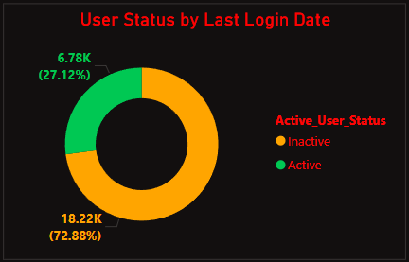
March 11 2025
Darshan Naik
naikdarshan221@gmail.com
3] User Status by Last Login Date
Active Users (27.12%) – Logged in within the last 30 days from March 8 2025.
Inactive Users (72.88%) – Haven’t logged in for over 30 days before March 8 2025.

Slide 6
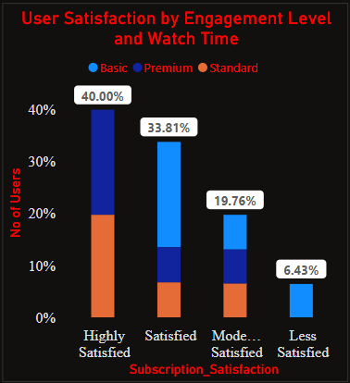
March 11 2025
Darshan Naik
naikdarshan221@gmail.com
4] User Satisfaction Categorization Based on User Engagement and Subscription type
40% of users are highly satisfied (Premium & Standard users).
33.81% are satisfied (a mix of all subscription types).
19.76% are moderately satisfied.(a mix of all subscription types).
6.43% are less satisfied (Basic plan users).

Slide 7
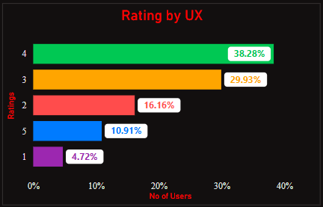
March 11 2025
Darshan Naik
naikdarshan221@gmail.com
5] User Ratings Breakdown
4 Stars: 9.6K users (38.28%)
3 Stars: 7.5K users (29.93%)
2 Stars: 4K users (16.16%)
5 Stars: 2.7K users (10.91%)
1 Star: 1.2K users (4.72%)

Slide 8
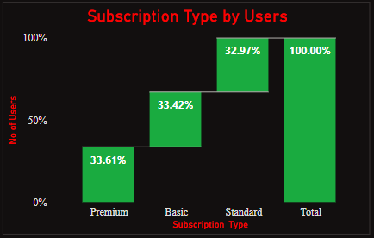
March 11 2025
Darshan Naik
naikdarshan221@gmail.com
6] Subscription Type Analysis
Premium Users: 33.61%
Basic Users: 33.42%
Standard Users: 32.97%
Total Subscription Coverage: 100%

Slide 9
March 11 2025
Darshan Naik
naikdarshan221@gmail.com
Recommendations
60.3% users have high engagement but 72.88% of users have been inactive for over 30 days, suggesting that while users enjoy the content, they may not find enough reasons to return frequently
thus can develop a algorithm that can pop up movie recommendations based on user choice & login time.
User satisfaction is closely tied to subscription type, with 40% of highly satisfied users being Premium or Standard subscribers, while only 6.43% of users, mostly on the Basic plan, reported low satisfaction thus improving features on basic plan to retain them and give better experience and gradually turn them in to upgraded subscriptions for more features that enrich the user experience.
Ratings indicate a mixed user experience, with most users giving 3 or 4 stars, while 1 and 2-star ratings from 5.2K users which highlights the areas for improvement.
Subscription distribution is nearly equal among Premium (33.61%), Basic (33.42%), and Standard (32.97%) users.
Thank You!

