Slide 1

🚖 OLA Bookings for the month July-2024 SQL QUERYING

Slide 2
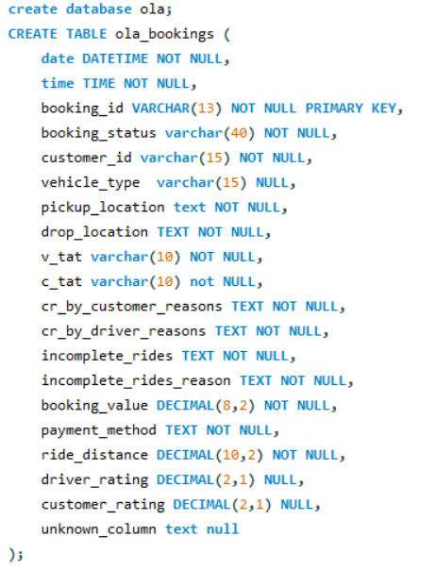
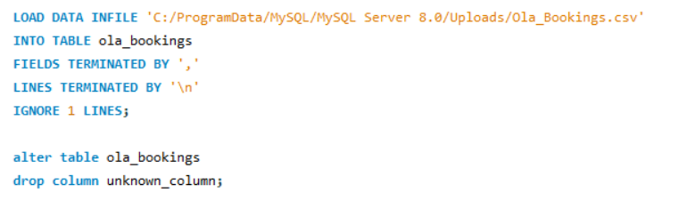
🚖 Analysis of OLA Bookings for July 2024
Data Base Creation, Data Importing and Alteration

Slide 3
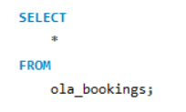
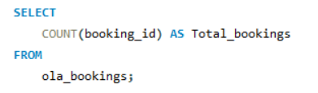

🚖 Analysis of OLA Bookings for July 2024
Data Exploration and Basic Queries

Slide 4

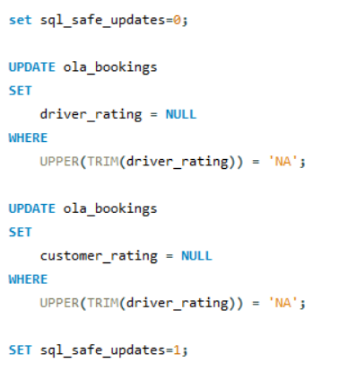
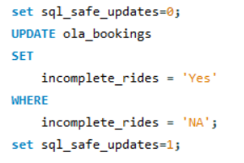
🚖 Analysis of OLA Bookings for July 2024
Data Cleaning and Updates

Slide 5
🚖 OLA Bookings for the month July-2024 SQL QUERYING
THANK YOU

