Slide 1

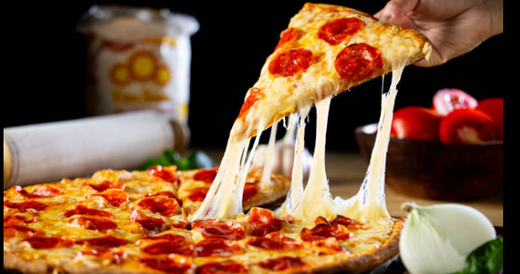


Data-Driven Insights & Analytics for Pizza Sales Using SQL
Automatic video captions available.

Slide 2
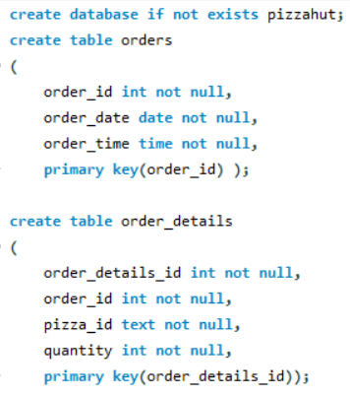
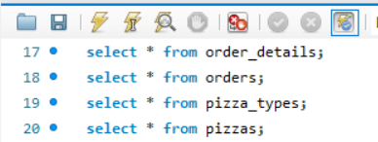
Darshan Rajeev Naik
naikdarshan221@gmail.com
Database Creation & Schema Design

Slide 3
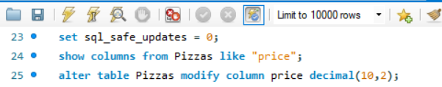

Darshan Rajeev Naik
naikdarshan221@gmail.com
Database Modification: Updating and Altering Table Structures
Altering Pizzas table and modifying Price column to decimal data type and restricting it to 2 decimal places

Slide 4
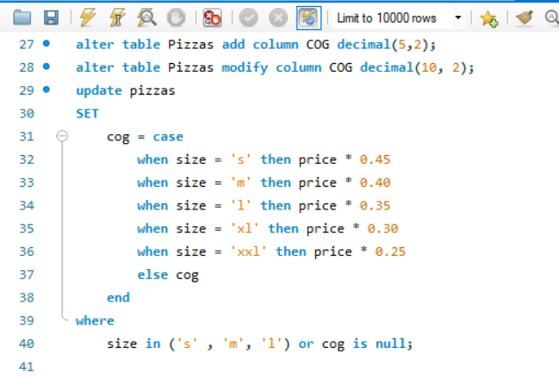


Darshan Rajeev Naik
naikdarshan221@gmail.com
Database Modification: Updating and Altering Table Structures
Adding “COG” column and altering it then to assign “COG” based on size of Pizza

Slide 5
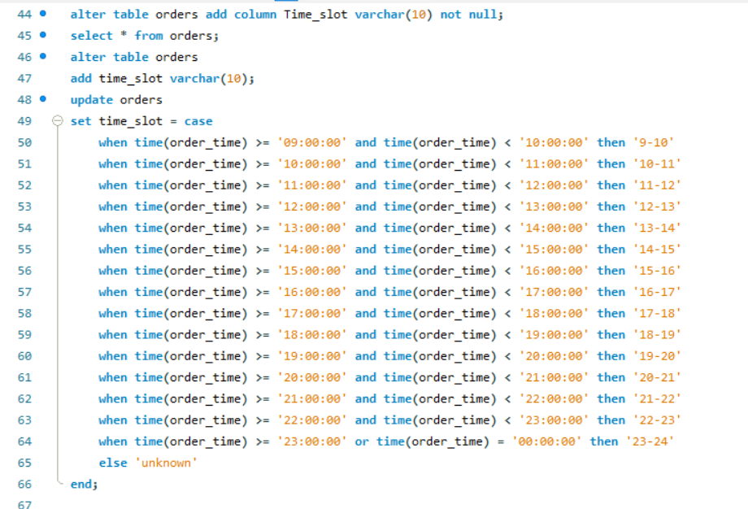

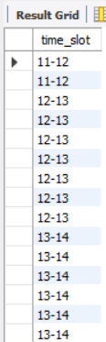
Darshan Rajeev Naik
naikdarshan221@gmail.com
Database Modification: Updating and Altering Table Structures
Adding “Time_slot” column and altering it then to assign “time frame” based on order_time

Slide 6
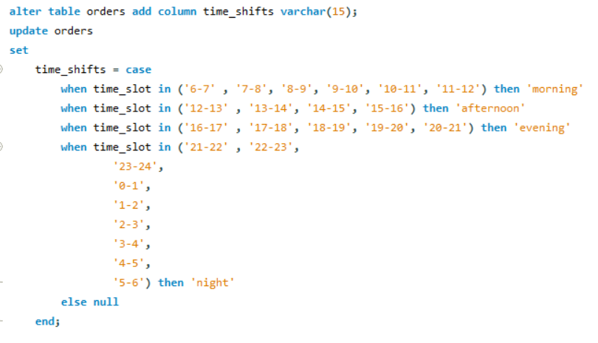
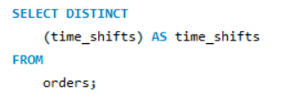
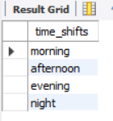
Darshan Rajeev Naik
naikdarshan221@gmail.com
Database Modification: Updating and Altering Table Structures
Adding “Time shifts” column and altering it then to assign “Naming's” based on Time_slots

Slide 7
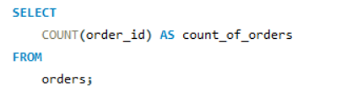

Darshan Rajeev Naik
naikdarshan221@gmail.com
Business Insights & Sales Analysis
Total number of orders placed

Slide 8
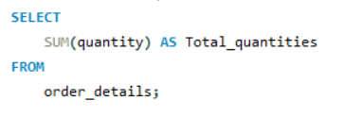

Darshan Rajeev Naik
naikdarshan221@gmail.com
Business Insights & Sales Analysis
Total quantity of Pizza’s sold

Slide 9
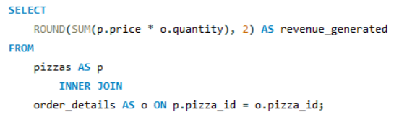

Darshan Rajeev Naik
naikdarshan221@gmail.com
Business Insights & Sales Analysis
Total Revenue from Pizza Sales

Slide 10
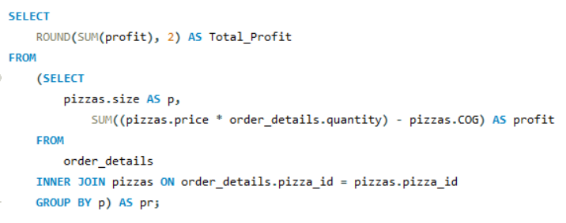

Darshan Rajeev Naik
naikdarshan221@gmail.com
Business Insights & Sales Analysis
Total Profit from Pizza Sales

Slide 11
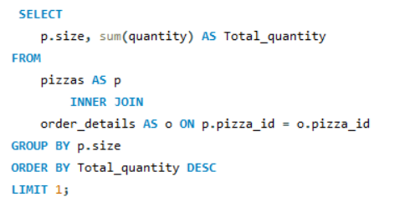

Darshan Rajeev Naik
naikdarshan221@gmail.com
Business Insights & Sales Analysis
Highest Sold Pizza Size

Slide 12
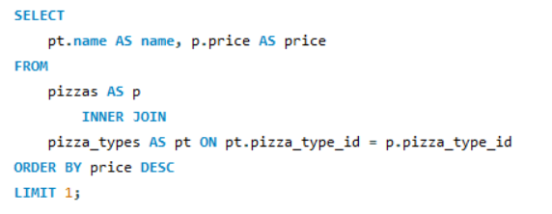

Darshan Rajeev Naik
naikdarshan221@gmail.com
Business Insights & Sales Analysis
Highest-Priced Pizza

Slide 13
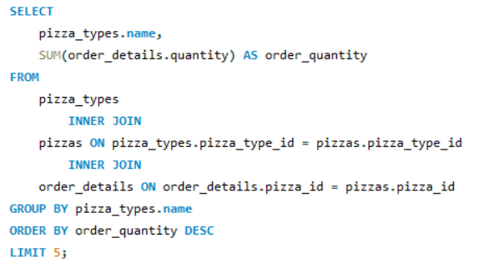
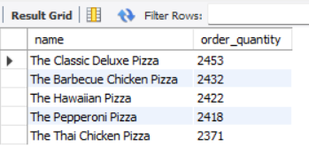
Darshan Rajeev Naik
naikdarshan221@gmail.com
Business Insights & Sales Analysis
Top 5 Most Sold Pizza Types

Slide 14
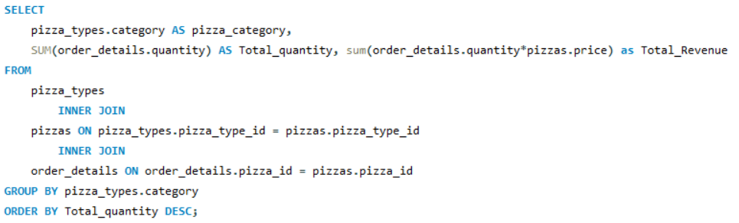
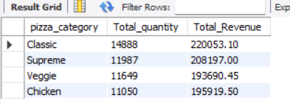
Darshan Rajeev Naik
naikdarshan221@gmail.com
Intermediate Analysis & Trends
Category wise Pizza’s sold and Revenue generated

Slide 15
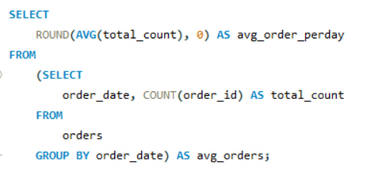

Darshan Rajeev Naik
naikdarshan221@gmail.com
Intermediate Analysis & Trends
Daily average orders received

Slide 16
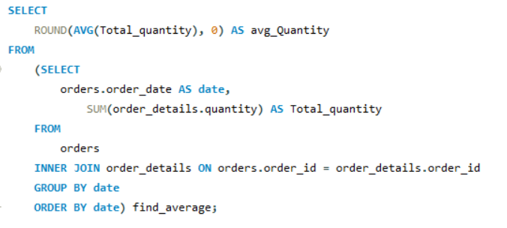

Darshan Rajeev Naik
naikdarshan221@gmail.com
Intermediate Analysis & Trends
Daily average Pizza quantity sold

Slide 17
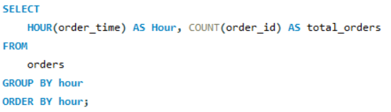
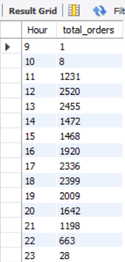
Darshan Rajeev Naik
naikdarshan221@gmail.com
Intermediate Analysis & Trends
Order distribution by hour

Slide 18
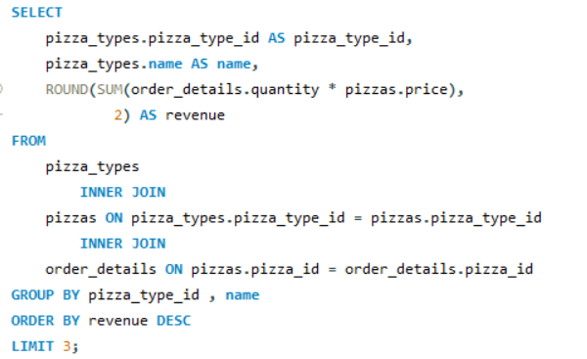
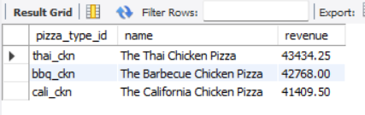
Darshan Rajeev Naik
naikdarshan221@gmail.com
Intermediate Analysis & Trends
Top 3 Pizza Types by Revenue

Slide 19
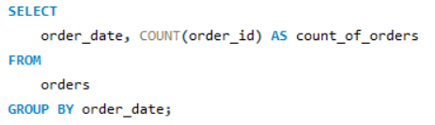
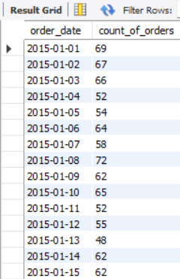
Darshan Rajeev Naik
naikdarshan221@gmail.com
Advanced Analytics & Revenue Insights
Daily Cumulative Order Count

Slide 20
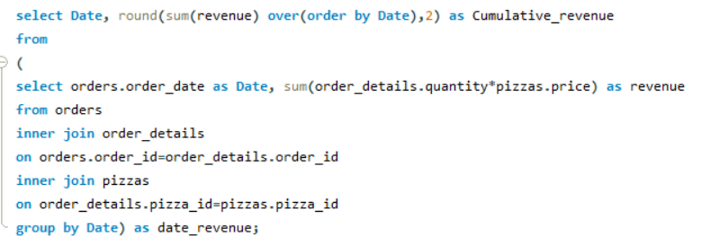
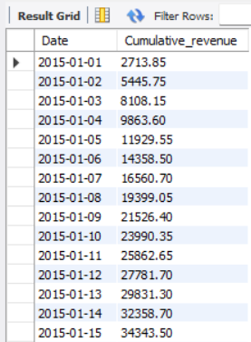
Darshan Rajeev Naik
naikdarshan221@gmail.com
Advanced Analytics & Revenue Insights
Cumulative Revenue Over Time

Slide 21
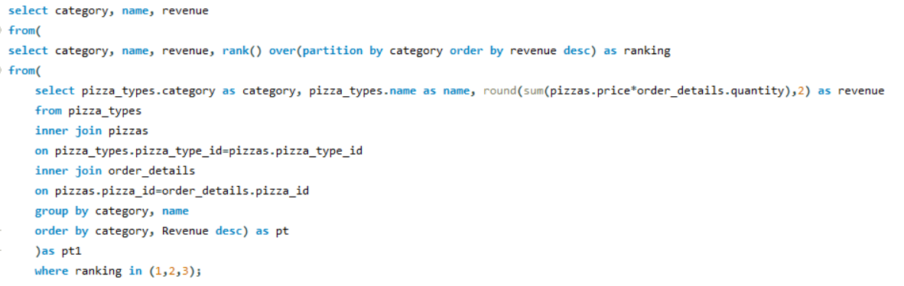
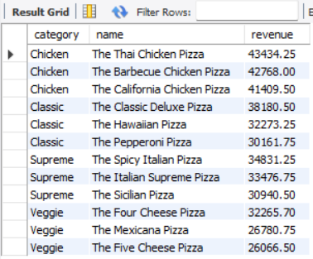
Darshan Rajeev Naik
naikdarshan221@gmail.com
Advanced Analytics & Revenue Insights
Top 3 Pizza Types by Revenue for Each Category

Slide 22
Darshan Rajeev Naik
naikdarshan221@gmail.com
Darshan Rajeev Naik
naikdarshan221@gmail.com
https://www.linkedin.com/in/darshan-naik-730b3a250
https://github.com/Darshan2908221?tab=repositories
Thank you for your attention
comment your views on querying and analysis on Pizza Hut database

