Slide 1
ACADEMIC MINI PROJECT REPORTING 2
WORMUP: HYPERLOCAL QUICK COMMERCE,
DARK STORE LOGISTICS & CLOUD PRINTING
Phase 2 Detailed Design, System Architecture, Module Decomposition & Data Modeling
Tech Stack: React 19 • React Native (Expo) • NestJS & Express • MongoDB Atlas Cluster • Socket.IO Telemetry
Project Team: WormUp Development Team | Academic Session: 2026-2027
Note: Live production demo will be presented directly on screen. Slides focus on architecture, algorithms, and schemas.

Slide 2
MINI PROJECT REPORTING 2
Executive Summary & Reporting 2 Scope
Reporting 1 Recap
• SRS Formulation — Analyzed quick commerce challenges (inventory loss, pricing conflicts).
• Feasibility Study — Evaluated 10-minute delivery economics & cloud printing demand.
• Scope Definition — Multi-role ecosystem (Customer, Picker, Rider, Super Admin).
• Tech Stack Approval — Selected NestJS, MongoDB, React, React Native Expo.
Reporting 2 Deliverables
• System Architecture — Multi-tier micro-modular design with WebSockets & REST APIs.
• 5 Functional Modules — Detailed workflow diagrams for each independent enterprise module.
• Dynamic Area Pricing — Multi-tier price override algorithm ({variantId, areaId}).
• Full Data Dictionary — Complete normalized schema tables with types & constraints.
Live Demo Execution
• Customer Web Experience — Geo-detection, area prices (Tragad ₹7), cart, live tracking.
• Store Picker Workflow — Digital pick-lists, shelf bin scanning, shift toggle.
• Rider Telemetry — Real-time GPS coordinate pinging & order dispatch.
• Admin Dynamic Overrides — Instant price updates, rider & customer profile editing.

Slide 3
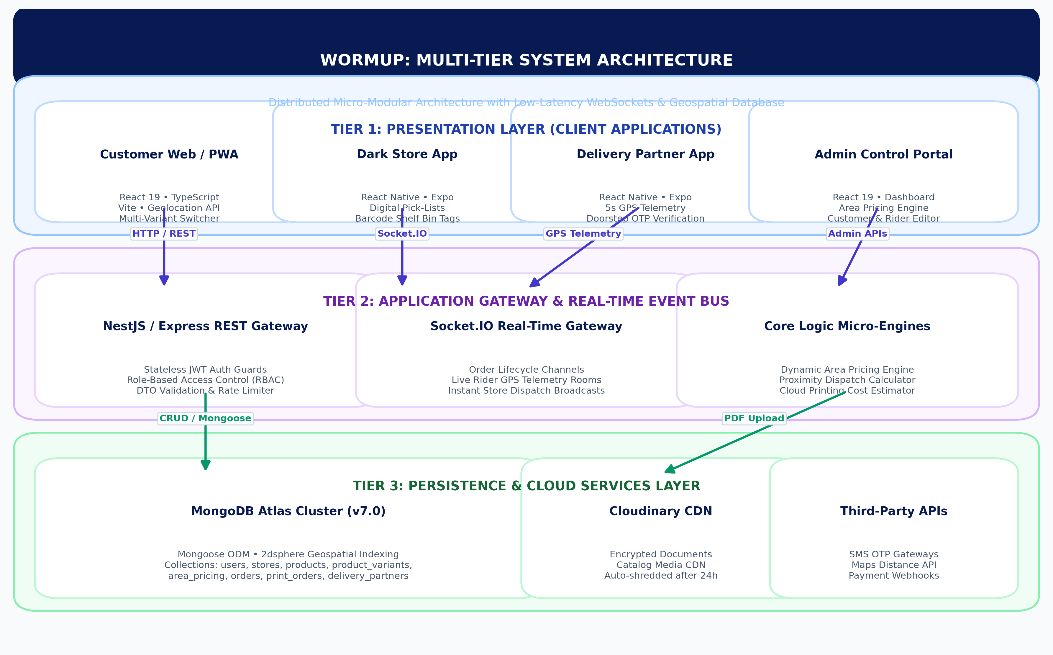
MINI PROJECT REPORTING 2
High-Level Distributed System Architecture
Architectural Highlights
• Presentation Tier — Responsive React 19 PWA & cross-platform React Native Expo apps.
• Application Gateway — NestJS controller layer with JWT guards & Socket.IO real-time channels.
• Dynamic Engines — Specialized micro-engines for Area Pricing, Fleet Dispatch, and Print Quoting.
• Data Tier — MongoDB Atlas cluster with 2dsphere geospatial indices and atomic operations.
• Media Cloud CDN — Cloudinary integration for product images and encrypted document uploads.

Slide 4
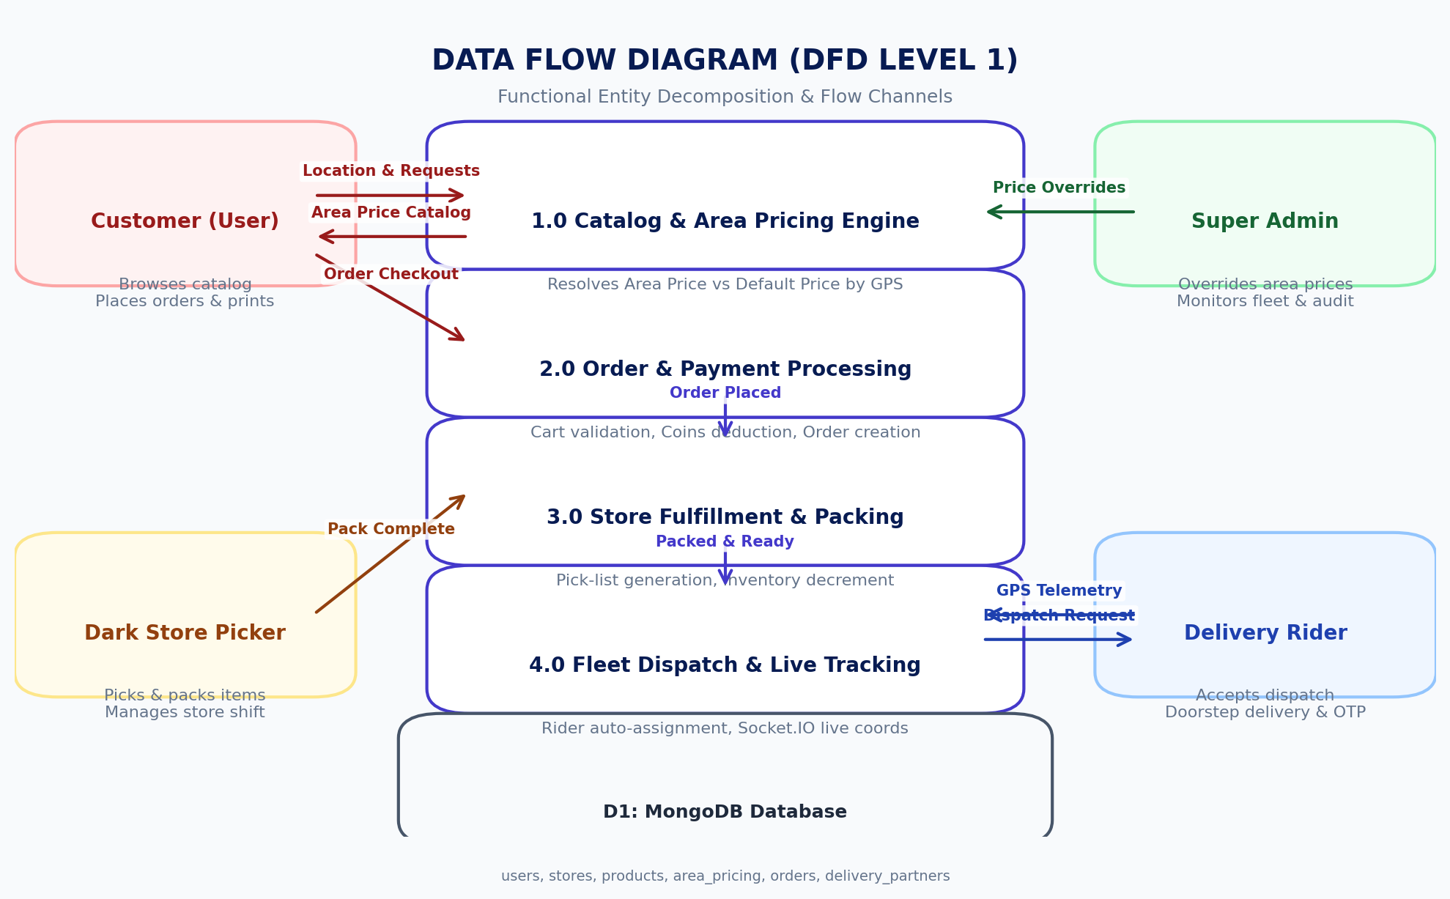
MINI PROJECT REPORTING 2
Data Flow Diagram (DFD Level 1 Decomposition)
DFD Level 1 Analysis
• Process 1.0 (Catalog) — Consumes customer geolocation; queries MongoDB area_pricing to resolve localized rates.
• Process 2.0 (Orders) — Validates cart, checks stock limits, redeems coins, and commits order.
• Process 3.0 (Fulfillment) — Routes order to nearest dark store; generates digital pick-list with bin tags.
• Process 4.0 (Fleet) — Pings idle riders; streams live telemetry over Socket.IO rooms.
• Admin Overseer — Super admin modifies pricing and monitors real-time system metrics.

Slide 5
MINI PROJECT REPORTING 2
Functional Module Breakdown (5 Core Subsystems)
Module 1: Customer Web/App
• Geofenced live catalog
• Multi-variant area pricing
• Cart & loyalty coins redemption
• Socket.IO live order countdown
Module 2: Dark Store Hub
• Multi-store inventory sync
• Digital pick-and-pack route
• Shelf bin tagging (A1-R1)
• Shift control (On/Off Shift)
Module 3: Delivery Fleet
• Proximity dispatch algorithm
• GPS telemetry & speed tracker
• Doorstep delivery OTP/QR
• Dynamic distance payout rates
Module 4: Cloud Printing
• Multi-page PDF/Doc upload
• B&W vs Color cost estimator
• Binding & paper selection
• 15-minute doorstep dispatch
Module 5: Admin Engine
• Dynamic Area Price Overrides
• Customer & Rider profile editor
• Live fleet map & shift control
• Financial settlement & audit

Slide 6
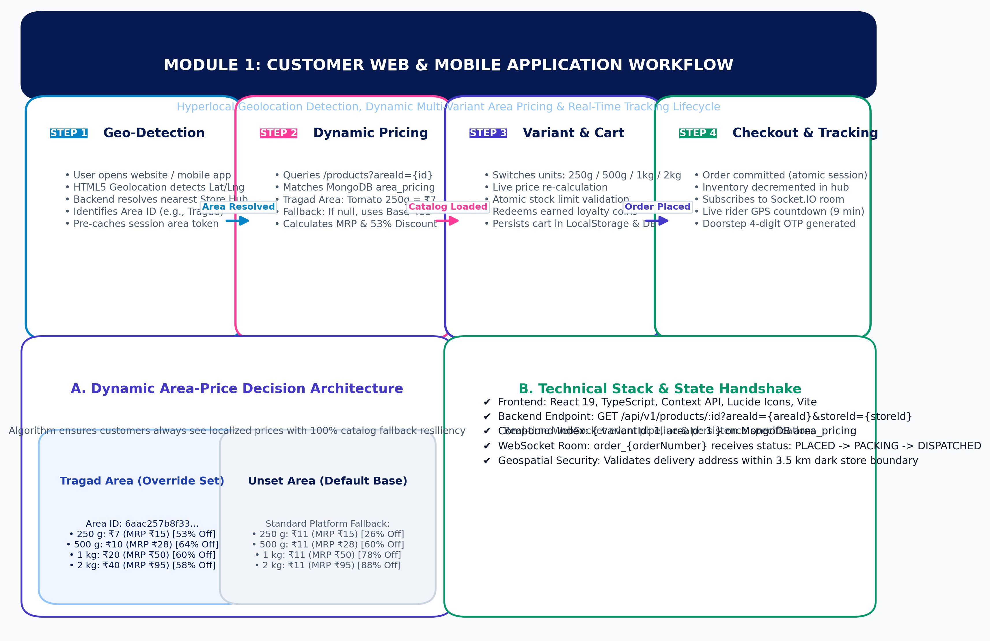
MINI PROJECT REPORTING 2
Module 1: Customer Web & Mobile Portal
Module 1 Engineering Details
• Tech Stack — React 19, TypeScript, Lucide Icons, Geolocation API, Context API.
• Dynamic Price Lookup — Queries /api/v1/products/:id?areaId=... to get live localized pricing.
• Multi-Variant Support — Seamlessly toggles variants (250g, 500g, 1kg, 2kg) updating price & MRP.
• Coin Redemption — Allows partial payment using earned shopping coins.
• Zero-Flicker Telemetry — WebSocket updates rider location smoothly on live tracking modal.

Slide 7
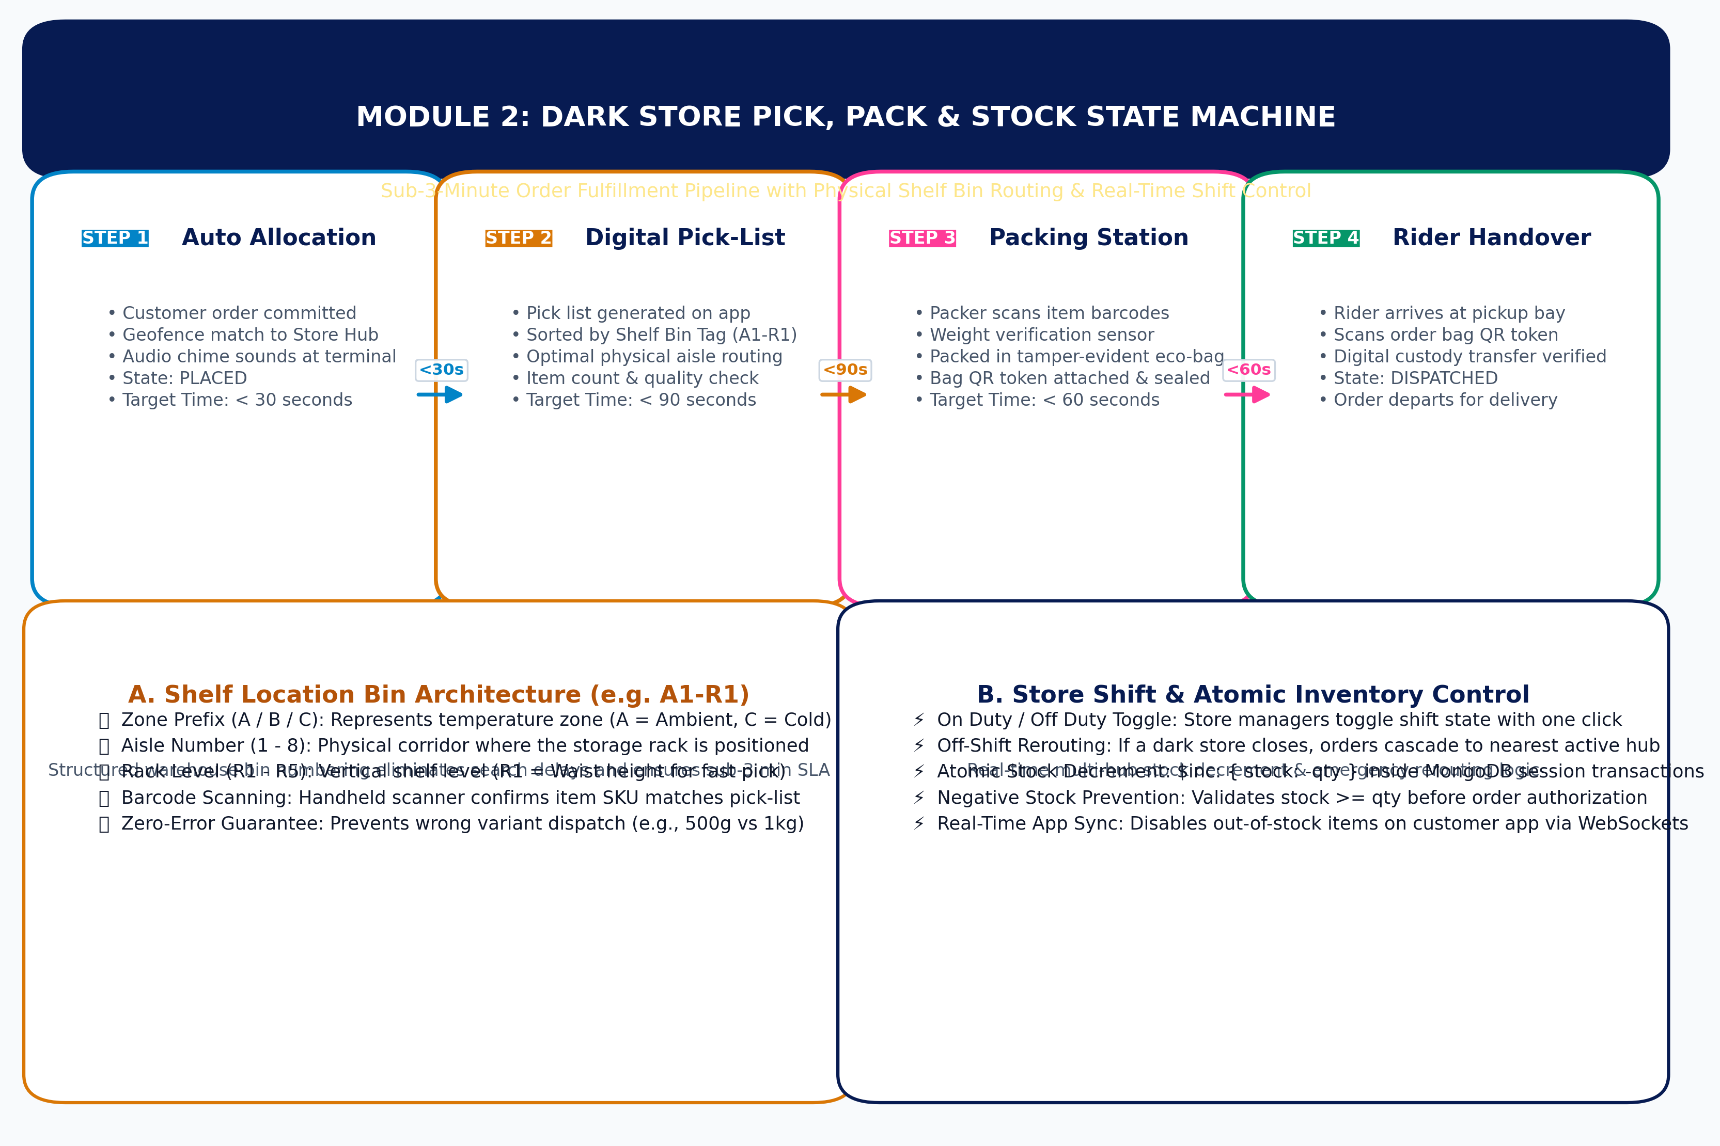
MINI PROJECT REPORTING 2
Module 2: Dark Store Operations & Fulfillment
Module 2 Engineering Details
• Target SLA — Sub-3-minute pick and pack time per customer order.
• Shelf Bin Tagging — Items indexed with shelf locations (e.g. A1-R1) reducing picker search time by 60%.
• Packing Verification — Barcodes scanned and sealed inside tamper-proof eco bags.
• Atomic Decrement — Stock decrements atomically inside MongoDB transaction session.
• Shift Resiliency — Manager shifts toggled between On/Off Duty; auto-reroutes orders if closed.

Slide 8
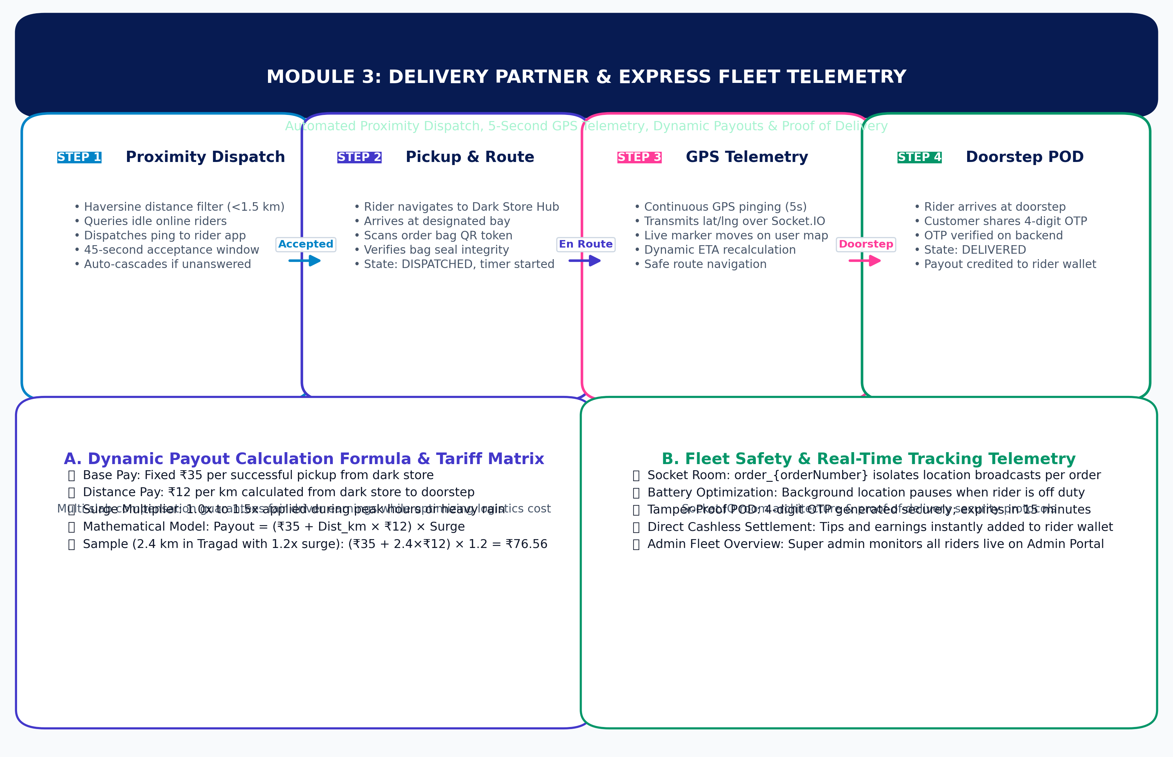
MINI PROJECT REPORTING 2
Module 3: Delivery Partner & Fleet Dispatch
Module 3 Engineering Details
• Haversine Dispatch — Dispatches to nearest idle rider within 1.5 km of dark store.
• Realtime Telemetry — GPS pings transmitted every 5 seconds over Socket.IO room channel.
• Dynamic Tariffs — Payout = Base ₹35 + (₹12/km × Distance) × Surge Multiplier.
• Proof of Delivery — Doorstep OTP verification unlocks payout and completes order cycle.
• Rider Wallet — Earnings and tips instantly credited to in-app withdrawal wallet.

Slide 9
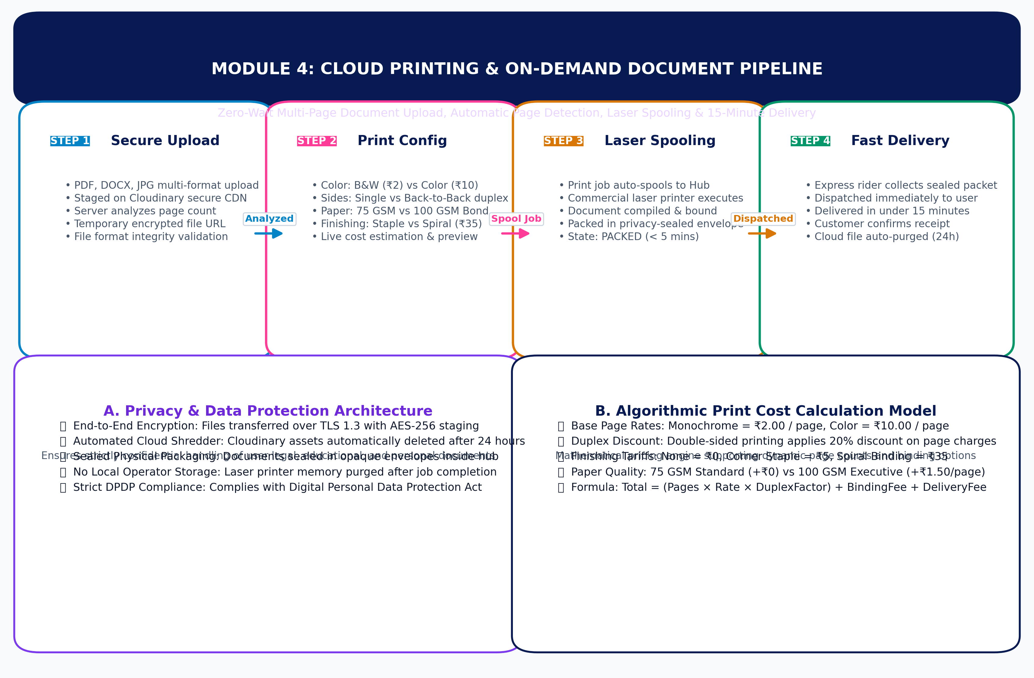
MINI PROJECT REPORTING 2
Module 4: Cloud Printing & On-Demand Document Pipeline
Module 4 Engineering Details
• File Ingestion — Uploads PDF, DOCX, and high-res images via Cloudinary encrypted storage.
• Auto Page Counting — Backend calculates total page count instantly upon file upload.
• Custom Print Specs — Black & White (₹2), Color (₹10), Double-sided discount, Spiral binding (₹35).
• Dark Store Printing — Automated spooling to high-speed laser printers stationed inside dark stores.
• Security & Privacy — Temporary signed URLs; files auto-purged from cloud after 24 hours.

Slide 10
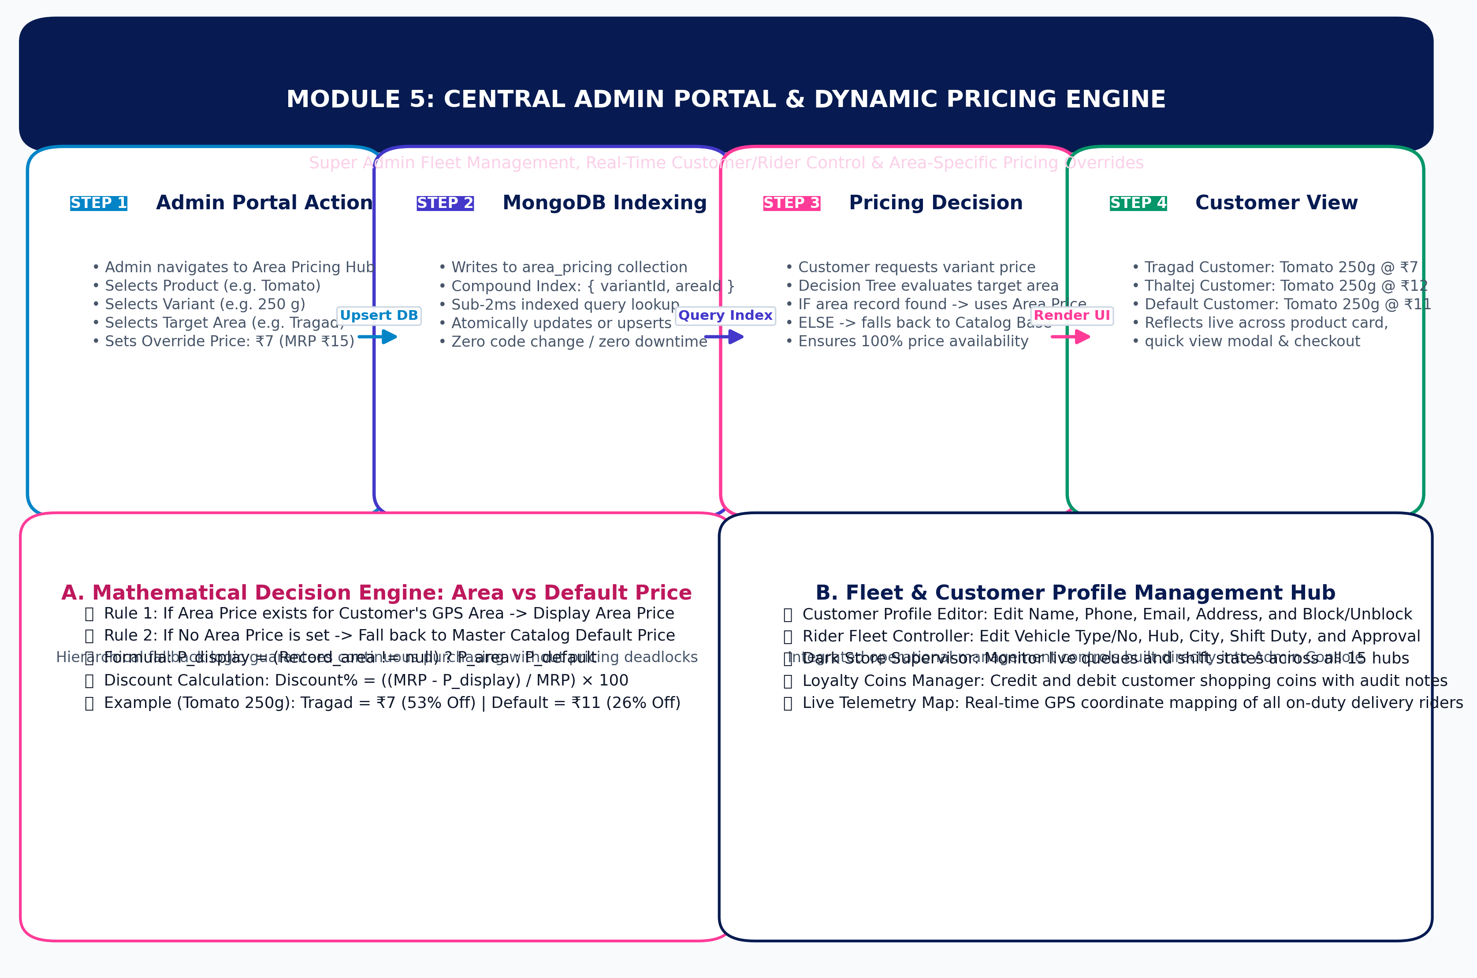
MINI PROJECT REPORTING 2
Module 5: Admin Control Portal & Pricing Engine
Module 5 Engineering Details
• Area Pricing Matrix — Admin sets customized pricing for specific areas without altering global catalog.
• Compound Index — Indexed by { variantId, areaId } for O(1) instantaneous resolution.
• Customer Management — Directly edit customer name, phone, email, address, and block/unblock status.
• Rider Management — Edit full details, vehicle type/no, hub assignment, duty shift, and status.
• Financial Ledger — Audit logs and wallet reconciliations for stores and riders.

Slide 11
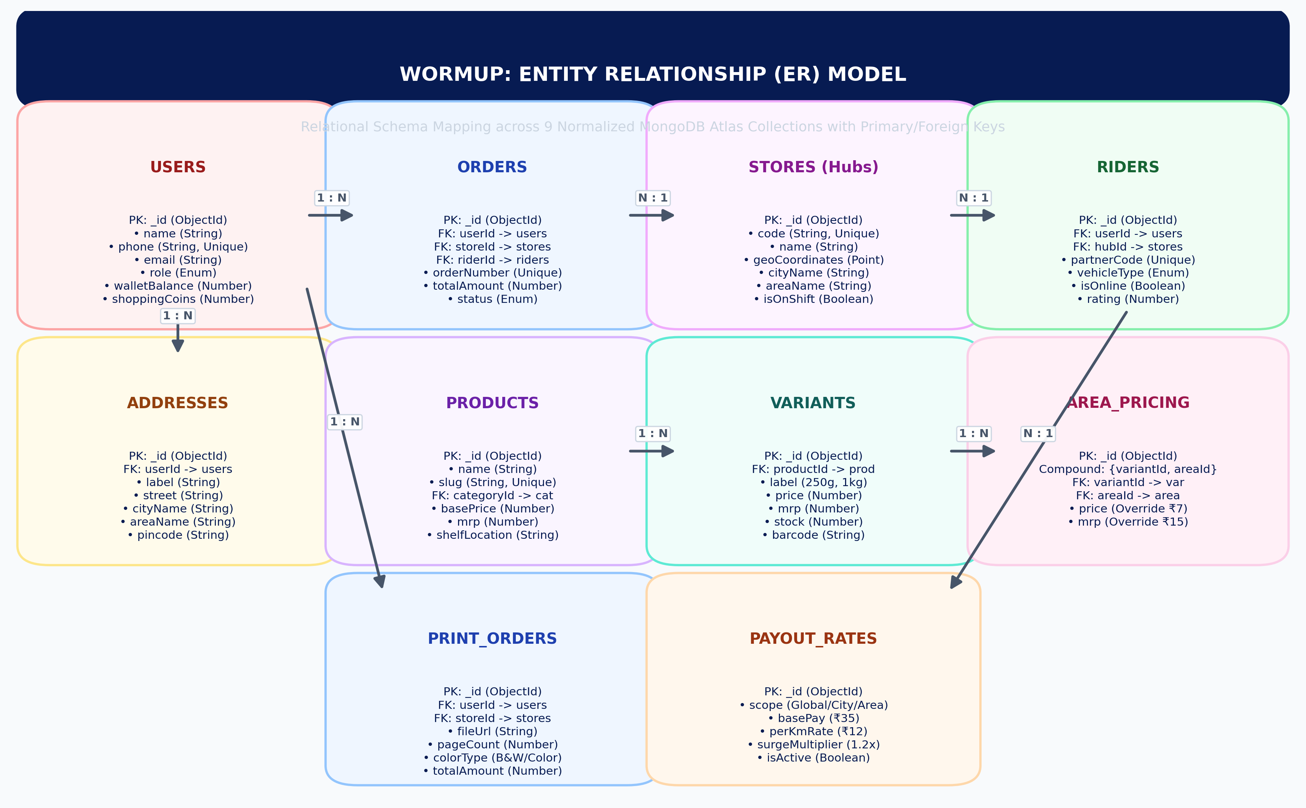
MINI PROJECT REPORTING 2
Database Architecture & Entity Relationship (ER) Model
ER Model Highlights
• NoSQL Schema Design — Leverages MongoDB Atlas for high write throughput and dynamic variant attributes.
• 1 : N Product Variants — One product has multiple weight variants (250g, 500g, 1kg, 2kg).
• Variant : Area Pricing — Area pricing overrides link variant ID to area ID for localized tariffs.
• Geospatial Indexing — Stores and Delivery Partners indexed with 2dsphere GeoJSON points.
• Referential Integrity — ObjectIds with Mongoose population for orders, items, and users.

Slide 12
MINI PROJECT REPORTING 2
Data Dictionary: Users & Stores Collections
Collection 1: users (Customers & Staff)
Collection 2: stores (Dark Store Hubs)
Field Name | Type | Constraints | Description
_id | ObjectId | PK, Required | Unique identifier of the user document
name | String | Required, Indexed | Customer / partner full legal name
phone | String | Unique, Required | E.164 mobile number (+91...)
role | String | Enum (4 roles) | CUSTOMER, STORE_STAFF, RIDER, ADMIN
walletBalance | Number | Default: 0, Min: 0 | In-app balance for fast refunds & pay
Field Name | Type | Constraints | Description
_id | ObjectId | PK, Required | Unique identifier of the store hub
code | String | Unique, Indexed | Hub operational code (e.g. STO-01)
name | String | Required | Dark store name (e.g. Tragad Hub)
geoCoordinates | Object | 2dsphere Point | [longitude, latitude] for geospatial lookup
isOnShift | Boolean | Default: true | Active shift status for order fulfillment

Slide 13
MINI PROJECT REPORTING 2
Data Dictionary: Products & Product Variants
Collection 3: products (Catalog Master)
Collection 4: product_variants (Weight Variants)
Field Name | Type | Constraints | Description
_id | ObjectId | PK, Required | Unique master product identifier
name | String | Required, Indexed | Product display name (e.g. Fresh Tomato)
slug | String | Unique, Indexed | URL slug for web SEO / routing
categoryId | ObjectId | FK -> categories | Product categorization link
basePrice | Number | Min: 0, Required | Global default fallback price (₹11)
Field Name | Type | Constraints | Description
_id | ObjectId | PK, Required | Unique variant identifier
productId | ObjectId | FK -> products | Parent product identifier
label | String | Required | Packaging quantity (250 g, 500 g, 1 kg)
price | Number | Required | Default base selling price for variant
mrp | Number | Required | Maximum retail price for discount calculation

Slide 14
MINI PROJECT REPORTING 2
Data Dictionary: Dynamic Area Pricing Overrides
Collection 5: area_pricing (Area Specific Price Overrides)
Indexing & Query Optimization
• Compound Unique Index — { variantId: 1, areaId: 1 } ensures instantaneous query response under 2ms.
• Type Resilience — Matches both MongoDB BSON ObjectId and hex string representations.
• Business Advantage — Enables hyper-local price discrimination based on area purchasing power and supply chain costs.
• Zero Data Redundancy — Only overrides are stored; products without overrides fall back to base catalog.
Field Name | Type | Constraints | Description
_id | ObjectId | PK, Required | Unique area override record ID
variantId | ObjectId / Str | Indexed, Compound | Specific variant ID being overridden
areaId | ObjectId / Str | Indexed, Compound | Target geographical delivery area ID
price | Number | Required, Min: 0 | Localized selling price (e.g. Tomato 250g = ₹7)
mrp | Number | Optional | Localized MRP for discount calculation (₹15)
isAvailable | Boolean | Default: true | Availability flag for this specific area

Slide 15
MINI PROJECT REPORTING 2
Data Dictionary: Orders & Cloud Print Orders
Collection 6: orders (Grocery & Essentials)
Collection 7: print_orders (Cloud Printing)
Field Name | Type | Constraints | Description
_id | ObjectId | PK, Required | Unique order identifier
orderNumber | String | Unique, Indexed | Human readable tracking ID (e.g. WUP-8492)
userId | ObjectId | FK -> users | Customer placing the order
storeId | ObjectId | FK -> stores | Assigned fulfilling dark store
status | String | Enum (6 states) | PLACED, PACKING, PACKED, DISPATCHED, DELIVERED
Field Name | Type | Constraints | Description
_id | ObjectId | PK, Required | Unique print order identifier
fileUrl | String | Required | Encrypted Cloudinary document link
pageCount | Number | Min: 1 | Total detected pages to print
colorType | String | B&W | Color | Monochrome (₹2) or Full Color (₹10)
bindingType | String | None | Spiral | Hard | Post-processing binding selection

Slide 16
MINI PROJECT REPORTING 2
Data Dictionary: Delivery Partners & Payout Rates
Collection 8: delivery_partners (Riders)
Collection 9: rider_payout_rates (Tariffs)
Field Name | Type | Constraints | Description
_id | ObjectId | PK, Required | Unique delivery partner identifier
partnerCode | String | Unique, Indexed | Rider badge code (e.g. RDR-6190)
vehicleType | String | BIKE | EV | SCOOTER | Mode of express transportation
isOnline | Boolean | Indexed | Real-time duty shift status
rating | Number | Range: 1.0 - 5.0 | Rolling average customer satisfaction rating
Field Name | Type | Constraints | Description
_id | ObjectId | PK, Required | Unique tariff structure identifier
scope | String | GLOBAL | CITY | AREA | Granularity level of payout tariff
basePay | Number | Min: 0 | Guaranteed compensation per pickup (₹35)
perKmRate | Number | Min: 0 | Distance compensation per kilometer (₹12)
surgeMultiplier | Number | Default: 1.0 | Weather/traffic demand pricing multiplier

Slide 17
MINI PROJECT REPORTING 2
Core Business Logic & Algorithms
Algorithm 1: Area Pricing Fallback
• Step 1: Geolocation — Extract customer coordinates; resolve target Area ID and Store ID.
• Step 2: Area Query — Lookup area_pricing for matching { variantId, areaId }.
• Step 3: Override Decision — If found -> display localized price (₹7) & calculate discount %.
• Step 4: Default Fallback — If not found -> display catalog default price (₹11).
Algorithm 2: Dynamic Payout
• Step 1: Distance Resolution — Compute road distance D between store hub and customer doorstep.
• Step 2: Rate Hierarchy — Fetch tariff with precedence: Area Rate -> City Rate -> Global Rate.
• Step 3: Formula Execution — Payout = (BasePay + D × PerKmRate) × SurgeMultiplier.
• Step 4: Wallet Credit — Atomically credit rider wallet upon verified delivery OTP.
Algorithm 3: Proximity Dispatch
• Step 1: Geo-Filtering — MongoDB $nearSphere query selects online riders within 1.5 km.
• Step 2: Load Balancing — Riders scored by rating, current queue, and proximity.
• Step 3: Timeout Ping — Dispatches ping with 45-second acceptance countdown.
• Step 4: Auto-Escalation — If rejected or expired, immediately cascades to next best candidate.

Slide 18
MINI PROJECT REPORTING 2
Security Architecture & Transaction Integrity
Stateless JWT Authentication
Tokens signed using HS256 secret key; refresh token rotation prevents replay attacks. Strict 15-minute access token lifespan.
Role-Based Access Control (RBAC)
NestJS guards enforce strict permissions: CUSTOMER, STORE_STAFF, RIDER, and ADMIN roles across all API controller routes.
Geofencing Validation
Prevents unauthorized orders placed outside delivery perimeter; protects 10-minute delivery promise and logistics safety.
Atomic Database Transactions
Stock decrement, payment confirmation, and loyalty coin deductions execute inside MongoDB session transactions to prevent race conditions.
Input Validation & Sanitization
DTO validation via class-validator and Zod prevents NoSQL injection, XSS attacks, and malformed payload exploits.
Document Privacy Shredder
Uploaded print documents are protected by encrypted signed URLs; auto-deleted from Cloudinary within 24 hours of fulfillment.

Slide 19
MINI PROJECT REPORTING 2
Technology Stack & Framework Mapping
Frontend Web & Admin
• React 19 — Modern component lifecycle, Hooks & concurrent rendering
• TypeScript — Strict type-safety across models, props & API services
• Vite — Ultra-fast HMR and optimized production bundle builds
• Lucide React — Lightweight vector icon set with consistent design system
Mobile Applications
• React Native — Native performance on iOS and Android devices
• Expo Framework — Fast iteration, native sensor access & unified builds
• React Navigation — Stack and tab navigation with native transition animations
• Expo Location — Background and foreground GPS coordinate tracking
Backend & Database
• NestJS & Node.js — Enterprise modular architecture with dependency injection
• MongoDB Atlas — Distributed NoSQL database with geospatial indexing
• Socket.IO — Low-latency bidirectional WebSocket communication
• Cloudinary CDN — Automated asset optimization and secure document storage

Slide 20
MINI PROJECT REPORTING 2
Work Completed vs Reporting 2 Milestones
Milestone 1: SRS & System Architecture Formulation
Complete multi-tier architectural specification and API contracts.
Milestone 2: Database Schema & Entity Normalization
Designed and deployed 9 core collections on MongoDB Atlas cluster.
100%
100%
Milestone 3: Customer Web Catalog & Geofencing
Live catalog with variant switching and automatic area resolution.
Milestone 4: Dynamic Area Pricing Override Engine
Admin override portal linked to MongoDB compound indices.
100%
100%
Milestone 5: Dark Store Picking, Packing & Shift State
Digital pick-lists, bin locations (A1-R1), and shift toggles.
Milestone 6: Rider Fleet Telemetry & Order Dispatch
Real-time GPS tracking and dynamic distance payout tariffs.
100%
100%
Milestone 7: Cloud Printing & Document Fulfillment
Encrypted uploads, auto page count, and 15-minute print dispatch.
Milestone 8: Central Admin Portal & User Management
Customer and rider editing, pricing controls, and revenue audit.
100%
100%

Slide 21
MINI PROJECT REPORTING 2
Roadmap to Reporting 3 & Final Submission
Phase 1: Payment Gateway Webhooks — Production integration with Razorpay & Cashfree; automated refund processing on order cancellations.
Phase 2: ML Demand Forecasting — Predictive demand model for dark store stock replenishment to prevent stockouts of perishable items.
Phase 3: Multi-Order Rider Batching — Algorithmic routing to bundle multiple orders headed in the same delivery corridor.
Phase 4: Concurrency & Stress Testing — Load testing with Apache JMeter / Artillery to validate 1000+ simultaneous WebSocket orders.
Phase 5: Cloud Deployment & Hardening — Containerization using Docker; orchestration on Kubernetes/AWS ECS with CI/CD pipeline.

Slide 22
REPORTING 2 PRESENTATION COMPLETE
Thank You! Ready for Demonstration & Committee Q&A
All project modules, real-time WebSockets, area pricing engines, and dark store portals are active.
Switching to live application demonstration on screen.
WormUp — Modern Hyperlocal Quick Commerce & Dark Store Infrastructure

