Slide 1
C++ Programming:
From Problem Analysis to Program Design, Fourth Edition
Chapter 2: Basic Elements of C++

Slide 2
Objectives
In this chapter, you will:
Become familiar with the basic components of a C++ program, including functions, special symbols, and identifiers
Explore simple data types
Discover how to use arithmetic operators
Examine how a program evaluates arithmetic expressions
C++ Programming: From Problem Analysis to Program Design, Fourth Edition

Slide 3
Objectives (continued)
Learn what an assignment statement is and what it does
Become familiar with the string data type
Discover how to input data into memory using input statements
Become familiar with the use of increment and decrement operators
Examine ways to output results using output statements
C++ Programming: From Problem Analysis to Program Design, Fourth Edition

Slide 4
Objectives (continued)
Learn how to use preprocessor directives and why they are necessary
Explore how to properly structure a program, including using comments to document a program
Learn how to write a C++ program
C++ Programming: From Problem Analysis to Program Design, Fourth Edition

Slide 5
The Basics of a C++ Program
Function: collection of statements; when executed, accomplishes something
  May be predefined or standard
Syntax: rules that specify which statements (instructions) are legal
Programming language: a set of rules, symbols, and special words
Semantic rule: meaning of the instruction
C++ Programming: From Problem Analysis to Program Design, Fourth Edition

Slide 6
Comments
Comments are for the reader, not the compiler
Two types:
  Single line
    // This is a C++ program. It prints the sentence:
    // Welcome to C++ Programming.
  Multiple line
    /*
    You can include comments that can
    occupy several lines.
    */
C++ Programming: From Problem Analysis to Program Design, Fourth Edition

Slide 7
Special Symbols
Special symbols
    +
    -
    *
    /
    .
    ;
    ?
    ,
    <=
    !=
    ==
    >=
C++ Programming: From Problem Analysis to Program Design, Fourth Edition

Slide 8
Reserved Words (Keywords)
Reserved words, keywords, or word symbols
  Include:
    int
    float
    double
    char
    const
    void
    return
C++ Programming: From Problem Analysis to Program Design, Fourth Edition

Slide 9
Identifiers
Consist of letters, digits, and the underscore character (_)
Must begin with a letter or underscore
C++ is case sensitive
  NUMBER is not the same as number
Two predefined identifiers are cout and cin
Unlike reserved words, predefined identifiers may be redefined, but it is not a good idea
C++ Programming: From Problem Analysis to Program Design, Fourth Edition

Slide 10
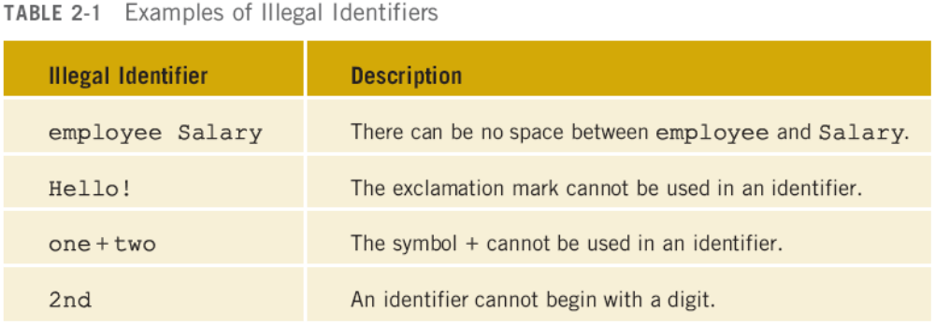
Identifiers (continued)
The following are legal identifiers in C++:
  first
  conversion
  payRate
C++ Programming: From Problem Analysis to Program Design, Fourth Edition

Slide 11
Whitespaces
Every C++ program contains whitespaces
  Include blanks, tabs, and newline characters
Used to separate special symbols, reserved words, and identifiers
Proper utilization of whitespaces is important
  Can be used to make the program readable
C++ Programming: From Problem Analysis to Program Design, Fourth Edition

Slide 12
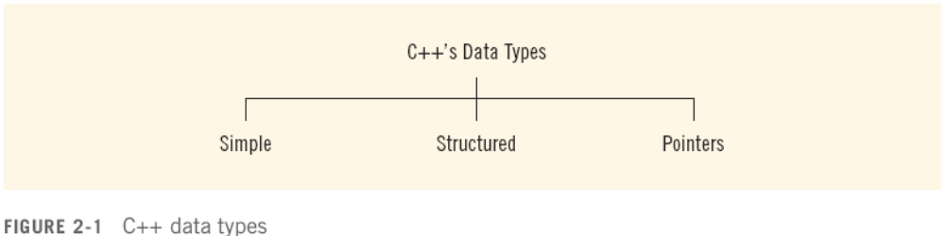
Data Types
Data type: set of values together with a set of operations
C++ data types fall into three categories:
C++ Programming: From Problem Analysis to Program Design, Fourth Edition

Slide 13
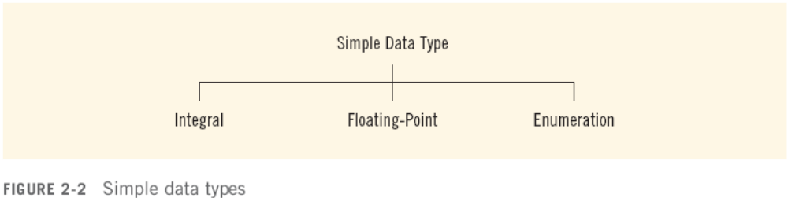
Simple Data Types
Three categories of simple data
  Integral: integers (numbers without a decimal)
  Floating-point: decimal numbers
  Enumeration type: user-defined data type
C++ Programming: From Problem Analysis to Program Design, Fourth Edition

Slide 14
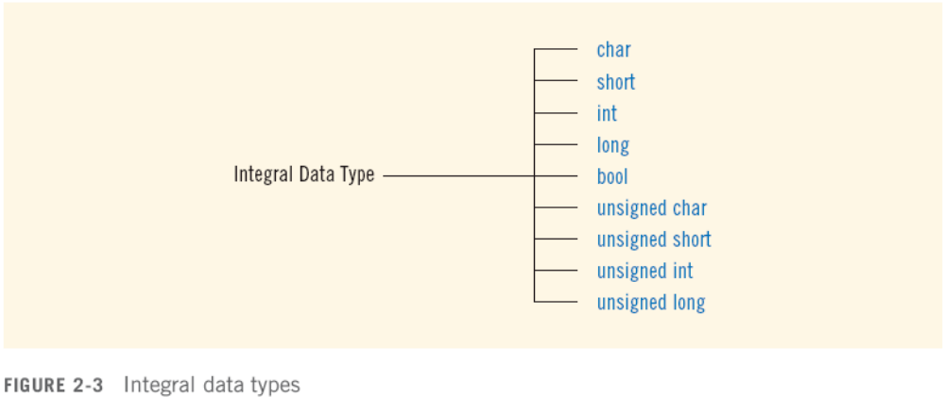
Simple Data Types (continued)
Integral data types are further classified into nine categories:
C++ Programming: From Problem Analysis to Program Design, Fourth Edition

Slide 15
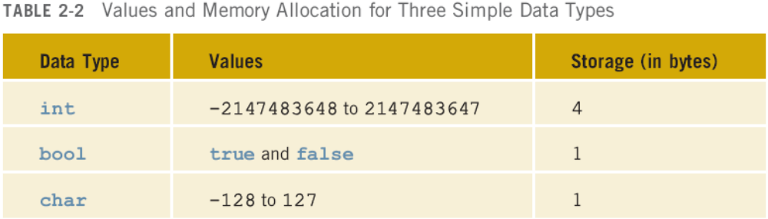
Simple Data Types (continued)
Different compilers may allow different ranges of values
C++ Programming: From Problem Analysis to Program Design, Fourth Edition

Slide 16
int Data Type
Examples:
  -6728
  0
  78
  +763
Positive integers do not need a + sign
No commas are used within an integer
  Commas are used for separating items in a list
C++ Programming: From Problem Analysis to Program Design, Fourth Edition

Slide 17
bool Data Type
bool type
  Two values: true and false
  Manipulate logical (Boolean) expressions
true and false are called logical values
bool, true, and false are reserved words
C++ Programming: From Problem Analysis to Program Design, Fourth Edition

Slide 18
char Data Type
The smallest integral data type
Used for characters: letters, digits, and special symbols
Each character is enclosed in single quotes
  'A', 'a', '0', '*', '+', '$', '&'
A blank space is a character and is written ' ', with a space left between the single quotes
C++ Programming: From Problem Analysis to Program Design, Fourth Edition

Slide 19
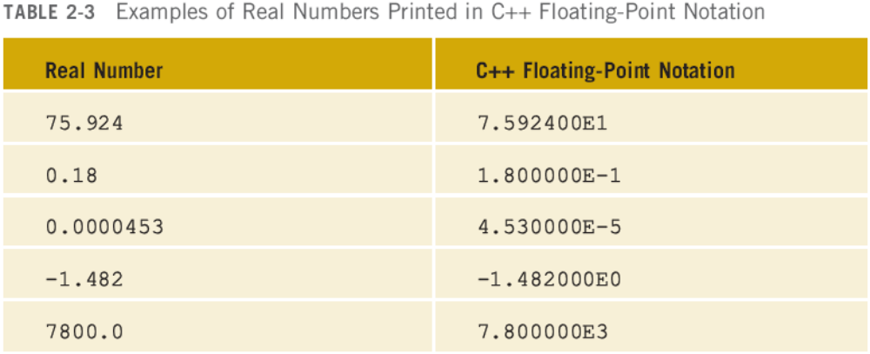
Floating-Point Data Types
C++ uses scientific notation to represent real numbers (floating-point notation)
C++ Programming: From Problem Analysis to Program Design, Fourth Edition

Slide 20
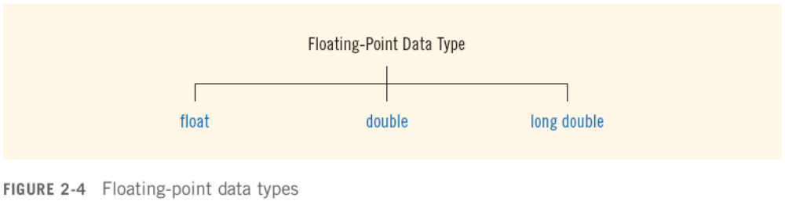
Floating-Point Data Types (continued)
  float: represents any real number
    Range: -3.4E+38 to 3.4E+38 (four bytes)
  double: represents any real number
    Range: -1.7E+308 to 1.7E+308 (eight bytes)
  On most newer compilers, data types double and long double are same
C++ Programming: From Problem Analysis to Program Design, Fourth Edition

Slide 21
Floating-Point Data Types (continued)
Maximum number of significant digits (decimal places) for float values is 6 or 7
Maximum number of significant digits for double is 15
Precision: maximum number of significant digits
  Float values are called single precision
  Double values are called double precision
C++ Programming: From Problem Analysis to Program Design, Fourth Edition

Slide 22
Arithmetic Operators and Operator Precedence
C++ arithmetic operators:
  + addition
  - subtraction
  * multiplication
  / division
  % modulus operator
+, -, *, and / can be used with integral and floating-point data types
Operators can be unary or binary
C++ Programming: From Problem Analysis to Program Design, Fourth Edition

Slide 23
Order of Precedence
All operations inside of () are evaluated first
*, /, and % are at the same level of precedence and are evaluated next
+ and – have the same level of precedence and are evaluated last
When operators are on the same level
  Performed from left to right (associativity)
3 * 7 - 6 + 2 * 5 / 4 + 6 means
  (((3 * 7) – 6) + ((2 * 5) / 4 )) + 6
C++ Programming: From Problem Analysis to Program Design, Fourth Edition

Slide 24
Expressions
If all operands are integers
  Expression is called an integral expression
    Yields an integral result
    Example: 2 + 3 * 5
If all operands are floating-point
  Expression is called a floating-point expression
    Yields a floating-point result
    Example: 12.8 * 17.5 - 34.50
C++ Programming: From Problem Analysis to Program Design, Fourth Edition

Slide 25
Mixed Expressions
Mixed expression:
  Has operands of different data types
  Contains integers and floating-point
Examples of mixed expressions:
  2 + 3.5
  6 / 4 + 3.9
  5.4 * 2 – 13.6 + 18 / 2
C++ Programming: From Problem Analysis to Program Design, Fourth Edition

Slide 26
Mixed Expressions (continued)
Evaluation rules:
  If operator has same types of operands
    Evaluated according to the type of the operands
  If operator has both types of operands
    Integer is changed to floating-point
    Operator is evaluated
    Result is floating-point
  Entire expression is evaluated according to precedence rules
C++ Programming: From Problem Analysis to Program Design, Fourth Edition

Slide 27
Type Conversion (Casting)
Implicit type coercion: when value of one type is automatically changed to another type
Cast operator: provides explicit type conversion
  static_cast<dataTypeName>(expression)
C++ Programming: From Problem Analysis to Program Design, Fourth Edition

Slide 28
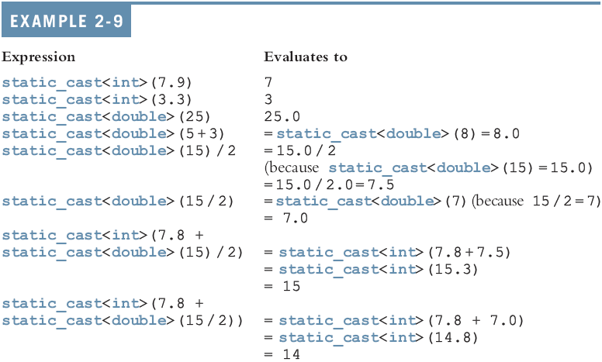
Type Conversion (continued)
C++ Programming: From Problem Analysis to Program Design, Fourth Edition

Slide 29
string Type
Programmer-defined type supplied in ANSI/ISO Standard C++ library
Sequence of zero or more characters
Enclosed in double quotation marks
Null: a string with no characters
Each character has relative position in string
  Position of first character is 0
Length of a string is number of characters in it
  Example: length of "William Jacob" is 13
C++ Programming: From Problem Analysis to Program Design, Fourth Edition

Slide 30
Input
Data must be loaded into main memory before it can be manipulated
Storing data in memory is a two-step process:
  Instruct computer to allocate memory
  Include statements to put data into memory
C++ Programming: From Problem Analysis to Program Design, Fourth Edition

Slide 31

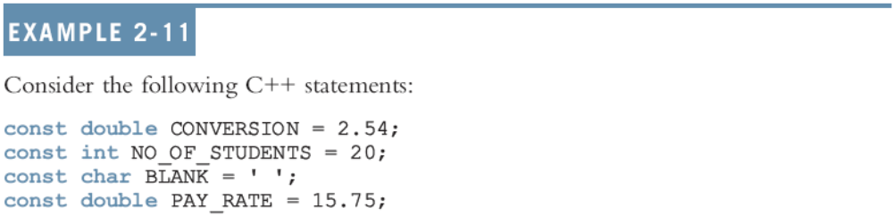
Allocating Memory with Constants and Variables
Named constant: memory location whose content can’t change during execution
The syntax to declare a named constant is:
In C++, const is a reserved word
C++ Programming: From Problem Analysis to Program Design, Fourth Edition

Slide 32
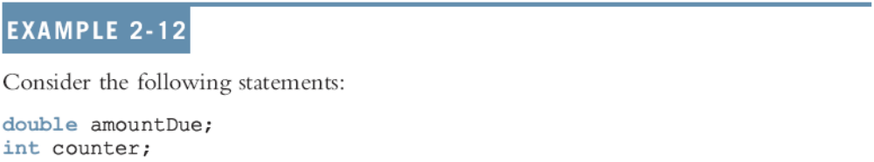
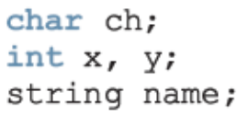
Allocating Memory with Constants and Variables (continued)
Variable: memory location whose content may change during execution
The syntax to declare a named constant is:
C++ Programming: From Problem Analysis to Program Design, Fourth Edition

Slide 33
Putting Data into Variables
Ways to place data into a variable:
  Use C++’s assignment statement
  Use input (read) statements
C++ Programming: From Problem Analysis to Program Design, Fourth Edition

Slide 34
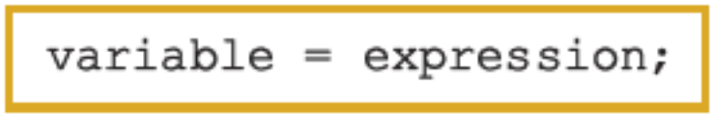
Assignment Statement
The assignment statement takes the form:
Expression is evaluated and its value is assigned to the variable on the left side
In C++, = is called the assignment operator
C++ Programming: From Problem Analysis to Program Design, Fourth Edition

Slide 35
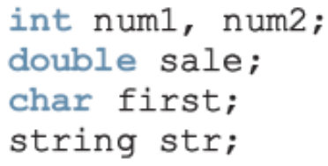
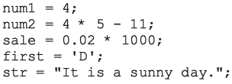
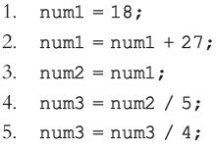
Assignment Statement (continued)
C++ Programming: From Problem Analysis to Program Design, Fourth Edition

Slide 36
Saving and Using the Value of an Expression
To save the value of an expression:
  Declare a variable of the appropriate data type
  Assign the value of the expression to the variable that was declared
    Use the assignment statement
Wherever the value of the expression is needed, use the variable holding the value
C++ Programming: From Problem Analysis to Program Design, Fourth Edition

Slide 37
Declaring & Initializing Variables
Variables can be initialized when declared:
  int first=13, second=10;
  char ch=' ';
  double x=12.6;
All variables must be initialized before they are used
  But not necessarily during declaration
C++ Programming: From Problem Analysis to Program Design, Fourth Edition

Slide 38

Input (Read) Statement
cin is used with >> to gather input
The stream extraction operator is >>
For example, if miles is a double variable
cin >> miles;
  Causes computer to get a value of type double
  Places it in the variable miles
C++ Programming: From Problem Analysis to Program Design, Fourth Edition

Slide 39
Input (Read) Statement (continued)
Using more than one variable in cin allows more than one value to be read at a time
For example, if feet and inches are variables of type int, a statement such as:
cin >> feet >> inches;
  Inputs two integers from the keyboard
  Places them in variables feet and inches respectively
C++ Programming: From Problem Analysis to Program Design, Fourth Edition

Slide 40
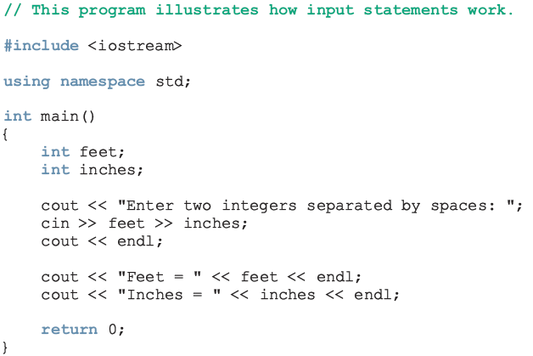
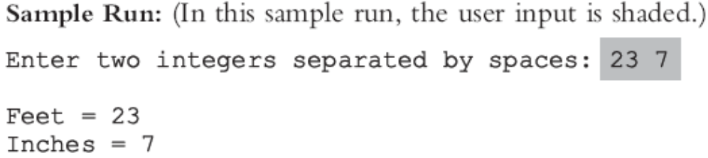
Input (Read) Statement (continued)
C++ Programming: From Problem Analysis to Program Design, Fourth Edition

Slide 41
Variable Initialization
There are two ways to initialize a variable:
  int feet;
  By using the assignment statement
    feet = 35;
  By using a read statement
    cin >> feet;
C++ Programming: From Problem Analysis to Program Design, Fourth Edition

Slide 42
Increment & Decrement Operators
Increment operator: increment variable by 1
  Pre-increment: ++variable
  Post-increment: variable++
Decrement operator: decrement variable by 1
  Pre-decrement: --variable
  Post-decrement: variable—
What is the difference between the following?
x = 5;
y = ++x;
x = 5;
y = x++;
C++ Programming: From Problem Analysis to Program Design, Fourth Edition

Slide 43
Output
The syntax of cout and << is:
  Called an output statement
The stream insertion operator is <<
Expression evaluated and its value is printed at the current cursor position on the screen
C++ Programming: From Problem Analysis to Program Design, Fourth Edition

Slide 44
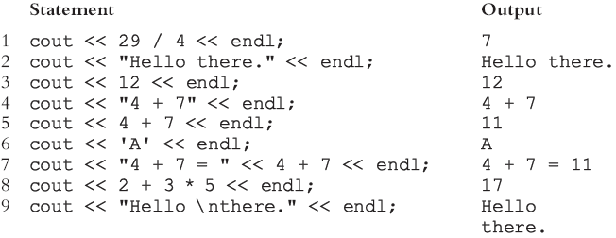
Output (continued)
A manipulator is used to format the output
  Example: endl causes insertion point to move to beginning of next line
C++ Programming: From Problem Analysis to Program Design, Fourth Edition

Slide 45
Output (continued)
The new line character is '\n'
  May appear anywhere in the string
    cout << "Hello there.";
    cout << "My name is James.";
    Output:
    Hello there.My name is James.
    cout << "Hello there.\n";
    cout << "My name is James.";
    Output :
    Hello there.
    My name is James.
C++ Programming: From Problem Analysis to Program Design, Fourth Edition

Slide 46
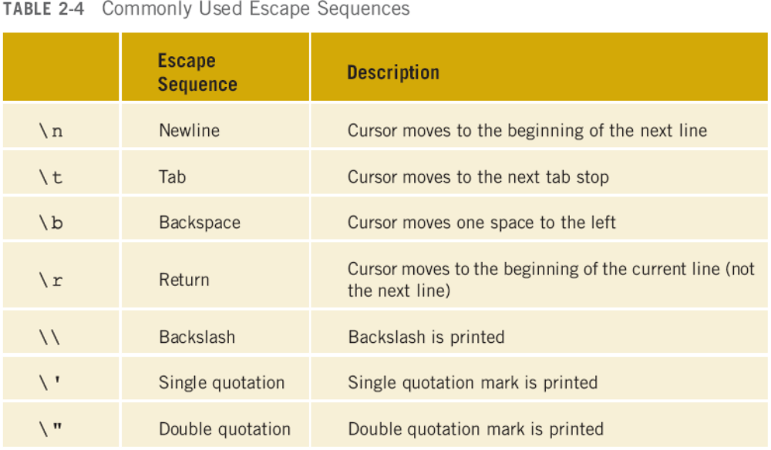
Output (continued)
C++ Programming: From Problem Analysis to Program Design, Fourth Edition

Slide 47
Preprocessor Directives
C++ has a small number of operations
Many functions and symbols needed to run a C++ program are provided as collection of libraries
Every library has a name and is referred to by a header file
Preprocessor directives are commands supplied to the preprocessor
All preprocessor commands begin with #
No semicolon at the end of these commands
C++ Programming: From Problem Analysis to Program Design, Fourth Edition

Slide 48

Preprocessor Directives (continued)
Syntax to include a header file:
For example:
#include <iostream>
  Causes the preprocessor to include the header file iostream in the program
C++ Programming: From Problem Analysis to Program Design, Fourth Edition

Slide 49
namespace and Using cin and cout in a Program
cin and cout are declared in the header file iostream, but within std namespace
To use cin and cout in a program, use the following two statements:
#include <iostream>
using namespace std;
C++ Programming: From Problem Analysis to Program Design, Fourth Edition

Slide 50
Using the string Data Type in a Program
To use the string type, you need to access its definition from the header file string
Include the following preprocessor directive:
#include <string>
C++ Programming: From Problem Analysis to Program Design, Fourth Edition

Slide 51
Creating a C++ Program
C++ program has two parts:
  Preprocessor directives
  The program
Preprocessor directives and program statements constitute C++ source code (.cpp)
Compiler generates object code (.obj)
Executable code is produced and saved in a file with the file extension .exe
C++ Programming: From Problem Analysis to Program Design, Fourth Edition

Slide 52
Creating a C++ Program (continued)
A C++ program is a collection of functions, one of which is the function main
The first line of the function main is called the heading of the function:
  int main()
The statements enclosed between the curly braces ({ and }) form the body of the function
  Contains two types of statements:
    Declaration statements
    Executable statements
C++ Programming: From Problem Analysis to Program Design, Fourth Edition

Slide 53
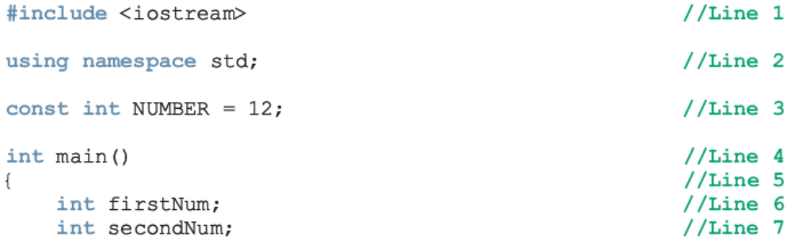
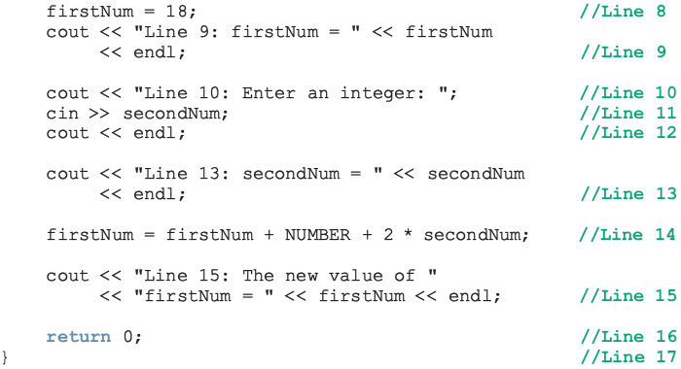
C++ Programming: From Problem Analysis to Program Design, Fourth Edition

Slide 54
Creating a C++ Program (continued)
Sample Run:
Line 9: firstNum = 18
Line 10: Enter an integer: 15
Line 13: secondNum = 15
Line 15: The new value of firstNum = 60
C++ Programming: From Problem Analysis to Program Design, Fourth Edition

Slide 55
Program Style and Form
Every C++ program has a function main
It must also follow the syntax rules
Other rules serve the purpose of giving precise meaning to the language
C++ Programming: From Problem Analysis to Program Design, Fourth Edition

Slide 56
Syntax
Errors in syntax are found in compilation
  int x; //Line 1
  int y //Line 2: error
  double z; //Line 3
  y = w + x; //Line 4: error
C++ Programming: From Problem Analysis to Program Design, Fourth Edition

Slide 57
Use of Blanks
In C++, you use one or more blanks to separate numbers when data is input
Used to separate reserved words and identifiers from each other and from other symbols
Must never appear within a reserved word or identifier
C++ Programming: From Problem Analysis to Program Design, Fourth Edition

Slide 58
Use of Semicolons, Brackets, and Commas
All C++ statements end with a semicolon
  Also called a statement terminator
{ and } are not C++ statements
Commas separate items in a list
C++ Programming: From Problem Analysis to Program Design, Fourth Edition

Slide 59
Semantics
Possible to remove all syntax errors in a program and still not have it run
Even if it runs, it may still not do what you meant it to do
For example,
  2 + 3 * 5 and (2 + 3) * 5
are both syntactically correct expressions, but have different meanings
C++ Programming: From Problem Analysis to Program Design, Fourth Edition

Slide 60
Naming Identifiers
Identifiers can be self-documenting:
  CENTIMETERS_PER_INCH
Avoid run-together words :
  annualsale
  Solution:
    Capitalize the beginning of each new word
      annualSale
    Inserting an underscore just before a new word
      annual_sale
C++ Programming: From Problem Analysis to Program Design, Fourth Edition

Slide 61
Prompt Lines
Prompt lines: executable statements that inform the user what to do
  cout << "Please enter a number between 1 and 10 and "
  << "press the return key" << endl;
  cin >> num;
C++ Programming: From Problem Analysis to Program Design, Fourth Edition

Slide 62
Documentation
A well-documented program is easier to understand and modify
You use comments to document programs
Comments should appear in a program to:
  Explain the purpose of the program
  Identify who wrote it
  Explain the purpose of particular statements
C++ Programming: From Problem Analysis to Program Design, Fourth Edition

Slide 63
Form and Style
Consider two ways of declaring variables:
  Method 1
int feet, inch;
double x, y;
  Method 2
  int a,b;double x,y;
Both are correct; however, the second is hard to read
C++ Programming: From Problem Analysis to Program Design, Fourth Edition

Slide 64
More on Assignment Statements
C++ has special assignment statements called compound assignments
  +=, -=, *=, /=, and %=
Example:
x *= y;
C++ Programming: From Problem Analysis to Program Design, Fourth Edition

Slide 65
Programming Example: Convert Length
Write a program that takes as input a given length expressed in feet and inches
  Convert and output the length in centimeters
Input: length in feet and inches
Output: equivalent length in centimeters
Lengths are given in feet and inches
Program computes the equivalent length in centimeters
One inch is equal to 2.54 centimeters
C++ Programming: From Problem Analysis to Program Design, Fourth Edition

Slide 66
Programming Example: Convert Length (continued)
Convert the length in feet and inches to all inches:
  Multiply the number of feet by 12
  Add given inches
Use the conversion formula (1 inch = 2.54 centimeters) to find the equivalent length in centimeters
C++ Programming: From Problem Analysis to Program Design, Fourth Edition

Slide 67
Programming Example: Convert Length (continued)
The algorithm is as follows:
  Get the length in feet and inches
  Convert the length into total inches
  Convert total inches into centimeters
  Output centimeters
C++ Programming: From Problem Analysis to Program Design, Fourth Edition

Slide 68
Programming Example: Variables and Constants
Variables
  int feet; //variable to hold given feet
  int inches; //variable to hold given inches
  int totalInches; //variable to hold total inches
  double centimeters; //variable to hold length in
  //centimeters
Named Constant
  const double CENTIMETERS_PER_INCH = 2.54;
  const int INCHES_PER_FOOT = 12;
C++ Programming: From Problem Analysis to Program Design, Fourth Edition

Slide 69
Programming Example: Main Algorithm
Prompt user for input
Get data
Echo the input (output the input)
Find length in inches
Output length in inches
Convert length to centimeters
Output length in centimeters
C++ Programming: From Problem Analysis to Program Design, Fourth Edition

Slide 70
Programming Example: Putting It Together
Program begins with comments
System resources will be used for I/O
Use input statements to get data and output statements to print results
Data comes from keyboard and the output will display on the screen
The first statement of the program, after comments, is preprocessor directive to include header file iostream
C++ Programming: From Problem Analysis to Program Design, Fourth Edition

Slide 71
Programming Example: Putting It Together (continued)
Two types of memory locations for data manipulation:
  Named constants
    Usually put before main
  Variables
This program has only one function (main), which will contain all the code
The program needs variables to manipulate data, which are declared in main
C++ Programming: From Problem Analysis to Program Design, Fourth Edition

Slide 72
Programming Example: Body of the Function
The body of the function main has the following form:
int main ()
{
declare variables
statements
return 0;
}
C++ Programming: From Problem Analysis to Program Design, Fourth Edition

Slide 73
Programming Example: Writing a Complete Program
Begin the program with comments for documentation
Include header files
Declare named constants, if any
Write the definition of the function main
C++ Programming: From Problem Analysis to Program Design, Fourth Edition

Slide 74
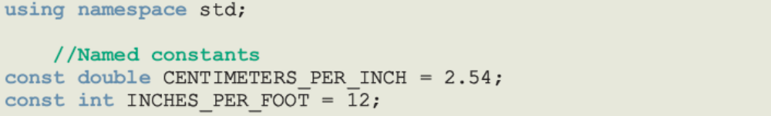
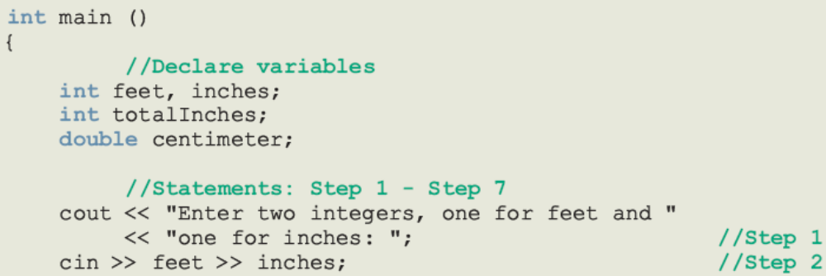
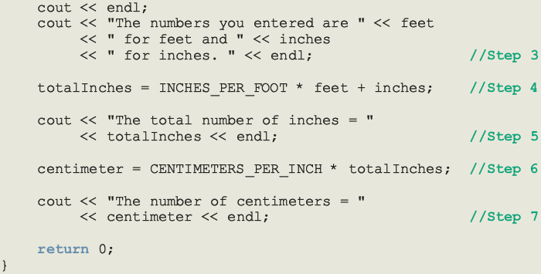
C++ Programming: From Problem Analysis to Program Design, Fourth Edition

Slide 75
Programming Example: Sample Run
Enter two integers, one for feet, one for inches: 15 7
The numbers you entered are 15 for feet and 7 for inches.
The total number of inches = 187
The number of centimeters = 474.98
C++ Programming: From Problem Analysis to Program Design, Fourth Edition

Slide 76
Summary
C++ program: collection of functions where each program has a function called main
Identifier consists of letters, digits, and underscores, and begins with letter or underscore
The arithmetic operators in C++ are addition (+), subtraction (-),multiplication (*), division (/), and modulus (%)
Arithmetic expressions are evaluated using the precedence associativity rules
C++ Programming: From Problem Analysis to Program Design, Fourth Edition

Slide 77
Summary (continued)
All operands in an integral expression are integers and all operands in a floating-point expression are decimal numbers
Mixed expression: contains both integers and decimal numbers
Use the cast operator to explicitly convert values from one data type to another
A named constant is initialized when declared
All variables must be declared before used
C++ Programming: From Problem Analysis to Program Design, Fourth Edition

Slide 78
Summary (continued)
Use cin and stream extraction operator >> to input from the standard input device
Use cout and stream insertion operator << to output to the standard output device
Preprocessor commands are processed before the program goes through the compiler
A file containing a C++ program usually ends with the extension .cpp
C++ Programming: From Problem Analysis to Program Design, Fourth Edition

