Slide 1
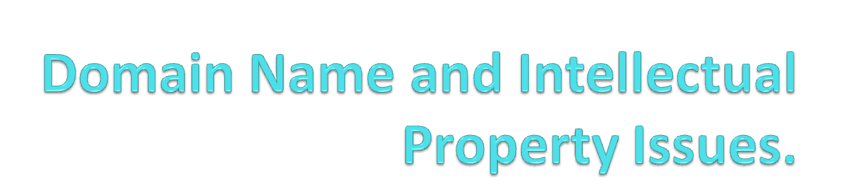
By Hardik H. Parikh, Advocate.

Slide 2
Introduction to Domain Names
Business Worldwide have started to realize the significance of web sites as a primary source of E – Commerce.
Domain names are the backbones of internet revolution.
By Hardik H. Parikh, Advocate.

Slide 3
Potential of internet in creating an information super highway has acquired a distinct commercial viability because of the advent of domain names.
By Hardik H. Parikh, Advocate.

Slide 4
Domain name system also poses certain challenges to Intellectual Property System.
By Hardik H. Parikh, Advocate.

Slide 5
In Traditional Commerce, trademarks are used to identify goods and services of particular person.
While, on the Internet, domain names are used as business identifiers.
By Hardik H. Parikh, Advocate.

Slide 6
Fundamental Questions to be answered..
What do we mean by domain name?
Can the domain names be misused?
Does the Law of Trademark apply with equal force to the internet domain names?
By Hardik H. Parikh, Advocate.

Slide 7
Meaning of Domain Name
Very basis of Internet is IP (Internet Protocol) which is used for computers.
The fact is this IP is not catchy and is difficult to remember.
Hence Domain Name System is in existance.
By Hardik H. Parikh, Advocate.

Slide 8
Domain name is a popular substitute of all numeric IP addresses.
To make the Internet more user friendly, a unique numeric address is matched with a unique domain name. (Ex. Yahoo.com)
By Hardik H. Parikh, Advocate.

Slide 9
Domain names are simply addresses of the Internet.
E-Mails can be sent and web pages can be found by using domain names.
By Hardik H. Parikh, Advocate.

Slide 10
For Example
Web address of microsoft web site is www. microsoft. Com
Bill Gates might have an e-mail id as bill@microsoft.com.
By Hardik H. Parikh, Advocate.

Slide 11
Without domain name, a computer would have no idea where to look for a web page and e-mail routers would not be able to send e-mails.
By Hardik H. Parikh, Advocate.

Slide 12
Domain names are divided in to two hierarchies.
  Top Level
  Second Level.
By Hardik H. Parikh, Advocate.

Slide 13
Top Level Domain Name
Top level domain name appears after the last dot .
In above domain name microsoft.com, the top level domain name is .com
By Hardik H. Parikh, Advocate.

Slide 14
.com is most commonly top level domain name that indicates that the website is owned by a commercial enterprise.
By Hardik H. Parikh, Advocate.

Slide 15
.org for non profit oganisation
.net for network ad internet related organisations.
.edu for educational colleges and universities
.gov for government entities.
By Hardik H. Parikh, Advocate.

Slide 16
Moreover, each companies are also given a specific top level domain names
By Hardik H. Parikh, Advocate.

Slide 17
Second Level Domain Names
Domain names to the left to the top level domain names.
Most of the disputes arises for this second level domain names.
By Hardik H. Parikh, Advocate.

Slide 18
Two identical second level domain names cannot coexist under the same top level domain.
They sometimes conflicts with the trademarks and other traditional business identifiers.
By Hardik H. Parikh, Advocate.

Slide 19
Domain name and Trademark
Domain names sometimes comes in conflict with Trademarks.
Domain names are global and unique and particular letters must be used for only one website.
By Hardik H. Parikh, Advocate.

Slide 20
Trademark may overlap in different industries of different geographical locations.
Domain names and Trademarks are differently registered.
By Hardik H. Parikh, Advocate.

Slide 21
One must file domain name application with a registrar with ICANN – Internet Corporation for Assign Names and Numbers.
By Hardik H. Parikh, Advocate.

Slide 22
Number of companies register a domain name for every trademark they own.
By Hardik H. Parikh, Advocate.

Slide 23
Some Domain Name Disputes
Microsoft.com
A company Zero Microsoft Softwares obtained Registration for micros0ft.com.
Registration was suspended after application from microsoft company.
By Hardik H. Parikh, Advocate.

Slide 24
Wired v. Wire
Yahoo! Inc. v. Yahooindia.com
Satyam Info way ltd. v. Sifynet Solutions P. Ltd.
By Hardik H. Parikh, Advocate.

Slide 25
Wired was a cyberspace magazine claimed domain name violation against WIRE.
WIRE – A computer network devoted to women’s issue.
Wired were using wired.com.
WIRE used wire.net.
Settlement done and WIRE changed website to wwire.net.
By Hardik H. Parikh, Advocate.

Slide 26
Yahoo! Inc. filed case against yahooindia.com who started business of internet related services.
Court held that it is violative and granted injunction against them.
By Hardik H. Parikh, Advocate.

Slide 27
Satyam Info Way Ltd invented word Sify.
It was used by other company and company started using various services..
Ex. Sifynet, sifymall.com, sifyrealestate.com..
Court granted injunction against such user.
By Hardik H. Parikh, Advocate.

Slide 28

By Hardik H. Parikh, Advocate.

