Slide 1
Chapter 11:
Payment Systems For Electronic Commerce

Slide 2
Online Payment Basics
Cash, cheques, credit cards, and debit cards
  Account for more than 90 percent of all consumer payments in the United States
Most popular consumer electronic transfers are automated payments of
  Auto loans
  Insurance payments
  Mortgage payments made from consumers’ checking accounts

Slide 3
Scrip
  Digital cash minted by a company instead of by a government
  Cannot be exchanged for cash
  Like a gift certificate that is good at more than one store

Slide 4
Payment Cards
Describe all types of plastic cards used to make purchases
Categories of payment cards:
Credit card
  Has spending limit based on user’s credit history
  User can pay off the entire credit card balance or pay a minimum amount each billing period.
  Card issuers charge interest on any unpaid balance.

Slide 5
Credit cards are widely accepted by merchants around the world and provide assurances for both the consumer and the merchant.
Consumer is protected by 30-day period in which he/she can dispute an online credit card purchase.
Merchants that already accept credit cards in an offline store can accept them immediately for online payment because the already have established a mechanism for accepting credit card payments.
Eg. Visa , Master card

Slide 6
Debit card
  Removes amount from cardholder’s bank account
  Transfers it to seller’s bank account
  Issued by card holder’s bank and usually carry the name of a major credit card issuer, such as visa or master card, by agreement between the issuing bank and the credit card issuer.
  By branding their debit cards with visa or mastercard, banks ensure that their debit cards will be accepted by merchants who recognize the credit card brand names.

Slide 7
Charge card (American express)
  Carries no spending limit
  Amount charged is due at end of billing period
  Do not involve lines of credit and do not accumulate interest charges.
  Companies issue their own charge cards.
  Consumers have issue providing their payment card numbers to vendors online, when the vendor is unknown to them. For this issue, several payment card companies offer cards with disposable numbers. These cards are sometimes called as Single-use cards.

Slide 8
Advantages and Disadvantages of Payment Cards
Advantages
  For merchants, they provide fraud protection.
    When merchant accepts payment cards for online payment or for orders placed over telephone, the merchant can authenticate and authorize purchases using a payment card processing network.
    Consumer Credit Protection Act limits the cardholder’s liability if the card is used fraudently. Once the cardholder notifies the card’s issuer of the card theft, the cardholder’s liability ends.

Slide 9
World wide acceptance
Payment cards can be used anywhere in the world and the currency conversion is handled by the card issuer.
The consumer does not need any special hardware or software to complete the transaction.
Disadvantage
  Payment card service companies charge merchants per-transaction fees and monthly processing fees. These fees add to the cost of doing business for merchants.

Slide 10
Merchants that does not accept payment cards for purchases risks losing a significant portion of sales to other merchants that do accept payment cards.
The consumers pay no direct transaction fees but the prices of goods and services are slightly higher than they would be in an environment free of payments cards.
Consumers pay an annual fee for credit cards and charge cards.
To process payment card transactions, a merchant must first set up a merchant account. The series of steps is transparent to the consumer. Several groups and individuals are involved: merchant, merchant’s bank, customer, customer’s bank and company that issued customer’s payment card.

Slide 11
Payment Acceptance and Processing
Steps followed once merchant receives consumer’s payment card information
  Merchant authenticates payment card to ensure it is valid and not stolen
  Merchant checks with payment card issuer
    To ensure that credit or funds are available
    Puts a hold on credit line or the funds needed to cover the charge
  Settlement occurs, means that funds travel between banks and are placed into the merchant’s account.

Slide 12
Open and Closed Loop System
Closed loop systems
  Card issuer pays merchants that accept the card directly and does not use an intermediary
  American express and Discover card
Open loop systems
  Involve three or more parties
  SBI-Master-Purchases-amazon-account in ICICI
  Systems using Visa or MasterCard are examples, are called as credit card associations that are operated by the banks who are members in the associations.

Slide 13
These member banks, which are also called customer issuing banks, issue credit cards to individual consumers and are responsible for establishing customer credit limits.

Slide 14
Merchant Accounts
A merchant bank or acquiring bank is a bank that does business with sellers that want to accept payment cards.
To process payment cards for Internet transactions, an online merchant must set up merchant account. When the merchant’s bank collects credit card receipts on behalf of the merchant from the payment card issuer, it credits their value to the merchant’s account.
New merchant must supply
  Business plan
  Details about existing bank accounts
  Business and personal credit history

Slide 15
Type of business also influences the bank’s likelihood of granting the account.
In some business banks will be reluctant to offer a merchant account because of the type of business, some business will have a higher likelihood of customers repudiating payment card charges than others. E.g. business that sells guaranteed weight loss scheme.
The bank assesses the level of risk in the business based on the type of business and the credit information that is provided. Merchant banks estimate what percentage of sales are likely to be contested by cardholders. Merchant bank must retrieve the money it placed in the merchant account in a process called chargeback. Companies must maintain sufficient funds to cover chargebacks.

Slide 16
Processing Payments Online
Software packaged with e-commerce software can handle payment card processing automatically or merchants can contract with a third party to handle payment card processing. Payment processing service providers:
Internet Secure- Provides secure payment card services
First Data- Provides merchant payment card processing services with the following programs
    ICVERIFY, PCAuthorize, and WebAuthorize
Banks connect to an Automated Clearing House (ACH) through highly secure, private leased telephone lines

Slide 17
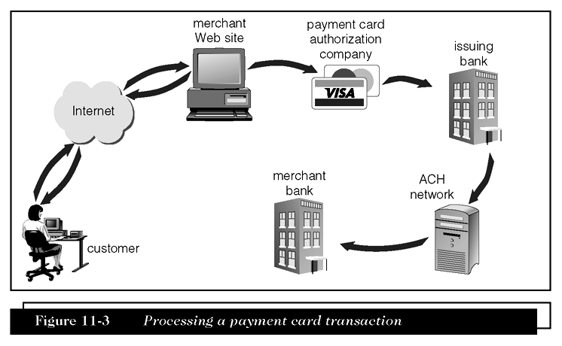
Processing a Payment Card Transaction

Slide 18
Electronic Cash
E-cash is a term that describes any value storage and exchange system created by a private entity that does not use paper documents or coins and that can serve as a substitute for government-issued physical currency.
Difference between e-cash and scrip is that e-cash can be exchanged for physical cash on demand.
E-cash is issued by private entities, there is a need for common standards among all e-cash issuers so that one issuer’s e-cash can be accepted by another issuer. This need has not yet been met. Each issuer has its own standards and e-cash is not universally accepted like government issued physical currency.

Slide 19
As credit card purchase require a minimum purchase amount since bank fees for small purchase amounts would be greater than the profits on those transactions. E-cash helps for small purchases like newspapers etc.
Many people do not have credit cards. Some adults do not have credit card due to minimum income requirements, children or teen agers are not eligible because of their age, infrastructure issues etc.

Slide 20
Micropayments and Small Payments
Micropayments
  Internet payments for items costing from a few cents to approximately a dollar
Small payments
  Payments of less than $10

Slide 21
Privacy and Security of Electronic Cash
Concerns about electronic payment methods include
  Privacy and security
  Independence
  Portability
  Convenience
  Privacy and security are the most important issues that have to be addressed with any payment system to be used by consumers. They want to know whether transactions are vulnerable and whether the electronic currency can be copied, reused or forged.

Slide 22
It has unique security problems. E-cash should have two important characteristics in common with physical currently.
First, it must be possible to spend e-cash only once, just as with traditional currency.
Second, e-cash ought to be anonymous, just as hard currency.
These procedures guarantee that the entire e-cash transactions occurs only between two parties and that the recipient knows that the e-currency being received is not counterfeit or being used in two different transactions.

Slide 23
E-cash has advantage i.e. it is independent and portable.
Independent means it is unrelated to any network or storage device. I should ideally be able to pass transparently across international borders and be converted automatically to the recipient country’s currency.
E-cash portability means that it must be freely transferable between any two parties. Credit and debit card do not possess this property of portability or transferability between every combination of two parties. In credit card transaction, payment recipient must already have a merchant account established with a bank. Merchant account is not required for a business to receive e-cash.

Slide 24
Most important characteristics of cash is convenience. If e-cash requires special hardware or software, it is not convenient for people to use.

Slide 25
Holding Electronic Cash: Online and Offline Cash
Online cash storage
  Trusted third party is involved in all transfers of electronic cash
  Holds consumers’ cash accounts
Offline cash storage
  Virtual equivalent of money kept in a wallet
  No third party is involved in the transaction
Double-spending is spending electronic cash twice by submitting the same e-currency to two different vendors. By the time the same electronic currency clears the bank for a second time, it is too late to prevent the fraudulent act.

Slide 26
Advantages and Disadvantages of Electronic Cash
Advantages of electronic cash
  Transactions are more efficient and less costly which eventually means lower prices for consumers.
  Transfer on the Internet costs less than processing credit card transactions
  Conventional money exchange system require banks, clerks, ATMs and e-transaction system to manage, transfer and dispense cash. So it isexpensive

Slide 27
E-cash transfers occurs on an existing infrastructure– Internet and through existing computer systems. Additional costs are nearly zero.
E-cash does not require that one party obtain an authorization as is required with credit card transactions.

Slide 28
Disadvantages of electronic cash
  Use provides no audit trail
  Like real cash it cannot be easily traced, so problem of money laundering arises.
  Money laundering is a technique used by criminals to convert money that they have obtained illegally into cash that they spend without having it identified as the proceeds of an illegal activity. It can be accomplished by purchasing goods or services with ill-gotten e-cash, then goods are sold for physical cash on the open market.
  Susceptible to forgery(fake)

Slide 29
How e-cash works:
Consumer opens an account with an e-cash issuer like bank or private vendor like PayPal and presents proof of identity.
He can then withdraw e-cash by accessing the issuer’s web sit and presenting proof of identity such as digital certificate issued by CA. After verification, the issuer gives the consumer a specific amount of e-cash and deducts the same amount from the consumer’s account. Issuer might charge a small processing fee. Consumer can store the e-cash in an e-wallet.

Slide 30
Providing Security for Electronic Cash
Cryptographic algorithms
  Keys to creating tamperproof electronic cash that can be traced back to its origins
Anonymous electronic cash
  Electronic cash that cannot be traced back to the person who spent it
Creating truly anonymous electronic cash
  Requires bank to issue electronic cash with embedded serial numbers . This way cash can be positively associated with a particular consumer.
  It does not solve the problem of double spending.

Slide 31
A single issuing bank could detect whether two deposits of the same e-cash are about to occur, it is impossible to ascertain who is at fault is such a situation- the consumer or the merchant.
E-cash having serial number is no longer anonymous.
Creating truly anonymous e-cash requires a bank to issue e-cash with embedded serial numbers such that the bank can digitally sign the e-cash while removing any association of the cash with a particular customer.
The process begins when a consumer creates a random serial number and sends to the bank issuing e-cash. The bank uses the consumer’s random serial

Slide 32
number along with the bank’s digital signature and sends the random number, e-cash and digital signature as one package back to the user.
When the user receives the e-cash bundle, user extracts the original random serial number and keeps the bank’s digital signature.
Consumer can now spend the e-cash which is digitally signed by the bank.
When consumer spends the e-cash and the merchant passes it along to the issuing bank, the bank validates the e-cash because it contains the bank’s digital signature.
However, the bank cannot determine the identity of the spender, it only knows that the e-cash is genuine.

Slide 33
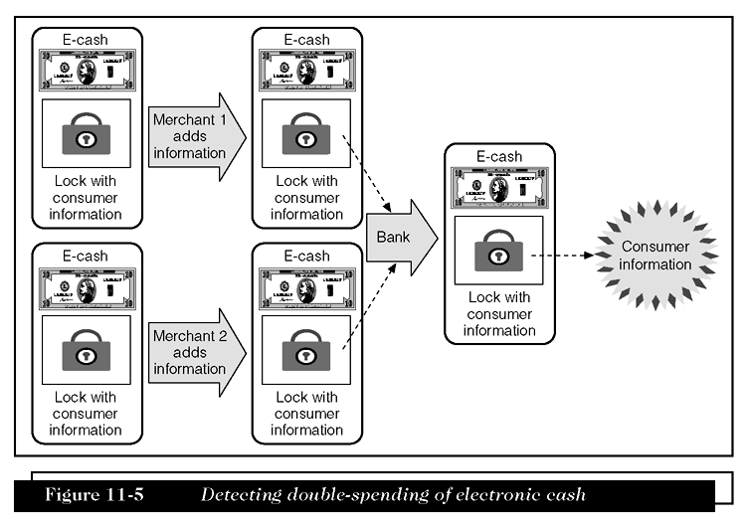
Detecting Double-Spending of Electronic Cash

Slide 34
Electronic Cash Systems
CheckFree
  Largest online bill processor in the world
  Provides online payment processing services
Clickshare
  An electronic cash system aimed at magazine and newspaper publishers

Slide 35
Electronic Cash Systems (Continued)
InternetCash
  Provides electronic currency that is very similar to traditional cash
  Customers must first purchase an InternetCash card from a store
PayPal
  Provides payment processing services to businesses and to individuals
  Peer-to-peer (P2P) payment system
    Free payment clearing service for individuals

Slide 36
Electronic Wallets
Consumers have to enter their information at each site with which they want to do business.
An electronic wallet, serving function similar to physical wallet holds credit card numbers, ecash, owner identification and contact information.
Makes shopping more efficient.

Slide 37
Server-side electronic wallet
  Stores customer’s information on a remote server belonging to a particular merchant or wallet publisher
  Security breach could reveal thousands of users’ personal information stored in e-wallets.
  Employ strong security measures that minimize the possibility of unauthorized disclosure.

Slide 38
Client-side electronic wallet
  Stores consumer’s information on his or her own computer
  Early e-wallets were client side wallets that requires users to download the wallet software.
  Need to download software onto every computer is a disadvantage.
  Not portable.
  Information is stored on user’s computer, no risk of revealing information.

Slide 39
Microsoft .NET Passport
An electronic wallet operated by Microsoft
Passport consists of four integrated services
  Passport single sign-in service (SSI)
  Passport Wallet service
  Kids Passport service
  Public profiles

Slide 40
Yahoo! Wallet
An electronic wallet offered by the Web portal site Yahoo!
Lets users store information about several major credit and charge cards.

Slide 41
Stored Value Cards
Instead of carrying many cards, it can be reduced to single plastic card called stored value card.
It can be an elaborate smart card with a microchip or a plastic card with a magnetic strip that records the currency balance.
Smart cards can store larger amounts of information and includes a processor chip on the card. Card readers needed for smart cards are different.

Slide 42
Magnetic Strip Cards: Hold value that can be recharged by inserting them into the appropriate machines, inserting currency into the machine and withdrawing the card, the card’s strip stores the increased cash value.
Magnetic strip cards are passive i.e. they cannot send or receive information nor can they increment or decrement the value of cash stored on the card.
Processing must be done on a device into which the card is inserted.

Slide 43
Smart Cards: Stored value card that is a plastic card with an embedded microchip that can store information. Credit, debit and charge cards currently store limited information on a magnetic strip.
A smart card can store about 100 times the amount of information that a magnetic strip plastic card can store.
A smart card can store private user data, such as financial facts, encryption keys, account information etc.
Safer than conventional credit cards because the information stored in smart cards are encrypted.
Phishing attacks

