Slide 1
Digital Portfolio
STUDENT NAME: Darshan R.M
REGISTER NO AND NMID:2426k0174and
DEPARTMENT: BSC Computer Technology
COLLEGE: KPR College of arts science and research/ Bharathiyar University

Slide 2
Weather app

Slide 3


AGENDA
Problem Statement
Project Overview
End Users
Tools and Technologies
Portfolio design and Layout
Features and Functionality
Results and Screenshots
Conclusion
Github Link
3/21/2024 Annual Review

Slide 4

PROBLEM STATEMENT
In today's fast-paced world, people need quick access to accurate weather data to plan their day, travel, or outdoor activities. Traditional weather websites can be cluttered or slow, and mobile apps may require installation and permissions. A lightweight, browser-based weather app offers a fast and accessible alternative.

Slide 5

PROJECT OVERVIEW
In an era where time and convenience are paramount, users need instant access to accurate weather data to make informed decisions about their daily activities. Traditional weather platforms often suffer from slow load times, excessive ads, or require app installations that consume device resources. This project aims to build a lightweight, browser-based weather application using HTML, CSS, and JavaScript that delivers real-time weather updates in a clean, responsive interface.

Slide 6

End User Profile: Weather App Everyday individuals who need quick access to weather updates. Travelers planning trips or commutes. Students and professionals checking weather before heading out. Outdoor enthusiasts (e.g., hikers, cyclists, runners). People without access to mobile apps or who prefer browser-based tools.

Slide 7

🛠️ Tools & Techniques (Quick View)
.
1.HTML – Builds the structure: input field, buttons, and display sections.
CSS – Styles the app with responsive design using Flexbox/Grid andmedia queries.
3.JavaScript – Fetches weather data from OpenWeatherMap API and updates the UI.

Slide 8
POTFOLIO DESIGN AND LAYOUT
🌦️ WeatherNow – Real-Time Weather App
Platform: Web App Focus: Live weather updates by city
Tools & APIs:
HTML, CSS, JavaScript
OpenWeatherMap API
Techniques:
Responsive layout (Flexbox, media queries)
Async data fetching
Dynamic DOM updates
Outcome: Built skills in API integration, UI responsiveness, and real-time data handling.
8

Slide 9
FEATURES AND FUNCTIONALITY
🌦️ Weather App – Features & Functionality
🔍 City-based weather search
🌡️ Live temperature, wind, and condition display
🖼️ Weather icons based on conditions
📱 Responsive design for all devices
⚙️ Real-time data with async JavaScript
🚫 Error handling for invalid input
Let me know if you want this styled for a résumé, portfolio site, or project card!

Slide 10
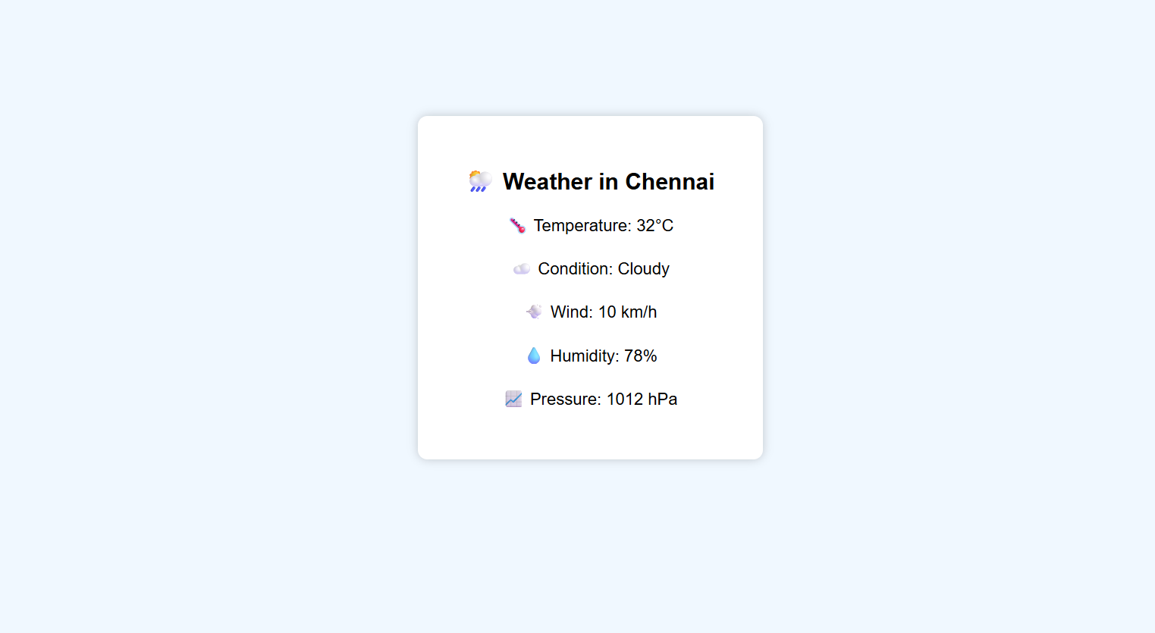

Result And Screenshot
A clean, centered weather card titled “Weather in Chennai” showing static details like temperature, condition, wind speed, humidity, and pressure — all hardcoded and instantly displayed without user input or internet.
.
3/21/2024 Annual Review
10

Slide 11
CONCLUSION
This static weather site offers a simple, fast-loading solution for showcasing weather data without relying on external APIs or user input. By hardcoding the weather details directly into the JavaScript, it ensures instant display and offline usability. The clean, centered card layout makes it ideal for UI demos, beginner projects, or portfolio mockups. Whether you're prototyping a weather dashboard or learning front-end basics, this approach keeps things lightweight, responsive, and easy to customize.
11

