Slide 1

Department of Computer Engineering
Presentation for TY Major Project , 2025-26
HAWK SIGHT AI: Ai Stock Market Prediction Model
Students Name:
Mandar Ghadge (202301100024)
Darshan Bhabad (202301040169)
Nikhil Bodre (202301100008)
Atharav Barapatre (202301040077)
Guide:
Mr. Chaitanya Patil

Slide 2
Index
Introduction
Objectives
Literature Survey
Project Design & Diagrams
System Architecture
Methodology & Algorithm
Conclusion & Future Scope

Slide 3
Introduction
The Problem:
Most student stock predictors over-claim accuracy by predicting next-day prices, which are ~99% noise.
Most tools score stocks one at a time and ignore co-movement, so users cannot judge real risk or diversify.
News sentiment is rarely combined with price models transparently; most rely on black-box scores.
The Solution (Hawk Sight AI):
Hawk Sight AI combines three honestly-evaluated models into one approve-before-trade workflow.
It leverages Logistic Regression on engineered momentum, trend & risk features to estimate P(stock up in ~3 months).
It uses walk-forward validation with measured skill, not over-claims.

Slide 4
Objectives
Honest Prediction: Build a 3-month directional outlook (Logistic Regression on 12 features) and report skill above the base rate via walk-forward AUC.
Custom News-Sentiment NLP: Train our own TF-IDF + Logistic Regression sentiment model on the Financial PhraseBank, with a finance lexicon and negation guard.
Portfolio-Level Action: Build a Markowitz max-Sharpe optimizer (SciPy SLSQP) that turns predictions into a diversified, approve-before-trade basket.
End-to-End Product: Deliver a full Flask + MySQL app with JWT auth, WebSocket live prices, virtual wallet and an audit-logged trade flow.

Slide 5
Literature Survey
Sr. No. | Author (Year) | Paper Title | Key Methodology / Findings
1 | Markowitz (1952) | Portfolio Selection (Journal of Finance) | Foundational Modern Portfolio Theory: the mean-variance trade-off implemented in our optimizer.
2 | Fama (1970) | Efficient Capital Markets: A Review of Theory and Empirical Work | Showed short-horizon prices are near-random; motivates predicting 3-month direction, not next-day price.
3 | Jegadeesh & Titman (1993) | Returns to Buying Winners and Selling Losers | Showed 3-12 month momentum predicts returns; validates our 1m/3m/6m/12m momentum features.
4 | Malo et al. (2014) | Good Debt or Bad Debt: Detecting Semantic Orientations in Economic Texts | Financial PhraseBank — expert-labelled finance sentences; our sentiment training corpus.

Slide 6
Literature Survey
Sr. No. | Author (Year) | Paper Title | Key Methodology / Findings
5 | Sharpe (1966) | Mutual Fund Performance (Journal of Business) | Introduced the Sharpe ratio — return per unit of risk — our optimizer's objective.
6 | López de Prado (2018) | Advances in Financial Machine Learning | Argued ML in finance needs walk-forward CV with embargo. We use 5 windows + 63-day gap.
7 | Araci (2019) | FinBERT: Financial Sentiment Analysis with Pre-trained Language Models | Deep-learning sentiment benchmark on PhraseBank. Our TF-IDF + LogReg matches its accuracy without a GPU.
8 | Ledoit & Wolf (2004) | Honey, I Shrunk the Sample Covariance Matrix | Showed Markowitz is fragile with noisy inputs; shrinking returns stabilises it. We apply the same shrinkage.

Slide 7
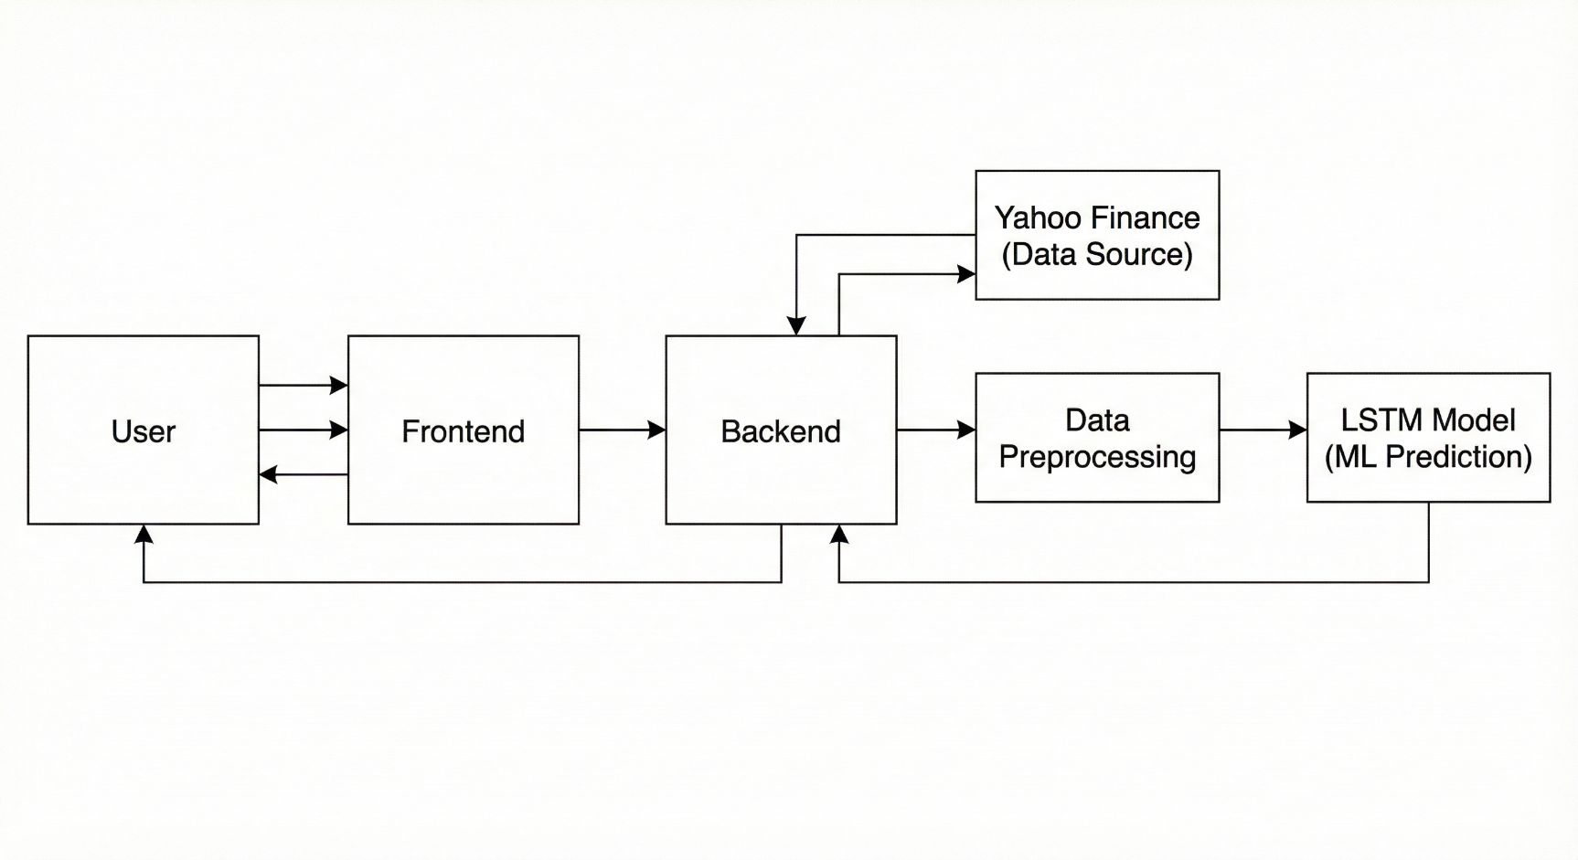
Project Design & Diagrams
Block Diagram
Data Acquisition: Daily OHLCV from yfinance, live quotes & news from Finnhub, and the Financial PhraseBank corpus.
Preprocessing: 12 features per stock (momentum, trend, volatility, RSI, volume) — z-scored.
Processing Unit: Logistic Regression outlook, TF-IDF sentiment NLP & Markowitz optimizer.
Output: A 3-month up-probability, news mood (0-100), and an approve-before-trade basket.

Slide 8
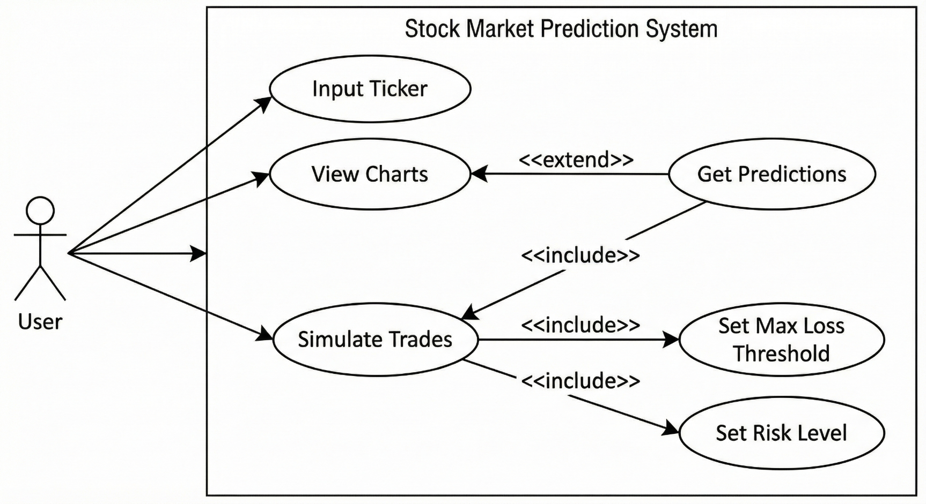
Project Design & Diagrams
Usecase Diagram
Interactions between the user and system.
Actor: User (Trader)
Register / Log in & manage favourites.
View outlook, news mood & live prices.
Approve Auto-Buy & place paper trades.
Actor: System (AI Engine)
Fetch prices (yfinance) & news (Finnhub).
Run outlook + sentiment models.
Build covariance & solve max-Sharpe (SLSQP).
Update wallet & write audit log (MySQL).

Slide 9
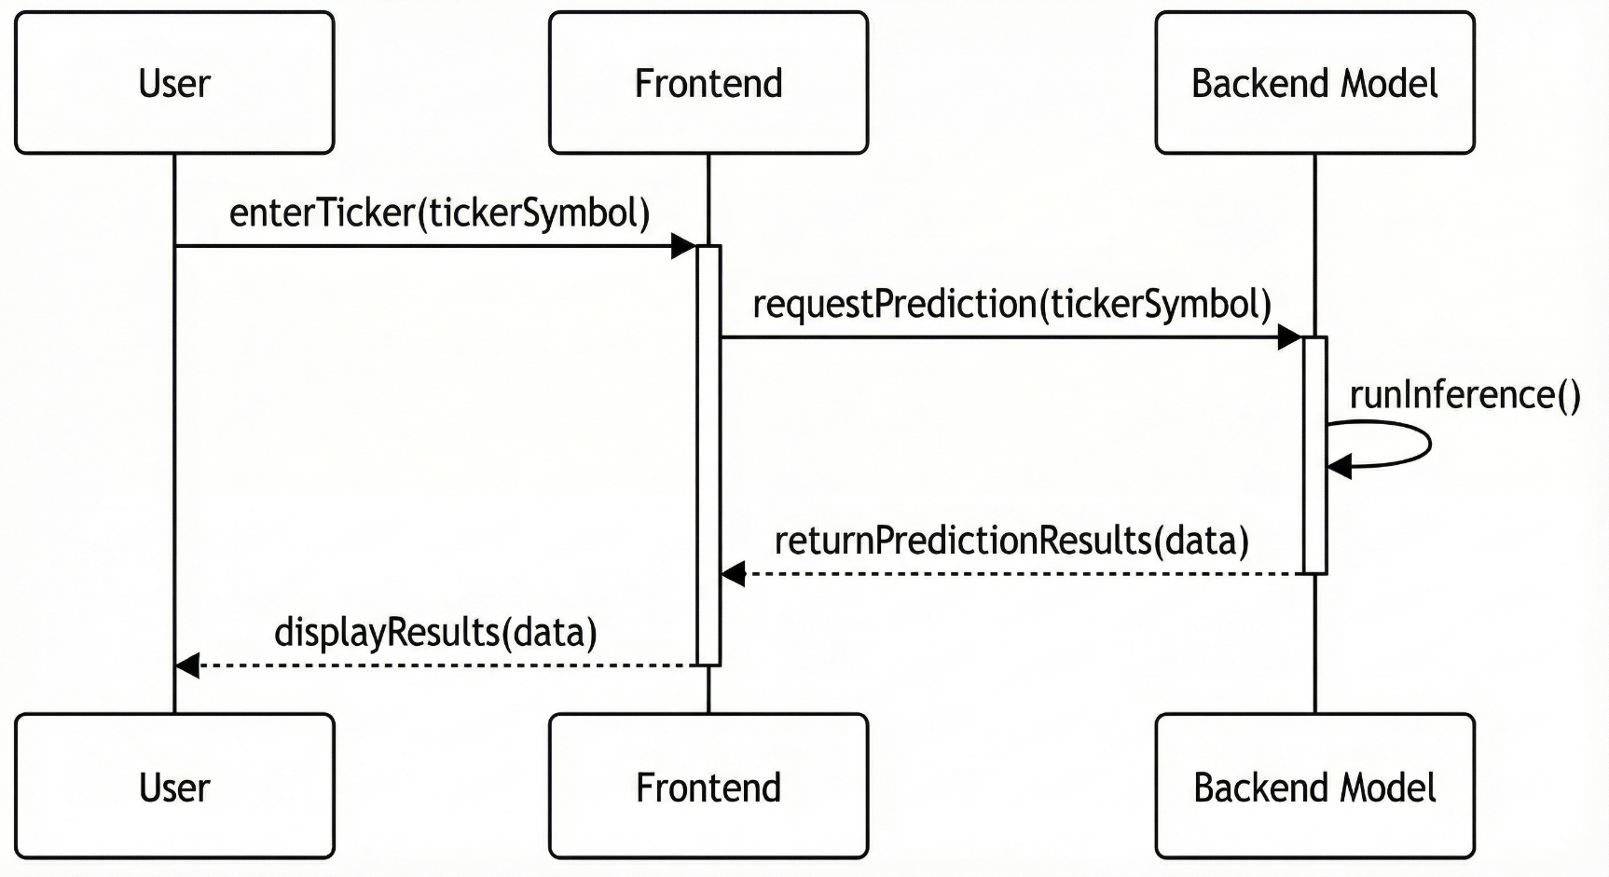
Project Design & Diagrams
Sequence Diagram
Relevance: Details the chronological order of operations for a single prediction request.
Step 1: UI sends JWT-authed POST /predict_longterm {symbol: 'TSLA'} to Flask.
Step 2: Server validates the JWT and loads cached LongTermPredictor class.
Step 3: Predictor fetches ~4 years OHLCV from yfinance and computes the 12 features.
Step 4: Features z-scored; Logistic Regression outputs P(up in ~3 months) via sigmoid.
Step 5: Server attaches walk-forward AUC, Brier, skill & the trustworthy flag.
Step 6: JSON returned; UI renders probability, risk & honest metrics.

Slide 10
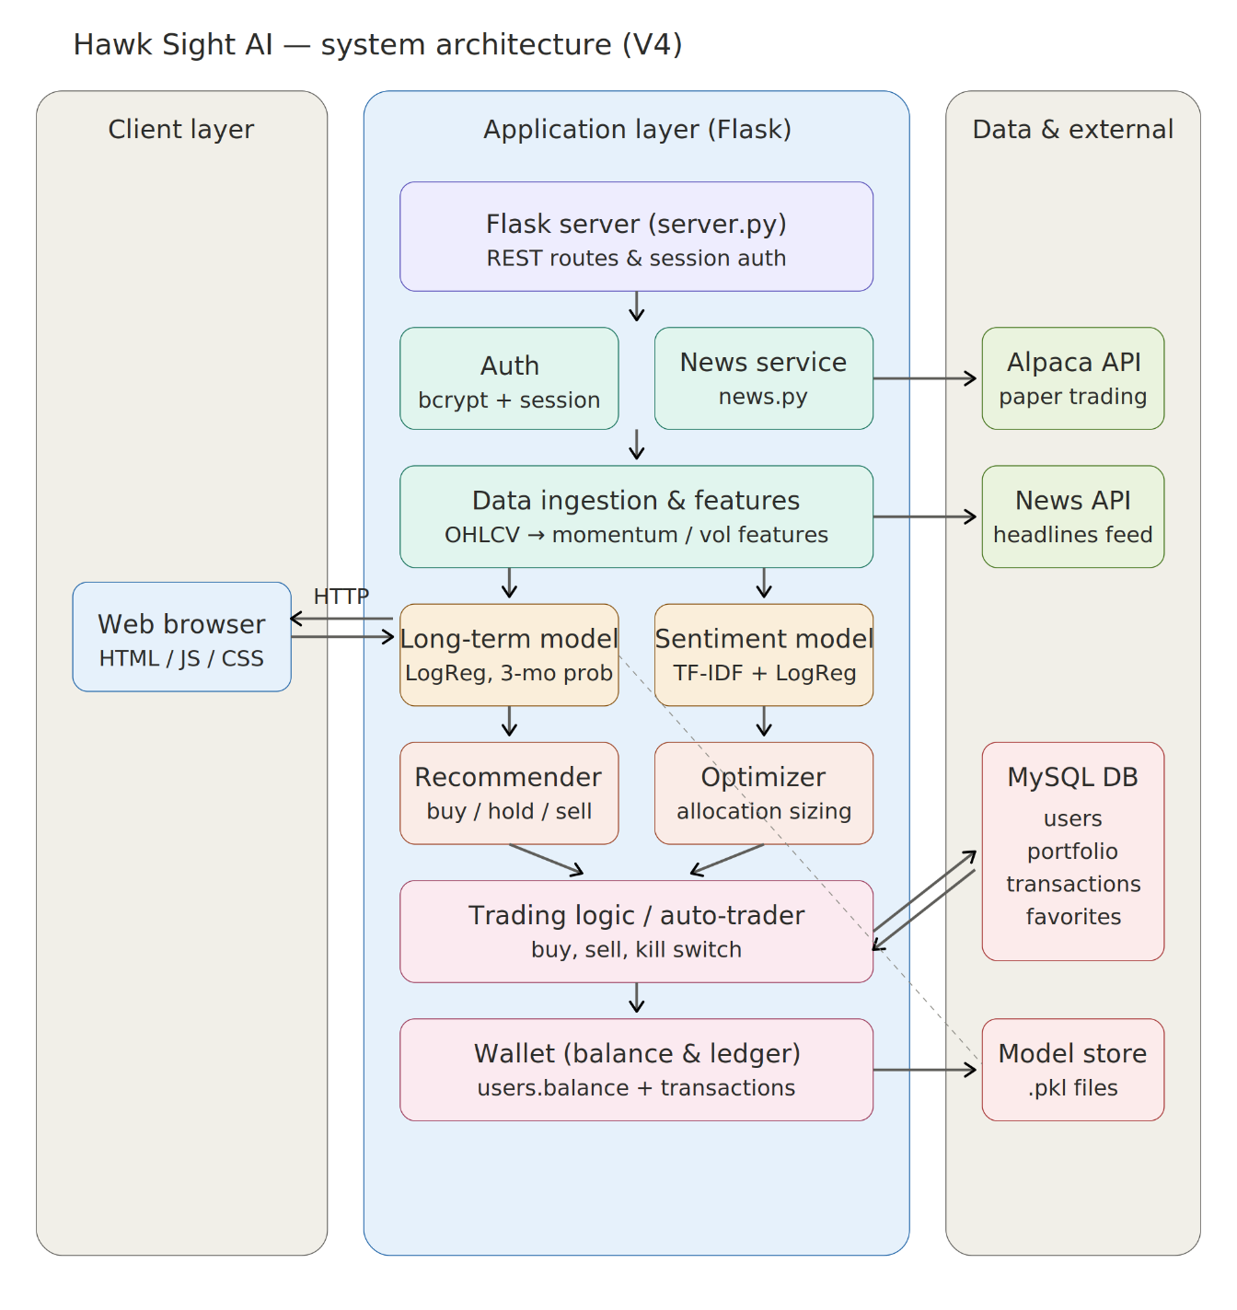
System Architecture
Model (The Brain - Python / scikit-learn + SciPy):
File: longterm_model.py, sentiment.py, optimizer.py
3-month outlook, sentiment NLP & max-Sharpe optimizer.
Feature engineering & walk-forward evaluation.
Weekly background retrain (APScheduler).
2. View (The Face - HTML / Tailwind / Chart.js):
File: frontend/ (index.html, js/, styles.css)
Tailwind CSS + Chart.js dashboard.
Live prices via WebSockets; JWT auth on client.
Panels for outlook, news, wallet & auto-buy.
3. Controller (The Bridge - Flask + MySQL):
File: server.py, auth.py, db.py, news.py
Exposes a REST API (/predict_longterm, /news, /auto_buy, /trade).
JWT-protected routes, rate limiting & MySQL audit log.

Slide 11
Methodology & Algorithm
The Algorithms: Logistic Regression + TF-IDF NLP + Markowitz Optimization
Why Logistic Regression? With only ~40-60 independent 3-month outcomes per stock, deep nets overfit. LR matched them out-of-sample.
Model Specifics:
Outlook Input: 12 features per stock (momentum, trend, volatility, RSI, MA-slope, volume) — z-scored.
Outlook Model: P(up)=sigma(w·x+b); log-loss + L2 (C=0.3).
Sentiment Model: TF-IDF -> multinomial LR with softmax; PhraseBank + finance lexicon.
Portfolio Optimizer: Max-Sharpe via SciPy SLSQP; w_i <= 0.35, long-only.
The "Honest Evaluation" Innovation:
Accuracy claims measured via 5-window walk-forward + 63-day embargo.
Reported above the base rate, AUC & Brier; the "trustworthy" flag fires only if walk-forward AUC >= 0.55.
APScheduler retrains weekly — no faked real-time precision.

Slide 12
Conclusion & Future Scope
Conclusion: Hawk Sight AI shows interpretable, honestly-evaluated models can beat over-claimed deep nets. The outlook gives real ranking signal (AUC ~0.71 on TSLA); sentiment hits 85.2% / 0.806 macro-F1; Markowitz turns these into an approve-before-trade basket.
Future Scope:
FinBERT Sentiment Upgrade: Benchmark a fine-tuned FinBERT against our TF-IDF model and adopt it only if it wins on macro-F1.
Reinforcement-Learning Allocation: Replace single-shot Markowitz with a multi-period RL agent that rebalances through changing regimes.
Live Brokerage with Safeguards: Move from Alpaca paper to a real broker with kill-switch, position caps & loss limits; deploy on AWS.

Slide 13
Thank You!!
Any questions.

