Slide 1
Control Problems from a Density Perspective
Darshan Gadginmath

Slide 2
Control problem – trajectory space
Single trajectory problem:
Fairly well understood for many classes of systems
Practical unknowns in the control problem:
Initial and final sets
Model

Slide 3
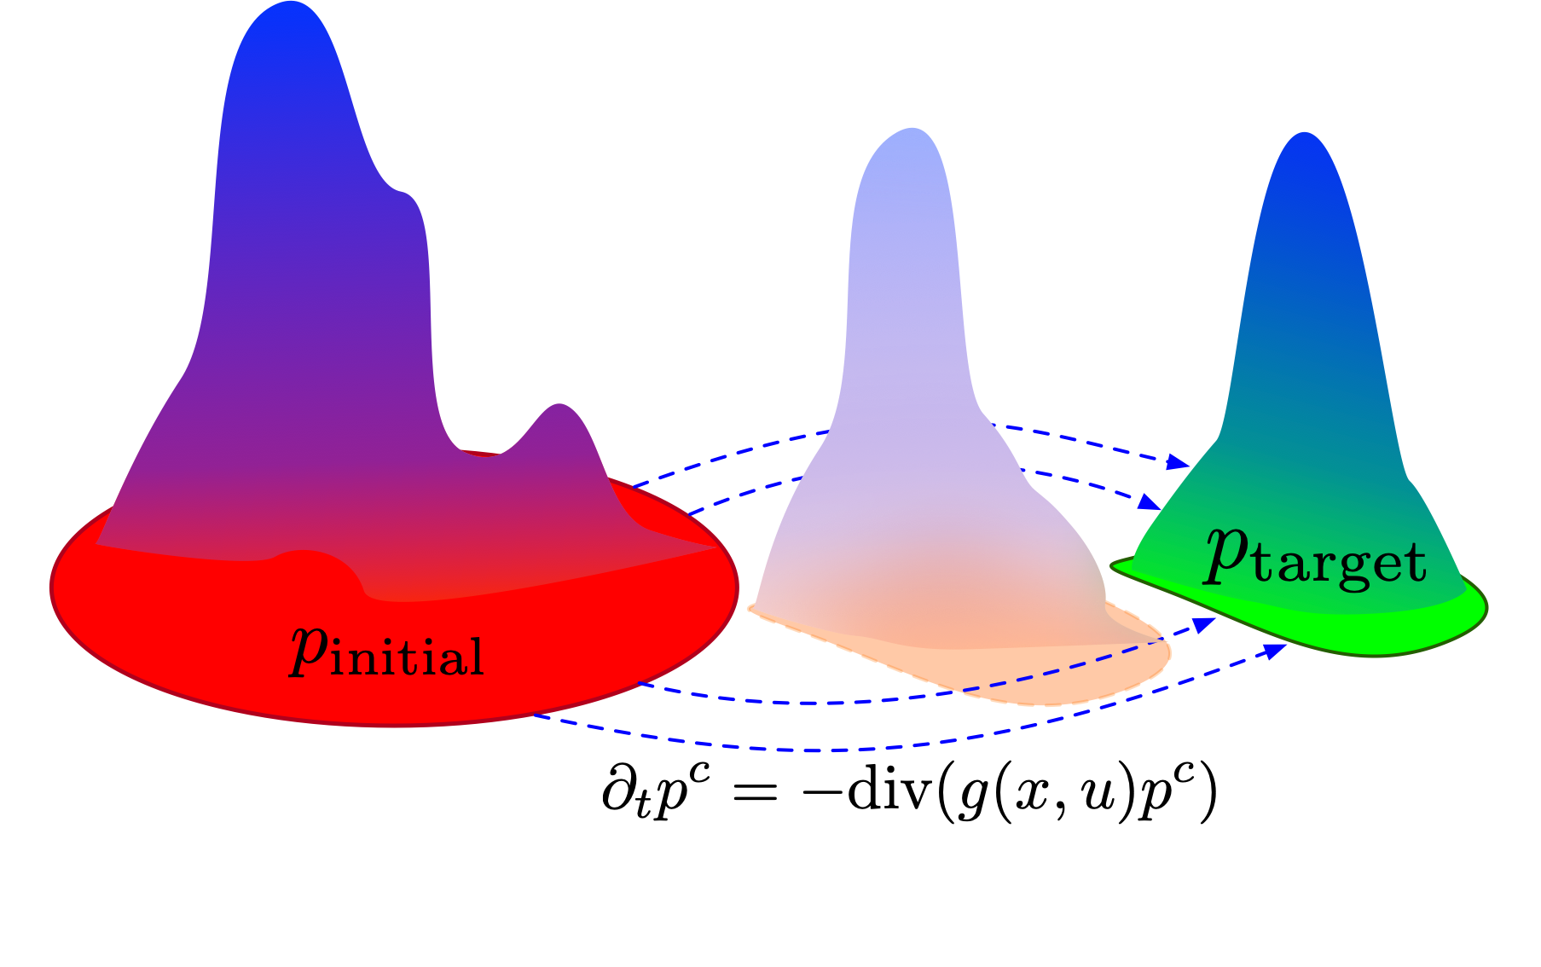
Control problem – density space
Given- initial and target densities, and model
Difficult problem even with known model
Existing solutions- optimal transport and density control
Similar unknowns as in the trajectory problem

Slide 4






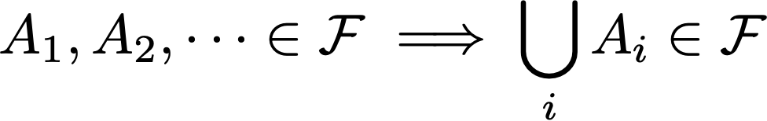


Preliminaries - Measure theory
Generalization of volume of sets
Given a set , its power set (set of all subsets of )
- field
Measurable space
Measure

Slide 5



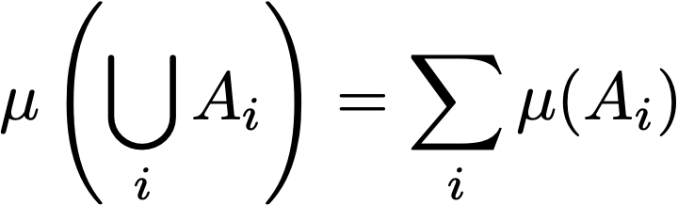


Properties of measures
Non-negativity:
Measure of null set:
Measure of countable unions of disjoint sets :
Measure space
Probability measure: , probability space

Slide 6




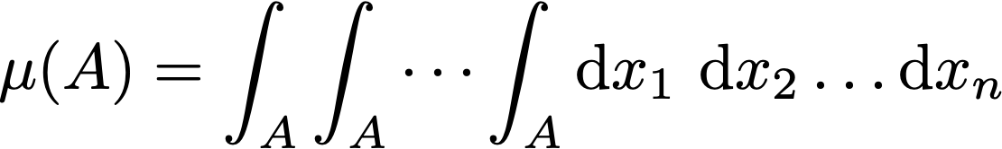
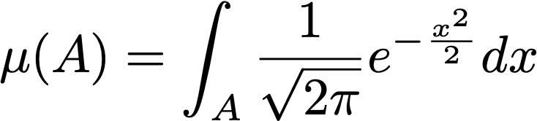
Examples
Counting measure,
Lebesgue measure,
Gaussian measure

Slide 7
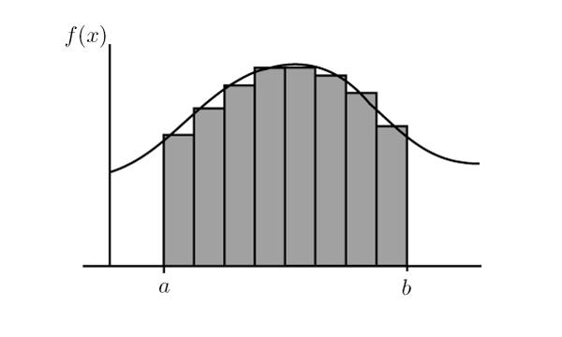
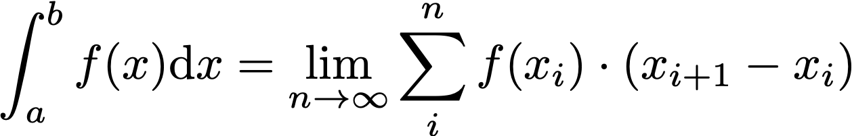
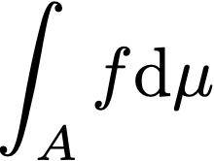

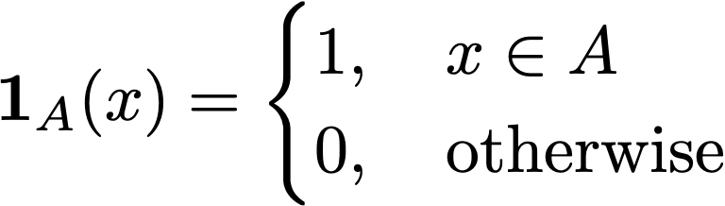
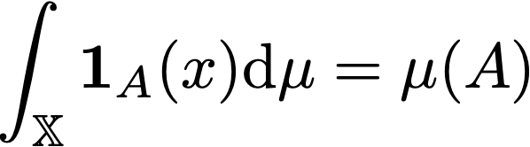
Integrals
Riemann integration (traditional):
Lebesgue integral w.r.t. measure ,
Integral of indicator function

Slide 8
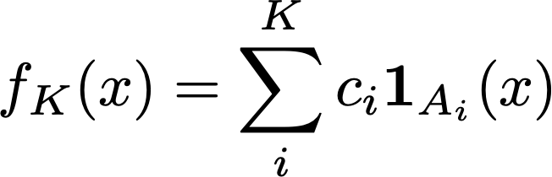
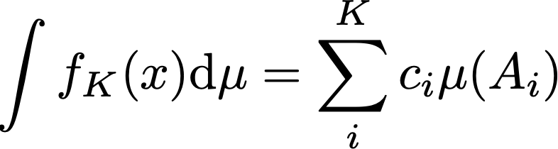

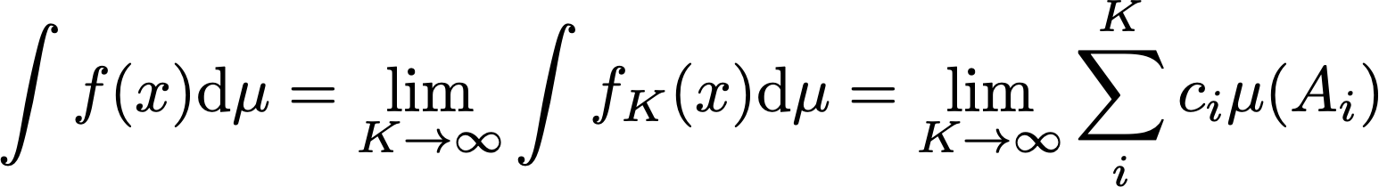


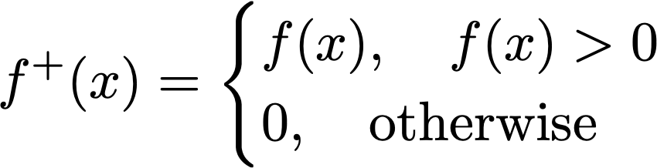
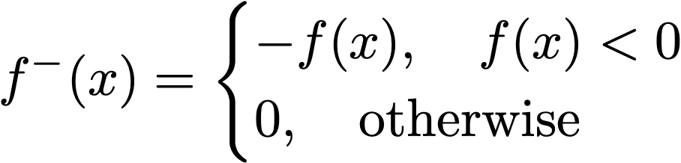
Integrals
Simple function:
Non-negative functions
Real functions

Slide 9
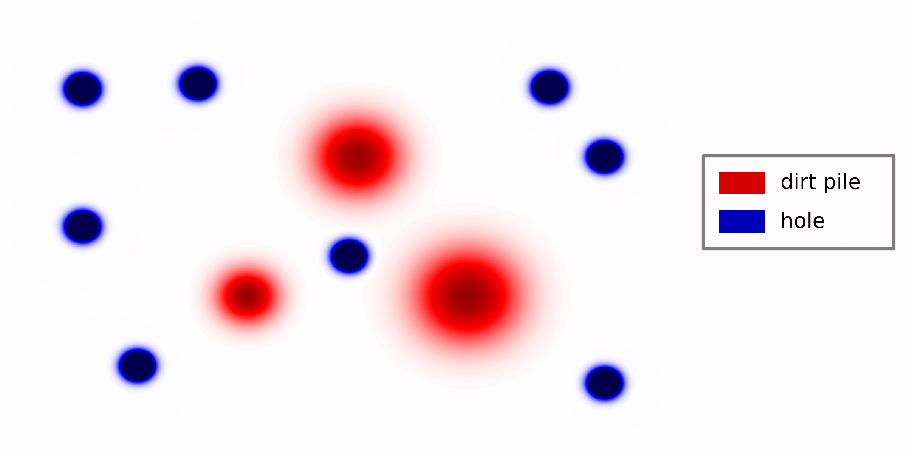
Optimal transport – static problem
Initial problem considered by Monge is very old (1781)
Example

Slide 10
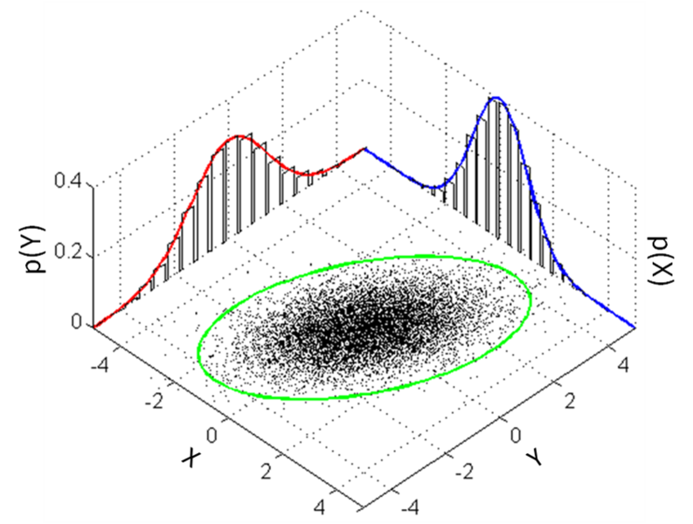


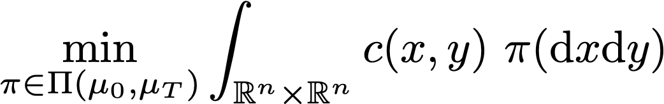

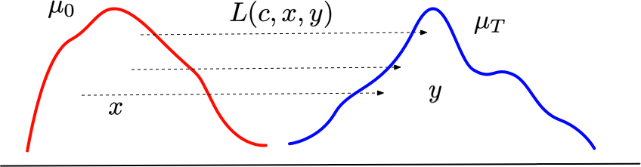
Optimal transport – static problem
Initial , target
Square root of the above optimal cost is the Wasserstein distance
Adding dynamics as constraint complicates this problem

Slide 11

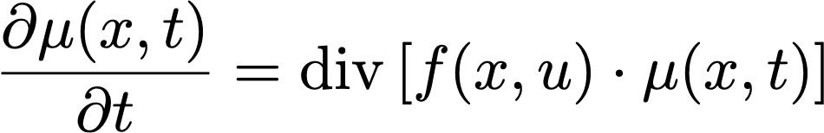



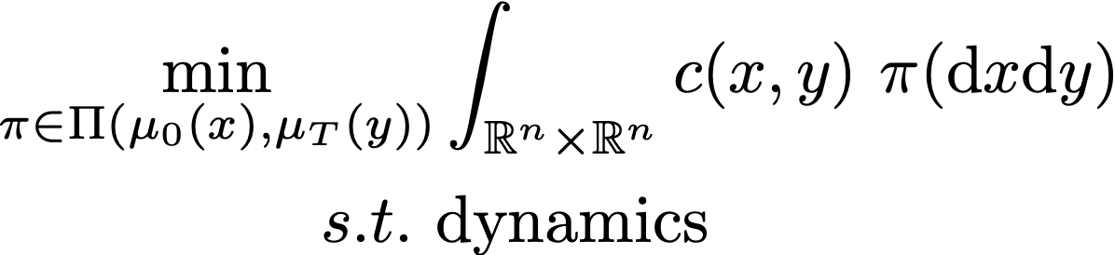
Density control
Initial , target , dynamics
Dynamics of density
Problem- density controller such that
Optimal transport with dynamics
Schrodinger bridge problem considers stochastic dynamics and finds the most probable path between and .

Slide 12
Similar problems
Covariance control: Ensure covariance of states affected by gaussian noise reaches a desired target covariance
Density steering in continuous and discrete time systems
Distributed optimal transport, networked systems, etc.
Prominent researchers in this field:
Tryphon Georgiou (UCI)
Yongxin Chen (Georgia Tech)
Behcet Acikmese (University of Washington)
Efstathios Bakolas (UT Austin)

Slide 13

Open problems in control
Data-driven control
Samples from and , experimental data to infer dynamics
Open problem, very few papers on it
Computational issues even in the model-based setting
Operator-theoretic approaches
PF operator is linear in even with nonlinear dynamics
Koopman techniques of lifting can also be useful for linearization
Interacting particles, network of agents, distributed control
Nonlinear system analysis
Fluid flow
Synchronization, brain networks, etc.
Protein synthesis, drug discovery

Slide 14
Open problems in ML
Generative modeling analysis
Transform noise to samples from dataset
Controlled generation: create image of black cat with blue eyes.
Many techniques in the ML community: diffusion, GANs, VAEs, transformers, etc.
Good tool to analyze and improve generative models
Adversarial issues – jailbreaking, hallucinating, etc.

Slide 15
Conclusion
Trajectory perspective can be impractical sometimes
Density perspective can relax the problem
Current density control techniques are computationally intensive
Many open problems in control
Good tool for analyses of generative models

