Slide 1
Operators and Density Evolution of Dynamical Systems
Darshan Gadginmath

Slide 2


Motivation
Discrete-time quadratic system
Chaotic system

Slide 3
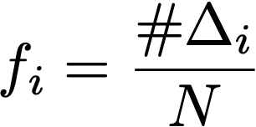
State transition probability for 1000 different initial conditions
Probability of finding point in a bin at any time instance:
Density perspective is useful to study
Chaotic systems
Uncertain systems- systems driven by NNs, transformers, etc.

Slide 4






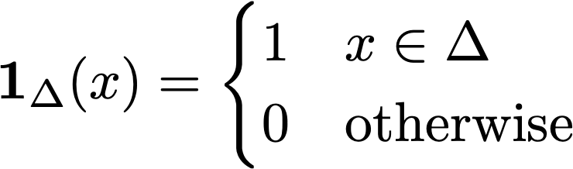
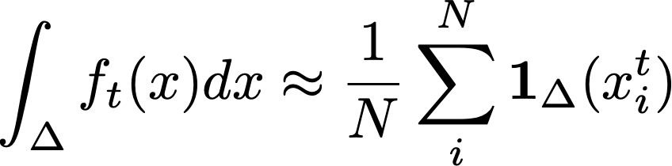
Evolution of densities
Discrete-time system:
trajectories: , ,
Define set:
Important
Indicator function:
Density function:

Slide 5


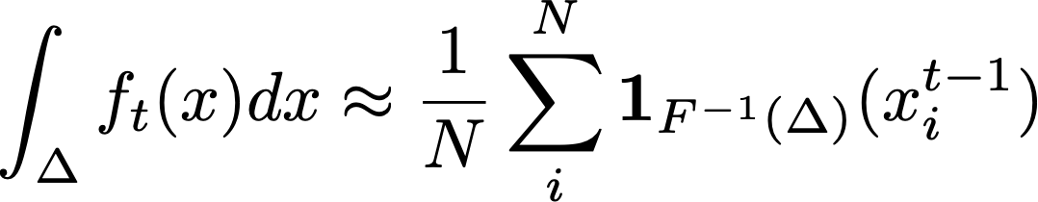
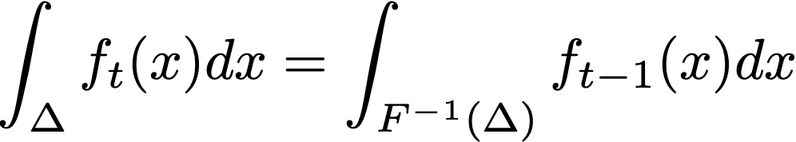
Evolution of densities
Counter-image:
See that:
Density in terms of counter-image:
Preserving density:

Slide 6
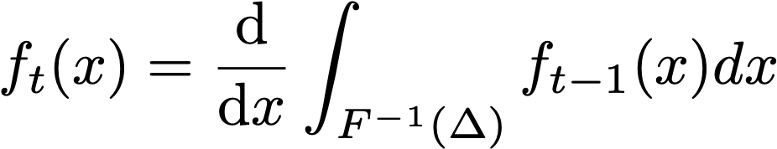


Perron-Frobenius operator
Preserving density:
Evolution:
is the Perron-Frobenius operator

Slide 7



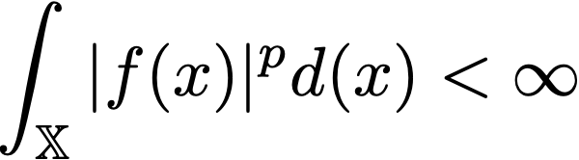
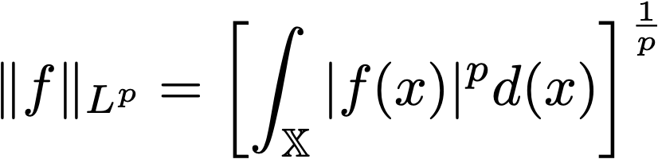



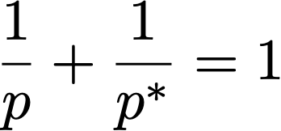
Preliminaries – Function spaces
space:
Family of real-valued functions
Condition:
norm:
space: family of essentially bounded functions everywhere in
Adjoint space to : space ,

Slide 8







Markov operators
Any linear operator:
Conditions, for
Non-negativity:
Norm preserving:
Useful properties:
Norm-upper bound:
Fixed-point:
Density:

Slide 9

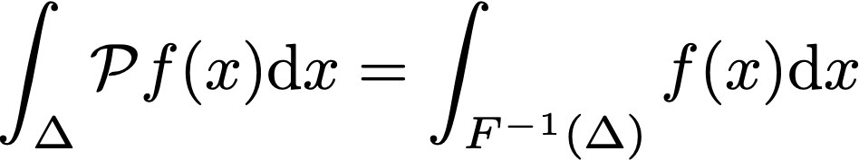



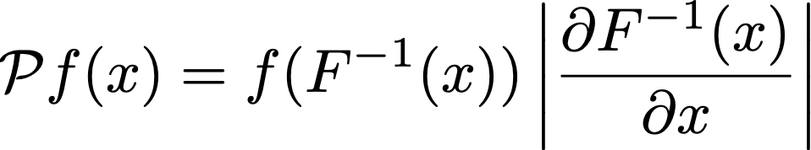
Perron-Frobenius (PF) operator
Same discrete-time system:
Markov operator, that satisfies
is unique for the system
Repeated application:
For invertible systems ( is non-singular):

Slide 10



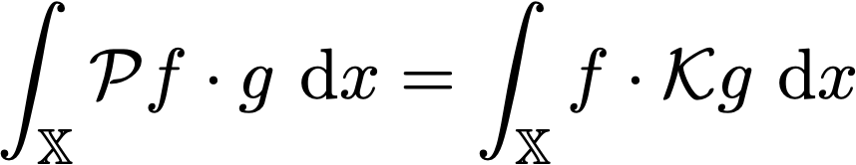
Koopman operator
Discrete time system:
Markov operator: satisfying
is the adjoint operator to :

Slide 11
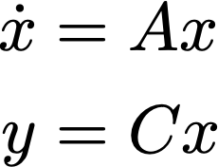
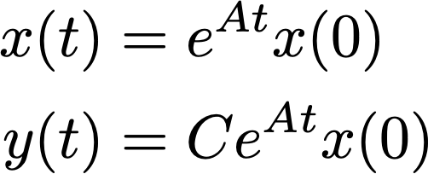



Continuous-time systems
Linear system:
Solution:
Semigroups generalize to nonlinear systems
Semigroups of interest:
Koopman operator semigroup:
PF-operator semigroup:

Slide 12

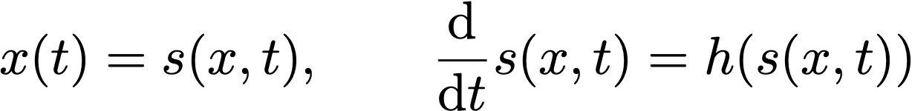

Continuous-time systems
Nonlinear system:
is called the flow of the system
Operators:

Slide 13

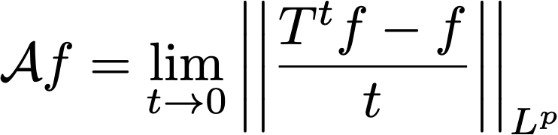

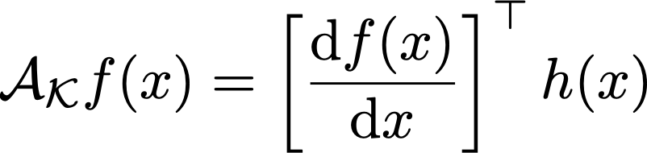

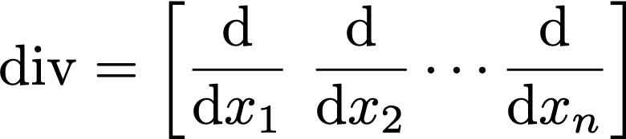
Infinitesimal generator
Operator that satisfies:
Domain of is
Koopman operator’s infinitesimal generator:
PF operator’s infinitesimal generator:
Liouville operator

Slide 14

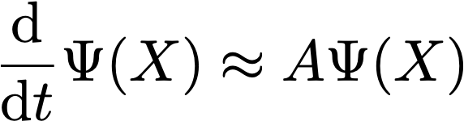
Data-driven approximations
Koopman’s popularity
Analyzing trajectories of autonomous systems
Linear representation for nonlinear systems in lifted spaces
Extended Dynamic Mode Decomposition (EDMD)
Data:
Lifting using a dictionary of functions:
Find approximately linear dynamics
Generator EDMD (gEDMD):

Slide 15
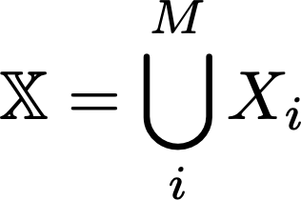


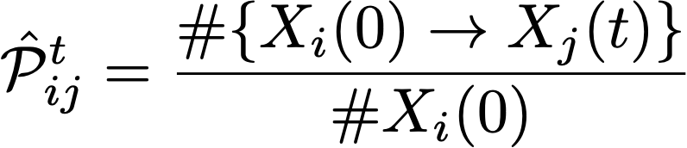




PF operator approximation- Ulam’s method
Discretize domain into parts:
Construct transition matrix
denotes number of points that map from
to from time to .
Scales badly with size of state space and dimension.
Poor approximation for complicated systems.
Stanislaw Ulam, Boris Galerkin (1947)

Slide 16
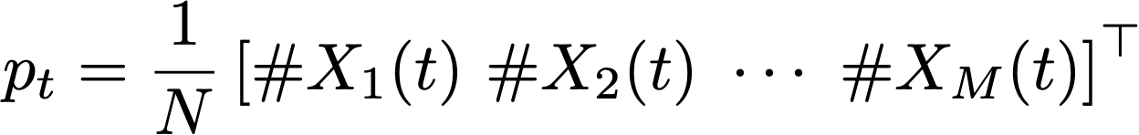



Ulam DMD
D. Goswami and D. Paley (L-CSS, 2018)
Connects Ulam’s method and DMD
Still suffers from discretization errors and the curse of dimensionality.

Slide 17
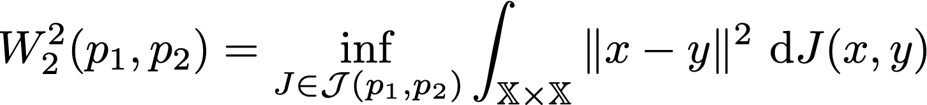
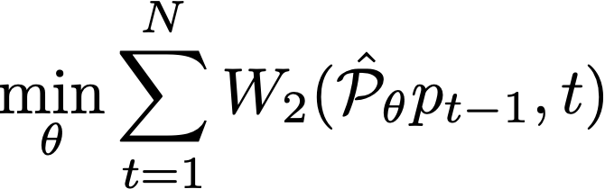


PF Approximation using Wasserstein metric
A. Karimi and T. Georgiou (IFAC World Congress, 2022)
Wasserstein distance:
Estimating PF operator:
For linear systems, with there exists closed-form solution.
Lift nonlinear system using a dictionary of functions, optimize via GD.
Computing for nonlinear systems and non-Gaussian densities is difficult, they assume exact information about densities.

Slide 18


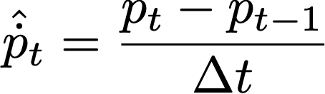


Exponential method
Y. Meng, et al. (Chuchu Fan’s group, CoRL 2021)
System is known!
Utilizes the Liouville operator
Given trajectory data:
Can be extended to unknown systems.
Exponential model is not an accurate representation of solution of nonlinear systems.

Slide 19
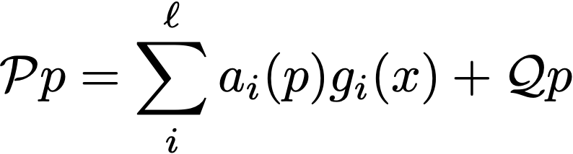



Spectral Decomposition approach
Our approach (submitted to Neurips, 2024)
Spectral decomposition theorem:
Split the action of the PF operator into components.
Functions , and operator have good properties that can be exploited.
Functions and are approximated using neural networks.
Works better than existing methods- comparison on complicated nonlinear systems
Requires two neural networks, is not known a priori

Slide 20
Conclusion
Studying density is useful:
Individual trajectories are difficult to analyze
Density perspective can provide probabilistic estimation of evolution
Unknown systems
Koopman operator – for analyzing trajectories
Well explored
Extended for control and other applications
PF operator – for analyzing densities
Very little in the literature
Extension to other applications has not been explored

