Slide 1
Sensor Data Classification Project
Data Simulation, Visualization, and Modeling using Random Forest

Slide 2
Agenda
- Data Simulation & Labeling
- Data Visualization
- Model Building
- Model Evaluation
- Conclusion

Slide 3
Data Simulation & Labeling
- Generated synthetic data for Temperature and Pressure
- Applied labeling function to classify into: Hot, Cold, Hard Pressure, Soft Pressure, Normal

Slide 4
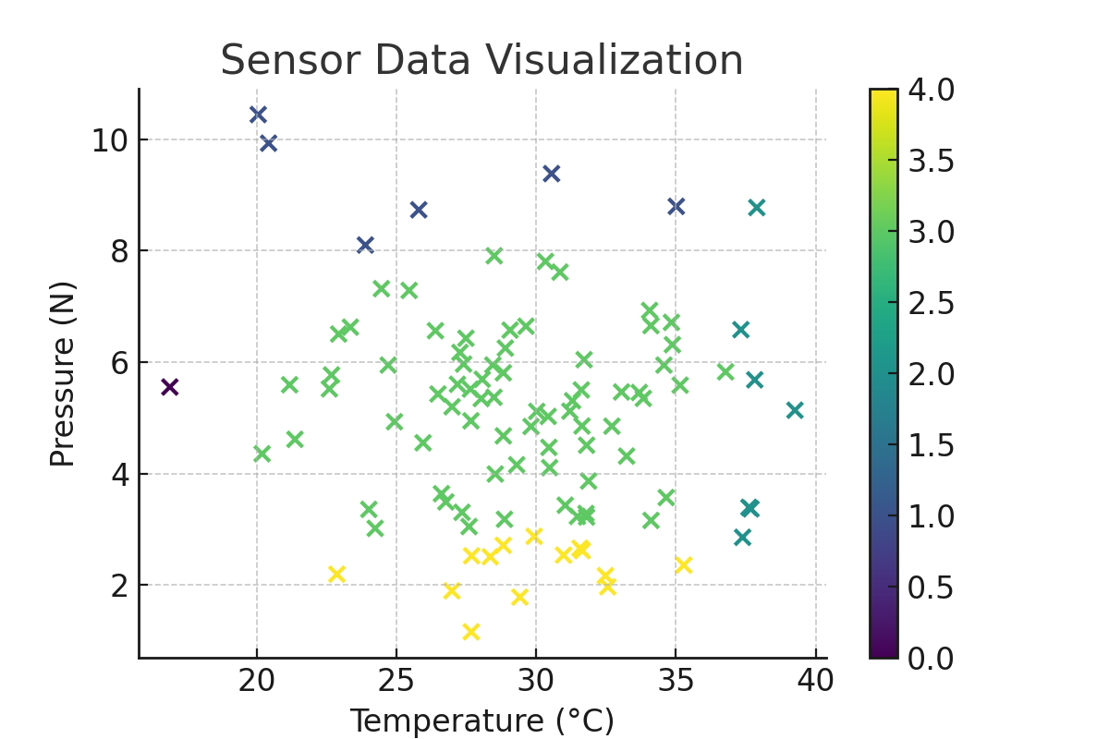
Sensor Data Visualization

Slide 5
Model Building
- Features: Temperature, Pressure
- Target: Label
- Algorithm: Random Forest Classifier
- 80% Training, 20% Testing split

Slide 6
Model Evaluation
- Classification Report: Precision, Recall, F1-score
- Confusion Matrix: True vs Predicted Labels
- Model performs well on synthetic data

Slide 7
Conclusion
- Successfully created and labeled synthetic sensor data
- Visualized patterns effectively
- Built and evaluated a predictive model
- Demonstrated full ML pipeline

