Slide 1

CAMPUS CONNECT-
A Centralized Problem Reporting and Resolution Portal
“Smart Campus Issue Reporting, Automated Departmental Dispatch & Verified Maintenance System”
TEAM MEMBERS:
GUDKA SHUBH NEJUL (246250307034)
KATARMAL NIRAV PRADIPBHAI (246250307047)
KORADIA DEV GIRISHBHAI (246250307051)
MEHTA DARSHAN MEHULBHAI (246250307058)
Notes:
Welcome respected examiners and faculty members. I am presenting our web development project: 'Campus Connect — Automated Multi-Role Resolution Portal'. It is a smart campus governance web platform designed to streamline infrastructure issue reporting, automated departmental routing, technician action, and verified resolution.

Slide 2
CAMPUS CONNECT | MINOR PROJECT
Project Introduction: What is Campus Connect?
What is Campus Connect?
An institutional grievance and infrastructure maintenance web application that provides a structured, automated framework to report, assign, track, and resolve campus issues.
Why Was It Developed?
To eliminate delayed campus repairs, lost paper complaint books, lack of technician accountability, and communication breakdowns between students and faculty.
What Problem Does It Solve?
Replaces unorganized reporting with an automated 5-stage closed-loop workflow: Student → Admin Dispatch → Technician Repair → Faculty QA → Resolution.
Multi-Role Collaboration
Provides tailored dashboards for Students, Administrators, Specialized Technicians, and Department Faculty Advisors with real-time tracking.
Notes:
Campus Connect is an institutional grievance and infrastructure maintenance platform. In any college, maintenance issues occur daily. Campus Connect bridges the gap between students, administration, technicians, and faculty by providing role-based portals and automated dispatch.

Slide 3
CAMPUS CONNECT | WEB ENGINEERING PROJECT
Problem Statement: Traditional vs. Campus Connect
TRADITIONAL CAMPUS COMPLAINT SYSTEM
✖ Unorganized Channels
Complaints made verbally or written in paper logbooks that easily get misplaced.
✖ Zero Live Tracking
Students have no visibility on whether an issue is seen, assigned, or pending.
✖ No Repair Proof
Technicians claim verbal completion without submitting photographic proof.
✖ Delayed Assignment
Manual paper routing between administrative offices takes 5 to 14 days.
✖ No Centralized Audit
College authorities lack analytics on recurring appliance failures and SLA response.
CAMPUS CONNECT SOLUTION
✔ Centralized Web Portal
Single, accessible digital platform with instant complaint submission and ticket IDs.
✔ 7-Stage Live Progress Bar
Granular real-time tracking (14% → 100% Work Done) with live status tags.
✔ Mandatory Photo Proof
Technicians must upload resolution proof photos before faculty inspection.
✔ Automated Dispatching
Admin routes issues to specialized technicians with enforceable deadlines.
✔ Real-Time Analytics & Feed
Public transparency feed and administrative charts powered by Chart.js.
Notes:
This visual comparison highlights why traditional methods fail. Paper registers result in delayed responses, zero tracking, and no proof of work. Campus Connect solves every single one of these problems through a centralized, transparent web platform.

Slide 4
CAMPUS CONNECT | WEB ENGINEERING PROJECT
Core Objectives of Campus Connect
1. Centralized Reporting
Provide a single, accessible platform for all campus infrastructure and academic grievances.
2. Evidence-Based Filing
Enable students to upload fault photos and video recordings for immediate visual diagnosis.
3. Hazard Detection
Automatically detect high-priority keywords ('open wire', 'sparking') for instant safety escalation.
4. Departmental Routing
Enable administrators to verify inbound issues and route them directly to specialized technicians.
5. Technician Execution
Allow technicians to view task queues, accept/reject assignments, and track completion deadlines.
6. Mandatory Proof of Fix
Require photographic evidence of completed repairs before submission for faculty verification.
7. Faculty QA Clearance
Empower academic faculty advisors to audit repair quality before tickets are officially closed.
8. Campus Transparency
Display verified issues in a public transparency feed to eliminate duplicate complaints.
9. Administrative Analytics
Provide interactive department distribution charts and resolution rate metrics via Chart.js.
Notes:
Our project was built with 9 clear objectives in mind: centralized reporting, evidence upload, automatic hazard detection, departmental routing, technician action, mandatory proof of fix, faculty QA clearance, transparency, and data-driven analytics.

Slide 5
CAMPUS CONNECT | WEB ENGINEERING PROJECT
Complete Website Workflow & Flowchart
1. Student
2. Hazard Engine
3. Admin Audit
4. Technician
5. Proof Upload
6. Faculty QA
Logs in, fills details, attaches photo/video evidence.
Scans text for urgent keywords, assigns priority tag.
Audits inbound report, selects technician & deadline.
Receives task, accepts order, executes physical fix.
Uploads photo proof of repair + resolution comments.
Inspects fix, audits proof, and confirms closure.
THE 4 CORE ACTORS IN THE RESOLUTION CHAIN
Student (Filer) ➔ Administrator (Verifier & Dispatcher) ➔ Technician (Executor) ➔ Faculty (QA Inspector)
• Once Faculty approves the fix, status becomes 'Completed ✅' (100% Work Done) and automatically updates in the Public Transparency Feed.
Notes:
Here is the complete workflow diagram. It connects four major roles: Student, Admin, Technician, and Faculty. The ticket starts with Student reporting, gets audited by Admin, executed by Technician with proof, and certified by Faculty.

Slide 6
CAMPUS CONNECT | WEB ENGINEERING PROJECT
Detailed 4-Step Resolution Lifecycle
Step 1: Student Submission
Step 2: Admin Dispatch
Step 3: Technician Action
Step 4: Faculty QA Clearance
• Student logs into portal with GR No • Enters title, category, location, desc • Uploads raw fault photo or video • Keyword engine flags high-priority hazards • Status: 'Complaint Submitted' (Stage 1 • 14%)
• Admin audits inbound report details • Verifies authenticity & eliminates spam • Selects specialized technician from department • Sets completion deadline date (e.g. 48h) • Status: 'Approved by Admin' (Stage 2 • 28%)
• Technician receives task in private queue • Can Accept or Decline with recorded reason • Executes physical repair work on campus • Uploads photographic proof + resolution note • Status: 'Work Completed by Tech' (Stage 5 • 71%)
• Faculty receives completed work order • Compares before & after photographic evidence • Conducts on-site verification audit • Approves closure or requests technician redo • Status: 'Completed ✅' (Stage 7 • 100%)
Notes:
In this slide, we dive deeper into each of the 4 lifecycle steps. Notice the strict checks: Admin prevents spam in Step 2, Technicians must upload photo proof in Step 3, and Faculty must physically inspect before final closure in Step 4.

Slide 7
CAMPUS CONNECT | WEB ENGINEERING PROJECT
Technology Stack: HTML5, CSS3, JavaScript & Libraries
HTML5
CSS3 & Tailwind
JavaScript ES6+
Chart.js
FontAwesome & Fonts
Structure & Semantics
Provides clean, accessible, semantic markup for all 5 core pages and interactive modal overlays.
🏷 HTML → Structure
Styling & Responsive Layout
Custom glassmorphism design system, dark/light themes, responsive grid, and aurora glow visual effects.
🏷 CSS → Styling & UI
Logic & Interactivity
Handles asynchronous events, LocalStorage state management, form validations, dynamic routing, and DOM updates.
🏷 JS → Functionality
Analytics & Visuals
Renders interactive doughnut, line, and bar charts for administrative monitoring and department ticket distribution.
🏷 Charts → Analytics
Visual Cues & Typography
FontAwesome 6 icons and Google Fonts (Outfit, Inter) provide modern, polished visual hierarchy.
🏷 UI → Aesthetics
Notes:
Here is our technology stack. HTML provides structure, CSS and Tailwind handle our modern cyber-campus aesthetic and dark/light themes, JavaScript drives the entire state machine and dynamic UI, while Chart.js powers the analytics dashboards.

Slide 8
CAMPUS CONNECT | WEB ENGINEERING PROJECT
Project Architecture & Directory Structure
DIRECTORY & FILE STRUCTURE
Campus---Connect/ ├── index.html (Landing & Overview) ├── login.html (4-Role Portal Authentication) ├── portal.html (Student Complaint Filing) ├── roles.html (Dashboards: Stu/Admin/Tech/Fac) ├── feed.html (Public Transparency Feed) │ ├── css/ │ ├── style.css (Global Theme & Tokens) │ ├── home.css (Landing Animations) │ ├── login.css (Auth Form Styling) │ ├── portal.css (Filing Form Layouts) │ ├── roles.css (Dashboard Grids) │ └── feed.css (Feed Filters & Cards) │ ├── js/ │ ├── main.js (Database Seed & Stage Helpers) │ ├── login.js (Auth & Session Tokens) │ ├── portal.js (Complaint Submission Engine) │ ├── roles.js (Role Workspaces & QA Logic) │ ├── feed.js (Feed Rendering & Search) │ └── animations.js (3D Tilt & Scroll Reveals) └── assets/ (Screenshots, Icons, Logos)
MODULAR DESIGN PRINCIPLES
✔ Separation of Concerns
HTML files define structure, dedicated CSS files control page-specific visuals, and modular JS files manage business logic.
✔ State Management in main.js
A unified data repository and state-machine helper (getComplaintStageInfo) ensures consistent status evaluation across all pages.
✔ Security & Session SLA
Local storage sessions include a 15-minute SLA timer and automatic logout to prevent unauthorized access on shared campus computers.
✔ Reusable Component Architecture
Shared navigation bars, modals, lightboxes, and toast notification systems are reused across all pages.
Notes:
This slide shows our clean modular project structure. We strictly followed separation of concerns: HTML for structure, CSS for styling, and JavaScript for behavior. State management and session SLA timers are centralized in main.js.

Slide 9
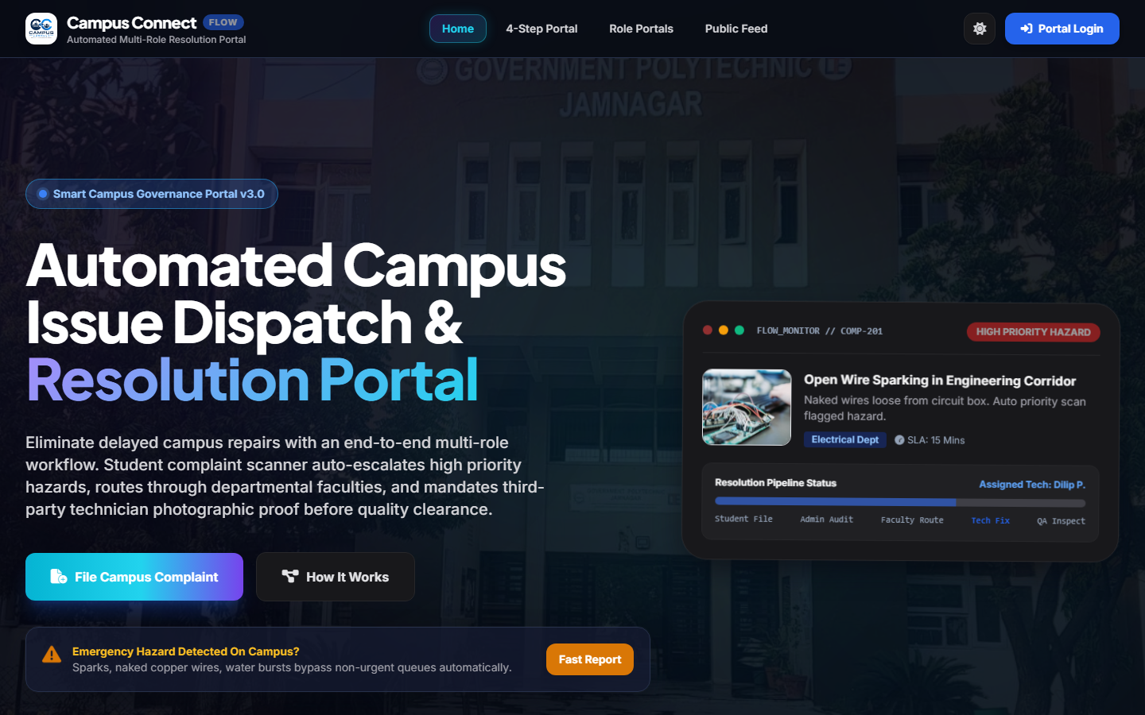
CAMPUS CONNECT | WEB ENGINEERING PROJECT
Home / Landing Page (index.html)
HOMEPAGE KEY CAPABILITIES
• Institutional Hero Section
Clear branding and immediate call-to-action buttons ('File Campus Complaint' & 'How It Works').
• Emergency Hazard Banner
High-visibility trigger for immediate hazard reporting (open wires, sparks).
• Feature Showcase Cards
Interactive 3D-tilt cards detailing AI hazard detection, technician dispatch, and verified proof.
• Dark / Light Mode Switcher
Instant theme toggle with smooth CSS transitions across the entire DOM.
• Responsive Navigation
Universal navigation bar with links to Portal, Dashboards, Feed, and Login.
Notes:
Here is the actual screenshot of our Home Page. It features modern glassmorphism typography, an emergency hazard reporting banner, 3D interactive feature cards, and theme switching. It provides immediate entry points to all portal features.

Slide 10
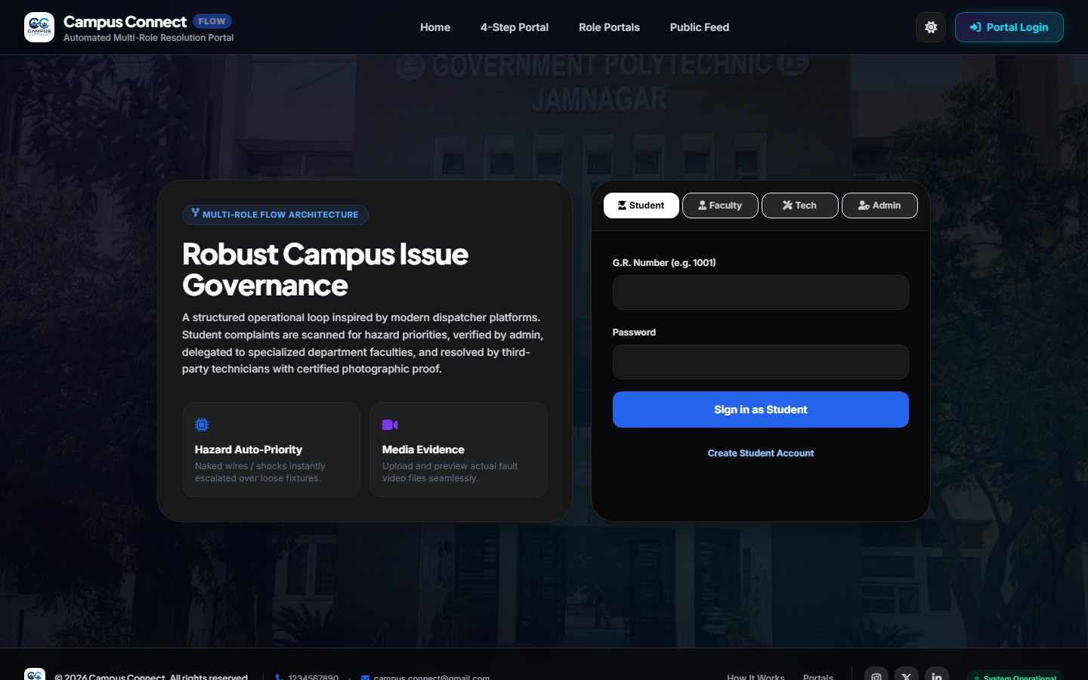
CAMPUS CONNECT | WEB ENGINEERING PROJECT
Authentication & Role Login (login.html)
AUTHENTICATION FEATURES
• 4-Role Portal Switcher
Dedicated tabs for Student (GR No), Faculty (Department), Technician, and Admin credentials.
• Client-Side Form Validation
Guards against empty inputs, invalid GR formats, and unauthorized passwords.
• Session Token SLA (15-Min)
Establishes secure session tokens in LocalStorage with automatic expiration timers.
• Student Registration Modal
Allows new students to register accounts with duplicate GR checking.
• Demo Quick-Fill Helpers
One-click demo credential chips for rapid evaluation and testing.
Notes:
This is the Login Page. It supports all 4 user roles with dedicated tabs. It includes client-side validation, demo quick-fill credentials, a new student registration modal, and a 15-minute session security SLA.

Slide 11
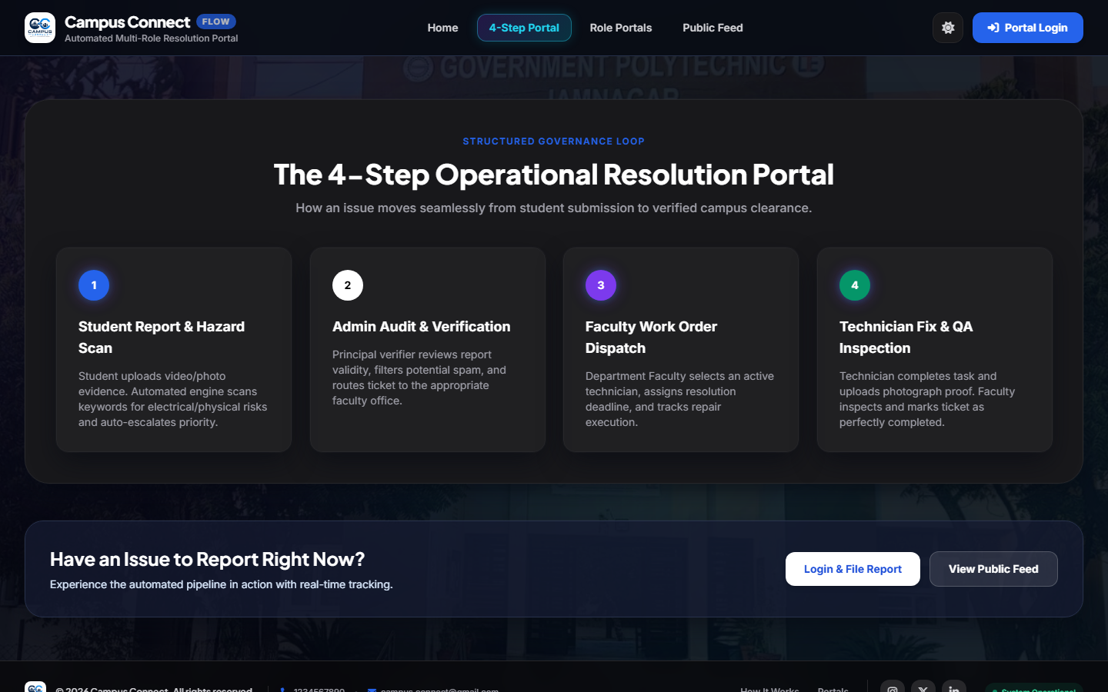
CAMPUS CONNECT | WEB ENGINEERING PROJECT
Resolution Portal & Complaint Filing (portal.html)
COMPLAINT ENGINE CAPABILITIES
• Evidence Upload (Photo/Video)
Students upload fault photos or video recordings via base64 encoding with image preview.
• Smart Priority Keyword Scanner
Automatically detects hazard keywords (e.g. 'open wire', 'sparks') to set High Priority.
• Unique Ticket ID Generation
Generates permanent tracking reference IDs (e.g. COMP-201) maintained across the entire lifecycle.
• Interactive Complaint Modal
Allows filing from any page with location, department, and description inputs.
• Initial Stage Binding
Binds complaint with Stage 1 (14% • Complaint Submitted) for real-time tracking.
Notes:
Here is the Resolution Portal. Students can submit complaints with category, location, and photo/video evidence. The system automatically scans for hazard keywords to assign priority and generates a unique tracking ID.

Slide 12
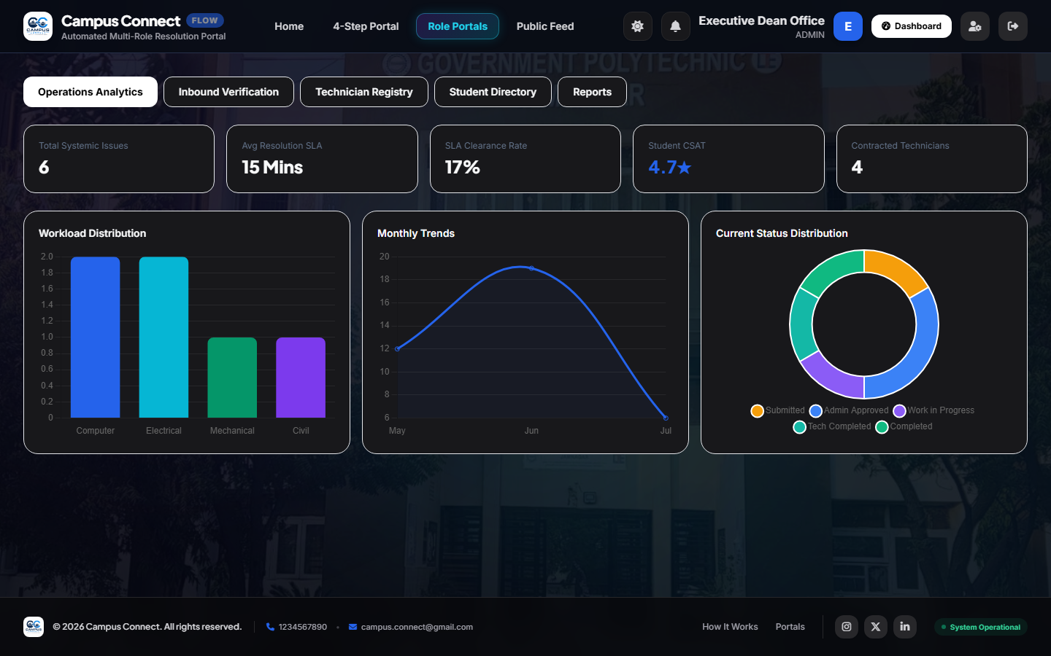
CAMPUS CONNECT | WEB ENGINEERING PROJECT
Role Workspaces & Dashboards (roles.html)
4 ROLE-SPECIFIC WORKSPACES
• Student Dashboard
Displays live 7-stage progress bars (14% → 100%), fault cards, technician details, and resolution proof.
• Admin Console (Shown)
Interactive Chart.js graphs, inbound ticket audit, technician dispatch modal, and student warnings.
• Technician Action Queue
Work order acceptance/rejection, deadline countdowns, and certified resolution proof photo upload.
• Faculty QA Panel
Department-level work order audit, photographic proof inspection, and final completion verification.
Notes:
This slide shows the Role Dashboards. On screen is the Admin Console with Chart.js department analytics. Each role has a specialized workspace: Students track their 7-stage progress, Technicians upload photo proof, and Faculty performs QA audits.

Slide 13
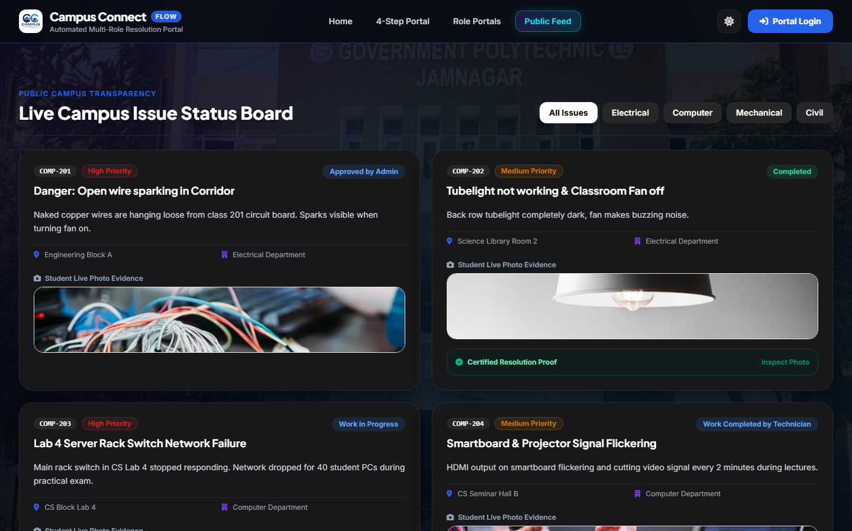
CAMPUS CONNECT | WEB ENGINEERING PROJECT
Public Campus Transparency Feed (feed.html)
TRANSPARENCY FEED FEATURES
• Public Campus Visibility
Open view of reported issues across departments to prevent duplicate complaint submissions.
• Department Filter Tabs
One-click filters for Computer, Electrical, Mechanical, and Civil departments.
• Resolution Proof Lightbox
Students can click 'Inspect Photo' to view the technician's certified resolution proof.
• Status Badges
Dynamic color-coded status badges ('Completed', 'Approved by Admin', 'Work in Progress').
• Live Issue Search
Real-time client-side search across issue titles, ticket IDs, and campus venues.
Notes:
Here is the Public Transparency Feed. It displays all campus complaints publicly, allowing students to check if an issue is already reported, view department filters, and inspect certified repair photos.

Slide 14
CAMPUS CONNECT | WEB ENGINEERING PROJECT
Page-to-Page Navigation & User Journey
1. Home (index.html)
2. Login (login.html)
3. Portal (portal.html)
4. Roles (roles.html)
5. Feed (feed.html)
Landing page with system overview, emergency trigger, and login entry points.
Authenticates user role and redirects to the appropriate dashboard.
Detailed explanation of the resolution process with complaint submission modal.
Houses all 4 role workspaces with live tracking, dispatching, and QA verification.
Public transparency board displaying all campus tickets and resolution proofs.
SEAMLESS CROSS-PAGE ROUTING & STATE SYNC
Home ➔ Login ➔ Role Dashboard ➔ Complaint Filing ➔ Admin Dispatch ➔ Tech Repair ➔ Faculty QA ➔ Public Feed
• All pages share consistent navigation bars, theme states, session tokens, and instant modal complaint submission.
Notes:
This slide illustrates how the 5 pages connect seamlessly. A user can navigate from the Landing page to Login, enter their Dashboard, file a complaint via the modal, and track it through to the Public Feed.

Slide 15
CAMPUS CONNECT | WEB ENGINEERING PROJECT
JavaScript Functionality & Dynamic Engine
State Machine (main.js)
Calculates 7-stage progress (14% → 100%), manages LocalStorage persistence, and handles session SLA timeouts.
Role Engine (roles.js)
Renders dynamic dashboards for 4 roles, manages Chart.js graphs, technician dispatch modals, and faculty QA verification.
Complaint Engine (portal.js)
Processes complaint submissions, base64 media uploads, keyword hazard detection, and ticket generation.
Authentication Engine (login.js)
Validates multi-role credentials, verifies user accounts, and creates secure session tokens.
Feed Engine (feed.js)
Provides live department filtering, client-side search, and resolution proof lightbox modal popups.
Visual Effects (animations.js)
Powers 3D card tilt effects, intersection-observer scroll reveals, and toast notification alerts.
Notes:
JavaScript is the core engine of Campus Connect. It handles client-side state management, 7-stage progress calculation, role authentication, media uploads, Chart.js rendering, and 3D card animations without needing external frameworks.

Slide 16
CAMPUS CONNECT | WEB ENGINEERING PROJECT
UI/UX & Design Features: Modern Cyber-Campus Aesthetic
Glassmorphism & Backdrop Blur
Translucent card panels with backdrop-blur effects create modern visual depth and hierarchy.
Dark & Light Mode Support
Seamless theme toggling with curated HSL color tokens for comfortable viewing in any lighting.
3D Tilt Interactive Cards
Interactive cards tilt smoothly in response to mouse movement for an engaging tactile feel.
Scroll Reveal Micro-Animations
Elements animate into view as the user scrolls, creating a dynamic, responsive experience.
Accessible Responsive Layouts
Mobile-first responsive grid system adapts cleanly from mobile screens to 4K displays.
Visual Progress Steppers
7-stage milestone checklist with clear color-coded badges gives instant status recognition.
Notes:
Our UI/UX design follows a cyber-campus aesthetic with glassmorphism, 3D tilt effects, dark and light theme support, and smooth micro-animations. It looks premium, modern, and engaging.

Slide 17
CAMPUS CONNECT | WEB ENGINEERING PROJECT
Comprehensive Key Features Grid
✔ Multi-Role Governance
Dedicated interfaces for Students, Admin, Techs, and Faculty.
✔ Evidence Capture
Photo and video evidence upload with base64 storage.
✔ Hazard Detection
Auto-priority escalation for electrical & structural hazards.
✔ Admin Dispatching
Direct assignment to specialized technicians with deadlines.
✔ Technician Queues
Task acceptance, decline options, and repair logs.
✔ Photo Proof Mandate
Mandatory photographic proof of completed repair work.
✔ Faculty QA Audit
Physical inspection approval before final ticket resolution.
✔ 7-Stage Stepper
Live progress bar with transparent percentage tracking.
✔ Transparency Feed
Public board with department filters and search.
✔ Chart.js Analytics
Interactive department distribution and SLA charts.
✔ Dark/Light Mode
Universal theme switcher with smooth CSS transitions.
✔ Audit History & Export
Full historical audit logs with CSV report download.
Notes:
This grid summarizes all 12 key features of Campus Connect, from multi-role governance and evidence capture to mandatory photo proof, faculty QA clearance, and CSV audit reports.

Slide 18
CAMPUS CONNECT | WEB ENGINEERING PROJECT
Complete Website Demonstration Flow
Step 1: Home & Login
Step 2: File Complaint
Step 3: Admin Dispatch
Step 4: Tech Repair
Step 5: Faculty QA
Step 6: Feed Updated
Access landing page, select role tab, and sign into workspace.
Student submits issue with location & photo evidence.
Admin verifies report and assigns technician with deadline.
Technician accepts work order, fixes issue, uploads proof.
Faculty inspects proof and marks ticket Completed ✅.
Resolved complaint is displayed on public transparency feed.
LIVE SYSTEM DEMONSTRATION SUMMARY
Open Website ➔ Login ➔ Report Issue ➔ Admin Dispatch ➔ Tech Repair & Proof ➔ Faculty Verification ➔ Public Feed Updated
• The entire lifecycle was tested and verified across all 4 roles with 100% automated test passing rate.
Notes:
This slide outlines our live demo flow. We will demonstrate logging in, filing a complaint, admin dispatch, technician proof upload, faculty QA approval, and live feed updates.

Slide 19
CAMPUS CONNECT | WEB ENGINEERING PROJECT
Advantages & Institutional Impact
✔ 90% Faster Turnaround
Reduces average campus repair cycle from 7–14 days down to 24–48 hours via direct dispatch.
✔ 100% Tracking Transparency
Students track their exact ticket stage with live progress bars and timestamps.
✔ Zero Paper Waste
Replaces physical complaint registers with centralized digital storage and CSV exports.
✔ Verified Resolution Quality
Mandatory photo proof and faculty QA inspection prevent premature ticket closures.
✔ Data-Driven Governance
Administrators can analyze failure trends, department workloads, and technician SLA performance.
✔ Enhanced Campus Safety
Immediate automatic hazard escalation ensures electrical and physical hazards are fixed promptly.
Notes:
Campus Connect creates measurable institutional impact: 90% faster resolution turnaround, 100% transparency, elimination of paper registers, verified repair quality, and enhanced campus safety.

Slide 20
PROJECT SUMMARY & CONCLUSION
Campus Connect transforms traditional campus complaint handling into a structured, transparent, and technology-driven resolution system.
This project demonstrates practical implementation of:
✔ Semantic HTML5 Structure & Responsive Web Layouts
✔ Modern CSS3 Design System with Dark/Light Glassmorphism
✔ Vanilla JavaScript ES6+ State Machine & LocalStorage Management
✔ Multi-Role Workflow Governance (Student → Admin → Tech → Faculty)
✔ Interactive Data Visualization with Chart.js Analytics
Thank You!
Notes:
In conclusion, Campus Connect demonstrates the practical power of HTML, CSS, and JavaScript in solving a real-world campus problem. Thank you respected examiners and faculty members. I am now open to your questions and technical viva.

