Slide 1

CA610-Machine learning Techniques Lab
National Institute of Technology
Tiruchirappalli
Project title – Comparative Study of different Machine Learning Classification models on Early Sepsis Prediction
Submitted by –
Darshan Mehta
M.Tech Data Analytics
205220006
Guided by –
Dr. U. Srinivasulu Reddy
Assistant Professor
Department of Computer Applications
Notes:
Thank you so much for attending my presentation. I welcome you both. If you have any questions during my presentation please stop me and ask and I will try my best to answer them.
My final year project is Analysis and Prediction of Sepsis using Clinical Data

Slide 2
Agenda
Sepsis – Affects and Symptoms
Objective
Challenge Dataset
Procedure
EDA – missing values
Feature Engineering
EDA – Dataset Imbalance
Data Modelling and Predictions
Comparison
Future Scope
Conclusion
Reference
Notes:
The agenda for today’s presentation is – first I will talk about sepsis, its statistics, affects and symptoms. The objective of the project, the challenge dataset, Procedure I took to solve the problem, Exploratory Data Analysis and my intuitions , findings and inferring the course of project, handling data imbalance and missingness, choosing the right accuracy metric. Then building prediction models, future scope of project and conclusion.

Slide 3
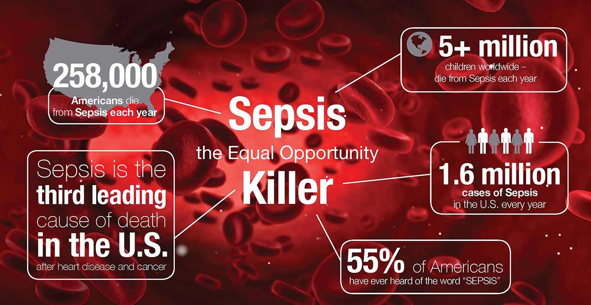
Sepsis - Statistics
Notes:
What is Sepsis ?
Sepsis is a potentially life-threatening condition caused by the body’s response to an infection. In a usual case, the body releases chemicals into bloodstream to neutralise an infection. Sepsis occurs when the body’s response to these chemicals is out of balance, triggering changes that can damage multiple organ systems.
Sepsis is caused by infection and can happen to anyone. Sepsis is most common and most dangerous in:
Older adults
Pregnant women
Children younger than 1
People who have chronic conditions, such as diabetes, kidney or lung disease, or cancer
People who have weakened immune systems
Statistics
In USA, 270,000 people die from sepsis each year
Internationally , 6 Million people die from sepsis each year
US hospitals spend 24 Billion each year on sepsis (13 % of Health Budget)
Each hour of delay in treatment can roughly increase mortality by 4–8 %
Source : https://www.mayoclinic.org/diseases-conditions/sepsis/symptoms-causes/syc-20351214

Slide 4
Sepsis - Affect and Symptoms
Affects:
very young children,
older adults,
people with chronic diseases,
and those with weakened immune system
Sepsis can be difficult to diagnose because it occurs quickly and can be confused with other conditions. Watch for a combination of the following symptoms.
S Shivering, fever, or very cold E Extreme pain or general discomfort (“worst ever”) P Pale or discolored skin S Sleepy, difficult to rouse, confused I “I feel like I might die!” S Short of breath

Slide 5
Objective
Goal of the analysis is the early detection of sepsis using physiological data.
The early prediction of sepsis is potentially life-saving, and we aim to predict sepsis 6 hours before the clinical prediction of sepsis.
Late prediction of sepsis is potentially life-threatening, and also consumes heavy hospital resources.
By predicting sepsis in non-sepsis patients or predicting sepsis very early in sepsis patients consumes limited resources and we can assume the risk of prediction to be minimal but revolutionary.

Slide 6
Challenge Dataset
Data used in the competition is sourced from ICU patients in two separate hospital systems and is obtained from Physionet.
The data will be split into 75% Training and 25 % testing set. The training set will be split for validating the training set.
The original data for each patient will be contained within a single pipe-delimited text file. Each file will have the same header and each row will represent a single hour's worth of data. Each hospital have 20,000 patients and hence 20,000 files.
Available patient co-variates consist of Demographics, Vital Signs, and Laboratory values
Features:
8 Vital Signs : Heart Rate, Temperature , Blood Pressure, Respiratory rate,
26 Laboratory Values : Platelet Count, Glucose , Calcium etc
6 Demographics : Age, Gender, Time in ICU , Hospital Admit time
1 Label :
0 (Non-sepsis) and 1 (Sepsis)
Notes:
The Challenge data repository contains one file per patient (e.g., training/p00101.psv ).
Each training data file provides a table with measurements over time. Each column of the table provides a sequence of measurements over time (e.g., heart rate over several hours), where the header of the column describes the measurement. Each row of the table provides a collection of measurements at the same time (e.g., heart rate and oxygen level at the same time).
Features:
Vital Signs : Heart Rate, Temperature , Blood Pressure, Respiratory rate, End tidal carbon dioxide
Laboratory Values : Platelet Count, Glucose , Calcium etc
Demographics : Age, Gender, Time in ICU , Hospital Admit time
Label :
0 (Non-sepsis) and 1 (Sepsis)
Hence we can see that this is a Binary Classification problem

Slide 7
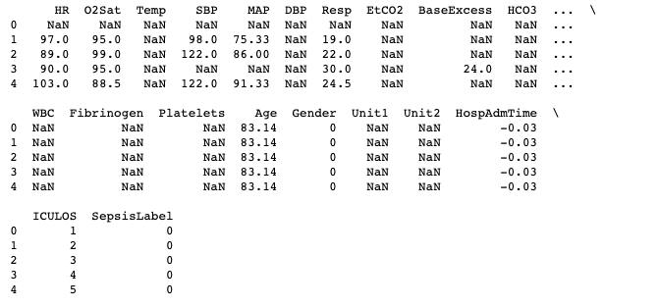
Sepsis Data
Notes:
I will explain the relevant features later

Slide 8
Assumptions
Combined dataset by appending all the patient files
Total files: 43,765 psv files
Shape of original file: (1552287 * 41)
The dataset is not time dependent.
2 approaches to solve it:
Add a time component and patient ID
Ignoring time component and consider each row independently
Following 2nd approach. Reason: Can predict sepsis without past patient data. More robust and need less resources.
Notes:
This approach would help in predicting Sepsis at each hour for any patient(with or without patient past data).
The data for the problem is an hourly time sequence record for each patient. But the records do not have a time-label associated with them, so that opens the scope of interpreting it as a non-temporal problem (ignoring the time component)
There are two ways in which one can approach this problem:
Temporal Approach : Take into the account the time component for the data. Sepsis is diagnosed for each patient at each hour using the past data.
Non-temporal Approach : Ignore the time component and treat record as independently and identically distributed. This approach would help in predicting Sepsis at each hour for any patient(with or without patient past data)

Slide 9
Procedure
Combine all Data
Non-time dependent approach
Handling Missing Values
Feature selection and feature Engineering
Handling Data Imbalance
Modelling and prediction
Notes:
Plan Of Action
The data for the problem is an hourly time sequence record for each patient. But the records do not have a time-label associated with them, so that opens the scope of interpreting it as a non-temporal problem (ignoring the time component)
There are two ways in which one can approach this problem:
Temporal Approach : Take into the account the time component for the data. Sepsis is diagnosed for each patient at each hour using the past data.
Non-temporal Approach : Ignore the time component and treat record as independently and identically distributed. This approach would help in predicting Sepsis at each hour for any patient(with or without patient past data)

Slide 10
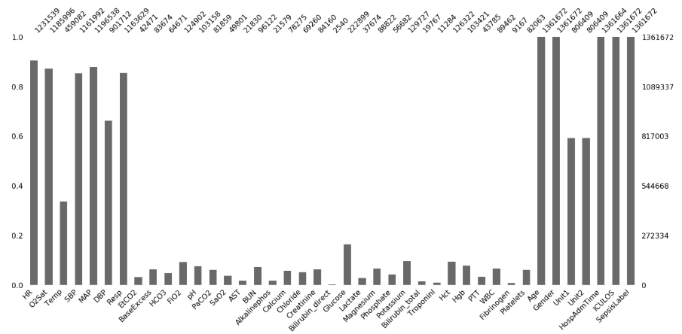
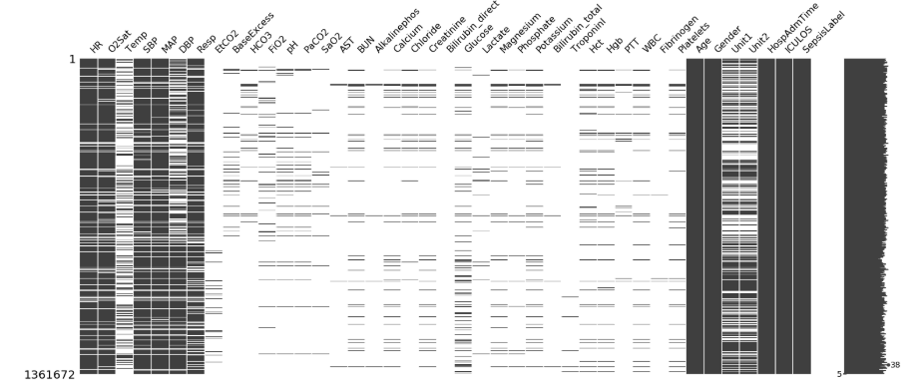
EDA - Handling Missing Values
Most of Laboratory Data are having missing values (Fig)
There are more than 90% of missingness in the dataset
2 steps to handle:
Remove features with missingness > 92%
Categorically encode features to handle missingness.

Slide 11
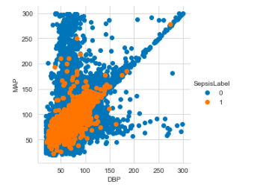
Feature Selection
Two Approaches employed for Feature Selection:
Checked correlation of features contributing to the presence of Sepsis
Read health magazines and Research journals such as
US National Library of Medicine, National Institutes of Health
Centers for Disease Control and Prevention
Sepsis - The American Journal of Medicine
and filtered out the most named indicator of Sepsis
Outcome: Heart rate, Pulse Oximetry, Body temperature, Blood Pressure (SBP, DBP), Mean Arterial Pressure, Respiration rate, Frac of inspired oxygen, Age, Gender, Hospital Admission Time and ICU length of stay.

Slide 12
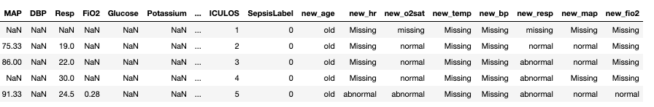
Feature Engineering & label encoding
Developed 8 new features and are described:
new_age : has 3 categorical values – old, young and adult
new_hr, new_temp, new_o2sat, new_bp, new_resp, new_map, new_fio2: has 3 categorical values – normal, abnormal and missing
Next, performed feature section again on them and selected all above features, plus Gender, Hospital Admission Time and ICU length of Stay for further processing as a training set
Notes:
1. Age¶
Three categories -
Child - Age less than 10 year
Adult - Age more than 10 year and less than 60 years
Senior - Age more than 60

Slide 13
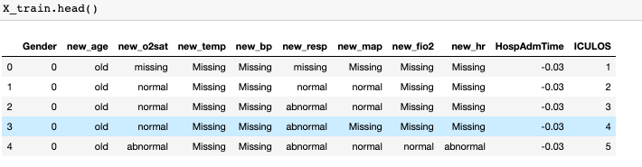
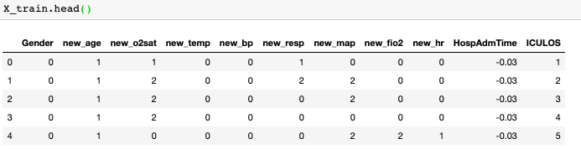
All these are categorically values. They are encoded so that it is easier to run a ML algorithm.

Slide 14
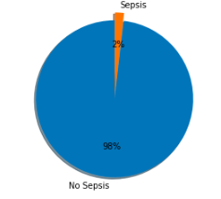
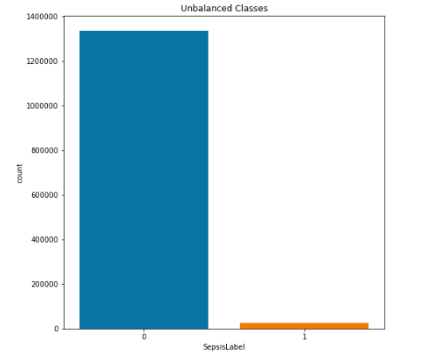
EDA – Handling Data Imbalance
98% of patients does not have sepsis and 2% have sepsis.
Problem with Accuracy
Ways to deal with Imbalance:
Under sampling
Oversampling
To deal with this data imbalance, we used oversampling technique (SMOTE).
Notes:
Non-Temporal Approach
In this approach we ignore the time component associated with each patient hourly record and treat them as independently and identically distributed.
Train-Validation-Test -Split
The data repository has data from two hospitals and a total of 40 thousand patients. The actual number of records would be higher as a patient could have stayed in the hospital for a variable amount of time.
Splitting these records to train , validation and test. While splitting I have made sure that each patient is fully contained in exactly one of the splits.
Train : 30K Patients
Test : 5K Patients
Validation : 5K Patients
Note : The script to divide the data to train -test-validation split can be found here https://github.com/kskaran94/Sepsis_Identification
Exploratory Data Analysis
After performing descriptive data analysis on the train data, these were the concerns that highlighted
Concerns
Extremely Imbalance data : As we can see from the bar plot, the records are extremely imbalanced (Less than 1 % vs 99 %+) with the minority class being Sepsis (1).

Slide 15
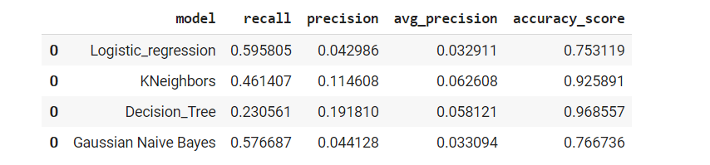
Data Modelling and Predictions
Before modelling our data with different models, we split it into training (75% of data) and testing (25% of data) parts.
For data modelling, we have used four different models, viz., Logistic Regression, KNN, Naïve Bayes, and Decision Trees.
The prediction results of all these models are tabulated as below in Table 1.
Table 1.

Slide 16
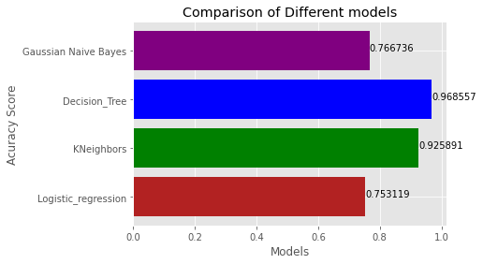
Comparison
Fig. below shows the comparison of different models on the basis of accuracy on predicting sepsis.
Among the four models, Decision Tree comes out with the best results with accuracy of 96.8557 %. K-Nearest Neighbors Classifier also gives a good accuracy of 92.5891%.
Notes:
Attribute Selection Measure:
Information Gain: which measures the impurity of the input set
Entropy: it refers to the impurity in a group of examples
Information gain computes the difference between entropy before split and average entropy after split of the dataset based on given attribute values
Gini Ratio: An extension to information gain known as the gain ratio. Gain ratio handles the issue of bias by normalizing the information gain using Split Info
Gini Index: Gini Index considers a binary split for each attribute. You can compute a weighted sum of the impurity of each partition
Attribute selection measure is a heuristic for selecting the splitting criterion that partition data into the best possible manner. It is also known as splitting rules because it helps us to determine breakpoints for tuples on a given node. ASM provides a rank to each feature(or attribute) by explaining the given dataset. Best score attribute will be selected as a splitting attribute (Source). In the case of a continuous-valued attribute, split points for branches also need to define. Most popular selection measures are Information Gain, Gain Ratio, and Gini Index.

Slide 17
Future Scope
Time component Approach ; need domain expert
PCA for understanding variables better
We can work further on SVM, XGBoost, Deep Learning techniques
Better Feature Engineering
Ways to reduce Hospital stay time

Slide 18
Conclusion
We have handled the missing ness and imbalance in the large dataset
We removed missing values > 92%
Performed feature engineering (8 new features) and selected important features
We aimed to predict the onset of the sepsis by 6 hours and so far the Machine Learning model employed seem to classify it partially
The project has a scope of continuing with further research on the importance of the features, better model building and under the guidance of a good health science domain expert.

Slide 19
References
[1] https://www.physionet.org/content/challenge-2019/1.0.0/
[2] https://www.datacamp.com/community/tutorials/decision-tree-classification-python
[3] https://towardsdatascience.com/using-bagging-and-boosting-to-improve-classification-tree-accuracy-6d3bb6c95e5b
[4] https://towardsdatascience.com/early-detection-of-sepsis-using-physiological-data-78d5f31fab9d
[5] https://iopscience.iop.org/article/10.1088/1757-899X/428/1/012004
[6] https://machinelearningmastery.com/roc-curves-and-precision-recall-curves-for-classification-in-python/
[7] https://www.cdc.gov/
[8] https://www.ncbi.nlm.nih.gov/pmc/articles/PMC6429642/
[9] http://www.erogol.com/fighting-class-unbalance-supervised-ml-problem/

Slide 20
Journals for publication
These are few journals in which I am thinking of publishing my paper:-
[1] https://jmai.amegroups.com/
[2] https://icacecs.org/callforpaper.php

Slide 21

Thank You
I would like to thank my professor Dr. U. Srinivasulu Reddy Sir for giving me the opportunity and necessary skills to attempt and complete the project.
I would also like to Jayanthan Sir for helping me throughout the project
I would also like to thank my friends for advising me different ways to approach the problem

