Slide 1
Stock Price Prediction
Project Instructors:-
Dr. Ravi Changle
Team Members:-
Chirag Jain
Darshan Mehta

Slide 2
Introduction
Analysis of Industry (as a whole in these time)
There are so many factors involved in the prediction – physical factors vs. pshycological, rational and irrational behaviour, fair trading, etc.
All these aspects combine to make share prices volatile and very difficult to predict with a high degree of accuracy.
Machine learning techniques have the potential to unearth patterns and insights we didn’t see before, and these can be used to make unerringly accurate predictions.
Research Papers

Slide 3
PROJECT OBJECTIVE :
Optimising returns with calculated risk as means of investment
In this project, we will work with historical data about the stock prices of a publicly listed company and try to understand its behavior.
Develop a platform for users to analyze the stocks as predicting how the stock market will perform is one of the most difficult things to do.
We will implement a mix of machine learning algorithms to predict the future stock price of this company, starting with simple algorithms like averaging and linear regression, and then move on to advanced techniques like Auto ARIMA and LSTM.

Slide 4
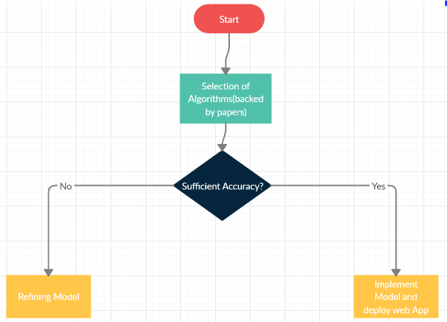

Slide 5
Plan of action:
Initialization and data gathering
Model Selection and creation (backed by Papers)
Deployment of Models & Refining (Linear Regression, LSTM, Decision Forest regression, ARIMA)
Deploying Web Services (Azure and Flask API)
Web App Creation (Development of site for the users)
Future Scope

Slide 6
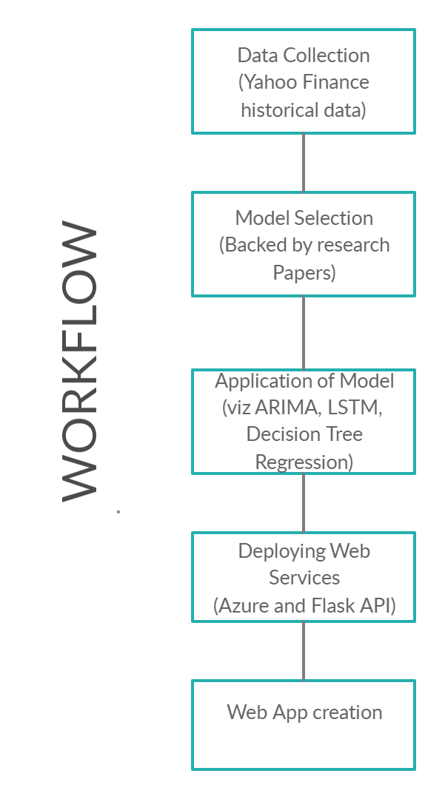

Slide 7
Initialization and data gathering
First the historical data of different companies were extracted from the yahoo! Finance with the time span of 4-5 years.
The historical data was collected from three sectors( to ensure diversity):-
IT Sector
Pharmaceutical Sector
Automobile sector
The main objective of splitting the data into two categories mentioned above is to compare the future stock prices of these three sectors as there is unusual fluctuation in the market due to the coronavirus pandemic.
Correlation in data ( non significant)
For the datasets :- click here

Slide 8
Data Preprocessing and Data Visualization
The collected data is preprocessed in the following ways:-
Checking the data has any missing values in any cell.
Finding the correlation between its feature columns and the target column.
Normalizing the dataset to reduce complexities.
Calculating the descriptive determination of the dataset.
The preprocessed data is then visualized by using various plots such as boxplot, scatterplot etc.

Slide 9
Model Creation
For the model selection ,we studied various research papers and publications and we find out that for the optimal results , the following models are suited as:-
Long Short Term Memory(LSTM)
Autoregressive Integrated Moving Average(ARIMA)
Ensembling Models.

Slide 10
Model Refining
In each model execution , we used different hyper parameter tunings such as RMSE(Root Mean Square Error) score and r2 score etc.
After the analysis of each model was done , we compared the results of each model with another.
After the detailed comparison , ARIMA model was selected as it contained the highest accuracy among the models.
Results of LSTM
Results of ARIMA

Slide 11
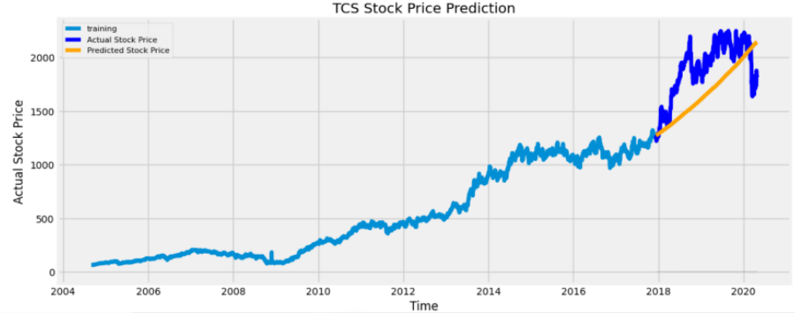


Slide 12
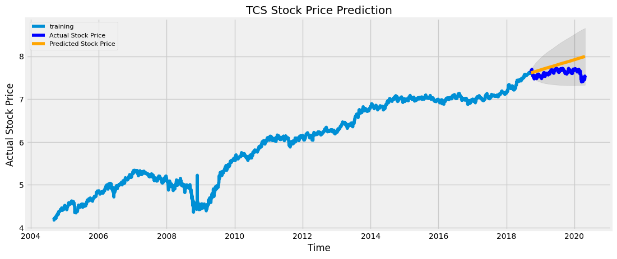

Slide 13
COMPARISON OF ALGORITHMS
Algorithm | Accuracy
Linear Regression | RMSE: 34
LSTM | RMSE: 0.17
ARIMA | RMSE: 0.16
After getting these results, we found ARIMA model most convincing

Slide 14
Azure Deployment
For the azure deployment , we created the resource group in azure portal.
In resource group , we used the machine learning workspace platform for experiment test.
After the successful execution of the experiment , the model was deployed on azure platform by generating the API key along with the codes in different languages.

Slide 15
Web App Creation
After generating the resource API key , our objective is to generate a web application.
For creating the web application , we used the flask framework along with the HTML and CSS.
After its successful execution , the application would be able to predict the future stock prices of different companies.

Slide 16
Future Scope
Future scope of this project will involve adding more parameters and factors like the financial ratios, multiple instances, etc and eventually delivering portfolio services.
The more the parameters are taken into account more will be the accuracy.
The algorithms can also be applied for analyzing the contents of public comments and thus determine patterns/relationships between the customer and the corporate employee.
It has a huge scope for improvement and development with the increasing trends and developments in Machine Learning.

