Slide 1
Efficient Product Inventory Management in E-Commerce Using Hash Table ADT
By darshan pranav cs
192511315

Slide 2

Introduction
E-commerce platforms such as Amazon, Flipkart, and eBay manage millions of products. Customers expect instant product searches and accurate stock information. To achieve this, efficient data structures are required. \
A Hash Table ADT is one of the most suitable choices for managing product information and inventory updates.

Slide 3
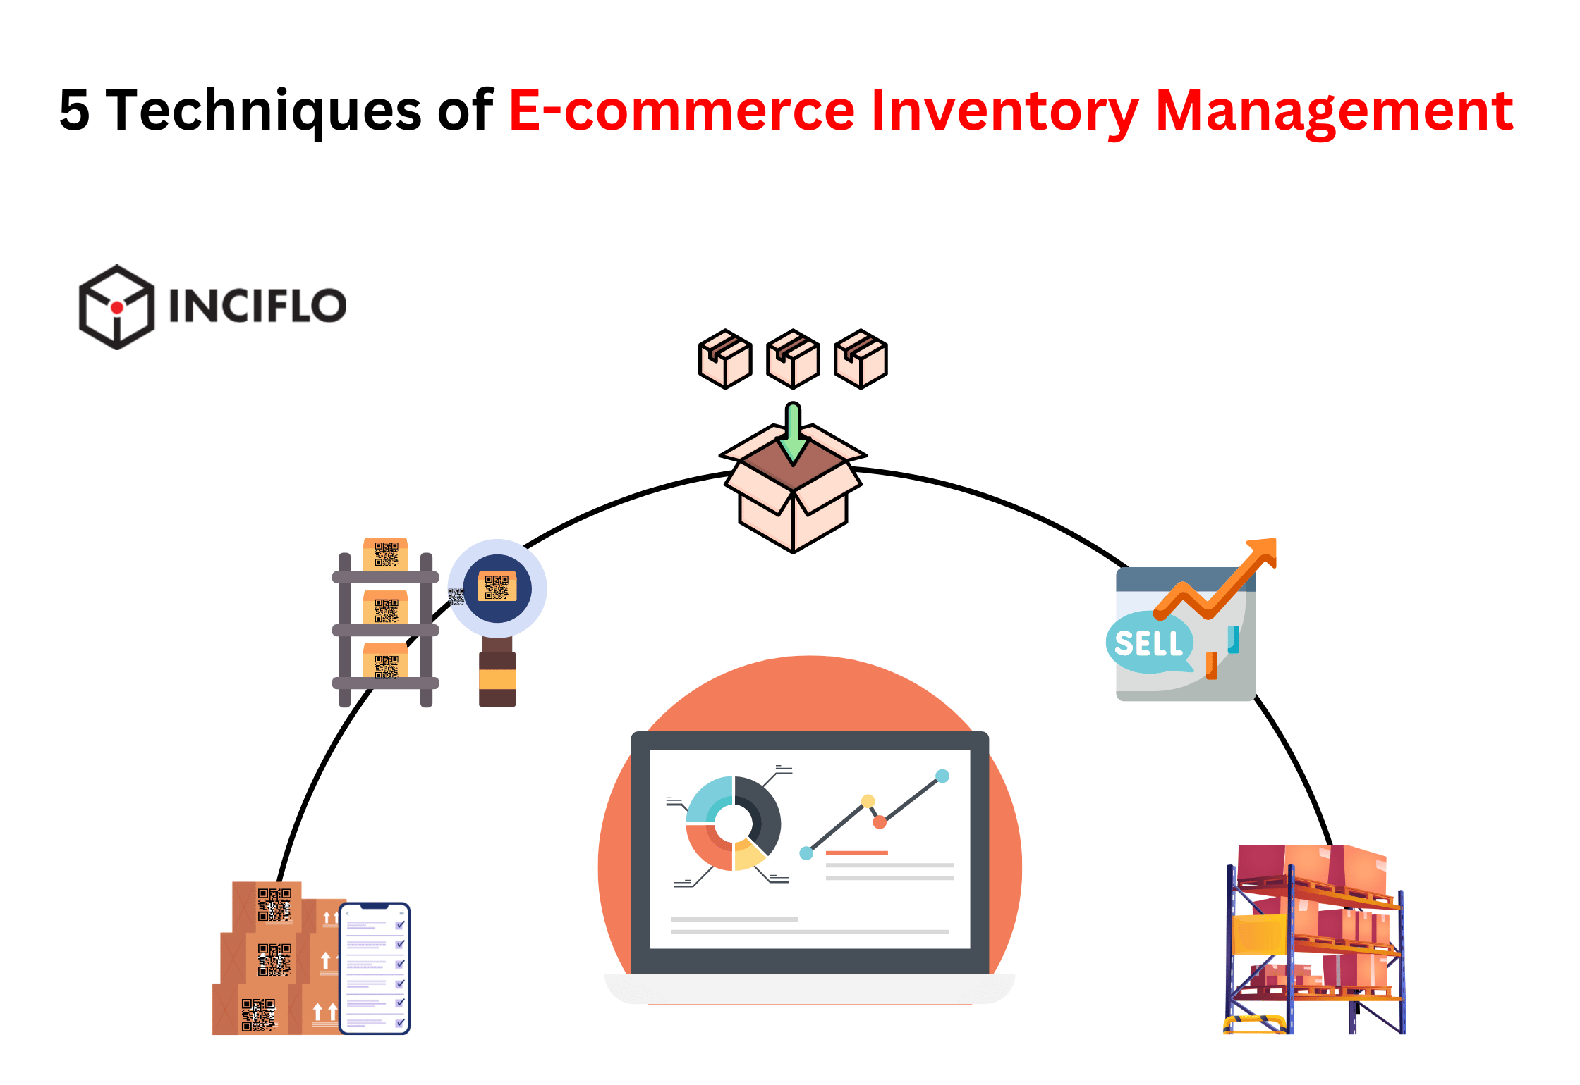
Problem Analysis and Requirements
Inventory Management Challenges
Large volume of product records.
Frequent stock updates due to purchases and restocking.
Need for fast product searches.
Prevention of stock inconsistencies.
Handling multiple customer requests simultaneously.
System Requirements
The inventory system should support:
Product insertion.
Product search.
Stock updates.
Product deletion.
Real-time inventory tracking.

Slide 4
Recommended ADT – Hash Table
Structure
Key: Product ID Value: Product Information
Example:
Product ID | Product Name | Price | Stock
P101 | Laptop | $800 | 25
P102 | Mobile | $500 | 40
P103 | Headphones | $50 | 15

Slide 5
Performance Efficiency Analysis
Time Complexity Comparison
Operation | Array | Linked List | Hash Table
Search | O(n) | O(n) | O(1)
Insert | O(1) | O(1) | O(1)
Update | O(n) | O(n) | O(1)
Delete | O(n) | O(n) | O(1)

Slide 6
Advantages, and Conclusion
Advantages of Hash Table ADT
Constant-time access (O(1)).
Efficient memory utilization.
Supports real-time stock management.
Easy implementation and maintenance.
High scalability for large databases.
Conclusion
A Hash Table ADT is the most suitable data structure for e-commerce inventory management because it provides:
Fast product searches.
Efficient stock updates.
Improved system performance.
Better scalability and user experience.

Slide 7
HTML Syntax Checking Using Stack ADT

Slide 8
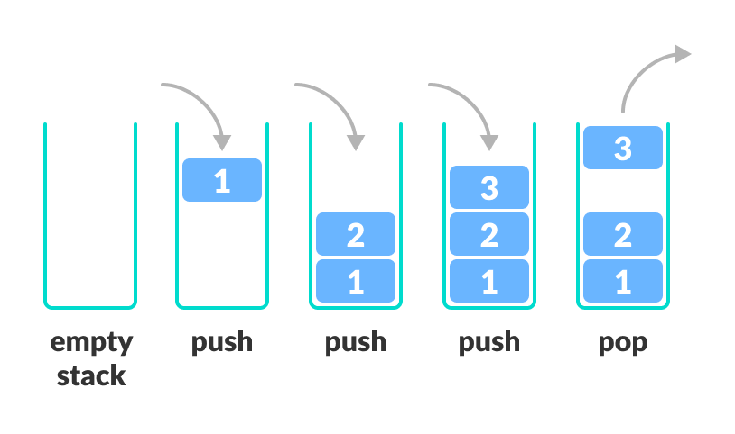
Introduction
Web browsers and code editors must verify whether HTML tags are properly opened and closed.
A syntax checker ensures that every opening tag has a corresponding closing tag and that tags are correctly nested. The
Stack ADT is the most suitable data structure for this task.

Slide 9
Problem Analysis and Requirements
Challenges in HTML Syntax Checking
Detecting missing closing tags.
Identifying incorrectly nested tags.
Processing large HTML documents efficiently.
Providing quick error detection during coding.
System Requirements
The syntax checker should:
Track opening tags.
Match closing tags with corresponding opening tags.
Detect syntax errors immediately.
Validate proper nesting of tags.

Slide 10
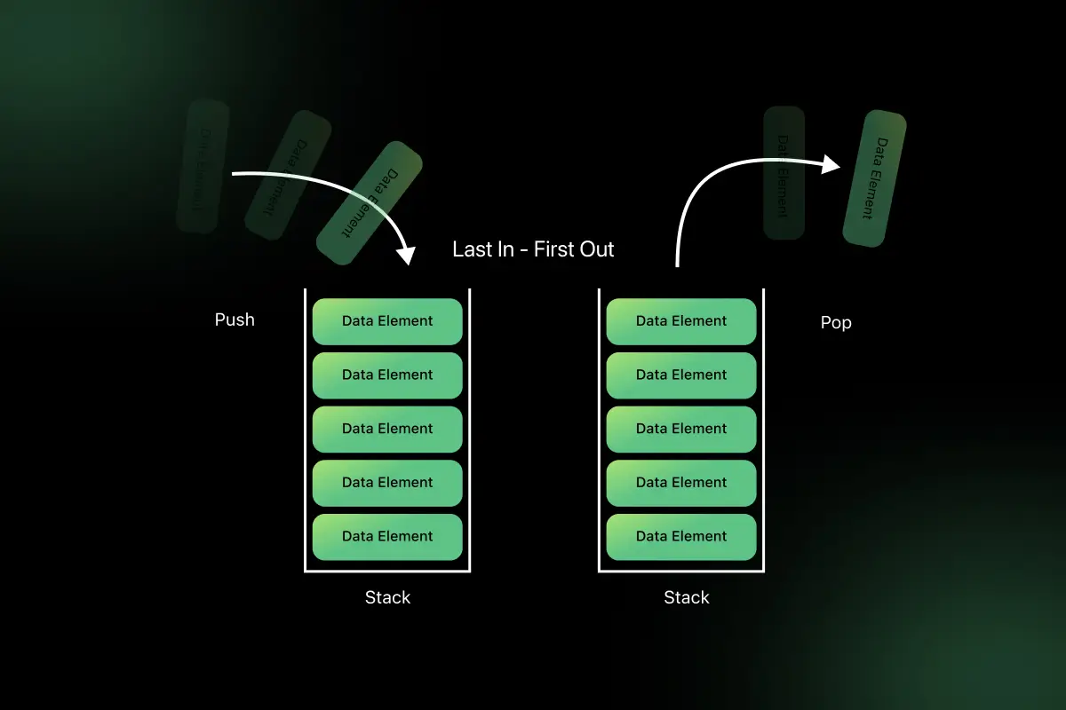
Recommended ADT – Stack
Basic Operations
Push: Add an element to the top.
Pop: Remove the top element.
Peek: View the top element.
IsEmpty: Check whether the stack is empty.
Push <div>
Push <p>
Encounter </p> → Pop <p>
Encounter </div> → Pop <div>
Stack becomes empty → HTML is valid

Slide 11
Performance Efficiency Analysis
Algorithm
Read HTML tags one by one.
Push opening tags onto the stack.
For every closing tag:
Check stack top.
If matching opening tag exists, pop it.
Otherwise report an error.
At the end, the stack must be empty
Operation | Stack
Push | O(1)
Pop | O(1)
Peek | O(1)
HTML Validation | O(n)

Slide 12
Advantages, and Conclusion
Advantages of Stack ADT
Simple and efficient implementation.
Naturally supports nested structures.
Constant-time insertion and deletion.
Easy detection of syntax errors.
Suitable for large HTML documents.
Conclusion
The Stack ADT is the most suitable data structure for HTML syntax checking because it follows the LIFO principle, which perfectly matches the nested nature of HTML tags.

