Slide 1


Slide 2
WHAT IS WEB FIREWALL?
A web application firewall is a type of firewall designated to protect web applications. It continuously inspects HTTP traffic to detect and block malicious traffic and web application attacks. This can include access violations, API manipulations, advanced HTTP DDoS attacks, cookie poisoning, and many more.

Slide 3



Slide 4
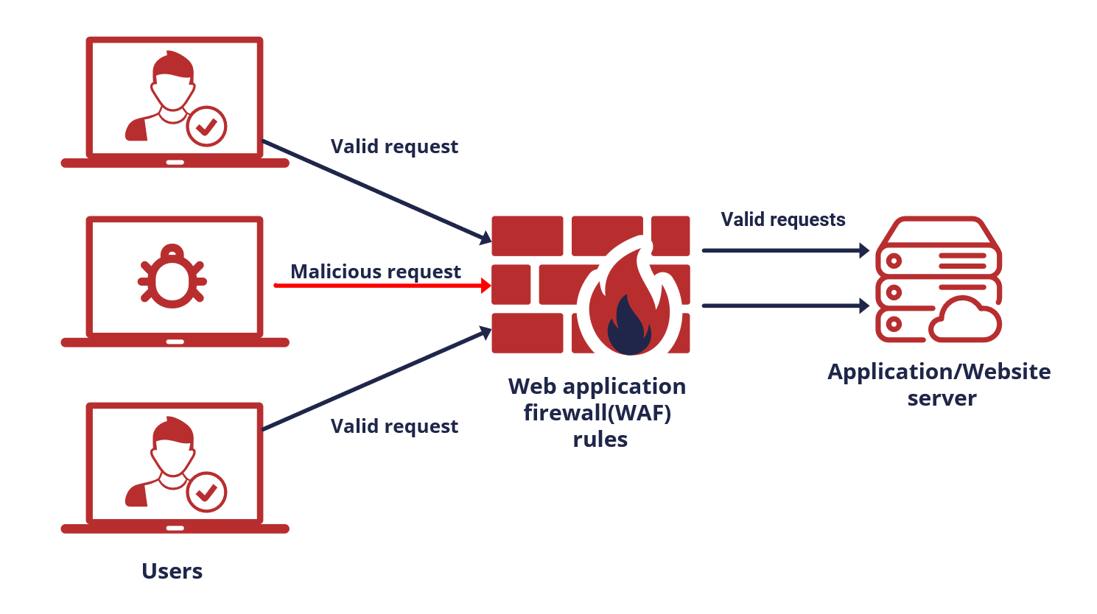

Slide 5
Types of Web Firewall
Web Firewall provides protection for web applications against attacks, including cross-site scripting, file inclusion, cross-site forgery, Structured Query Language (SQL) injection, and other threats. In the Open Systems Interconnection (OSI) model, a WAF works within Layer 7.

