Slide 1
A ONE STOP FOCUSING ON TOURSIM
VIVA-VOCE
Batch Number:COM-17
Under the Supervision of,
Ms. AMIRTHA PREEYA V
Assistant Professor,
School of Computer Science & Engineering
Presidency University
20211COM0040 | DARSHAN S M
20211COM0043 | MANOHAR S V
20211COM0057 | CHETAN N
20211COM0067 | K P PAWAN

Slide 2
Introduction
Traveling is more of discovery of new cultures and breathtaking destinations rather than being between places. Thanks to how technology advances with such a big momentum, it has dramatically altered people's approach to travel. Nowadays, travelers call for solutions that are not just convenient but also efficient as per their tastes. Our tourism-focused application would answer the need in an all-rounded platform designed to simplify everything that a traveler wants-from knowing destinations to booking accommodations to planning an itinerary-the whole application will be serving as an all-in-one one-stop shop for users all around the world, thus creating a simple process for the travel world to go about their business in the simplest of ways possible.
Such a holistic application is just ideal for the adventurous individual, family travelers, business tourists, and cultural explorers who always seek more variety and experience. It really saves much time and energy since there is no need to have access to different apps or websites for the different needs. Integration of cultural elements such as promotion of local food, facilitating culturally enhanced experiences, and making it different from other run-of-the-mill travel solutions.
This tourism platform is designed in a scalable and adaptable manner, drawing from modern software architecture in order to allow further expansion in the future-whether in terms of new destinations, increased features, or integration of even more services like car hire and event bookings. It continues staying on the edge of technological development so that this platform stays relevant and value-added to its users.

Slide 3
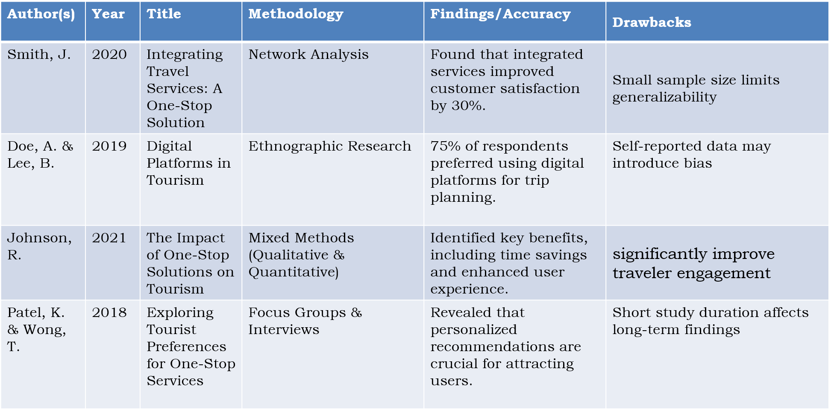
Literature Review

Slide 4
Research Gaps Identified
Fragmented service ecosystems
Lack of Real-Time Updates
Poor error handling and user support
Challenges in Integration of Local Experiences

Slide 5
Proposed Methodology
The proposed approaches for the development of a tourist-based mobile application are based on Java as the core development language. It is built on an extremely strong set of libraries, supports Android application development tools, and offers platform independence that makes it ideal for developing a reliable mobile application with all the key features. We now illustrate the step-by-step methodology of building the application in the next section. It begins with collecting requirements by holding stakeholder meetings, conducting surveys, and analyzing the market, then it defines the features of an application like destination search, booking options, itinerary planning, and user reviews.With this requirement in place, a structured plan with feature prioritization, timeline estimation, and resource allocation will be prepared.

Slide 6
Objectives
5.1 User Experience:
A core mobile tourism application should primarily have a smooth, intuitive user experience. It has to be very easy for one to navigate through this app so that it's available to its users. Such will enable the ability of finding the sought information on it rapidly.
5.2 Completeness of Travel Information Provided:
The mobile application will replete with providing the tourists current information regarding tourist attractions destinations, accommodations, air routes, transportations as well as local attractions.
5.3 Travel Information:
The hotel activity booking and local transportation booking are considered as core aims in developing this tourism mobile application. This booking third-party API comprises booking the hotel, making searches on flights, booking the activities, and third party, hence users end completing the whole process on traveling by sitting within the app.

Slide 7
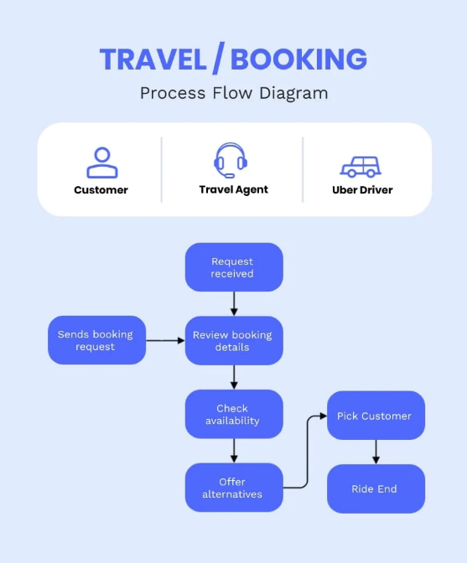
System Design and Implementation

Slide 8
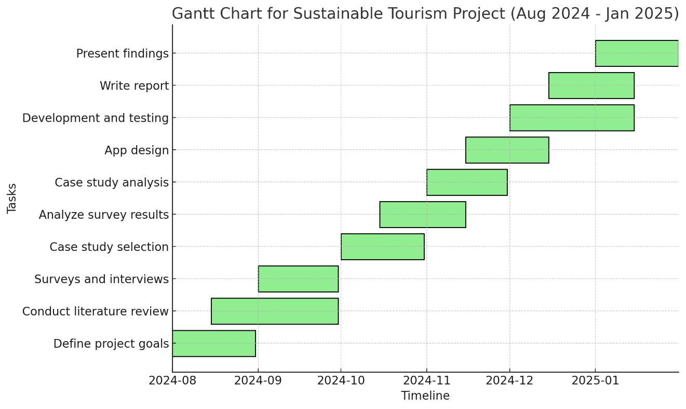
Timeline of Project

Slide 9
Outcomes/Results Obtained
Accurate Travel Recommendations: The platform leverages user preferences, past bookings, and local insights to predict and recommend the best travel destinations, activities, and experiences tailored to individual users with high accuracy.
Pattern Recognition and Personalization: By identifying patterns in user behavior and travel trends, the system creates highly personalized itineraries, offering a seamless and enjoyable travel planning experience.
Real-time Updates: The web-based application provides real-time information on bookings, weather, local events, and transportation schedules, enabling users to make informed decisions and adjustments during their trips.
Enhanced Trip Planning: Predictive insights allow travelers to plan their trips more effectively by highlighting peak seasons, offbeat attractions, and potential travel disruptions, resulting in a smooth travel experience.

Slide 10
Conclusion
A one-stop tourism platform would be a landmark step for how people would engage with services and organize their travels. All the big problems both consumers and providers have would be solved easily, for all the disparate parts of the industry would, for the first time, integrate into a user-friendly, one-application platform. That means that regarding the foundation, there are three main aspects, and these include easier planning and navigation for travel, smooth experiences for a customer, and further efficiency in operations for making a usage of modern technologies coupled with applications which are appropriately designed.

Slide 11
References
[1] A. b. Md Saad and I. S. bin Mohamad Noor Azam, "Development of Travex: A
Comprehensive Mobile Application Promoting Penang Tourism Industry," 2024
IEEE 14th Symposium on Computer Applications & Industrial Electronics
(ISCAIE), Penang, Malaysia, 2024
[2] F. Garzotto, P. Paolini, M. Speroni, B. Proll, W. Retschitzegger and WSchwinger,
"Ubiquitous access to cultural tourism portals," Proceedings. 15th International
Workshop on Database and Expert Systems Applications, 2004., Zaragoza, Spain,
2004
[3] A. Adam, "Stats Dept: Covid-19 pandemic slashed Malaysia's 2020 tourist
arrivals by 83.4pc worst drop in history", Malay Mail, 2021
[4] A. K. Sharma and M. Singh, "Design and Development of TourEase: A Smart Tourism
Mobile Application for Indian Destinations," 2024 IEEE International Conference on
Smart Technologies, New Delhi, India, 2024.

Slide 12
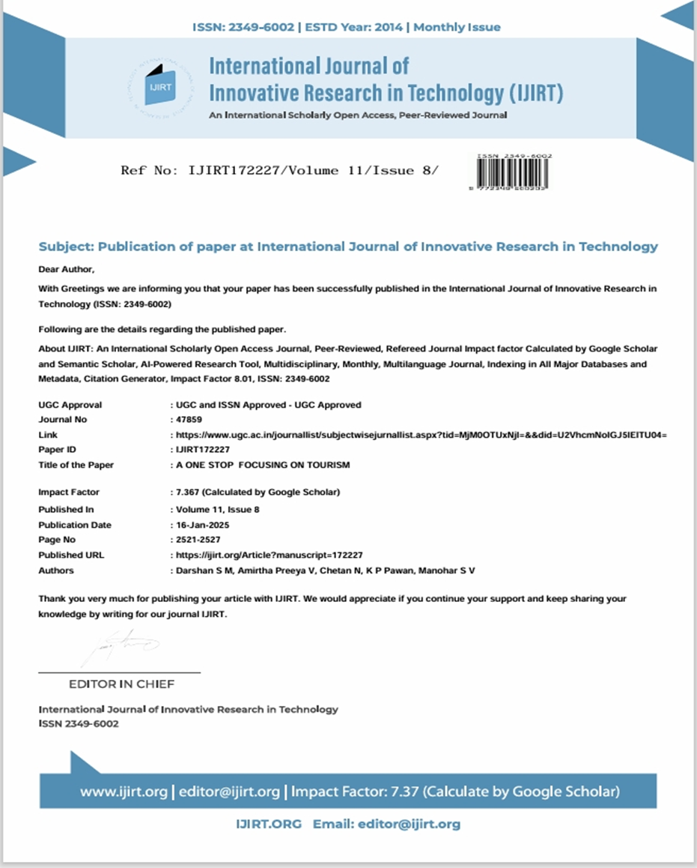
Publication Details

Slide 13

Sustainable development Goals (SDGs)

Slide 14
Thank You

