Slide 1
CSE University Project Final Review
Chatbot to respond to text queries pertaining to various Acts, Rules, and Regulations applicable to Mining industries
Batch Number: COM17
Roll Number | Student Name
20211COM0040 | Darshan S M
20211COM0043 | Manohar S V
20211COM0057 | Chetan N
20211COM0067 | K P Pawan
20211COM0021 | T Bhavitha Reddy
Under the Supervision of,
Ms. Amirtha Preeya V
Assistant Professor
School of Computer Science and Engineering
Presidency University
Name of the Program: B.Tech
Name of the HoD: Dr. Gopal Krishna Shyam
Name of the Program Project Coordinator: Dr. P. Sudha
Name of the School Project Coordinators: Dr. Sampath A K / Dr. Abdul Khadar A / Mr. Md Ziaur Rahman

Slide 2
INTRODUCTION
This project offers a simple but practical chatbot interface that allows users to interact with an AI-powered bot, providing an interactive conversation experience. The chatbot is triggered by a floating chat button at the screen's bottom right corner. On clicking, the chat button opens the chatbot interface, presenting a conversation window where users can type messages and receive responses. The chatbot utilizes OpenAI's GPT-3.5 model, in which the user's input is analyzed and answered right away using human responses in order to make the conversation seem natural. The chatbot contains a header with the name of the bot and close icon, a message area to display the conversation, and an input field in which users can write their messages. User messages are displayed on the right-hand side of the screen with a red background, and bot responses on the left-hand side with a darker background so that they can be easily distinguished. Integration with the OpenAI API is perhaps the most significant feature of this chatbot implementation.

Slide 3
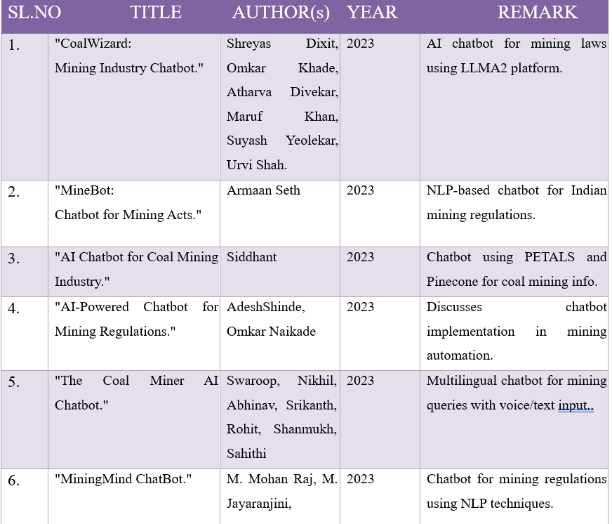
LITERATURE SURVEY

Slide 4
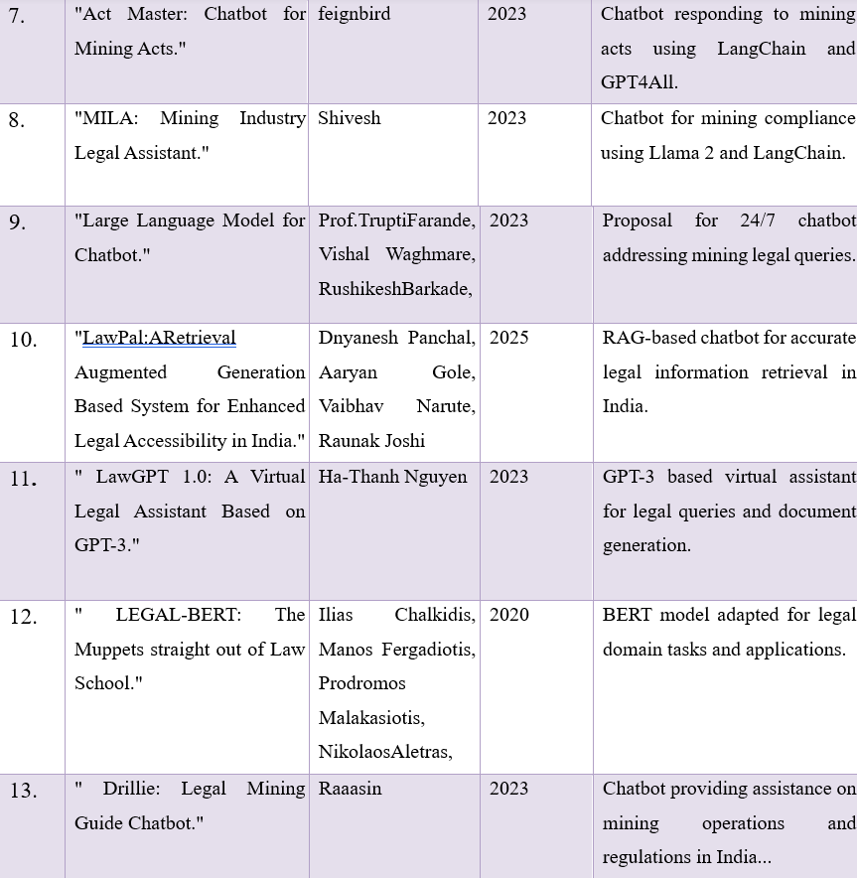
CONTINUE

Slide 5
Objectives
The ultimate aim of this project is to develop a chatbot platform for the legal and operational needs of the mining industry. Following are some specific objectives:
Design a conversational AI interface via which end-users can interact with a bot trained or prompted on mining regulations. Integrate OpenAI’s GPT-based models to provide intelligent, context-aware responses to user queries. Offer multi-mode input modes like text, voice, and file upload to assist it in various ways. Offer interactive and responsive frontend design with the advantage of next-gen web tech to provide extended support for it accessed by multiple users on diverse devices.

Slide 6
Outcomes/Results Obtained
The modals have a dark theme similar to the rest of the site's look and feel and provide an immersive user experience with clean input fields and styled buttons. Once the conversation has begun, the sidebar appears, providing settings to view and clear chat history. The chatbot window is a properly designed fixed pane with a title, scrollable message content, and an input box that accepts text input, voice input via Speech Recognition API, and file upload option. Message bubbles differentiate user and bot messages with alternative styles for improved readability.
Voice input is smoothly supported, hence users can send messages via voice, thus enhancing the usability of the platform. Secondly, client-side JavaScript controls UI interactions effectively such as controlling dropdowns to show or hide, open and close modals, add new messages, and refresh the page. The control of visibility of chat history is controlled by a button, and it is easy for users to remove conversation logs. Following minimalist yet effective animations, interactive elements, and a new dark UI theme, it becomes feasible for a professional user experience.

Slide 7
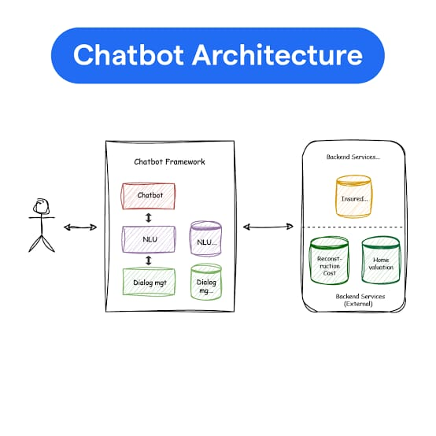
SYSTEM DESIGN & IMPLEMENTATION

Slide 8
SYSTEM DESIGN & IMPLEMENTATION
The image illustrates a typical chatbot architecture, showcasing the interaction between users, the chatbot framework, and backend services. At the front end, a user interacts with the chatbot through a user interface. The chatbot receives the input and passes it to the Natural Language Understanding (NLU) module, which analyzes the text to determine the user’s intent and extract relevant entities. The NLU module is connected to a knowledge base or database that supports its processing capabilities. Once the intent is identified, the dialog management component takes over. This module maintains the context of the conversation, manages session flow, and determines the appropriate response or next action. It ensures the chatbot behaves logically and contextually throughout the interaction. If the required information is not available internally, the chatbot communicates with external backend services. These include databases such as "Insured Data" and services like "Reconstruction Cost" and "Home Valuation", which may reside in external systems. The dialog manager fetches data from these sources as needed and formulates a final response, which is sent back to the user via the chatbot interface. This architecture allows for modular, scalable, and intelligent chatbot systems capable of handling complex user queries by integrating natural language processing with external data services.

Slide 9
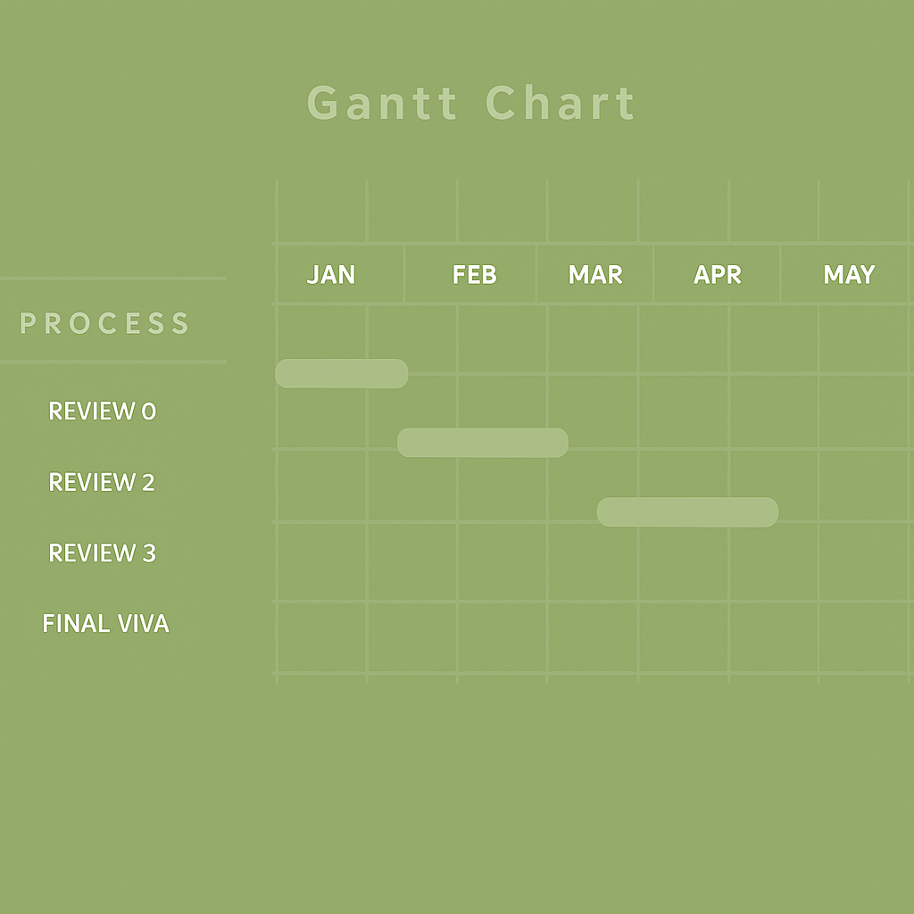
Timeline of the Project (Gantt Chart)

Slide 10
References (IEEE Paper format)
International Research Journal of Modernization in Engineering Technology and Science, vol. 5, no. 9, pp. 450–457, Sep. 2023.
Bharath S, Kavya S, Gokula Vadhana S, Gladson Rennis S. "A Regulatory Chatbot for Mining Industries." International Research Journal of Modernization in Engineering Technology and Science, vol. 5, no. 9, pp. 450–457, Sep. 2023.
"Chatbot to Respond to Text Queries Pertaining to Various Acts, Rules, and Regulations Applicable to Mining Industries." International Journal of Emerging Technologies and Innovative Research, vol. 10, no. 11, pp. 380–390, Nov. 2023.
M.-H. Tsai, H.-Y. Chan, Y.-L. Chan, H.-K. Shen, P.-Y. Lin, and C.-W. Hsu, "A Chatbot System to Support Mine Safety Procedures during Natural Disasters," Sustainability, vol. 13, no. 2, p. 654, Jan. 2021.
G. Devi M and K. Siranjeevi, "Minebot: Chatbot to Respond to Text Queries Pertaining to Various Acts, Rules, and Regulations Applicable to Mining Industries," International Journal of Research Publication and Reviews, vol. 5, no. 3, pp. 4317–4325, Mar. 2024.

Slide 11
Continue References
H. Joshi and K. Tiwari, “Designing Conversational AI Systems for Regulatory Compliance,” in Proc. 2024 Int. Conf. on Artificial Intelligence and Law (ICAIL), pp. 212–218, Mar. 2024.
P. N. Rao, R. Venkatesh, and M. L. Roy, “Automation in Mining: Leveraging AI for Legal Query Systems,” IEEE Transactions on Industry Applications, vol. 60, no. 1, pp. 375–382, Jan. 2024.
S. R. Das and M. R. Pillai, “Chatbot Framework for Indian Mining Regulations Using NLP,” in Proc. 2023 IEEE Int. Conf. Industrial Informatics and Smart Manufacturing (ICIISM), pp. 66–71, Nov. 2023.
B. N. Acharya and A. S. Reddy, “Application of AI in Mining Compliance Monitoring,” IEEE Access, vol. 11, pp. 142320–142330, Dec. 2023.
V. K. Sharma and D. Thomas, “AI-Powered Legal Assistants for Indian Industrial Sectors,” in Proc. 2024 Int. Conf. on Emerging Trends in AI and Machine Learning (ICETAML), pp. 55–60, Feb. 2024.

Slide 12
GitHub Link
https://github.com/DarshanSM26/universityproject8th

Slide 13

Sustainable development Goals (SDGs)

Slide 14


