Slide 1

XXIII CISCON2026
Paper ID: 234
Deep Learning Driven Brain Tumor Detection
Using ResNet50–ResUNet
Presenter Name: Darshan Suresh
Presentation Date: 8th August 2026
Department & Institution Name: Dept. of Computer Science, Amrita School of Computing, Amrita Vishwa Vidyapeetham, Mysuru
Contact Details: darshansuresh1804@gmail.com
Notes:
Good morning, respected session chair, distinguished professors, researchers, and fellow participants. I am Darshan Suresh from the Department of Computer Science, Amrita School of Computing, Amrita Vishwa Vidyapeetham, Mysuru. Today I present our work, 'Deep Learning Driven Brain Tumor Detection Using ResNet50-ResUNet.' Brain tumors are among the most serious neurological diseases, and accurate MRI-based diagnosis directly affects treatment planning and survival. However, manual interpretation is time-consuming and expertise-dependent. We propose a two-stage deep learning framework: ResNet50 first determines whether a scan contains a tumor, and ResUNet then segments the tumor boundary - giving both detection and localization in one pipeline.

Slide 2
Content
• Introduction & Motivation
• Literature Summary & Research Gap
• Objectives of the Research Work
• Proposed Methodology
• Dataset, Preprocessing & Model Design
• Experimental Results & Performance
• Comparison with Existing Methods
• Real-World Applications & Conference Theme Alignment
• Conclusion & Future Scope
Notes:
Here is the outline for today's talk - starting with the clinical motivation, moving through the literature gap our work addresses, the proposed two-stage methodology, our experimental results and comparisons, and closing with applications, limitations and future scope.

Slide 3
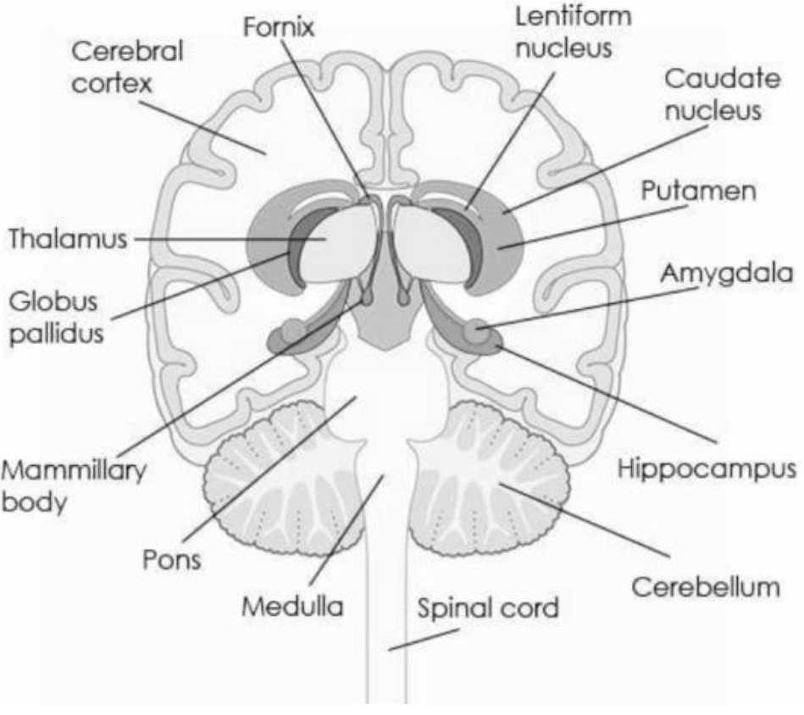
Introduction
• Brain tumors are among the most serious neurological diseases — early diagnosis is critical for treatment planning and survival
• MRI is the preferred imaging modality: excellent soft-tissue contrast, no ionizing radiation
• Manual interpretation of MRI scans is time-consuming and highly dependent on radiologist expertise
• Existing deep learning approaches largely address classification OR segmentation in isolation, with limited statistical validation
• This work proposes an integrated ResNet50–ResUNet framework for simultaneous tumor detection and localization, validated through repeated experimental runs
Fig. Annotated cross-sectional view of the human brain
Notes:
Brain tumors are one of the most challenging neurological diseases because accurate diagnosis directly influences treatment planning and patient survival. MRI is widely used because it visualizes soft tissue with high resolution without ionizing radiation. But manual interpretation is time-consuming and depends heavily on radiologist expertise - a growing burden as imaging volumes rise. Prior deep learning work tends to solve only classification or only segmentation, and rarely reports statistical validation. Our framework integrates both stages and validates results across repeated runs. To be clear - our goal is not to replace radiologists, but to act as an intelligent assistant that highlights suspicious regions so clinicians can focus on diagnosis and treatment planning.

Slide 4
Literature Summary
• CNNs automatically learn hierarchical MRI features, outperforming traditional handcrafted feature-extraction methods [1]
• Transfer learning with ImageNet-pretrained weights improves performance on limited medical imaging datasets [5]
• ResNet's residual learning eases training of very deep networks and mitigates the vanishing-gradient problem; several studies report >95% classification accuracy [2]
• U-Net's encoder–decoder architecture with skip connections preserves spatial detail for biomedical segmentation [3]
• ResUNet integrates residual blocks into U-Net, improving feature extraction and segmentation accuracy over conventional segmentation networks [4]
• Focal Tversky Loss effectively handles class imbalance in medical image segmentation [6]
Research Gap: Most existing studies focus on classification or segmentation alone, and give little attention to statistical validation and reproducibility of results.
Notes:
Numerous deep learning models have been proposed for brain tumor analysis. Some focus only on classification - whether a scan has a tumor; others focus only on segmentation - outlining the tumor boundary. Individually these have shown promise, but they solve only one part of the diagnostic process. Another gap in the literature is that many studies report high accuracy but give limited evidence of consistency and reproducibility. Our work addresses both limitations by integrating classification and segmentation in one framework and validating it through repeated experimental runs.

Slide 5
Objectives of the Research Work
• Develop an integrated ResNet50–ResUNet framework for simultaneous tumor detection and localization
• Utilize transfer learning to improve classification performance on limited MRI datasets
• Apply advanced preprocessing and data augmentation to improve model robustness and generalization
• Conduct comprehensive evaluation using both classification and segmentation metrics
• Perform statistical validation through repeated experimental runs and confidence-interval analysis
Notes:
Our objectives are five-fold: build an integrated ResNet50-ResUNet framework that both detects and localizes tumors; use transfer learning to make the most of a limited MRI dataset; apply preprocessing and augmentation for robustness; evaluate comprehensively with both classification and segmentation metrics; and statistically validate the results through repeated runs and confidence intervals - so the reported performance can be trusted as reproducible, not a one-off result.

Slide 6
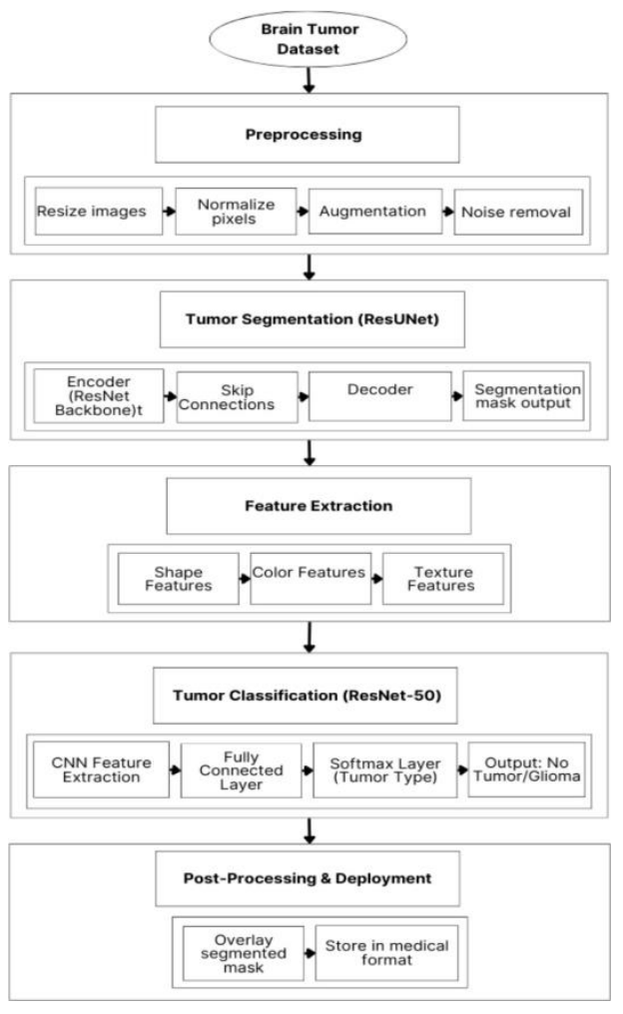
Methodology – Proposed Two-Stage Framework
• Stage 1 – Classification:
  – MRI input → preprocessing → ResNet50 → Tumor / Non-Tumor prediction
• Stage 2 – Segmentation:
  – Tumor-positive MRI → ResUNet → pixel-wise mask → tumor localization
• Segmentation runs only on tumor-positive scans — efficient, avoids unnecessary computation
• Answers both “Is there a tumor?” and “Where exactly is it?” in a single workflow
Notes:
Our system is a two-stage deep learning pipeline. The process begins with an MRI image, preprocessed for consistency, then passed to ResNet50 for binary classification - tumor or non-tumor. If no tumor is found, the workflow ends, avoiding unnecessary computation. If a tumor is detected, the image moves to ResUNet, which performs pixel-wise segmentation to generate a tumor mask, giving the exact location and boundary. So our contribution isn't just detecting tumors - it's combining detection and localization within a single workflow, the way airport security screens all baggage quickly and only inspects suspicious bags in detail.

Slide 7
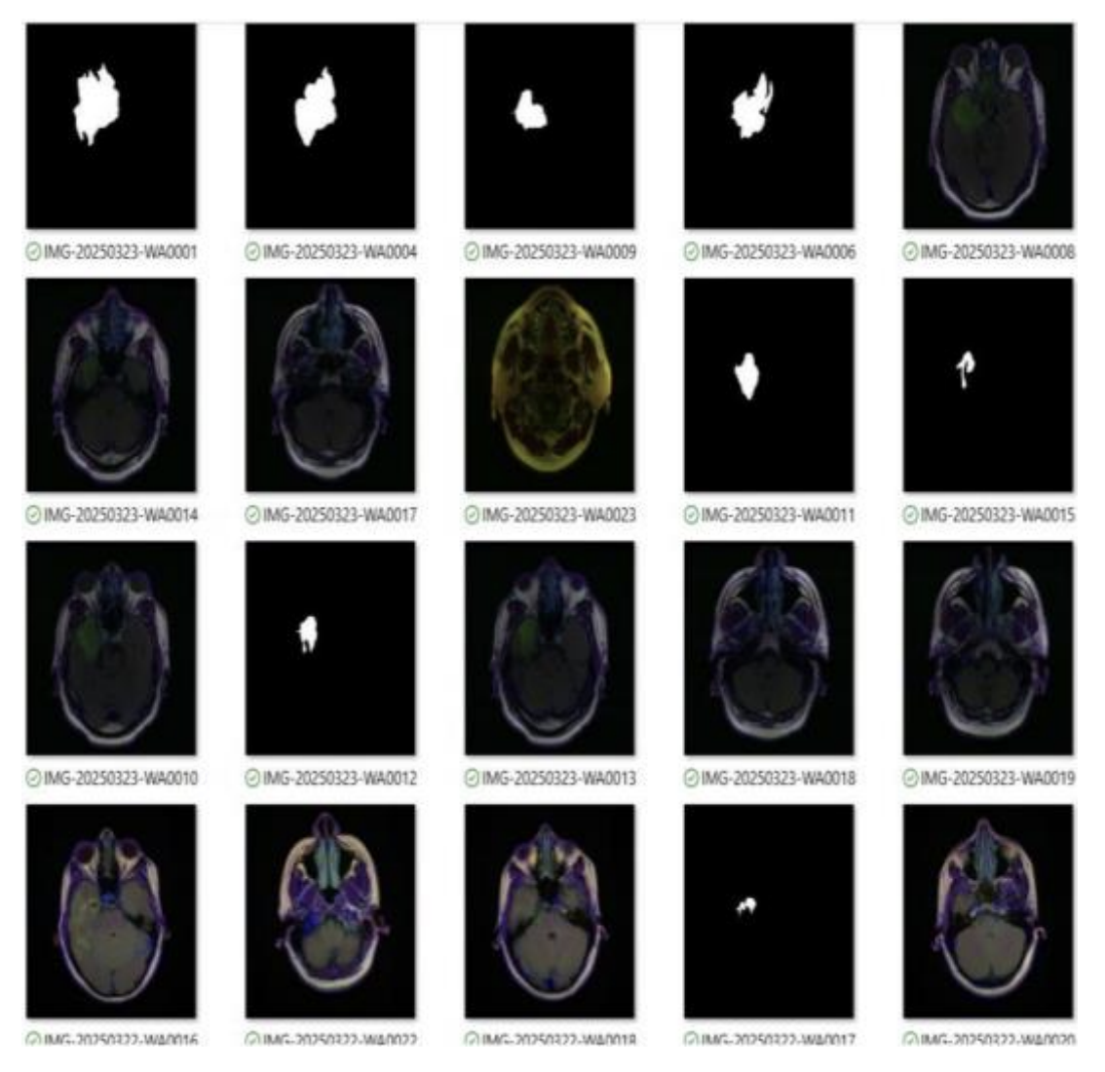
Methodology – Dataset, Preprocessing & Augmentation
Dataset
• Total MRI images: 3,929 (Kaggle Brain MRI + BraTS repositories)
• Categories: Glioma, Meningioma, Pituitary Tumor, Non-Tumor
• Split: 70% train / 20% validation / 10% test, plus 5-fold cross-validation
Preprocessing
• Image resizing • Pixel normalization (0–1) • Contrast enhancement
• Gaussian filtering for noise removal • Removal of corrupted images
Augmentation
• Random rotation, horizontal/vertical flip, zoom, width/height shift, brightness adjustment, Gaussian noise injection
Fig. Augmented MRI images and corresponding tumor masks
Notes:
Our experiments used 3,929 MRI images spanning glioma, meningioma, pituitary tumor and non-tumor categories from Kaggle Brain MRI and BraTS. Since MRI images from different sources vary in brightness, contrast and noise, we resized, normalized, contrast-enhanced, denoised with Gaussian filtering, and removed corrupted images before training. We then applied augmentations - rotation, flips, zoom, shifts, brightness changes and noise injection - to simulate real-world acquisition variation and reduce overfitting, especially important given the limited size of medical imaging datasets.

Slide 8
Methodology – Model Design & Training Configuration
ResNet50 (Classification)
Parameter | Classification | Segmentation
Optimizer | Adam | Adam
Learning Rate | 0.0002 | 0.0002
Batch Size | 16 | 32
Epochs | 45 | 90
Loss Function | Categorical Cross-Entropy | Focal Tversky Loss
Metric | Accuracy | Dice Similarity Coefficient
• Transfer learning with ImageNet pre-trained weights
• Residual learning blocks for efficient gradient propagation
• Global average pooling → fully connected layers → softmax output
ResUNet (Segmentation)
• Encoder–decoder architecture with residual blocks
• Skip connections preserve spatial information for accurate boundaries
• Output: binary pixel-wise tumor mask
ReduceLROnPlateau scheduler (reduces LR if validation loss stalls for 5 epochs) and Early Stopping (halts training after 10 epochs without improvement) were used to improve convergence and reduce overfitting.
Notes:
ResNet50 performs tumor classification using transfer learning from ImageNet, with residual learning easing the training of deep networks. Once a tumor is detected, ResUNet - combining U-Net's encoder-decoder structure with residual learning - generates a precise pixel-wise tumor mask, with skip connections preserving spatial detail lost during downsampling. Both models were trained with the Adam optimizer; classification for 45 epochs, segmentation for 90 epochs using Focal Tversky Loss, which handles class imbalance well in medical segmentation. We also used a ReduceLROnPlateau scheduler and early stopping to improve convergence stability and avoid overfitting.

Slide 9
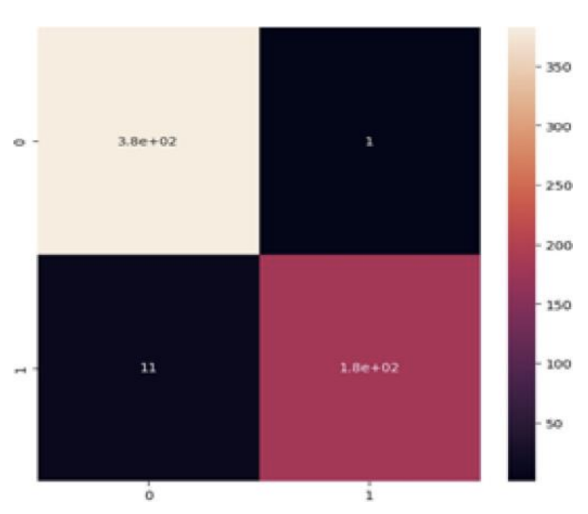
Experimental Results & Performance
Classification Performance
5 repeated runs; low std. dev. confirms consistency & reproducibility
Segmentation Performance
Fig. Confusion matrix (ResNet50 classifier)
• Dice Similarity Coefficient: 96.7% • IoU: 94.2%
• Hausdorff Distance: 2.1 mm • FPR: 0.3% • FNR: 5.8%
Notes:
ResNet50 achieved 98.5% accuracy, 99.4% precision - meaning very few false alarms - and 94.2% recall, meaning it catches most true tumor cases, which matters clinically since missing a tumor is far more serious than a false alarm. F1-score of 96.7% and AUC of 99.0% confirm a strong, well-separated classifier. For segmentation, ResUNet achieved a Dice score of 96.7% and IoU of 94.2%, with a low false positive rate of 0.3% and false negative rate of 5.8%. Importantly, we repeated all experiments five times with different random seeds and report the mean - the low standard deviation confirms the framework's results are consistent and reproducible, which is essential for medical AI.

Slide 10
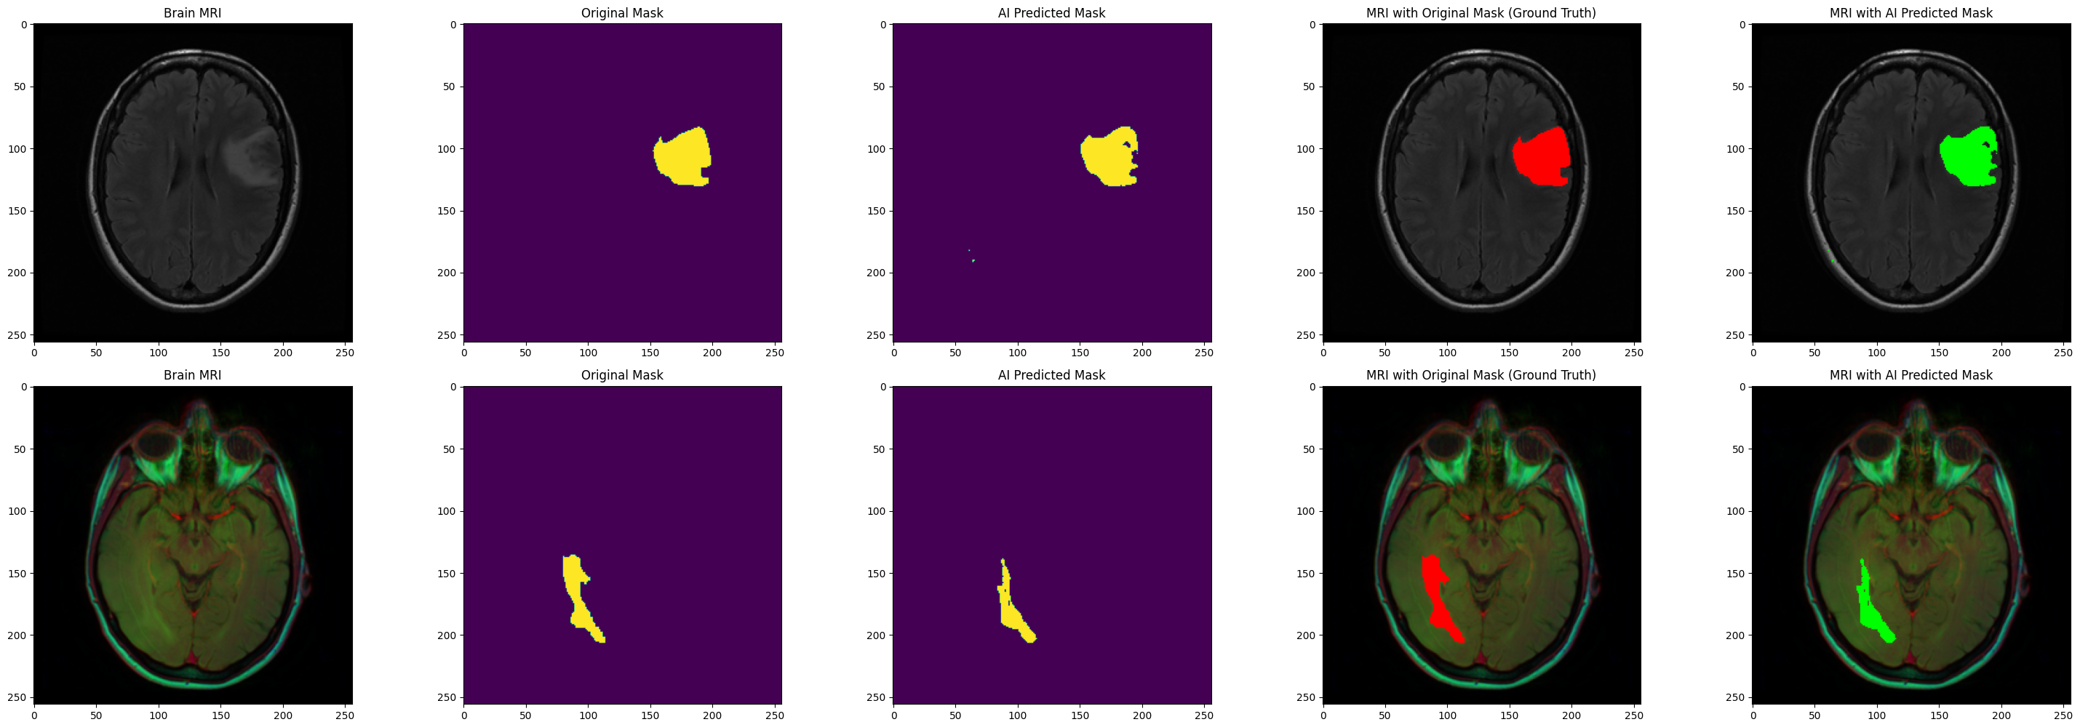
Experimental Results & Performance
Fig. Predicted results with the Original test data
Notes:
ResNet50 achieved 98.5% accuracy, 99.4% precision - meaning very few false alarms - and 94.2% recall, meaning it catches most true tumor cases, which matters clinically since missing a tumor is far more serious than a false alarm. F1-score of 96.7% and AUC of 99.0% confirm a strong, well-separated classifier. For segmentation, ResUNet achieved a Dice score of 96.7% and IoU of 94.2%, with a low false positive rate of 0.3% and false negative rate of 5.8%. Importantly, we repeated all experiments five times with different random seeds and report the mean - the low standard deviation confirms the framework's results are consistent and reproducible, which is essential for medical AI.

Slide 11
Comparison with Existing Methods
Model | Accuracy | Dice Score
CNN (baseline) | 93.2% | —
VGG16 | 94.8% | —
U-Net | — | 92.5%
Proposed ResNet50 + ResUNet | 98.5% | 96.7%
• Highest classification accuracy and strongest segmentation overlap among compared methods
• Combines detection + localization in a single workflow, unlike most prior methods which address only one task
• Backed by statistical validation across 5 repeated runs — not a single-run result
Notes:
We compared our framework against commonly reported approaches. Conventional CNNs reached about 93.2% accuracy, VGG16 around 94.8%. For segmentation, U-Net achieved a Dice score of 92.5%. Our ResNet50-ResUNet framework reached 98.5% accuracy with a 96.7% Dice score - and, importantly, it's the only approach here that performs both classification and segmentation in one pipeline. We're not claiming universal state-of-the-art performance; the main contribution is this integrated, statistically validated two-stage framework.

Slide 12
Significant Outcome of the Research
Clinical Applications & Healthcare Impact
CISCON Theme Alignment
• AI-assisted diagnosis & computer-aided diagnosis (CAD)
• Tumor localization for treatment planning and follow-up monitoring
• Hospital radiology departments and emergency screening
• Telemedicine and rural / resource-constrained healthcare settings
• System Monitoring:
  – Continuous, automated MRI analysis
• Optimal Technology:
  – Two-stage design runs segmentation only when needed, cutting unnecessary computation
• Sustainable Technology:
  – Reduces radiologist workload and supports scalable AI-assisted diagnosis
Notes:
Beyond raw performance, this framework is designed to support radiologists - automatically flagging suspicious cases and highlighting tumor regions so clinicians can focus on diagnosis and treatment planning. It fits naturally into hospital radiology departments, telemedicine platforms and rural healthcare settings with limited specialist access. Connecting to this conference's theme of System Monitoring, Optimal and Sustainable Technologies: our framework continuously monitors MRI scans, performs segmentation only when needed for optimal efficiency, and supports sustainable, scalable AI-assisted diagnosis. To be clear, clinical deployment would need further validation - but this demonstrates AI's potential to enhance, not replace, medical expertise.

Slide 13
Conclusion and Future Scope
Limitations
Conclusion
• Trained and evaluated on public MRI datasets only
• Single imaging modality (MRI)
• Requires multi-center clinical validation before deployment
• High computational requirements for training
• Two-stage ResNet50–ResUNet framework for integrated tumor detection and localization
• High classification accuracy (98.5%) and segmentation performance (96.7% Dice), confirmed via statistical validation
• Supports radiologists with faster, more consistent decision support
Future Scope
• Multi-modal imaging (e.g., CT, PET) and Explainable AI (XAI)
• Vision Transformer architectures; Federated Learning across hospitals
• Cloud / hospital-PACS integration for real-world clinical deployment
“AI is not replacing doctors — it is empowering doctors with faster and more consistent decision support.”
Notes:
Every study has limitations. Ours was trained on public datasets and a single imaging modality, and needs multi-center clinical validation before deployment. Looking ahead, promising directions include multi-modal imaging, explainable AI to build clinician trust, vision transformers, federated learning for privacy-preserving collaboration across hospitals, and integration into cloud or hospital PACS systems. To conclude: we presented a two-stage ResNet50-ResUNet framework combining classification and segmentation, achieving strong, statistically validated performance. Its significance lies in reducing diagnostic workload and enabling earlier identification of suspicious cases. AI is not replacing doctors - it is empowering them with faster, more consistent decision support.

Slide 14
References
• [1] G. Litjens et al., “A survey on deep learning in medical image analysis,” Medical Image Analysis, vol. 42, pp. 60–88, 2017.
• [2] K. He, X. Zhang, S. Ren, J. Sun, “Deep residual learning for image recognition,” in Proc. IEEE CVPR, 2016, pp. 770–778.
• [3] O. Ronneberger, P. Fischer, T. Brox, “U-Net: Convolutional networks for biomedical image segmentation,” in MICCAI, Springer, 2015, pp. 234–241.
• [4] Z. Zhang, Q. Liu, Y. Wang, “Road extraction by deep residual U-Net,” IEEE Geosci. Remote Sens. Lett., vol. 15, no. 5, pp. 749–753, 2018.
• [5] J. Deng et al., “ImageNet: A large-scale hierarchical image database,” in Proc. IEEE CVPR, 2009, pp. 248–255.
• [6] N. Abraham, N. M. Khan, “A novel focal Tversky loss function with improved attention U-Net for lesion segmentation,” in IEEE ISBI, 2019, pp. 683–687.
Notes:
These are the core references underpinning our methodology - covering deep learning in medical imaging, residual learning, U-Net and ResUNet architectures, ImageNet transfer learning, and the Focal Tversky loss used in our segmentation stage. The full reference list is available in the paper.

Slide 15
Thank You
Questions & Suggestions are welcome
Darshan Suresh | darshansuresh1804@gmail.com
Notes:
Thank you all for your valuable time and attention. I sincerely appreciate your interest in our work, and I would be happy to answer any questions or receive your valuable suggestions. Artificial Intelligence should not be viewed as a replacement for clinical expertise - it should be seen as a trusted assistant that enhances the speed, consistency and confidence of medical decision-making. Our work is one step toward that vision. Thank you.

