Slide 1

AMRITANETRA – Amrita Network Threat Recognition & Analysis
Suspicious Link Analyzer
Team No :10A
Presented By
Darshan Suresh –MY.EN.U3BCA22274
Vidhyadhara M–MY.EN.U3BCA22272
Project Guide
Dr. Adwitiya Mukhopadhyay
Deputy Controller
Department of Examination
Amrita Vishwa Vidyapeetham, Mysuru Campus

Slide 2
Problem Statement
Why do existing security tools struggle to detect evolving phishing techniques, fake login forms, and dark web threats? Is it due to outdated blacklists and limited monitoring, which fail to adapt to new attack methods? Additionally, since these tools often block threats without providing explanations, how does this impact user awareness of cyber risks, and what solutions can improve both security effectiveness and user education?

Slide 3
Motivation
Increase in Phishing & Cyber Attacks – Traditional security tools rely on outdated blacklists, making them ineffective against new and evolving phishing techniques.
Lack of User Awareness – Most users fail to recognize fraudulent links, leading to credential theft, financial fraud, and malware infections.
Ineffective Threat Explanation – Existing tools simply block suspicious links without explaining why they are dangerous, leaving users uninformed.
Inability to Detect Fake Login Forms – Conventional solutions do not analyze malicious login/payment forms, which are primary attack vectors for credential theft.
Limited Dark Web Monitoring – Many security tools fail to track scam URLs from the dark web, missing historical fraud records.
No Safe Browsing Alternative – Current solutions either block links entirely or allow access, without offering a secure preview mode for risk-free browsing.

Slide 4
Scope of the proposed application
Real-Time Suspicious Link Detection – Uses AI and ML to analyze URLs for phishing, malware, and scam threats across web and mobile platforms.
Fake Form & Credential Theft Prevention – Identifies fraudulent login and payment forms to protect user credentials.
AI-Powered Threat Explanation – Provides phishing storytelling and chatbot-based explanations for better user awareness.
Safe Link Sanitization – Removes risky tracking elements from URLs and offers a secure preview mode instead of blocking access completely.
Dark Web Intelligence Integration – Cross-references URLs with dark web databases to detect previously reported fraud cases.
Continuous AI Learning & Updates – Improves threat detection using real-time user feedback and evolving phishing techniques.

Slide 5
Objectives of the Project
Enhance Cybersecurity with AI – Utilize machine learning and AI algorithms to detect phishing, malware, and scam links in real-time.
Improve User Awareness & Education – Implement AI-generated phishing storytelling and a chatbot to explain security threats in an easy-to-understand manner.
Prevent Credential Theft – Analyse webpages for fake login and payment forms, detecting hidden input fields and unauthorized data collection.
Enable Safe Browsing with Link Sanitization – Modify risky URLs by removing tracking parameters and offering a safe preview mode instead of outright blocking.
Leverage Dark Web Intelligence – Cross-check URLs with dark web scam databases to identify previously reported fraudulent domains.
Ensure Continuous Improvement with AI Learning – Update detection models in real time using user feedback and new phishing trends, ensuring adaptive cybersecurity protection.

Slide 6
Existing Applications
S.No | Name of the Existing Application/System | Purpose | Technology used | Performance | Technical gaps identified
1 | Google Safe Browsing | Detects and blocks phishing, malware, and deceptive websites | Machine Learning, URL Blacklists, Google’s Security APIs | High detection rate but relies on reported threats | No real-time AI analysis; can't explain why a URL is suspicious
2 | VirusTotal | Scans URLs and files for malware using multiple antivirus engines | AI, Signature-based Detection, Sandbox Analysis | Effective at detecting known threats | No deep analysis of webpage structure; lacks phishing storytelling
3 | PhishTank | Crowdsourced phishing link reporting and verification | Crowdsourcing, URL Database, Pattern Matching | Good for community-driven reporting | Slow updates; does not use AI for proactive detection

Slide 7
Existing Applications
S.No | Name of the Existing Application/System | Purpose | Technology used | Performance | Technical gaps identified
4 | URLVoid | Checks website reputation using multiple security engines | Threat Intelligence APIs, Blacklists, Heuristic Analysis | Fast and lightweight for basic checks | No AI-driven behavioral analysis; lacks real-time phishing detection
5 | Zscaler Safe Browsing | Enterprise-level web filtering and threat protection | Cloud-Based AI, Behavioral Analysis, DNS Filtering | Strong protection for businesses | Not accessible for individual users; lacks user-friendly threat explanations
6 | Netcraft Anti-Phishing | Provides real-time phishing protection and cybercrime analysis | AI, Browser Extensions, Web Crawling | Effective in detecting phishing attacks in real-time | Requires manual user input for reporting new threats; lacks automation in deep analysis

Slide 8
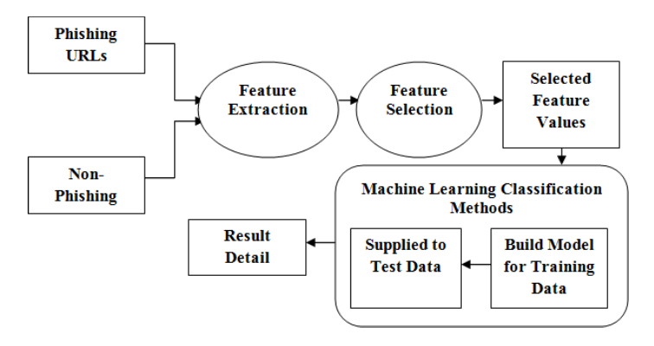
Project Flow

Slide 9
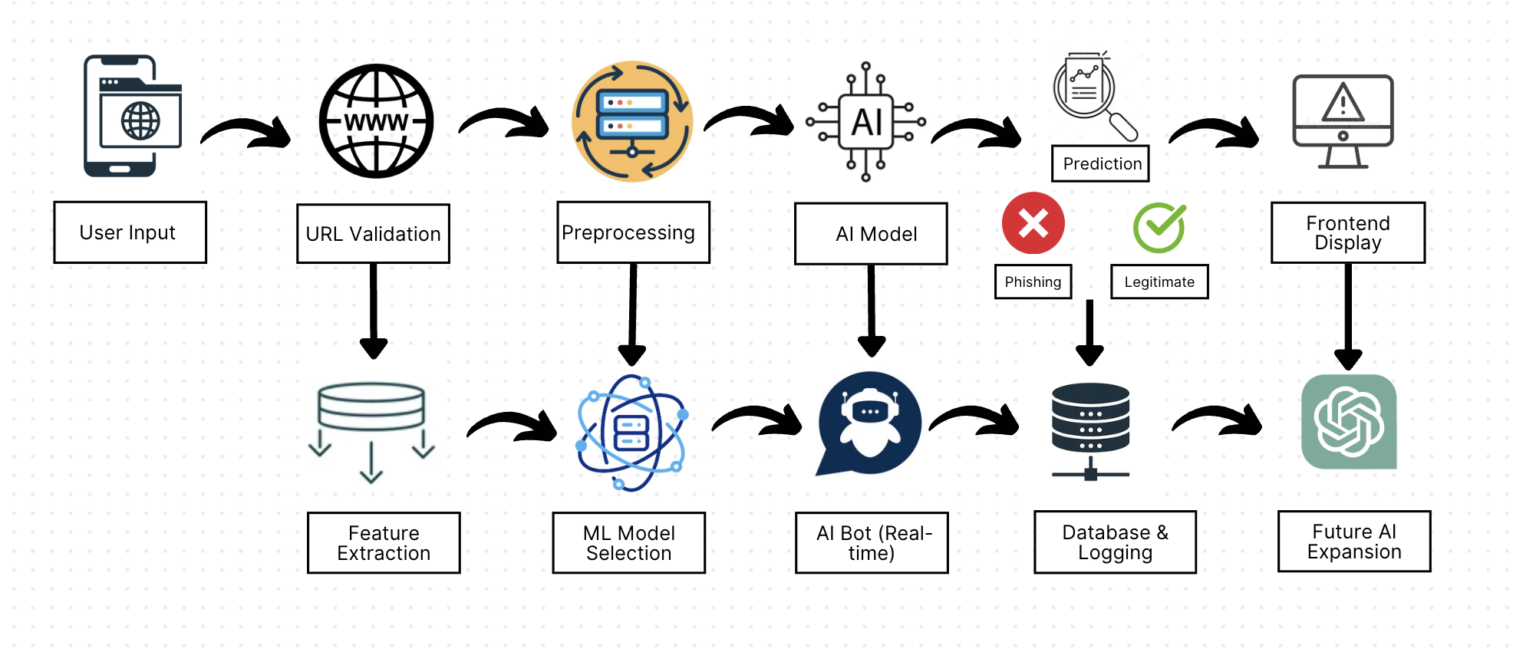
System Architecture of the proposed system

Slide 10
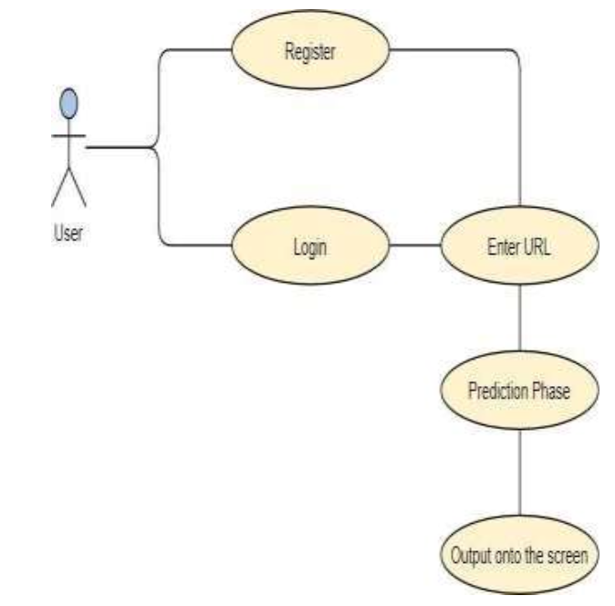
USE CASE DIAGRAM

Slide 11
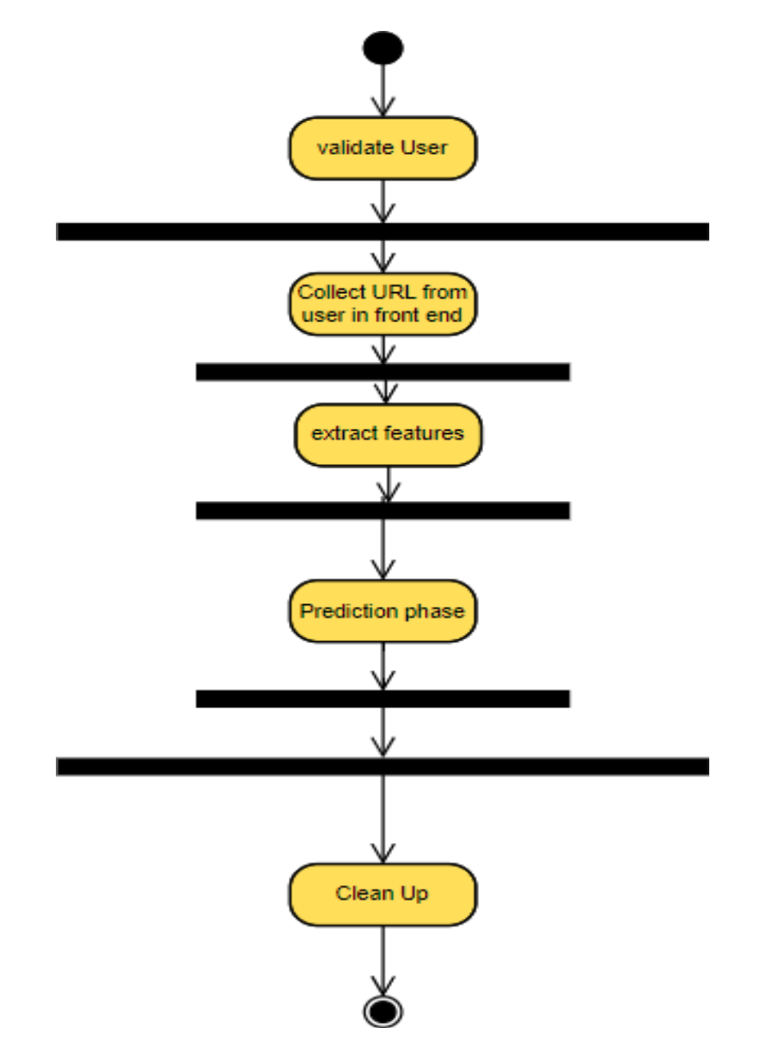
ACTIVITY DIAGRAM

Slide 12
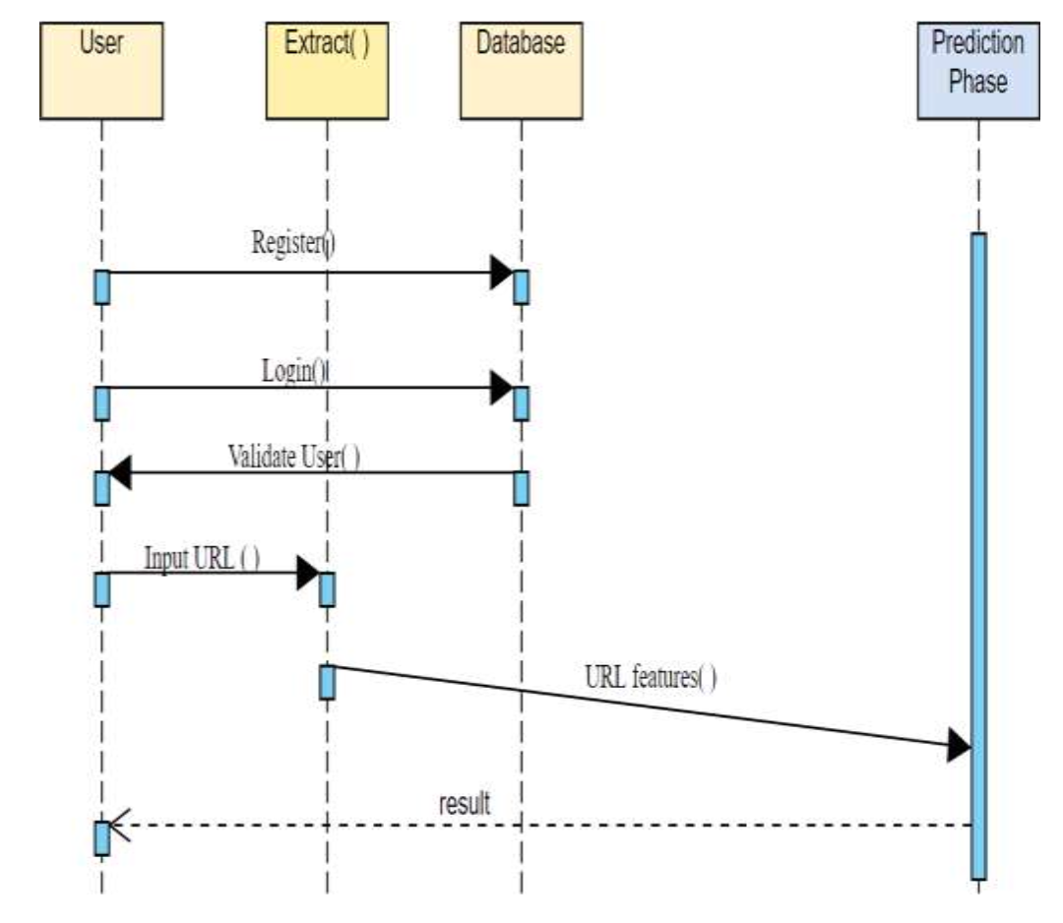
SEQUENCE DIAGRAM

Slide 13
System Requirements of proposed system
1️ Hardware Requirements
Processor: Intel Core i3 or higher
RAM: Minimum 8GB (Recommended: 16GB for AI/ML processing)
Storage: At least 5GB of free space
GPU: Recommended for machine learning-based phishing detection
Internet Connectivity: Required for real-time URL analysis
2️ Software Requirements
Operating System: Windows 10/11, macOS, or Linux
Programming Languages: Python, JavaScript (for frontend)
Frameworks & Libraries: Flask/Django for backend, TensorFlow/PyTorch for AI models
Database: MySQL / PostgreSQL for storing phishing data
API Integrations: Google Safe Browsing, VirusTotal API for real-time phishing detection
Development Tools: Jupyter Notebook, VS Code, Postman (for API testing)

Slide 14
Status of the proposed system
✔ ML Phase Completed – Dataset collected, preprocessing done, multiple ML models trained and evaluated, best model (Gradient Boosting Classifier) selected.
✔ Comparative Analysis Done – ML models compared, performance visualized, and best approach finalized.
🔄 Application Building Phase (In Progress) – Frontend and backend development, integrating the trained model into a user-friendly interface.
🔄 AI Integration Phase (Pending) – Exploring deep learning models like LSTM, CNN, and BERT for enhanced phishing detection.
📌 Future Plans:
✅ Additional paper submission planned after model deployment and further improvements.

Slide 15
Work done so far
Dataset Collection & Preprocessing – Gathered data, applied tokenization, stopword removal, lemmatization, and TF-IDF.
ML Models – Implemented Logistic Regression, Random Forest, SVM, KNN, Naïve Bayes, Multi-Layer Perceptron, CatBoost, Gradient Boosting, and XGBoost.
Best Model Selection – Compared ML models based on accuracy, precision, recall, and F1-score. Found Gradient Boosting Classifier performed best.
Feature Extraction – Extracted 30 features from URLs, including Address Bar, Domain, HTML, and JavaScript-based indicators.
Comparative Analysis – Visualized model performance using bar graphs and scatter plots for better interpretability.
Final Prediction Model – Integrated the best-performing model with a frontend interface for real-time phishing detection.

Slide 16
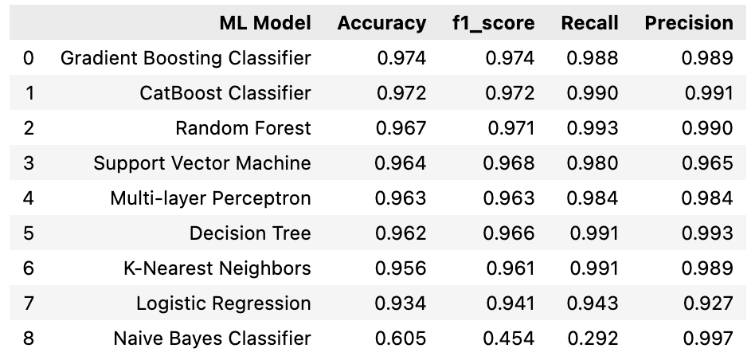
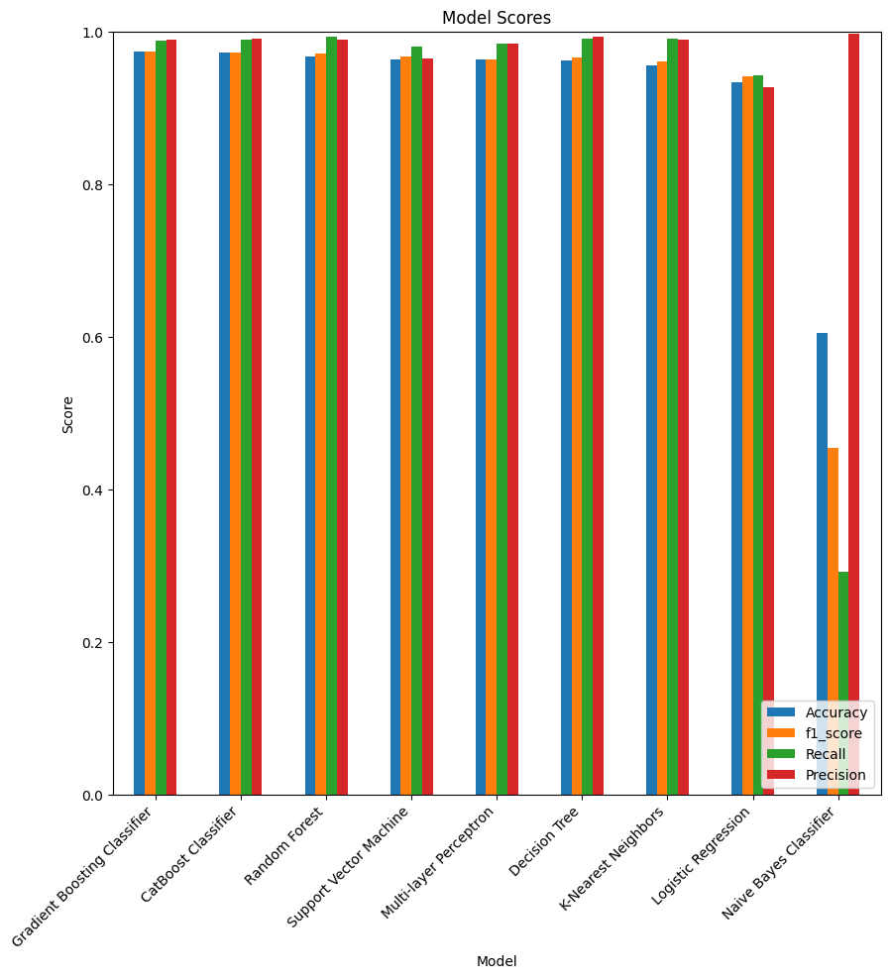
Implementation

Slide 17
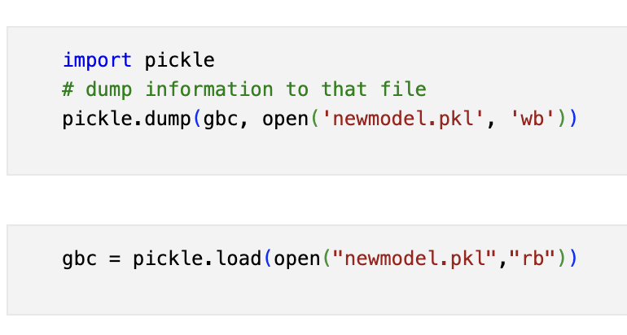
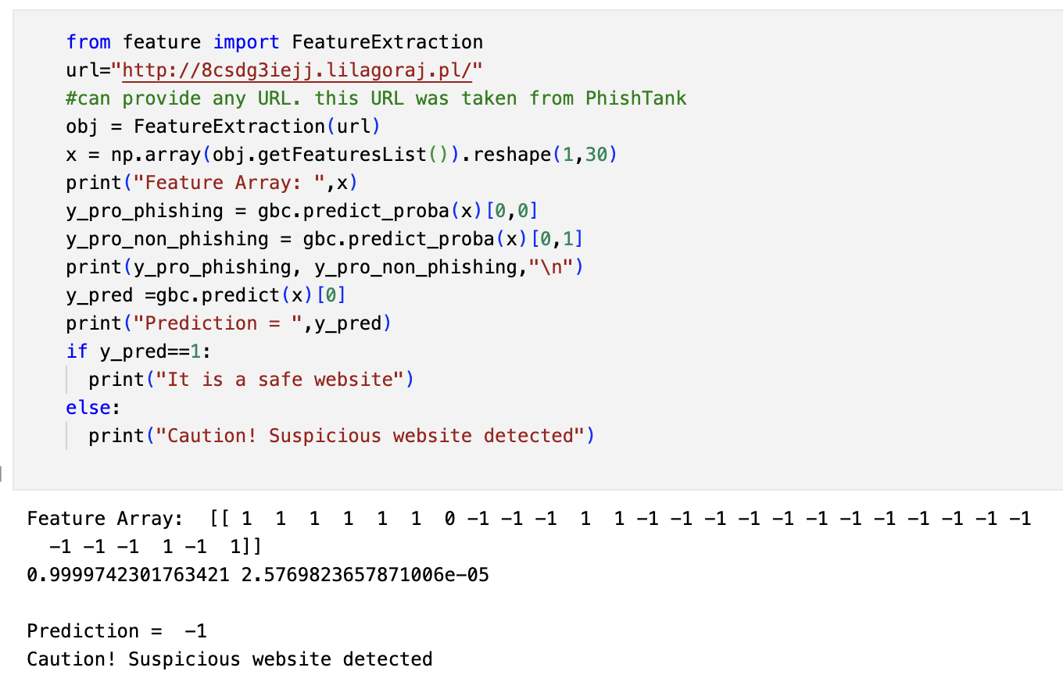
Implementation
Storing Best Model:
Best Model Performance:

Slide 18
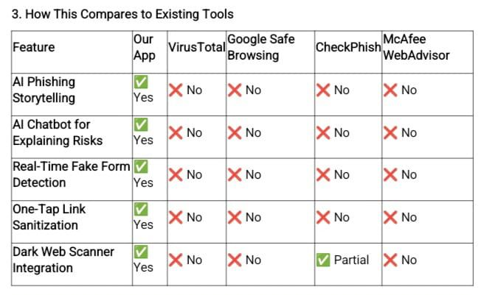

Slide 19
References/Web Resources
[1] Google Safe Browsing API – https://developers.google.com/safe-browsing
[2] VirusTotal – https://www.virustotal.com/
[3] PhishTank – https://www.phishtank.com/
[4] Kaggle Phishing Dataset – https://www.kaggle.com/eswarchandt/phishing-website-detector
[5] OWASP Phishing Resources – https://owasp.org/www-community/attacks/Phishing
[6] URLScan.io – https://urlscan.io/
[7] National Cyber Security Centre (UK) – https://www.ncsc.gov.uk/
[8] MITRE ATT&CK - Phishing Tactics – https://attack.mitre.org/
[9] Zscaler ThreatLabZ – https://www.zscaler.com/blogs/security-research
[10] CheckPhish AI – https://checkphish.ai/

