Slide 1



MapReduce & Spark
Experimental Comparison
Darshana Ariyarathna - 248206P
Notes:
Hi everyone,
I am Darshana Ariyarathna,
And now I am going to do an Experiment on MapReduce and Spark in AWS EMR.

Slide 2
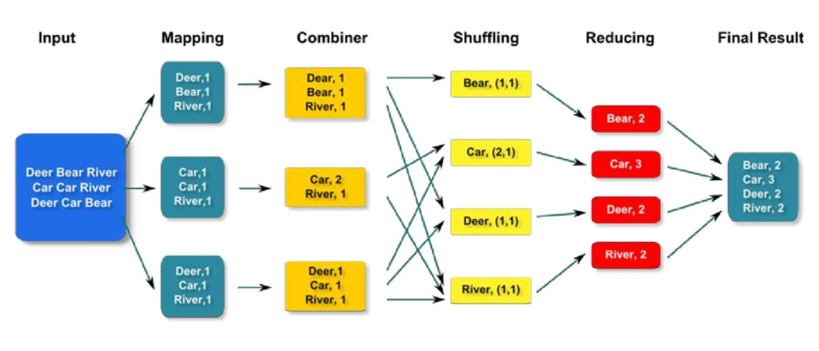
What is MapReduce
MapReduce is a programming model and data processing technique designed for parallel and distributed computing on large datasets.
Notes:
What is MapReduce?
Map reduce is A programming model and processing technique for distributed and parallel computing on large datasets.
And it was Developed by Google for processing and generating large datasets on distributed clusters.
Why MapReduce is popular
Its Scalability: Easily scales horizontally across multiple machines.
It provides Fault Tolerance: Can handle node failures and continue processing.
And its Parallel Processing: Processes data in parallel, reducing processing time.
The Key Components of MapReduce
Mapper:
Converts input data into key-value pairs.
Reducer:
Aggregates and processes the output of the Mapper.
Shuffler:
Transfers output from Mappers to Reducers.
How MapReduce Works – it has 3 phases.
Map Phase:
Input data is divided into chunks.
Mapper processes each chunk and produces intermediate key-value pairs.
Shuffle and Sort Phase:
Intermediate data is shuffled and sorted based on keys.
Reduce Phase:
Reducer processes sorted data and produces the final output.

Slide 3
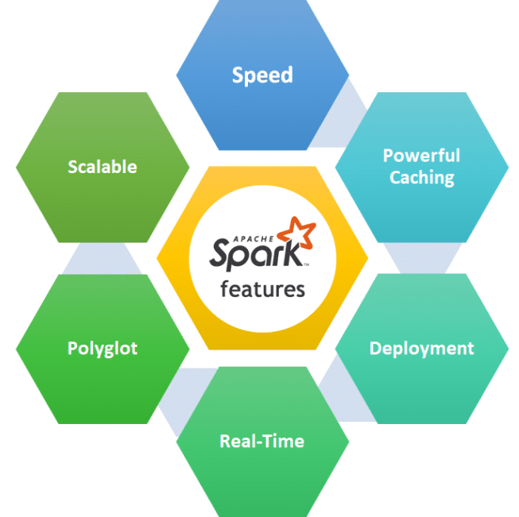
What is spark
An open-source system designed for fast and versatile big data processing.
now widely used for large-scale data tasks.
Spark is flexible, supporting various programming languages and data workloads.
Notes:
Apache Spark is a powerful open-source system designed for fast and versatile big data processing.
it's now widely used for large-scale data tasks.
Spark is flexible, supporting various programming languages and data workloads.
Why Apache Spark?
Speed: In-memory processing for faster data processing.
Ease of Use: APIs in Java, Scala, Python, and R.
Versatility: Batch processing, iterative algorithms, interactive queries, and streaming.
Key Features
In-Memory Processing: Faster data processing by keeping data in RAM.
Ease of Use: High-level APIs in multiple languages.
Fault Tolerance: Reliable distributed data processing.
Compatible with Hadoop, HBase and more: Works with Hadoop, Hive, HBase, and more.
Components
Spark Core: Foundation for parallel and distributed data processing.
Spark SQL: Allows querying structured data using SQL.
Spark Streaming: Real-time data processing.
MLlib: Machine learning library.
GraphX: Graph processing library.

Slide 4

Demonstration
Step 1 – MapReduce
Step 2 – Spark
Notes:
Let's we move on to the demonstration

Slide 5
Results
Analysis of Results of the experiment
Notes:
These are the results that we have collected through the experiment

Slide 6
Results
Time taken for Iterative Executions
Notes:
Observations of Time taken for Iterative Executions
Overall: Both Hive QL and Spark-SQL execution times seem to decrease as the number of iterations increases.
Speed: Spark-SQL appears consistently faster than Hive QL across all iterations.
Improvement: The sharpest decreases in time seem to occur between the first and second iterations for both technologies.
Possible Explanations for those results:
Learning Curve: The initial executions may be slower due to setup, loading data, or establishing connections. Subsequent runs might benefit from this initial work.
Caching: Systems like Spark and Hive often keep parts of the data in memory after the first run, making later executions faster.

Slide 7
Results
Time taken for each Queries
Notes:
The results of the Time taken for each Query illustrate the time taken to execute different queries using HiveQL and Spark-SQL in the face of various delays.
Overall, it seems that weather delays cause the most significant slowdown in query processing times for both types of queries.
HiveQL appears to be slightly more affected by weather delays than Spark-SQL. Interestingly, NAS delays seem to have the least impact on query performance.

Slide 8
Compare and Contrast
Ease of Use
Fast Processing
Notes:
MapReduce and Apache Spark are both distributed computing frameworks that are used for processing large volumes of data.
However, there are some differences between them in terms of ease of use and processing speed.
Considering Ease of Use:
MapReduce is a simple and easy-to-use framework that is used for batch processing of large data sets
Apache Spark provides a higher-level programming model that makes it easier for developers to work with large data sets
Considering Fast Processing:
Apache Spark is generally faster than MapReduce due to its in-memory processing capabilities
MapReduce reads and writes data to disk for each MapReduce job, therefore it takes more time to execute the queries.

Slide 9

Notes:
And This is the end of the video, Thank you.

