Slide 1
Smart Parking System

Slide 2
Outline :
What is smart Parking System.
System Unit.
Main features.
Coordinator
Software Application
Problems
Future Work
Conclusion.

Slide 3
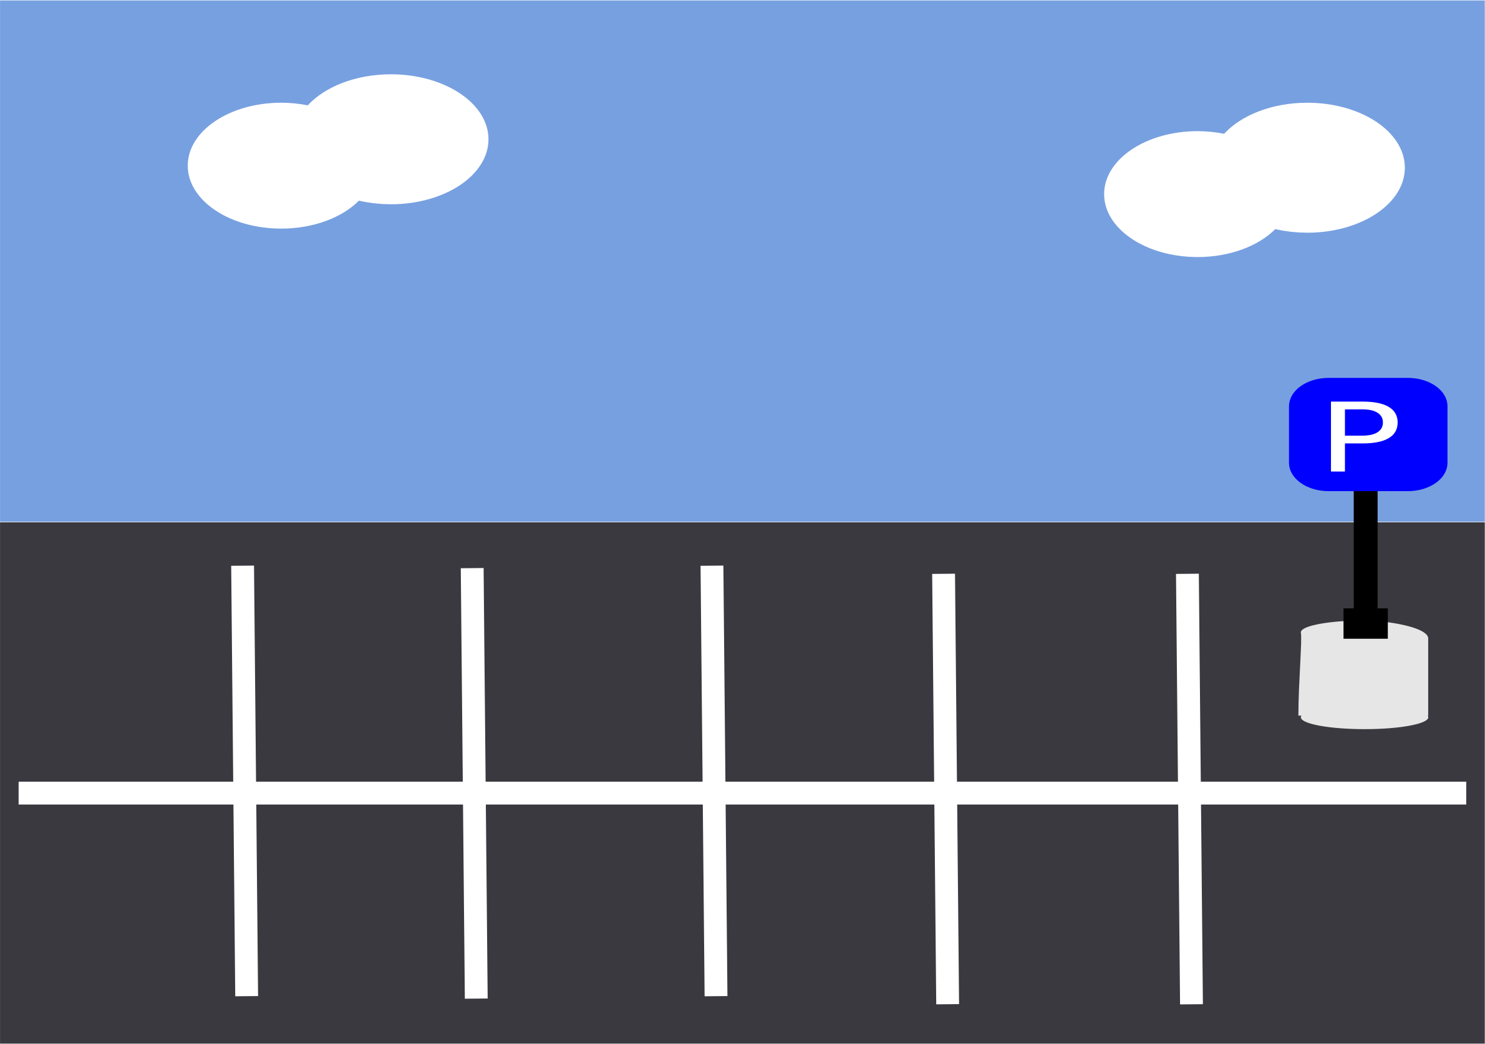
What is smart Parking System
Smart parking system is an integrated system to organize cars in public parks.
The system will be used for every slot in park.
The motivation of this project is to help drivers. And make the payment way easier.

Slide 4
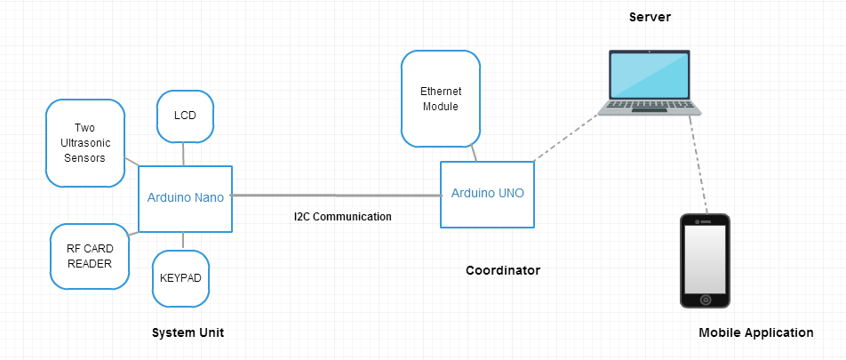
What is smart Parking System
Our projects consist of two sides, the first one is the main unit, and this unit will be located in every spot in the parking lot.
These units will be connected with our second, the coordinator.
So every coordinator will control the information from and to the units connected with it.

Slide 5
System Unit
Every spot in the parking lot will contain the main unit.
Our unit consist of:
Arduino Nano .
Two ultrasonic HC-SR04 sensors.
RF Card Reader.
Keypad.
LCD.

Slide 6
System Unit
The system will detect the existence of a car in the slot using sensors.
the system will use RF reader for automatic payment.
The system also will use a display and a keypad for the interaction with the user, like interaction for entering information about the time needed. Or interaction for payment if the user forget the card.

Slide 7
Main features
Car detection.
Check In to the system using phone number or RF Card.
Automatic payment using phone number or RF Card.
Check Out using phone number and RF Card.

Slide 8
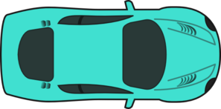
Car detection.
The detection of a car is done by using the ultrasonic sensor. We use two ultrasonic sensor for detection.
We have to take in mind that the system will not consider a moving body as a car, so one sensor will not be enough, we have to detect the existence of the car from different points and distances.

Slide 9
Car detection
There are things we considered when using more than one ultrasonic sensor:
1) Collision and interference between the ultrasonic sensors.
The reading of the two sensors at this way will not affect each other.
2) Timing between multiple readings for the sensors.
Since we can't read the two sensor at the same time, we read them one after another. The time between the two readings is very small less than one second, so if there's a car detected by one sensor then it will be detected by the other one.

Slide 10
State of the System
There is three main states in the system after a car detected.
The check in state, payment and checkout state.
The user will use the keypad and LCD in every state. there's more than way that the user can choose, either by phone or by RF card reader or by entering the card number.

Slide 11
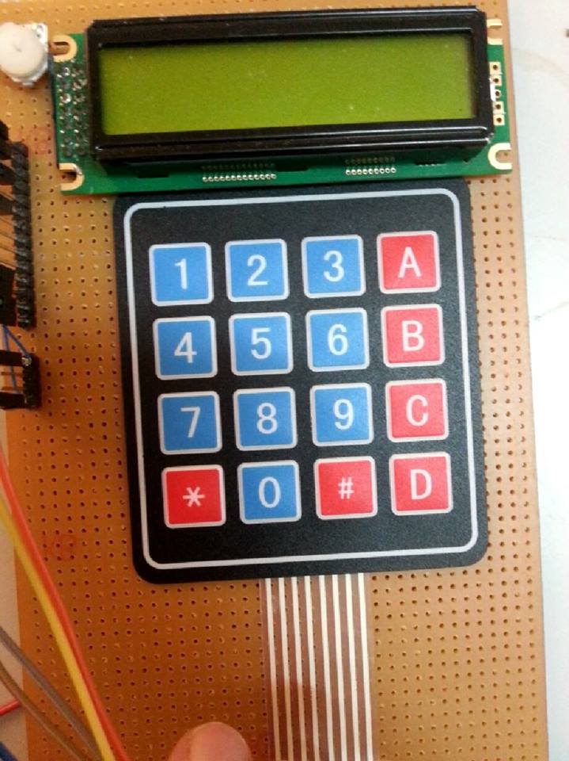
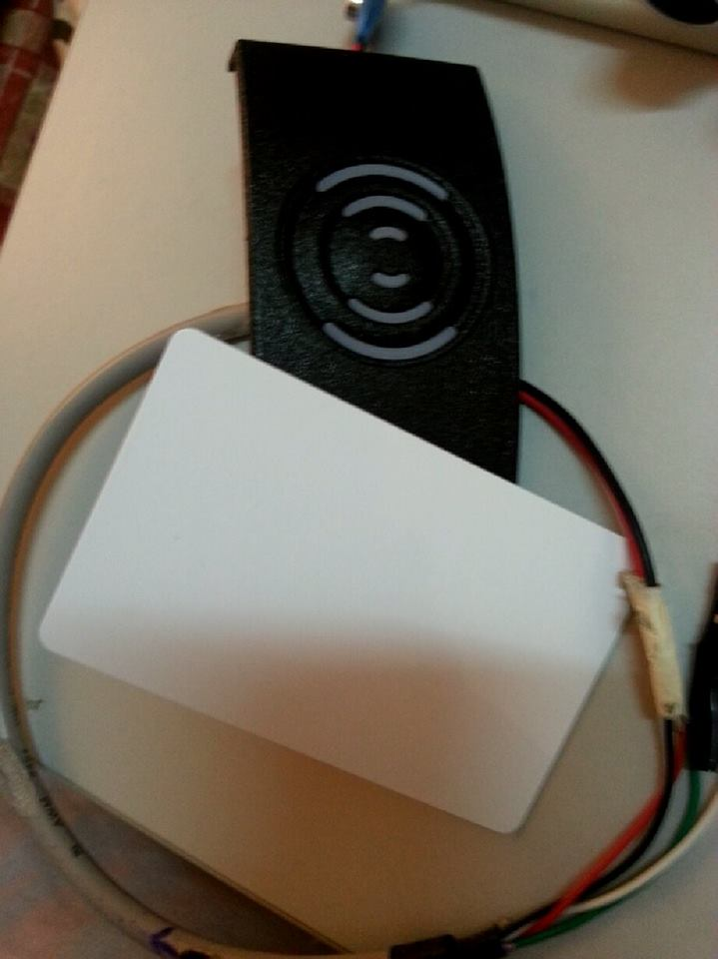
State of the System
State can be: Check in, pay, Check out
System unit
Coordinator
State
OR
information

Slide 12
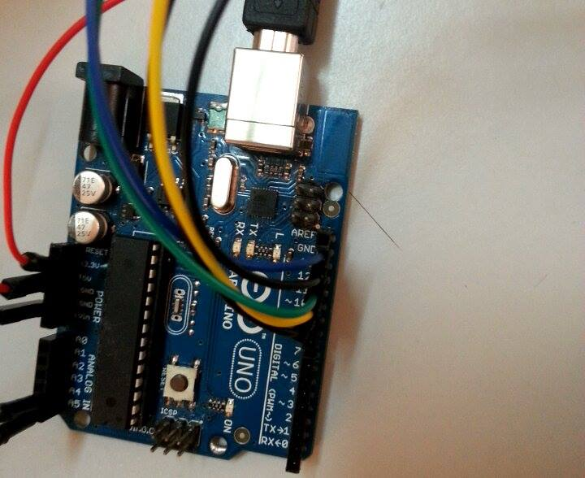
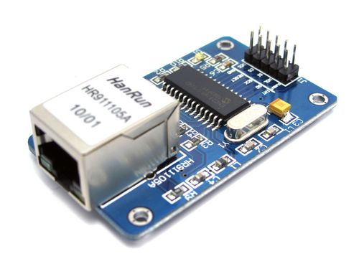
The Coordinator
The coordinator consist of:
Arduino Uno
ENC28J60 Ethernet Module.

Slide 13
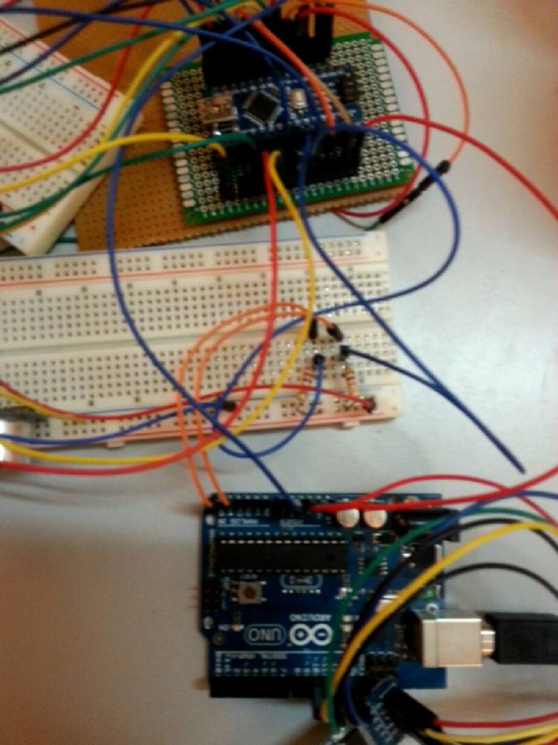
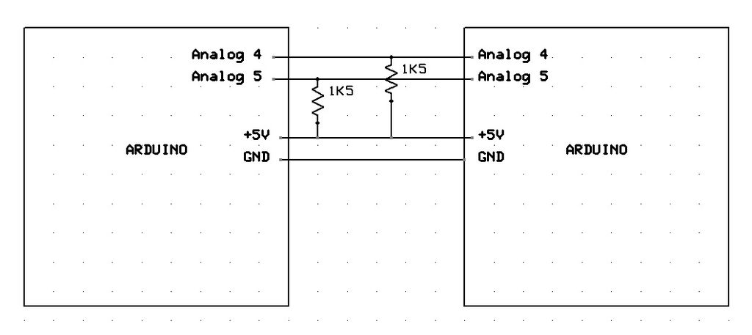
Communication between the Arduino’s
We use I2C to communicate . The coordinator will be the master, and the other units will be connected as a slave.
The coordinator will continuously request data from each unit.
The information sent will contains the state of the unit, the way that the unit will use in each state also the phone number or the RF number.

Slide 14
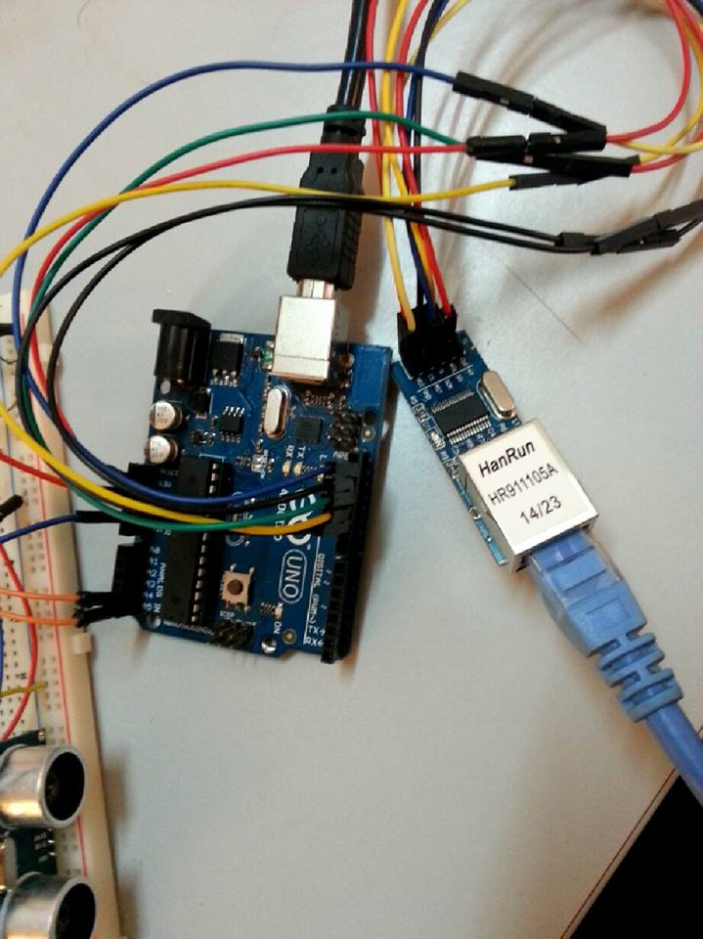
Communicating with the server.
The coordinator is connected with the Ethernet module.
When the data received in the coordinator from the slaves.The coordinator will parse these information and store them according to the state in server using the Ethernet module.

Slide 15
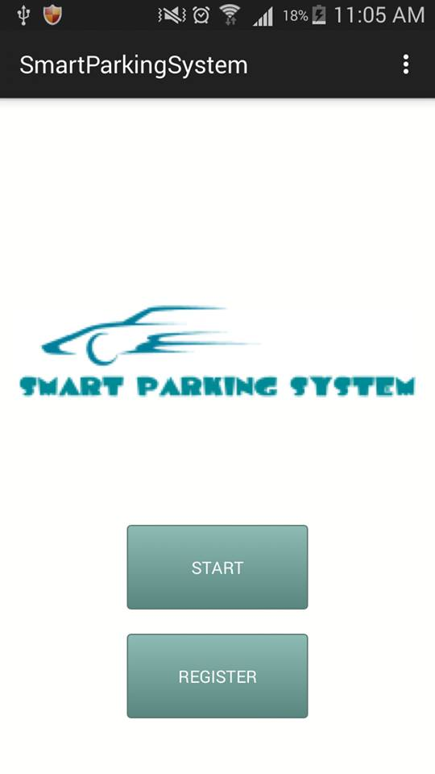
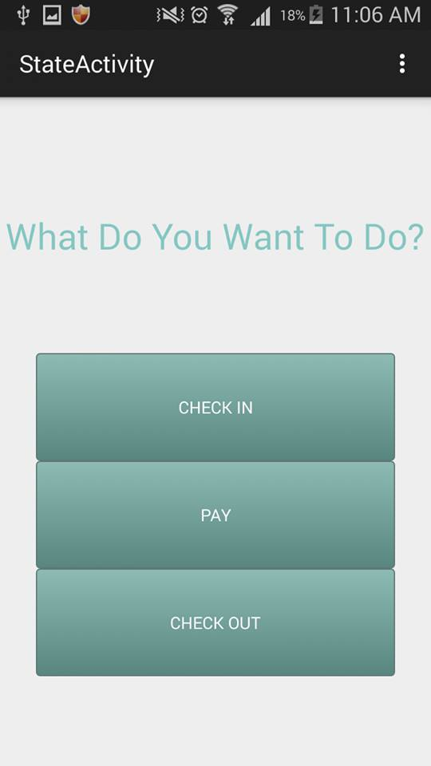
Software Application
The software application can be used by the drivers to check in , pay and check out.
The user will register in the system,
add the needed information like the phone
number and the RF number.

Slide 16
Problems
Which sensor to use:
After comparing to other sensors available, the ultrasonic sensor is the most accurate one, the IR sensor is not very accurate also doesn’t work fine outside in the sunlight, and the available IR sensors had a range less than the ultrasonic sensors.
Detection a car not a moving object:
This is solved by using more than one ultrasonic sensor to detect from different points and distances.
Also by using delay and multiple readings to ensure that there is a car.

Slide 17
Problems
Communication between multiple Arduino’s:
There are a lot of ways to communicate between Arduino’s like UART, SPI and I2C.
In The UART only one device can send data to another.
SPI and I2C use addressing. But SPI is more costly. Each slave you add, adds 1 I/O pin on the master. In the other hand, I2C just needs two lines. And you can add up to 127 slave to the master without extra hardware or running out of pins on the master.
So our project is done by using I2C
Using I2C we can connect the coordinator with much more units up to 127 without using extra hardware.

Slide 18
Problems
Running out of pins:
Our project utilized all of the pins in the arduino, and in order to overcome this problem, we used shift Register

Slide 19
Future Work
We can add a GPS module to store the location for every unit.
Adding other ultrasonic sensor would be more efficient.
Also we can implement other ways for the payment. For example connect the payment with the bank account for the user.
And to make our project more useful in our countries, we could integrate our system with the ordinary way of payment.

Slide 20
Conclusion
What is smart parking system?
Our smart parking system project is planned to be integrated with another software application to help drivers to find the empty spot in parking lot more easily with less time.
Also our project implement most of the functionalities needed in a parking lot. for example, implement an automatic way for payment.

