Slide 1
Table of Contents :-
Part 1: Research Paper Overview
• Introduction & Problem Statement
• Literature Review & Related Works
• Methodology & Approaches
• Dataset Description
Part 2: Code Implementation & Analysis
Data Preprocessing & Feature Engineering
Classification Models Comparison
Regression Models Comparison
Model Performance & Diagnostics
Feature Prediction

Slide 2
PART 1 : RESEARCH PAPER OVERVIEW
UNDERSTANDING THE AGRICULTURE ML PROBLEM

Slide 3
INTRODUCTION AND PROBLEM STATEMENT
The Agricultural Challenge :-
• Agriculture is pivotal for economy but faces challenges: diseases, soil degradation, water scarcity
• Farmers struggle with crop selection, fertilization, and irrigation optimization
• Need for data-driven decision support systems to improve yield and food security
• Machine Learning enables prediction, classification, and automation in agriculture
Research Objectives
• Develop crop recommendation system (22 crops) based on soil & weather parameters
• Create wheat yield prediction model for Pakistan (1992-2024 data)
• Evaluate 7+ ML algorithms for both classification and regression tasks
• Apply Explainable AI (XAI) techniques for farmer decision support

Slide 4
DATASET OVERVIEW
Crop Recommendation Dataset
Crop Recommendation (Classification problem) Suggest best crop based on soil + weather conditions
Yield Prediction (Regression problem) Predict future crop production (wheat yield)
Wheat Yield Prediction Dataset
• Source: World Bank & FAO data
• Coverage: Pakistan wheat yield data (1992-2013, 22 years)
• Input Features: Area (hectares), Average Temperature, Average Rainfall, Pesticide Used
• Target: Yield expressed in hectograms per hectare (Hg/Ha)
• Data Imputation: Used MICE (Multivariate Imputation by Chained Equations) for 2014-2024
Dataset | Source | Rows / period | Target | Notable features
Crop recommendation | Kaggle | 2200 records | 22 crop classes | N, P, K, pH, temperature, humidity, rainfall
Wheat yield | FAO / World Bank / Kaggle references | 1992-2013 plus imputed 2014-2024 | Yield in Hg/Ha | Year, rainfall, pesticide usage, temperature

Slide 5
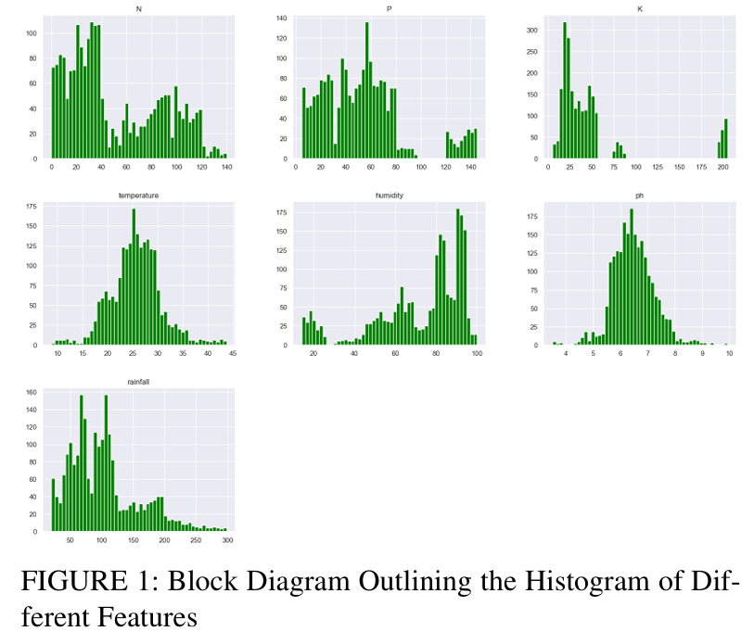
DATASET OVERVIEW (Research Paper)
Temperature & pH → roughly normal (good for ML models)
Rainfall & humidity → slightly skewed
N, P, K → uneven distribution → may need normalization
Helps understand data variability

Slide 6
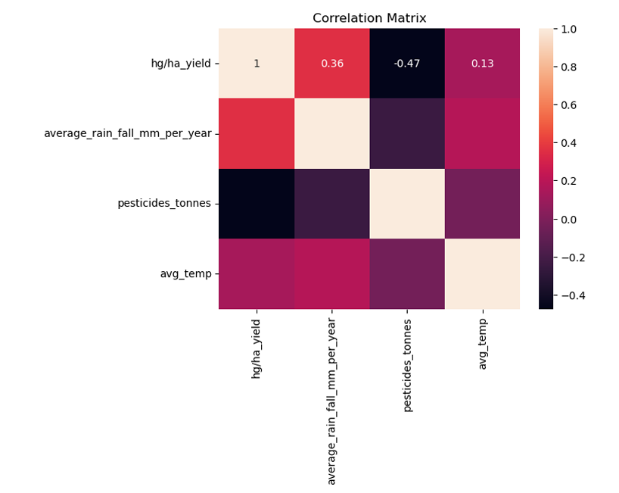
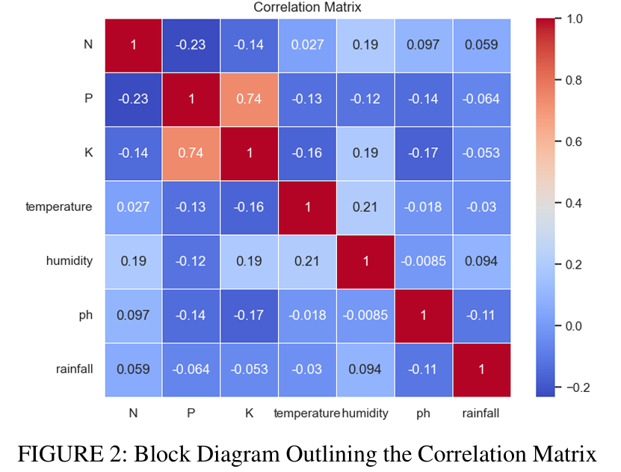
DATASET OVERVIEW (Research Paper)
1. Focused on yield vs key variables
2. Yield & Rainfall (0.36) → moderate positive, Yield & Temperature (0.13) → weak positive, Yield & Pesticides (-0.47) → negative correlation
3. Rainfall improves yield & Excess pesticides may reduce yield
P & K (0.74) → strong positive correlation
Most other features → weak correlation
No strong multicollinearity (good for model stability)

Slide 7
Paper Methodology Architecture
Three independent workflows inside one study
DATA PRE-PROCESSING PIPELINE
Data Cleaning: Handle missing values, detect and remove outliers using IQR method
Feature Engineering: Encode categorical variables (Soil_Type, Region, Season, Irrigation_Type)
Feature Scaling: StandardScaler normalization (zero mean, unit variance) for ML algorithms
Train-Test Split: 70% training / 30% testing with stratification for classification
Crop Recommendation Dataset (Classification)
1. Data Collection (soil + weather data)
2. Data Preprocessing (cleaning, normalization)
3. Feature Engineering (improve input features)
4. Apply ML Models (RF, SVM, KNN, etc.)
5. Model Evaluation (accuracy, F1-score)
6. Output: Best crop suggestion (22 crops)
Yield Prediction System (Regression)
1. Data Collection (wheat yield data: 1992-2013)
2. Missing Data Handling using MICE
3. Preprocessing & Feature Selection
4. Apply ML Models (SVR, RF, XGBoost, etc.)
5. Model Evaluation (R2, RMSE)
6. Output: Future yield prediction (up to 2025)

Slide 8
Paper Methodology Architecture
Hyper-Parameter Optimization
• Grid Search & Random Search for finding optimal parameters
• K-fold cross-validation (5-fold) for robust performance estimation
• SVR tuning: kernel type, regularization parameter C, epsilon (ε), gamma (γ)
• XGBoost tuning: Learning Rate, Max Depth, Number of Estimators, Subsample, Gamma
Evaluation Metrics :-
• R² Score (coefficient of determination) - fraction of variance explained
• RMSE & MAE - prediction error magnitude
• MAPE (%) - percentage error for interpretability
Evaluation Metrics for classification
Accuracy :- Total correct predictions out of all predictions.
Precision :-Correctly predicted positive out of all predicted positives.
F1 score:-Harmonic mean of precision and recall.
K-fold Cross validation :- Splits data into K parts and trains/tests the model K times using different splits.
Confusion Matrix :- Table showing actual vs predicted values to evaluate classification performance.

Slide 9
Explainable AI (X-AI) Methods :-
Feature Important Analysis
• Identify which features most impact model predictions
• Tree-based importance: MDI (Mean Decrease in Impurity)
• Permutation importance: Feature removal → accuracy drop
• Reveals agronomic insights: N, Rainfall, Temperature are most critical
LIME ( Local Interpretable Model – Agnostic Explanations):-
• Approximates complex model with simpler, interpretable model locally
• Explains individual predictions: why was this crop recommended?
• Identifies key feature ranges affecting each prediction
• Makes ML decisions transparent for farmer adoption & trust
Impact on Agriculture Decision Making
• Farmers understand which soil/weather factors matter for their field
• Policy makers can design interventions targeting key factors
• Builds confidence in AI systems for sustainable farming

Slide 10
Paper Reported Results
Regressor | MAE | MSE | RMSE | Std. Dev.
SVR | 0.1614 | 0.1047 | 0.3236 | 26.97
KNNR | 0.4540 | 0.3538 | 0.5948 | 26.92
XGBoostR | 0.4407 | 0.4346 | 0.6592 | 27.13
RFR | 0.3931 | 0.3754 | 0.6127 | 27.05
DTR | 0.4282 | 0.4289 | 0.6549 | 27.14
Best classifier reported: Random Forest with 99.7% accuracy.
Best regressor reported: Support Vector Regressor with 99.99% R².
The paper frames these outcomes as evidence for robust agricultural decision support.
Additional Findings
K-Fold Cross Validation improved reliability
Feature Engineering boosted model performance
MICE Imputation successfully handled missing data
Explainable AI (LIME + Feature Importance) made predictions interpretable

Slide 11
Paper Contributions and Future Scope
Contributions
Developed a dual ML system for:
Crop recommendation (classification)
Yield prediction (regression)
Compared multiple ML models and identified:
Random Forest (best for classification)
SVR (best for regression)
Used feature engineering + K-Fold validation to improve accuracy
Applied MICE imputation to handle missing data
Integrated Explainable AI (LIME + Feature Importance) for transparency
Future Scope (In Brief)
🌱 Use real-time data (IoT sensors, weather APIs)
🌍 Extend model to other regions/countries
🛰️ Incorporate satellite & image data
🤖 Apply deep learning models for better accuracy
📱 Develop farmer-friendly apps/tools

Slide 12
PART 2 : CODE IMPLEMENTATION AND ANALYSIS
TRANSLATING RESEARCH INTO WORKING MODELS

Slide 13
Code Architecture Overview :-
Code Implementation Stack
• Language: Python 3 with Jupyter Notebook for interactive analysis
• ML Libraries: scikit-learn (models, metrics), pandas (data), numpy (arrays)
• Visualization: matplotlib, seaborn for comprehensive EDA and results
• Tools: StandardScaler for normalization, LabelEncoder for categorical encoding
What Does the Code Do?
This Python script is a complete machine learning project that analyses agricultural data to help predict two things:
Which crop is best suited for a field? (Classification — choosing from 6 crop types)
How much yield (in tons per hectare) a field will produce (Regression — predicting a number)
📌 KEY CONCEPT: Classification = predicting a category (e.g., 'grow Wheat'). Regression = predicting a number (e.g., '4.5 tons per hectare').

Slide 14
Code Architecture Overview :-
The Code is Organized into following Sections..
Section | What it Does
Section 0 | Loads data and performs basic EDA — getting to know the data
Section 1 | Preprocessing — cleaning, encoding, and normalising the data
Section A | Classification — testing 7 different algorithms to predict crop type
Section B | Regression — testing 7 algorithms to predict crop yield
Section C | Feature Importance — which input variables matter most?

Slide 15
Load Data and Perform EDA – getting to know data
Core Libraries
Classification Models Imported
Library | What it Does | Analogy
numpy | Fast number-crunching on arrays | A calculator
pandas | Loads and manages data in tables (DataFrames) | Excel in Python
matplotlib / seaborn | Creates charts and graphs | A drawing board
Model | Simple Explanation
DecisionTreeClassifier | Creates a flowchart of Yes/No questions to classify
RandomForestClassifier | Builds hundreds of decision trees and takes a vote
SVC / LinearSVC | Finds the widest possible gap between classes
KNeighborsClassifier | Looks at the K nearest data points and follows the majority
GaussianNB | Uses probability statistics (Bayes' theorem) to classify

Slide 16
Load Data and Perform EDA – getting to know data
Regression Models Imported
Model | Simple Explanation
LinearRegression | Fits a straight line through the data points
RandomForestRegressor | Ensemble of trees that vote on a numerical value
GradientBoostingRegressor | Boosting approach applied to predicting numbers
LinearSVR | Finds the flattest tube that contains most data points
XGBRegressor | Highly optimised gradient boosting — often the best regressor

Slide 17
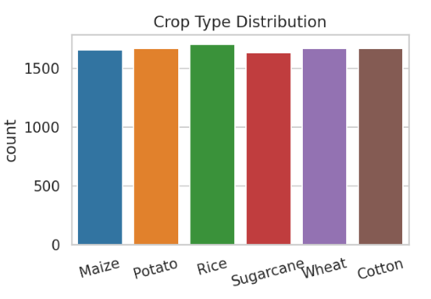
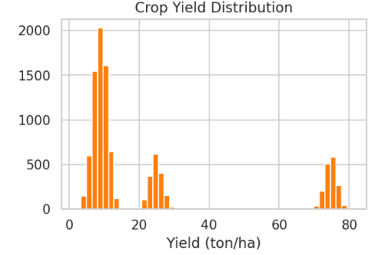
DATASET OVERVIEW ( Implementation Dataset )
Uniform distribution
No class Imbalance Problem
Suitable for Classification Model
Improves model fairness and accuracy
All crops have almost equal counts
DATASET IS BALANCED
Data is not uniform → multiple peaks (clusters)
This indicated different Crops produce different yield levels.
Not normally distributed
Important for regression modelling

Slide 18
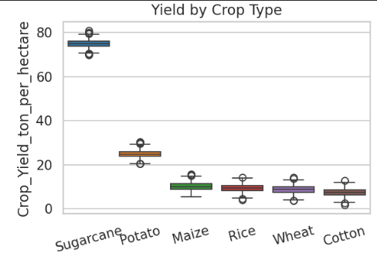
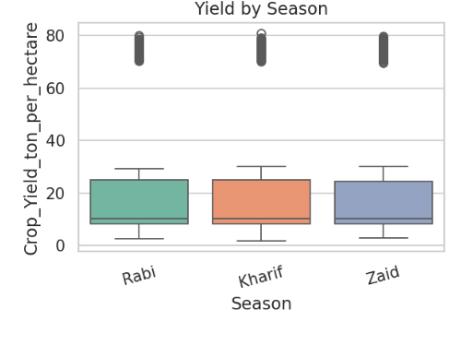
DATASET OVERVIEW
Median yield for all seasons is almost similar (~8–12 ton/ha)
Spread (variation) is also quite similar
All seasons show high outliers (~70–80 ton/ha)
No season clearly dominates in yield
Conclusion: Season alone does not strongly affect yield → other factors (soil, crop type) matter more
Sugarcane → highest yield (~70–80) yeild
Potato → medium (~20–30) yeild
Others → lower (~5–15) yield
Shows Spread -> Variation
Presence of outliers

Slide 19
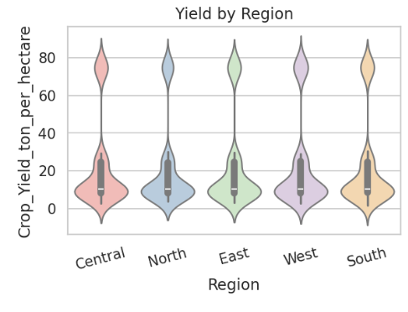
DATASET OVERVIEW
This is a violin plot showing distribution of crop yield (crop_yield_ton) across different categories (likely crops or regions).
Combines:
Box plot (inside) → median & quartiles
Density Shape (outside) → Data Distribution
Key observations:
Wider sections → more data points (high frequency)
Narrow sections → fewer data points
Some categories show higher variability in yield
Density shape (outside) → data distribution

Slide 20
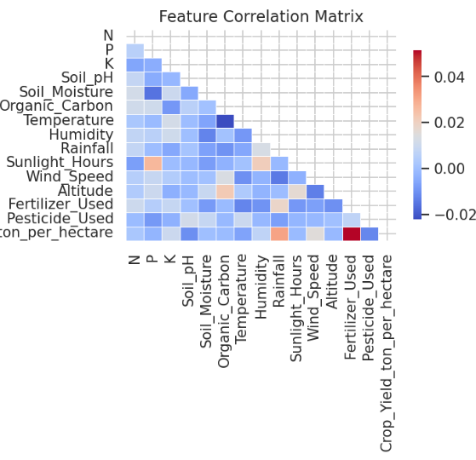
DATASET OVERVIEW
Shows relationship between features
Most values are close to 0
Weak correlation between features
Slight correlations:
Rainfall, humidity, temperature (expected)
Yield has some relation with inputs
Good for ML models (less redundancy)
Yield depends on multiple combined factors

Slide 21
Code Preprocessing Pipeline
Encoding & Scaling Pipeline
• LabelEncoder: Transform categorical variables (Soil_Type, Region, Season) → integers
• Separate crop type label for stratified train-test split
• StandardScaler: (X - mean) / std on all numerical features
• Scaling ensures algorithms like SVM, KNN, LR are not biased by feature magnitude
Train-Test Split Strategy
• Classification: Stratified split maintains crop type proportions in train & test sets
• Regression: Random 80-20 split for yield prediction
• Random state = 42 for reproducibility across model runs
Ensemble Methods (Best Performers)
• Random Forest: 100 trees, each trained on random feature subset → reduces overfitting
• Extra Trees: Similar to RF but uses random thresholds → faster, adds diversity
• Gradient Boosting: Sequential tree building, each corrects previous errors → high accuracy
Linear Distance Based Model
• Logistic Regression: Learns linear decision boundary via sigmoid function
• KNN: Classifies by majority vote of K nearest neighbors (K=5 typically)
• Gaussian Naive Bayes: Probabilistic classifier assuming feature independence
• SVM: Finds optimal hyperplane maximizing margin between crop classes
Model Training and Evaluation Loop
• Train each model on (1,760 samples)
• Calculate predictions on (440 samples)
• Compute Accuracy, F1-Score, Precision, Recall for each model

Slide 22
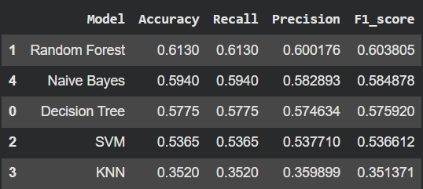
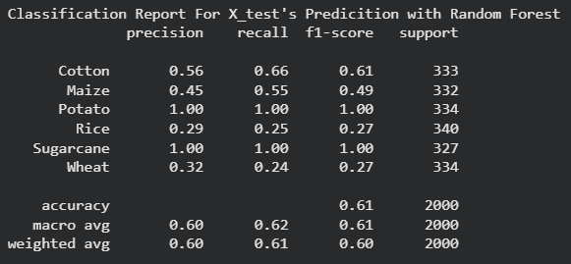
Classification Models Implementation & Result
The Training Loop — How All Models Are Evaluated
The code uses a for loop to train and evaluate every model the same way:
Fit the model on training data
Predict on the test data
Calculate 4 metrics: Accuracy, F1-Score, Recall, Precision
Code Output of Classification Model :-

Slide 23
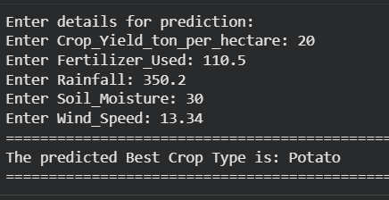
Classification Models Prediction
Code Input of Classification Model Prediction :-
Code Output of Classification Model Prediction :-

Slide 24
Regression Based Models Implementation
Tree Based Regressor
• Random Forest Regressor: Ensemble of trees averaging predictions → captures non-linear yield patterns
• Gradient Boosting Regressor: Sequential correction of residuals → excellent accuracy (R² 0.9975-09979)
• XGBoost: Optimized GBR with regularization → handles non-monotonic rainfall-yield relationship
Linear & Kernal Methods
• Linear Regression: Fits Y = wX + b assuming linear relationships
• SVR: RBF kernel projects data to high-dimensional space for non-linear fitting
Model Training and Hyper Parameter Tuning
• Grid Search explores parameter combinations for optimal performance
• For SVR: optimize C (margin tolerance), epsilon (tube width), gamma (kernel spread)
• Track R², RMSE, MAE for comprehensive performance assessment
Extracting Important Feature
• Tree-based models (RF, GB, XGB): feature_importances_ attribute
• Formula: Sum of impurity decrease across all tree splits for each feature
• Permutation Importance: measure accuracy drop when feature values are shuffled
• All importances normalized to [0, 1] and sorted for comparison

Slide 25
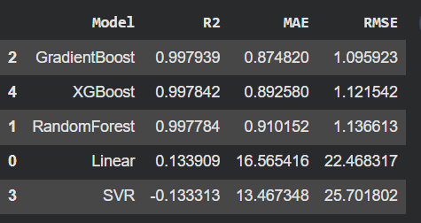
Regression Models Implementation & Result
The Training Loop — How All Models Are Evaluated
The code uses a for loop to train and evaluate every model the same way:
Fit the model on training data
Predict on the test data
Calculate 3 metrics: R2, MAE, RMSE
Code Output of Regression Model :-

Slide 26
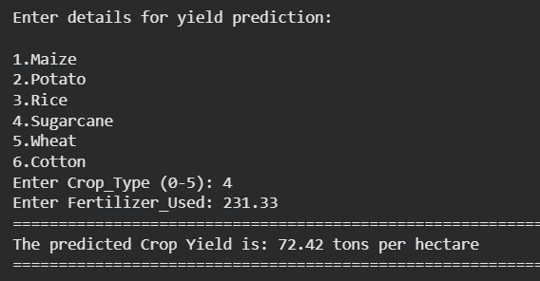
Regression Models Prediction
Code Input of Regression Model Prediction :-
Code Output of Regression Model Prediction :-

Slide 27
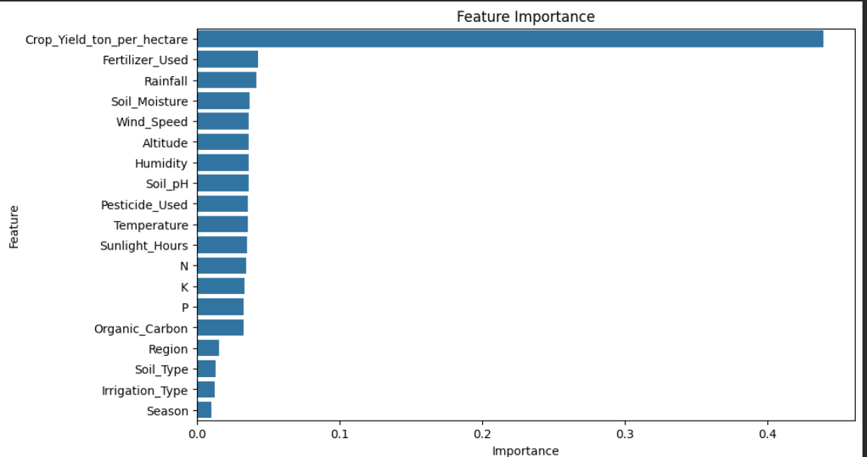
Feature Importance Analysis (Classification)
Classification (RF) Feature Importance
This looks at which features the model used to predict the actual numerical yield.
The Meaning: The feature importance chart shows that Crop Yield per hectare is the most dominant factor influencing the model’s predictions.
Variables like Fertilizer Used, Rainfall, and Soil Moisture have moderate impact, indicating their significant role in agricultural productivity.
Environmental factors such as Temperature, Humidity, and Sunlight Hours contribute moderately but are less influential than yield-related inputs.
Nutrient elements (N, P, K) and soil properties like Soil pH and Organic Carbon have relatively smaller but still relevant effects.
Categorical features such as Region, Soil Type, Irrigation Type, and Season have the least importance, suggesting limited influence on prediction outcomes.

Slide 28
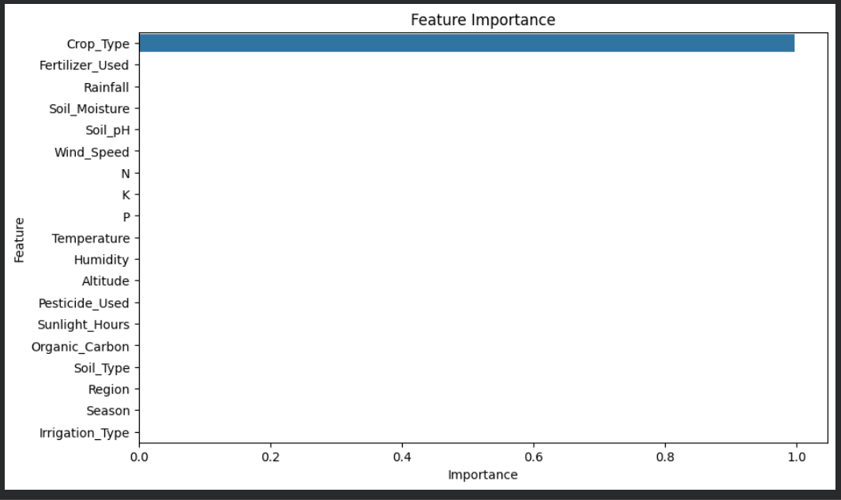
Feature Importance Analysis (Regression)
Regression (Grediant Boost) Feature Importance
This looks at which features the model used to predict the actual numerical yield.
The Meaning:
The chart indicates that Crop Type is the most influential feature, dominating the model’s predictions significantly.
All other variables such as Fertilizer Used, Rainfall, and Soil Moisture have extremely low importance in comparison.
Environmental factors like Temperature, Humidity, and Wind Speed contribute minimally to the prediction outcome.
Soil nutrients (N, P, K) and properties such as Soil pH and Organic Carbon show negligible impact on the model.
Categorical features like Region, Season, Soil Type, and Irrigation Type have almost no influence, suggesting the model heavily depends on crop type alone.

Slide 29
Thank You

