Slide 1

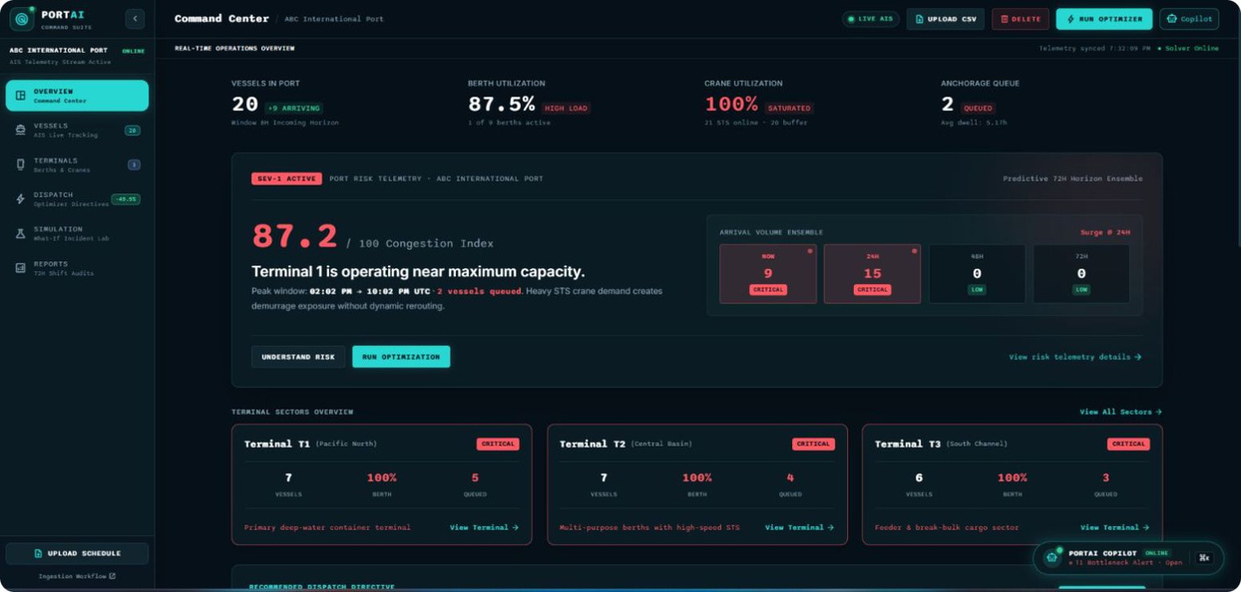
TEAM REDUX
PORTAI
Autonomous 72-Hour Port Congestion Predictor & Shift Planner
Predict · Optimize · Simulate · Brief
An AI-powered maritime operations command centre that predicts harbour congestion 72 hours ahead, optimises berth and crane dispatching, and simulates disruption scenarios in real time.
PORTAI COMMAND CENTER
  Predict: 72-hour congestion forecasting
  Optimize: Priority-aware berth & crane dispatch
  Simulate: Non-destructive disruption testing
  Brief: AI-powered operational recommendations
From reactive port operations to proactive decision-making.

Slide 2
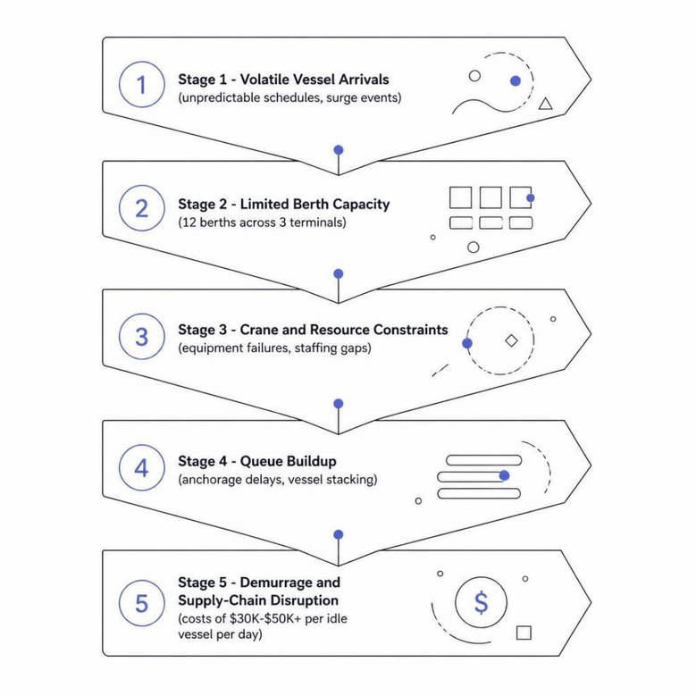
The Multi-Million-Dollar Harbour Bottleneck
Ports react to congestion after it has already formed. Static spreadsheets and naive FCFS scheduling create costly, avoidable delays.
Serving: Harbour Masters · Port Operations Directors · Shift Dispatchers · Marine Terminal Operators
$30K–$50K+ Demurrage
Naive FCFS Scheduling
Cascading Failures
Visibility Gap
Potential cost per idle vessel per day
Static logic prioritises the wrong vessel at the wrong time
A single crane outage triggers terminal-wide congestion
Dispatchers lack forward-looking 72-hour congestion forecasting

Slide 3
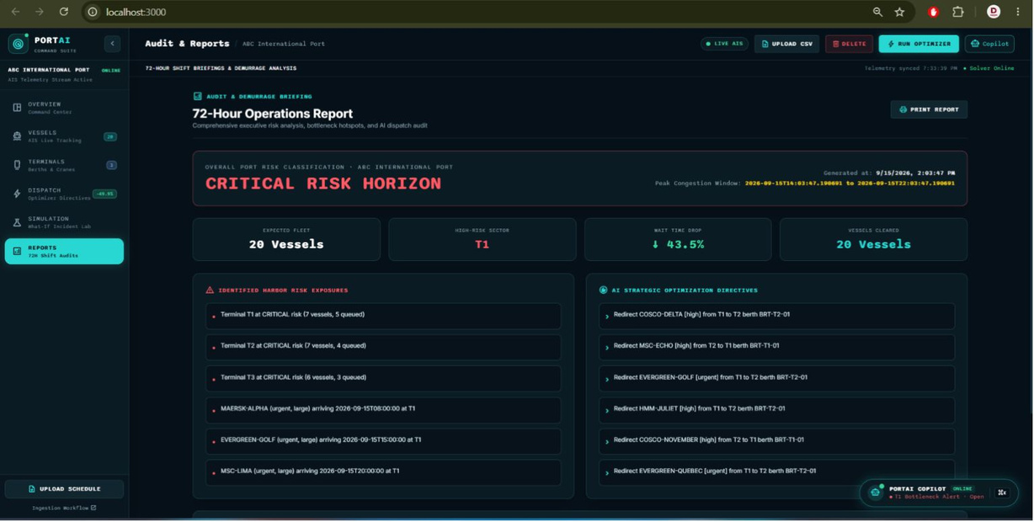



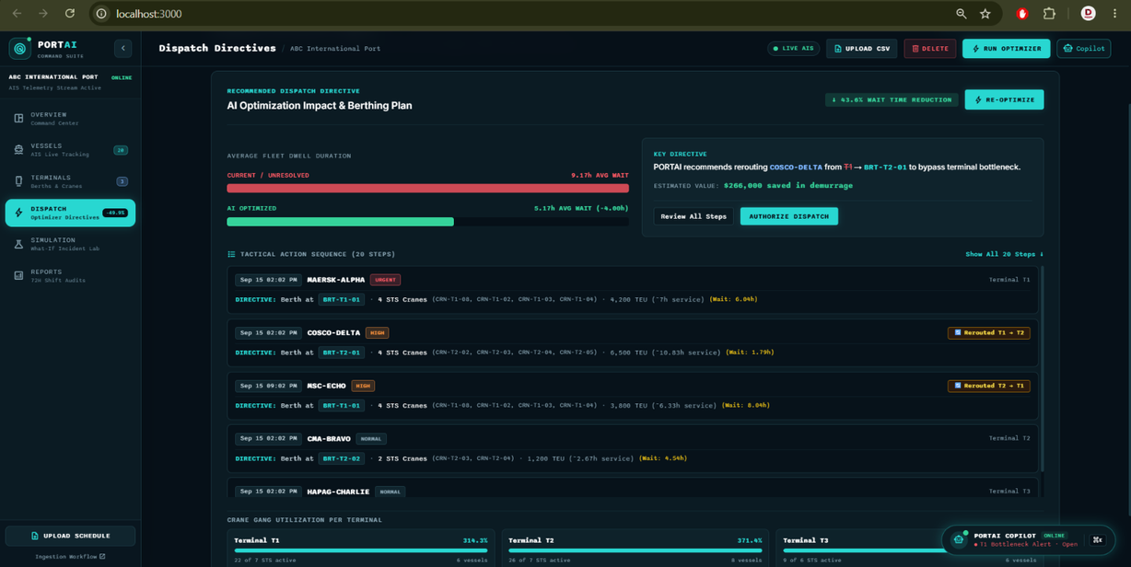


Meet PORTAI:
From Reactive to Predictive
PORTAI transforms port operations into a
predictive decision system with four core capabilities.
Predict
72-hour multi-terminal congestion forecast with normalised 0–100 index
Optimise
Priority-aware berth allocation and STS crane grouping
Simulate
Non-destructive What-If incident simulation via in-memory state clone
Brief
Grounded AI operations copilot and automated 72-hour executive shift briefing

Slide 4
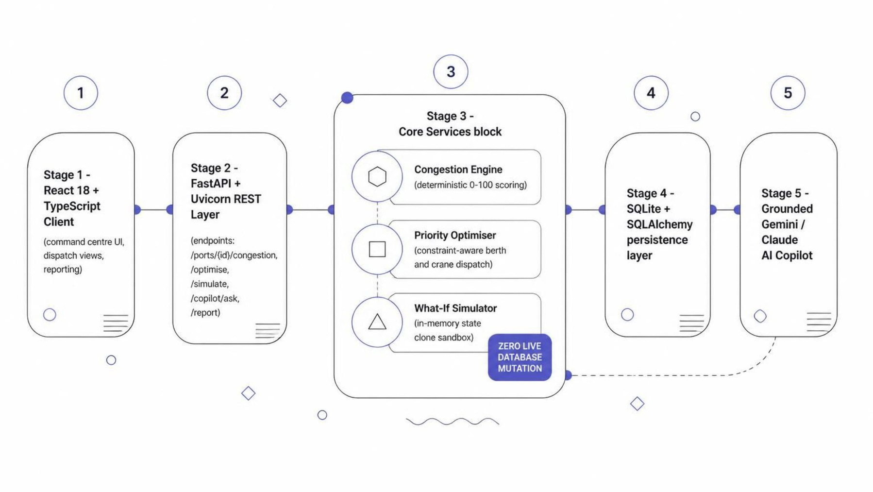
How PORTAI Works
A modular React + FastAPI architecture combines forecasting, optimisation, grounded AI, and safe simulation — all with zero live database mutation.

Slide 5
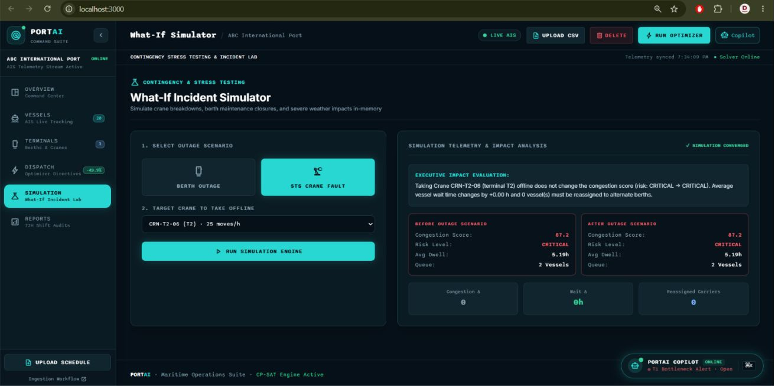
What-If Simulation: Break It Before It Breaks You
Test catastrophic equipment failures without modifying live operational data. The in-memory clone sandbox preserves 100% database integrity throughout.
STS Crane 3 — Hydraulic Failure
Terminal 1 during a 13-vessel arrival surge
Normal Port State
Simulate Crane Failure
Clone State in Memory
Recalculate Congestion
Measure Queue / Dwell Impact
Generate Rerouting Recommendation

Slide 6
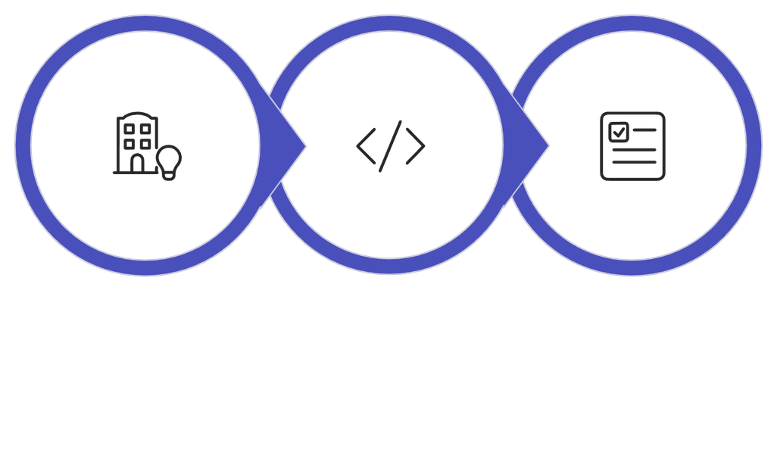

Built Faster with IBM Bob
IBM Bob accelerated our engineering workflow from architecture scaffolding through to automated validation — compressing development time significantly.
Architect
Engineer
Validate
Transparency Note: IBM Bob was used as a development engineering assistant. Runtime LLM generation uses Google Gemini API and Anthropic Claude API. IBM Bob is not the runtime AI model.

Slide 7
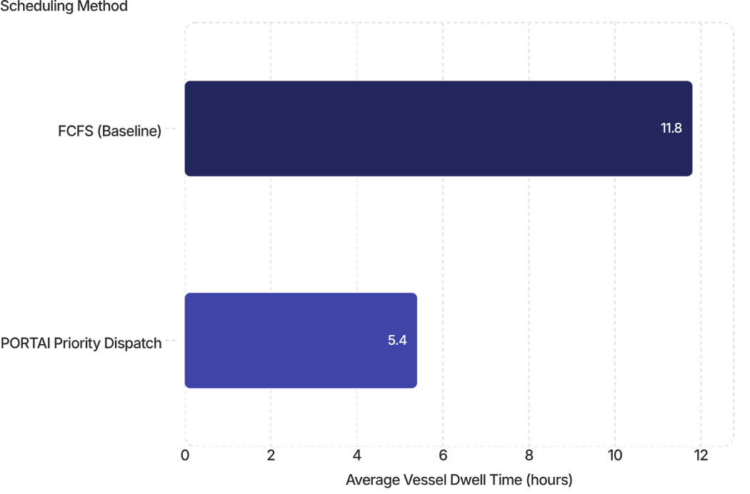
Measured Performance
PORTAI significantly reduces vessel waiting time while maintaining sub-second optimisation across a 45-vessel, 12-berth, 25-crane test environment.
40–55%
<250ms
100%
Dwell-Time Reduction
Solver Execution
Database Integrity
Compared to naive FCFS scheduling
Across 45 vessels, 12 berths, 25 cranes
Maintained during all incident simulations
13
Vessels in Surge
Arrival surge detected 24 hours before projected harbour gridlock
Benchmark Result
FCFS average: 11.8 hours
PORTAI dispatch: 5.4 hours
≈ 54.2% reduction in this benchmark

Slide 8
Team Redux
Om Chauhan
Darshan Hotchandani
Shreya Patel
Ansh Patel
Team Lead & Full-Stack Integration
Backend Architecture & Core Services
Frontend Engineering & UI
Product & Research
  Problem & domain research
  Requirements & feature analysis
  Product workflow & solution planning
  React command centre
  Dispatch views
  Reporting & navigation
  Backend / API integration
  Automated test harness
  UI & submission integration
  FastAPI & database architecture
  Congestion engine & optimiser
  Simulation / backend services

