Slide 1
OTT Trend Analysis Project
This project focuses on analyzing trends across various OTT platforms.
It includes end-to-end data cleaning, transformation, and visual analytics using Power BI.
The main goal is to understand user viewing patterns and content performance.
Scope includes Movies, TV Shows, Genres, Ratings, Release Trends, and Popularity analysis.

Slide 2
Objectives
• Identify top-performing genres across OTT platforms.
• Compare engagement levels between Movies and TV Shows.
• Evaluate yearly growth in content production.
• Study how ratings vary based on genre and release year.
• Support content decision-making for OTT providers.
• Build a dashboard that allows slicing data by genre, year, and category.

Slide 3
Dataset Overview
• The dataset includes both Movies and TV Shows.
• Key attributes: Title, Genre, Release Year, Duration, Rating, Popularity.
• Additional fields: Content Category, Platform, Description, Age Rating.
• Data size: 1000+ records to ensure realistic analysis.
• Cleaned missing values, standardized genres, and formatted dates.

Slide 4
Visuals Used in the Dashboard
Main Dashboard
Line Chart – Popularity Score of Movies & Shows by Release Year
Bar Chart – Average IMDb Rating by Platform
Card Visuals – Total Titles, Total Movies, Total Shows
Slicers – Age Rating, Genre
Movies Dashboard
Tree map – Movies by Genre
Line Chart – Movies by Release Year
Bar Chart – Average IMDb Rating by Platform
Line Chart – Popularity Score of Movies by Release Year
TV Shows Dashboard
Tree map – Shows by Genre
Line Chart – Shows by Release Year
Bar Chart – Average IMDb Rating by Platform
Line Chart – Popularity Score of Shows by Release Year

Slide 5
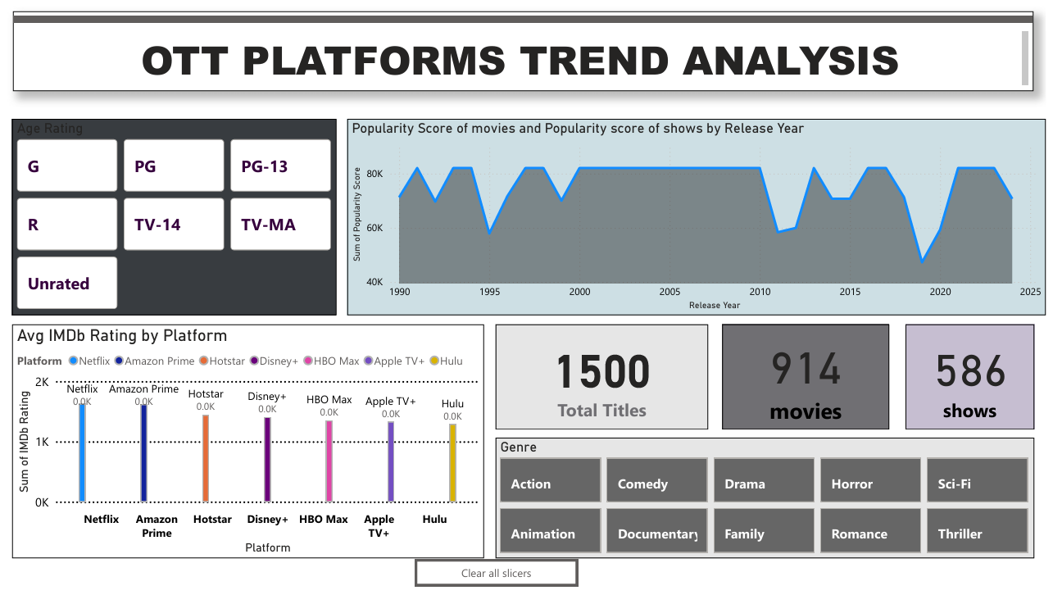
Snapshots

Slide 6
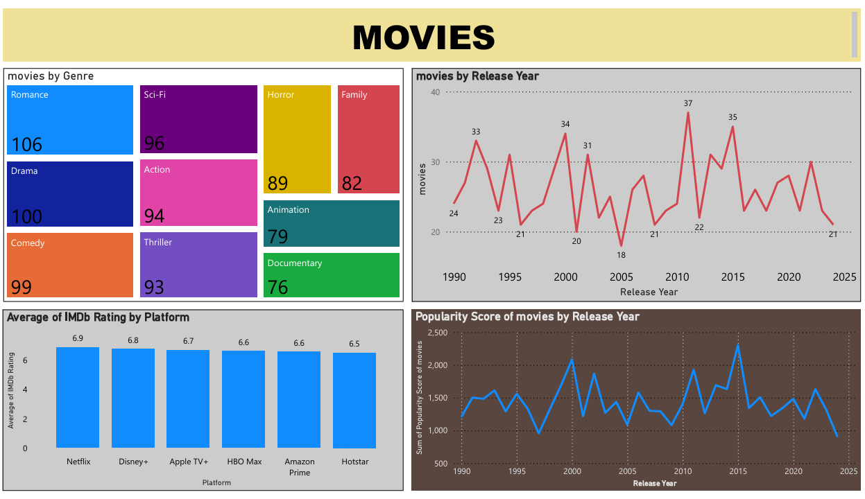
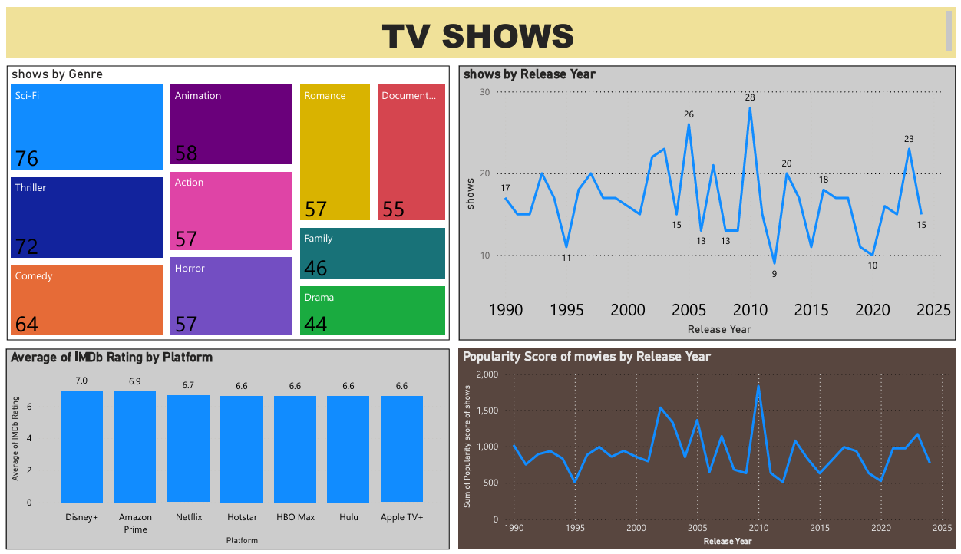
Snapshots

Slide 7
Key Insights
• Drama and Action remain consistently top-viewed genres.
• The highest content production occurred between 2018–2022.
• Shows outperform movies due to longer engagement time.
• Ratings peak for titles released between 2016–2020.
• Family and Comedy genres receive strong ratings but lower volume.
• Short-duration content gaining popularity among youth audiences.

Slide 8
Conclusion
This project provides in-depth insights into OTT trends using Power BI.
It helps OTT platforms strategize content acquisition and production.
Advanced filtering in dashboards makes analysis highly interactive.
The project reflects strong skills in data cleaning, modeling, and visualization.
Suitable for resume, portfolio, and interview demonstration.

