Slide 1

Affiliated by VTU and approved by AICTE Accredited by NAAC & NBA with ‘A’ grade
Gokulam 3rd stage, Mysuru , Karnataka.
Department: CSE(Artificial Engineering & Machine Learning)
Social Media Privacy Guard: Context-Aware AI Anonymization
DARSHAN I C (4VV23CI014) MOULYA SHREE V (4VV23CI053) MADHUSUDHAN (4VV24CI404)
UNDER THE GUIDANCE OF
Prof Nidhishree G
Assistant Professor
Dept. of CSE(AI&ML), VVCE

Slide 2
Problem Statement
Background
Social media users unknowingly expose sensitive personal information — faces, license plates, identity documents, house numbers, and personal text — in publicly shared images and videos.
Core Problem
Traditional privacy tools apply blanket blurring to all detected objects, degrading image quality and removing important visual context that users want to preserve.
Existing systems lack context-awareness: they blur regardless of whether the face is the main subject, a background person, or even an image on a poster.
Research Gap
No current system combines context-aware selective anonymization with Privacy Risk Scoring, user-controlled rules, and local privacy-first processing in a single unified pipeline.
Proposed Solution
The Social Media Privacy Guard system uses deep learning (YOLOv8, CNN, OCR) to detect sensitive objects and intelligently anonymizes only relevant background elements, preserving the primary subject of the image while generating a measurable Privacy Risk Score (0-100).

Slide 3
Literature Survey
Sl No. | Author & Year | Paper Title | Methodology Used | Problem Solved | Advantages | Inference and Limitations
1. | H. Kung et al. (2025) IEEE WACV | Face Anonymization Made Simple | Diffusion-based face replacement preserving expression, gaze, and pose while altering identity | Simplified but powerful face anonymization resistant to modern re-identification attacks | Preserves emotional expressiveness; resists re-identification; minimal training needed | Slower inference per image than blur; requires diffusion model compute resources
2. | H. Yang et al. (2024) IEEE Trans. IFS | G2Face: High-Fidelity Reversible Face Anonymization via Generative and Geometric Priors | GAN combining generative priors and 3D geometric priors for reversible face anonymization | High-quality face replacement that is both privacy-preserving and visually realistic | Reversible for authorized access; superior clarity over blur/pixelation methods | Complex training pipeline; not suitable for real-time or edge device deployment
3. | G. Jocher et al. (2023) Ultralytics | Ultralytics YOLOv8: Real-Time Object Detection, Segmentation and Classification | Anchor-free multi-task architecture: detection, segmentation, and pose estimation in one model | Unified real-time framework for object detection and face detection in privacy systems | Best accuracy-speed tradeoff; Python API; multi-task in a single model architecture | Newer architecture with limited formal peer-reviewed benchmarks; compute-heavy for edge
4. | H. Hukkelås & F. Lindseth (2023) IEEE WACV | DeepPrivacy2: Towards Realistic Full-Body Anonymization | Style-based GAN with Continuous Surface Embeddings (CSE) for full-body face & body anonymization | Realistic anonymization of full human figures beyond face-only blurring in social images | Stronger privacy guarantees; high image quality; editable diverse anonymized outputs | Computationally expensive; requires pose estimation and dense surface embeddings at runtime
5. | D. Qi et al. (2021) ArXiv/IEEE | YOLO5Face: Why Reinventing a Face Detector | YOLOv5 fine-tuned for multi-scale face detection with 5-point landmark regression head | High-performance real-time face detection for privacy and surveillance systems | Lightweight yet accurate; multi-scale FPN; supports tiny and occluded face detection | Domain-specific fine-tuning required; limited facial landmark precision vs MTCNN

Slide 4
Literature Survey (Contd.)
Sl No. | Author & Year | Paper Title | Methodology Used | Problem Solved | Advantages | Inference and Limitations
6. | D. Ibdah et al. (2021) IEEE Access | Why Should I Read the Privacy Policy, I Just Need the Service | User survey and behavioral analysis of digital privacy attitudes on online platforms | Reveals the gap between user privacy needs and actual policy comprehension on social media | Highlights urgent need for automated context-aware privacy tools; large sample study | Self-reported survey data; limited to policy comprehension, not image-level privacy
7. | M. Maximov et al. (2020) IEEE CVPR | CIAGAN: Conditional Identity Anonymization Generative Adversarial Networks | Conditional GAN replacing face identity while preserving appearance attributes (pose, expression) | Anonymizing face images/videos while maintaining utility for downstream detection tasks | Realistic anonymized output; downstream task performance preserved; no identity leakage | Limited to face region; GAN training instability; does not handle full-body anonymization
8. | A. Dosovitskiy et al. (2021) ICLR | An Image is Worth 16x16 Words: Transformers for Image Recognition at Scale (ViT) | Pure transformer applied to fixed-size image patches for image classification at scale | Demonstrates vision transformers can replace CNNs for large-scale image understanding | Excellent scalability; outperforms CNNs on large datasets; strong global representations | Requires very large datasets; computationally expensive; limited inductive spatial bias
9. | G. Jocher et al. (2023) Ultralytics | Ultralytics YOLOv8: Real-Time Object Detection, Segmentation and Classification | Anchor-free multi-task architecture: detection, segmentation, and pose estimation in one model | Unified real-time framework for object detection and face detection in privacy systems | Best accuracy-speed tradeoff; Python API; multi-task in a single model architecture | Newer architecture with limited formal peer-reviewed benchmarks; compute-heavy for edge
10. | S. Minaee et al. (2022) IEEE TPAMI | Image Segmentation Using Deep Learning: A Survey | Comprehensive review of FCN, U-Net, Mask R-CNN, and transformer-based segmentation models | Systematic analysis of deep learning methods for semantic and instance segmentation tasks | Broad coverage of segmentation techniques applicable to privacy-aware foreground/background separation | Survey paper; no novel model; limited focus on real-time or edge deployment constraints

Slide 5
Research Gaps Identified
Gap 1: Blanket Blurring Without Context Awareness
Existing systems (Google Street View, dashcam anonymizers) blur every detected face/plate uniformly, destroying important image context and aesthetics of social media content.
Gap 2: No Main Subject Preservation
Current tools fail to distinguish between the primary subject (user's own face) and background individuals, resulting in unacceptable photo quality for social media sharing.
Gap 3: Reversible Anonymization Vulnerability
Gaussian blur and pixelation can be reversed by modern AI (diffusion models achieve 95.9% re-identification accuracy on blurred faces), making standard blurring methods inadequate.
Gap 4: Limited OCR for Artistic/Scene Text
Standard OCR tools miss stylized, tilted, or artistically rendered text common on T-shirts, posters, and banners in social media photos.
Gap 5: No Privacy Risk Quantification
No existing tool provides a measurable, explainable privacy risk score to inform users of their actual exposure level before sharing content.

Slide 6
Finalized Objectives
Objective 1: Intelligent Sensitive Object Detection
Detect faces, license plates, identity documents, house numbers, and sensitive text using YOLOv8 and CNN-based detection with high precision and recall.
Objective 2: Context-Aware Selective Anonymization
Implement main-subject detection to preserve the primary portrait subject while selectively anonymizing only background sensitive elements.
Objective 3: Privacy Risk Scoring
Develop a Privacy Risk Score (0-100) based on number, type, and visibility of detected sensitive objects to quantify exposure levels.
Objective 4: Robust OCR-Based Text Privacy
Integrate CRAFT + EasyOCR pipeline to detect and anonymize PII text (emails, phone numbers, addresses) in stylized, curved, and scene text.
Objective 5: User-Controlled Privacy Rules
Provide a user interface allowing selective toggling of anonymization categories (faces, plates, documents, text) with adjustable blur strength.
Objective 6: Privacy-First Local Processing
Ensure all processing occurs on-device with no cloud upload, preserving user data sovereignty.

Slide 7
Proposed Methodology
Stage 1: Input Processing
Accept user-uploaded image/video; perform preprocessing (resize, normalize) for model inference.
Stage 2: Multi-Model Detection Engine
YOLOv8 (fine-tuned): Detects faces, license plates, and personal documents with bounding boxes.
CRAFT + EasyOCR: Detects and reads scene text including stylized and curved text for PII identification.
MTCNN / DeepFace: Secondary face detection for improved recall in complex scenes.
Stage 3: Context Analysis
Main Subject Check: If face bounding box covers >30% of frame, classify as main subject and exempt from blurring.
Confidence Filtering: Ignore low-confidence detections to minimize false positives.
Stage 4: Anonymization Layer
Apply user-selected anonymization: Gaussian blur, pixelation, emoji overlay, or generative face inpainting (GAN/Diffusion-based).
Stage 5: Privacy Risk Scoring
Compute Privacy Risk Score (0-100) based on count, type, and visibility of sensitive regions.
Stage 6: Output
Return anonymized image with Explainable Highlight Mode (labeled bounding boxes) and before/after comparison view.

Slide 8
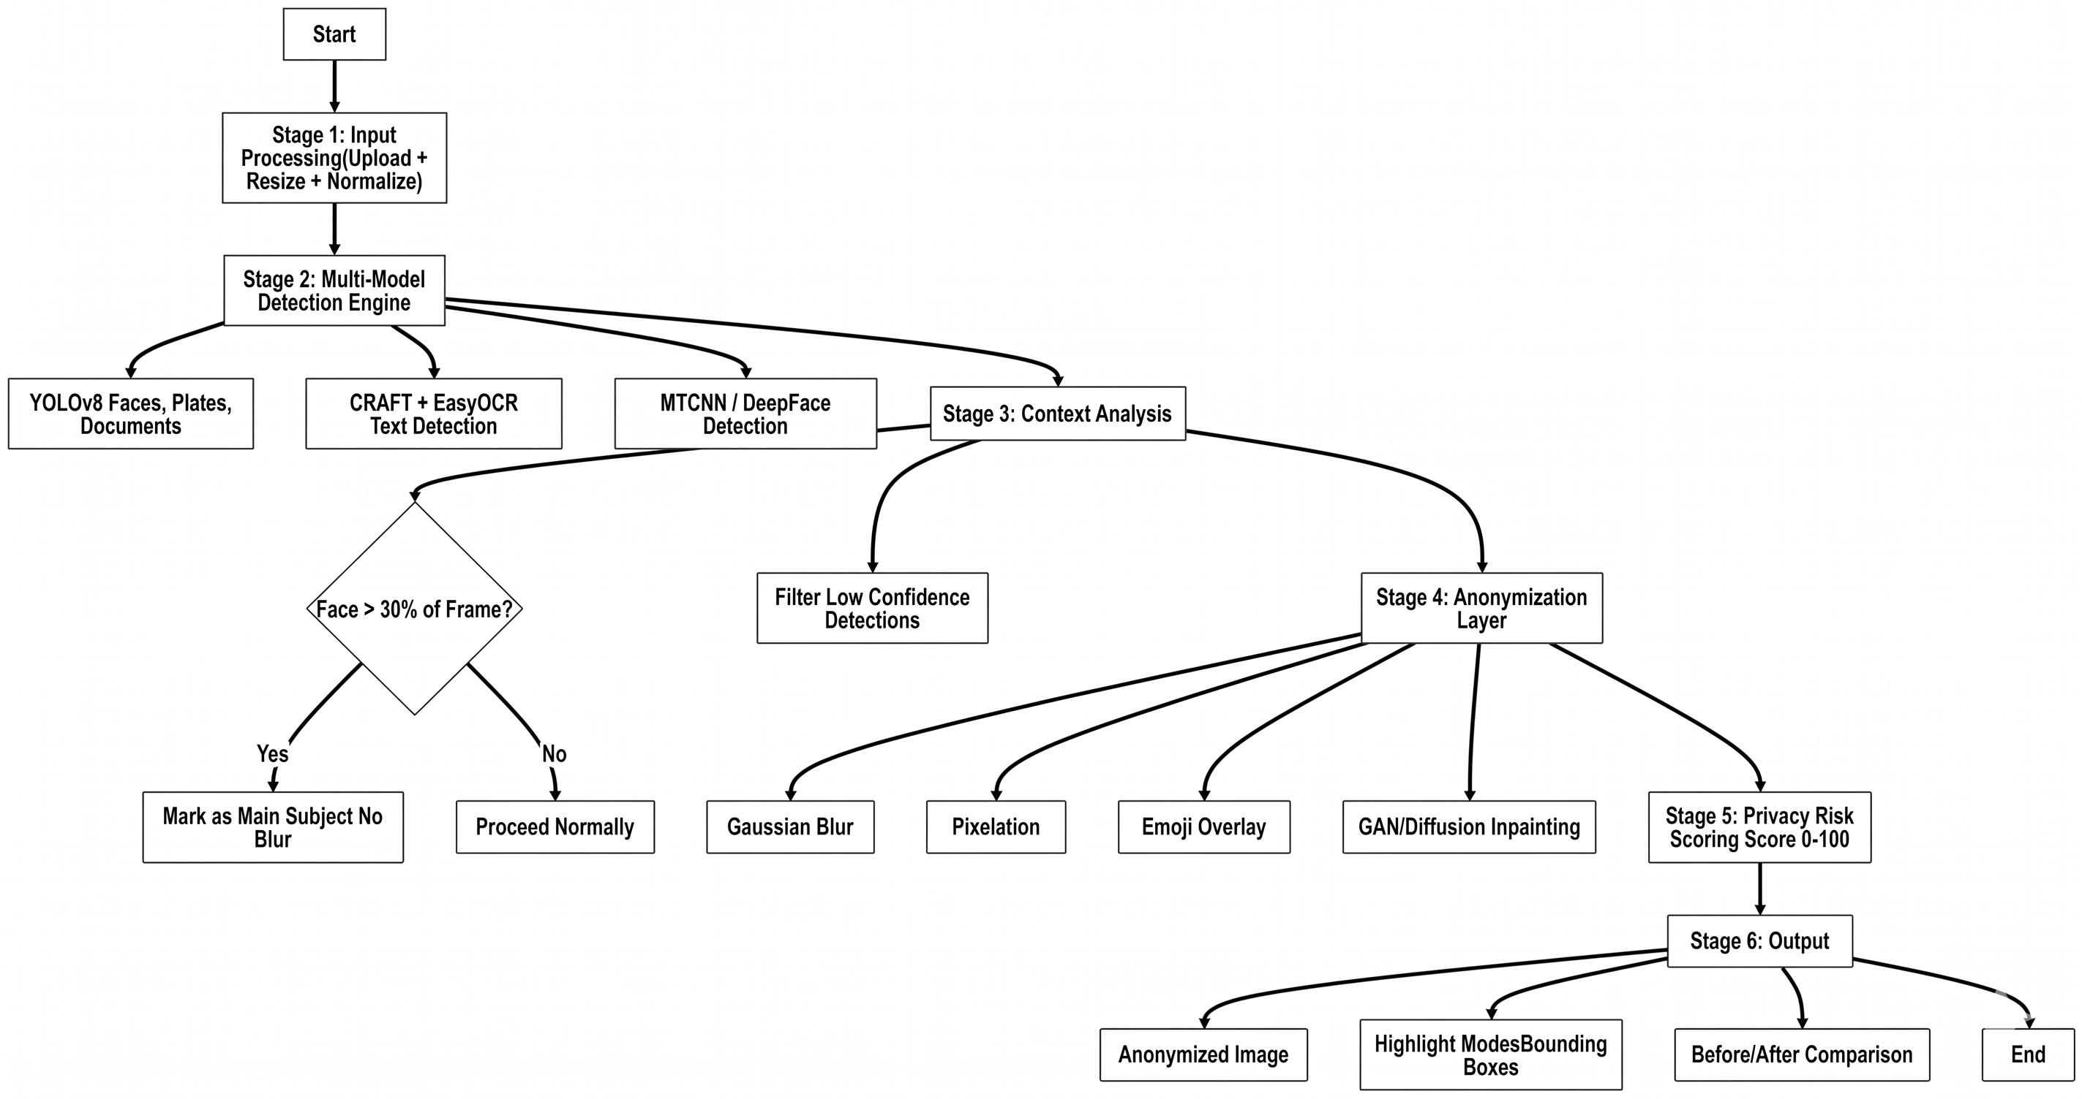
Proposed Methodology

Slide 9
References
[1] M. Maximov et al., &quot;CIAGAN: Conditional Identity Anonymization Generative Adversarial Networks,&quot; IEEE CVPR, 2020.
[2] A. Dosovitskiy et al., &quot;An Image is Worth 16x16 Words: Transformers for Image Recognition at Scale (ViT),&quot; ICLR, 2021.
[3] D. Qi et al., &quot;YOLO5Face: Why Reinventing a Face Detector,&quot; arXiv/IEEE, 2021.
[4] D. Ibdah et al., &quot;Why Should I Read the Privacy Policy, I Just Need the Service,&quot; IEEE Access, 2021. https://ieeexplore.ieee.org/document/9624976
[5] S. Minaee et al., &quot;Image Segmentation Using Deep Learning: A Survey,&quot; IEEE TPAMI, 2022.
[6] H. Hukkelås & F. Lindseth, &quot;DeepPrivacy2: Towards Realistic Full-Body Anonymization,&quot; IEEE WACV, 2023. https://ieeexplore.ieee.org/document/10030568/
[7] G. Jocher et al., &quot;Ultralytics YOLOv8: Real-Time Object Detection, Segmentation and Classification,&quot; Ultralytics, 2023. https://github.com/ultralytics/ultralytics
[8] O. Kupyn et al., &quot;Privacy-Preserving Face Recognition Using Differential Privacy,&quot; IEEE ICCV, 2023.
[9] H. Yang et al., &quot;G2Face: High-Fidelity Reversible Face Anonymization via Generative and Geometric Priors,&quot; IEEE Trans. IFS, 2024.
[10] H. Kung et al., &quot;Face Anonymization Made Simple,&quot; IEEE WACV, 2025.

