Slide 1
ANDRITZ CMMS
CMMS Application Feature Walkthrough
Client review presentation for evaluating the complete maintenance management platform
Step-by-step journey from organization setup to operations, inventory, approvals, notifications, reports, and business value.
Assets
Maintenance
Inventory
Approvals
Reports

Slide 2
CMMS Application
CLIENT REVIEW
OVERVIEW
What the CMMS Application Covers
Foundation Setup
- Company branding
- Sites and locations
- Employees, users, roles, permissions
Maintenance Operations
- Equipment and vendors
- Requests and assignments
- Technician execution and downtime
Inventory Control
- Spare part stock
- Manager/store approvals
- Reorder and purchase tracking
Governance
- Authentication
- Role/site/API access
- Approval workflow
Monitoring
- Dashboard
- Notifications
- Reports and analytics
Setup
Operate
Approve
Track Stock
Notify
Report
CMMS Feature Walkthrough
2

Slide 3
CMMS Application
CLIENT REVIEW
OVERVIEW
End-to-End Application Journey
Company
Sites
Employees
Roles
Equipment
Requests
Assignments
Work Logs
Approvals
Spare Parts
Inventory
Purchase
PM
Notifications
Dashboard
Reports
Client View
- The system starts with master data setup and then supports daily plant maintenance from request creation through closure.
Management View
- Every workflow produces status, stock, downtime, approval, and history data for operational review.
CMMS Feature Walkthrough
3

Slide 4
SECTION
Part 1 - Foundation Setup
How the customer configures the organization before maintenance work begins.
1
Create company identity
2
Register operating sites
3
Maintain employee master
4
Control users, roles, permissions, and site access
4

Slide 5
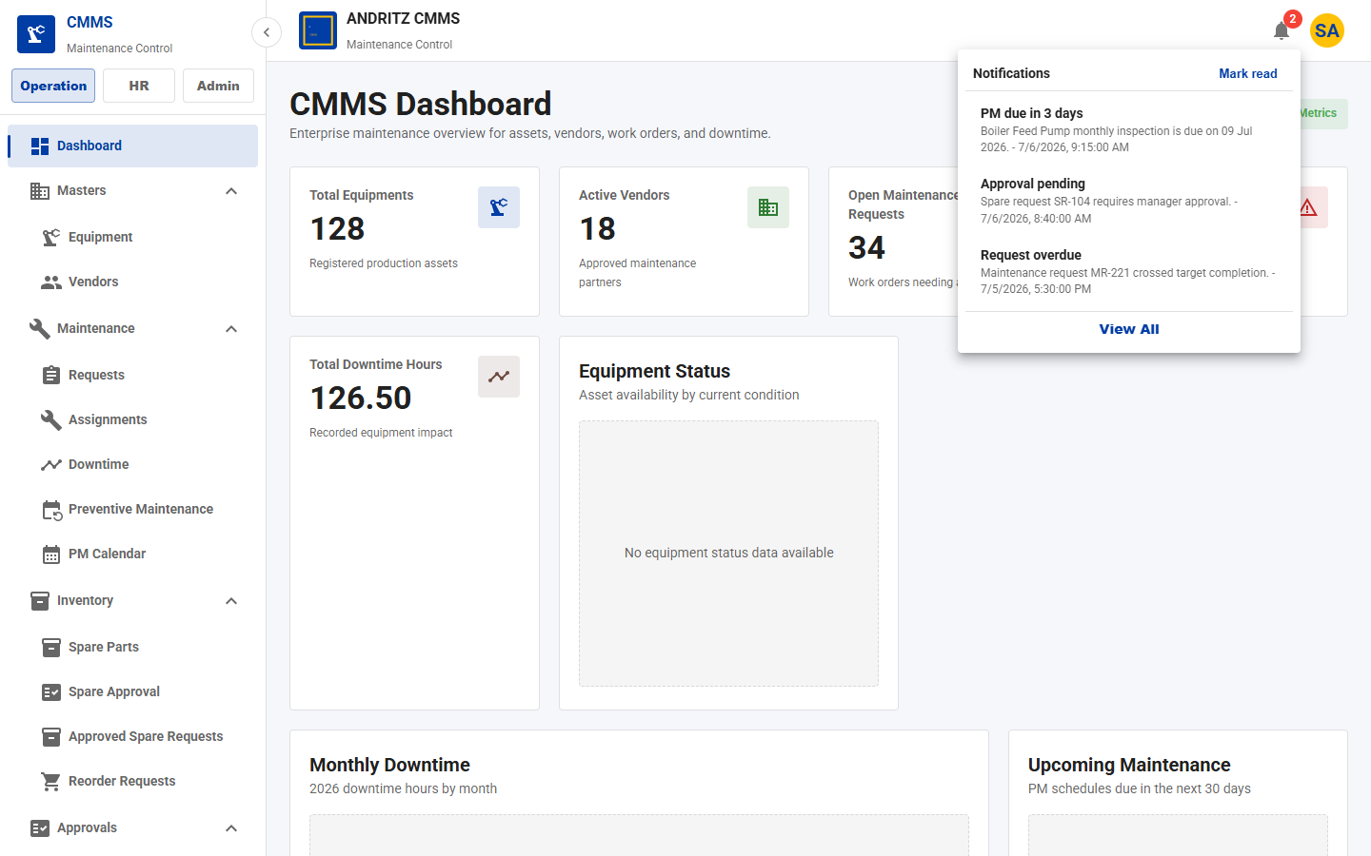
CMMS Application
CLIENT REVIEW
STEP 1
Company Master and Branding
What this feature does
- Maintains the company profile used throughout the application.
- Stores company name, code, contact details, address, status, and logo.
How the client uses it
- Admin opens Company Master.
- Admin enters company details and uploads the logo.
- The top navbar uses this brand identity for all users.
Why it is useful
- Makes the application feel owned by the client.
- Keeps organization details centralized.
- Supports professional demos, daily use, and reporting identity.
Open Admin
Company Master
Enter Details
Upload Logo
Save Branding
Application screen from the current CMMS UI
CMMS Feature Walkthrough
5

Slide 6
CMMS Application
CLIENT REVIEW
STEP 2
Site Master
What this feature does
- Registers plants, warehouses, service centers, or client operating locations.
- Captures site code, name, type, address, contact, city/state, and status.
How the client uses it
- Admin creates all physical locations.
- Users filter equipment, requests, employees, inventory, and reports by site.
- Inactive sites can be retained historically without being used for new work.
Why it is useful
- Gives management clear site-wise control.
- Enables location-specific access and reporting.
- Supports multi-plant rollout from one system.
Company
Site
Employees
Assets
Inventory
Reports
CMMS Feature Walkthrough
6

Slide 7
CMMS Application
CLIENT REVIEW
STEP 3
Employee Master and Site Assignment
What this feature does
- Maintains employee records for technicians, managers, store teams, admins, and HR users.
- Tracks employee code, name, department, designation, contact details, status, and assigned site count.
How the client uses it
- HR/Admin adds employee profiles.
- Employees are linked to sites.
- Technicians become available for maintenance assignment and work logging.
Why it is useful
- Creates an accountable workforce directory.
- Improves technician planning.
- Supports site-wise responsibility and audit traceability.
Create Employee
Assign Site
Assign User/Role
Use in Workflows
CMMS Feature Walkthrough
7

Slide 8
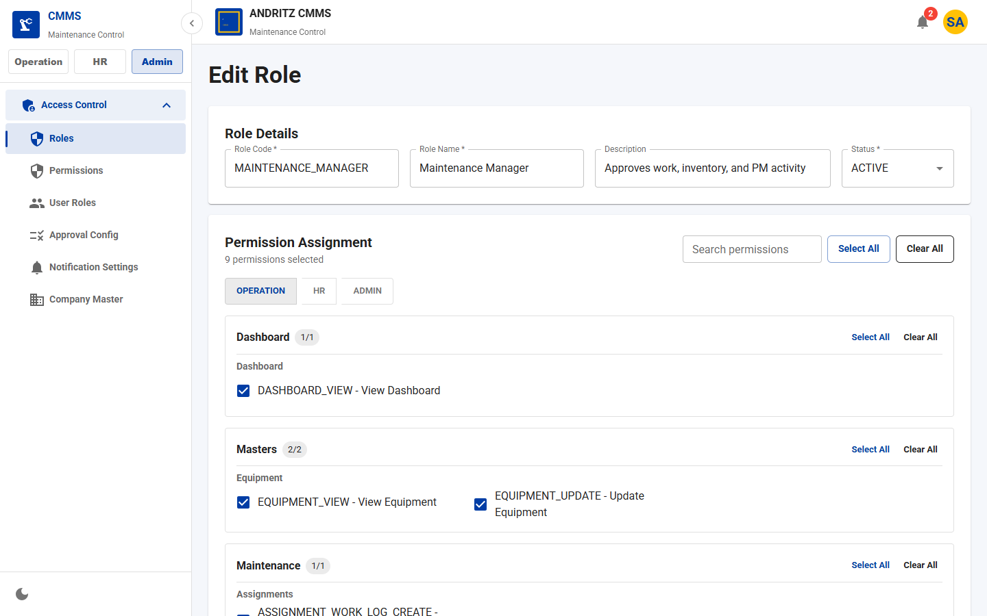
CMMS Application
CLIENT REVIEW
STEP 4
Users, Roles, and Permissions
What this feature does
- Controls what each user can see and do in the application.
- Roles contain permissions such as EQUIPMENT_VIEW, REQUEST_CREATE, APPROVAL_APPROVE, and REPORT_VIEW.
How the client uses it
- Admin creates roles for Super Admin, Maintenance Manager, Store, Technician, HR, and Viewer profiles.
- Admin maps users to roles and optionally to sites.
- Navigation and actions appear based on permissions.
Why it is useful
- Enforces least-privilege access.
- Reduces mistakes by hiding unauthorized actions.
- Supports different responsibilities across departments and sites.
User
Role
Permission
Allowed Pages
Allowed Actions
Application screen from the current CMMS UI
CMMS Feature Walkthrough
8

Slide 9
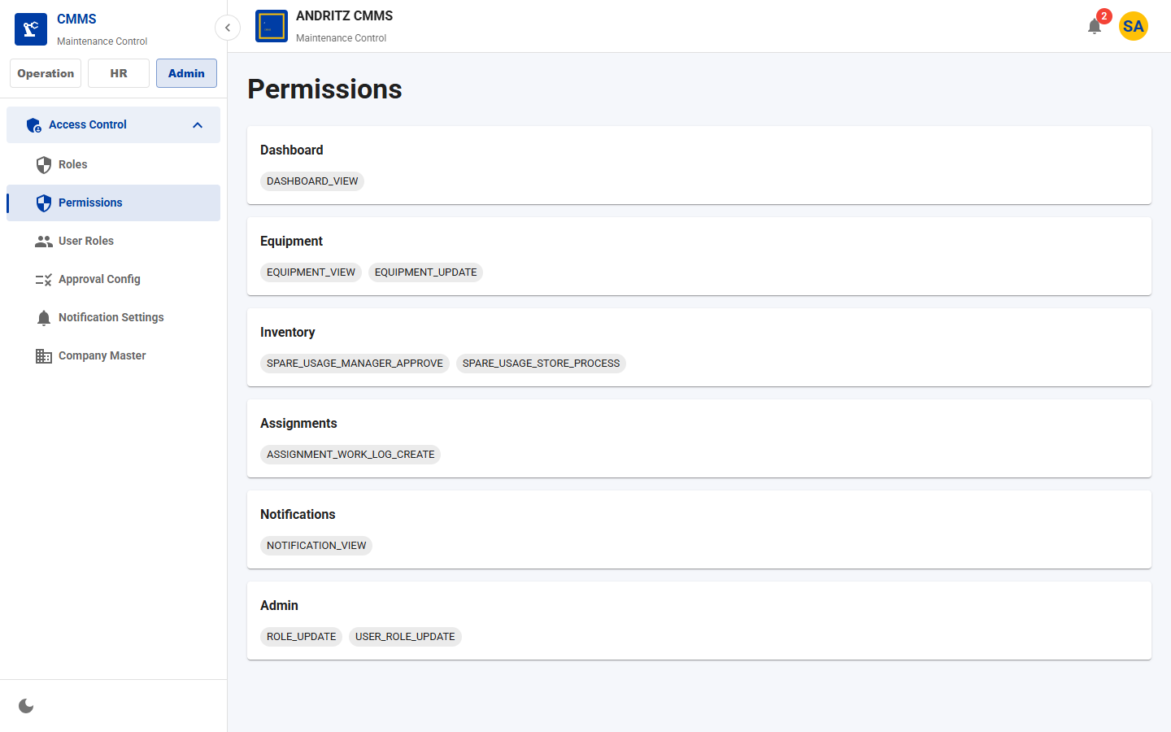
CMMS Application
CLIENT REVIEW
STEP 5
API Permission Mapping Security
What this feature does
- Protects backend APIs using permission-to-endpoint mapping.
- The CSV mapping is loaded into the database and checked by JwtFilter through ApiPermissionService.
How the client uses it
- When a user calls an API, the backend validates hasPermission(userId, requestUrl, method).
- Public APIs such as login and health checks stay whitelisted.
- Unauthorized or unmapped protected APIs return 403.
Why it is useful
- Protects data beyond the frontend screen.
- Improves governance for client IT review.
- Prevents direct URL/API access by unauthorized users.
Login
JWT
API Request
Permission Mapping
Allow or 403
Application screen from the current CMMS UI
CMMS Feature Walkthrough
9

Slide 10
SECTION
Part 2 - Asset and Maintenance Operations
Daily maintenance workflow from assets to technician execution.
1
Register equipment and vendors
2
Create maintenance requests
3
Approve work where required
4
Assign technicians/vendors
5
Capture work logs and downtime
10

Slide 11
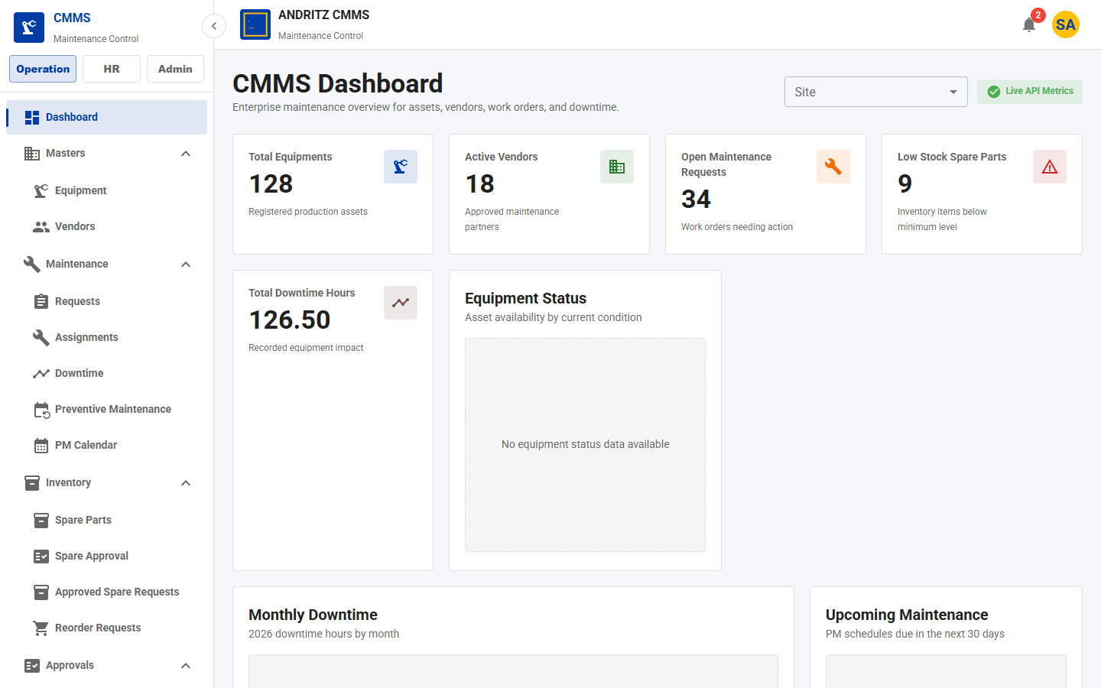
CMMS Application
CLIENT REVIEW
STEP 6
Dashboard Landing Page
What this feature does
- Provides an executive overview after login.
- Shows counts and indicators for equipment, vendors, requests, downtime, and low stock.
How the client uses it
- Managers open the dashboard to see current maintenance health.
- Site filter helps review one plant or all locations.
- Cards highlight urgent operational areas.
Why it is useful
- Gives quick decision support.
- Reduces dependency on manual status calls.
- Helps leadership identify backlog, downtime, and inventory risk.
Application screen from the current CMMS UI
CMMS Feature Walkthrough
11

Slide 12
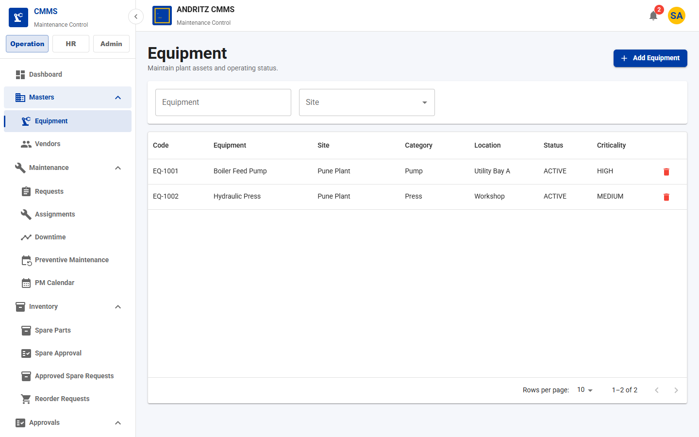
CMMS Application
CLIENT REVIEW
STEP 7
Equipment Master
What this feature does
- Registers all maintainable assets in the plant.
- Stores asset code, name, site, category, location, manufacturer, model, serial number, warranty, status, and criticality.
How the client uses it
- Admin or maintenance planner creates equipment records.
- Users search and filter equipment by site.
- Each maintenance request, downtime event, PM schedule, and report links back to equipment.
Why it is useful
- Creates a single source of truth for assets.
- Improves maintenance context and warranty tracking.
- Supports asset lifecycle visibility.
Create Asset
View Asset
Link Request
Track Downtime
Report History
Application screen from the current CMMS UI
CMMS Feature Walkthrough
12

Slide 13
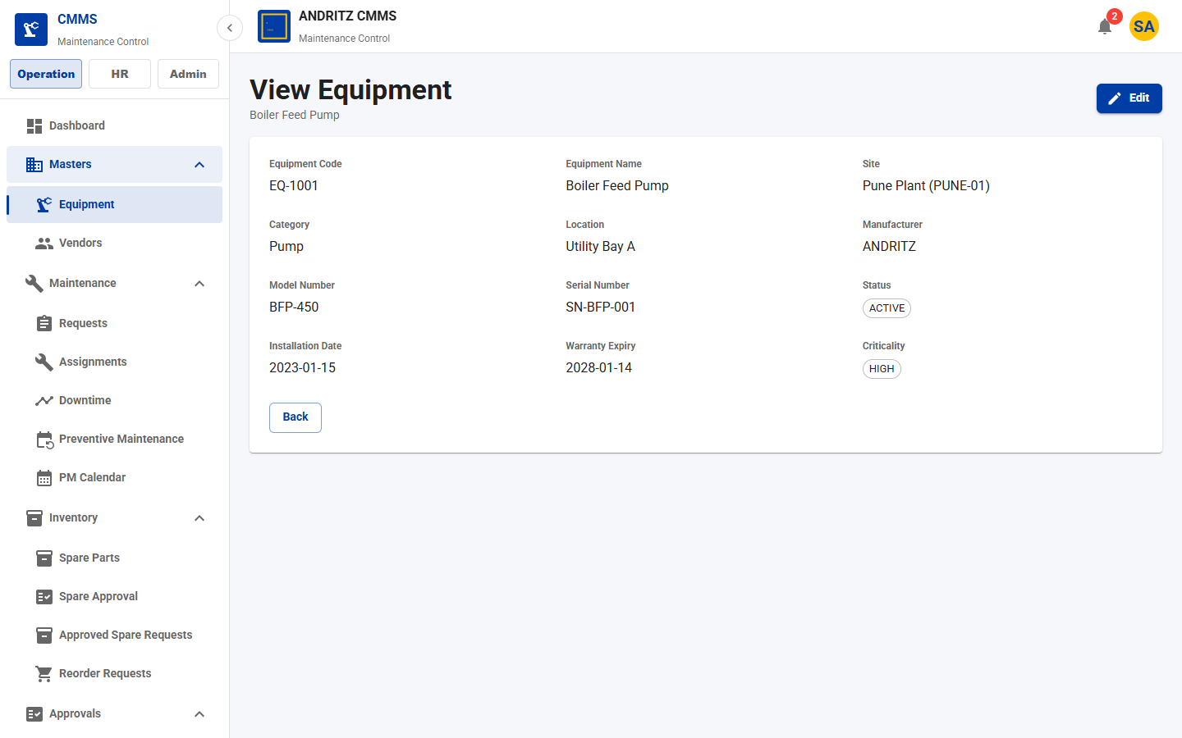
CMMS Application
CLIENT REVIEW
STEP 8
Equipment View and Edit Control
What this feature does
- Equipment rows open a read-only View page for inspection.
- Edit action is shown only to users with EQUIPMENT_UPDATE permission.
How the client uses it
- Operators can view equipment details without editing.
- Authorized users can open Edit and update master data.
- Direct edit routes are protected by route permission checks.
Why it is useful
- Protects asset master data quality.
- Allows wide visibility with controlled updates.
- Supports audit-friendly asset governance.
List Row Click
View Page
Permission Check
Edit Page
Application screen from the current CMMS UI
CMMS Feature Walkthrough
13

Slide 14
CMMS Application
CLIENT REVIEW
STEP 9
Vendor Master
What this feature does
- Maintains external service vendors and contractors.
- Stores vendor code, name, category, contact person, email, phone, site links, and active status.
How the client uses it
- Admin registers approved vendors.
- Maintenance planner selects vendors during assignment or PM planning.
- Inactive vendors can be blocked from new assignments.
Why it is useful
- Improves contractor control.
- Speeds assignment planning.
- Keeps vendor contact and service category information in one place.
Register Vendor
Assign to Site
Use in Work Order
Track Performance
CMMS Feature Walkthrough
14

Slide 15
CMMS Application
CLIENT REVIEW
STEP 10
Maintenance Request Creation
What this feature does
- Captures corrective, breakdown, inspection, calibration, or general maintenance demand.
- Links request to site, equipment, priority, requested date, target date, and description.
How the client uses it
- User raises a request when equipment needs attention.
- Manager reviews priority and status.
- Request becomes the starting point for assignment, spare usage, downtime, and reporting.
Why it is useful
- Standardizes work intake.
- Improves prioritization and backlog visibility.
- Prevents informal maintenance tasks from being lost.
Issue Found
Create Request
Prioritize
Approve
Assign
CMMS Feature Walkthrough
15

Slide 16
CMMS Application
CLIENT REVIEW
STEP 11
Maintenance Request List and Details
What this feature does
- Tracks open, in-progress, completed, and rejected maintenance requests.
- Provides searchable, filterable request history with equipment and site context.
How the client uses it
- Maintenance teams review current backlog.
- Users open details before assignment.
- Managers monitor request age and status.
Why it is useful
- Improves operational transparency.
- Creates a shared view of maintenance demand.
- Supports faster triage and handoff.
Search
Filter
Open Details
Assign Work
CMMS Feature Walkthrough
16

Slide 17
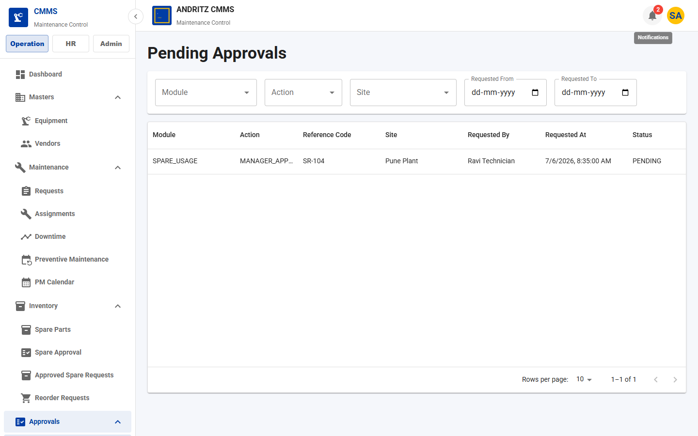
CMMS Application
CLIENT REVIEW
STEP 12
Approval Workflow
What this feature does
- Routes configured work items to the right approver.
- Supports manager, HR/admin/store approval where applicable.
How the client uses it
- Approvers open Pending Approvals.
- They filter by module, action, site, and dates.
- They approve/reject with comments, producing a decision history.
Why it is useful
- Adds governance before cost, stock, or workflow changes.
- Prevents unauthorized work and material movement.
- Creates traceability for review.
Workflow Event
Approval Request
Approver Role
Decision
History
Application screen from the current CMMS UI
CMMS Feature Walkthrough
17

Slide 18
CMMS Application
CLIENT REVIEW
STEP 13
Maintenance Assignment
What this feature does
- Converts an approved request into executable work.
- Assigns technician, vendor, planned dates, estimated cost, actual cost, and status.
How the client uses it
- Planner selects request, site, vendor, and technician.
- Assignment becomes the execution workspace.
- Technicians update logs, checklist, and spare usage from the assignment view.
Why it is useful
- Turns request backlog into accountable work.
- Improves technician scheduling.
- Connects labor, material, cost, and completion information.
Request
Assignment
Technician
Vendor
Execution
Closure
CMMS Feature Walkthrough
18

Slide 19
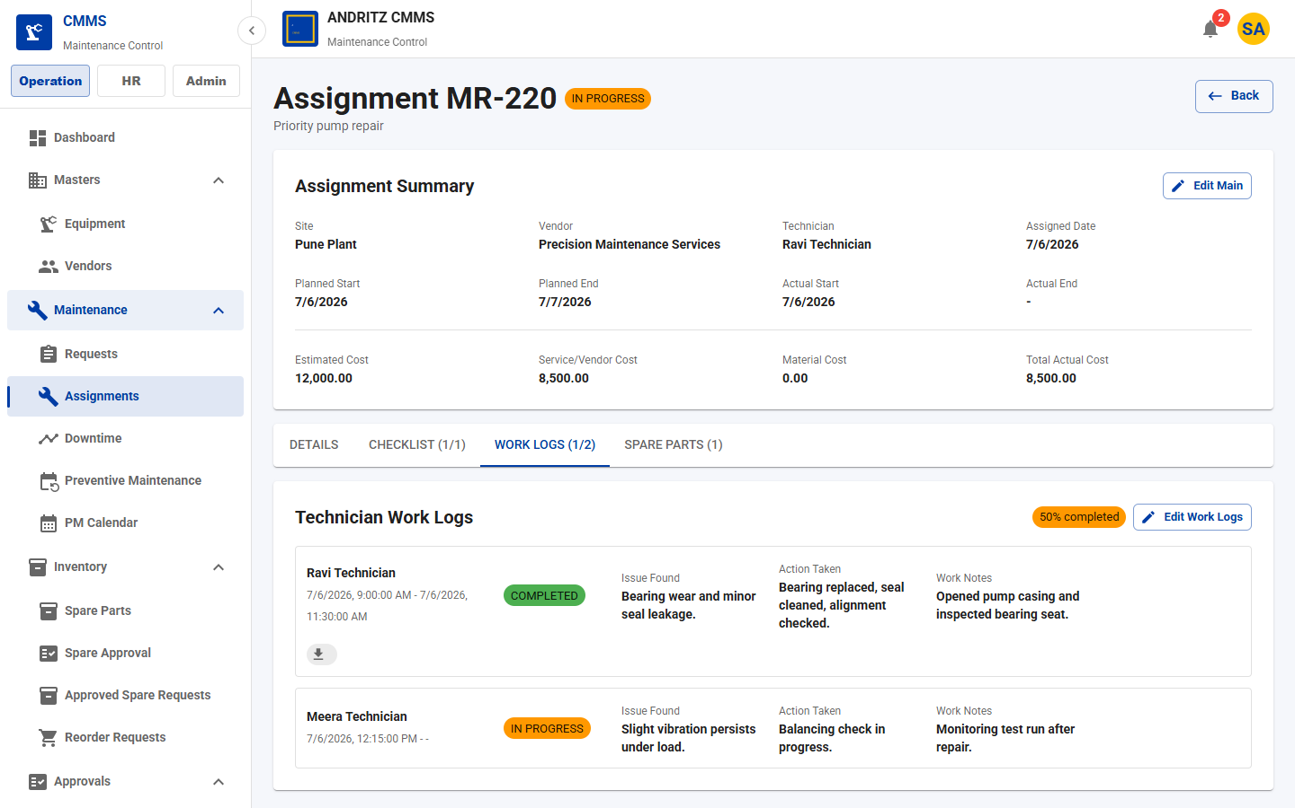
CMMS Application
CLIENT REVIEW
STEP 14
Technician Work Logs
What this feature does
- Captures field execution details for each assignment.
- Tracks start/end time, technician, issue found, action taken, notes, completion status, and attachments/photos.
How the client uses it
- Technician records work as it happens.
- Supervisor reviews work notes and evidence.
- Completion readiness can depend on work-log progress.
Why it is useful
- Improves accountability.
- Creates maintenance history for future troubleshooting.
- Supports audit and service quality review.
Start Work
Record Issue
Action Taken
Attach Proof
Complete
Application screen from the current CMMS UI
CMMS Feature Walkthrough
19

Slide 20
CMMS Application
CLIENT REVIEW
STEP 15
Maintenance Checklist and Proof
What this feature does
- Adds structured task steps to assignments and preventive maintenance work.
- Supports required steps, response values, remarks, proof-required flags, and uploaded proof files.
How the client uses it
- Planner or PM schedule defines checklist items.
- Technician marks each step complete and uploads proof where required.
- System prevents weak closeout when required checks are missing.
Why it is useful
- Improves work quality.
- Supports safety and compliance processes.
- Reduces missed inspection steps.
Checklist Step
Technician Response
Proof Upload
Completion Readiness
CMMS Feature Walkthrough
20

Slide 21
CMMS Application
CLIENT REVIEW
STEP 16
Downtime Management
What this feature does
- Records equipment downtime events and duration.
- Links downtime to equipment, site, request, start/end time, planned/unplanned reason, and remarks.
How the client uses it
- Maintenance or operations team records downtime whenever equipment is unavailable.
- Managers review downtime list and analysis.
- Downtime data contributes to reporting and reliability discussion.
Why it is useful
- Quantifies production impact.
- Supports root-cause analysis.
- Helps prioritize unreliable assets.
Equipment Stops
Record Downtime
Link Request
Analyze Hours
CMMS Feature Walkthrough
21

Slide 22
SECTION
Part 3 - Preventive Maintenance and Inventory
Planned maintenance and material control.
1
Create PM schedules
2
Generate work orders
3
Manage spare part stock
4
Approve and issue spares
5
Reorder unavailable material
22

Slide 23
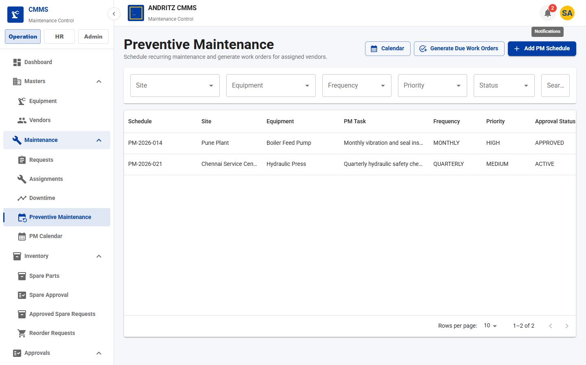
CMMS Application
CLIENT REVIEW
STEP 17
Preventive Maintenance Scheduling
What this feature does
- Creates recurring maintenance plans for assets.
- Stores equipment, site, title, frequency, priority, next due date, vendor, checklist, and active status.
How the client uses it
- Planner creates PM schedule for critical equipment.
- System tracks next due date and completion percentage.
- User can generate work orders from due PM schedules.
Why it is useful
- Moves maintenance from reactive to planned.
- Reduces breakdown risk.
- Improves maintenance compliance.
PM Schedule
Next Due
Generate Work Order
Assignment
Completion
Application screen from the current CMMS UI
CMMS Feature Walkthrough
23

Slide 24
CMMS Application
CLIENT REVIEW
STEP 18
PM Calendar, Due Reminder, and Status Tracking
What this feature does
- Shows upcoming PM work and reminder status.
- Notification settings control PM reminder window and recipient roles.
How the client uses it
- Maintenance manager reviews PM list/calendar.
- System sends due reminders for upcoming schedules.
- Generated work orders follow the standard assignment workflow.
Why it is useful
- Prevents missed scheduled work.
- Gives visibility before due dates.
- Improves asset availability and planning discipline.
Upcoming PM
Reminder
Work Order
Execute
Update Status
CMMS Feature Walkthrough
24

Slide 25
CMMS Application
CLIENT REVIEW
STEP 19
Spare Parts Master and Site Stock
What this feature does
- Maintains spare part records and stock by site.
- Tracks part code, part name, site, current stock, reserved stock, available stock, minimum stock, unit cost, storage location, QR label, and low-stock status.
How the client uses it
- Store team creates spare records.
- Users filter stock by site and low-stock status.
- Stock can be adjusted, transferred, or replenished.
Why it is useful
- Improves material availability.
- Reduces repair delays.
- Supports site-wise inventory control.
Part Master
Site Stock
Available Stock
Low Stock
Reorder
CMMS Feature Walkthrough
25

Slide 26
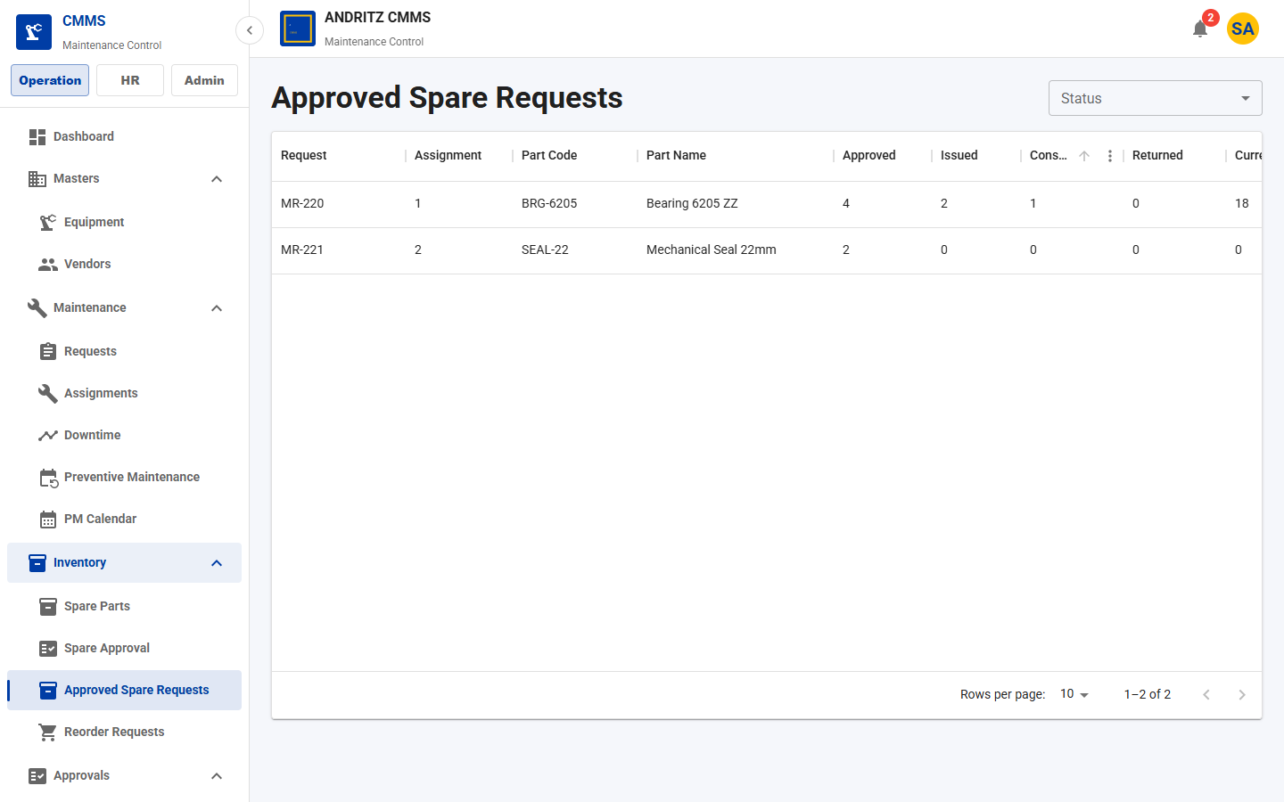
CMMS Application
CLIENT REVIEW
STEP 20
Spare Request Workflow
What this feature does
- Controls material requests raised from maintenance assignments.
- Supports technician request, manager approval, store review, stock available/not available, issue, consume, and return.
How the client uses it
- Technician requests required spare.
- Manager approves or rejects quantity.
- Store checks stock and either issues material or triggers purchase/reorder.
Why it is useful
- Prevents uncontrolled stock usage.
- Links material to maintenance work.
- Creates traceability from request to consumption.
Request
Manager Approval
Store Review
Issue/Purchase
Consume/Return
Application screen from the current CMMS UI
CMMS Feature Walkthrough
26

Slide 27
CMMS Application
CLIENT REVIEW
STEP 21
Inventory Stock Movement
What this feature does
- Records stock-in, adjustment, transfer, reserve, issue, consume, and return movements.
- Maintains transaction history with before/after quantities and reference context.
How the client uses it
- Store team updates stock when material arrives or moves.
- Technicians consume or return issued material.
- Managers review stock transaction history for audit.
Why it is useful
- Improves inventory accuracy.
- Reduces stock mismatch.
- Supports audit and cost tracking.
Stock In
Adjust
Transfer
Reserve
Issue
Consume/Return
CMMS Feature Walkthrough
27

Slide 28
CMMS Application
CLIENT REVIEW
STEP 22
Purchase and Reorder Requests
What this feature does
- Creates purchase requests when stock is low or unavailable.
- Tracks requested quantity, estimated cost, expected date, purchase status, and received stock.
How the client uses it
- Store creates reorder from low-stock item or unavailable spare request.
- Purchase request is tracked until stock is received.
- Received stock closes the replenishment loop.
Why it is useful
- Reduces stockout risk.
- Connects maintenance demand to procurement.
- Gives management purchasing visibility.
Low Stock
Create Reorder
Purchase Request
Receive Stock
Update Inventory
CMMS Feature Walkthrough
28

Slide 29
SECTION
Part 4 - Communication, Reports, and Platform Quality
How users stay informed and how management reviews performance.
1
Notifications and settings
2
Reports and dashboard
3
Common UI and usability
4
API response contract and observability
5
Business value
29

Slide 30
CMMS Application
CLIENT REVIEW
STEP 23
Notification Center and Bell
What this feature does
- Delivers in-app notifications for important workflow events.
- Includes notification bell, unread count, popover preview, notification center, read/archive actions, and reference links.
How the client uses it
- Users see alerts from the navbar.
- They open notification details and navigate directly to related work.
- Admins configure notification settings and recipient roles.
Why it is useful
- Brings important work to users immediately.
- Reduces missed approvals and PM due dates.
- Improves operational responsiveness.
Event
Recipient Role
Bell Alert
Open Work
Mark Read
Application screen from the current CMMS UI
CMMS Feature Walkthrough
30

Slide 31
CMMS Application
CLIENT REVIEW
STEP 24
Notification Types and Configuration
What this feature does
- Supports PM due reminders, overdue maintenance request alerts, approval pending alerts, and optional email configuration.
- Runtime settings control reminder days, scan time, enabled channels, and fallback roles.
How the client uses it
- Admin configures notification preferences.
- System scans daily for due PM and overdue work.
- Recipients receive in-app alerts.
Why it is useful
- Configurable communication for client operating model.
- Improves escalation discipline.
- Keeps critical work visible without manual follow-up.
Settings
Daily Scan
Generate Alert
In-App Notification
CMMS Feature Walkthrough
31

Slide 32
CMMS Application
CLIENT REVIEW
STEP 25
Reports and Analytics
What this feature does
- Provides management reports for equipment history and downtime analysis.
- Reports are filterable and linked to equipment, site, date, request, assignment, and downtime data.
How the client uses it
- Manager opens Equipment History to review all work done on an asset.
- Manager opens Downtime Analysis to see frequency and duration of downtime.
- Reports support maintenance review meetings.
Why it is useful
- Turns workflow data into decisions.
- Helps identify recurring failures.
- Supports maintenance planning and reliability improvement.
Workflow Data
Equipment History
Downtime Analysis
Management Review
CMMS Feature Walkthrough
32

Slide 33
CMMS Application
CLIENT REVIEW
STEP 26
Equipment History Report
What this feature does
- Combines requests, assignments, downtime, and status history by equipment.
- Shows reference, type, detail, status, site, and date.
How the client uses it
- Maintenance manager selects an equipment filter.
- System returns the maintenance record history.
- Team uses history for troubleshooting, warranty discussions, and replacement decisions.
Why it is useful
- Makes asset history easy to inspect.
- Supports faster root-cause analysis.
- Improves asset lifecycle decisions.
Select Equipment
Review History
Identify Patterns
Plan Action
CMMS Feature Walkthrough
33

Slide 34
CMMS Application
CLIENT REVIEW
STEP 27
Downtime Analysis Report
What this feature does
- Summarizes downtime events, unplanned events, total minutes, total hours, and total days.
- Aggregates downtime by equipment and site.
How the client uses it
- Manager filters by equipment or reviews all assets.
- High downtime assets are identified for deeper investigation.
- Results help prioritize PM and replacement plans.
Why it is useful
- Quantifies production loss.
- Supports reliability KPIs.
- Improves investment decisions.
Downtime Events
Summary Metrics
Asset Ranking
Action Plan
CMMS Feature Walkthrough
34

Slide 35
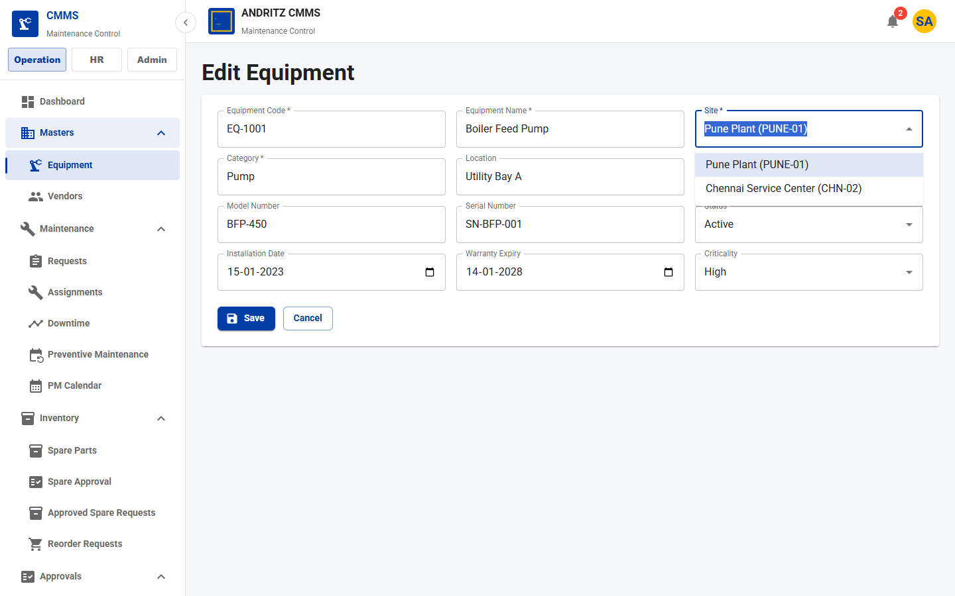
CMMS Application
CLIENT REVIEW
STEP 28
Common UI Components
What this feature does
- Standardizes lists, dropdowns, inputs, date pickers, form cards, and form actions across modules.
- Shared components are used in list, create, edit, and dialog forms.
How the client uses it
- Users see the same interaction pattern across equipment, PM, approvals, reports, and inventory.
- Typeahead dropdowns help find sites, equipment, roles, and users faster.
Why it is useful
- Reduces training effort.
- Improves consistency and data-entry quality.
- Makes future modules faster to add.
Application screen from the current CMMS UI
CMMS Feature Walkthrough
35

Slide 36
CMMS Application
CLIENT REVIEW
STEP 29
Authentication, Site Access, and Protected Navigation
What this feature does
- JWT authentication protects the application.
- Frontend routes and backend APIs both check permissions.
- Allowed sites and roles are stored after login and used across navigation and filters.
How the client uses it
- User logs in.
- Navigation shows only authorized modules.
- Service-level checks keep site-specific data protected.
Why it is useful
- Protects client data.
- Supports multi-site access control.
- Reduces accidental access to irrelevant operations.
Login
JWT
Roles
Allowed Sites
Protected Routes
CMMS Feature Walkthrough
36

Slide 37
CMMS Application
CLIENT REVIEW
STEP 30
Standard API Responses and Error Handling
What this feature does
- Normal JSON APIs return a consistent ApiResponse envelope.
- Errors include code, message, details, and correlationId through the global exception handler.
How the client uses it
- Frontend reads the standard error format.
- Validation errors show field-level details.
- Support teams can trace issues using correlation IDs.
Why it is useful
- Improves maintainability and support.
- Makes integration predictable.
- Helps client IT teams review reliability and troubleshooting readiness.
Request
ApiResponse
ApiErrorResponse
Correlation ID
Support Trace
CMMS Feature Walkthrough
37

Slide 38
CMMS Application
CLIENT REVIEW
STEP 31
Observability and Operational Readiness
What this feature does
- Every request receives a correlation ID.
- Structured logs include method, path, status, duration, userId where available, and error code.
- Metrics support scheduled jobs and critical workflows.
How the client uses it
- Support/admin teams review logs during incidents.
- Notification and approval jobs can be monitored.
- Sensitive values such as passwords and tokens are not logged.
Why it is useful
- Improves production support.
- Supports audit and troubleshooting.
- Gives the buyer confidence in operating the system.
Request
Correlation ID
Structured Log
Metrics
Health Checks
CMMS Feature Walkthrough
38

Slide 39
SECTION
Part 5 - End-to-End Client Workflows
This section connects all modules into real operating scenarios.
1
Corrective maintenance flow
2
Preventive maintenance flow
3
Spare parts and purchase flow
4
Manager review flow
39

Slide 40
CMMS Application
CLIENT REVIEW
PROCESS
Corrective Maintenance - Full Workflow
Issue
Request
Approval
Assignment
Work Log
Close
How the user works
- Operator identifies equipment issue.
- Maintenance request is created and prioritized.
- Approval is taken if configured.
- Planner assigns technician/vendor.
- Technician logs work, checklist, spares, and completion.
Business outcome
- Clear ownership from issue to closure.
- Reduced untracked maintenance work.
- Complete history for every equipment problem.
- Better cost and material visibility.
CMMS Feature Walkthrough
40

Slide 41
CMMS Application
CLIENT REVIEW
PROCESS
Preventive Maintenance - Full Workflow
Schedule
Due Date
Reminder
Work Order
Checklist
Complete
How the user works
- Planner creates recurring PM schedule.
- System tracks next due date.
- Reminder notifies responsible roles.
- Due PM generates work order.
- Technician executes checklist and closes assignment.
Business outcome
- Fewer surprise breakdowns.
- Better maintenance compliance.
- More predictable technician workload.
- Improved asset availability.
CMMS Feature Walkthrough
41

Slide 42
CMMS Application
CLIENT REVIEW
PROCESS
Spare Parts - Full Workflow
Request
Approve
Check Stock
Issue/Purchase
Consume
Return
How the user works
- Technician requests part from assignment.
- Manager approves requested quantity.
- Store checks available stock.
- Material is issued or purchase request is created.
- Technician consumes or returns issued quantity.
Business outcome
- Material usage is controlled.
- Stock is accurate by site.
- Purchasing is linked to maintenance need.
- Audit trail exists for every spare movement.
CMMS Feature Walkthrough
42

Slide 43
CMMS Application
CLIENT REVIEW
PROCESS
Manager Review - Full Workflow
Dashboard
Approvals
Notifications
Inventory
Reports
How the user works
- Manager opens dashboard for operational health.
- Reviews pending approvals and overdue notifications.
- Checks low-stock indicators.
- Uses reports for equipment history and downtime analysis.
Business outcome
- Faster daily review.
- Better decision-making from live workflow data.
- Improved accountability across teams.
- Clearer maintenance performance visibility.
CMMS Feature Walkthrough
43

Slide 44
CMMS Application
CLIENT REVIEW
REFERENCE
Typical User Roles and Responsibilities
Role
Primary Responsibilities
Super Admin
Full system setup, roles, security, company configuration
Maintenance Manager
Requests, assignments, PM, approvals, reports
Technician
Assigned work, checklist, work logs, spare requests
Store User
Spare stock, issue, consume/return, purchase escalation
HR/Admin
Sites, employees, user role assignment
Viewer/Management
Dashboard, reports, read-only operational review
CMMS Feature Walkthrough
44

Slide 45
CMMS Application
CLIENT REVIEW
REFERENCE
Feature Map for Client Evaluation
Area
Client Value
Company/Site
Branding, plant structure, location-wise rollout
Employees/Roles
User identity, site access, role-based permissions
Equipment/Vendor
Asset and contractor master data
Requests/Assignments
Corrective maintenance execution
Work Logs/Checklist
Technician activity, proof, completion readiness
PM
Recurring planned maintenance and due reminders
Spares/Inventory
Material request, stock, issue, purchase, consume/return
Notifications/Reports
Alerts, dashboard, equipment history, downtime analysis
CMMS Feature Walkthrough
45

Slide 46
CMMS Application
CLIENT REVIEW
BUSINESS VALUE
Why This Application Is Useful to the Client
Operational Control
- Every request, assignment, spare, and approval has an owner and status.
- Teams work from one shared system.
Lower Downtime Risk
- PM schedules and reminders reduce missed maintenance.
- Downtime reports identify recurring problem assets.
Inventory Discipline
- Spare usage is approved and traceable.
- Low-stock and purchase flows reduce repair delays.
Governance
- Role, site, and API permissions protect data and actions.
- Approval history supports audit review.
Management Visibility
- Dashboard, alerts, and reports convert daily activity into decisions.
- Managers can review status without manual follow-up.
CMMS Feature Walkthrough
46

Slide 47
CMMS Application
CLIENT REVIEW
CLIENT ADOPTION
Suggested Implementation Rollout
1. Configure Company
2. Add Sites
3. Add Employees
4. Assign Roles
5. Load Equipment
6. Load Spares
7. Configure PM
8. Start Requests
9. Use Approvals
10. Track Inventory
11. Review Reports
12. Optimize
Recommended First Phase
- Company, sites, employees, roles, equipment, vendors, and request workflow.
Recommended Second Phase
- Preventive maintenance, inventory controls, notifications, and reporting review cadence.
CMMS Feature Walkthrough
47

Slide 48
CMMS Application
CLIENT REVIEW
SUMMARY
Complete CMMS Coverage
What the buyer receives
- A complete maintenance management workflow covering setup, assets, requests, approvals, execution, PM, spares, inventory, notifications, dashboard, and reports.
For Operations Teams
- Structured work intake and assignment.
- Technician logs, checklist proof, spare usage, and downtime capture.
For Management Teams
- Dashboard, approvals, alerts, reports, site-wise access, and audit-ready workflow history.
Final client message
- The application gives the client one governed platform to plan, execute, track, and improve maintenance operations across multiple sites.
CMMS Feature Walkthrough
48

Slide 49
Thank You
CMMS Application - Client Review Feature Walkthrough
Ready for review with client stakeholders, operations teams, maintenance managers, store teams, and IT/security reviewers.
49

