Slide 1
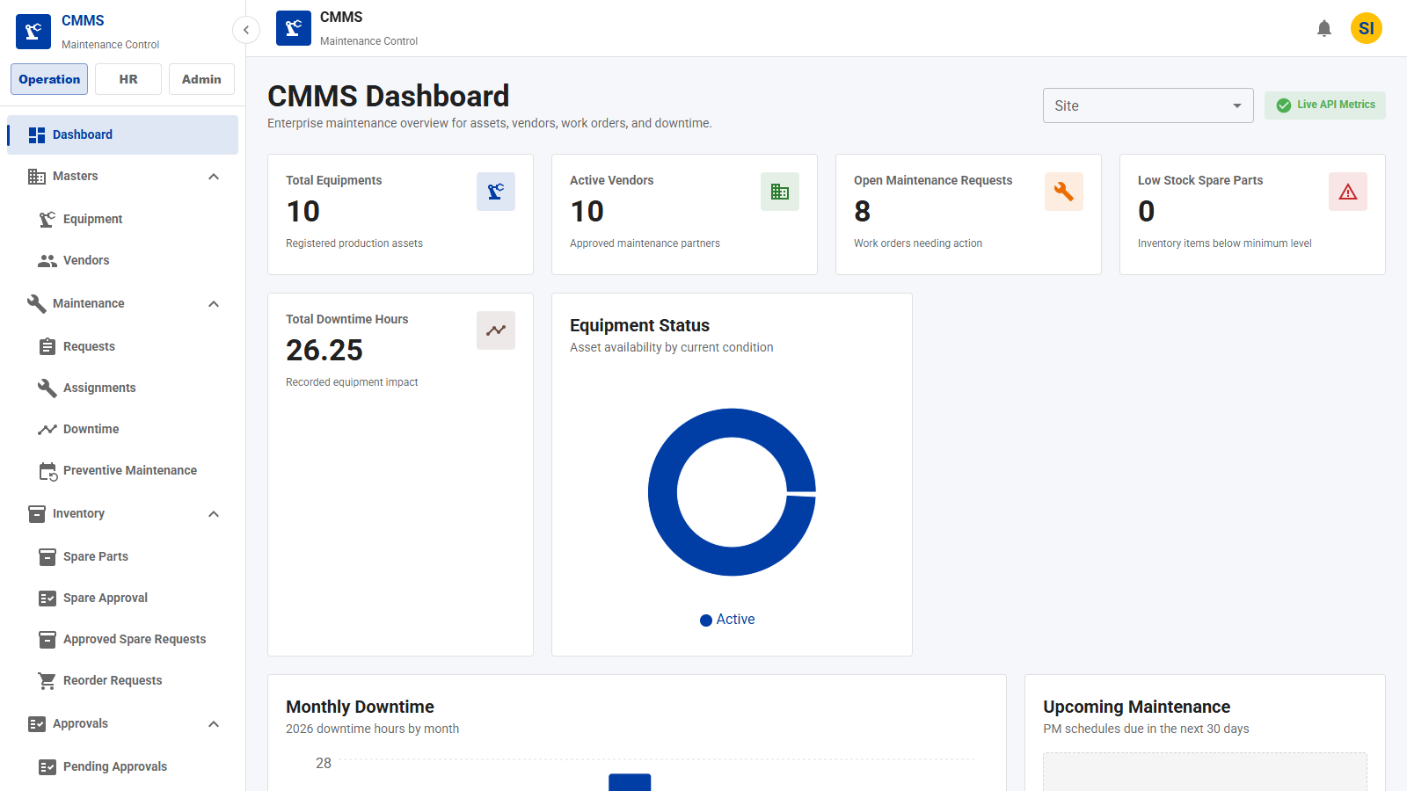
CMMS Application
Computerized Maintenance Management System
Generated from current application
ANDRITZ
CMMS Application Demo
1

Slide 2
CMMS Application
ANDRITZ
Application Overview
Asset Management
Maintenance Management
Inventory Management
Vendor Management
Employee Management
Preventive Maintenance
Spare Parts Management
Purchase Requests
Reporting and Dashboard
Built to connect master data, maintenance execution, spare-parts control, and operational reporting in one flow.
CMMS Application Demo
2

Slide 3
CMMS Application
ANDRITZ
Table of Contents
1
Application overview and navigation flow
2
Master data: company, site, employee, roles, vendor, equipment
3
Maintenance: request, assignment, downtime, preventive maintenance
4
Inventory: spare parts, stock movement, purchase requests
5
Notifications, dashboard, reports, and workflows
New enhancement section added: API permission security, site-wise access, reusable UI components, work logs, approvals, notifications, PM reminders, dashboard and demo screenshots.
CMMS Application Demo
3

Slide 4
CMMS Application
ANDRITZ
Application Navigation Flow
Company
→
Site
→
Employee
Roles & Permissions
→
Vendor
→
Equipment
Maintenance Request
→
Assignment
→
Downtime
Preventive Maintenance
→
Spare Parts
→
Inventory
Purchase Requests
→
Reports
Routes discovered automatically from App.jsx: 54
CMMS Application Demo
4

Slide 5
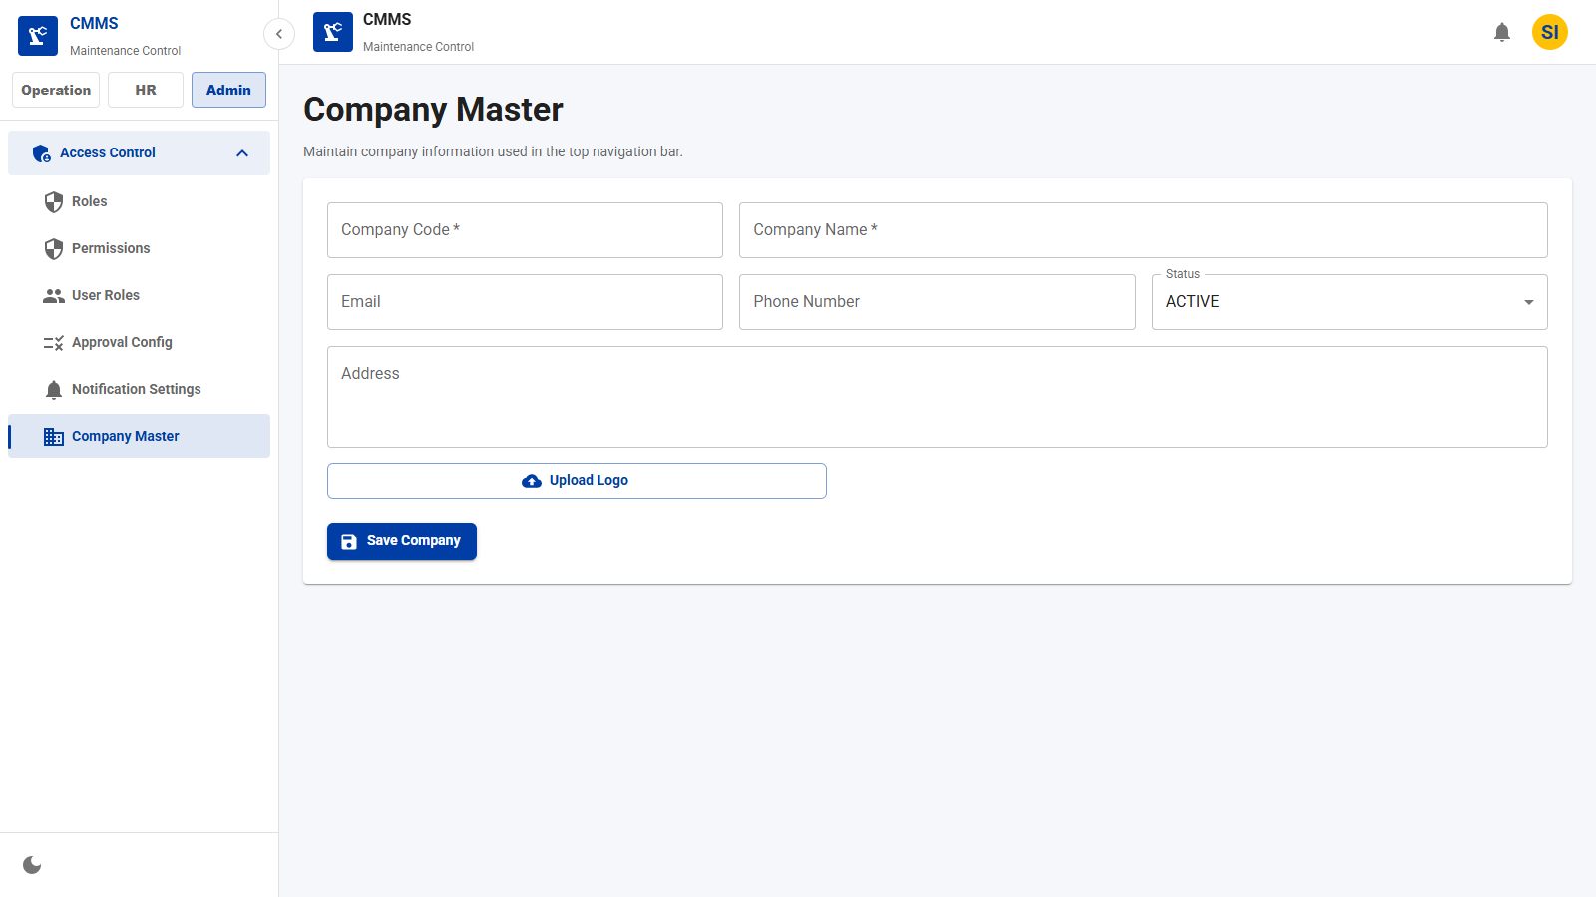
Company Module
ANDRITZ
Company Creation Page
Maintain the company master profile used throughout the application.
Key Fields
• Company code
• Company name
• Email
• Phone
• Address
• Status
Features
• Create or update company profile
• Upload and preview company logo
• Use company data in navigation
Business Benefits
• Consistent company identity
• Centralized master information
CMMS Application Demo
5

Slide 6
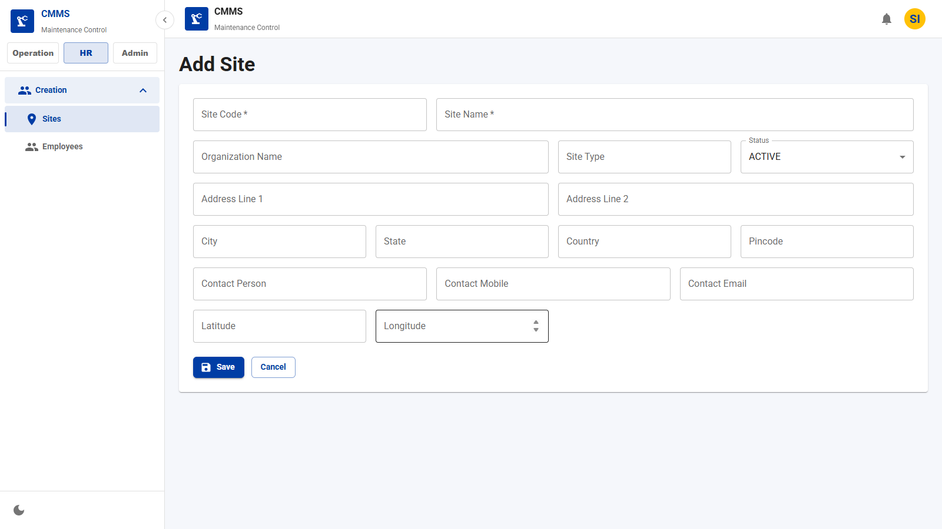
Site Module
ANDRITZ
Site Creation
Register operating locations and service centers.
Key Fields
• Site code
• Site name
• Type
• Address
• Contact
• Geo location
Features
• Create site master records
• Capture address and contact data
• Support active/inactive status
Business Benefits
• Clear site ownership
• Site-based maintenance visibility
CMMS Application Demo
7

Slide 7
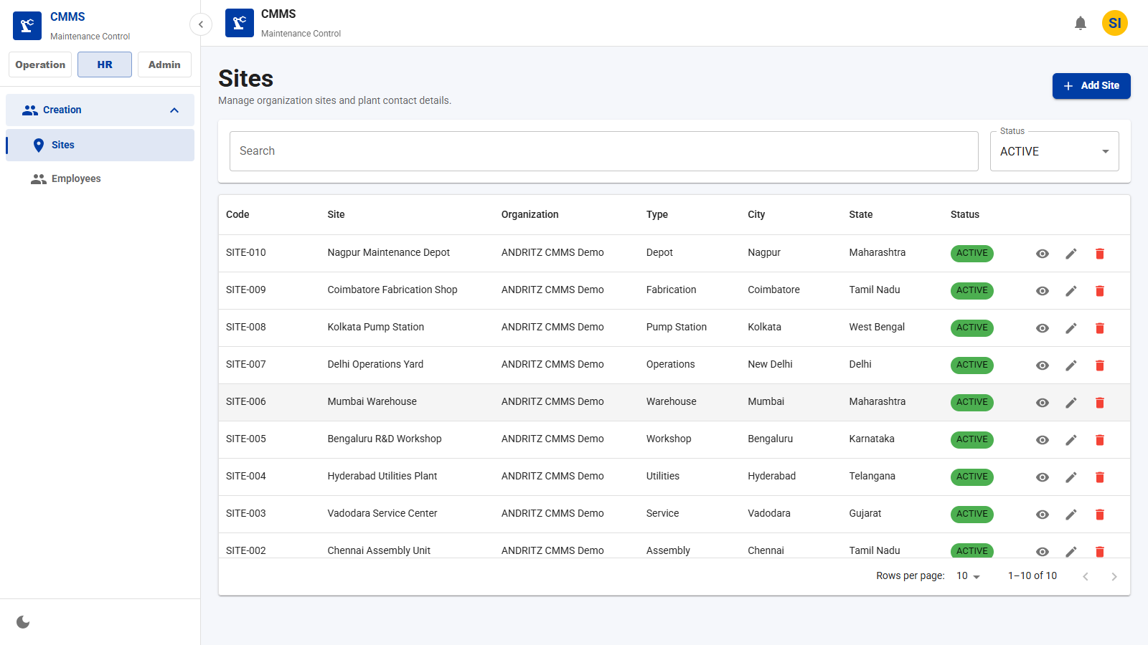
Site Module
ANDRITZ
Site List
Browse and filter all configured sites.
Key Fields
• Site code
• Name
• City
• State
• Status
Features
• Search site records
• Edit site details
• Manage operational status
Business Benefits
• Faster site administration
• Cleaner location hierarchy
CMMS Application Demo
8

Slide 8
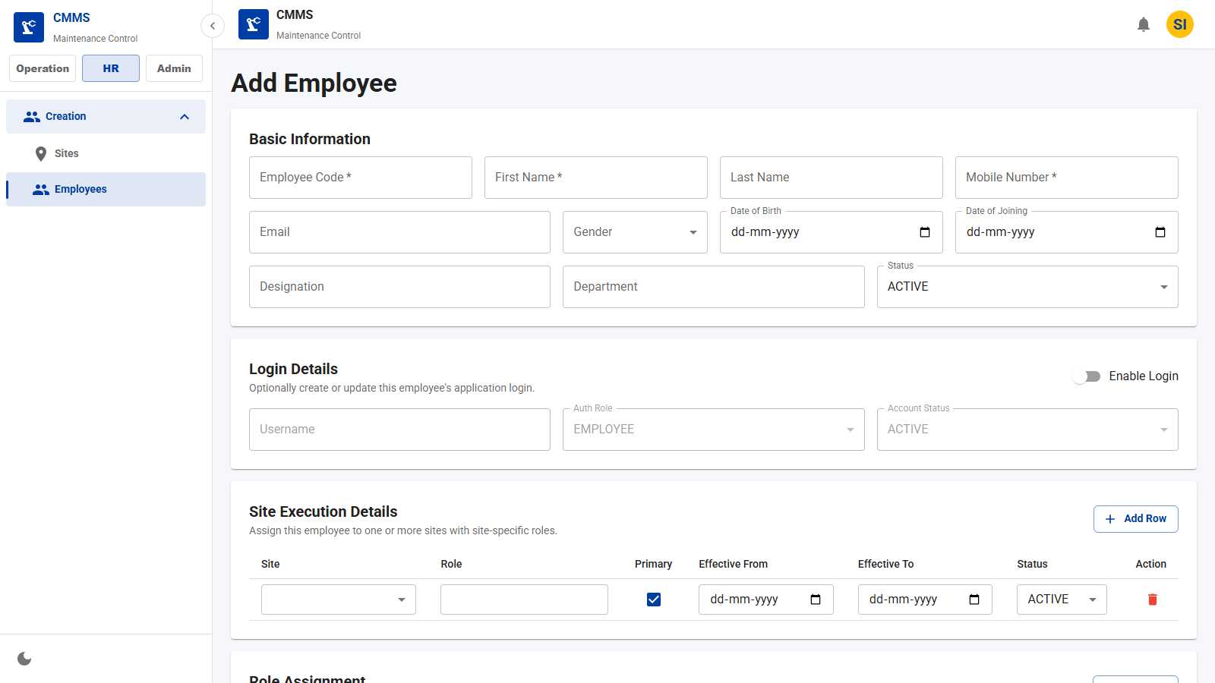
Employee Module
ANDRITZ
Employee Creation
Create employee master records for operations and maintenance teams.
Key Fields
• Employee code
• Name
• Mobile
• Email
• Designation
• Department
Features
• Maintain employee identity
• Track department/designation
• Enable site and user-role assignment
Business Benefits
• Reliable workforce directory
• Improved accountability
CMMS Application Demo
9

Slide 9
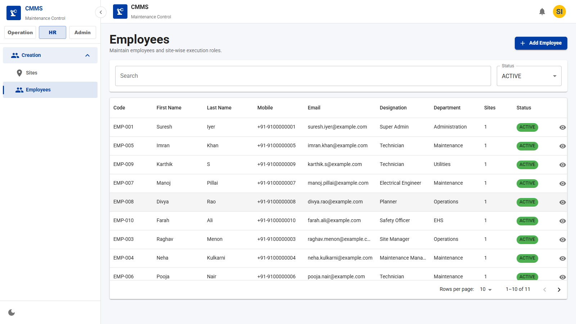
Employee Module
ANDRITZ
Employee List
Review employee records and status.
Key Fields
• Employee code
• Name
• Department
• Designation
• Status
Features
• Search employee data
• Edit employee profile
• Deactivate records
Business Benefits
• Central HR-maintenance alignment
• Cleaner technician assignment data
CMMS Application Demo
10

Slide 10
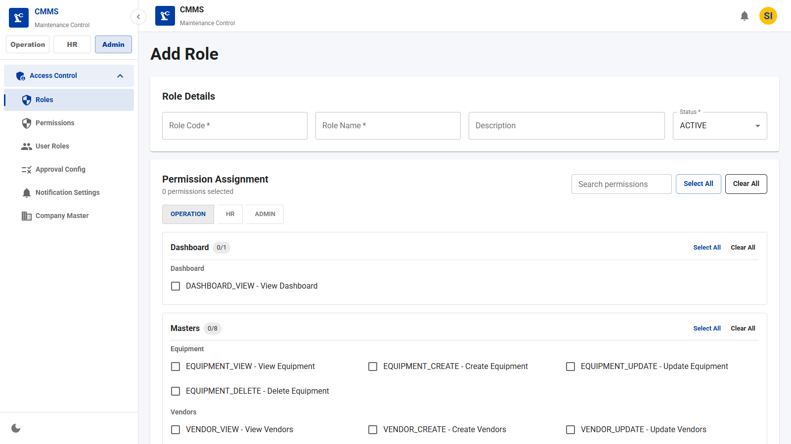
Roles & Permissions
ANDRITZ
Role Creation
Define application roles for access control.
Key Fields
• Role code
• Role name
• Description
• Status
• Permissions
Features
• Create reusable roles
• Map permissions by module
• Control page access
Business Benefits
• Stronger governance
• Consistent role-based access
CMMS Application Demo
11

Slide 11
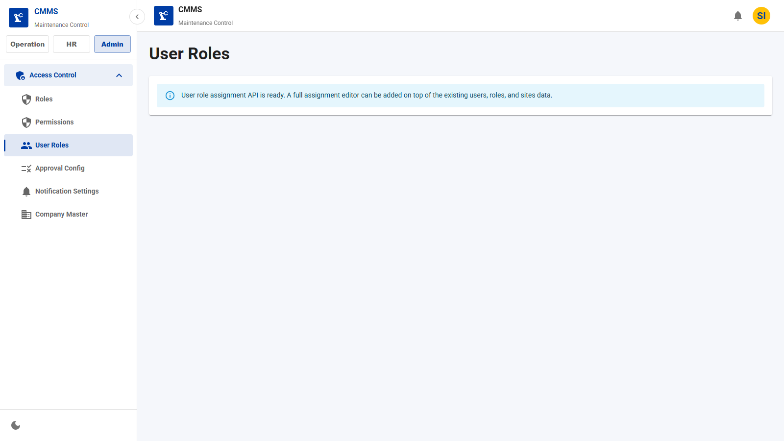
Roles & Permissions
ANDRITZ
Permission Mapping
Assign user roles and site-level access.
Key Fields
• User
• Role
• Site
• Status
Features
• Map users to roles
• Limit access by site
• Update role assignments
Business Benefits
• Preserved authentication flow
• Least-privilege access control
CMMS Application Demo
12

Slide 12
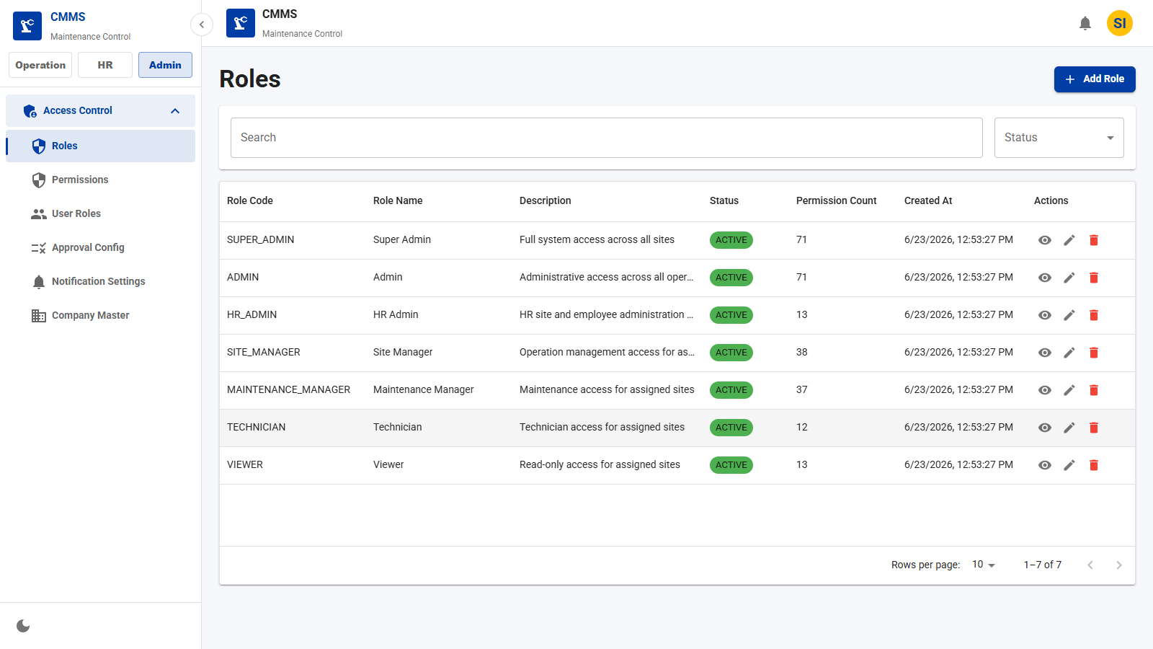
Roles & Permissions
ANDRITZ
Role List
Review roles and permission counts.
Key Fields
• Role code
• Role name
• Status
• Permission count
Features
• Search roles
• View role permissions
• Edit or inactivate roles
Business Benefits
• Transparent authorization model
• Simplified admin review
CMMS Application Demo
13

Slide 13
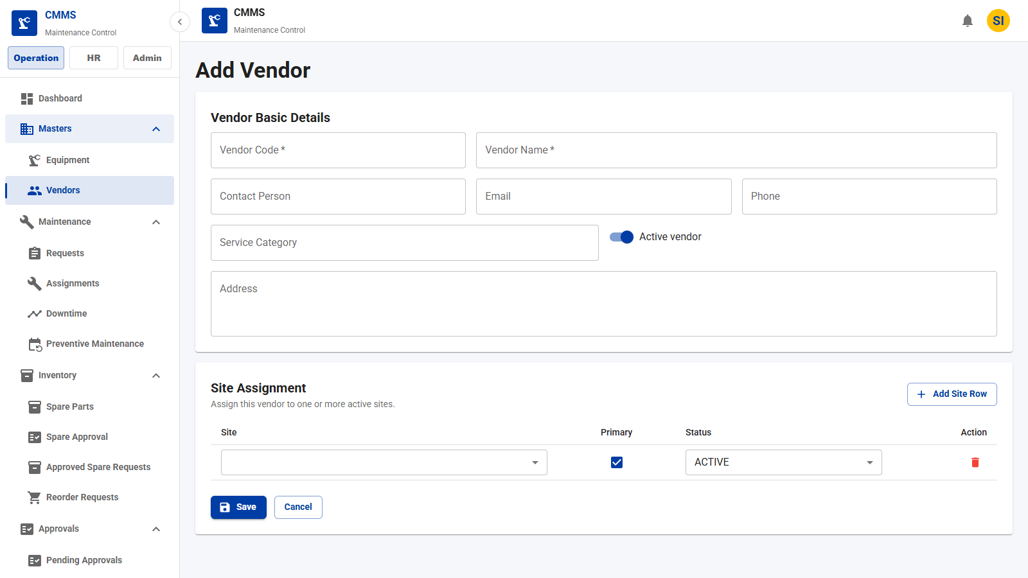
Vendor Module
ANDRITZ
Vendor Creation
Register service vendors and contractors.
Key Fields
• Vendor code
• Vendor name
• Contact person
• Email
• Phone
• Category
Features
• Maintain vendor master data
• Enable vendor-site assignment
• Support active/inactive status
Business Benefits
• Better vendor control
• Faster assignment planning
CMMS Application Demo
14

Slide 14
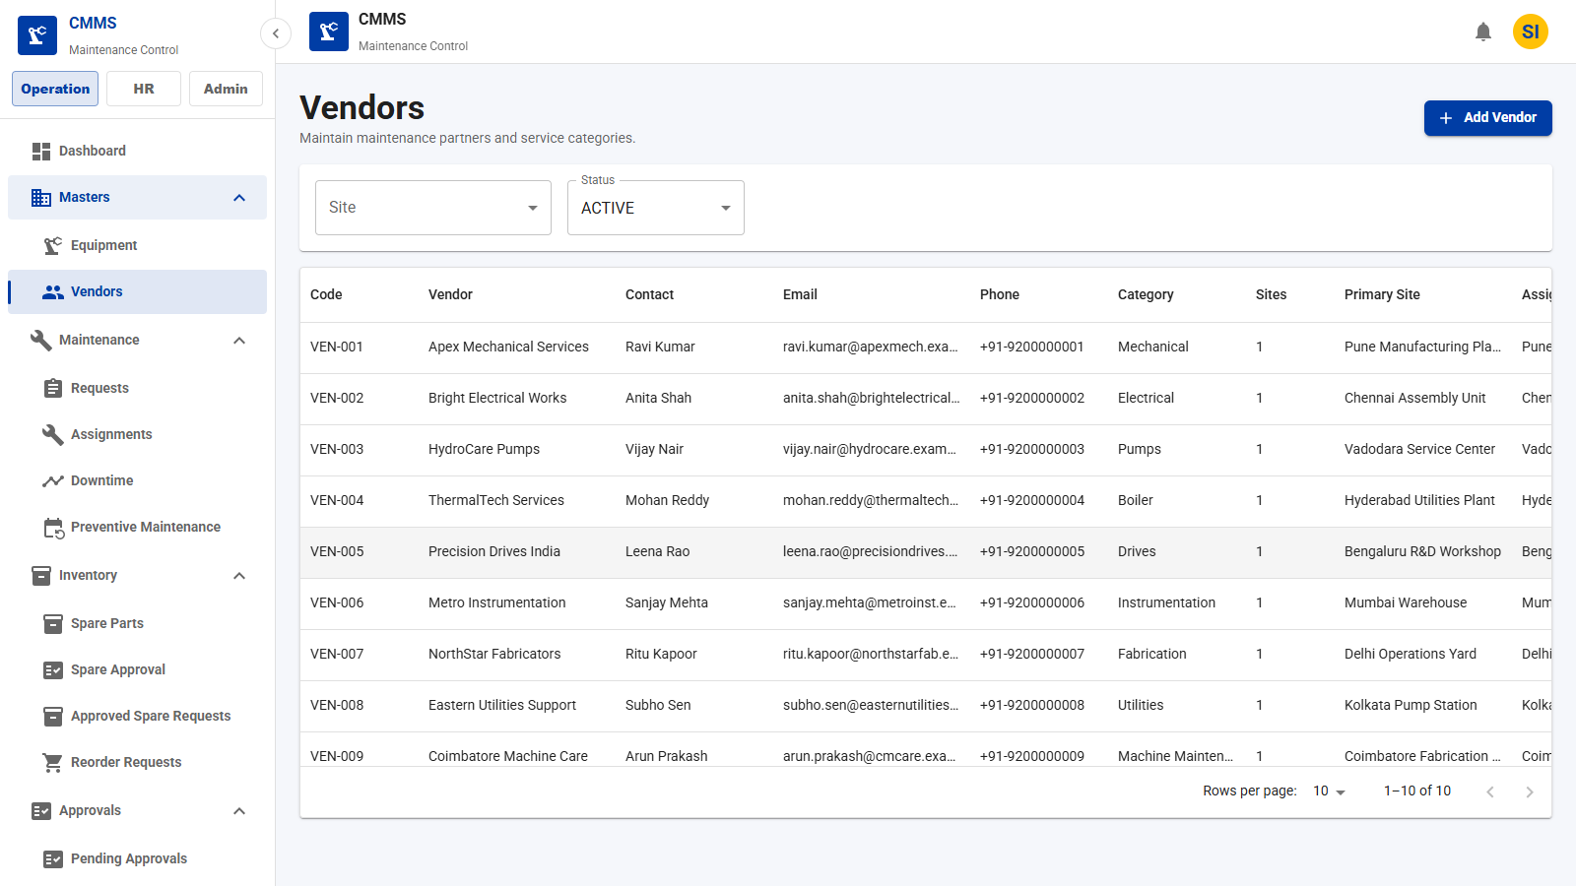
Vendor Module
ANDRITZ
Vendor List
Browse approved vendors and service categories.
Key Fields
• Vendor code
• Name
• Category
• Contact
• Status
Features
• Search vendors
• Edit vendor details
• Deactivate vendors
Business Benefits
• Centralized contractor records
• Better sourcing decisions
CMMS Application Demo
15

Slide 15
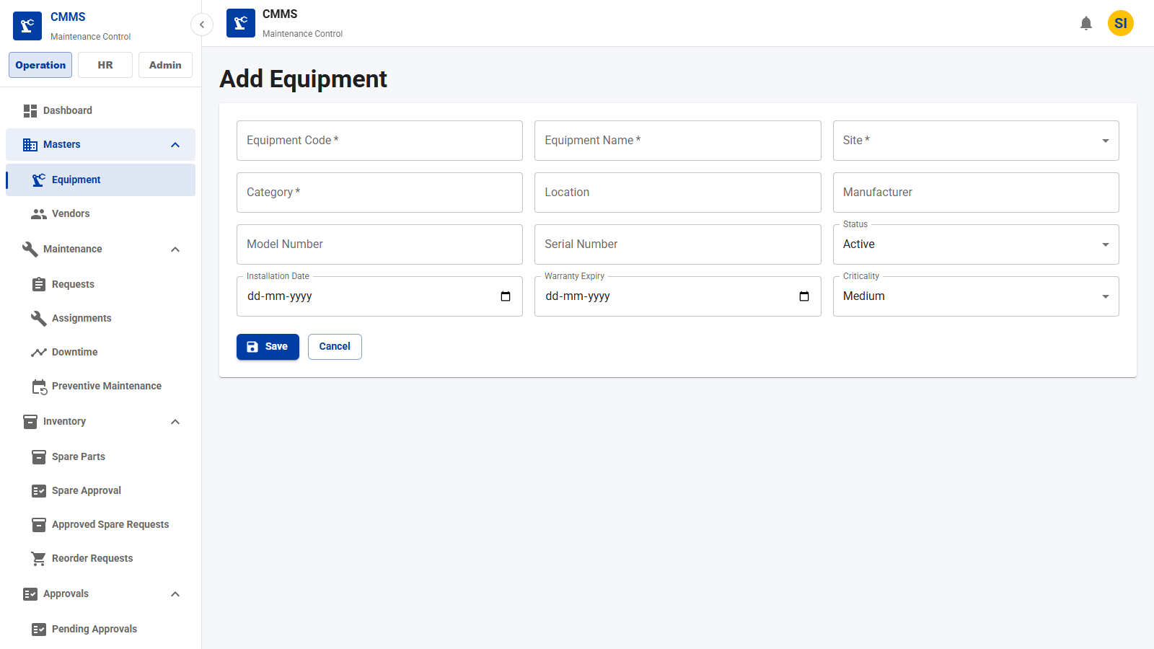
Equipment Module
ANDRITZ
Equipment Creation
Register assets and link them to sites.
Key Fields
• Equipment code
• Name
• Site
• Category
• Manufacturer
• Criticality
Features
• Create asset records
• Track warranty and status
• Link to site ownership
Business Benefits
• Centralized asset management
• Improved maintenance planning
CMMS Application Demo
16

Slide 16
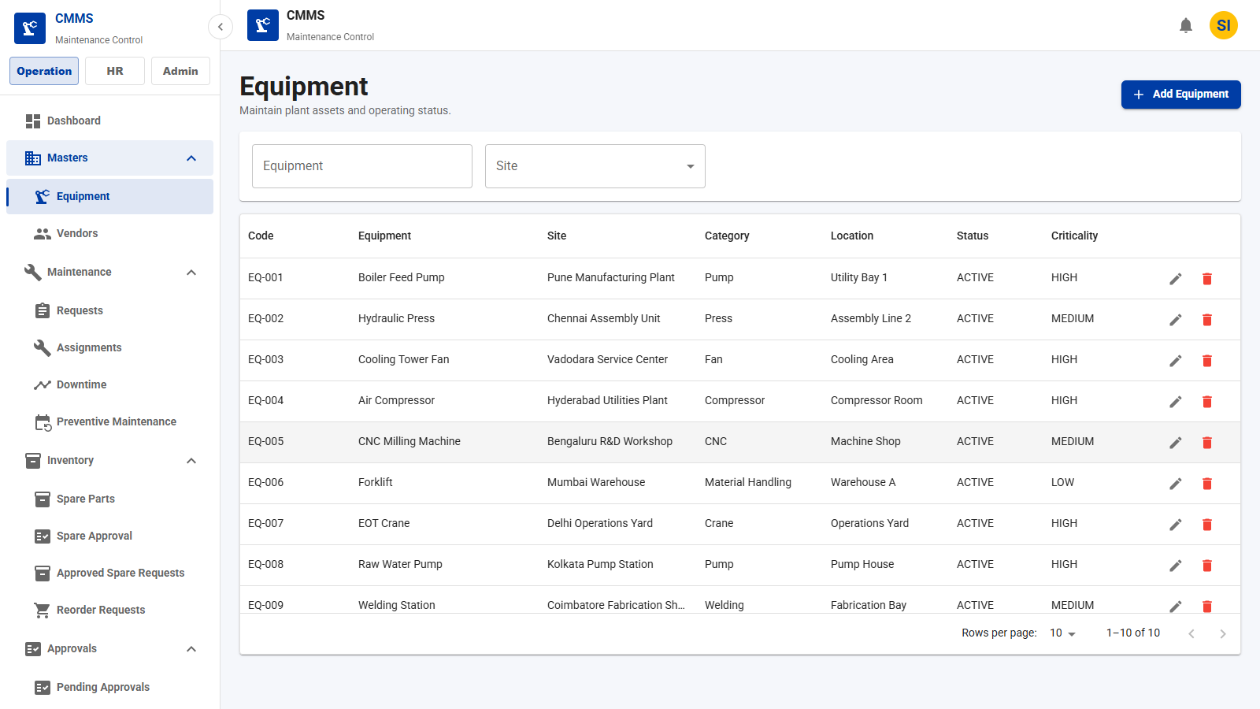
Equipment Module
ANDRITZ
Equipment List
Browse plant assets and operating status.
Key Fields
• Equipment code
• Name
• Site
• Category
• Criticality
Features
• Filter by site
• Search assets
• Edit equipment
Business Benefits
• Fast asset lookup
• Better visibility into critical assets
CMMS Application Demo
17

Slide 17
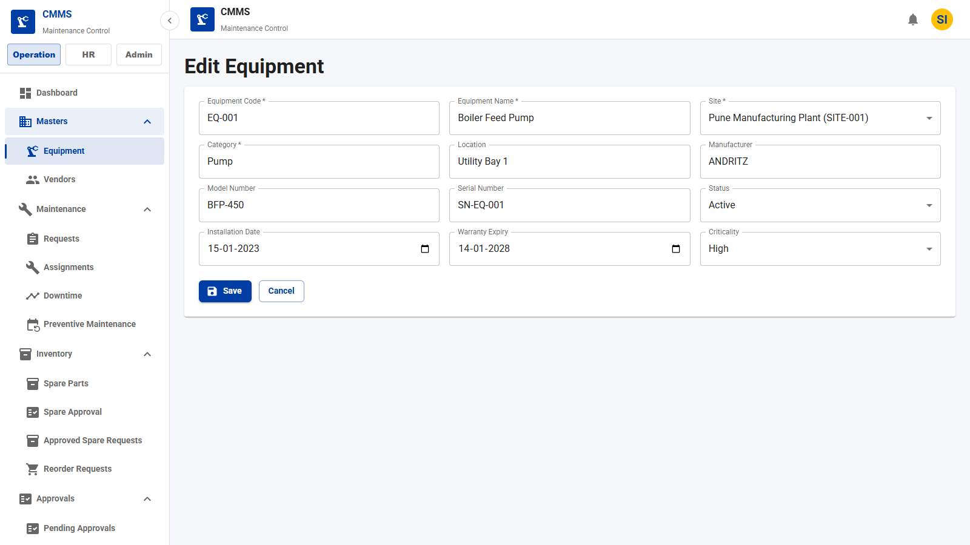
Equipment Module
ANDRITZ
Equipment Details
View or edit detailed asset master data.
Key Fields
• Installation date
• Warranty expiry
• Serial number
• Status
Features
• Complete asset profile
• Update technical details
• Maintain criticality
Business Benefits
• Accurate maintenance context
• Better lifecycle tracking
CMMS Application Demo
18

Slide 18
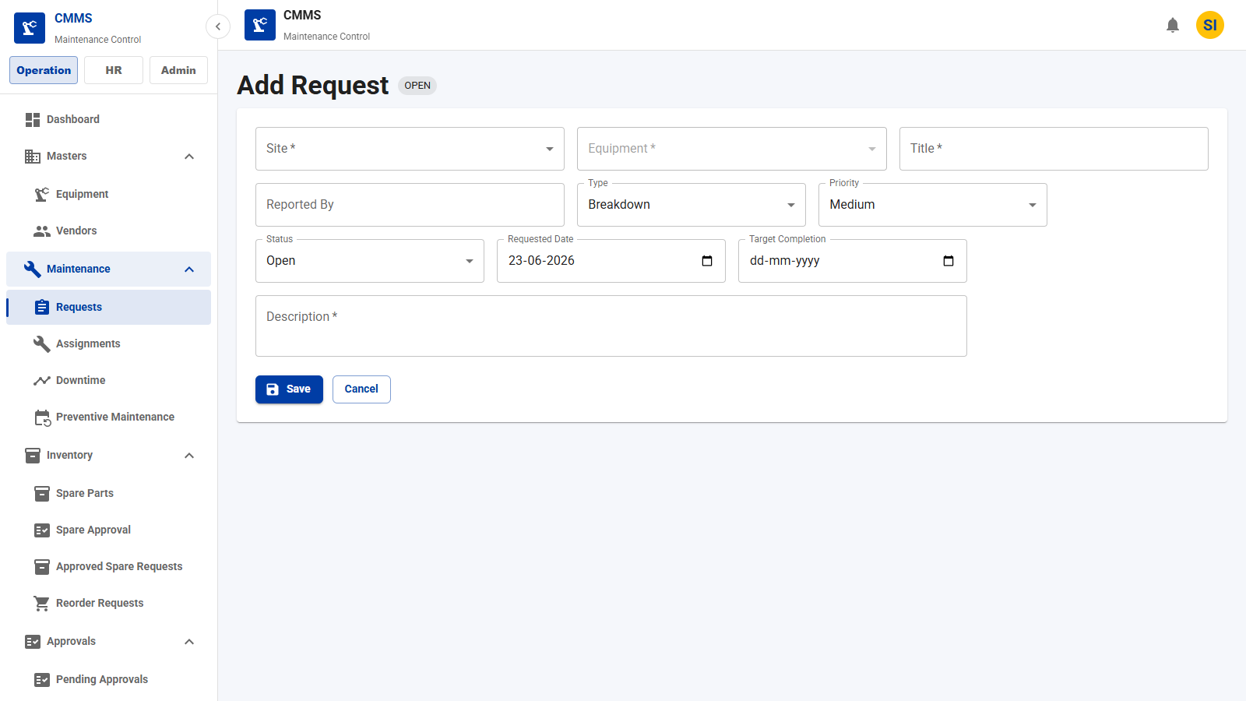
Maintenance Request Module
ANDRITZ
Request Creation
Create corrective, breakdown, inspection, or calibration requests.
Key Fields
• Site
• Equipment
• Title
• Priority
• Requested date
Features
• Log maintenance demand
• Classify request type
• Set target completion
Business Benefits
• Structured work intake
• Better prioritization
CMMS Application Demo
19

Slide 19
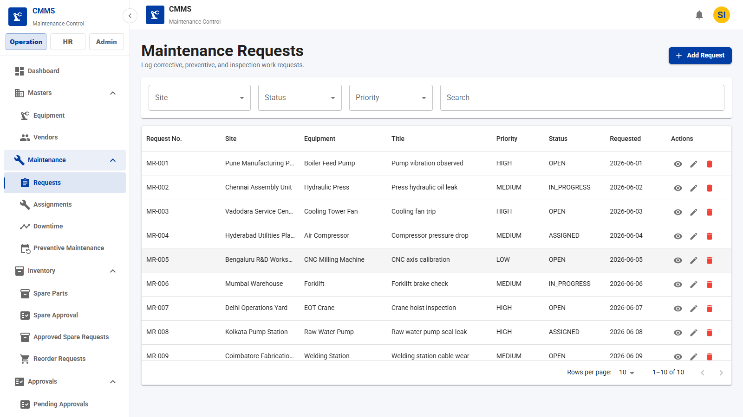
Maintenance Request Module
ANDRITZ
Request List
Track open and in-progress maintenance requests.
Key Fields
• Request number
• Equipment
• Site
• Priority
• Status
Features
• Search requests
• Filter status
• Open request details
Business Benefits
• Improved backlog visibility
• Faster triage
CMMS Application Demo
20

Slide 20
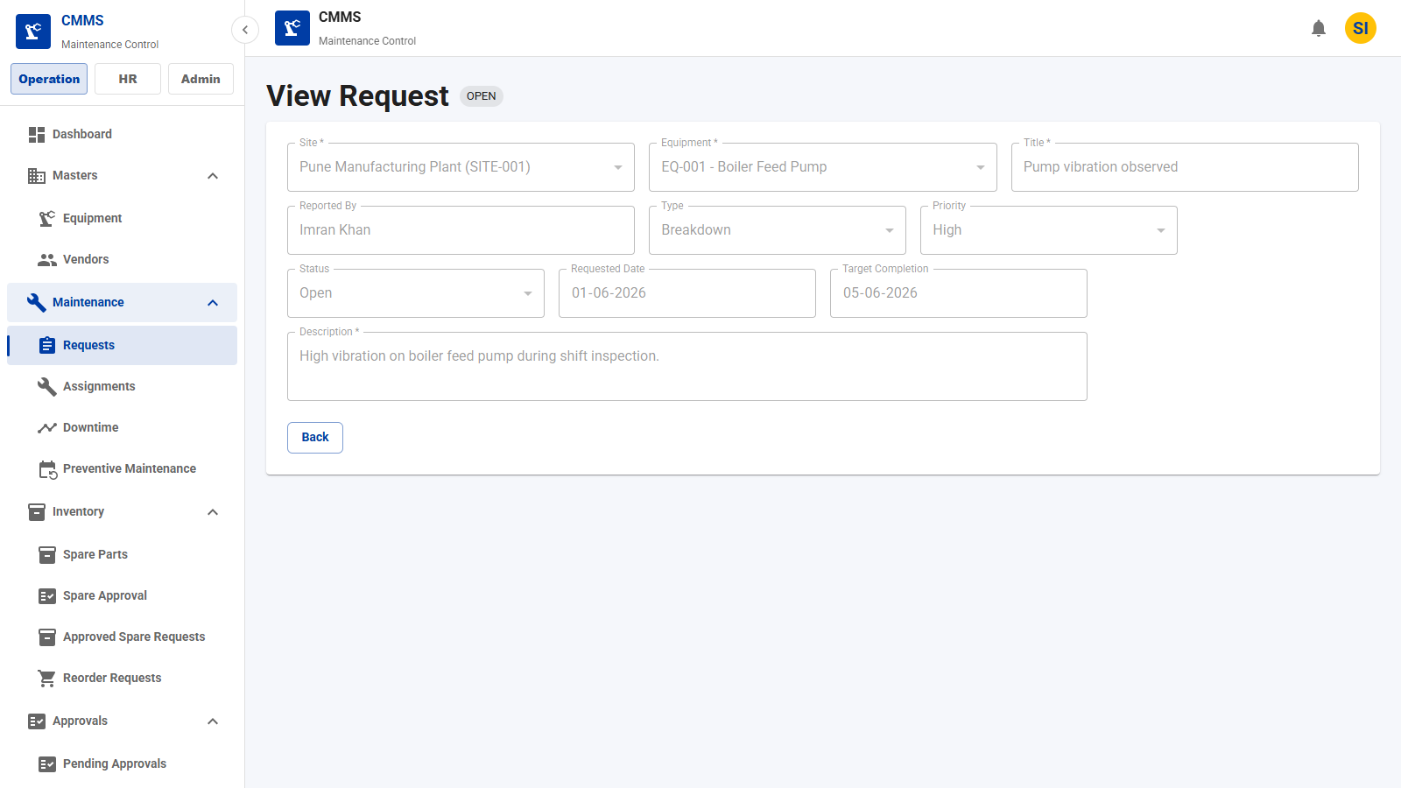
Maintenance Request Module
ANDRITZ
Request Details
Review maintenance request details in read-only context.
Key Fields
• Description
• Reported by
• Priority
• Target date
Features
• Read-only review
• Status visibility
• Equipment linkage
Business Benefits
• Clear request context
• Better handoff to assignments
CMMS Application Demo
21

Slide 21
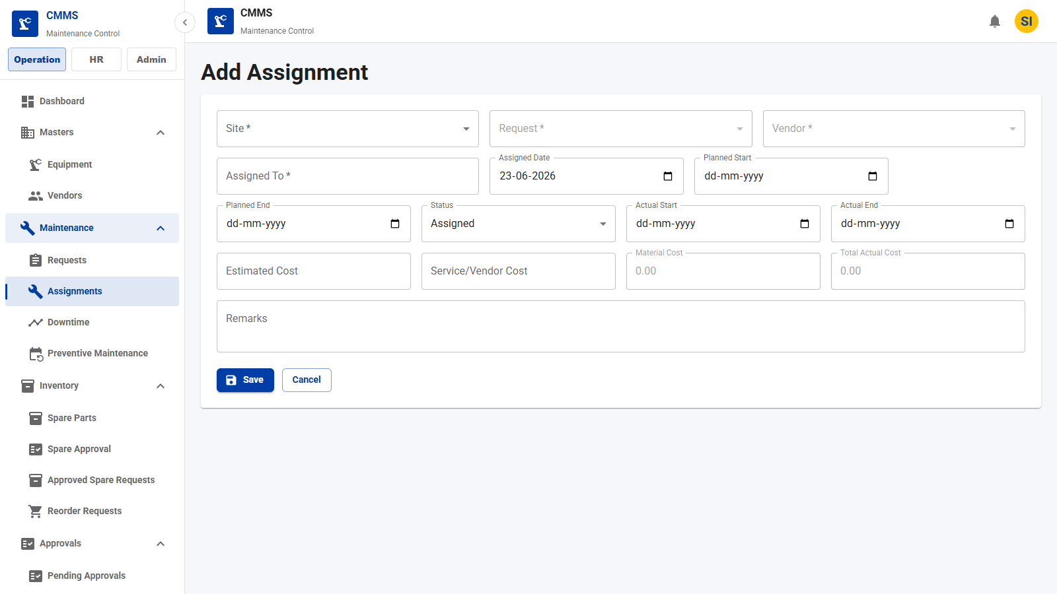
Assignment Module
ANDRITZ
Assignment Creation
Assign maintenance work to technicians and vendors.
Key Fields
• Request
• Vendor
• Assigned to
• Planned dates
• Cost
Features
• Create work assignment
• Plan start/end dates
• Estimate cost
Business Benefits
• Controlled execution planning
• Vendor accountability
CMMS Application Demo
22

Slide 22
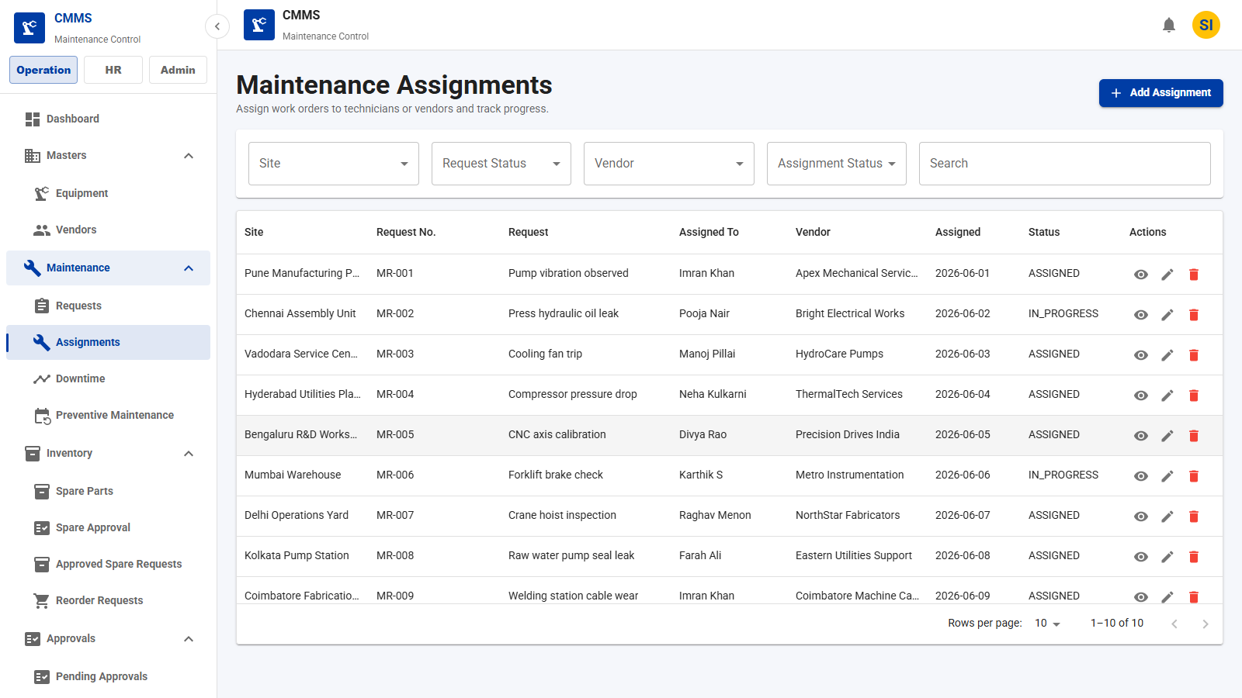
Assignment Module
ANDRITZ
Assignment List
Monitor work assignments and execution status.
Key Fields
• Request
• Vendor
• Technician
• Status
• Cost
Features
• Search assignments
• Track progress
• Open details
Business Benefits
• Improved workload visibility
• Better field coordination
CMMS Application Demo
23

Slide 23
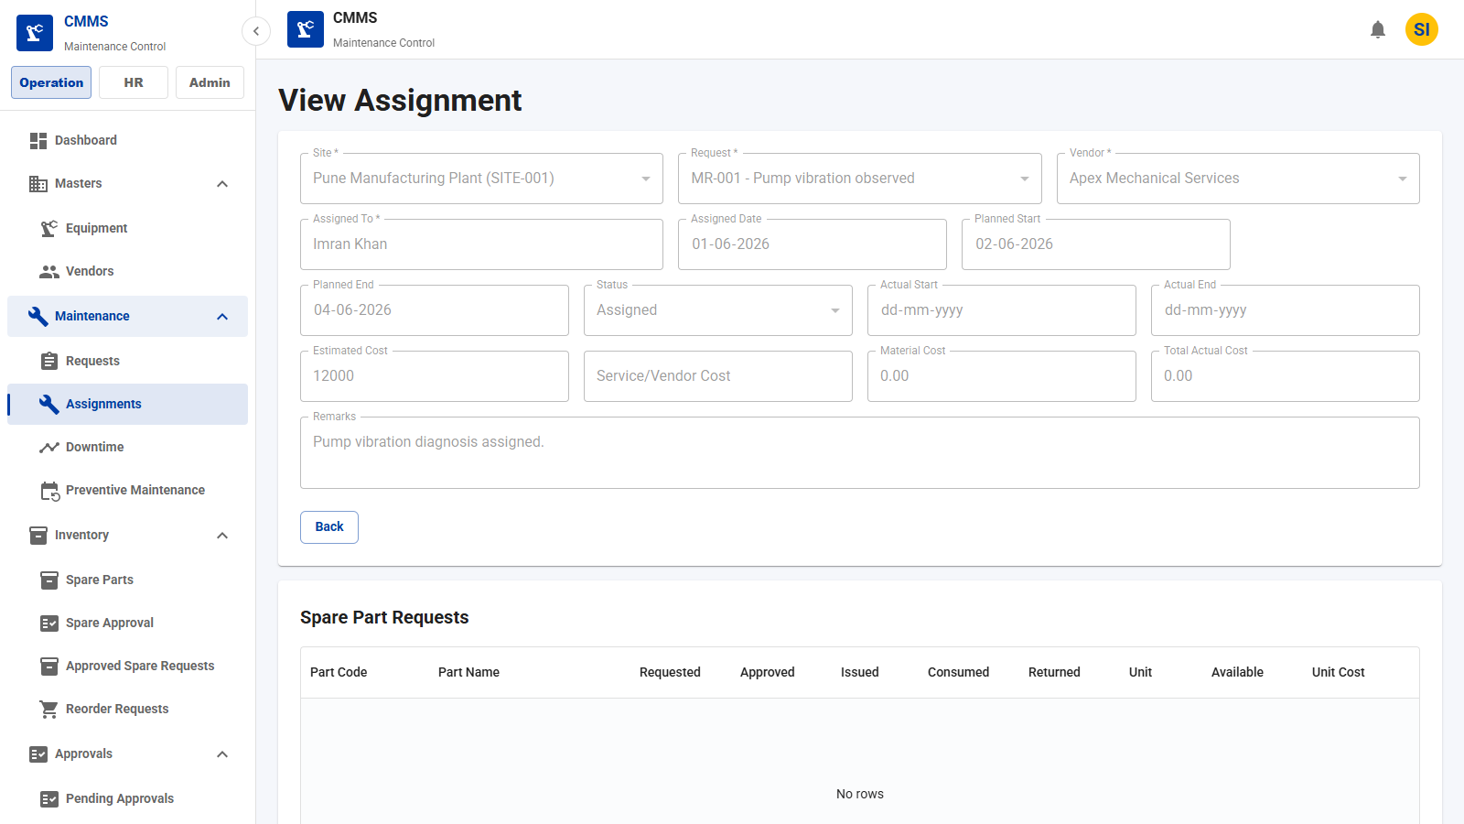
Assignment Module
ANDRITZ
Assignment Details
Review assignment details and spare usage workflow.
Key Fields
• Actual dates
• Spare requests
• Status
• Remarks
Features
• Read-only assignment review
• Spare usage table
• Execution tracking
Business Benefits
• Traceable maintenance work
• Cleaner closeout process
CMMS Application Demo
24

Slide 24
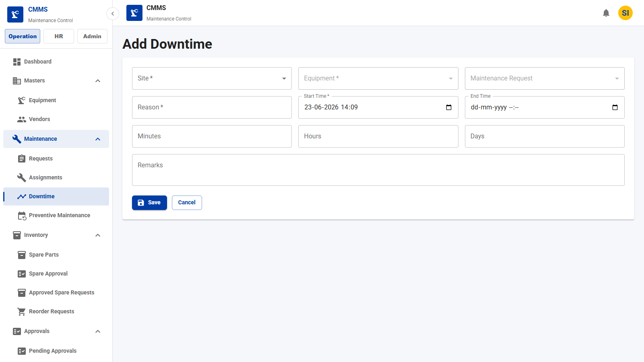
Downtime Module
ANDRITZ
Downtime Creation
Record equipment downtime events.
Key Fields
• Equipment
• Request
• Start
• End
• Reason
Features
• Capture planned/unplanned downtime
• Calculate duration
• Link to request
Business Benefits
• Accurate downtime accounting
• RCA-ready history
CMMS Application Demo
25

Slide 25
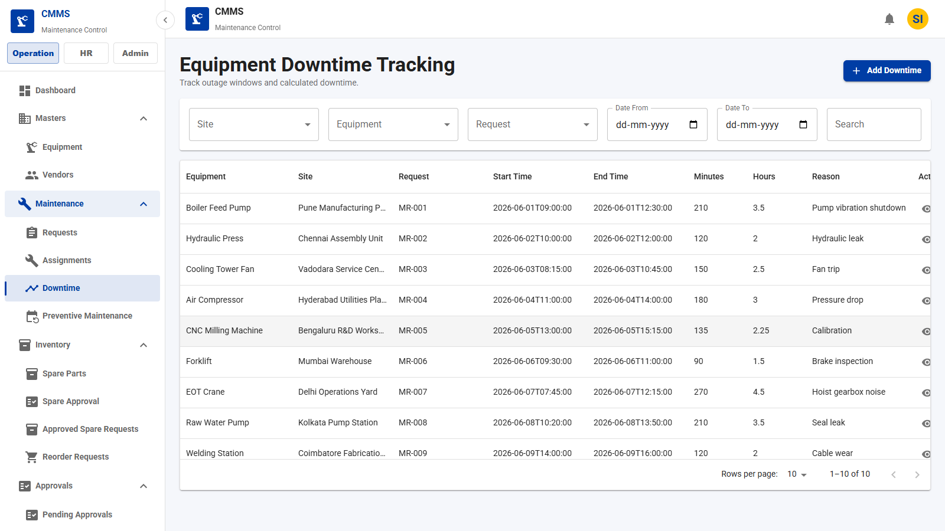
Downtime Module
ANDRITZ
Downtime List
View downtime events across sites and equipment.
Key Fields
• Equipment
• Site
• Duration
• Reason
• Planned
Features
• Search downtime
• Filter records
• Open details
Business Benefits
• Operational loss visibility
• Better maintenance analysis
CMMS Application Demo
26

Slide 26
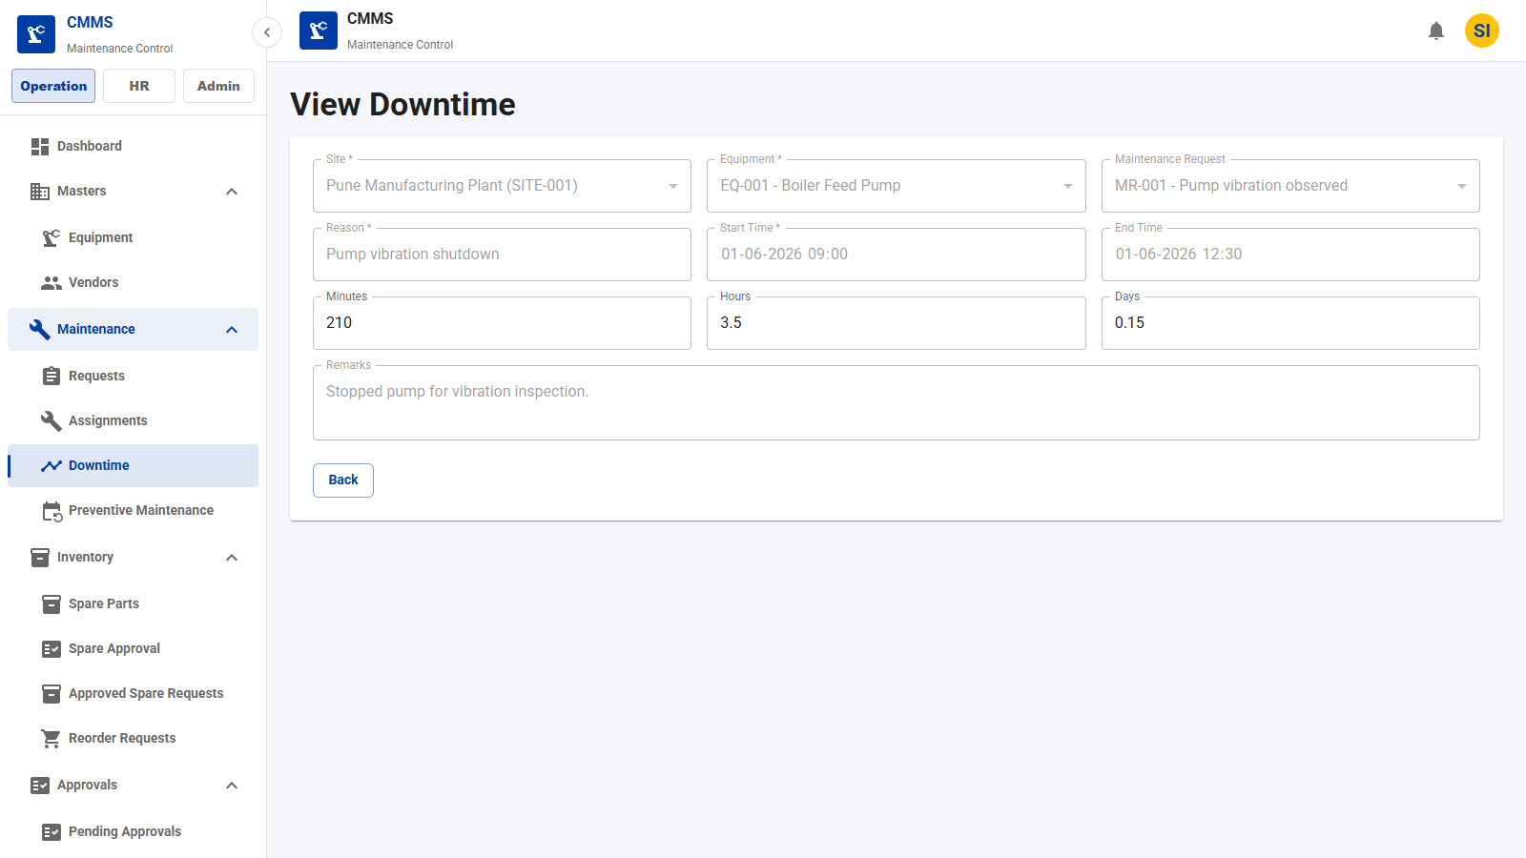
Downtime Module
ANDRITZ
Downtime Tracking
Inspect downtime event timing and maintenance context.
Key Fields
• Start time
• End time
• Hours
• Minutes
• Remarks
Features
• Detailed tracking
• Request linkage
• Duration calculation
Business Benefits
• Improved uptime reporting
• Better reliability metrics
CMMS Application Demo
27

Slide 27
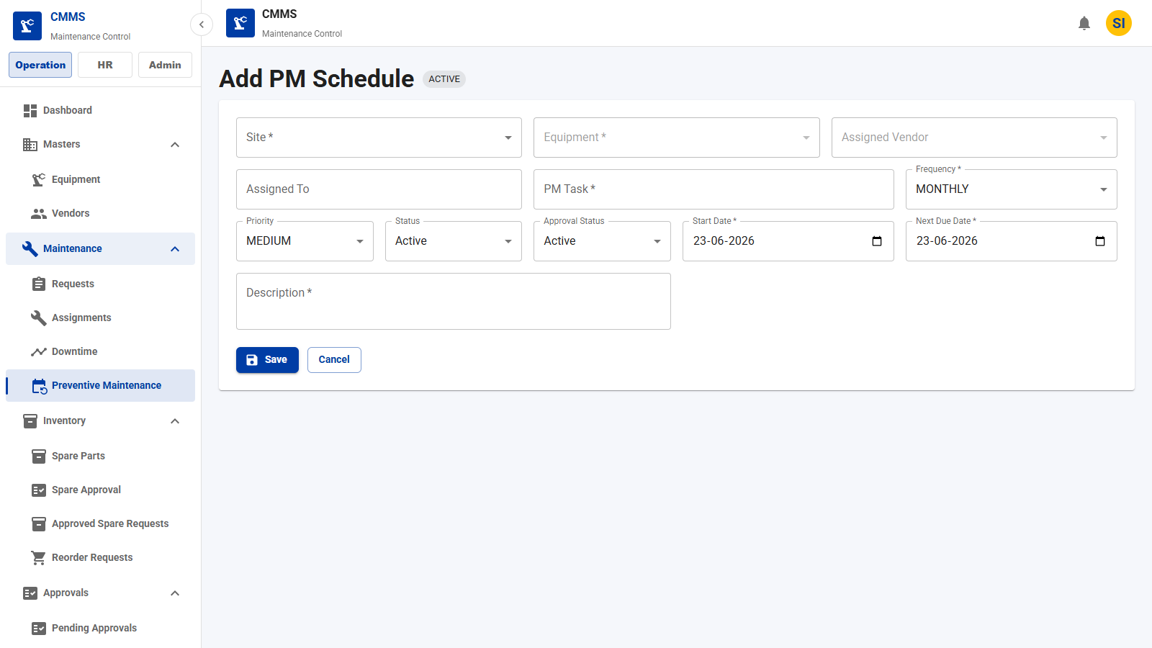
Preventive Maintenance Module
ANDRITZ
PM Schedule Creation
Create recurring preventive maintenance schedules.
Key Fields
• Equipment
• Frequency
• Next due date
• Priority
• Vendor
Features
• Define recurrence
• Assign vendor/site
• Set SLA priority
Business Benefits
• Reduced breakdowns
• Planned maintenance rhythm
CMMS Application Demo
28

Slide 28
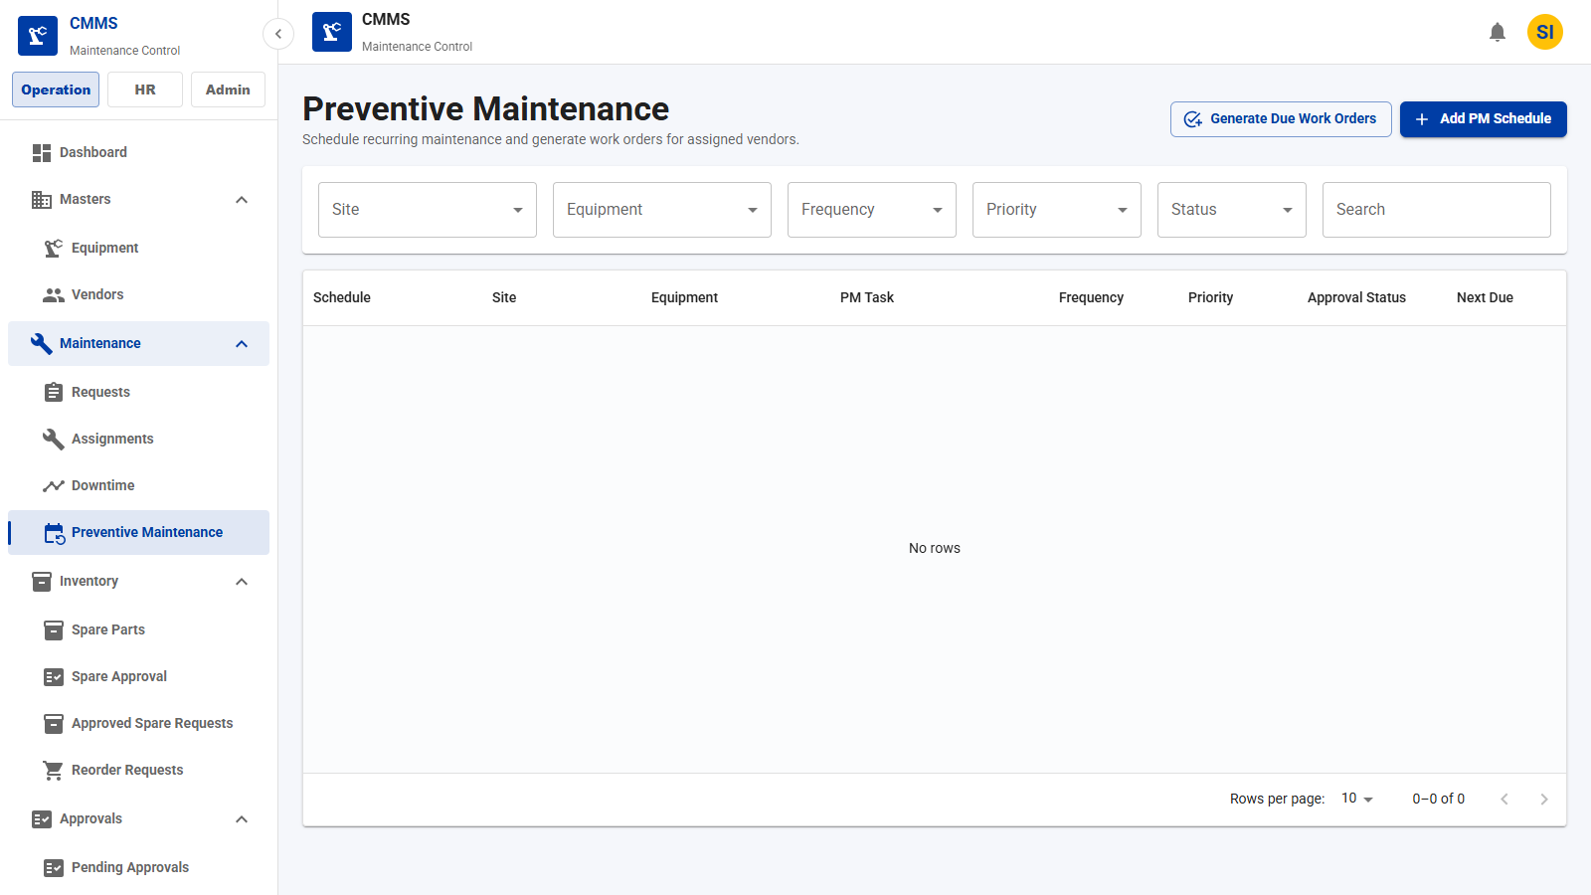
Preventive Maintenance Module
ANDRITZ
PM List
Track preventive schedules and due work generation.
Key Fields
• Equipment
• Frequency
• Next due
• Active
• Completion %
Features
• Filter schedules
• Generate work orders
• Monitor PM compliance
Business Benefits
• Proactive maintenance
• Higher asset availability
CMMS Application Demo
29

Slide 29
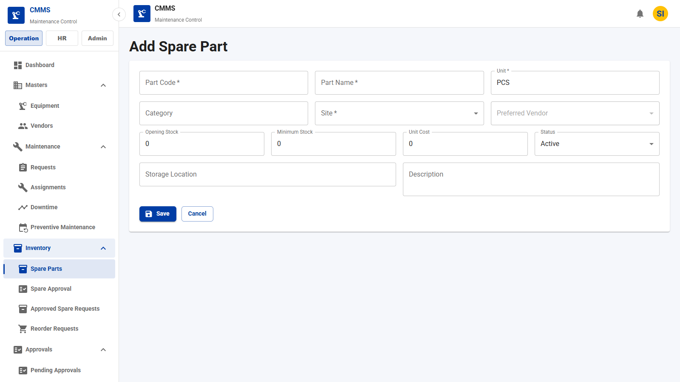
Spare Parts Module
ANDRITZ
Spare Part Creation
Create spare part and site stock records.
Key Fields
• Part code
• Part name
• Site
• Stock
• Minimum stock
• Unit cost
Features
• Maintain spare master
• Set min/max levels
• Attach vendor/category
Business Benefits
• Material availability
• Better repair readiness
CMMS Application Demo
32

Slide 30
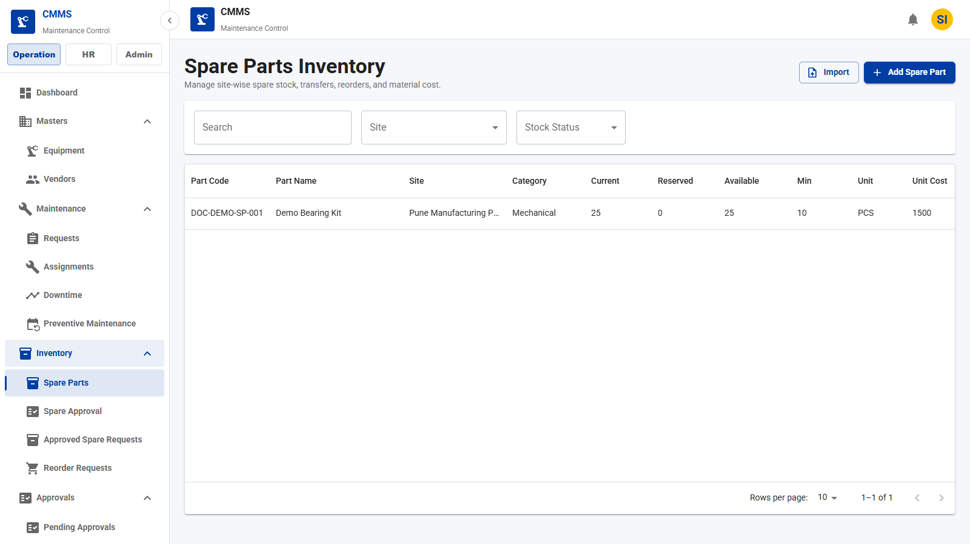
Spare Parts Module
ANDRITZ
Spare Part List
Manage site-wise spare stock and actions.
Key Fields
• Part code
• Site
• Available stock
• Minimum stock
• Low stock
Features
• Search inventory
• Stock in/adjust/transfer
• Create reorder
Business Benefits
• Fast stock visibility
• Lower maintenance delays
CMMS Application Demo
33

Slide 31
Spare Parts Module
ANDRITZ
Stock View
View current, reserved, and available stock by site.
Key Fields
• Current stock
• Reserved stock
• Available stock
• Storage location
Features
• Site-level stock view
• Low-stock filter
• QR label support
Business Benefits
• Inventory transparency
• Reduced stockouts
CMMS Application Demo
34

Slide 32
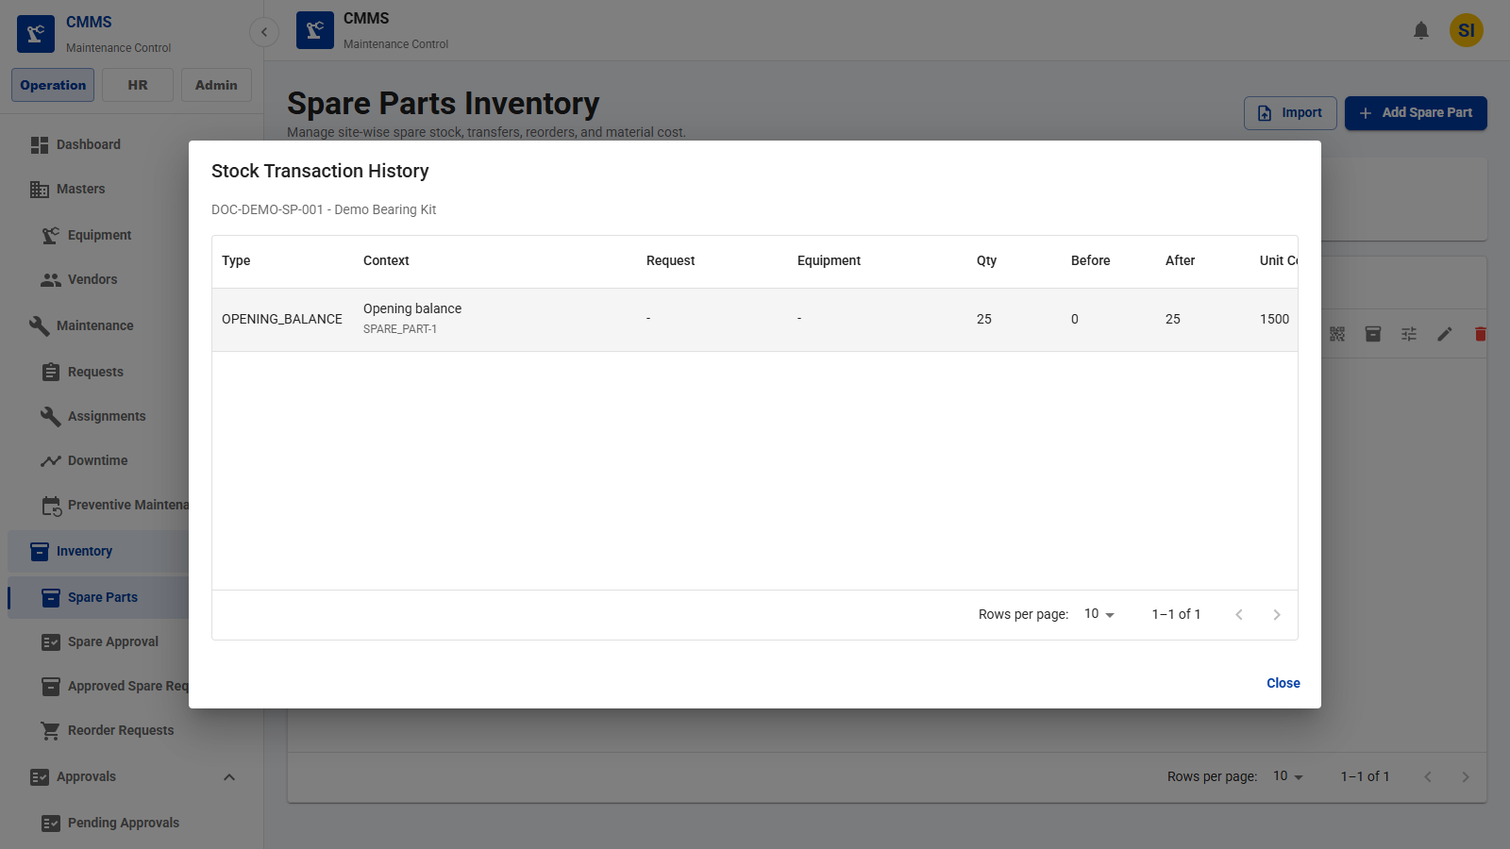
Spare Parts Module
ANDRITZ
Stock Transaction History
Review stock movement history for a selected spare part.
Key Fields
• Transaction type
• Quantity
• Before/after stock
• Reference
Features
• Open transaction history dialog
• Audit material movements
Business Benefits
• Traceable inventory activity
• Stronger stock control
CMMS Application Demo
35

Slide 33
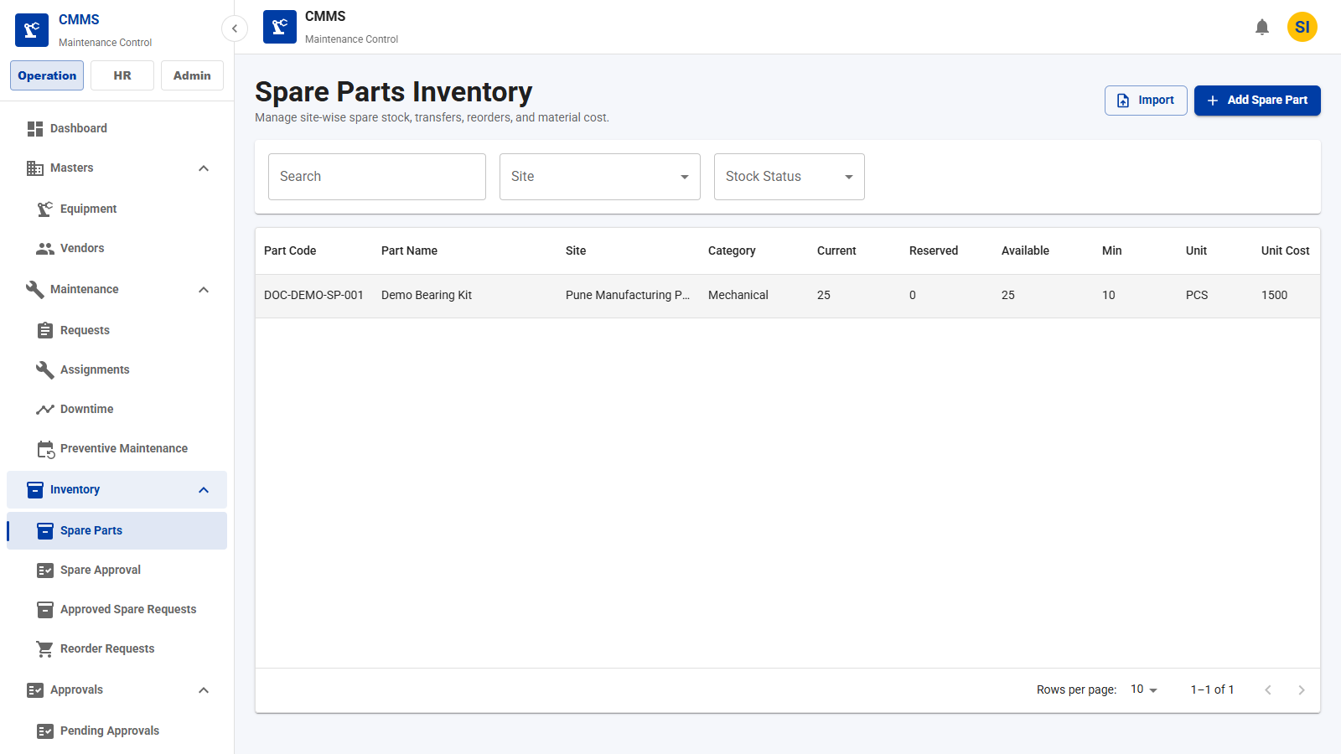
Inventory Module
ANDRITZ
Inventory List
List site stock records across all spare parts.
Key Fields
• Part
• Site
• Available
• Minimum
• Unit cost
Features
• Filter inventory
• Identify low stock
• Edit stock master
Business Benefits
• Cleaner stock administration
• Faster spare lookup
CMMS Application Demo
37

Slide 34
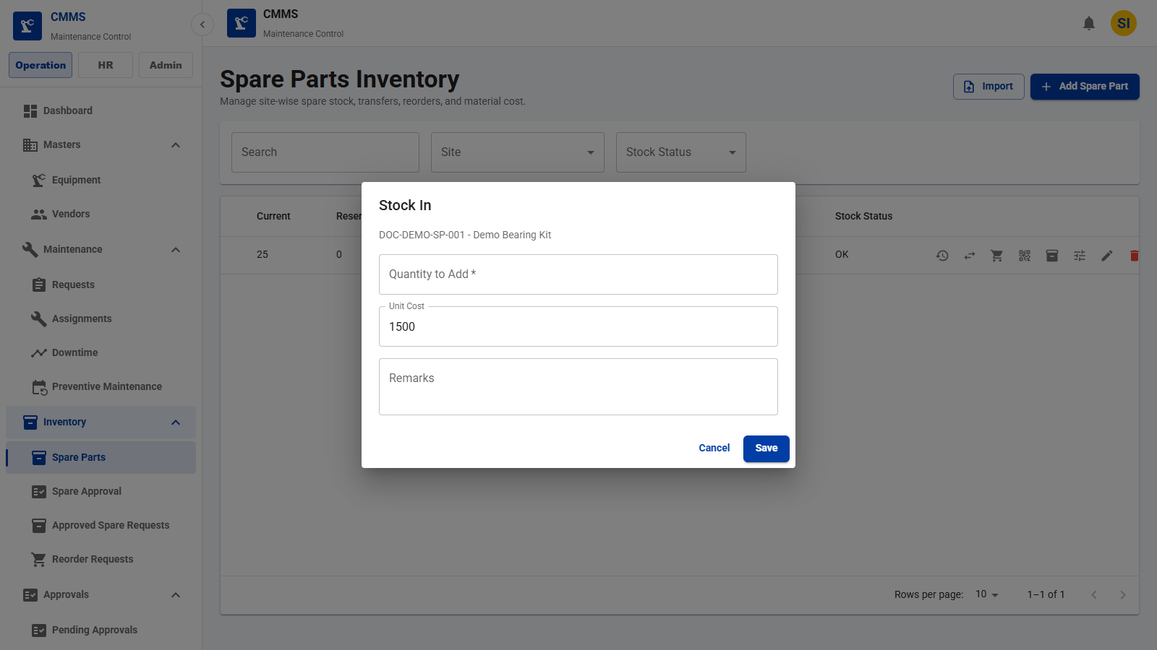
Inventory Module
ANDRITZ
Stock Movement
Record stock in, adjustment, and transfer movement.
Key Fields
• Movement type
• Quantity
• Unit cost
• Remarks
Features
• Open stock movement dialog
• Adjust site stock
• Capture movement remarks
Business Benefits
• Controlled stock updates
• Inventory auditability
CMMS Application Demo
38

Slide 35
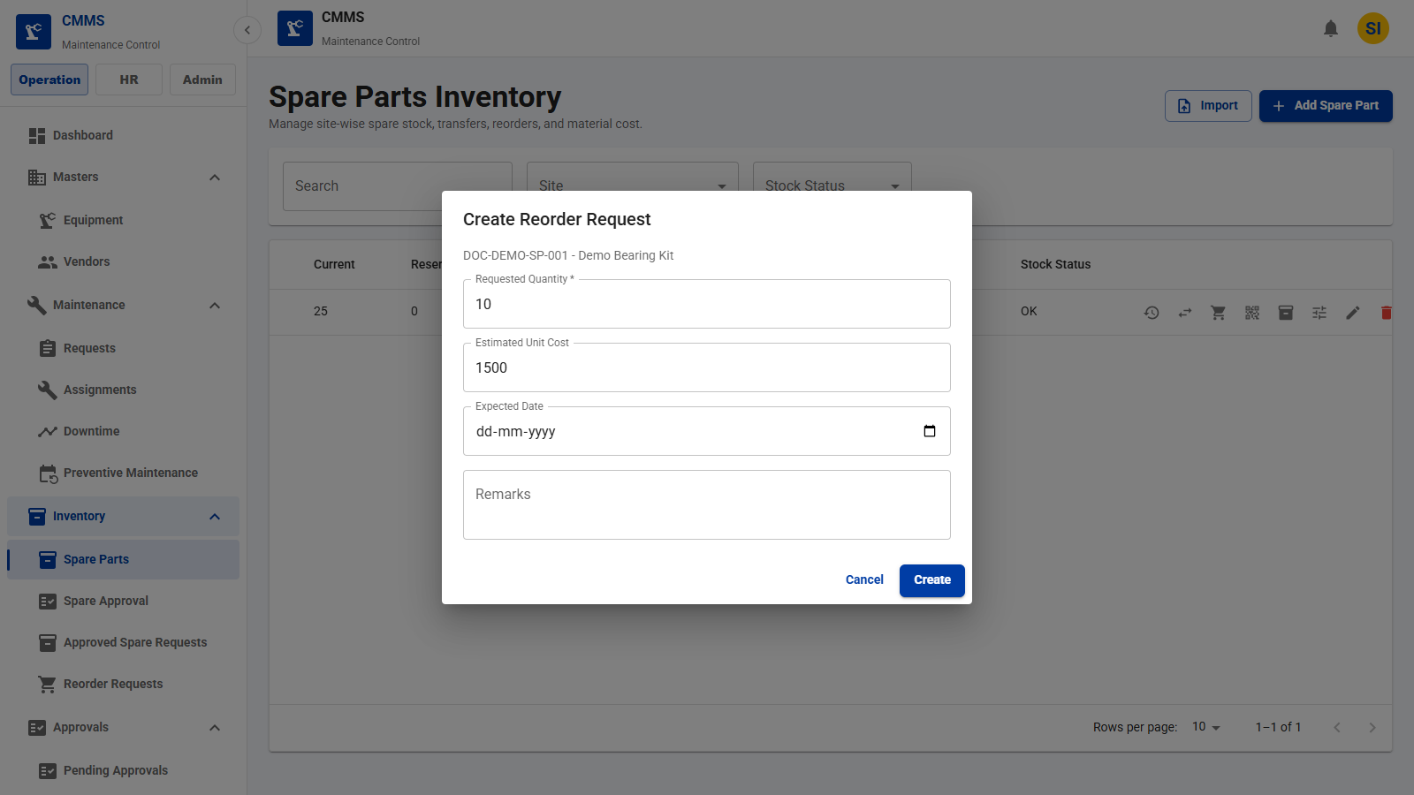
Purchase Request Module
ANDRITZ
Purchase Request Creation
Create reorder requests from low or planned stock requirements.
Key Fields
• Stock item
• Requested quantity
• Estimated cost
• Expected date
Features
• Open reorder dialog
• Create purchase request
• Link to stock item
Business Benefits
• Faster replenishment
• Reduced stockout risk
CMMS Application Demo
39

Slide 36
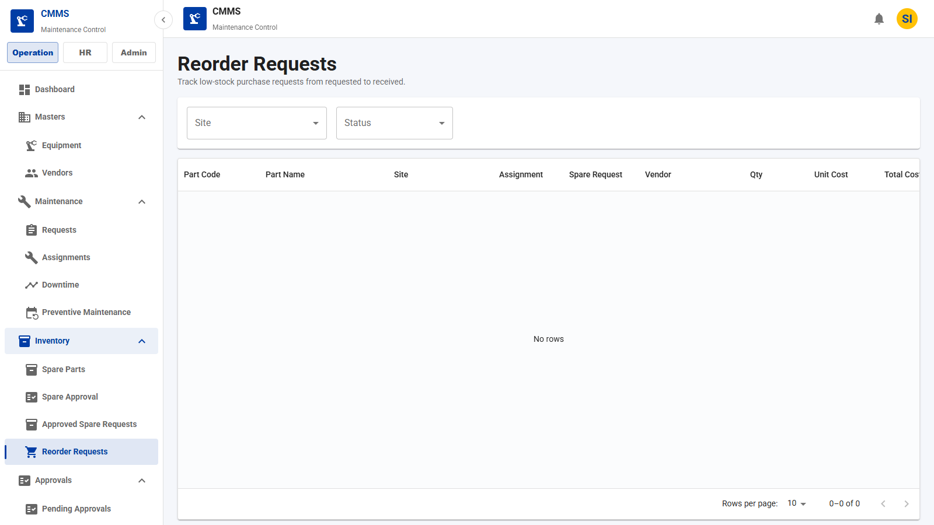
Purchase Request Module
ANDRITZ
Purchase Request List
Track reorder and purchase requests.
Key Fields
• Request
• Part
• Site
• Status
• Requested quantity
Features
• View reorder records
• Receive stock
• Update purchase status
Business Benefits
• Purchasing visibility
• Closed loop stock replenishment
CMMS Application Demo
40

Slide 37
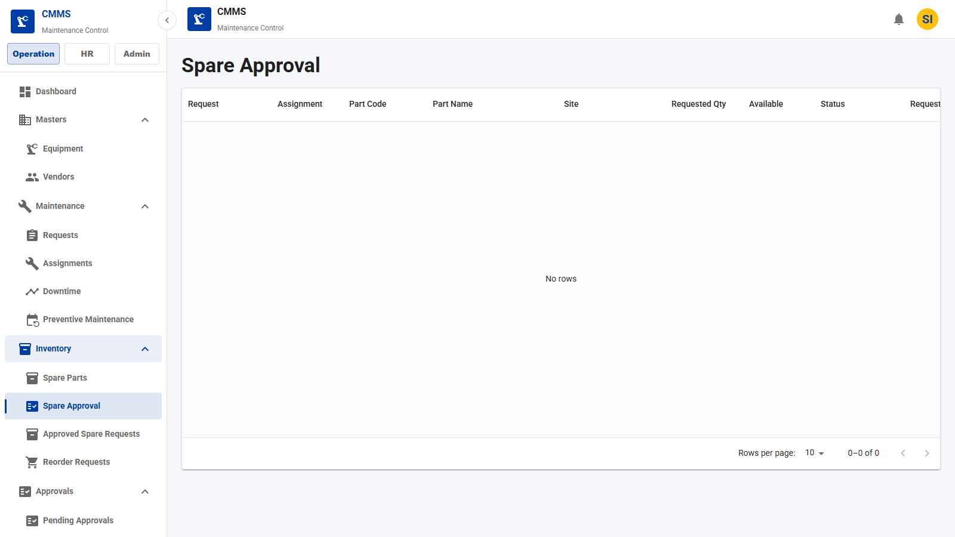
Purchase Request Module
ANDRITZ
Purchase Approval Flow
Review spare requests before store processing or purchasing.
Key Fields
• Spare request
• Manager approval
• Stock status
• Decision
Features
• Manager review queue
• Approve/reject request
• Escalate to purchase
Business Benefits
• Controlled material release
• Better approval governance
CMMS Application Demo
41

Slide 38
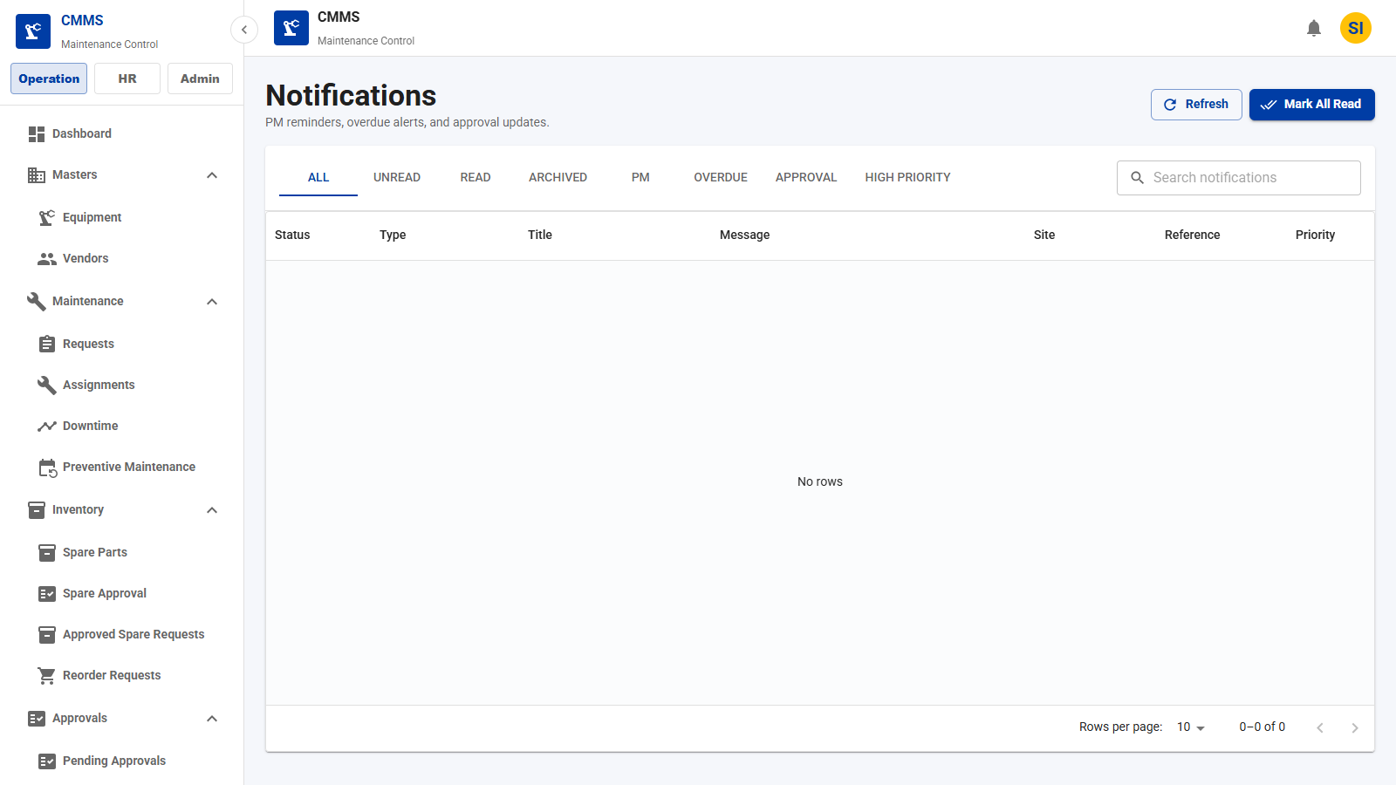
Notification Module
ANDRITZ
Notification Center
View system notifications generated from workflows.
Key Fields
• Type
• Priority
• Status
• Reference
• Created at
Features
• In-app notification list
• Read/archive actions
• Reference links
Business Benefits
• Faster user awareness
• Better exception handling
CMMS Application Demo
42

Slide 39
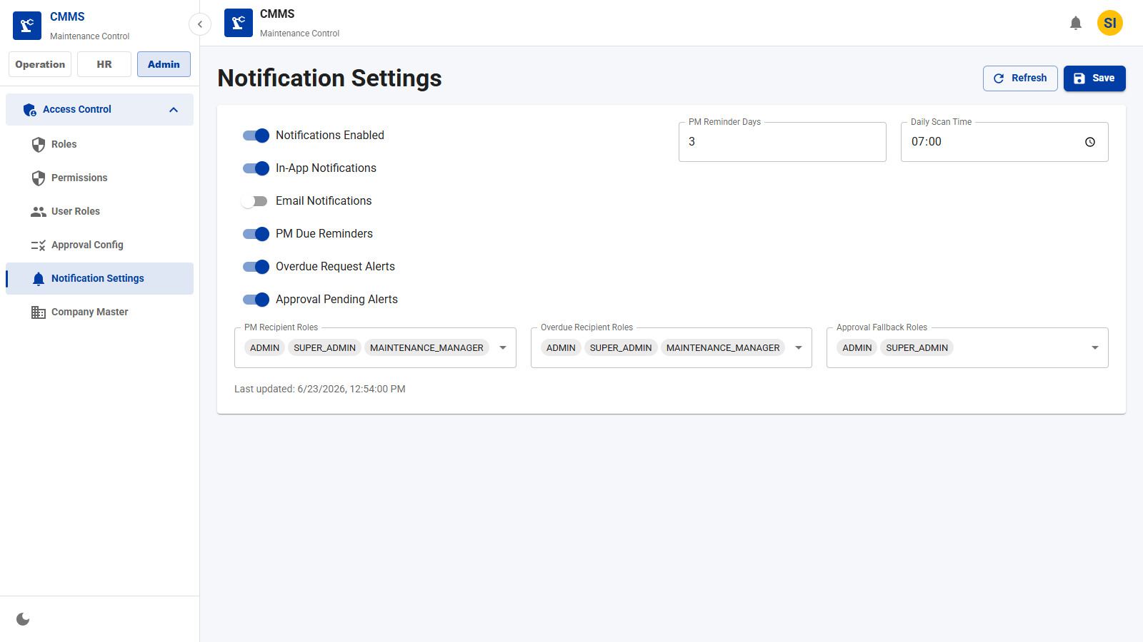
Notification Module
ANDRITZ
Notification Workflow
Configure notification preferences and recipient roles.
Key Fields
• Email enabled
• PM reminders
• Overdue alerts
• Fallback roles
Features
• Adjust notification settings
• Control reminder windows
• Define recipients
Business Benefits
• Timely escalations
• Configurable communication
CMMS Application Demo
43

Slide 40
Dashboard Module
ANDRITZ
Dashboard Overview
Executive view of CMMS status and activity.
Key Fields
• Open requests
• Assignments
• Downtime
• Inventory
Features
• KPI cards
• Site filters
• Recent activity
Business Benefits
• Fast operational awareness
• Single landing view
CMMS Application Demo
44

Slide 41
Dashboard Module
ANDRITZ
KPI Cards
Summarize important operational counts.
Key Fields
• Requests
• Equipment
• Downtime
• Assignments
Features
• At-a-glance indicators
• Color-coded cards
• Site-aware metrics
Business Benefits
• Faster decision making
• Management-ready visibility
CMMS Application Demo
45

Slide 42
Dashboard Module
ANDRITZ
Charts and Metrics
Visualize trends and operational distribution.
Key Fields
• Status mix
• Downtime trends
• Maintenance volume
Features
• Charts and metric panels
• Operational summaries
Business Benefits
• Better trend review
• Data-driven planning
CMMS Application Demo
46

Slide 43

Company Settings Module
ANDRITZ
Company Profile
Maintain company profile data used by the application shell.
Key Fields
• Company name
• Company code
• Contact
• Address
Features
• Edit company details
• Persist master profile
Business Benefits
• Consistent enterprise identity
• Centralized configuration
CMMS Application Demo
47

Slide 44
Company Settings Module
ANDRITZ
Logo Configuration
Upload and preview company branding.
Key Fields
• Logo file
• Logo preview
• Company status
Features
• Logo upload field
• Preview configured branding
Business Benefits
• Branded demos and reports
• Consistent presentation layer
CMMS Application Demo
48

Slide 45
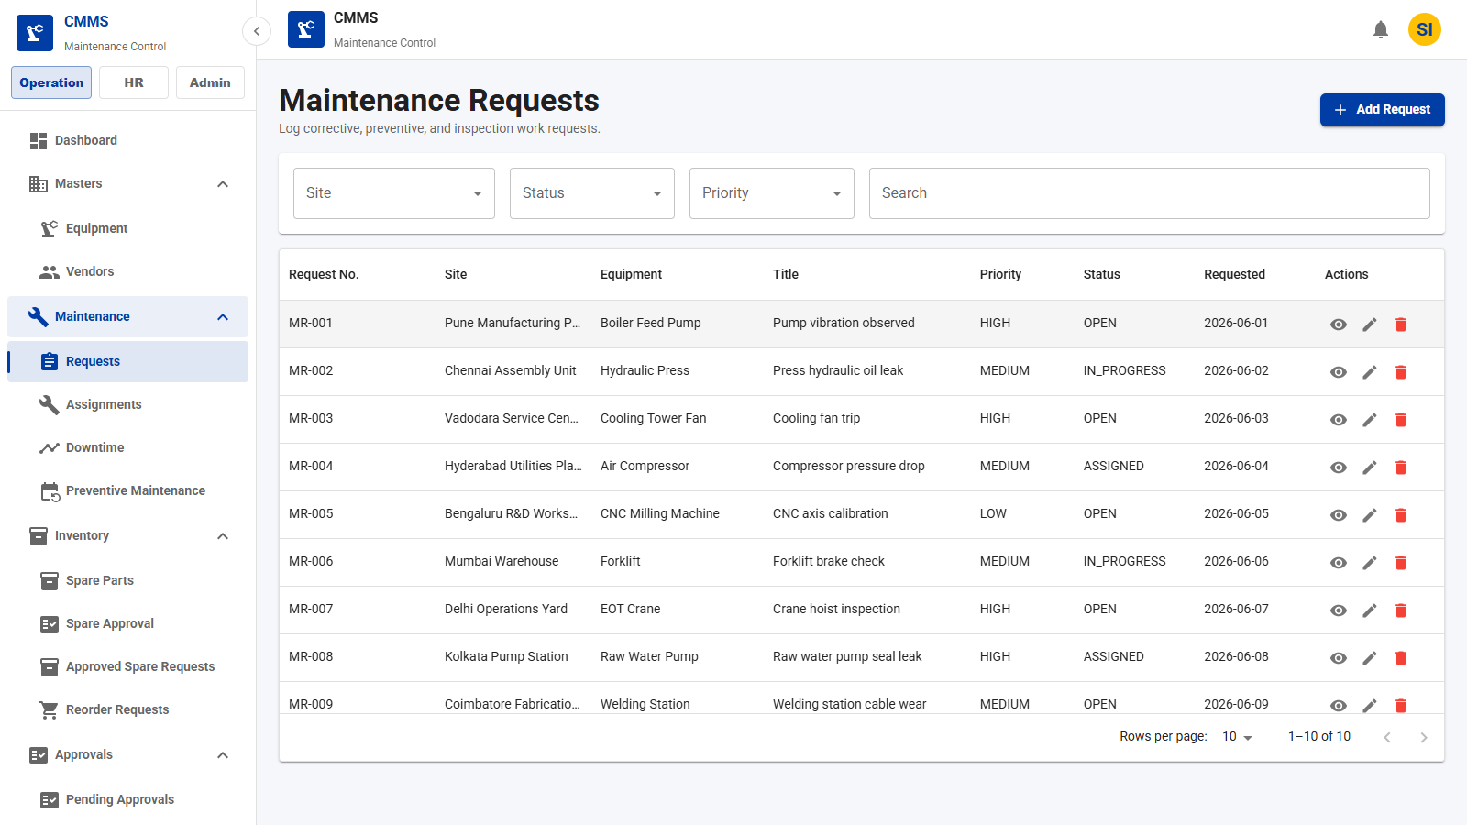
Workflow
ANDRITZ
Maintenance Workflow
Corrective work moves from request intake to assignment, technician execution, and closure.
Maintenance Request
→
Assignment
→
Technician Work Log
Completion
Business Value
• Traceable process ownership
• Standardized approval and execution
• Clear operational handoffs
CMMS Application Demo
49

Slide 46
Workflow
ANDRITZ
Preventive Maintenance Workflow
Recurring schedules generate planned work orders that follow the standard assignment and completion path.
PM Schedule
→
Auto Generation
→
Assignment
Completion
Business Value
• Traceable process ownership
• Standardized approval and execution
• Clear operational handoffs
CMMS Application Demo
50

Slide 47
Workflow
ANDRITZ
Spare Parts Workflow
Spare requests are approved, checked for stock, issued when available, or converted to purchase requests.
Technician Request
→
Manager Approval
→
Store Manager Review
Stock Available?
→
Issue / Purchase Request
→
Consume / Return
Business Value
• Traceable process ownership
• Standardized approval and execution
• Clear operational handoffs
CMMS Application Demo
51

Slide 48
Workflow
ANDRITZ
Inventory Workflow
Inventory movements preserve traceability from reservation through issue, consumption, and return.
Stock
→
Reserve
→
Issue
Consume
→
Return
Business Value
• Traceable process ownership
• Standardized approval and execution
• Clear operational handoffs
CMMS Application Demo
52

Slide 49
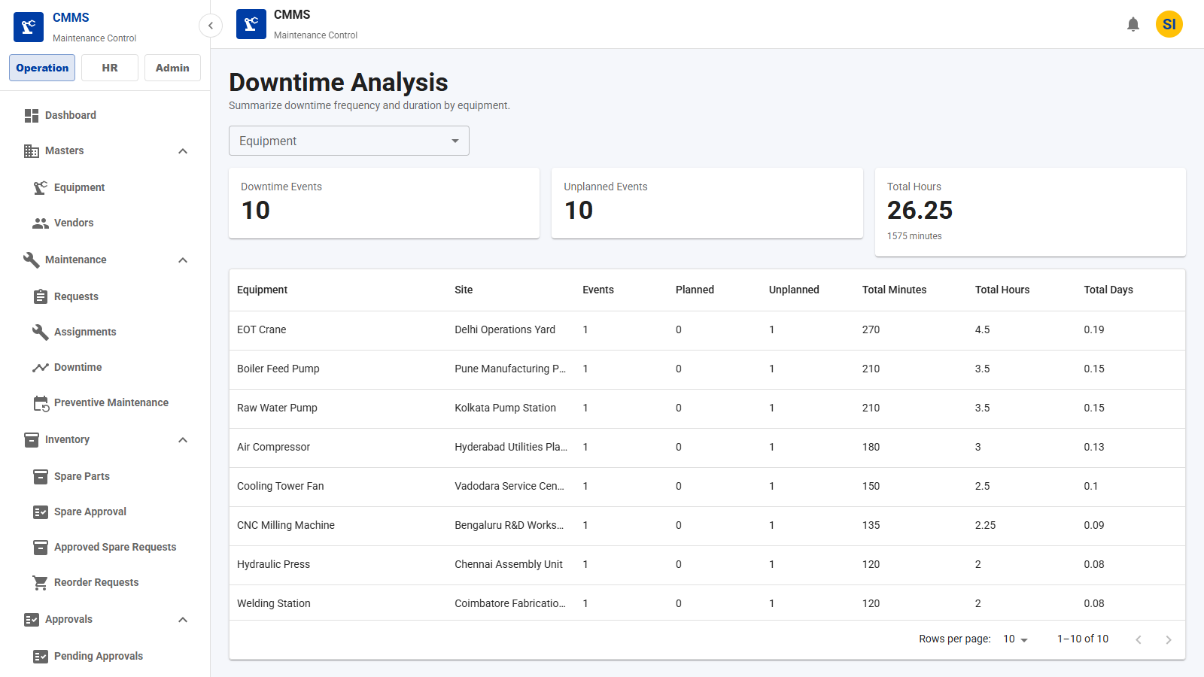
Reports Module
ANDRITZ
Reports & Analytics
Analyze equipment history and downtime performance.
Key Fields
• Equipment
• Site
• Date range
• Downtime hours
Features
• Downtime analysis report
• Equipment history report
• Filterable views
Business Benefits
• Reliability insights
• Better maintenance prioritization
CMMS Application Demo
53

Slide 50
CMMS Application
ANDRITZ
New Features
Recently Added CMMS Capabilities
Security
API permission mapping
Role-based API access
403 deny for unauthorized APIs
Operations
Equipment view flow
Technician work logs
Approval inbox and history
Inventory
Spare request lifecycle
Manager/store approvals
Issue, consume, and return
Platform
Common UI components
Company branding
Notifications and dashboard updates
API
Security and access
PM
Workflow automation
SPARES
Inventory lifecycle
UI
User experience
CMMS Application Demo

Slide 51
CMMS Application
ANDRITZ
Security
API Permission Architecture
User Login
User Roles
Role Permissions
Permission API Mapping
API Request
Allow / 403
Backend Enforcement
JwtFilter centralizes protected API checks
ApiPermissionService evaluates hasPermission(userId, requestUrl, method)
Unauthorized APIs return standardized 403 responses
Mapping Source
api-permission-mapping.csv defines permission-to-endpoint rules
CSV is loaded into permission_api_mapping on startup
Public API whitelist stays outside role checks
CMMS Application Demo

Slide 52
CMMS Application
ANDRITZ
Security
Permission-to-API Mapping Flow
CSV Mapping
Startup Loader
Database Table
Repository Query
Cache: api-permissions
Allow / Deny
CSV Contract
Path includes /api context
HTTP method is mapped
Permission code links endpoint access
Runtime Check
Request URI normalized
Public patterns bypassed
Repository count determines access
Governance
Unmapped APIs denied in production
Cache cleared after mapping changes
Standard error envelope returned
CMMS Application Demo

Slide 53
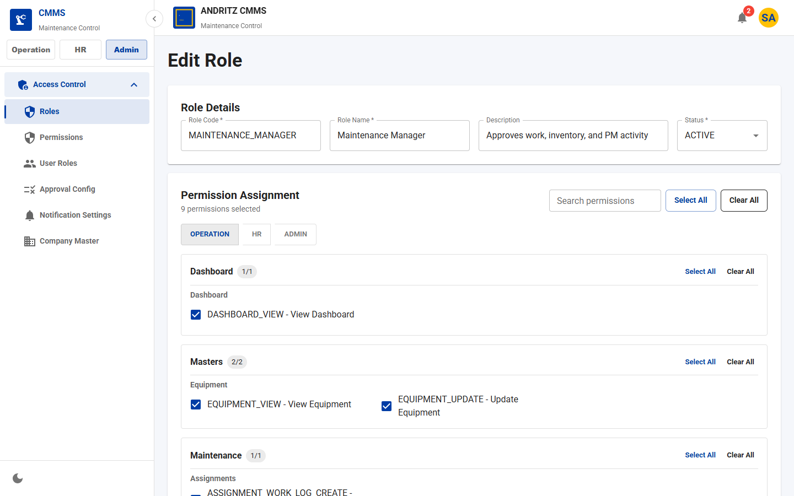
CMMS Application
ANDRITZ
Access Control
Role-Based API Access and Site Scope
Access Model
User -> Role -> Permission -> API mapping
Backend repository query validates endpoint permission
Public API whitelist supports login, docs, health, and logo
Site-Aware Control
Employees are assigned to sites
Roles can be scoped per site
Service-layer checks filter accessible data
Role permissions are grouped by operation, HR, and admin areas.
CMMS Application Demo

Slide 54
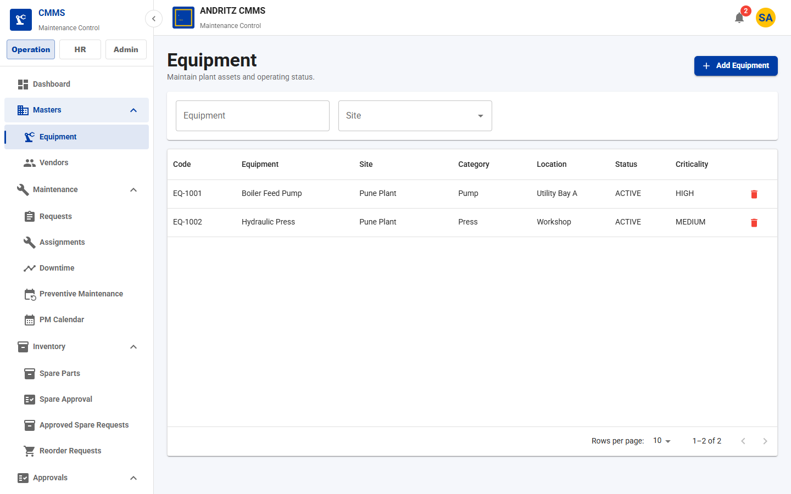
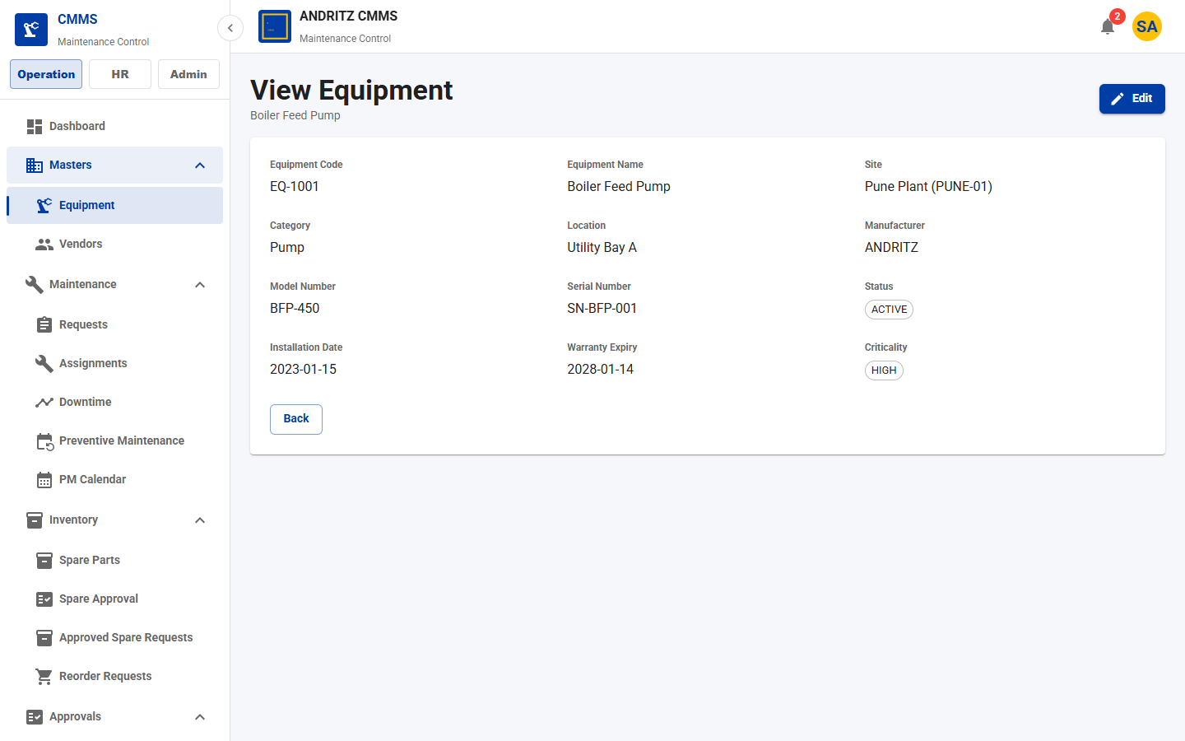
CMMS Application
ANDRITZ
Equipment
Equipment View and Edit Permission Flow
Equipment List
Row Click
Equipment View
EQUIPMENT_UPDATE?
Edit Page
Direct Edit Blocked
List row opens the read-only view page.
Edit action appears only with update permission.
CMMS Application Demo

Slide 55
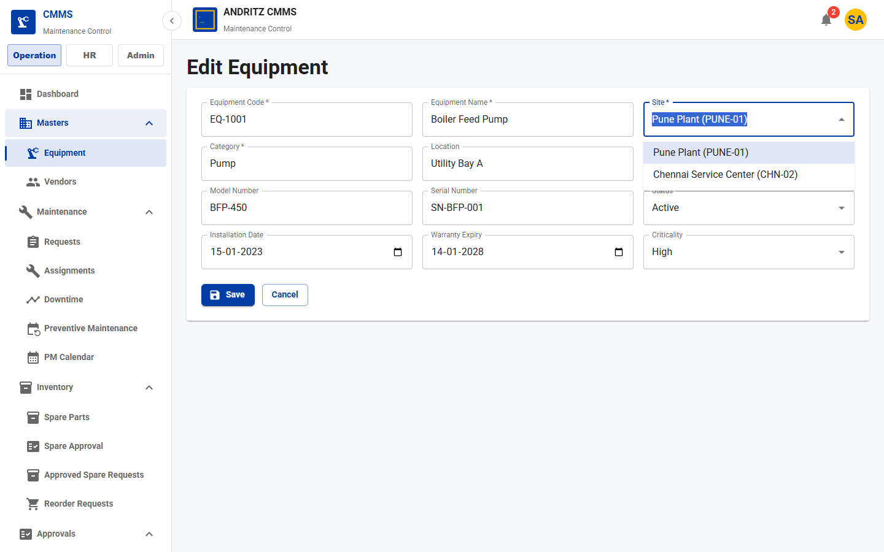
CMMS Application
ANDRITZ
Frontend Platform
Common Component Architecture
Reusable Controls
CommonList for server-side tables
CommonDropdown for typeahead selections
CommonInput and text areas
CommonDatePicker and DateTimePicker
CommonFormCard and CommonFormActions
Adoption
Used across list, create, edit, checklist, and dialog workflows
Shared form card, input, date picker, and dropdown components.
CMMS Application Demo

Slide 56
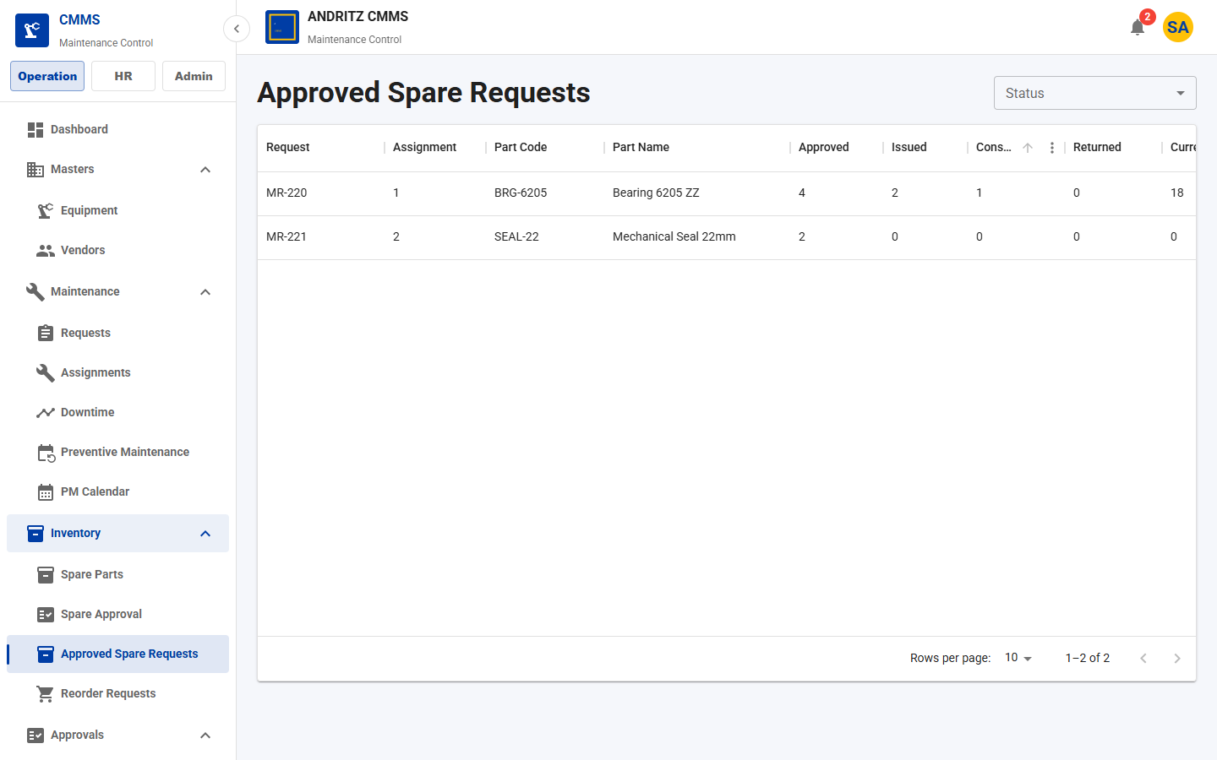
CMMS Application
ANDRITZ
Inventory
Spare Parts and Inventory Workflow
Technician Request
Manager Approval
Store Review
Stock Check
Issue / Purchase
Consume / Return
Workflow Coverage
Spare request from assignment
Manager approval / rejection
Store stock review
Purchase request when unavailable
Issue, consume, and return tracking
CMMS Application Demo
Approved spare requests show stock, purchase, issue, consume, and return state.

Slide 57
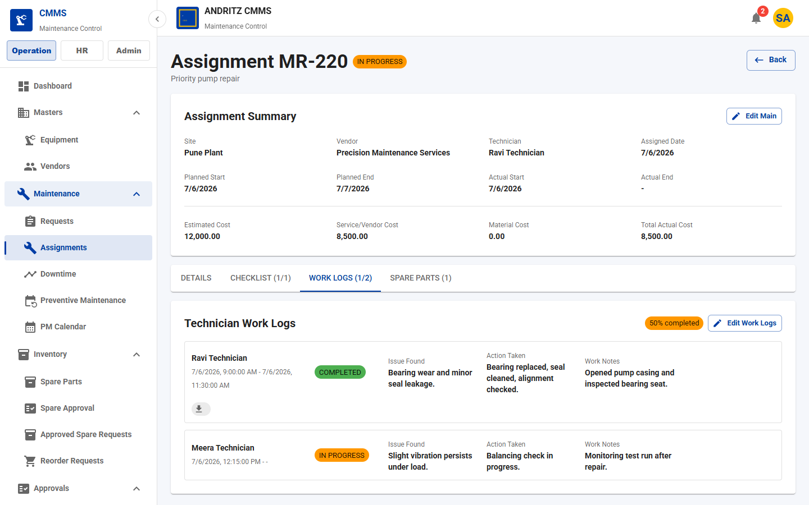
CMMS Application
ANDRITZ
Maintenance Execution
Technician Work Log Flow
Captured Details
Start and end time
Issue found
Action taken
Work notes
Attachments/photos
Completion status
Closeout Guardrails
Checklist and work-log progress inform completion readiness
Proof uploads preserve field evidence
Work log tab captures technician activity and completion state.
CMMS Application Demo

Slide 58
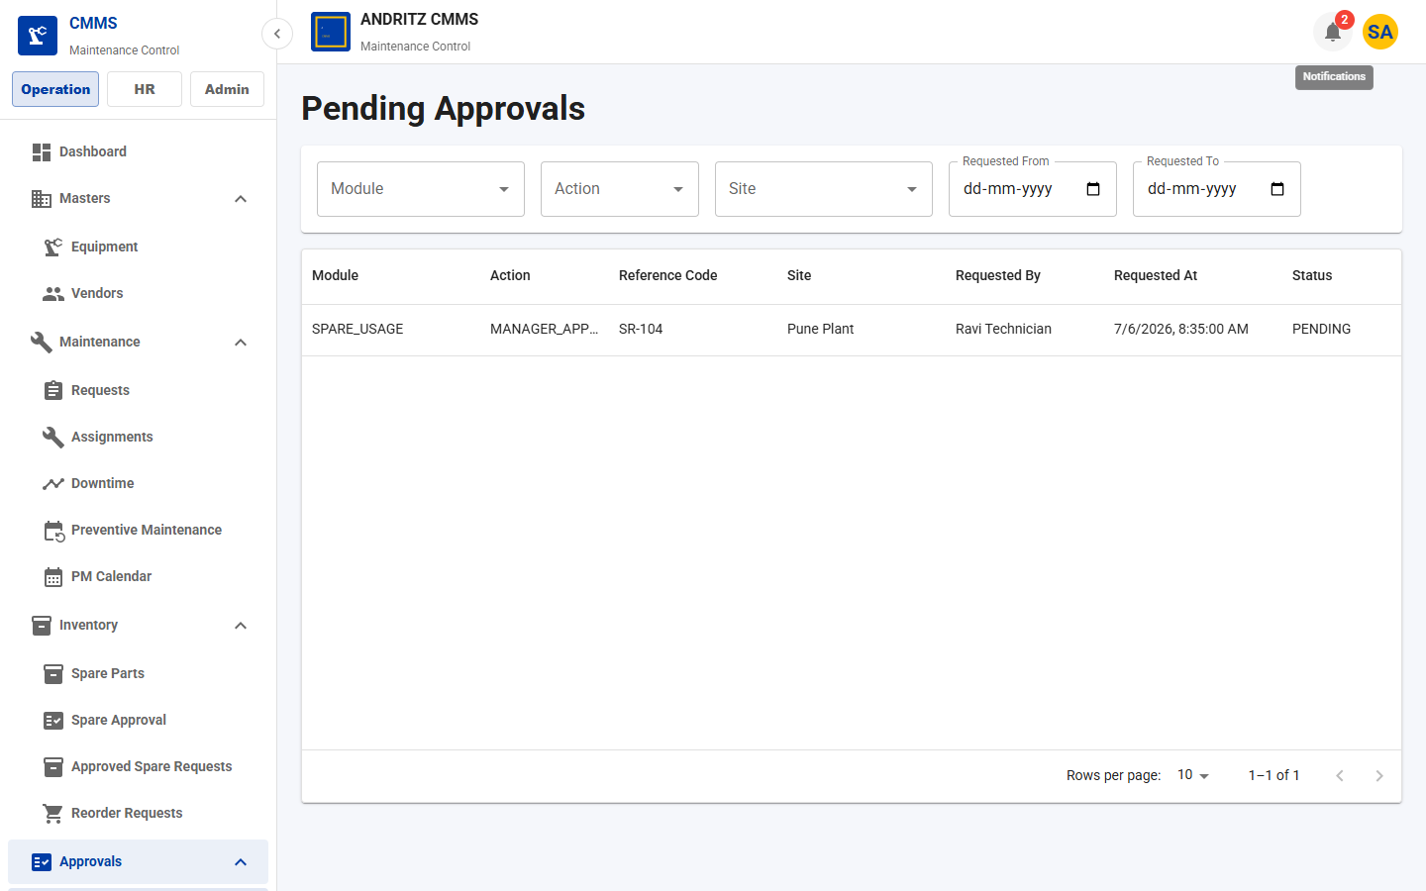
CMMS Application
ANDRITZ
Approvals
Approval Workflow
Workflow Event
Approval Request
Approver Role
Approve / Reject
History
Supported Review Points
Manager approval
HR/admin/store approval where configured
Pending inbox scoped to role and site
Decision comments and audit history
Pending approvals are filtered for the logged-in approver role.
CMMS Application Demo

Slide 59
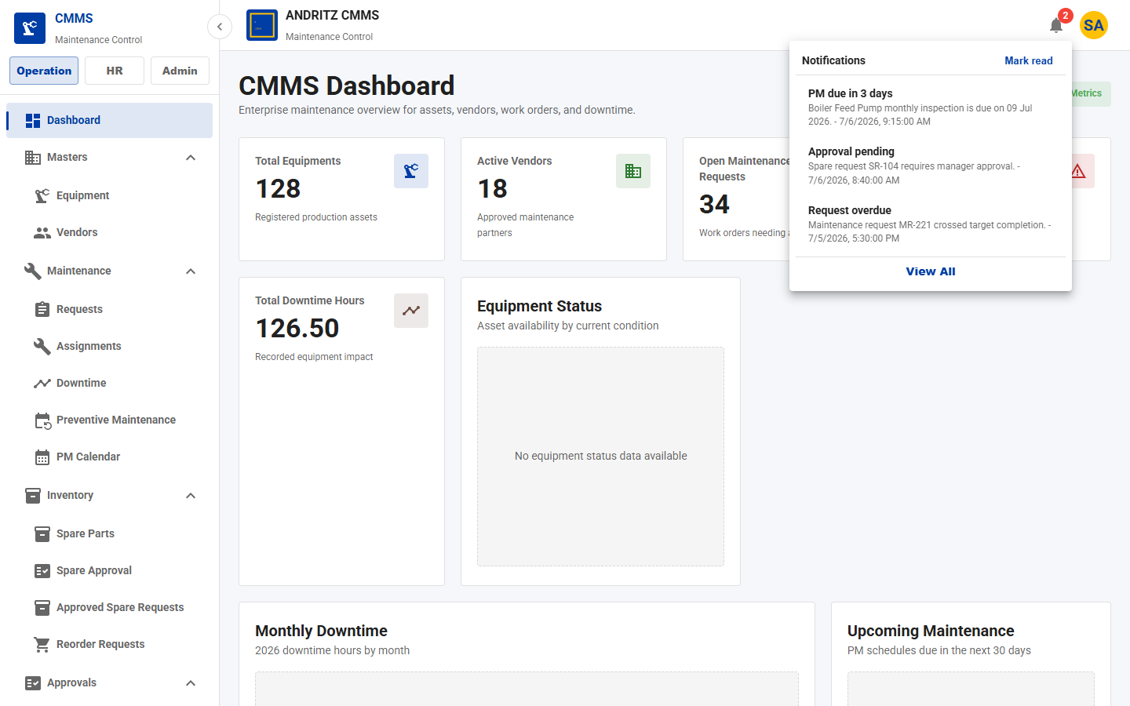
CMMS Application
ANDRITZ
Experience
Notification Bell and Company Branding
Notification Types
PM due reminder
Overdue request alert
Approval pending alert
In-app notification center
Read/archive actions
Branding
Company logo in navbar
Company name shown globally
User avatar and logout menu
Top navbar shows company logo/name, notification badge, avatar, and logout menu.
CMMS Application Demo

Slide 60
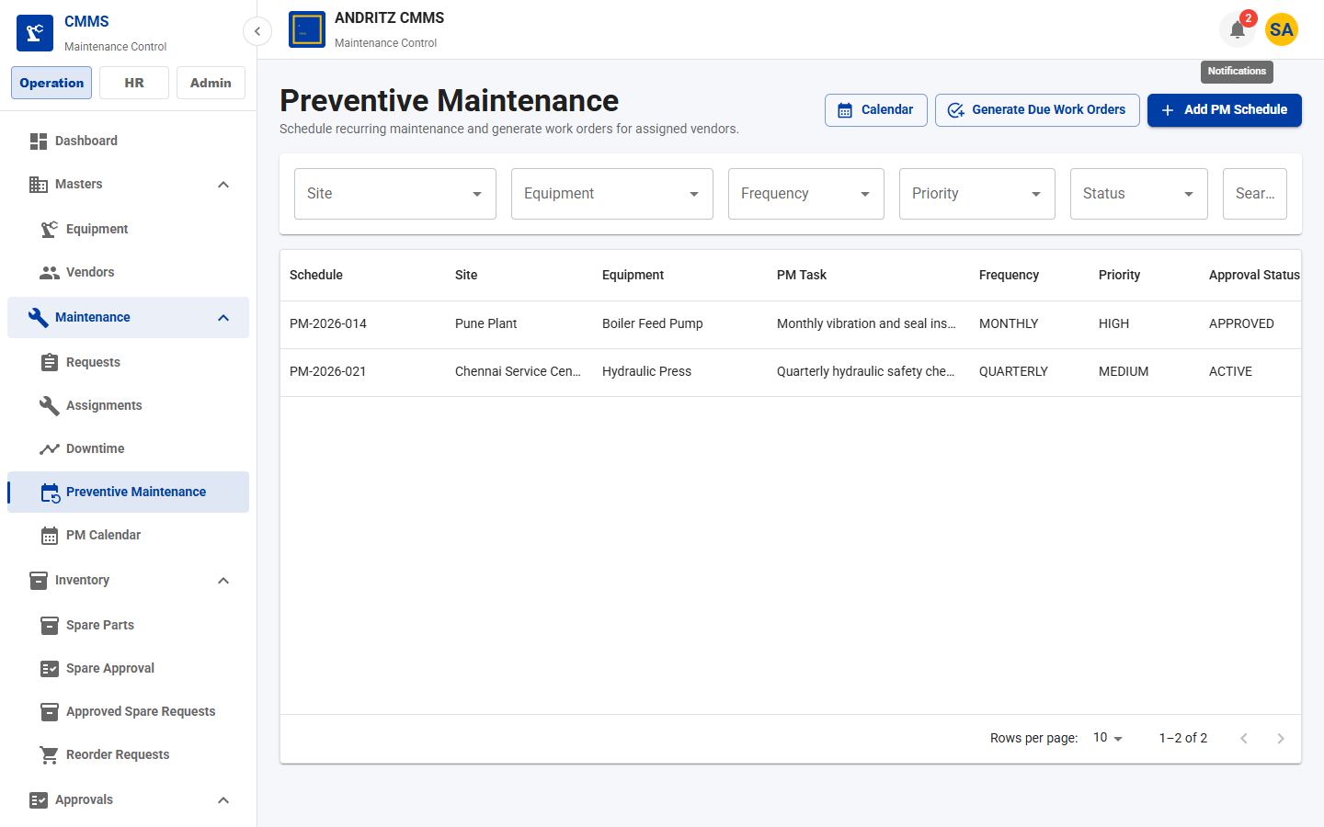
CMMS Application
ANDRITZ
Preventive Maintenance
Preventive Maintenance Enhancements
Enhancements
PM schedules by equipment/site
Checklist-driven execution
Due reminder notifications
Generated work orders
Status and completion percentage
Business Value
Moves maintenance from reactive to planned
Improves compliance and uptime
PM list supports due work generation, calendar access, status, and completion tracking.
CMMS Application Demo

Slide 61
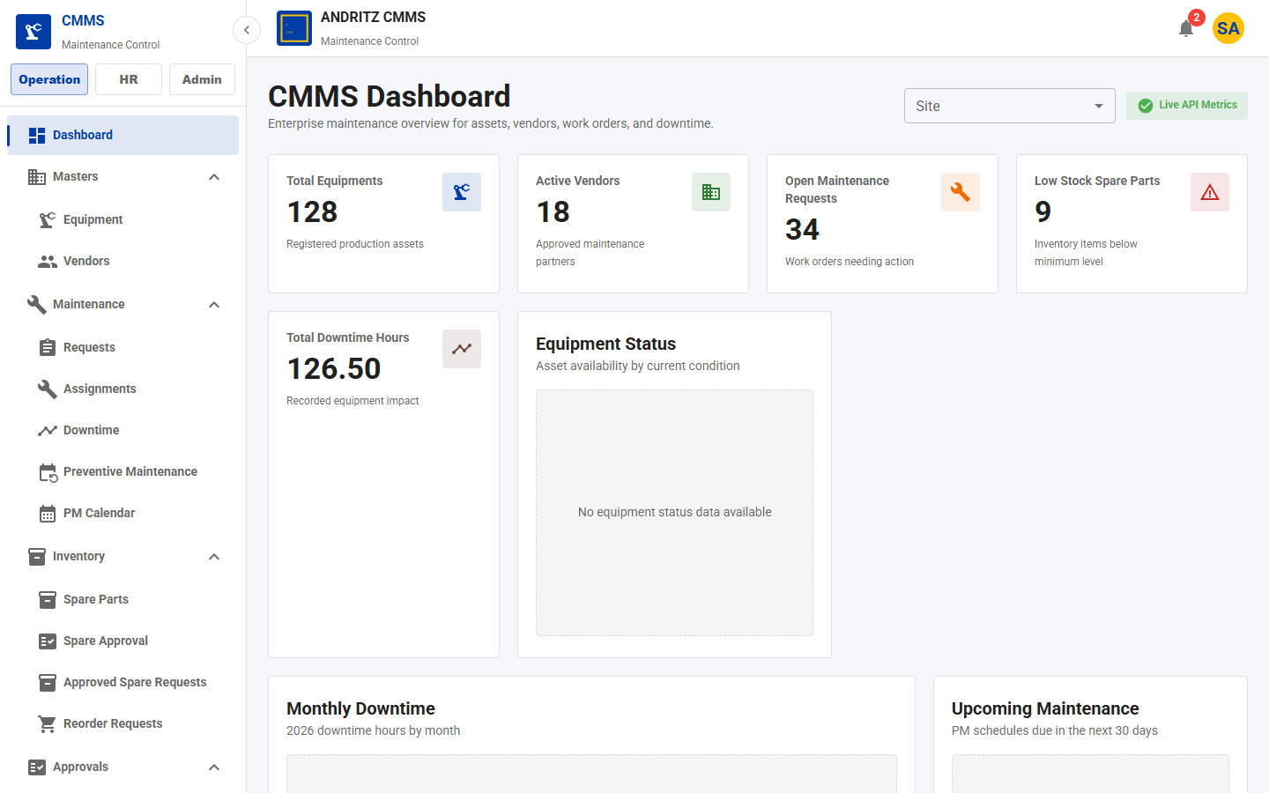
CMMS Application
ANDRITZ
Dashboard & Reports
Dashboard and Reporting Enhancements
Dashboard Indicators
Equipment count and status
Maintenance request status
Downtime summary
Low stock indicators
Site-aware KPI filtering
Reports
Equipment history report
Downtime analysis
Filterable views for management review
Dashboard summary cards and site filter provide quick operational status.
CMMS Application Demo

Slide 62
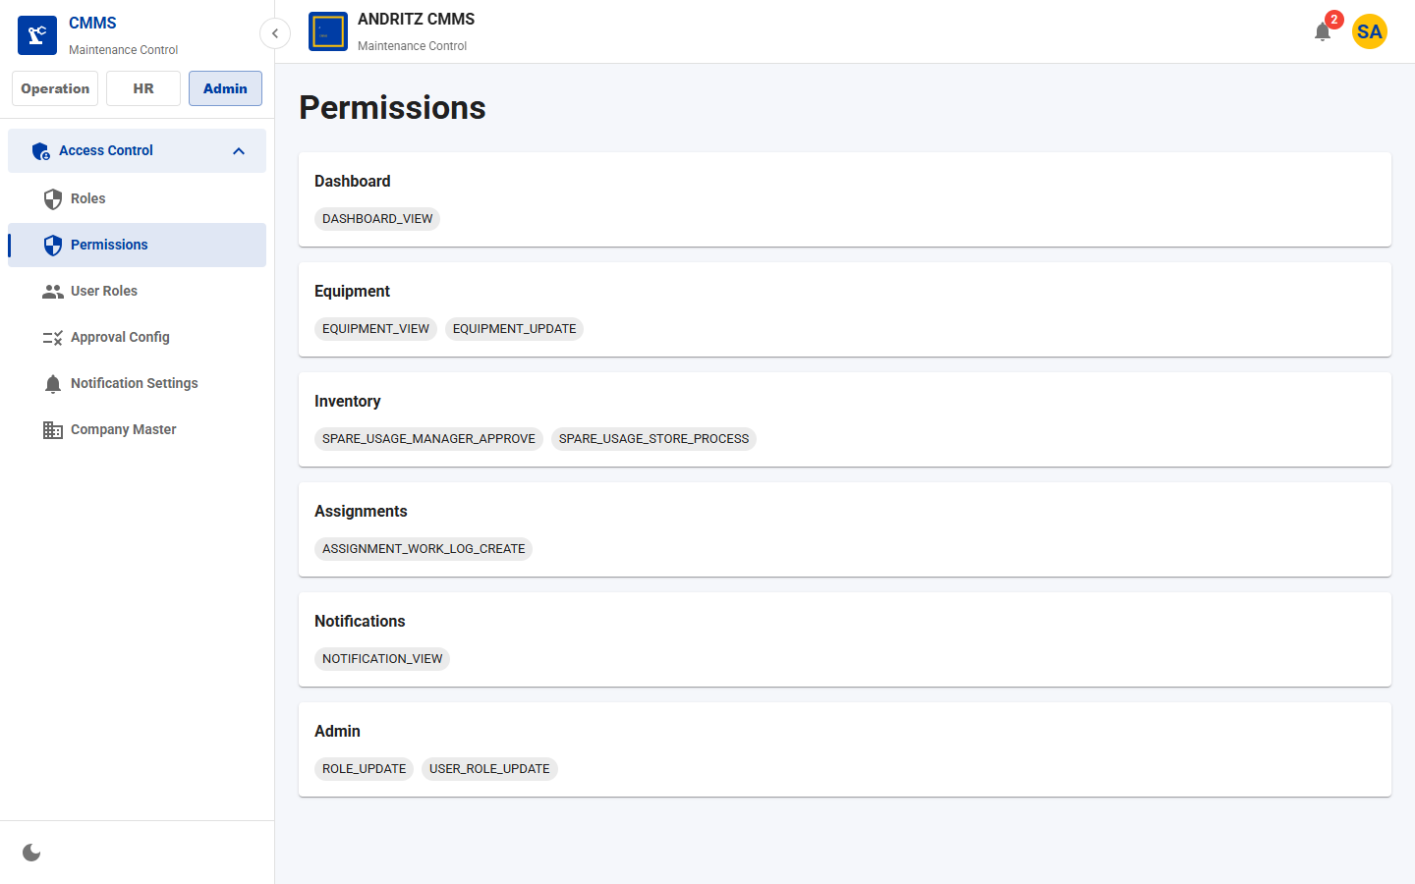
CMMS Application
ANDRITZ
Demo Evidence
Updated Application Screenshots
Permission catalog
Equipment list
Equipment view
Store spare workflow
Technician work log
Preventive maintenance
CMMS Application Demo

Slide 63
CMMS Application
ANDRITZ
Business Value
Benefits of the New Features
Governance
Centralized endpoint authorization
Least-privilege role control
Auditable approval decisions
Reliability
Preventive reminders reduce missed PM
Work logs improve closure quality
Downtime and history support RCA
Inventory Control
Closed-loop spare requests
Stock visibility before issue
Purchase escalation when unavailable
User Productivity
Common components standardize forms
Role-based navigation reduces clutter
Notifications bring work to the user
CMMS Application Demo

Slide 64
Roadmap
ANDRITZ
Future Enhancements
Potential Next Steps
• Mobile technician app
• QR-based asset scan flow
• Advanced predictive maintenance
• Deeper purchase integration
• Role-specific dashboards
• Exportable analytics packs
CMMS Application Demo
54

Slide 65
Thank You
CMMS Application Demo
Generated from current running application UI
CMMS Application Demo
55

