Slide 1
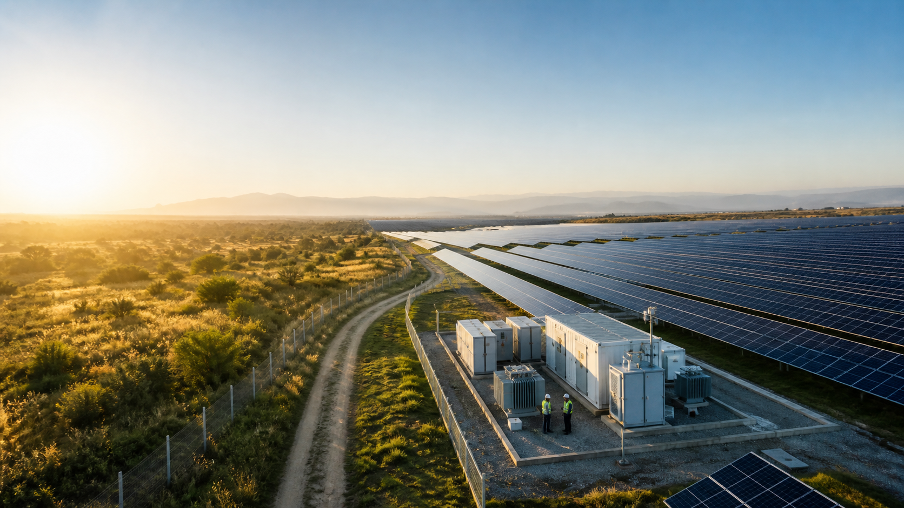
SOLAR OPERATIONS & MAINTENANCE
Solar Plant Maintenance
& Asset Management Platform
Improve maintenance visibility, equipment availability
and operational control—across every plant.
01
02
03
Centralize assets
Plan maintenance
Respond faster
A customer-focused view of the current product
SOLAR O&M | CURRENT PRODUCT CAPABILITIES
01

Slide 2
THE OPERATING REALITY
Solar O&M becomes complex long before the plant looks complex
Distributed assets, many hand-offs and fragmented records make routine maintenance harder to control.
AS
Thousands of distributed assets
PM
Preventive work gets missed
BR
Breakdowns live in calls and chats
Inverters, transformers, panels, trackers and auxiliaries spread across the plant.
Manual calendars and reminders create gaps in planned maintenance.
Issue ownership, priority and progress become difficult to trace.
DT
Downtime lacks a clear timeline
SP
Spares are found too late
MV
Management sees fragments
Start, restoration, verification and root cause are often recorded separately.
Stock, reservation, issue and consumption are not visible when work begins.
Excel, paper, calls and messages delay a reliable plant-level view.
The cost is not only downtime—it is slow decisions, weak accountability and lost maintenance knowledge.
SOLAR O&M | CURRENT PRODUCT CAPABILITIES
02

Slide 3
THE SOLUTION
One maintenance operating system for the complete asset lifecycle
A connected workflow turns plant events into controlled action and management visibility.
01
02
03
04
PLANT
ASSETS
MAINTENANCE
PLATFORM
O&M
TEAM
MANAGEMENT
VISIBILITY
Inverters • transformers
trackers • panels
Assets • work • spares
downtime • vendors
Managers • technicians
site & store teams
Dashboards • reports
history • cost
THE CONNECTED CONTROL LAYER
Structured records
Site-based access
Configurable approvals
Reminders & alerts
Traceable history
Role-aware dashboards
SOLAR O&M | CURRENT PRODUCT CAPABILITIES
03

Slide 4
ASSET FOUNDATION
Build a complete, searchable equipment registry
Create a structured operating record for every maintainable asset at every solar plant.
SOLAR ASSET UNIVERSE
ONE STRUCTURED ASSET RECORD
PV
PV modules
SI
String inverters
CI
Central inverters
TR
Transformers
INV-01 • CENTRAL INVERTER
Identity
Code • type • serial • location
SW
HT/LT & switchgear
TK
Trackers
WS
Weather stations
AU
UPS & auxiliaries
Lifecycle
Commissioning • warranty • status
Context
Site • vendor • criticality • owner
Economics
Purchase • maintenance • TCO
Evidence
Documents • spare BOM • AMC
SEARCHABLE • SITE-SCOPED • AUDITABLE
Business value: faster identification, consistent records and a reliable base for every maintenance workflow.
SOLAR O&M | CURRENT PRODUCT CAPABILITIES
04

Slide 5
PLAN BEFORE FAILURE
Turn preventive maintenance into a repeatable operating rhythm
Schedules, reminders, work orders and checklists keep planned activity visible from due date to completion.
1
2
3
4
5
6
Equipment
PM schedule
Due reminder
Work order
Checklist
History
INV-01
Monthly
In-app / email
Auto-generated
Text • number • photo
Completed work
DAILY
WEEKLY
MONTHLY
QUARTERLY
YEARLY
Calendar view • upcoming work • completion % • generated vs completed work orders
PLAN
Less missed maintenance
RELY
More reliable equipment
PROVE
Checklist-backed completion
SOLAR O&M | CURRENT PRODUCT CAPABILITIES
05

Slide 6
RESPOND WITH CONTROL
Replace calls and chat threads with a formal breakdown workflow
Every issue gets an asset, site, priority, owner, target date and auditable status.
SOLAR EVENT
1
Record
2
Assign
3
Start
Type • priority • description
Employee or vendor
Responsibility is clear
INV-01
Central inverter
not available
4
Work
5
Complete
6
Close
Hold / resume if needed
Action and evidence
Optional approval gate
Create a maintenance request
Result
A single queue for open, assigned, in-progress, on-hold, completed and closed work—with approval history where configured.
SOLAR O&M | CURRENT PRODUCT CAPABILITIES
06

Slide 7
FIELD ACCOUNTABILITY
Make every assignment clear—and every intervention traceable
Technicians and external vendors work from a defined job, plan, checklist and evidence trail.
FROM RESPONSIBILITY TO PROOF
WORK LOG
JOB
PLAN
DO
LOG
PROOF
Technician
Employee responsibility
Assignment
Plan
Execute
Work log
Evidence
Time
Actual start and end
Asset • request • owner
Planned start / end
Checklist responses
Start / end • notes
Checklist proof • files
Finding
Issue identified
Action
Work performed
CLEAR OWNER
REAL DURATION
AUDIT TRAIL
Outcome
Completion status
Know who is responsible
Compare plan vs actual
Retain intervention evidence
Evidence
Supporting attachments
Accountability without ambiguity
SOLAR O&M | CURRENT PRODUCT CAPABILITIES
07

Slide 8
CONTROL RESTORATION
Give every downtime event a start, a story and a verified end
The product records duration, status history, cause and corrective actions—without claiming SCADA or generation telemetry.
DOWNTIME LIFECYCLE
1
2
3
4
5
6
OPEN
CONFIRM
MAINTAIN
RESTORE
VERIFY
CLOSE
Failure recorded
Event confirmed
Under maintenance
Asset restored
Operation verified
Event closed
What the team captures
Management can identify
Start / end / duration
Planned vs unplanned
Reason category & code
• Repeated failures
• High-downtime assets
• Restoration bottlenecks
• Open RCA actions
Root cause & remarks
Linked maintenance request
Timeline & reopen history
NO AUTOMATIC GENERATION-LOSS CLAIM
SOLAR O&M | CURRENT PRODUCT CAPABILITIES
08

Slide 9
KEEP MAINTENANCE MOVING
Connect spare availability to the work that needs it
Site stock, approvals, reservation, issue, consumption and reorder history reduce the “part not available” surprise.
REQUEST
APPROVE
CHECK
RESERVE
ISSUE
CONSUME / RETURN
ILLUSTRATIVE SITE STOCK SNAPSHOT
INVENTORY CONTROL ALREADY CONNECTED
FU
FUSE
CO
CONTACTOR
Site stock
Movement history
20 PCS
10 PCS
Current • reserved • available • minimum
Stock-in • adjust • transfer • issue
Replenishment
Maintenance context
IN
INVERTER FAN
DC
DC CONNECTOR
Low-stock alert • reorder • receive
Assignment • request • equipment
5 PCS
50 PCS
Equipment BOM
Cost traceability
Recommended quantity by asset
Unit cost • material consumption
Business value: fewer maintenance delays, better stock discipline and a complete record of what was used—where and why.
SOLAR O&M | CURRENT PRODUCT CAPABILITIES
09

Slide 10
COORDINATE EXTERNAL SUPPORT
Manage vendors and AMC coverage as part of maintenance—not beside it
Centralize service contacts, plant associations, equipment coverage, contract terms and renewal history.
SERVICE PARTNER
AMC CONTRACT
MANAGEMENT
Vendor master
Coverage that follows the asset
Stay ahead of coverage risk
Contact person & communication
TERM Start / end / status
Active / expiring / expired contracts
1
Service category
SLA Response & resolution hours
2
Contract value and covered equipment
Assigned plants
COVER Labour • spares • scope
3
Upcoming PM under AMC
MAP Equipment covered
Linked AMC contracts
4
Vendor performance visibility
PM Linked PM schedules
Maintenance assignments
5
Expiry alerts and dashboard
RENEW Renewal chain preserves history
One view of the partner relationship
SOLAR O&M | CURRENT PRODUCT CAPABILITIES
10

Slide 11
SCALE WITH THE PORTFOLIO
Operate multiple plants from one controlled environment
Assets, people, vendors, work and dashboards remain site-aware—while leadership gains a portfolio view.
ILLUSTRATIVE PORTFOLIO
SOLAR O&M ORGANIZATION
A
PLANT A
B
PLANT B
C
PLANT C
100 MW
50 MW
200 MW
Site assets
Local users
Work & stock
Site assets
Local users
Work & stock
Site assets
Local users
Work & stock
Site-scoped access • shared standards • portfolio dashboards • cross-site inventory transfer
SOLAR O&M | CURRENT PRODUCT CAPABILITIES
11

Slide 12
GOVERN RESPONSIBILITY
Give every role the access—and approval responsibility—it needs
Granular permissions protect each plant while configurable approvals add control to critical actions.
SUPPORTED OPERATING ROLES
CONFIGURABLE APPROVAL GATES
SA
Super Admin
AD
Admin
PM
PM schedule create / update
Full portfolio control
Administration across sites
Optional maintenance-manager gate
HR
HR Admin
SM
Site Manager
WO
PM work-order generation
Sites & employees
Assigned-site operations
Optional approval before release
MM
Maintenance Manager
TE
Technician
Request create / close
Maintenance & approvals
Assigned work execution
MR
Control entry and closure
VI
Viewer
Spare reserve / issue
Read-only visibility
SP
Protect inventory movement
Request → Inbox → Approve / Reject → History
SOLAR O&M | CURRENT PRODUCT CAPABILITIES
12

Slide 13
ACT BEFORE WORK IS FORGOTTEN
Convert due dates and risk conditions into actionable alerts
A role-aware notification center can deliver verified product events through in-app and email channels.
PM
Preventive maintenance due
AMC
AMC expiring or expired
NOTIFICATION
CENTER
OD
Maintenance request overdue
LS
Spare part low stock
AP
Approval pending
ROLE-AWARE DELIVERY
In-app center • unread status • email option • direct link to the record
ONLY VERIFIED ALERT TYPES SHOWN
SOLAR O&M | CURRENT PRODUCT CAPABILITIES
13

Slide 14
SEE THE WORK—WITHOUT CHASING UPDATES
Turn daily maintenance activity into management visibility
Role-aware dashboards surface operational priorities; reports support deeper equipment, downtime and cost analysis.
DASHBOARD VISIBILITY
ANALYSIS & REPORTING
EQ Total equipment
RQ Open requests
HISTORY
Equipment history
Requests • assignments • downtime
DT Downtime hours
LS Low-stock spares
Downtime analysis
Planned / unplanned • duration
DOWNTIME
PM Upcoming PM
VP Vendor performance
COST
Equipment maintenance cost
Maintenance • spares • downtime
AS Assignment queue
AMC Active AMC contracts
TCO
Cost groupings
Site • category • criticality • TCO
ROLE-AWARE WIDGETS
Management, maintenance, technician and inventory views surface the queues each team can act on.
Decide with a shared operational picture—not a manually assembled spreadsheet.
SOLAR O&M | CURRENT PRODUCT CAPABILITIES
14

Slide 15
ASSET INTELLIGENCE
Select one asset—and understand its complete maintenance context
The equipment view and linked reports bring reliability, maintenance, downtime, coverage, evidence and cost together.
COS
COST
SPA
SPARES
Purchase • maintenance • spares • TCO
Equipment BOM and site stock links
PRO
PROFILE
AMC
AMC
Identity • lifecycle • documents
INV-01
Active coverage and contract history
CENTRAL
INVERTER
HEA
HEALTH
DOW
DOWNTIME
Score • MTBF • MTTR • repeat failures
One asset • one operating context
This month • last event • reason
REQ
REQUESTS
PM
PM
Open work and equipment history
Active schedules • next due • last maintenance
ONE ASSET. ONE MAINTENANCE CONTEXT. ONE SOURCE OF TRUTH.
SOLAR O&M | CURRENT PRODUCT CAPABILITIES
15

Slide 16
THE TRANSFORMATION
Move from fragmented maintenance to controlled plant operations
A visual before-and-after for the day-to-day reality of solar O&M.
BEFORE
AFTER
Maintenance by memory
Maintenance with control
XL
Excel asset lists
AR
Centralized asset records
PP
Paper registers
→
WF
Structured request-to-close workflow
CL
Calls for assignment
PM
Scheduled preventive maintenance
WA
WhatsApp status updates
OW
Clear responsibility & evidence
RM
Manual reminders
DT
Downtime and RCA visibility
SC
Scattered vendor & work records
BI
Management dashboards & reports
Slow hand-offs • unclear ownership • weak history
Shared visibility • faster decisions • retained knowledge
SOLAR O&M | CURRENT PRODUCT CAPABILITIES
16

Slide 17
BUSINESS OUTCOMES
Create a stronger operating system for solar O&M
The value comes from disciplined execution, better information and reusable maintenance knowledge—not invented percentage claims.
01
Improve equipment availability
Plan work earlier and restore assets through a controlled process.
02
Reduce response delays
Move issues quickly from record to priority, owner and action.
03
Strengthen PM compliance
Use calendars, due reminders and auto-generated work orders.
04
Increase accountability
Retain responsibility, timing, findings, action and evidence.
05
Improve downtime visibility
Analyze duration, repeat failures, timelines and root cause.
06
Plan spares with context
See site stock, reservations, consumption, reorders and equipment BOM.
07
Control external service
Link vendors, AMC coverage, equipment, SLAs and renewals.
08
Standardize every plant
Apply one workflow while preserving site-level access and ownership.
09
Improve management visibility
Use role-aware dashboards and equipment, downtime and cost reports.
10
Build long-term asset knowledge
Preserve the maintenance context needed for better future decisions.
SOLAR O&M | CURRENT PRODUCT CAPABILITIES
17

Slide 18
THE VALUE PROPOSITION
Smarter Maintenance.
Higher Equipment Availability.
Better Solar Plant Operations.
A maintenance platform built for operational control
• Assets and equipment health
• Preventive and corrective work
• Assignments, logs and evidence
• Downtime, RCA and restoration
• Spares, vendors and AMC
• Dashboards, reports and approvals
ASSETS
MAINTENANCE
RESPONSE
Centralize
Plan
Accelerate
DOWNTIME
SPARES
VISIBILITY
READY FOR THE SALES CONVERSATION
Understand
Control
Improve
SOLAR O&M | CURRENT PRODUCT CAPABILITIES
18

