Slide 1

ANDRITZ CMMS
All Pages Team Demo Walkthrough
Fresh screenshots from the current frontend routes with page-by-page explanation for internal demonstration.
44 routed screens captured and documented.

Slide 2
CMMS Application
TEAM DEMO
OVERVIEW
Page Coverage
Foundation
Login, dashboard, company, site, employee, user-role setup
Masters
Equipment and vendor list, create/edit, and view pages
Maintenance
Requests, assignments, work logs, checklist, downtime, PM
Inventory
Spare parts, approvals, store workflow, and reorders
Governance
Roles, permissions, approval config, notifications, reports
All Pages Screenshot Walkthrough
2

Slide 3
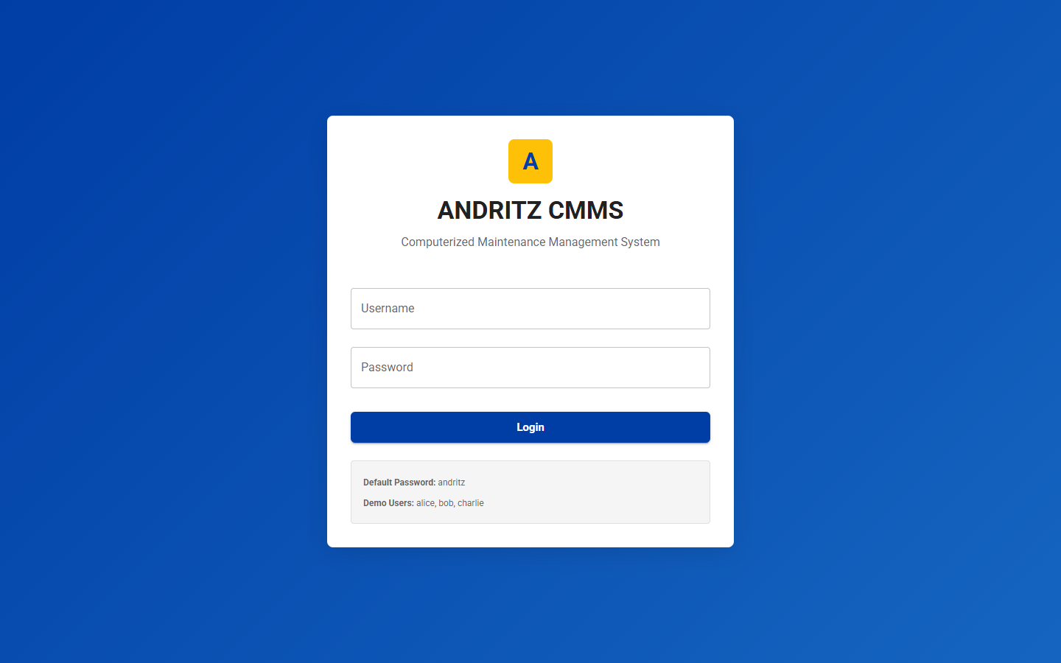
CMMS Application
TEAM DEMO
PAGE 1
Login Page
Purpose
User authentication screen for entering the CMMS application.
Demo Talk Track
Explain what the user can view, create, update, approve, or track on the Login Page page.
Value
Shows how this page supports day-to-day CMMS operations and team accountability.
All Pages Screenshot Walkthrough
3

Slide 4
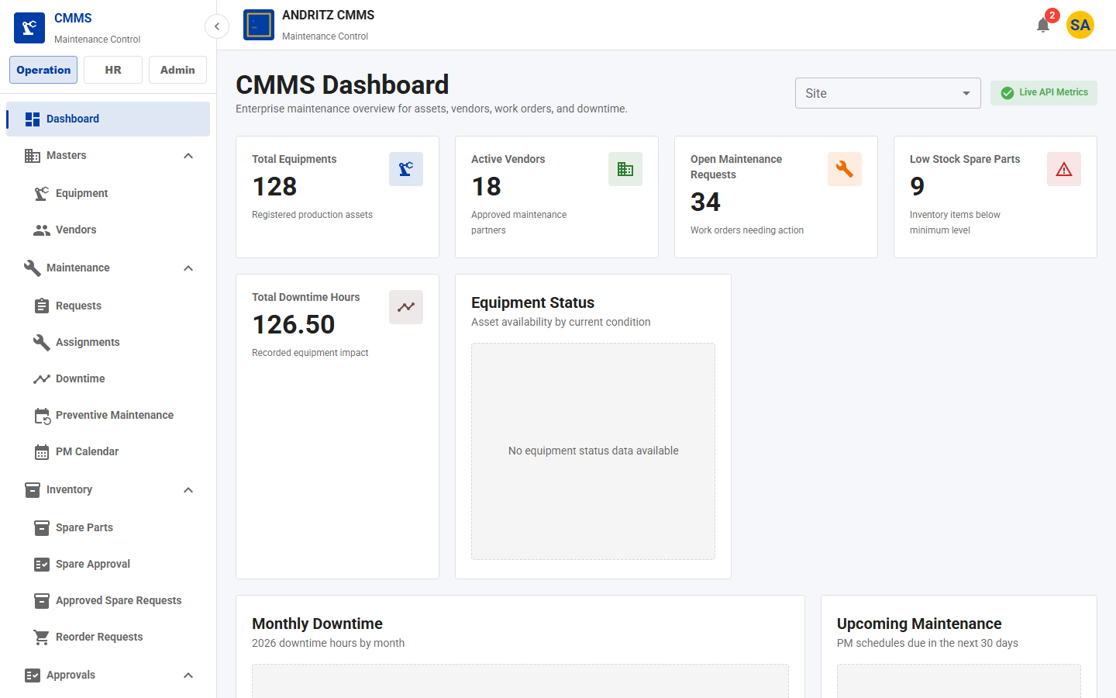
CMMS Application
TEAM DEMO
PAGE 2
Dashboard
Purpose
Executive overview of assets, requests, downtime, vendors, and low-stock indicators.
Demo Talk Track
Explain what the user can view, create, update, approve, or track on the Dashboard page.
Value
Shows how this page supports day-to-day CMMS operations and team accountability.
All Pages Screenshot Walkthrough
4

Slide 5
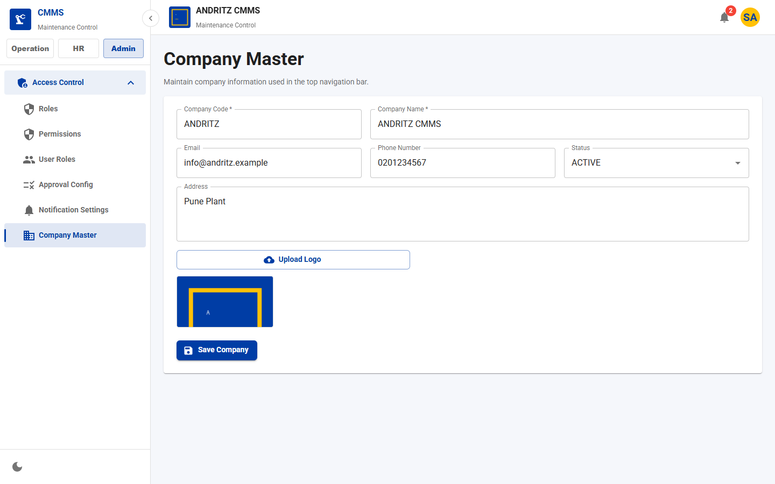
CMMS Application
TEAM DEMO
PAGE 3
Company Master
Purpose
Maintains company profile, logo, and branding shown in the application shell.
Demo Talk Track
Explain what the user can view, create, update, approve, or track on the Company Master page.
Value
Shows how this page supports day-to-day CMMS operations and team accountability.
All Pages Screenshot Walkthrough
5

Slide 6
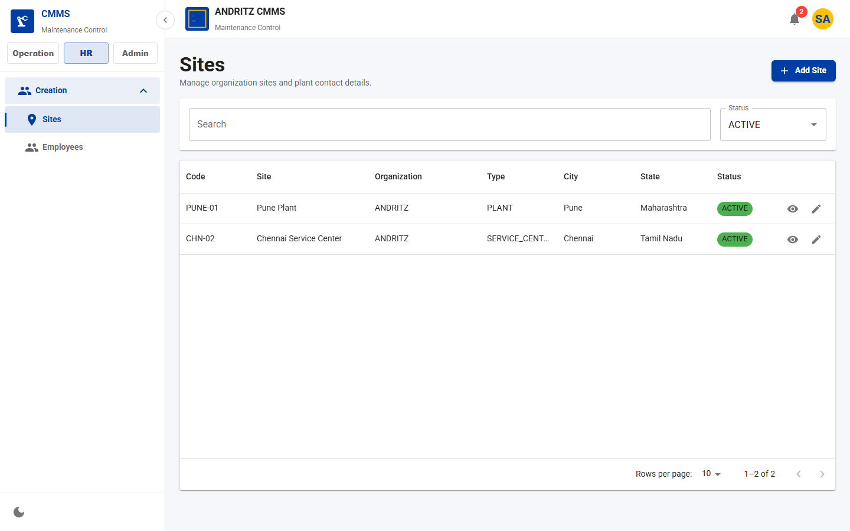
CMMS Application
TEAM DEMO
PAGE 4
Site List
Purpose
Manage plants, warehouses, service centers, and location status.
Demo Talk Track
Explain what the user can view, create, update, approve, or track on the Site List page.
Value
Shows how this page supports day-to-day CMMS operations and team accountability.
All Pages Screenshot Walkthrough
6

Slide 7
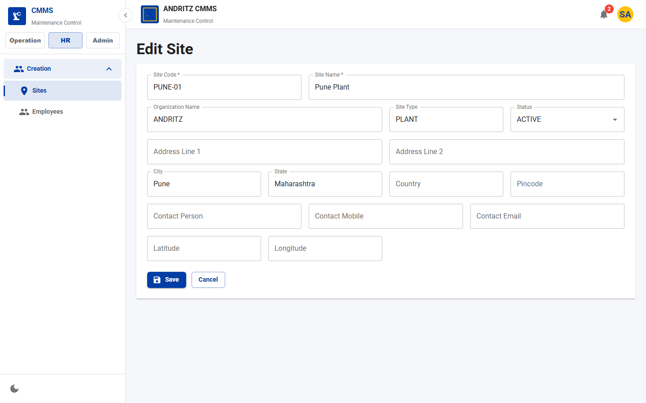
CMMS Application
TEAM DEMO
PAGE 5
Site Form
Purpose
Create or update site master details used across assets, requests, and inventory.
Demo Talk Track
Explain what the user can view, create, update, approve, or track on the Site Form page.
Value
Shows how this page supports day-to-day CMMS operations and team accountability.
All Pages Screenshot Walkthrough
7

Slide 8
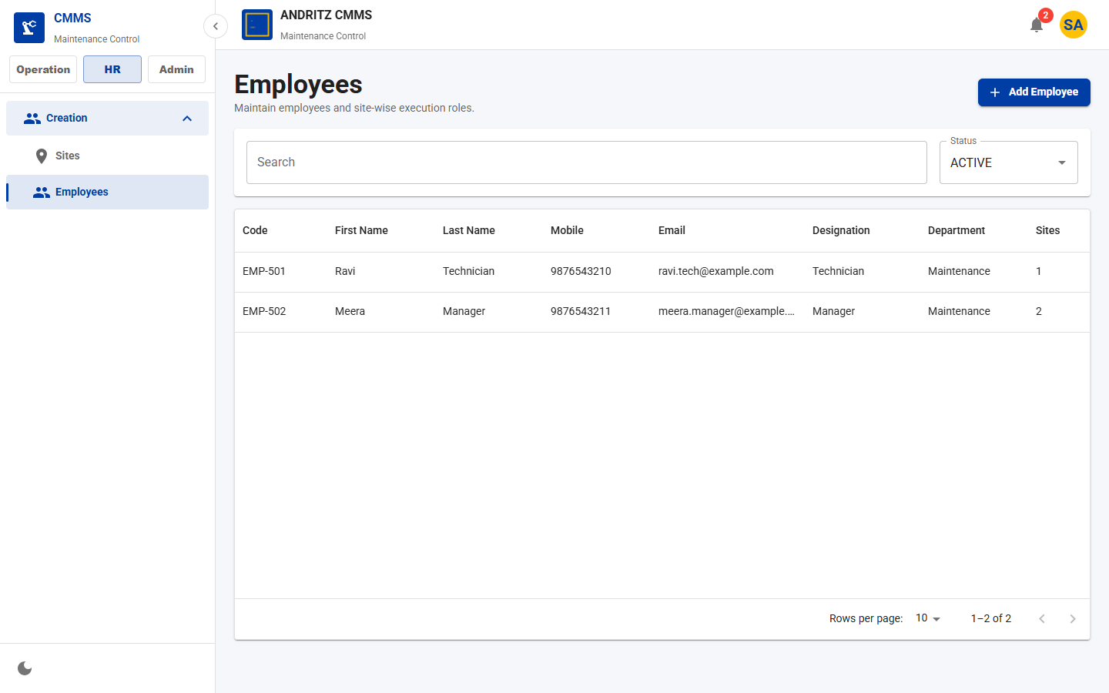
CMMS Application
TEAM DEMO
PAGE 6
Employee List
Purpose
Maintain employees and inspect site-wise workforce records.
Demo Talk Track
Explain what the user can view, create, update, approve, or track on the Employee List page.
Value
Shows how this page supports day-to-day CMMS operations and team accountability.
All Pages Screenshot Walkthrough
8

Slide 9
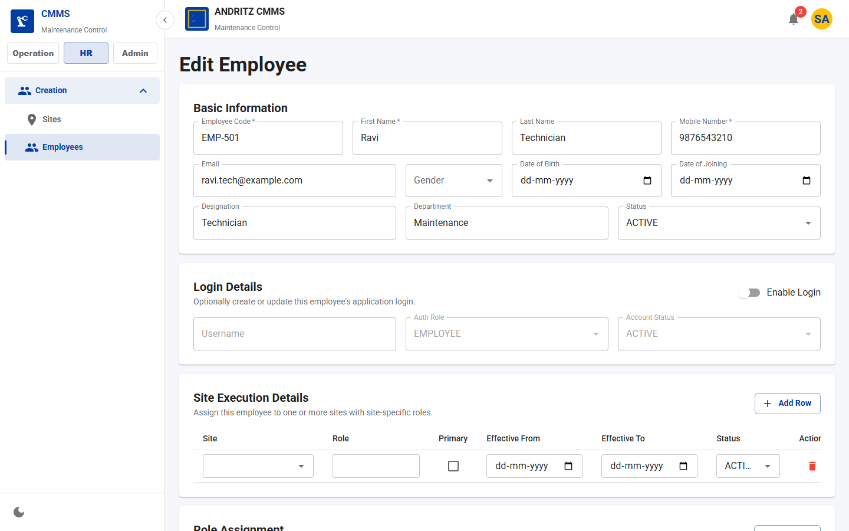
CMMS Application
TEAM DEMO
PAGE 7
Employee Form
Purpose
Create or update employee information for assignment and site access.
Demo Talk Track
Explain what the user can view, create, update, approve, or track on the Employee Form page.
Value
Shows how this page supports day-to-day CMMS operations and team accountability.
All Pages Screenshot Walkthrough
9

Slide 10
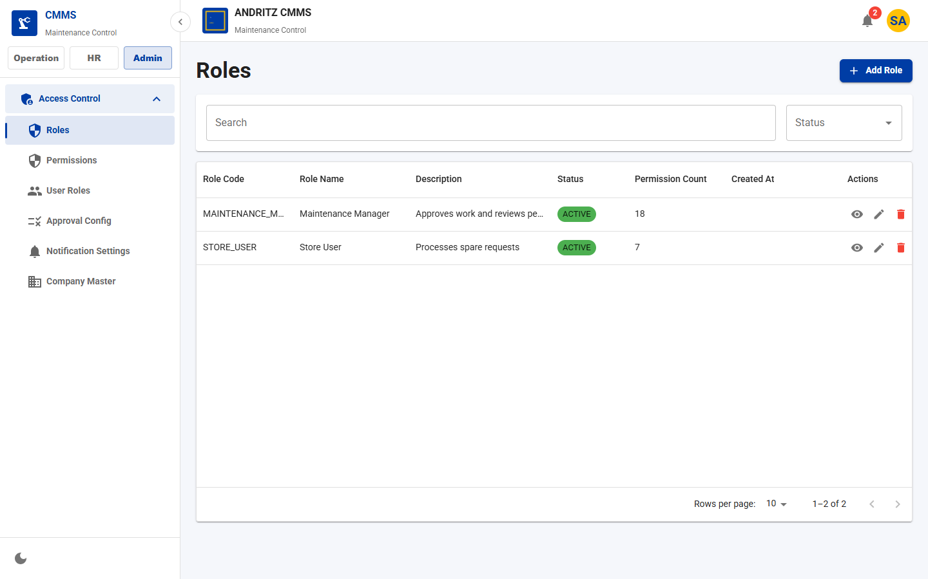
CMMS Application
TEAM DEMO
PAGE 8
Role List
Purpose
Review configured roles and permission counts.
Demo Talk Track
Explain what the user can view, create, update, approve, or track on the Role List page.
Value
Shows how this page supports day-to-day CMMS operations and team accountability.
All Pages Screenshot Walkthrough
10

Slide 11
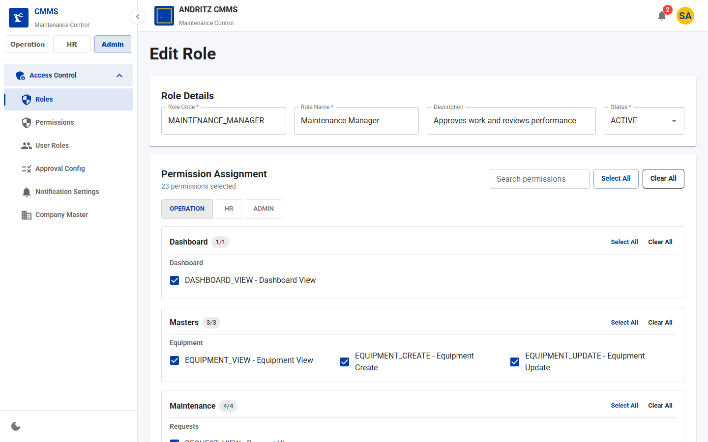
CMMS Application
TEAM DEMO
PAGE 9
Role Form
Purpose
Assign permissions to application roles by operation, HR, and admin categories.
Demo Talk Track
Explain what the user can view, create, update, approve, or track on the Role Form page.
Value
Shows how this page supports day-to-day CMMS operations and team accountability.
All Pages Screenshot Walkthrough
11

Slide 12
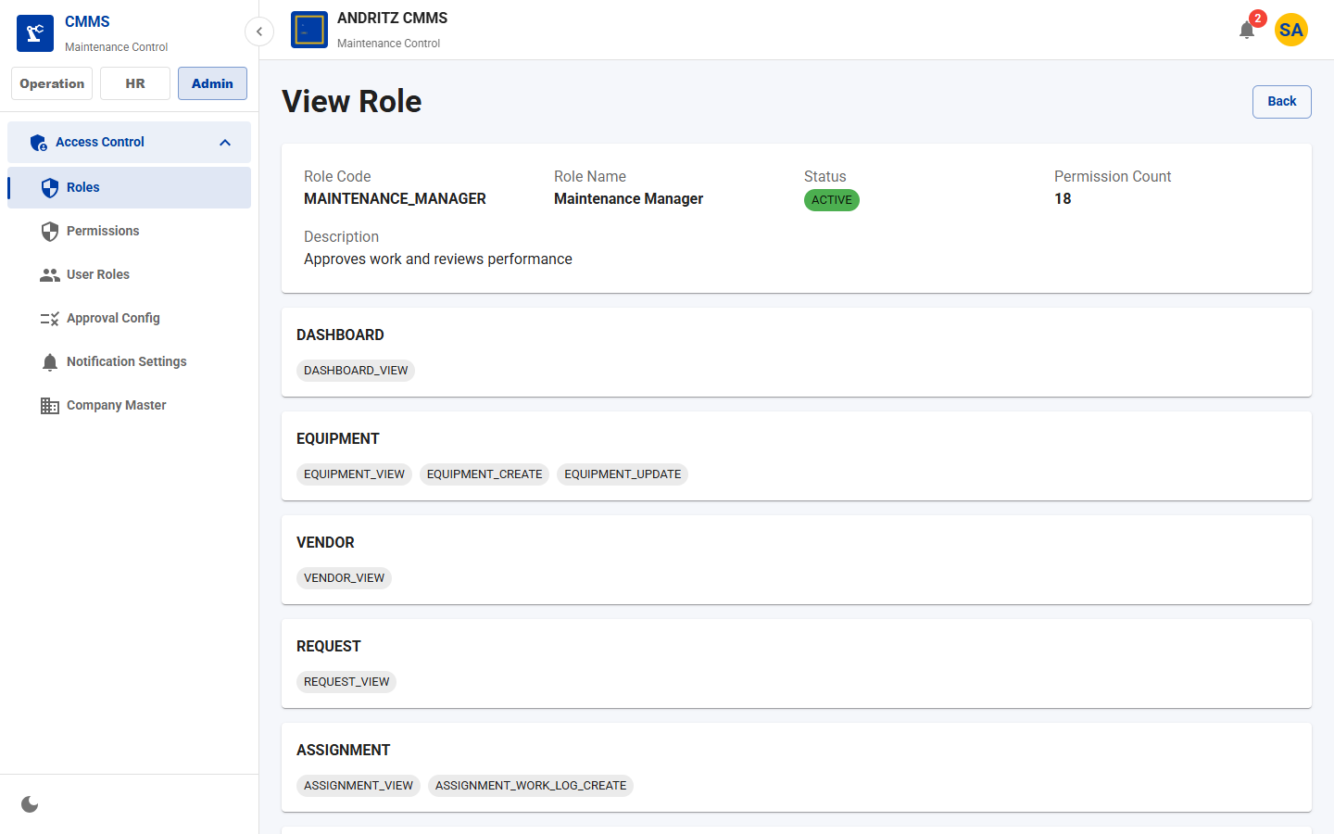
CMMS Application
TEAM DEMO
PAGE 10
Role View
Purpose
Read-only role permission review page.
Demo Talk Track
Explain what the user can view, create, update, approve, or track on the Role View page.
Value
Shows how this page supports day-to-day CMMS operations and team accountability.
All Pages Screenshot Walkthrough
12

Slide 13
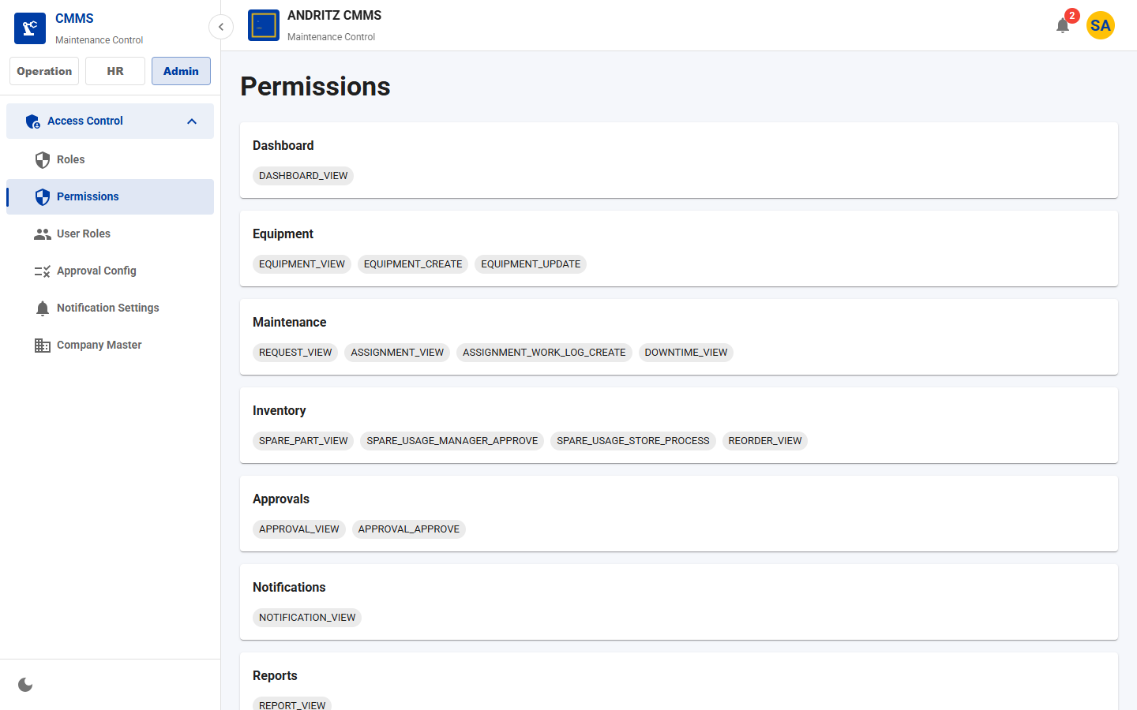
CMMS Application
TEAM DEMO
PAGE 11
Permissions
Purpose
Permission catalog grouped by module.
Demo Talk Track
Explain what the user can view, create, update, approve, or track on the Permissions page.
Value
Shows how this page supports day-to-day CMMS operations and team accountability.
All Pages Screenshot Walkthrough
13

Slide 14
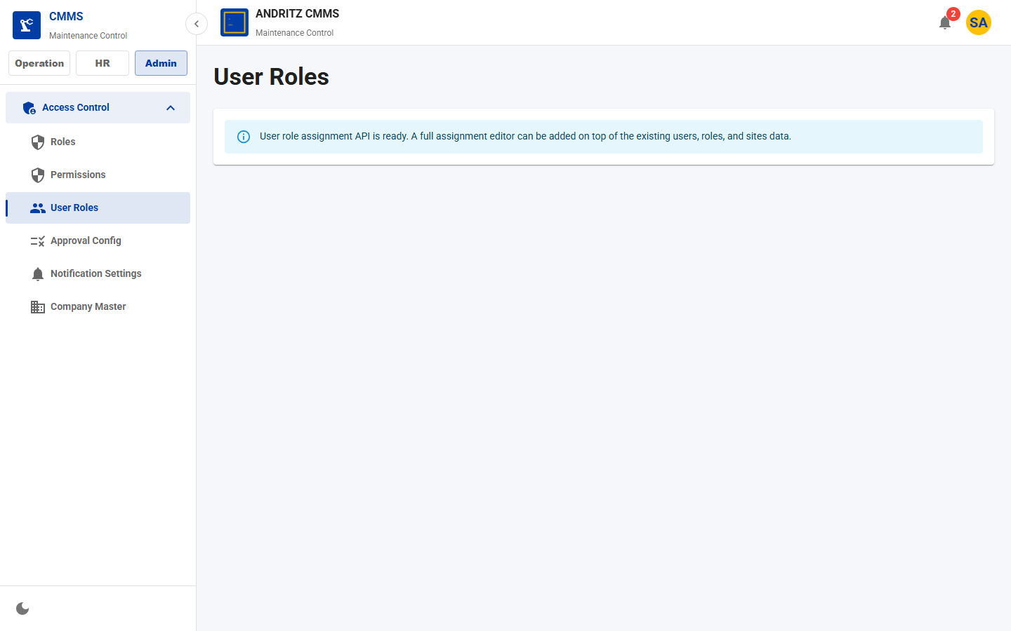
CMMS Application
TEAM DEMO
PAGE 12
User Role Assignment
Purpose
Map users to roles and site-specific access.
Demo Talk Track
Explain what the user can view, create, update, approve, or track on the User Role Assignment page.
Value
Shows how this page supports day-to-day CMMS operations and team accountability.
All Pages Screenshot Walkthrough
14

Slide 15
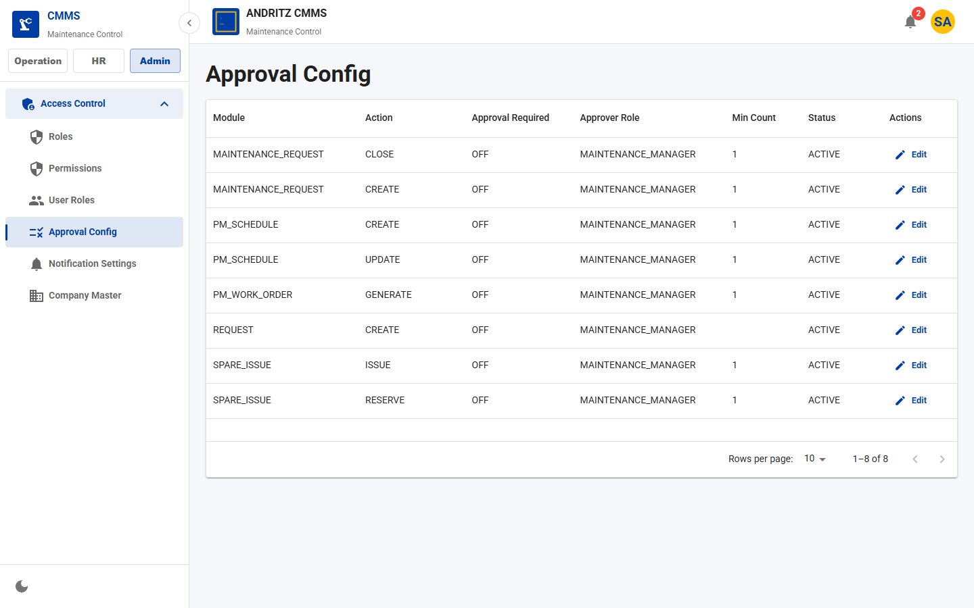
CMMS Application
TEAM DEMO
PAGE 13
Approval Configuration
Purpose
Configure which workflow events require approval and which role approves.
Demo Talk Track
Explain what the user can view, create, update, approve, or track on the Approval Configuration page.
Value
Shows how this page supports day-to-day CMMS operations and team accountability.
All Pages Screenshot Walkthrough
15

Slide 16
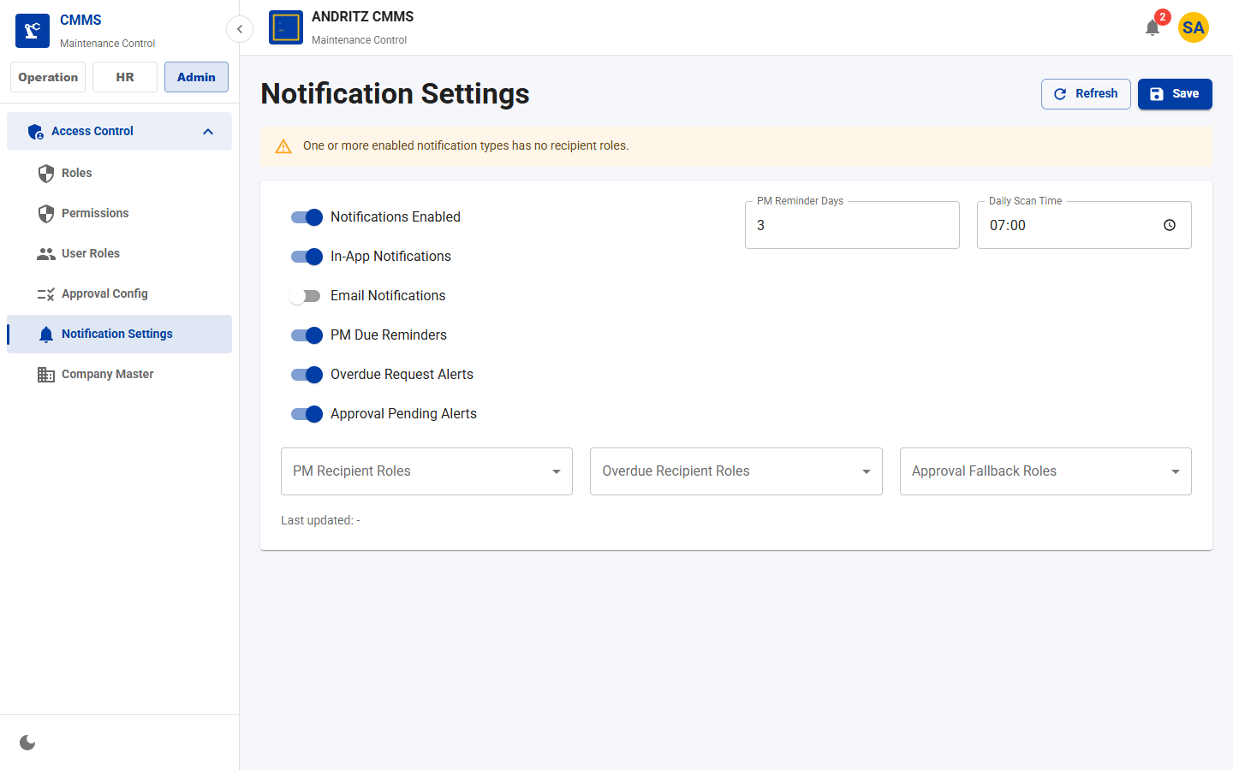
CMMS Application
TEAM DEMO
PAGE 14
Notification Settings
Purpose
Configure in-app/email notification behavior, reminder windows, and scan timing.
Demo Talk Track
Explain what the user can view, create, update, approve, or track on the Notification Settings page.
Value
Shows how this page supports day-to-day CMMS operations and team accountability.
All Pages Screenshot Walkthrough
16

Slide 17
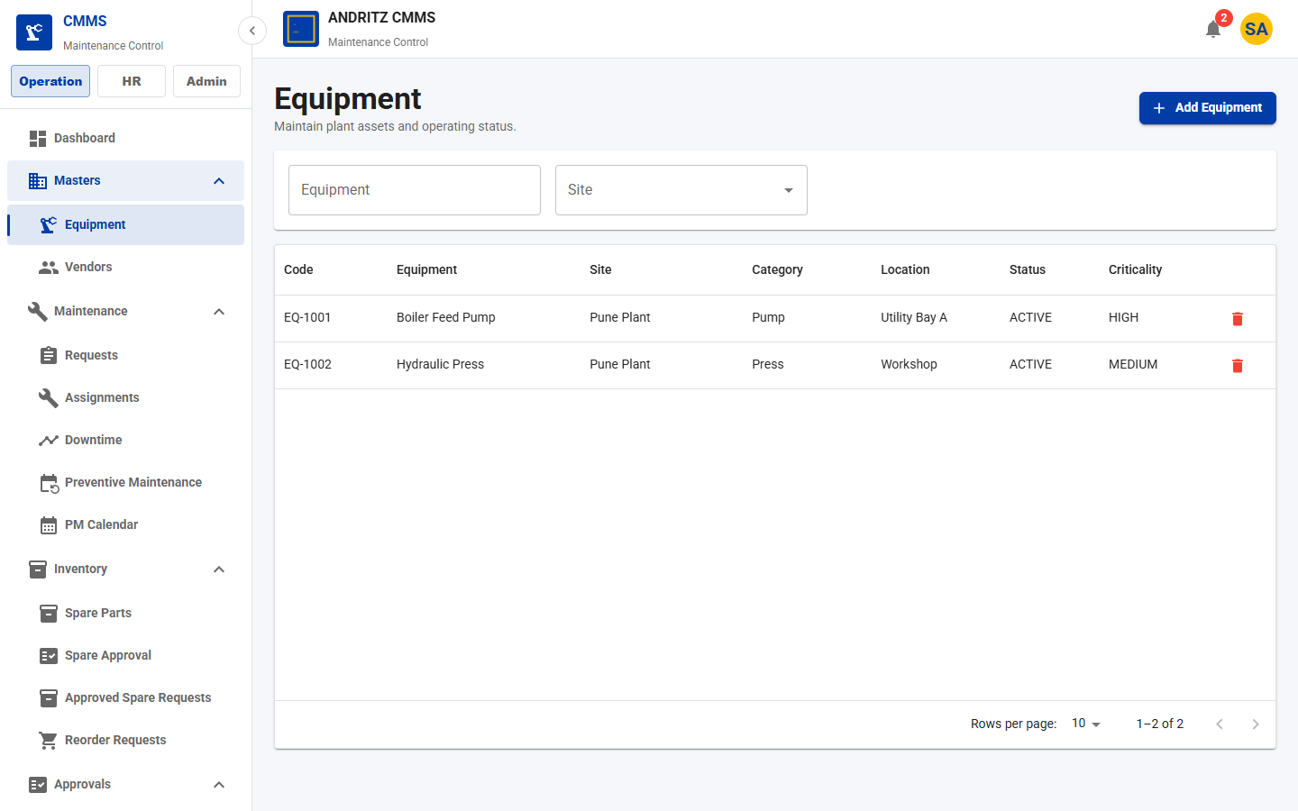
CMMS Application
TEAM DEMO
PAGE 15
Equipment List
Purpose
Search and manage maintainable plant assets.
Demo Talk Track
Explain what the user can view, create, update, approve, or track on the Equipment List page.
Value
Shows how this page supports day-to-day CMMS operations and team accountability.
All Pages Screenshot Walkthrough
17

Slide 18
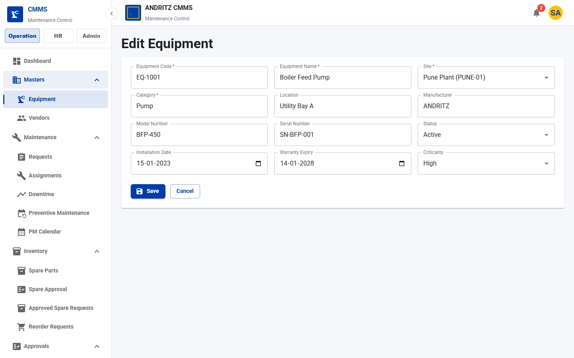
CMMS Application
TEAM DEMO
PAGE 16
Equipment Form
Purpose
Create or update equipment technical and lifecycle details.
Demo Talk Track
Explain what the user can view, create, update, approve, or track on the Equipment Form page.
Value
Shows how this page supports day-to-day CMMS operations and team accountability.
All Pages Screenshot Walkthrough
18

Slide 19
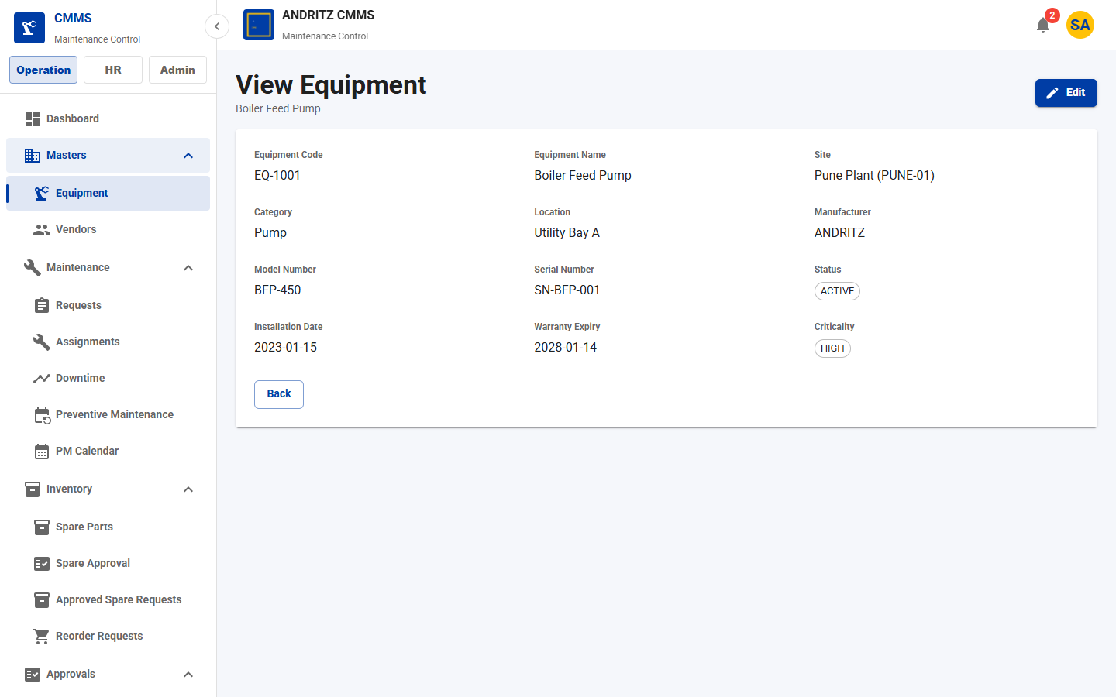
CMMS Application
TEAM DEMO
PAGE 17
Equipment View
Purpose
Read-only equipment detail view with protected edit action.
Demo Talk Track
Explain what the user can view, create, update, approve, or track on the Equipment View page.
Value
Shows how this page supports day-to-day CMMS operations and team accountability.
All Pages Screenshot Walkthrough
19

Slide 20
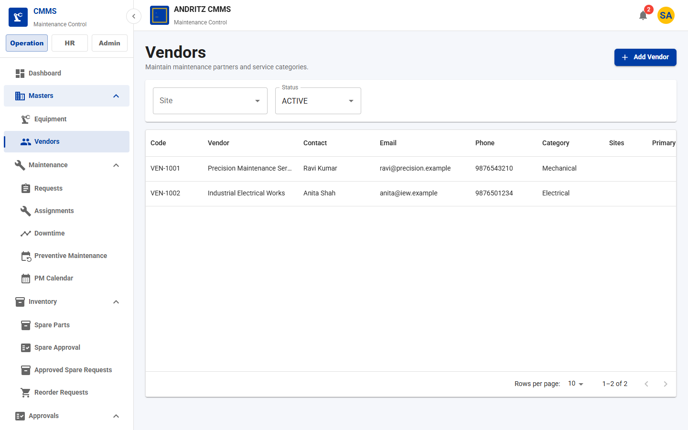
CMMS Application
TEAM DEMO
PAGE 18
Vendor List
Purpose
Manage approved maintenance vendors and contractors.
Demo Talk Track
Explain what the user can view, create, update, approve, or track on the Vendor List page.
Value
Shows how this page supports day-to-day CMMS operations and team accountability.
All Pages Screenshot Walkthrough
20

Slide 21
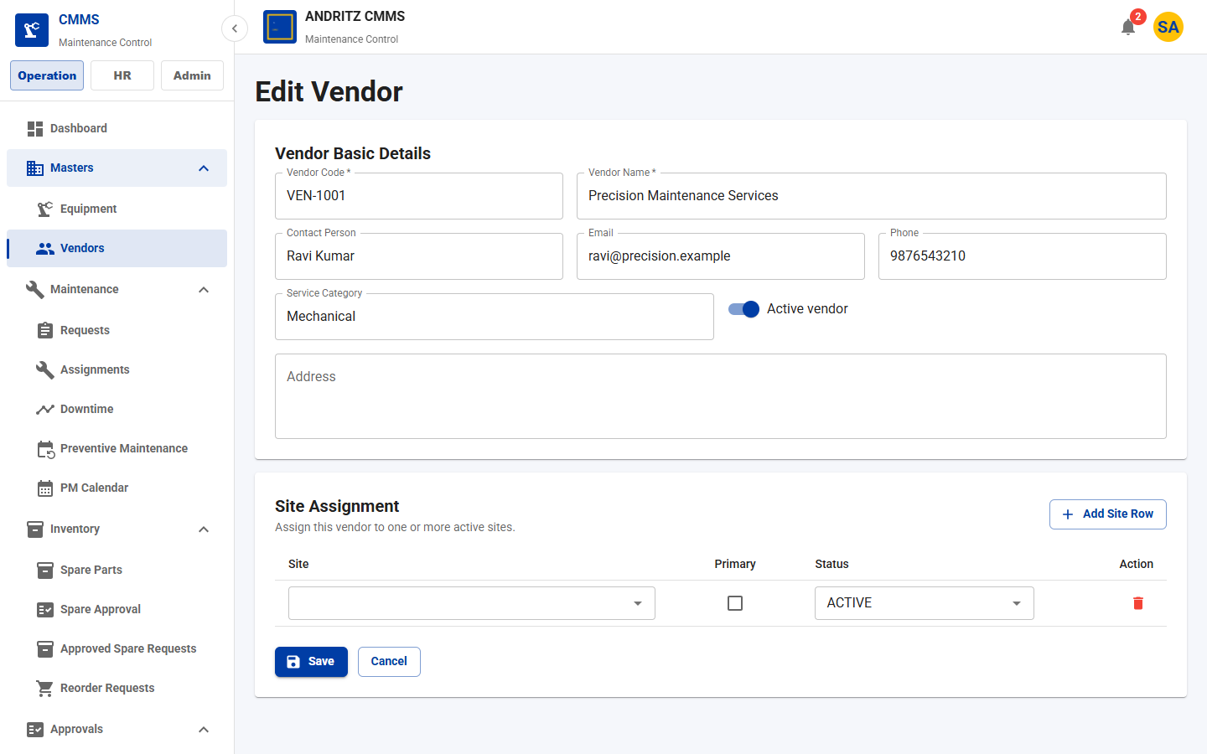
CMMS Application
TEAM DEMO
PAGE 19
Vendor Form
Purpose
Create or update vendor contact and category details.
Demo Talk Track
Explain what the user can view, create, update, approve, or track on the Vendor Form page.
Value
Shows how this page supports day-to-day CMMS operations and team accountability.
All Pages Screenshot Walkthrough
21

Slide 22
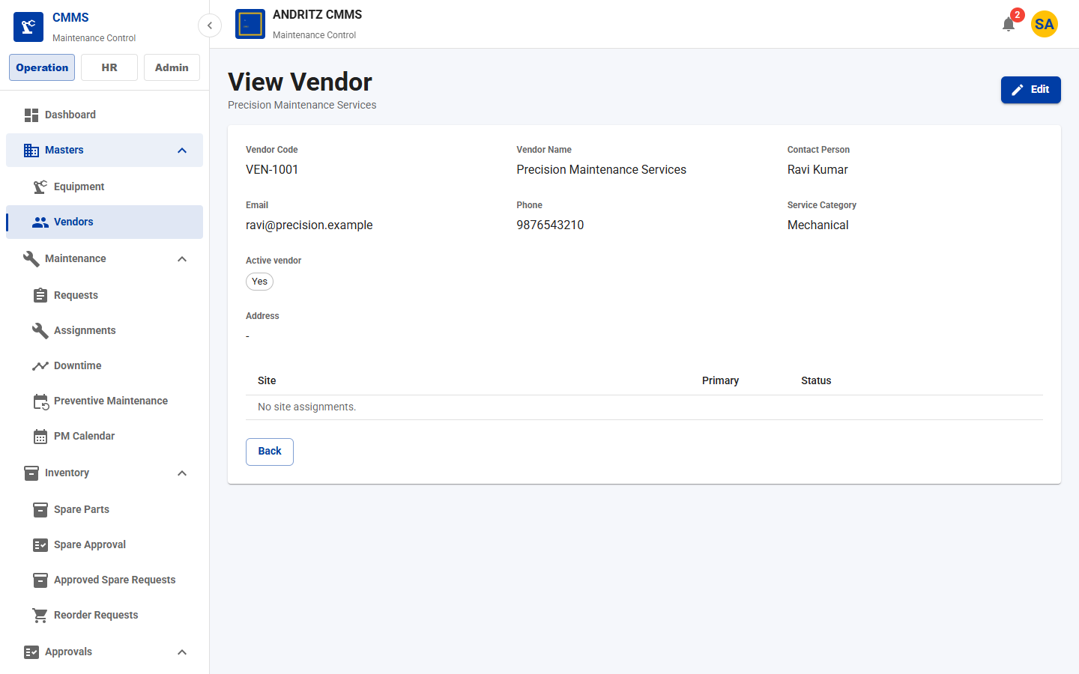
CMMS Application
TEAM DEMO
PAGE 20
Vendor View
Purpose
Review vendor information without editing.
Demo Talk Track
Explain what the user can view, create, update, approve, or track on the Vendor View page.
Value
Shows how this page supports day-to-day CMMS operations and team accountability.
All Pages Screenshot Walkthrough
22

Slide 23
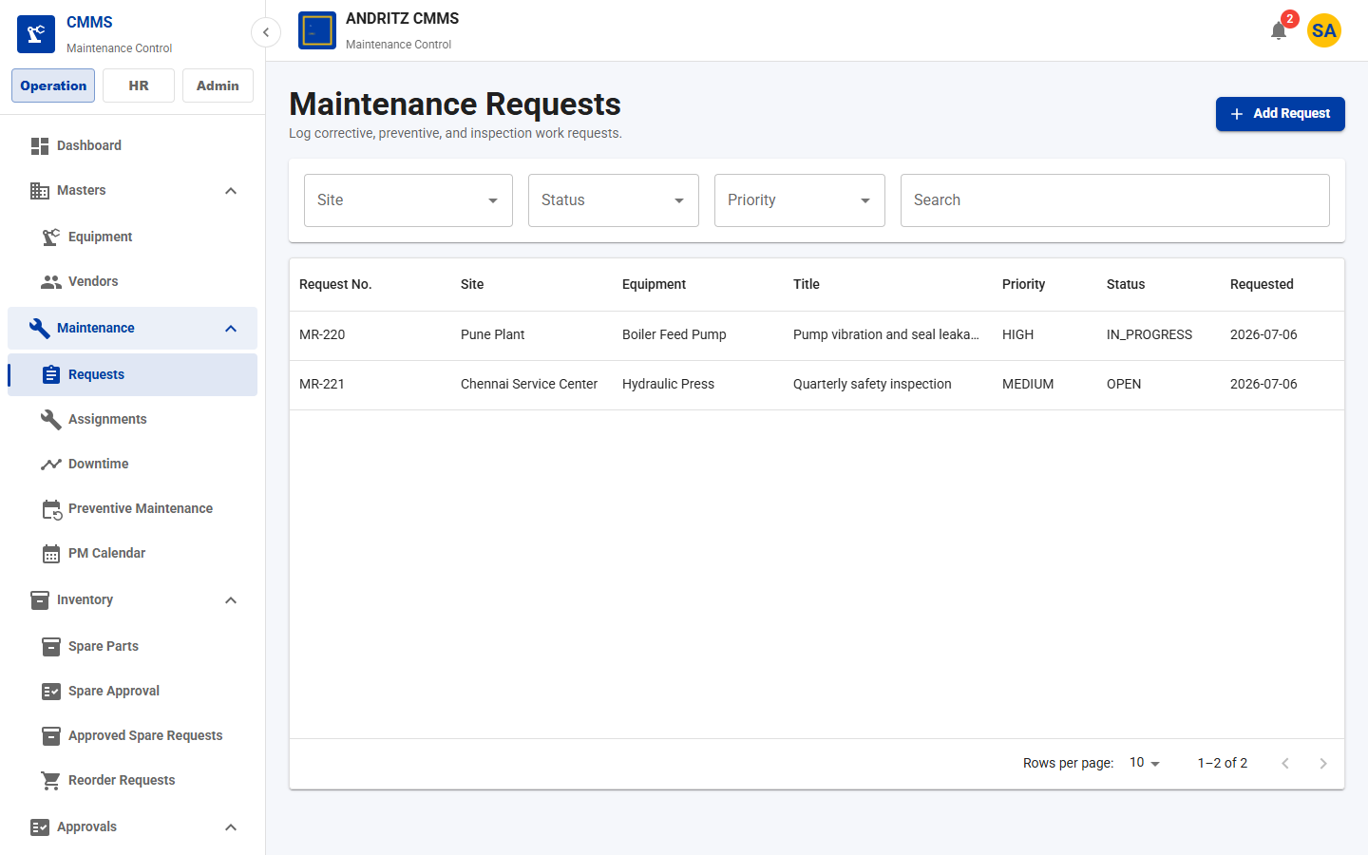
CMMS Application
TEAM DEMO
PAGE 21
Maintenance Request List
Purpose
Track corrective, breakdown, inspection, and calibration requests.
Demo Talk Track
Explain what the user can view, create, update, approve, or track on the Maintenance Request List page.
Value
Shows how this page supports day-to-day CMMS operations and team accountability.
All Pages Screenshot Walkthrough
23

Slide 24
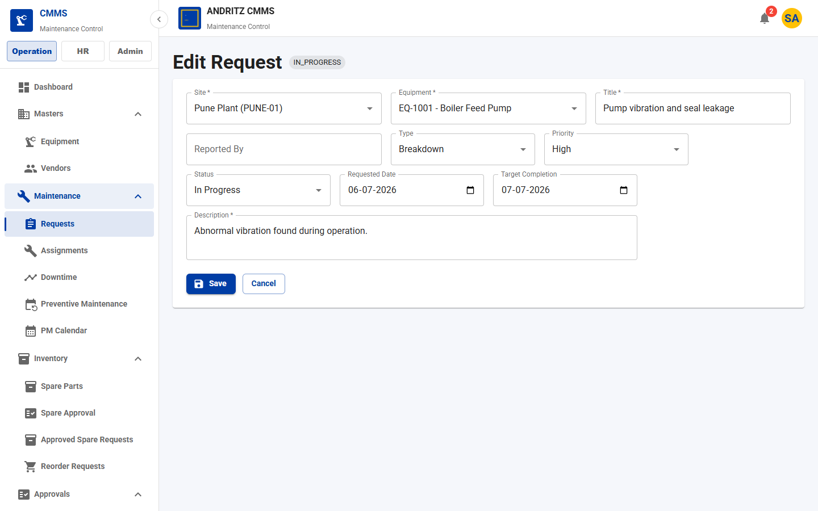
CMMS Application
TEAM DEMO
PAGE 22
Maintenance Request Form
Purpose
Create or update maintenance request details and priority.
Demo Talk Track
Explain what the user can view, create, update, approve, or track on the Maintenance Request Form page.
Value
Shows how this page supports day-to-day CMMS operations and team accountability.
All Pages Screenshot Walkthrough
24

Slide 25
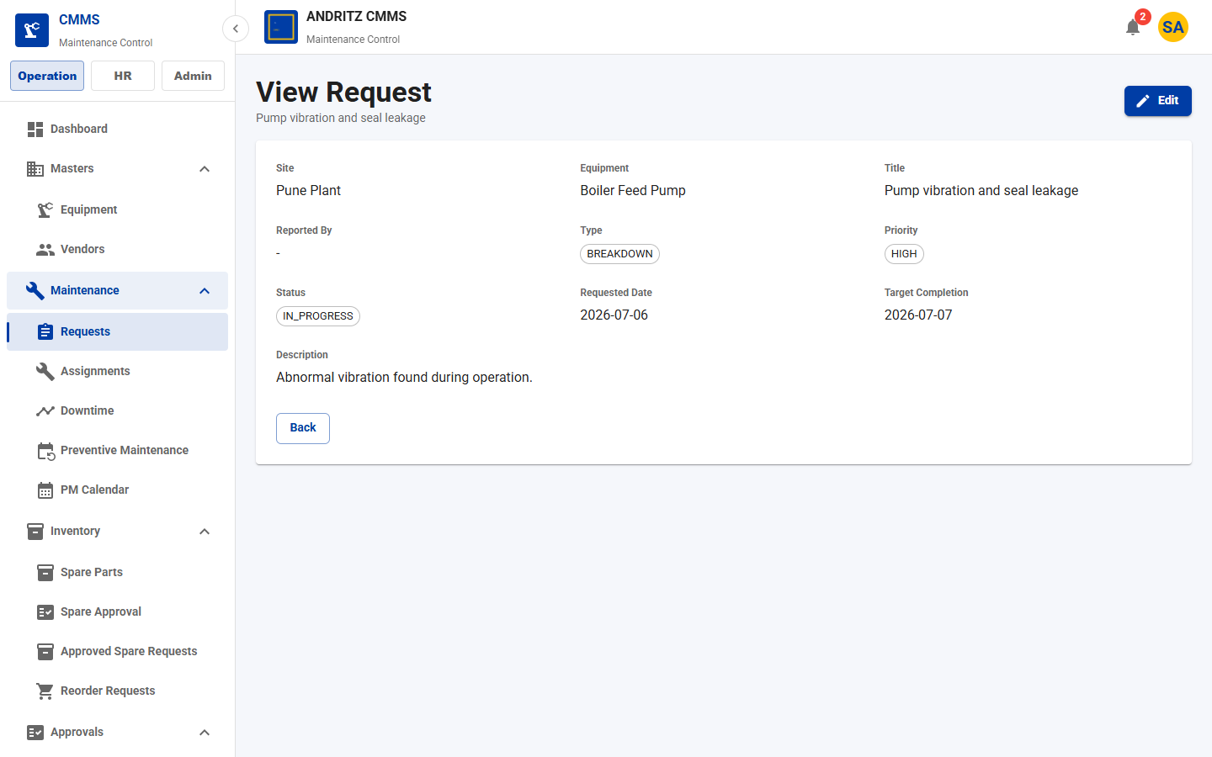
CMMS Application
TEAM DEMO
PAGE 23
Maintenance Request View
Purpose
Read-only request details for handoff and review.
Demo Talk Track
Explain what the user can view, create, update, approve, or track on the Maintenance Request View page.
Value
Shows how this page supports day-to-day CMMS operations and team accountability.
All Pages Screenshot Walkthrough
25

Slide 26
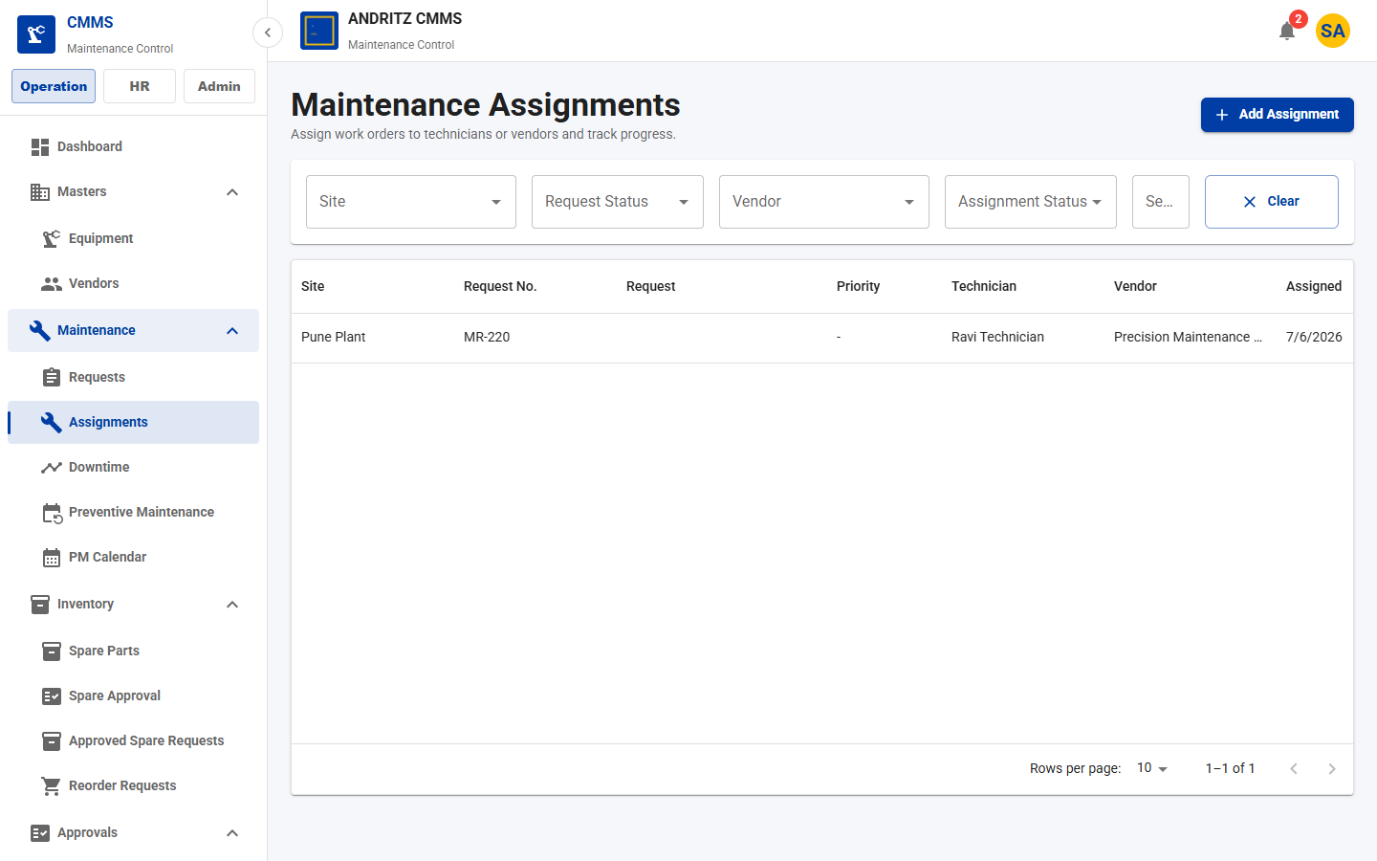
CMMS Application
TEAM DEMO
PAGE 24
Assignment List
Purpose
Monitor work assignments, technician ownership, vendor, cost, and status.
Demo Talk Track
Explain what the user can view, create, update, approve, or track on the Assignment List page.
Value
Shows how this page supports day-to-day CMMS operations and team accountability.
All Pages Screenshot Walkthrough
26

Slide 27
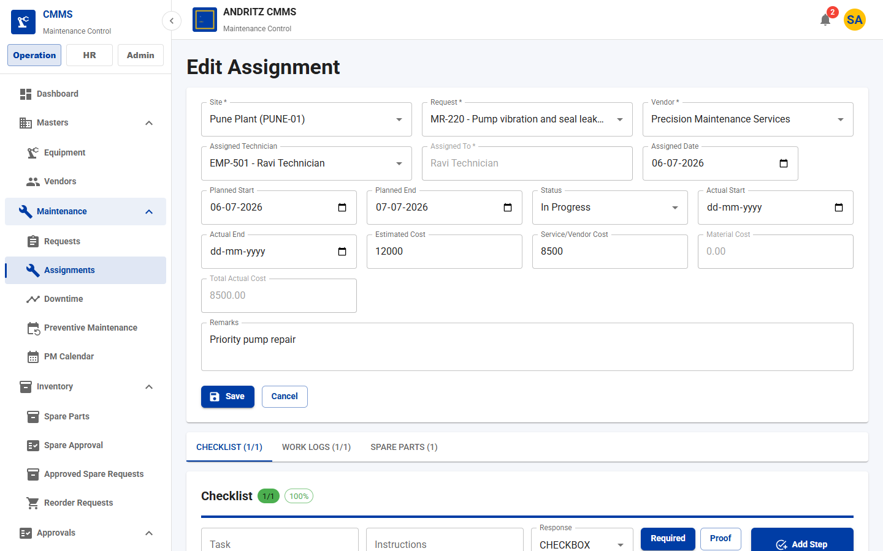
CMMS Application
TEAM DEMO
PAGE 25
Assignment Form
Purpose
Plan or update assigned work, technician, vendor, schedule, and cost.
Demo Talk Track
Explain what the user can view, create, update, approve, or track on the Assignment Form page.
Value
Shows how this page supports day-to-day CMMS operations and team accountability.
All Pages Screenshot Walkthrough
27

Slide 28
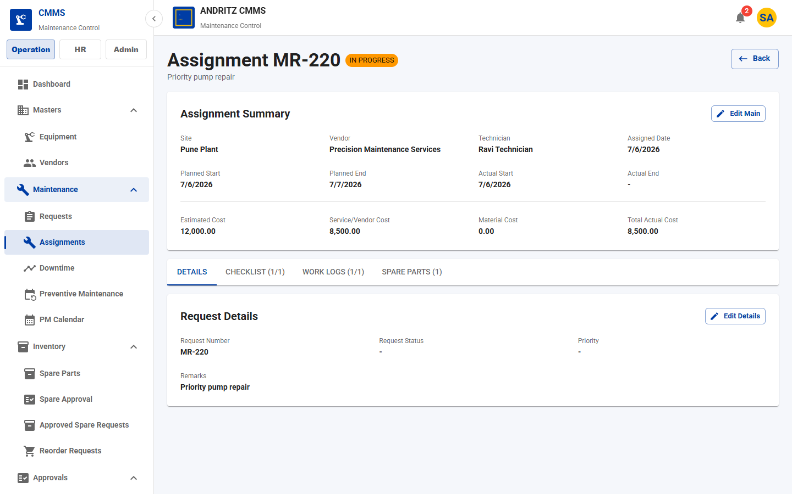
CMMS Application
TEAM DEMO
PAGE 26
Assignment View
Purpose
Execution workspace for details, checklist, work logs, and spare usage.
Demo Talk Track
Explain what the user can view, create, update, approve, or track on the Assignment View page.
Value
Shows how this page supports day-to-day CMMS operations and team accountability.
All Pages Screenshot Walkthrough
28

Slide 29
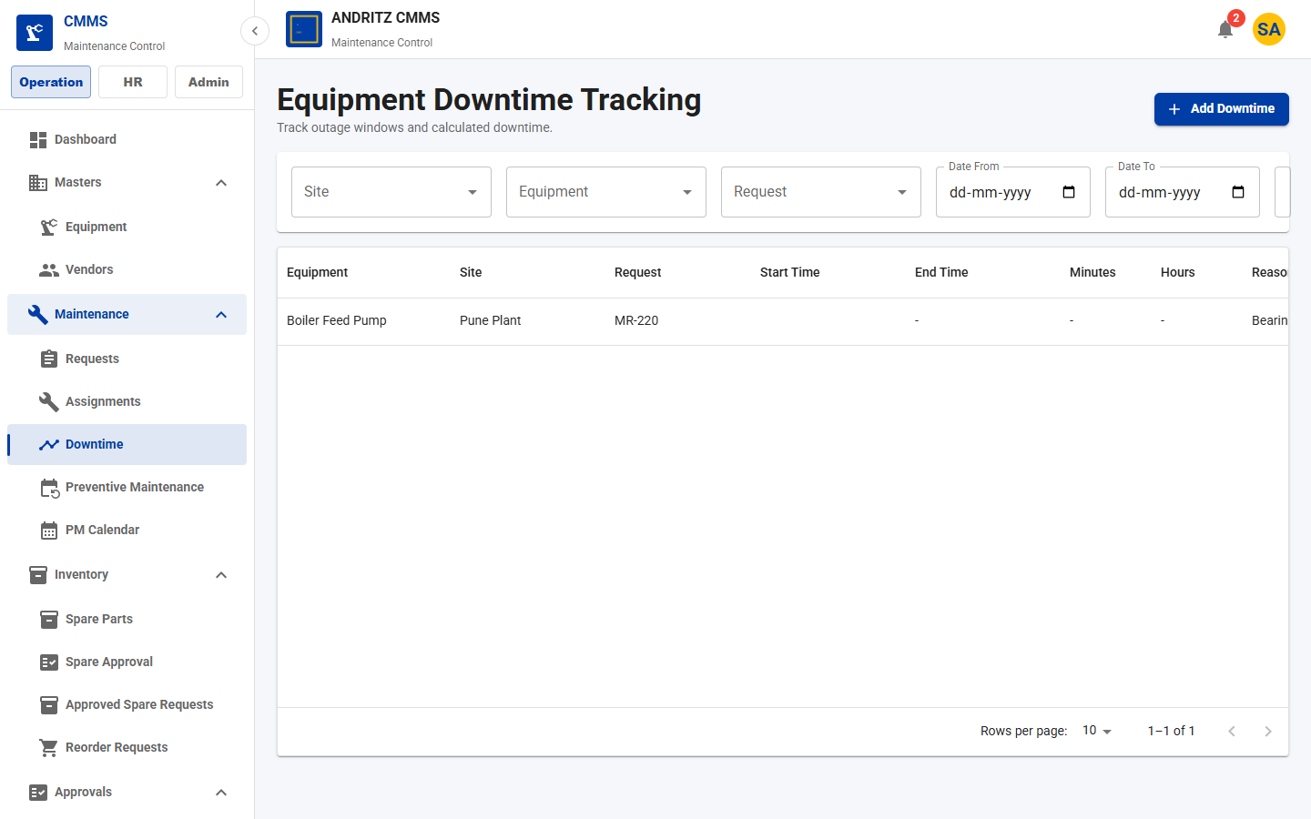
CMMS Application
TEAM DEMO
PAGE 27
Downtime List
Purpose
Track planned and unplanned equipment downtime records.
Demo Talk Track
Explain what the user can view, create, update, approve, or track on the Downtime List page.
Value
Shows how this page supports day-to-day CMMS operations and team accountability.
All Pages Screenshot Walkthrough
29

Slide 30
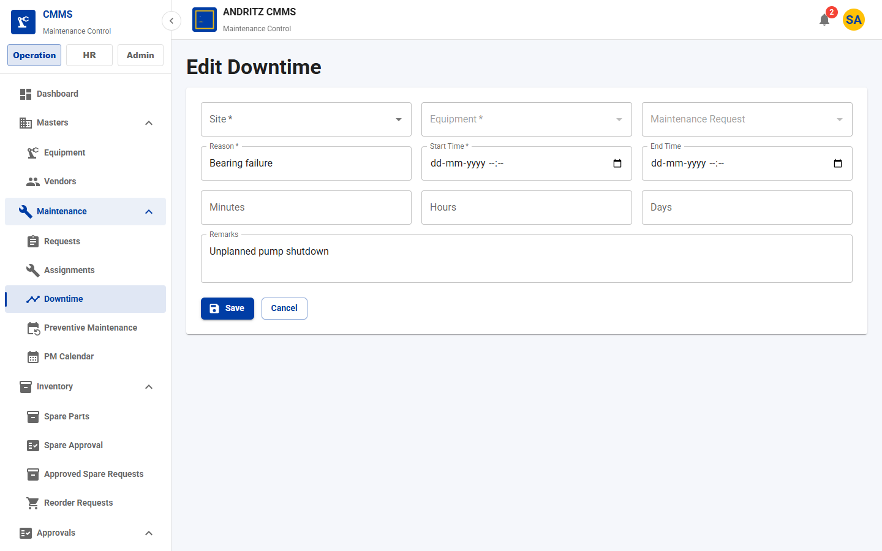
CMMS Application
TEAM DEMO
PAGE 28
Downtime Form
Purpose
Record downtime timing, reason, request link, and equipment impact.
Demo Talk Track
Explain what the user can view, create, update, approve, or track on the Downtime Form page.
Value
Shows how this page supports day-to-day CMMS operations and team accountability.
All Pages Screenshot Walkthrough
30

Slide 31
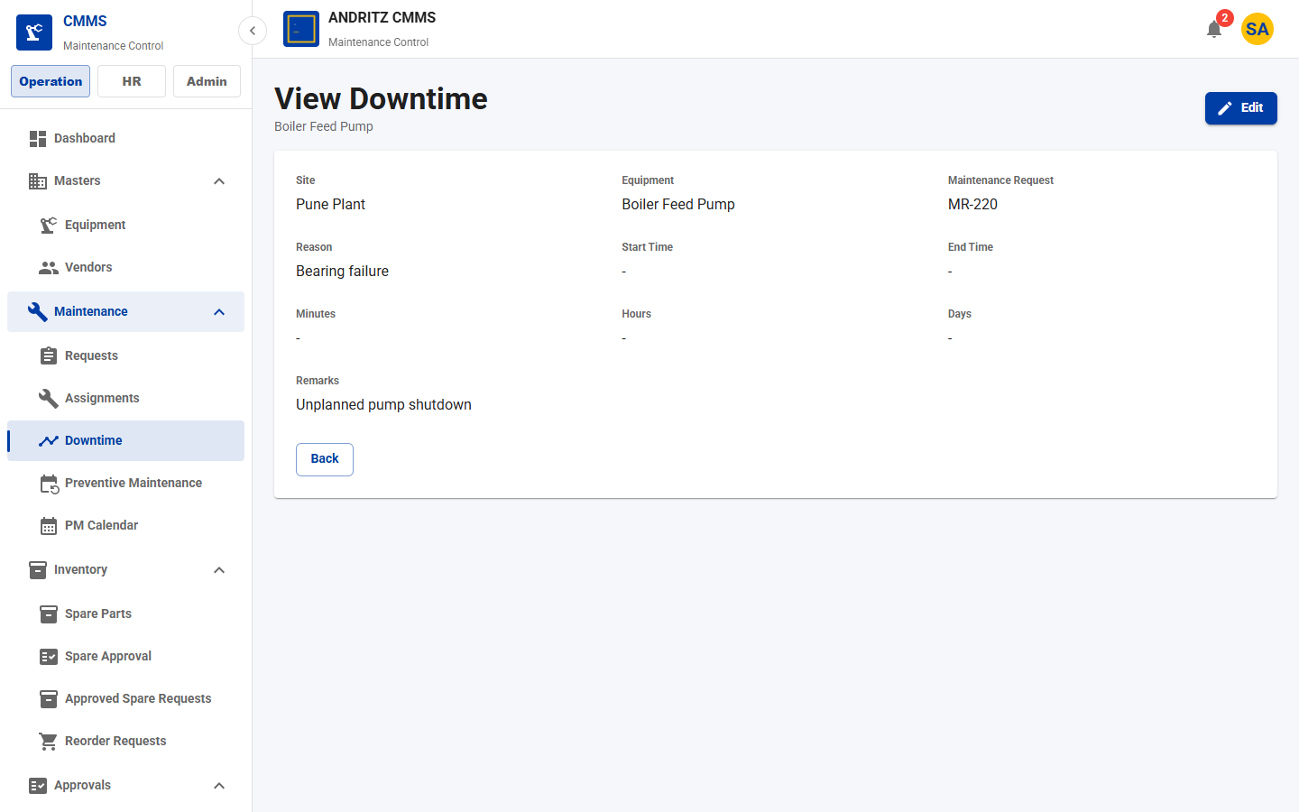
CMMS Application
TEAM DEMO
PAGE 29
Downtime View
Purpose
Read-only downtime detail review.
Demo Talk Track
Explain what the user can view, create, update, approve, or track on the Downtime View page.
Value
Shows how this page supports day-to-day CMMS operations and team accountability.
All Pages Screenshot Walkthrough
31

Slide 32
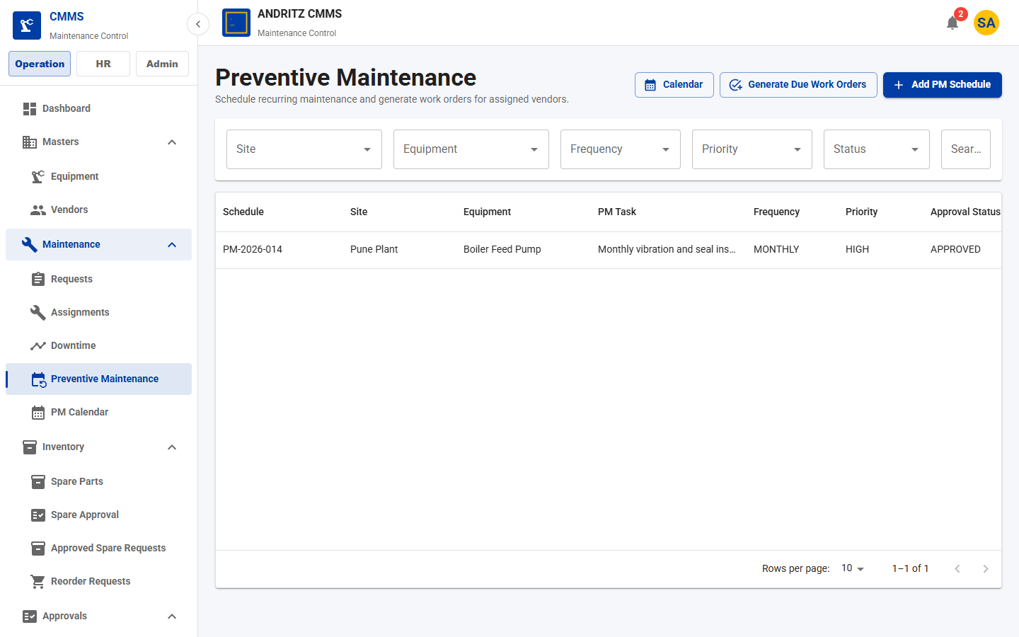
CMMS Application
TEAM DEMO
PAGE 30
Preventive Maintenance List
Purpose
Manage recurring PM schedules and generate due work orders.
Demo Talk Track
Explain what the user can view, create, update, approve, or track on the Preventive Maintenance List page.
Value
Shows how this page supports day-to-day CMMS operations and team accountability.
All Pages Screenshot Walkthrough
32

Slide 33
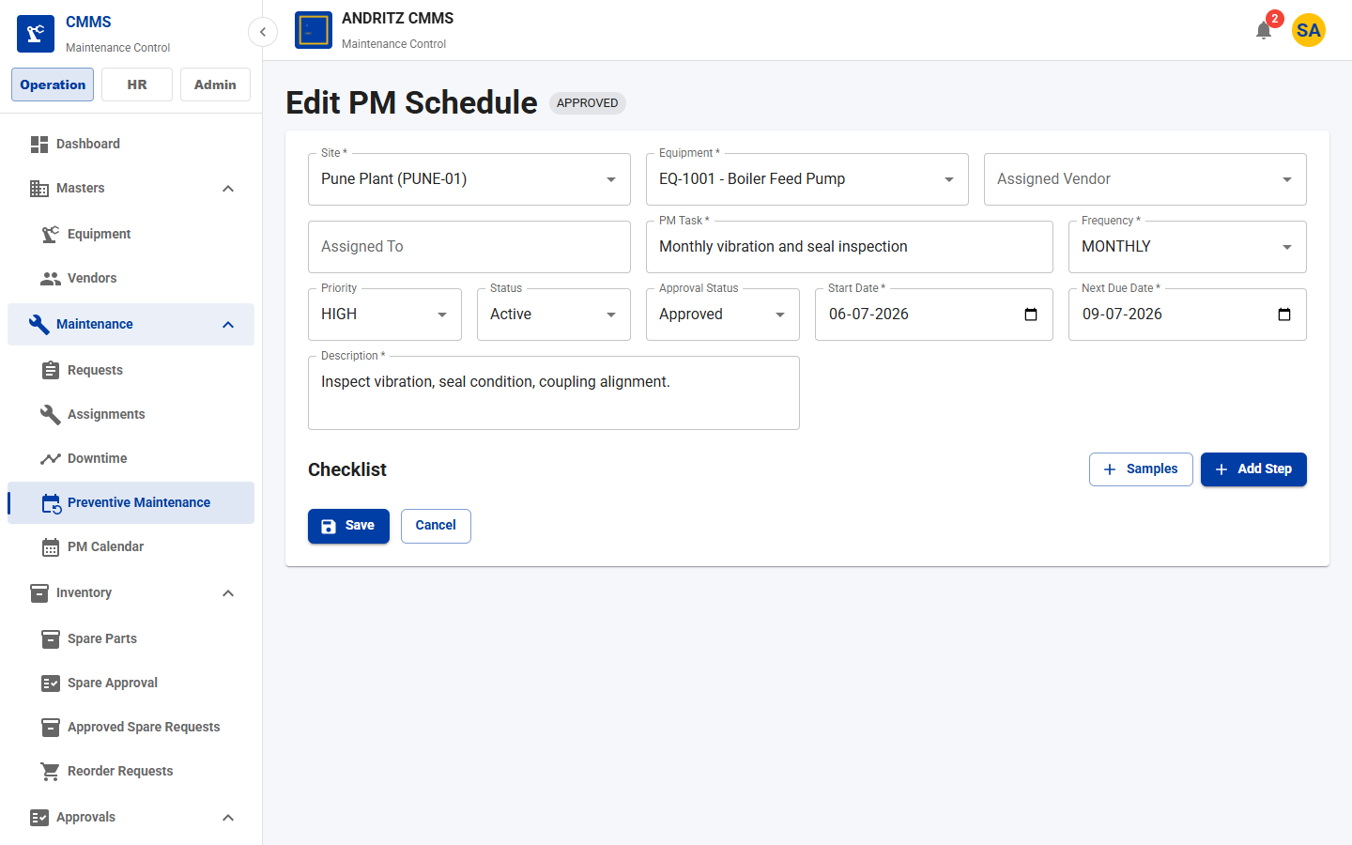
CMMS Application
TEAM DEMO
PAGE 31
Preventive Maintenance Form
Purpose
Create or update PM recurrence, vendor, due date, and checklist settings.
Demo Talk Track
Explain what the user can view, create, update, approve, or track on the Preventive Maintenance Form page.
Value
Shows how this page supports day-to-day CMMS operations and team accountability.
All Pages Screenshot Walkthrough
33

Slide 34
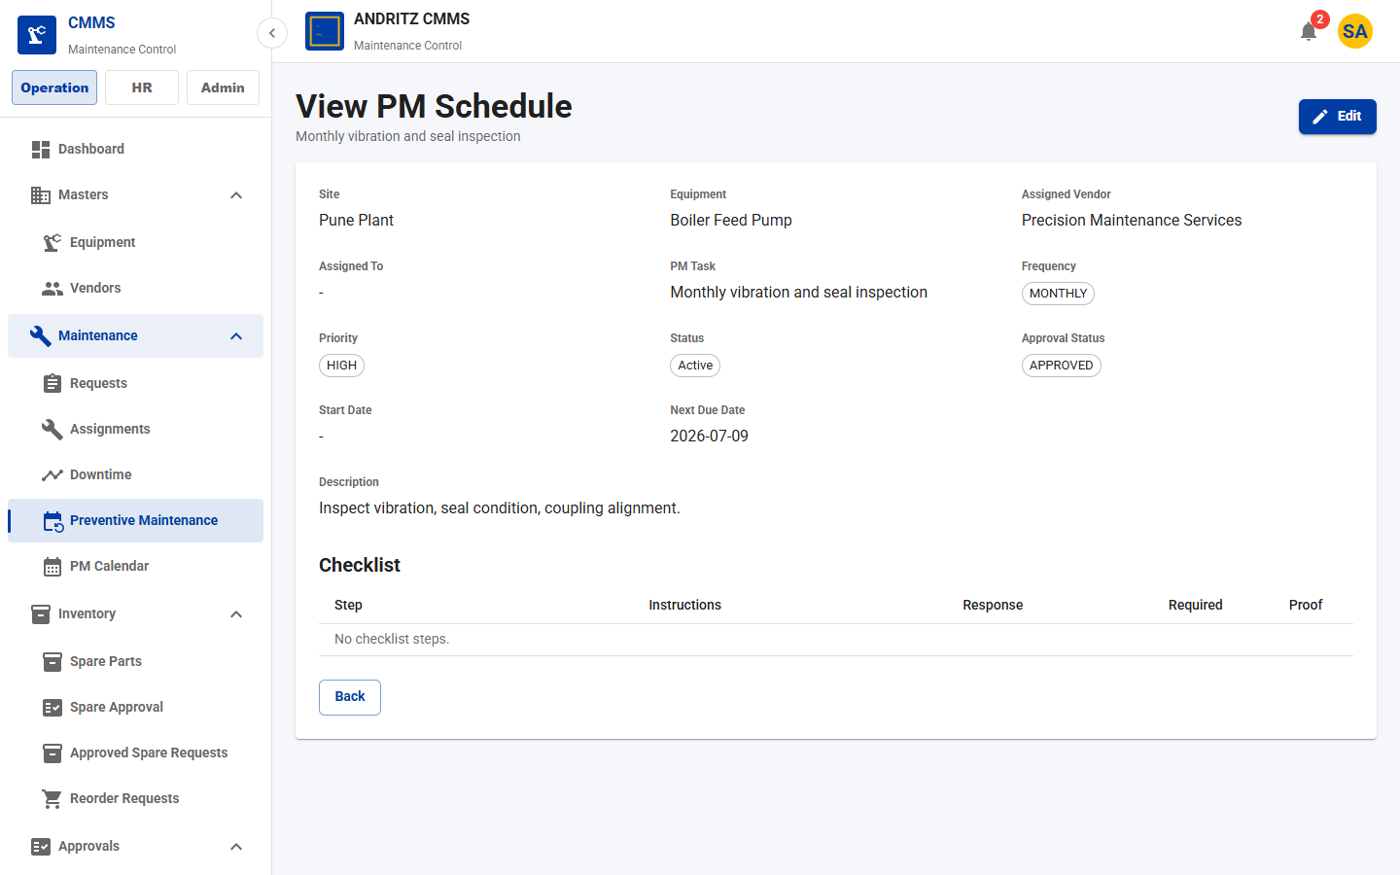
CMMS Application
TEAM DEMO
PAGE 32
Preventive Maintenance View
Purpose
Review PM schedule status, equipment, recurrence, and work order context.
Demo Talk Track
Explain what the user can view, create, update, approve, or track on the Preventive Maintenance View page.
Value
Shows how this page supports day-to-day CMMS operations and team accountability.
All Pages Screenshot Walkthrough
34

Slide 35
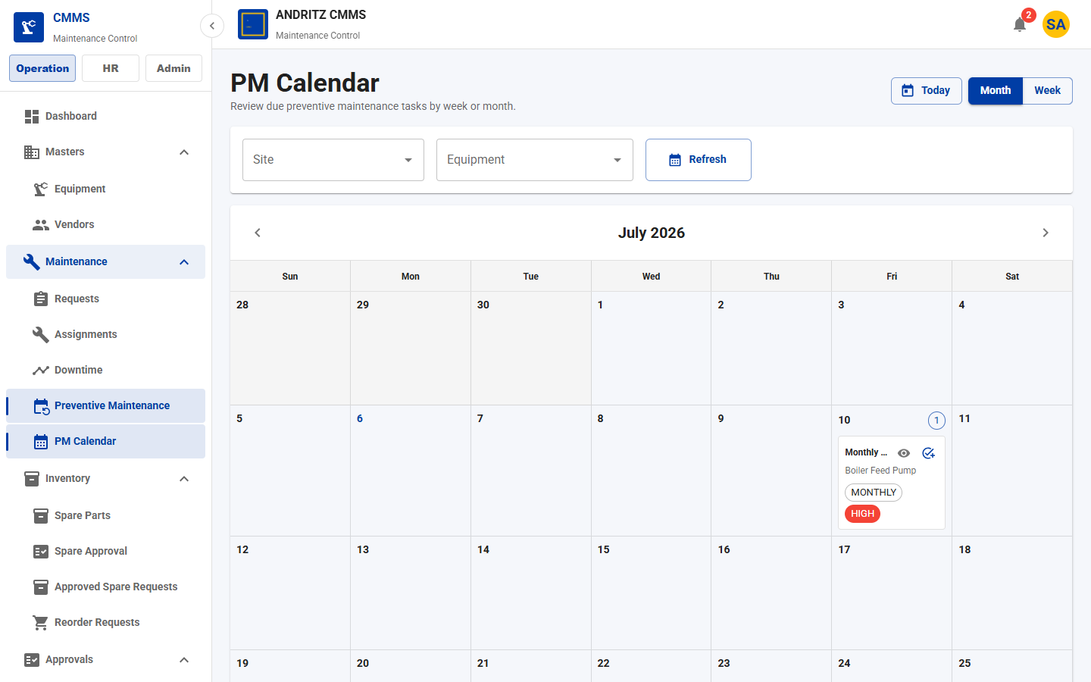
CMMS Application
TEAM DEMO
PAGE 33
PM Calendar
Purpose
Calendar-style view of planned preventive work.
Demo Talk Track
Explain what the user can view, create, update, approve, or track on the PM Calendar page.
Value
Shows how this page supports day-to-day CMMS operations and team accountability.
All Pages Screenshot Walkthrough
35

Slide 36
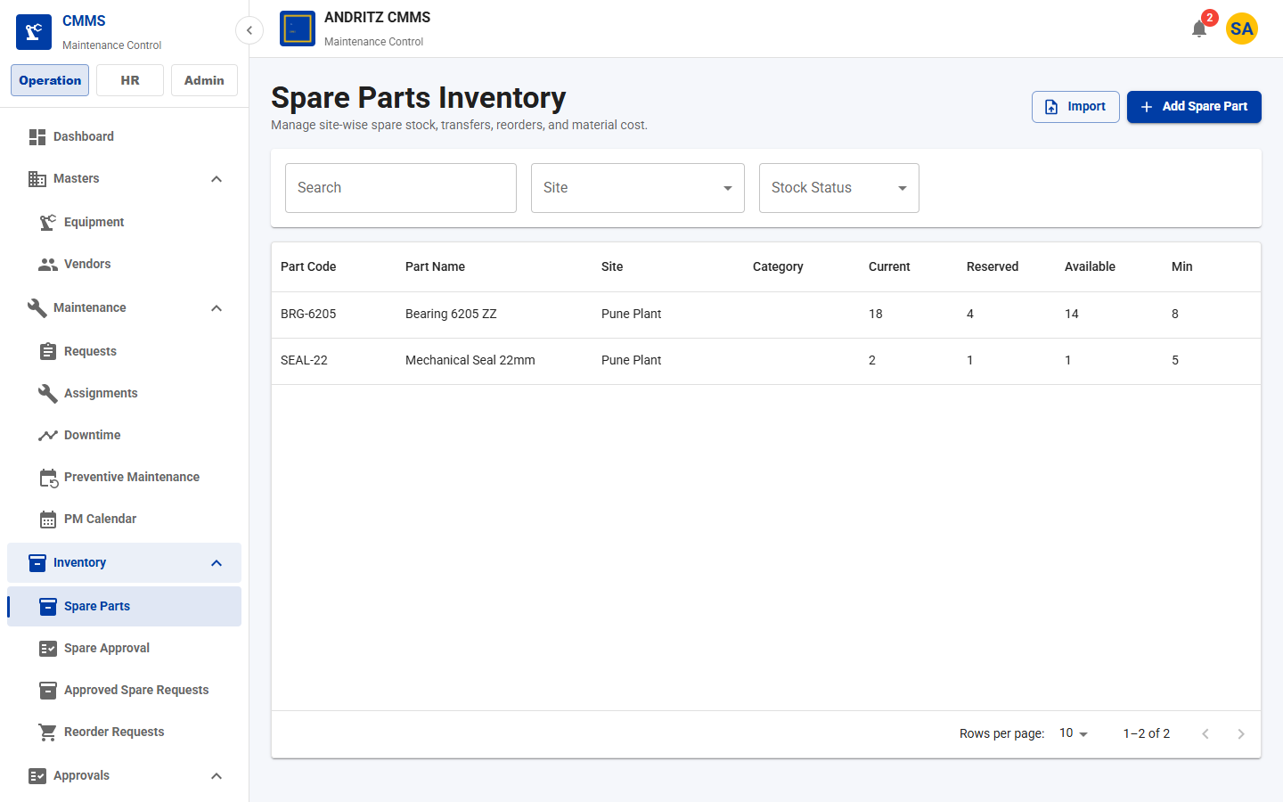
CMMS Application
TEAM DEMO
PAGE 34
Spare Parts
Purpose
Manage site-wise spare stock, low-stock indicators, stock actions, and QR labels.
Demo Talk Track
Explain what the user can view, create, update, approve, or track on the Spare Parts page.
Value
Shows how this page supports day-to-day CMMS operations and team accountability.
All Pages Screenshot Walkthrough
36

Slide 37
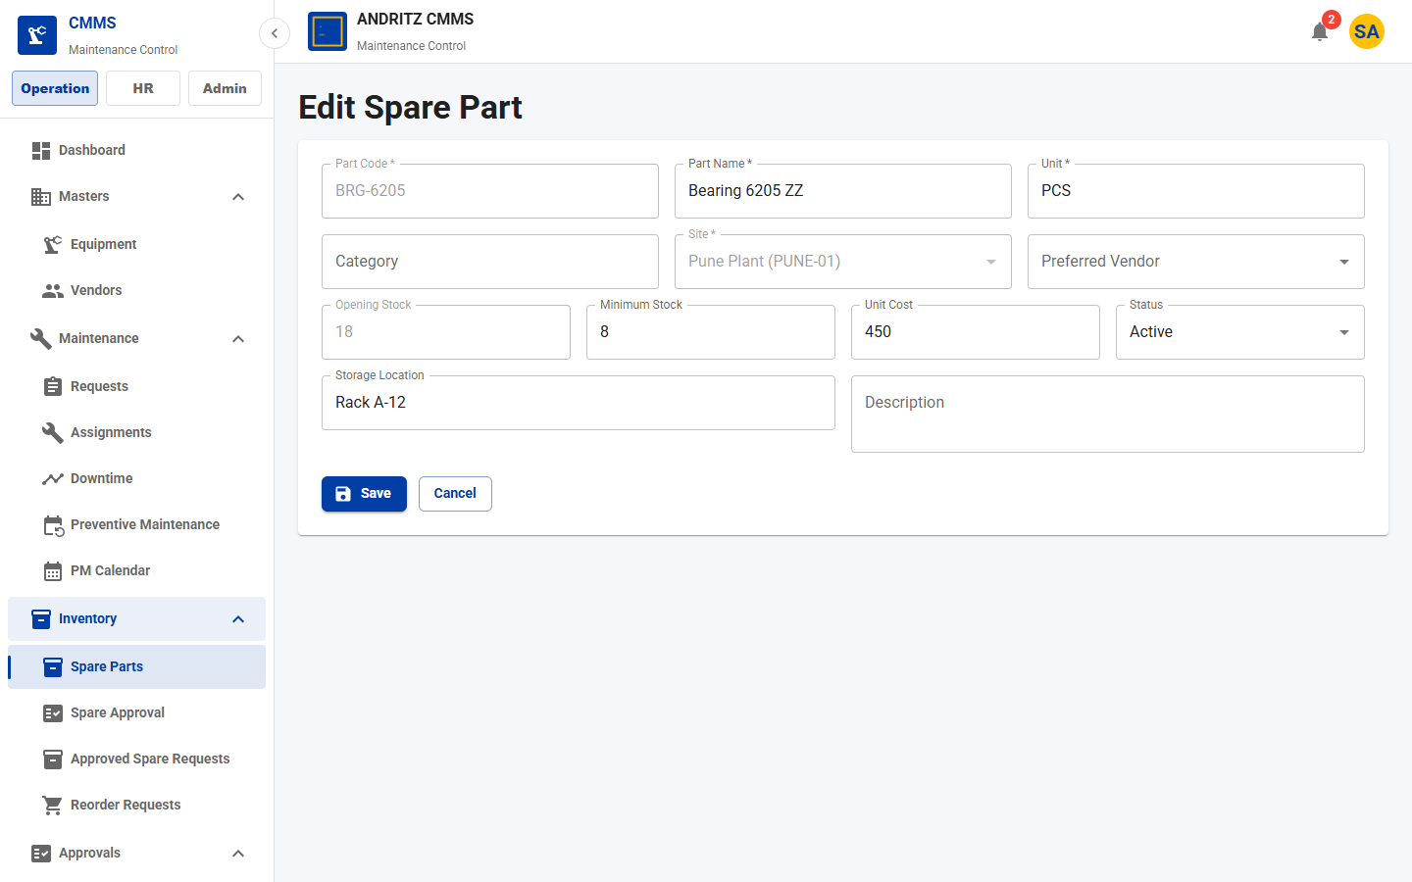
CMMS Application
TEAM DEMO
PAGE 35
Spare Part Form
Purpose
Create or update part master, site stock, minimum levels, and unit cost.
Demo Talk Track
Explain what the user can view, create, update, approve, or track on the Spare Part Form page.
Value
Shows how this page supports day-to-day CMMS operations and team accountability.
All Pages Screenshot Walkthrough
37

Slide 38
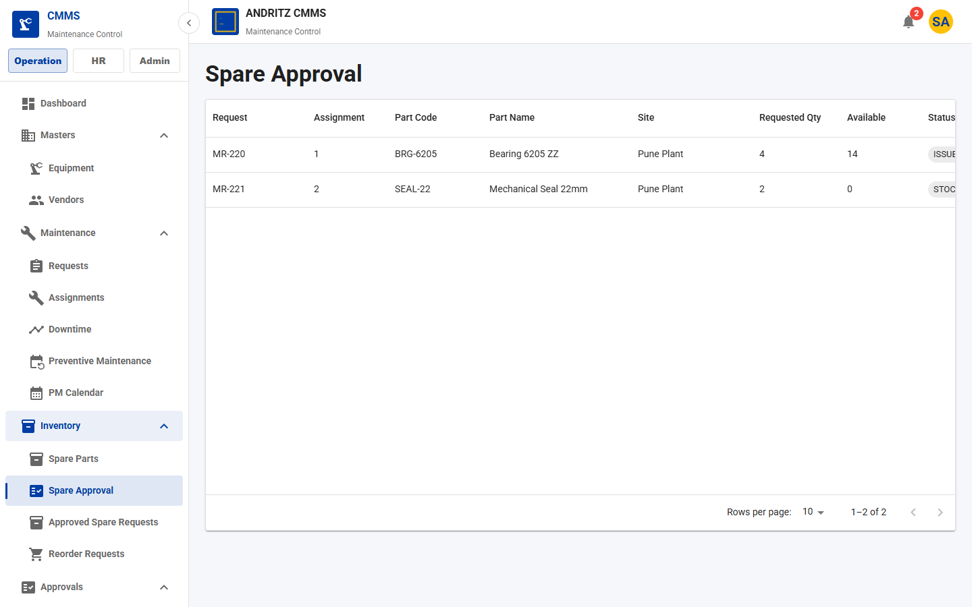
CMMS Application
TEAM DEMO
PAGE 36
Spare Approval
Purpose
Manager queue to approve or reject technician spare requests.
Demo Talk Track
Explain what the user can view, create, update, approve, or track on the Spare Approval page.
Value
Shows how this page supports day-to-day CMMS operations and team accountability.
All Pages Screenshot Walkthrough
38

Slide 39
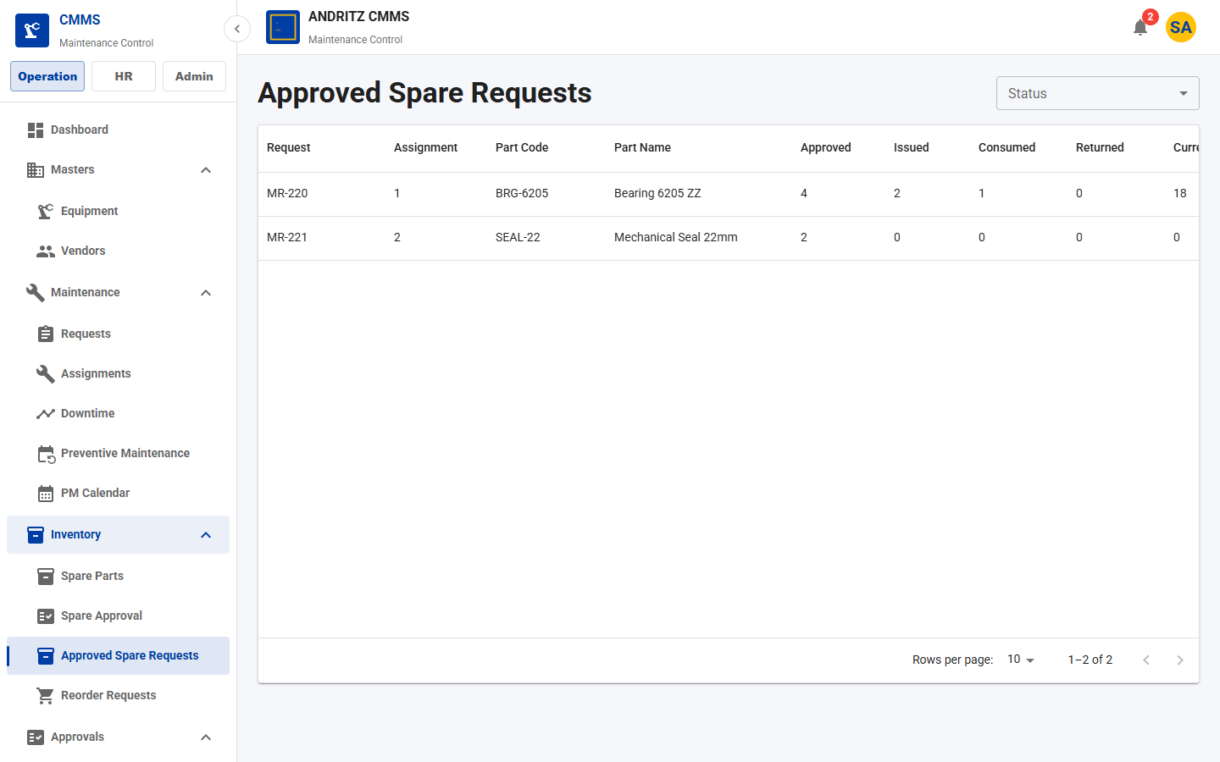
CMMS Application
TEAM DEMO
PAGE 37
Approved Spare Requests
Purpose
Store workflow for stock check, reserve, issue, purchase, consume, and return.
Demo Talk Track
Explain what the user can view, create, update, approve, or track on the Approved Spare Requests page.
Value
Shows how this page supports day-to-day CMMS operations and team accountability.
All Pages Screenshot Walkthrough
39

Slide 40
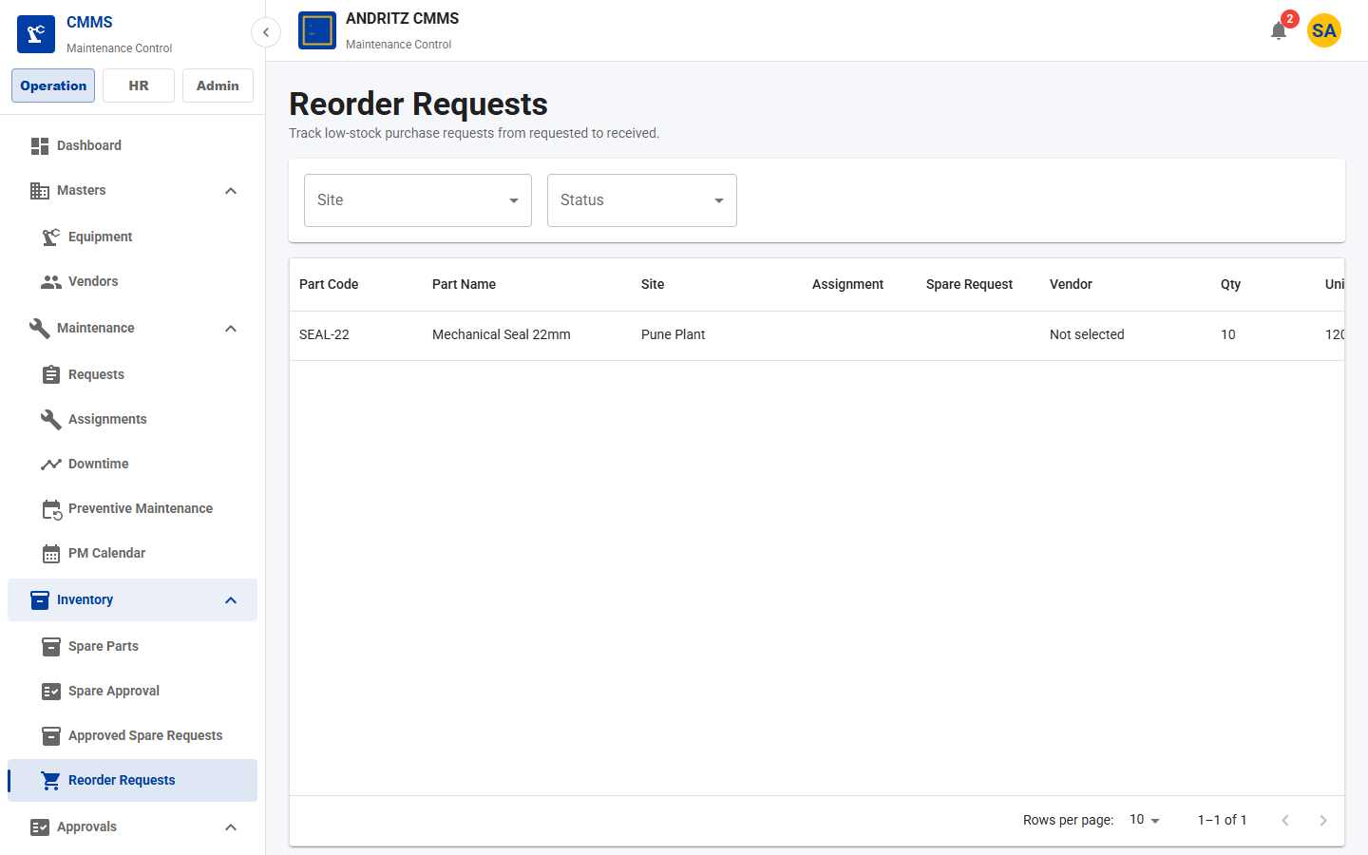
CMMS Application
TEAM DEMO
PAGE 38
Reorder Requests
Purpose
Track purchase/reorder requests and received stock.
Demo Talk Track
Explain what the user can view, create, update, approve, or track on the Reorder Requests page.
Value
Shows how this page supports day-to-day CMMS operations and team accountability.
All Pages Screenshot Walkthrough
40

Slide 41
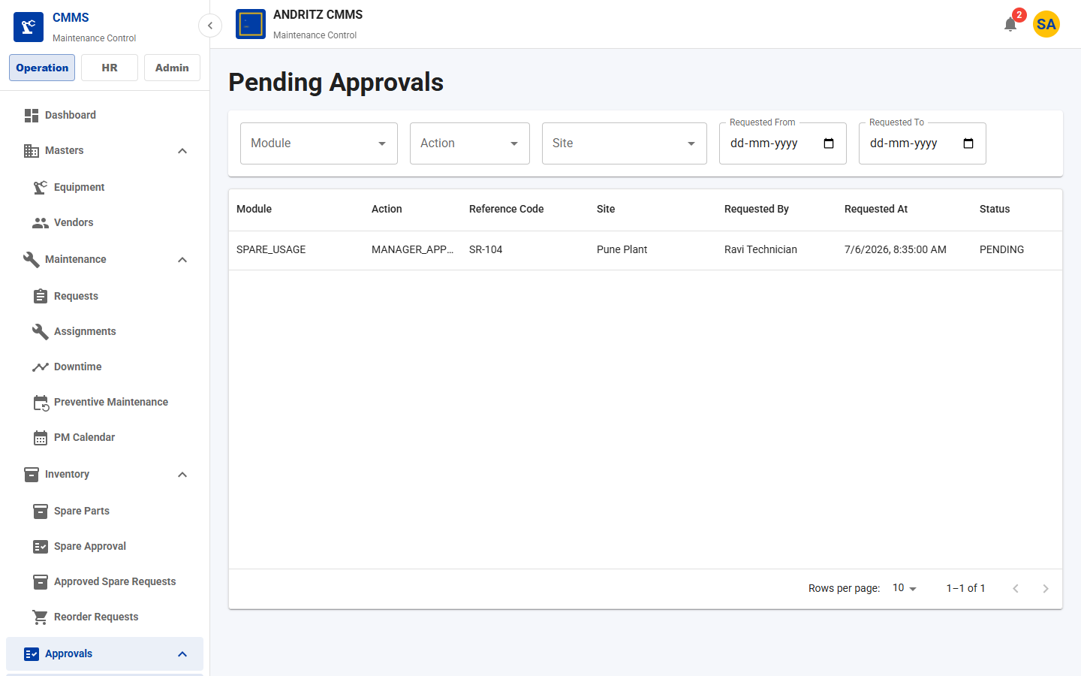
CMMS Application
TEAM DEMO
PAGE 39
Pending Approvals
Purpose
Role-filtered approval inbox for manager/admin/store decisions.
Demo Talk Track
Explain what the user can view, create, update, approve, or track on the Pending Approvals page.
Value
Shows how this page supports day-to-day CMMS operations and team accountability.
All Pages Screenshot Walkthrough
41

Slide 42
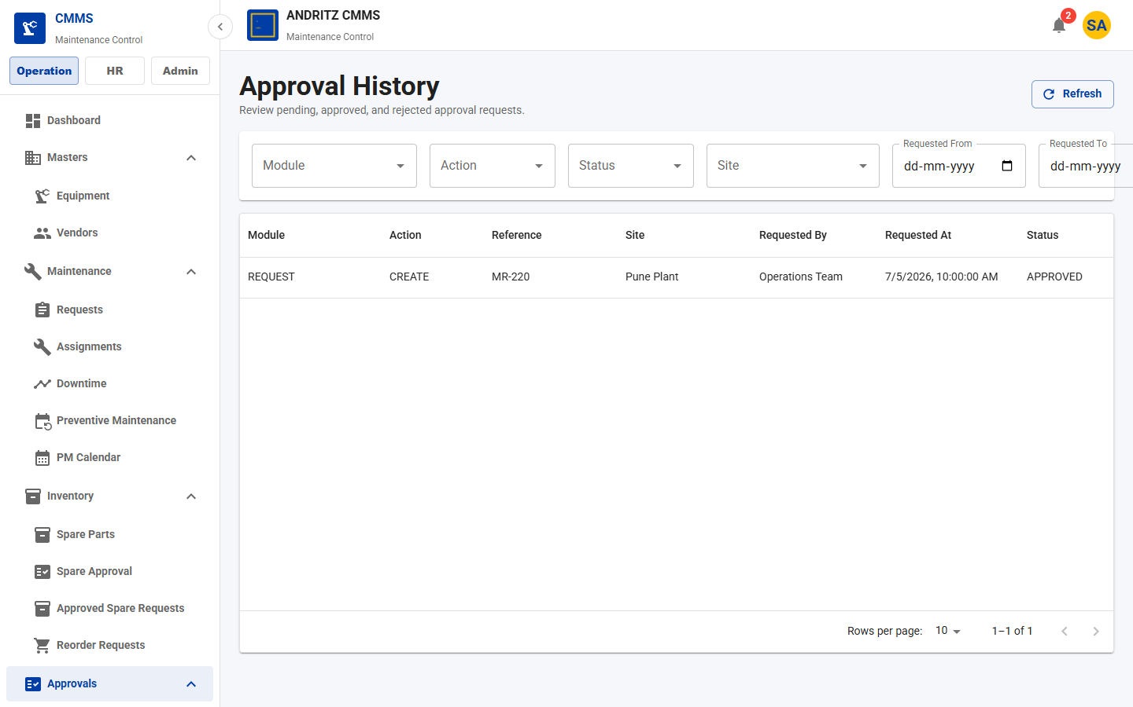
CMMS Application
TEAM DEMO
PAGE 40
Approval History
Purpose
Audit history of approval requests and decisions.
Demo Talk Track
Explain what the user can view, create, update, approve, or track on the Approval History page.
Value
Shows how this page supports day-to-day CMMS operations and team accountability.
All Pages Screenshot Walkthrough
42

Slide 43
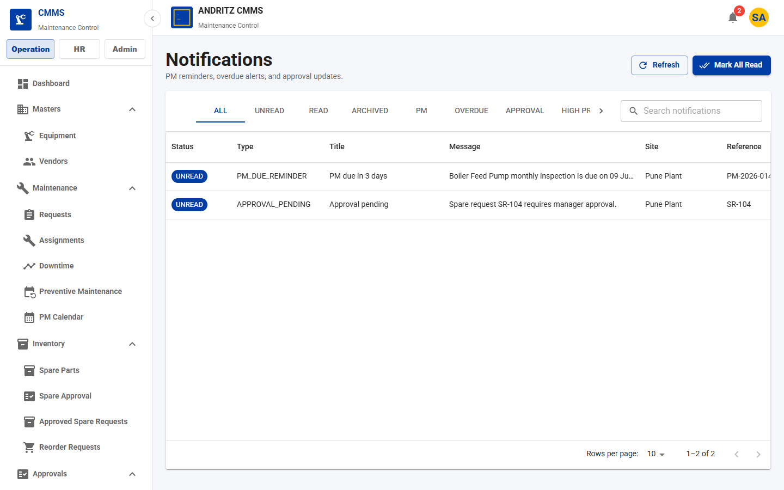
CMMS Application
TEAM DEMO
PAGE 41
Notification Center
Purpose
In-app alerts for PM due, overdue requests, and pending approvals.
Demo Talk Track
Explain what the user can view, create, update, approve, or track on the Notification Center page.
Value
Shows how this page supports day-to-day CMMS operations and team accountability.
All Pages Screenshot Walkthrough
43

Slide 44
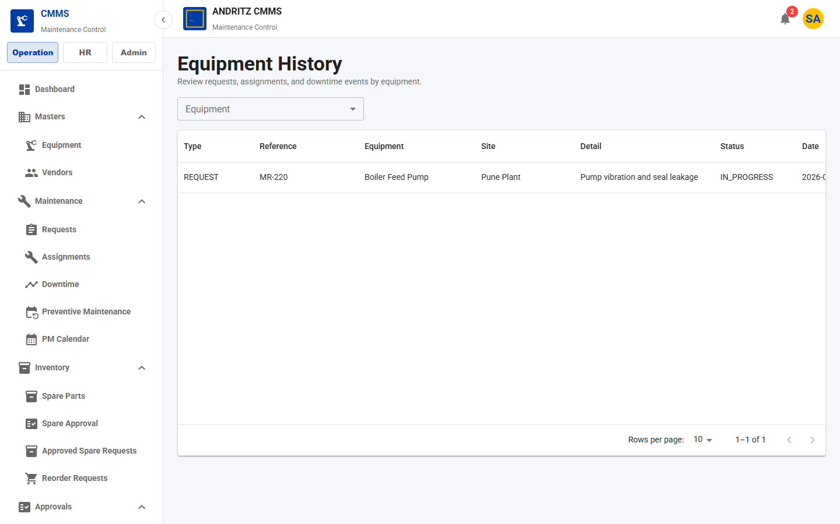
CMMS Application
TEAM DEMO
PAGE 42
Equipment History Report
Purpose
Review request, assignment, and downtime history by equipment.
Demo Talk Track
Explain what the user can view, create, update, approve, or track on the Equipment History Report page.
Value
Shows how this page supports day-to-day CMMS operations and team accountability.
All Pages Screenshot Walkthrough
44

Slide 45
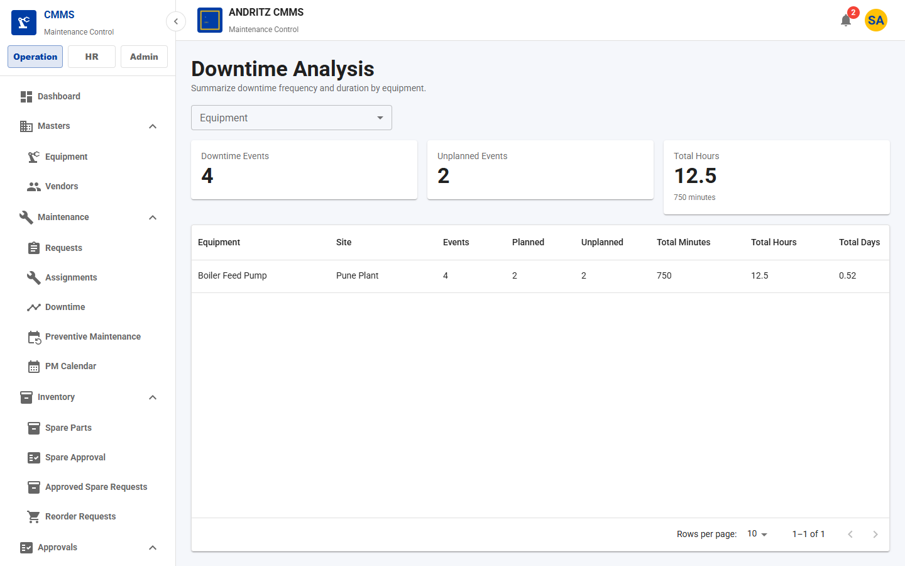
CMMS Application
TEAM DEMO
PAGE 43
Downtime Analysis Report
Purpose
Summarize downtime frequency and duration by equipment.
Demo Talk Track
Explain what the user can view, create, update, approve, or track on the Downtime Analysis Report page.
Value
Shows how this page supports day-to-day CMMS operations and team accountability.
All Pages Screenshot Walkthrough
45

Slide 46
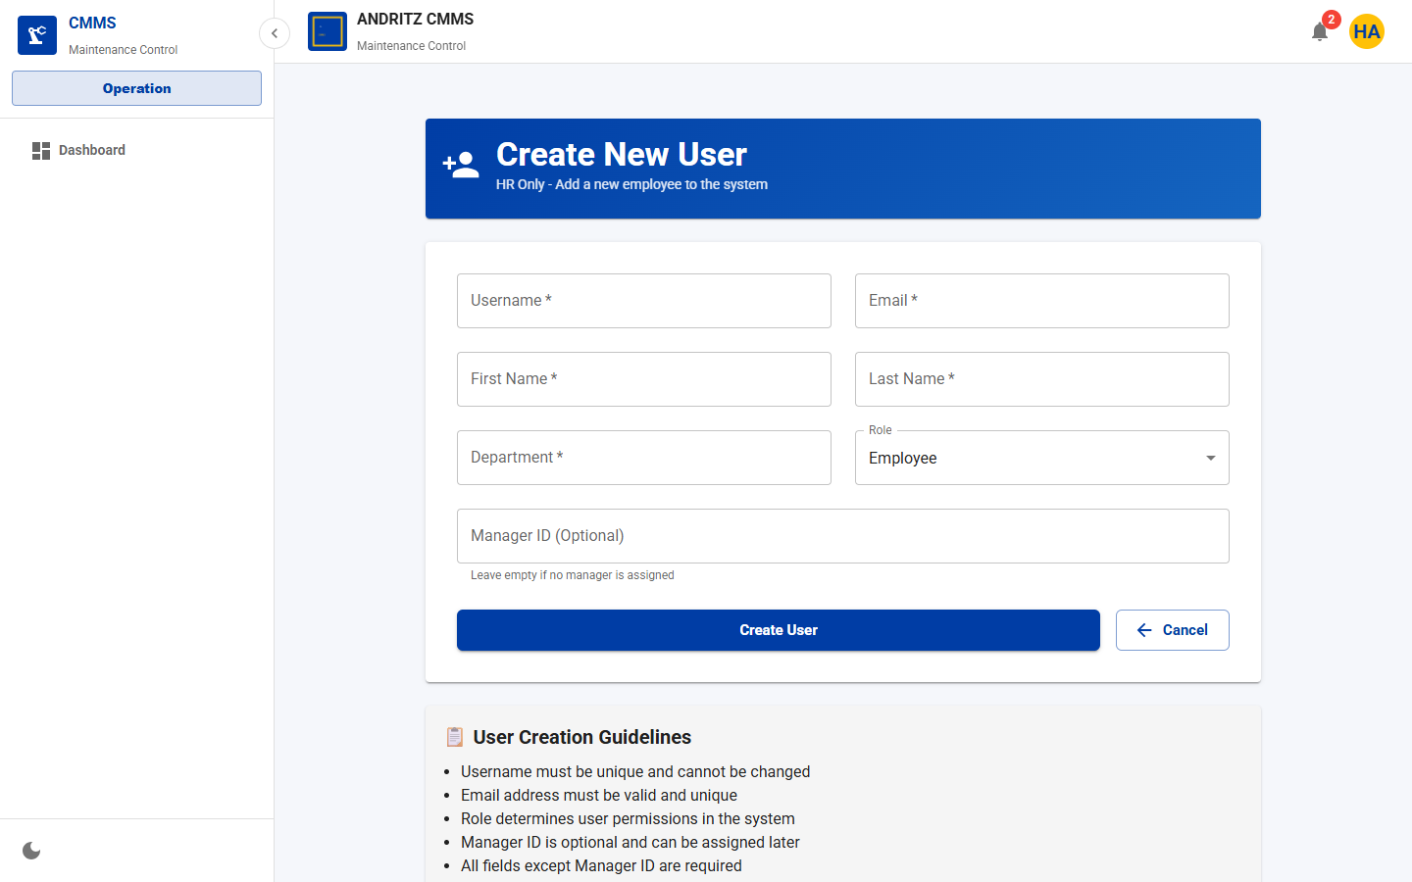
CMMS Application
TEAM DEMO
PAGE 44
User Management
Purpose
Create or maintain application users when using the user administration route.
Demo Talk Track
Explain what the user can view, create, update, approve, or track on the User Management page.
Value
Shows how this page supports day-to-day CMMS operations and team accountability.
All Pages Screenshot Walkthrough
46

